Slide 1
IBF Exercises
Liz Page
WMO Public Weather Services Training Workshop on Impact Based Forecast and Warning Services

Slide 2
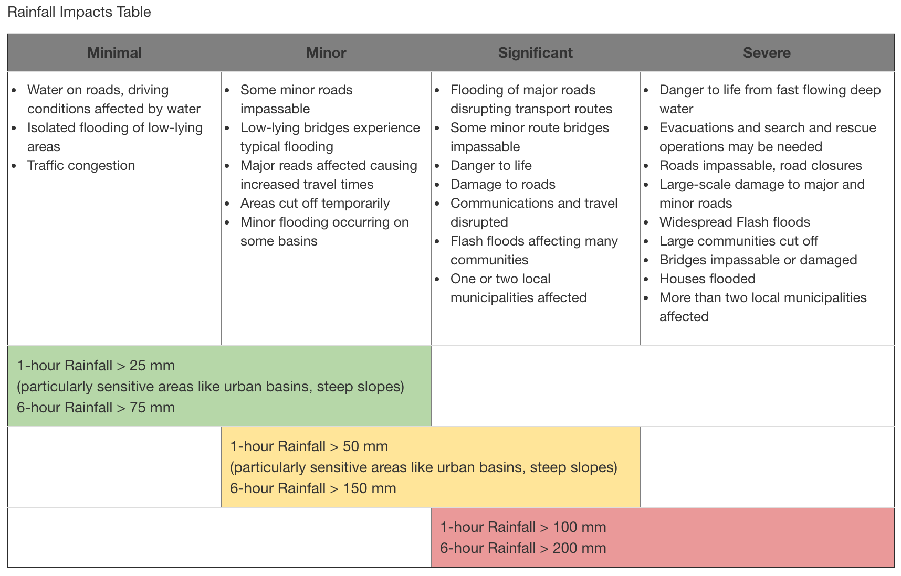
Response Matrix Exercises

Slide 3
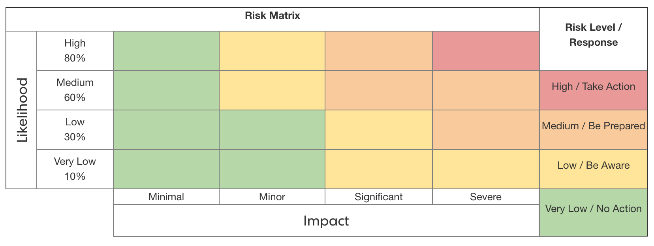

Slide 4
Early Morning
Forecasters are evaluating the potential for heavy rain
Currently, they are not confident that the event will occur
If it does happen, major roads may be flooded and may cut people off from a residential area

Slide 5
Where does this situation fall in the risk matrix?

Slide 6
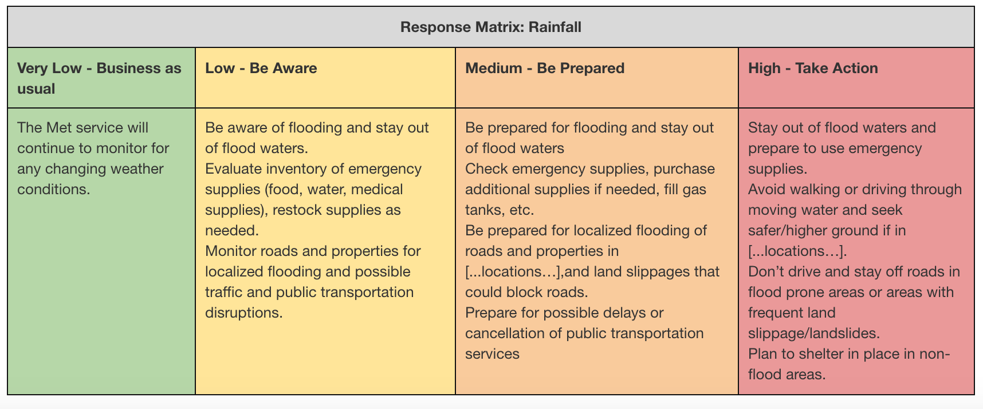
What is your advice?

Slide 7
Late Afternoon
Heavy rain is more likely
Children are traveling home from school
People are beginning to leave work

Slide 8
Where does this situation fall in the risk matrix?
How has it changed since the morning?

Slide 9
What is your advice?

Slide 10
Impact-based Forecast Simulations
https://deved.meted.ucar.edu/wrn_sims/navmenu.php
Login: deved
Password: comet12

Slide 11
Scenario 2
Strong winds up to 30 kts sustained are expected
Winds will begin at 2200 and continue overnight

Slide 12
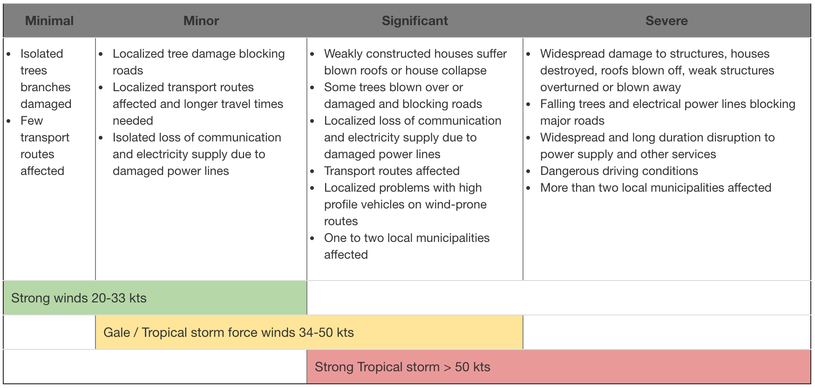
Wind Impacts Table

Slide 13
Where does this situation fall in the risk matrix?

