Slide 1
Impact Based Forecasting
Case of the UK Met Office
Delivered by Issa Lele Mouhamadou -
consultant to the Met Office under the ASPIRE
project

Slide 2
Which statement is more likely to lead to action?
Up to 50mm of rain will fall in Niamey between 14:00 – 16:00h this afternoon.
Heavy rain will cause widespread travel disruption and delays in central Niamey this afternoon. Avoid travel during these hours if possible.

Slide 3
Moving from forecasting weather to forecasting its impacts
WHAT WILL THE WEATHER BE?
WHAT WILL THE WEATHER DO?
Hazard + Vulnerability + Exposure = IMPACT
Forecasting IMPACT leads to ACTION
ACTION protects lives, livelihoods and property
Notes:
What are Impact Based Warnings? We as hydrometeorologists and climate advisers are used to dealing with the weather that effects us and our users. We deal with the weather every day. And we have been forecasting the weather and communicating this to communities. Why do we do this? We want people to listen to our forecasts and to take action that helps them make the most of the weather and in the instance of severe weather respond to help protect life and property.
Over the last few years NMHSs have been moving away from just providing weather warnings, but moving to understanding how the weather effects our stakeholders and communities. Essentially moving from what the weather might be, to what the weather might do.
This is about bringing together hazard information (weather and hydrology) with vulnerability and exposure information (the risk that people are exposed to understand the IMPACT that stakeholders might experience.
So simply an impact based warning moves away from for example ‘a warning for 100mm of rain in 24 hours in a particular catchment’ to ‘heavy rain will result in flooding to farmland and properties and the potential loss of susceptible roads causing disruption to food and transport supplies’. It is this type of information that allows people to take effective action

Slide 4
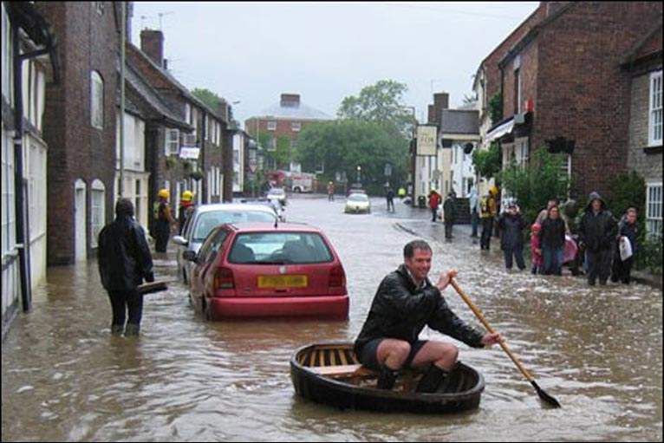
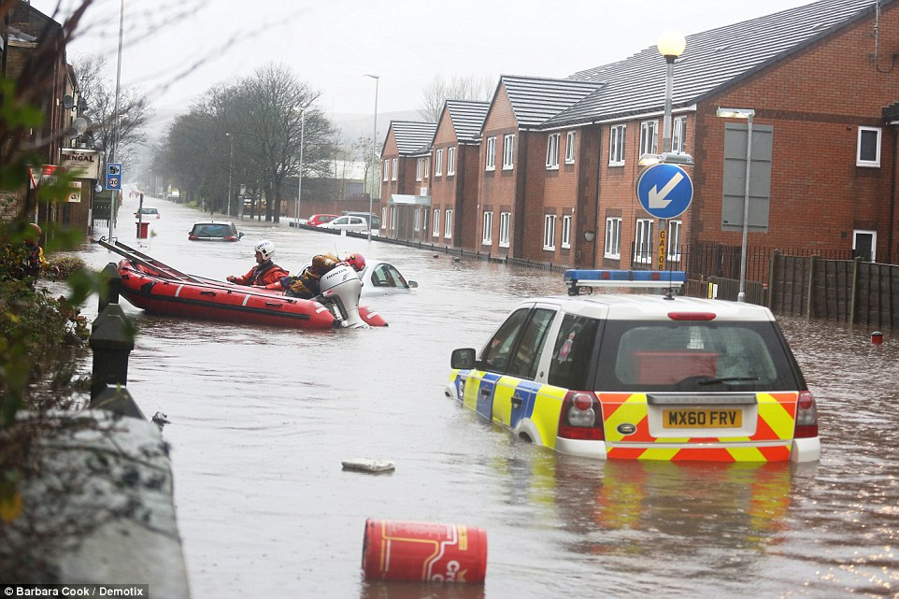
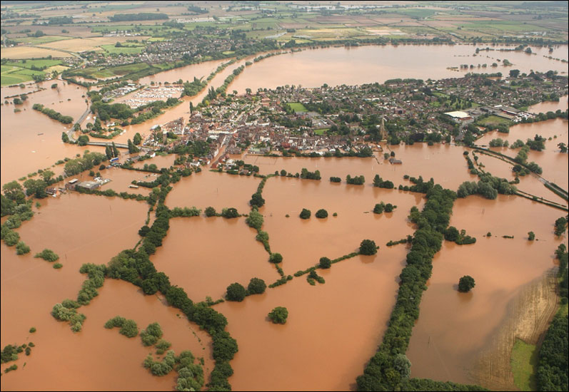
Notes:
In 2007 UK experienced widespread flooding with a cost to the economy of £3.2 billion.
Government enquiry afterwards into why damage was so widespread
Enquiry found that whilst the there was a good forecast of prolonged and heavy rain, there was not a warning issued for flooding
Enquiry recommended that the Met Office and the Environment Agency (hydrology) needed to work together to combine data on when and where there will be rain with information on what the impact of the rain will be on rivers
Now have a joint Flood Forecasting Centre that issues flood warnings.
Met Office also work with other government agencies to issue impact based warnings (e.g. public health England for Heat Health warning)

Slide 5
Warnings issued to the public via website, TV, apps Issued to DRM community and government via telecon, SMS and email.
About warnings
Each warning will contain the following sections:
Headline – a short weather headline, which states what weather type, is forecast
What to expect – details on the types of impact forecast and an indication of how likely those impacts are
What should I do – this section links to advice and guidance from our partners on how to stay safe in severe weather
Further details – additional information on the forecast weather.
Notes:
In 2007 UK experienced widespread flooding with a cost to the economy of £3.2 billion.
Government enquiry afterwards into why damage was so widespread
Enquiry found that whilst the there was a good forecast of prolonged and heavy rain, there was not a warning issued for flooding
Enquiry recommended that the Met Office and the Environment Agency (hydrology) needed to work together to combine data on when and where there will be rain with information on what the impact of the rain will be on rivers
Now have a joint Flood Forecasting Centre that issues flood warnings.
Met Office also work with other government agencies to issue impact based warnings (e.g. public health England for Heat Health warning)

Slide 6
https://www.metoffice.gov.uk/public/weather/warnings
Notes:
In 2007 UK experienced widespread flooding with a cost to the economy of £3.2 billion.
Government enquiry afterwards into why damage was so widespread
Enquiry found that whilst the there was a good forecast of prolonged and heavy rain, there was not a warning issued for flooding
Enquiry recommended that the Met Office and the Environment Agency (hydrology) needed to work together to combine data on when and where there will be rain with information on what the impact of the rain will be on rivers
Now have a joint Flood Forecasting Centre that issues flood warnings.
Met Office also work with other government agencies to issue impact based warnings (e.g. public health England for Heat Health warning)

Slide 7
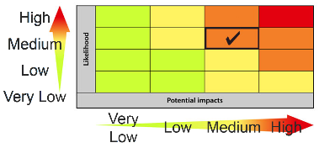
Understanding the impact – this can only be done through engagement with users
Working with users to understand impact
Disaster Response Agencies
First Responders
Public
Government Departments
Local Government
Sector Specialists (Health, Transport, Utilities)
Media
Notes:
Understanding the impact.
In bringing the impacts out it is necessary to work with others to understand how weather will affect communities. As I said NMHSs will not hold all the information on vulnerability and exposure and must work with colleages to understand this,
This means working with a wide range of stakeholders not only in government, but with the public sector specialists in industry.

Slide 8
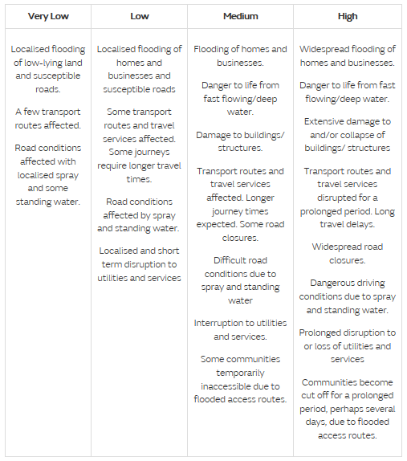
Understand the Impact
Impacts are designed for each type of weather that may affect the country
Typical impact statements are developed in partnership with the responder community and other users
Impacts can include on flooding, damage to buildings, disrupted transport links, interruptions to utilities and services, cut-off communities, damage to agriculture and danger to life
Notes:
Through this collaboration is it possible to design a set of impact statements that are relevant to users and help to provide impact advice

Slide 9
What the colours mean
Yellow: Be aware of possible delays & disruption. Severe weather possible
Amber: Be prepared to protect yourself, your family & community. Likelihood of bad weather which could cause delays, power interruption, danger to life.
Red: Take action now to be safe. Extreme weather expected to cause widespread damage, travel, power disruption, risk to life.
Notes:
Through this collaboration is it possible to design a set of impact statements that are relevant to users and help to provide impact advice

Slide 10
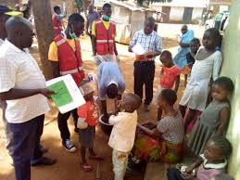
Taking action
Responders have pre-agreed standard operating procedures which define thresholds for action and define what action should be taken.
For example – Red Cross in Uganda, high impact low likelihood of floods….preposition supplies of water chlorination tablets. High impact, high likelihood of floods: Evacuate community to evacuation shelters.
Notes:
Understanding the impact.
In bringing the impacts out it is necessary to work with others to understand how weather will affect communities. As I said NMHSs will not hold all the information on vulnerability and exposure and must work with colleages to understand this,
This means working with a wide range of stakeholders not only in government, but with the public sector specialists in industry.

Slide 11
Benefits of IBF
Provides information that is actionable and more likely to save lives and livelihoods. Red cross recognise that IBF underpins forecast based early action.
Expresses the inherent uncertainty in forecasting – users can understand it.
Easy to understand by users. Colour coding was easily understood by illiterate fishermen in Kenya and coloured flags helped them decide whether to go out fishing or not.
Actions can be agreed by user organisations and ratified in standard operating procedures – this takes away individual discretion/blame.
Builds trust in a Meteorology service as becomes the authoritative voice on weather and climate related issues. 5 million people downloaded weather app during snow event last winter
Demonstrates why Met Services have to work in partnership with other government organisations – they can’t do it on their own! A review of the Met Office has found that warning and forecasting services mean that each £1 invested in the Met Office by government leads to £13 saved through avoiding loss of life and infrastructure.

Slide 12
Discussion
Who are the key users/sectors DMN would need to work with who have information on the IMPACTS of weather

