Slide 1
Flood Early Warning System in Albania
Institute of Geoscience, Energy, Water and Environment
(IGEWE)
Tirana, Albania
Amparo Samper Hiraldo
CIM International Hydrologist
amparosamper@hotmail.com

Slide 2
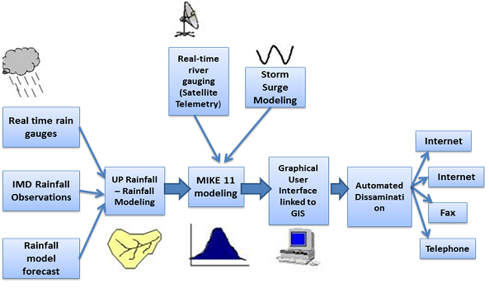
What do we need to set up a FEWS?
Flood Forecasting System (FFS)
Disaster Risk Management Mechanism (DRM)

Slide 3
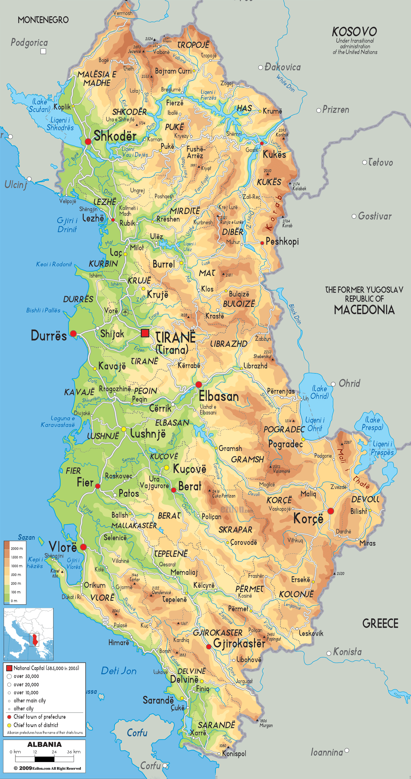
Albania’s Hydrology
Characteristics
Area of Albania: 28.748 Km²
Transboundary River Basins: Drin and Vjosa Rivers. Basin areas outside of Alabania 14.557 Km².
Costal Mediterranean climate combined with continental in uplands.
Average rainfall: around 1500 mm, big variability.
Floods from November to March.
Snow cover during winter.
Ground water connexions. And natural lakes.
River Basin and Physical maps

Slide 4
Important recent floods in Albania
Avalanches cause also big damages and deaths in the past years

Slide 5
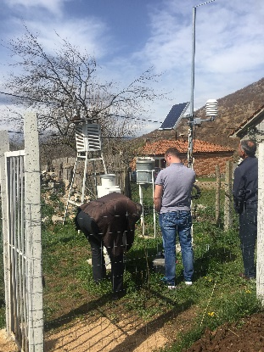
Flood Early Warning System in Albania after 2010
Manual (over a 250) and Automatic data (49 stations).
Meteo forecasting tools: COSMO &ECMWF&ALADIN.
Flood forecasting tools:
EFAS
DEWETRA CIMA Foundation (Satellite data and weather Forecast).
Southeast Europe Flash Floods Guidance System (SEEFFGS).
Panta Rhei model (to be transformed into forecasting model).
OUTPUT: Warning Bulletin 12:00 o’clock every day. Strong relationship with Civil Protection.

Slide 6
Priorities

Slide 7
Conclusions

Slide 8
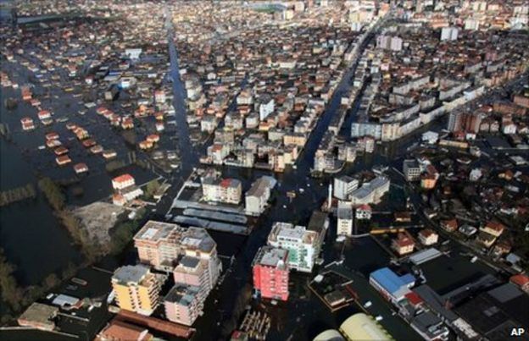
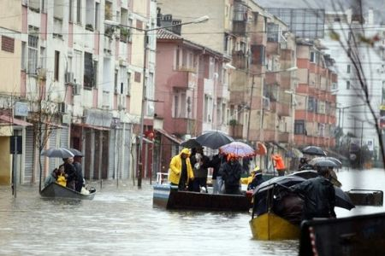
THANK YOU!!

