Slide 1
Hydro-Meteorological Hazards and their impacts in Mauritius
WORKSHOP TO IMPLEMENT
A PILOT PROJECT ON IMPACT-BASED FORECASTING AND RISK-BASED WARNINGS
Dhurmea Ram
Divisional Meteorologist
Mauritius Meteorological Services
26 October 2015

Slide 2
Outline
Introduction
Cyclones
Heavy precipitations
Floods/flash floods
Landslides
Droughts
Storm surge
High waves
Emerging hazards
Conclusions

Slide 3
Introduction
Tropical cyclones
Flood/Flash flood
Heavy/Torrential Rain
Hydro-Meteorological Hazards in Mauritius
Mud & landslides
Storm Surges
High Waves
Droughts
Thunderstorm/Lightning
Funnel Clouds/Mini tornadoes

Slide 4
Summary of Hazards Impact
Introduction
Date | Disaster Type | Total Deaths | Date | Disaster Type | Total Affected | Date | Disaster Type | Economic Damage/'000 US $
Feb-60 | Storm | 42 | Feb-75 | Storm | 82658 | Feb-75 | Storm | 200000
Mar-13 | Flood | 11 | Dec-79 | Storm | 105257 | Dec-79 | Storm | 175000
Feb-75 | Storm | 9 | Jan-82 | Storm | 32000 | Jan-99 | Drought | 175000
Dec-79 | Storm | 5 | Feb-72 | Storm | 25016 | Feb-94 | Storm | 135400
Mar-08 | Flood | 4 | Dec-67 | Storm | 23524 | Jan-89 | Storm | 60000
Dec-96 | Storm | 3 | Jan-91 | Storm | 7500 | Jan-02 | Storm | 50000
Jan-02 | Storm | 3 | Jan-89 | Storm | 4507 | Dec-67 | Storm | 5000
Feb-72 | Storm | 2 | Feb-94 | Storm | 2300 | Jan-82 | Storm | 650
Feb-94 | Storm | 2 | Jan-02 | Storm | 1050 | Feb-82 | Storm | 323
Feb-07 | Storm | 2

Slide 5
Cyclones over Mauritius
  On average 9 formation every year. Can be as low as 3 storms (2010-2011) or high with 15 storms (1993-1994).
  No discernible trend in number of cyclone storm formation.
TC Humba
ITC Gamede
Feb 2007
  Number of storm reaching intensity ≥ TC is on the increase in the SWIO.

Slide 6
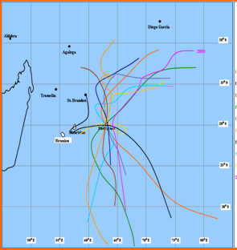
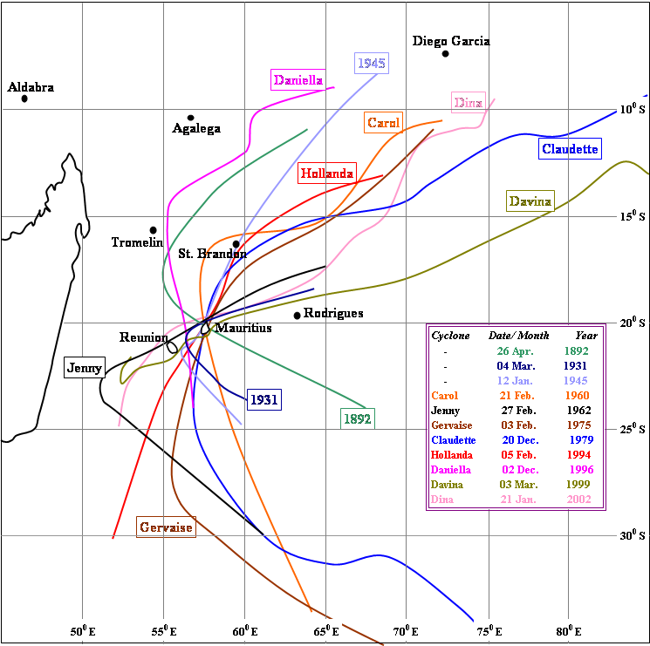
Prone to Impact from Cyclones
Last direct hit in 1975.
The threat is still here.
Even cyclone passing at a distance have their radius of maximum wind affecting Mauritius.

Slide 7
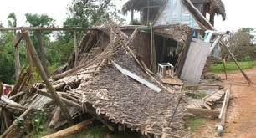
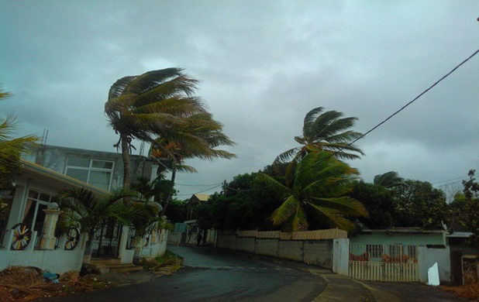
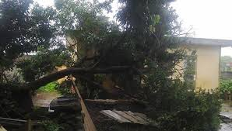
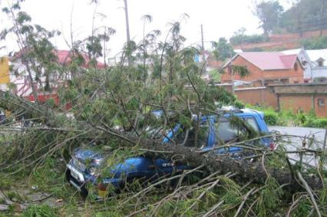
Cyclones Direct Impact
The destructive winds is the most direct threat.
Our current infrastructure can withstand cyclonic winds
But falling trees can be still fatal.
Damaged electric network is both a hazard and a nuisance to socioeconomic activities.

Slide 8
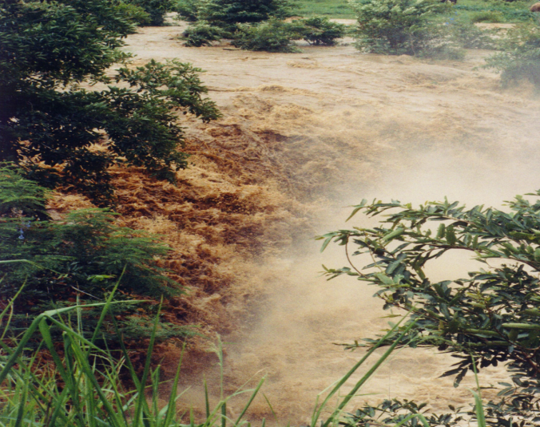
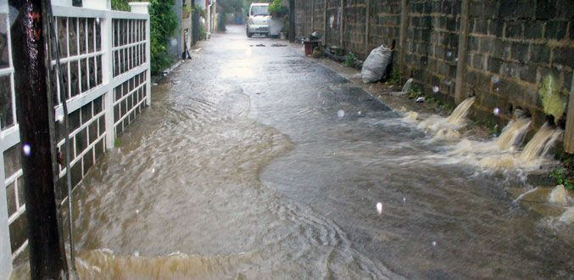
Other Impacts of Cyclones
Rapid unplanned urbanisation and other man made structures has increased the vulnerability to other weather associated with storms.
Heavy rainfall from cyclone causing floods and flash floods is superseding the winds as a major risk.

Slide 9
Heavy Precipitation
One of the important criteria which determines the type of flood.
Heavy precipitation could be in terms of:
  Low intensity long duration rainfall
  High intensity short duration rainfall
  High intensity long duration rainfall

Slide 10
Heavy Precipitation
  Low intensity long duration rainfall

Slide 11
Heavy Precipitation
  High intensity short duration rainfall

Slide 12
Heavy Precipitation
  High intensity long duration rainfall

Slide 13
Evolution of Rainfall Intensity and Duration
RainIntensity/ Duration | 23-24 Mar 2005 | 16-17 Sep2008 | 26 Mar 2008 | 30 Mar 2009 | 13 Feb 2013 | 30 Mar 2013
 | Riverine Flood | Riverine Flood | Flash Flood | Flash Flood | Flash Flood | Flash Flood
≥ 30 mm/h |  | 1 | 10 | 6 | 13 | 16
1 hour |  | - | 2 | 6 | 11 | 9
2 hours |  | 1 | 3 | - | 2 | 6
3 hours |  | - | 5 | - | - | 1
≥ 40 mm/h |  |  | 10 | 2 | 7 | 11
1 hour |  |  | 6 | 2 | 7 | 7
2 hours |  |  | 3 | - | - | 4
3 hours |  |  | 1
≥ 50 mm/h |  |  | 5 | 1 | 3 | 6
1 hour |  |  | 3 | 1 | 3 | 5
2 hours |  |  | 2 | - | - | 1
≥ 60 mm/h |  |  | 1 |  | 1 | 4
1 hour |  |  | 1 |  | 1 | 4
2 hours |  |  |  |  |  | -
≥ 70 mm/h |  |  |  |  |  | 3
1 hour |  |  |  |  |  | 3
2 hours |  |  |  |  |  | -
≥ 80 mm/h |  |  |  |  |  | 3
1 hour |  |  |  |  |  | 3
2 hours |  |  |  |  |  | -
≥ 90 mm/h |  |  |  |  |  | 3
1 hour |  |  |  |  |  | 3
2 hours |  |  |  |  |  | -
≥ 100 mm/h |  |  |  |  |  | 2
1 hour |  |  |  |  |  | 2
2 hours |  |  |  |  |  | -

Slide 14
Rainfall Intensities and Floods
Flash Floods usually associated with intensities of ≥ 40 mm/h.
Will the impact of this rainfall intensity be same in the future?
Date | Flood Type | ≥ 30 mm/h | ≥ 40 mm/h | ≥ 50 mm/h | ≥ 60 mm/h | ≥ 70 mm/h | ≥ 80 mm/h | ≥ 90 mm/h | ≥ 100 mm/h
Mar-05 | Riverine Flood
Mar-08 | Flash Flood | 10 | 10 | 5 | 1
Sep-08 | Riverine Flood | 1
Mar-09 | Flash Flood | 6 | 2 | 1
Feb-13 | Flash Flood | 13 | 7 | 3 | 1
Mar-13 | Flash Flood | 16 | 11 | 6 | 4 | 3 | 3 | 3 | 2
Mar-14 | Riverine Flood | 3 | 3 | 2

Slide 15
Types of Flood in Mauritius
Water accumulation.
Flash Floods
River Floods
Urban flood

Slide 16
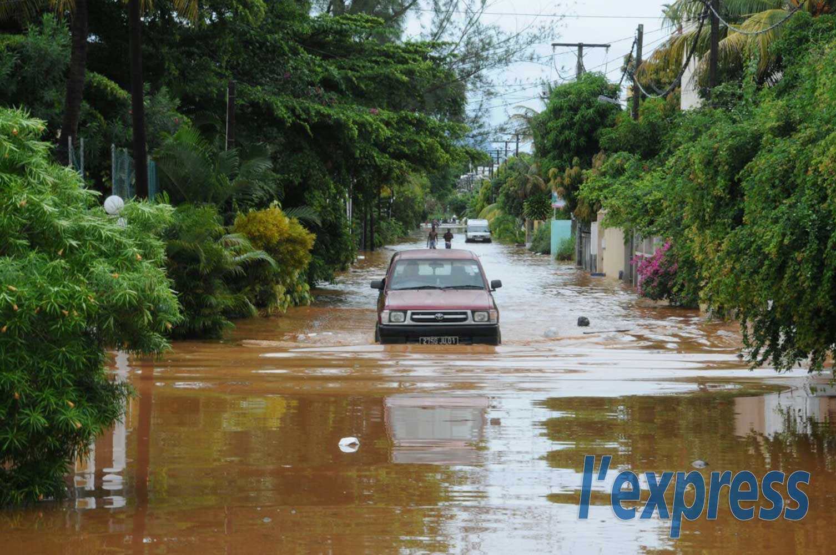
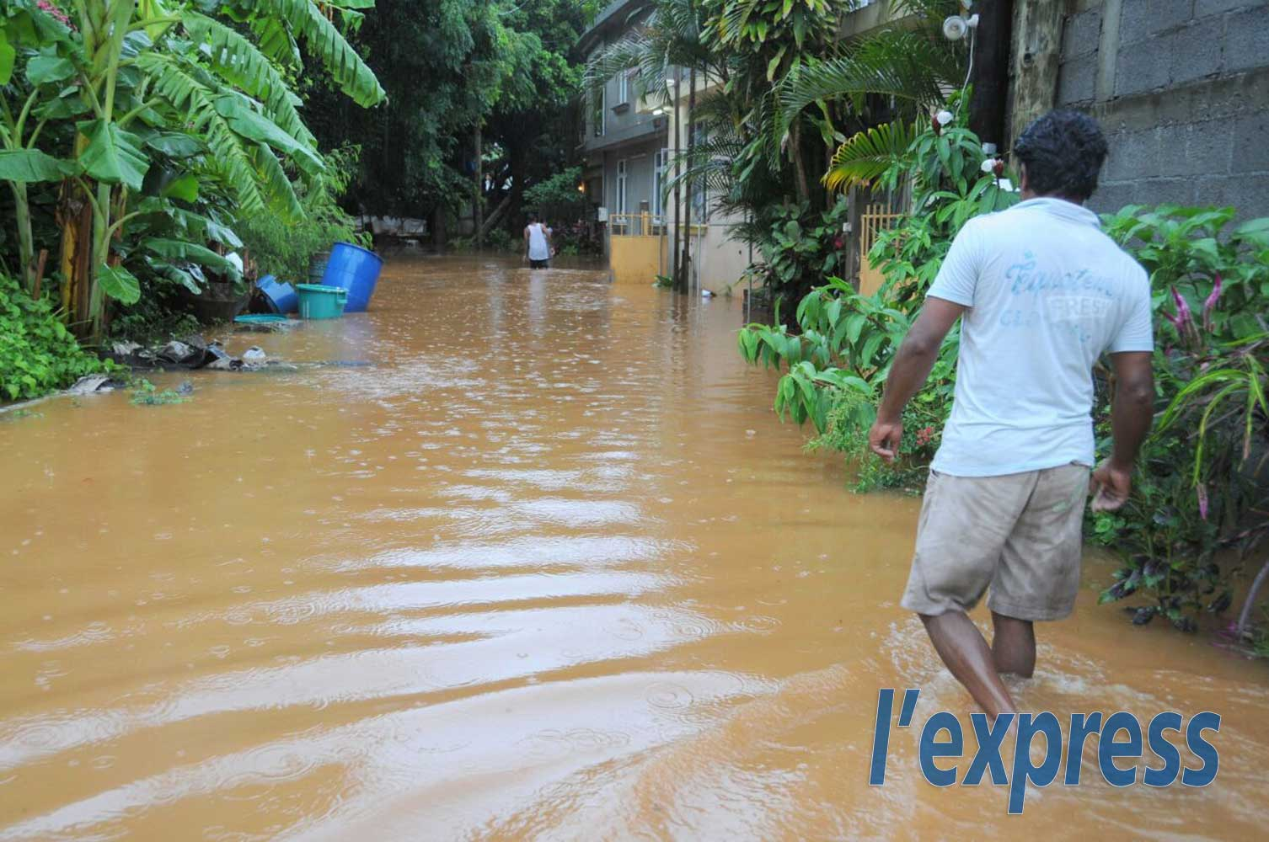
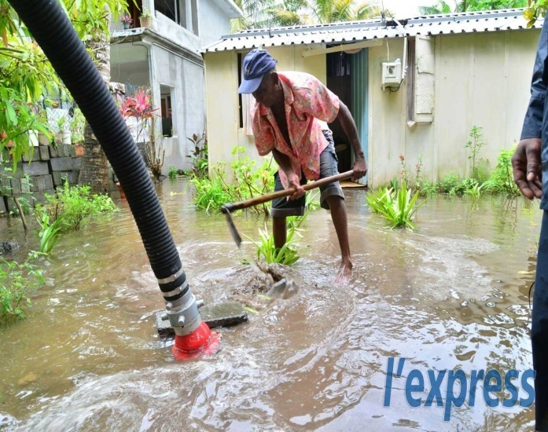
Water accumulations
Occurs in low lying areas and those with poor drainage facilities.

Slide 17
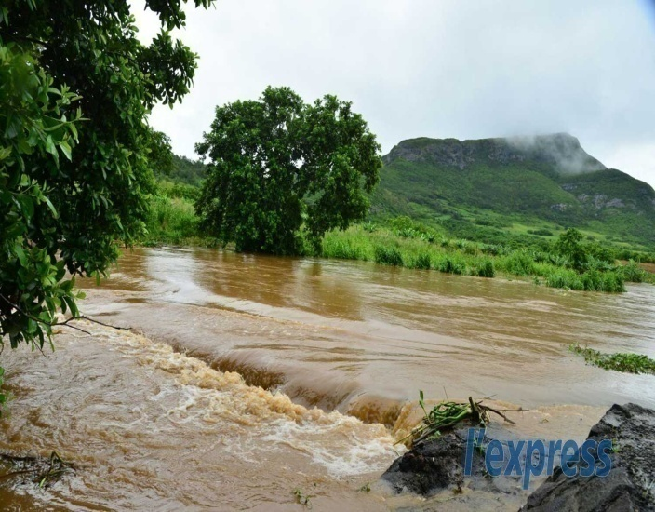
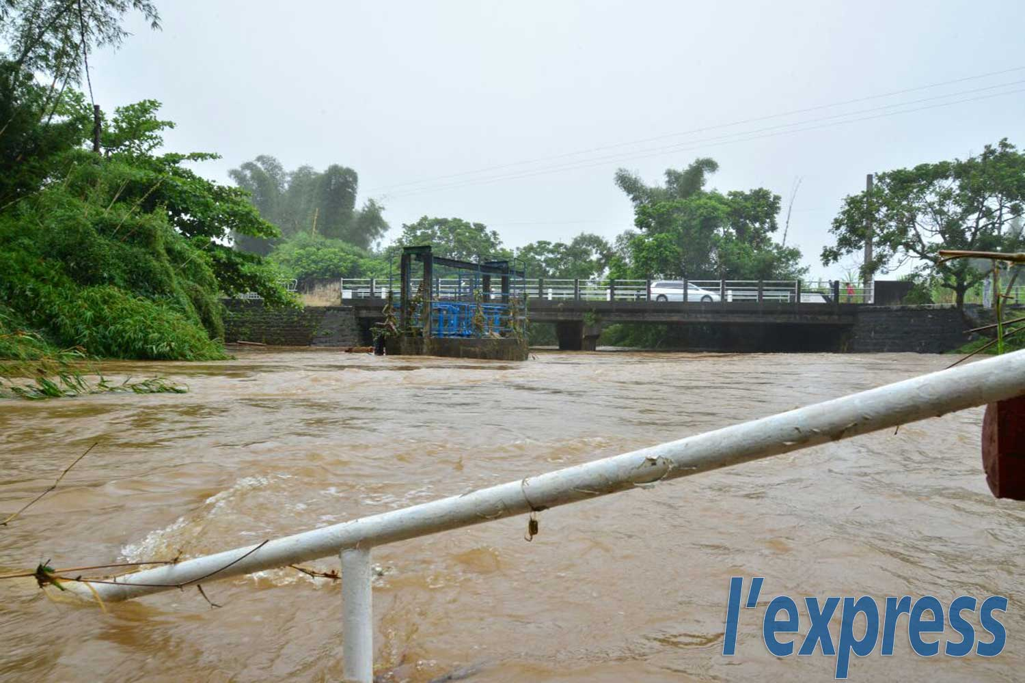
River Floods
Floods caused by precipitation over a large catchment‟s area over several days. Built up slowly but may continue for days.

Slide 18

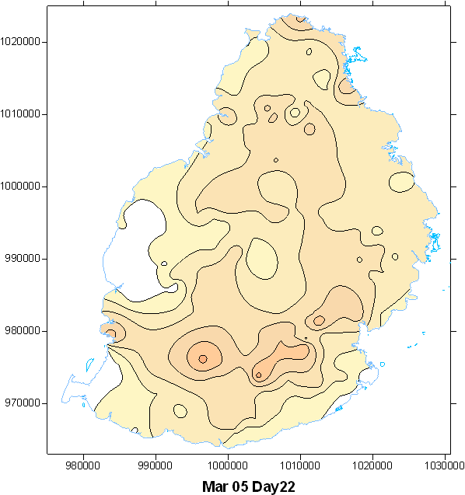
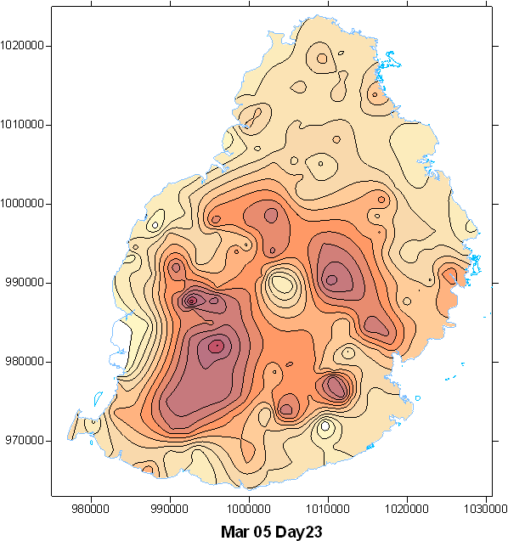
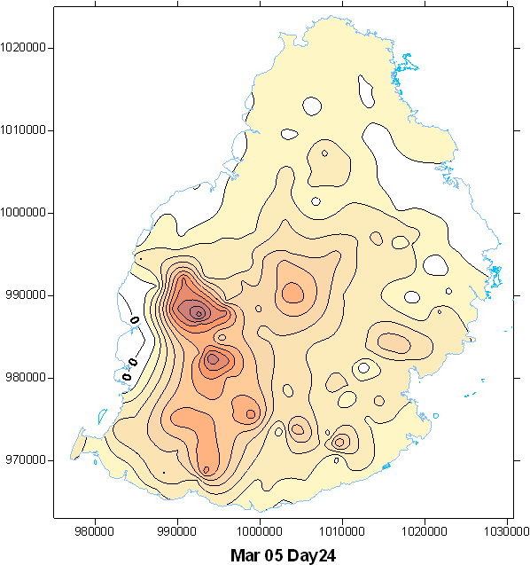
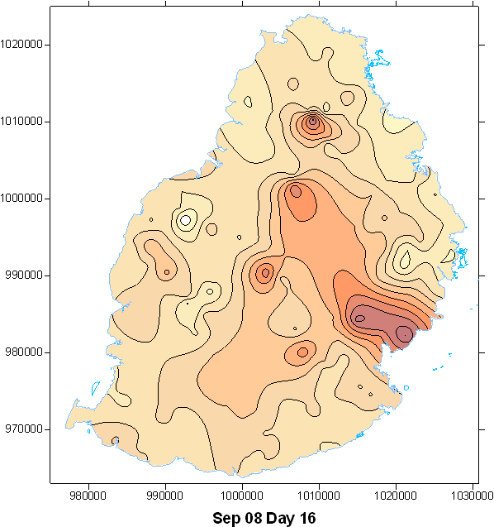
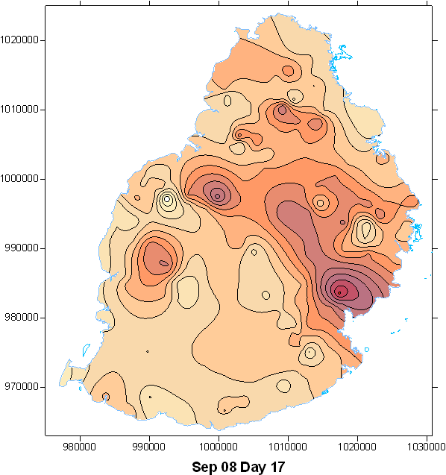
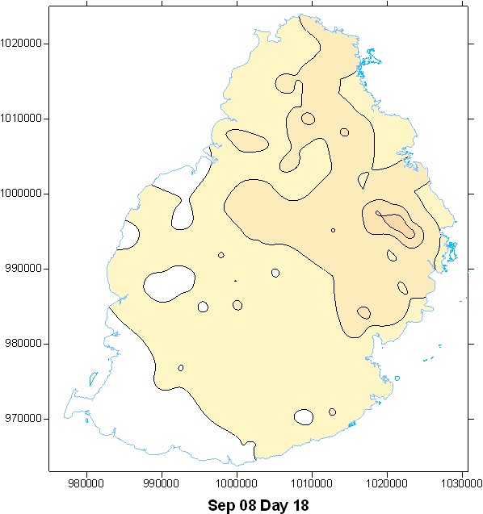
Flood/Riverine flood
No loss of lives
Agriculture severely affected.
Socio-economic activities affected.
22-24 Mar 2005
Max. 24 hours rainfall: 274 mm (Day 23)
Maximum rainfall intensity: 25.2 mm/h
16-18 Sep 2008
Max. 24 hours rainfall: 285 mm
Maximum rainfall intensity: 30 mm/h

Slide 19
Flash Floods
Floods occurring within 2-4 hours of start of rainfall which is of high intensity.
Can be confined to a single river basin or occurring in different basins.
Usually exacerbated by topography and man made features.
Can occur even after a dry period.

Slide 20
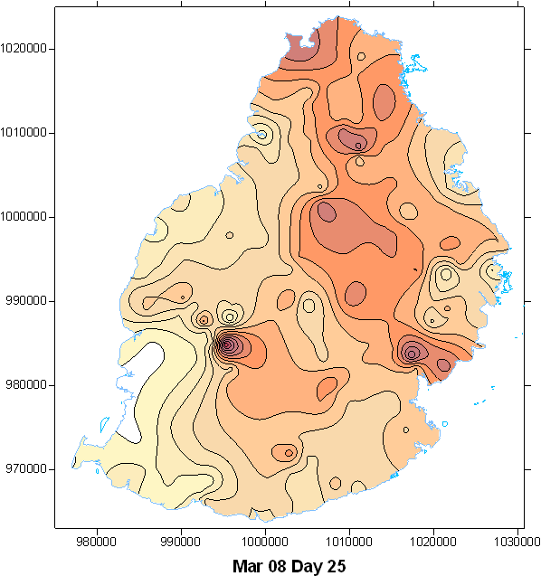
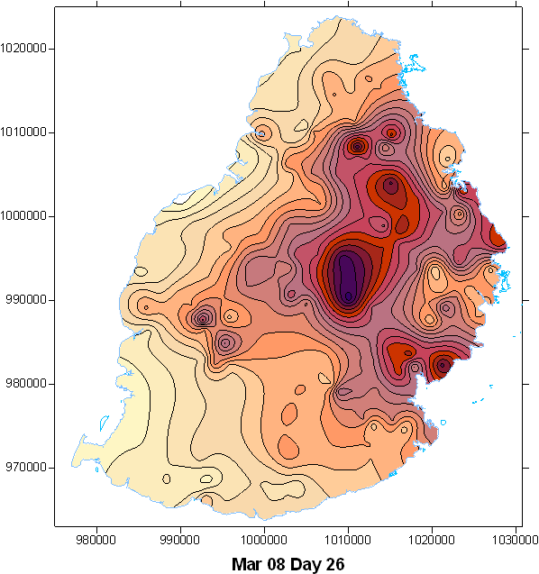
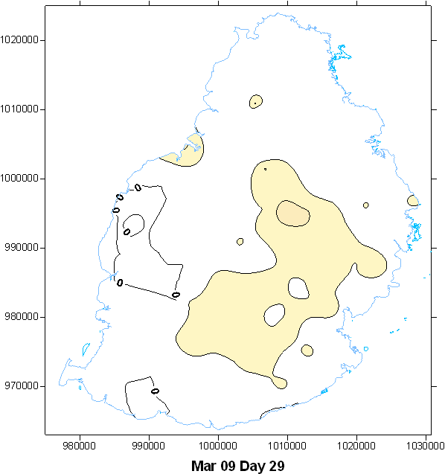
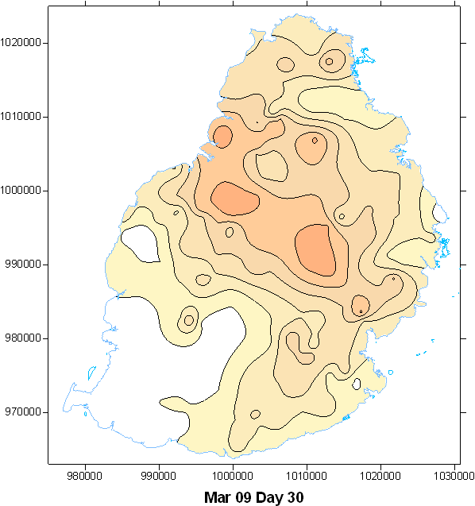
Flash Flood: March 2008 and March 2009
25-26 Mar 2008
Prior wet conditions
Widespread rainfall
4 casualties
Max. 24 hours rainfall: 393 mm (Day 26)
Maximum rainfall intensity: 60 mm/h
28-30 Mar 2009
Prior dry conditions
Localised high intensity rainfall
No loss of lives
Max. 24 hours rainfall: 135 mm (Day 30)
Maximum rainfall intensity: 60 mm/h

Slide 21
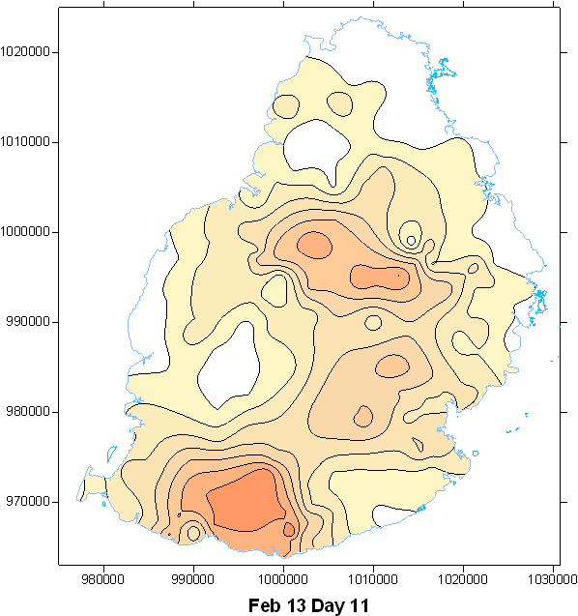
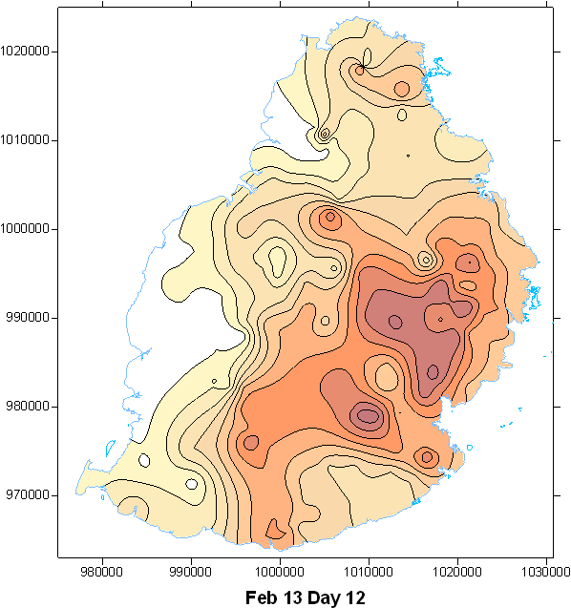
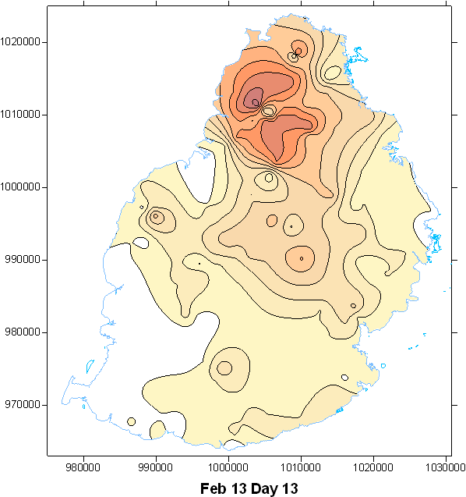
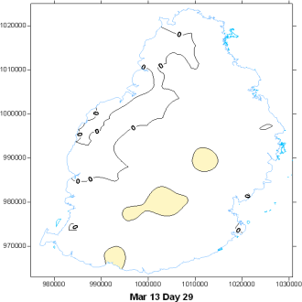
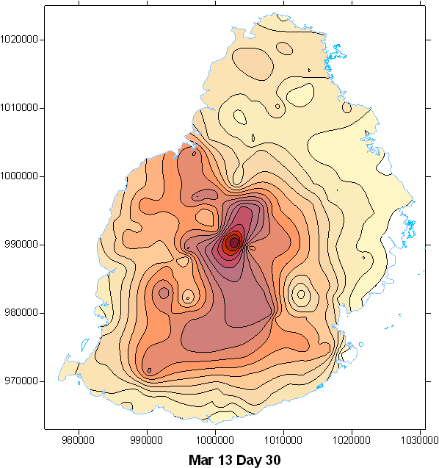
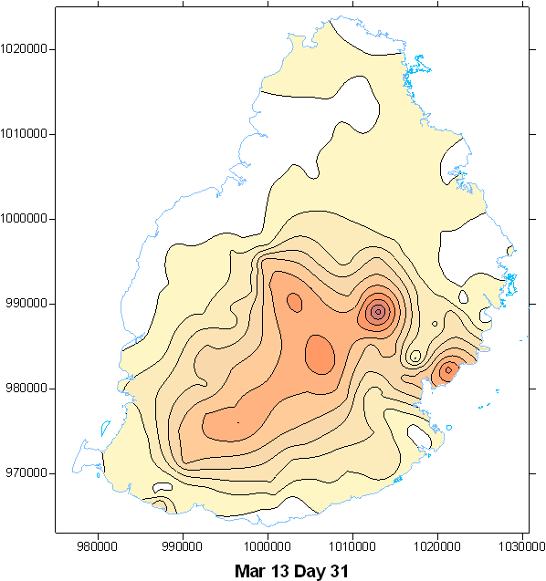
Flash Flood Feb and March 2013
Max. 24 hours rainfall: 212 mm
Highest rainfall intensity: : 64 mm/h
11-13 Feb 2013
Scattered rainfall locally of heavy intensity.
Wet conditions prior to flood.
No lives lost.
Max. 24 hours rainfall: 336mm
Highest rainfall intensity: : 123 mm/h
29-31 Mar 2013
Scattered rainfall locally of violent intensity.
Dry conditions prior to flood.
11 lives lost.

Slide 22
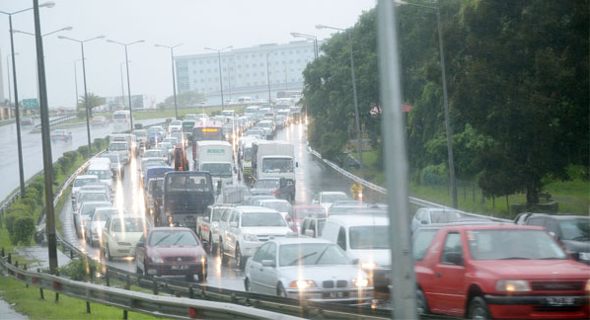
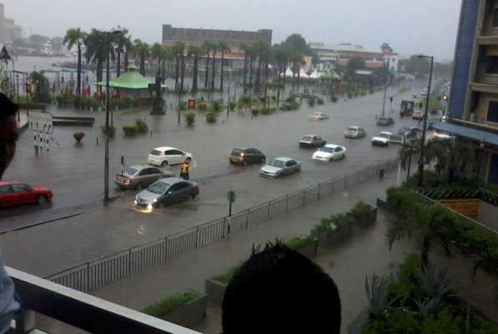
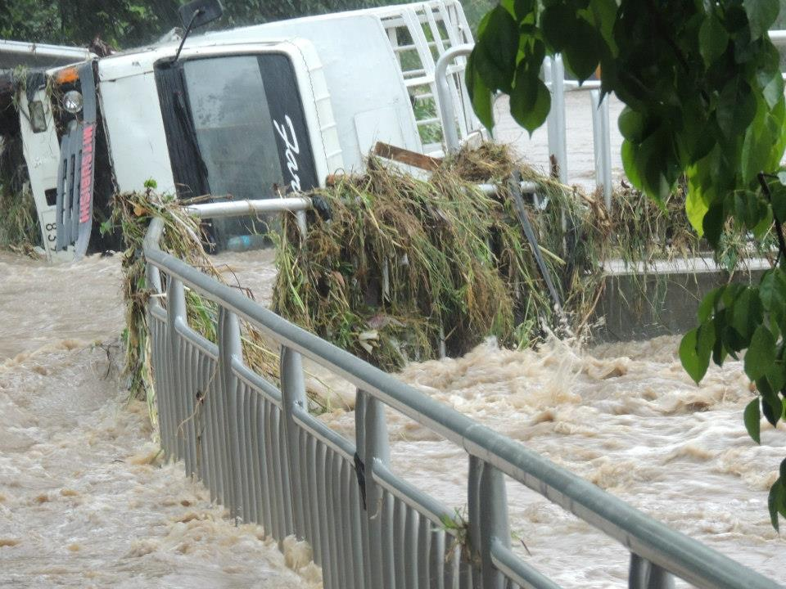
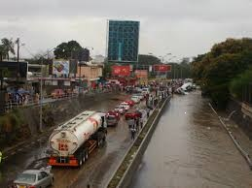
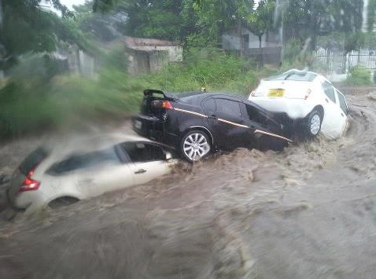
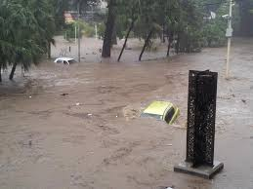
Flash Flood Impact
13 February 2013: motorway was still practicable. City centre was underwater though little rainfall . In other areas rivers flooded carrying debris and overturning vehicles on its way.
30 Mar 2013: motorway downtown turn into a devastating torrent of water . Cars got stacked on each other, some of them carried away and totally submerged. People was taken by surprise in their car.

Slide 23
Urban Flood
Is a result of changes in land surface: asphalt and concrete reducing infiltration of rain water.
Characterised by streets turning into swift moving rivers and underground structures becoming death traps as they fill with water.
Tampering with natural water courses at the expense of buildings and roads.

Slide 24
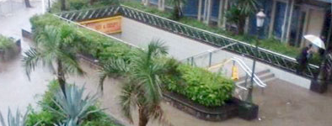
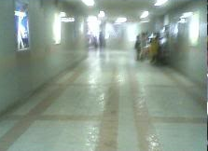
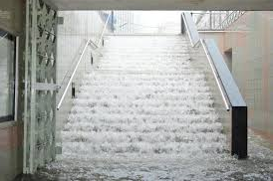
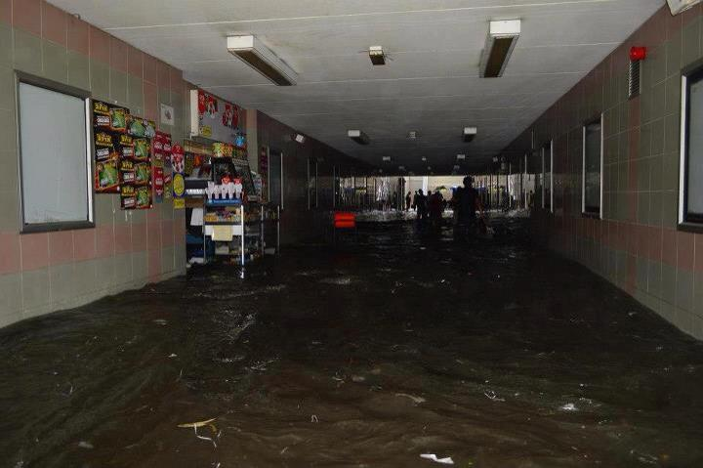
Impacts of Urban Flood
Underground Tunnel in the Capital City
13 February 2013: water level was still below the raised
30 mar 2013-water level overflow the raised staircase to flow into the tunnel.

Slide 25
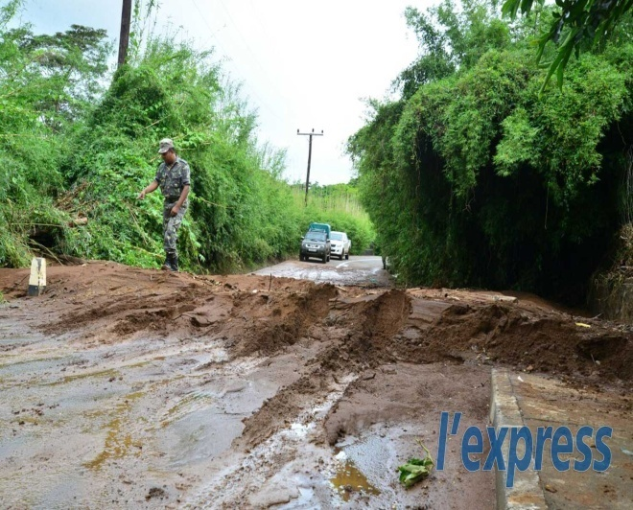
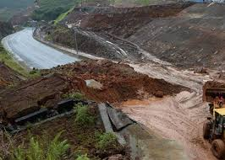
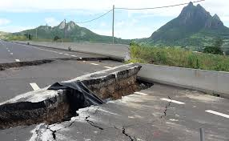
Landslides
In Mauritius caused by:
Prolonged heavy rainfall
Growing Population pressure on sloping grounds
Poor land use and management practices

Slide 26
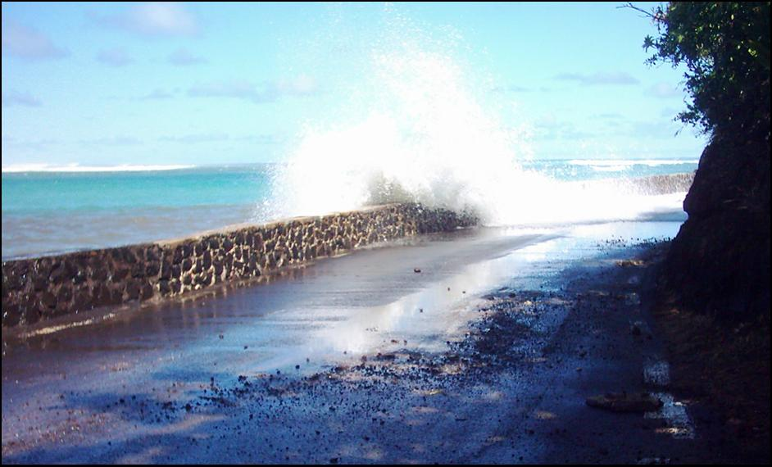
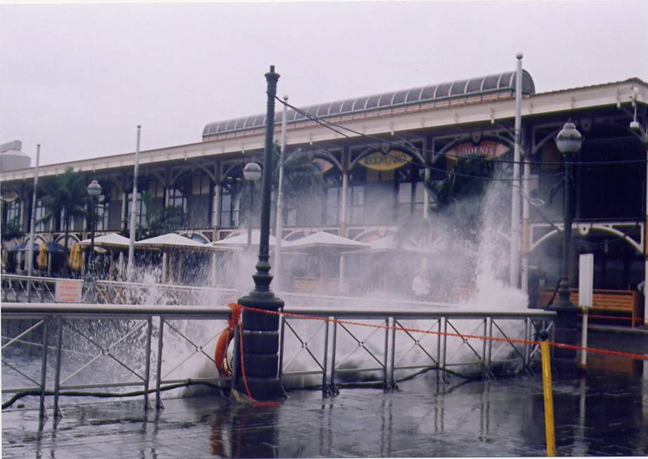
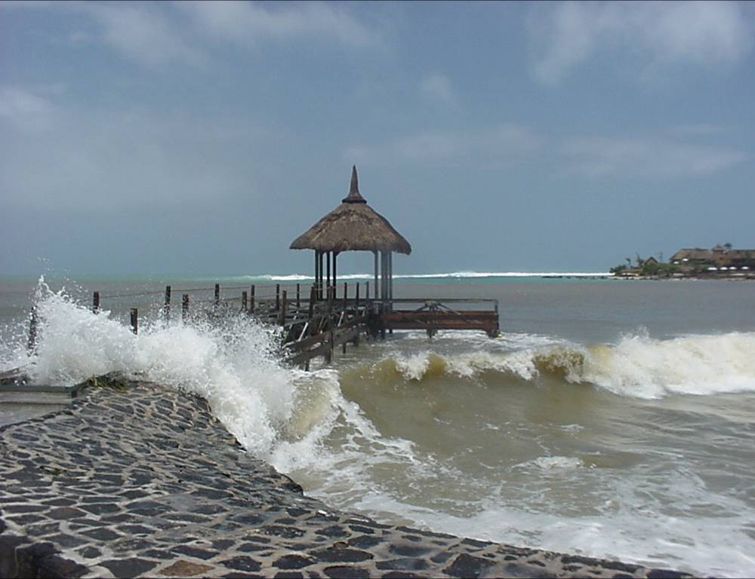
Storm Surge
Associated with Tropical Storms

Slide 27
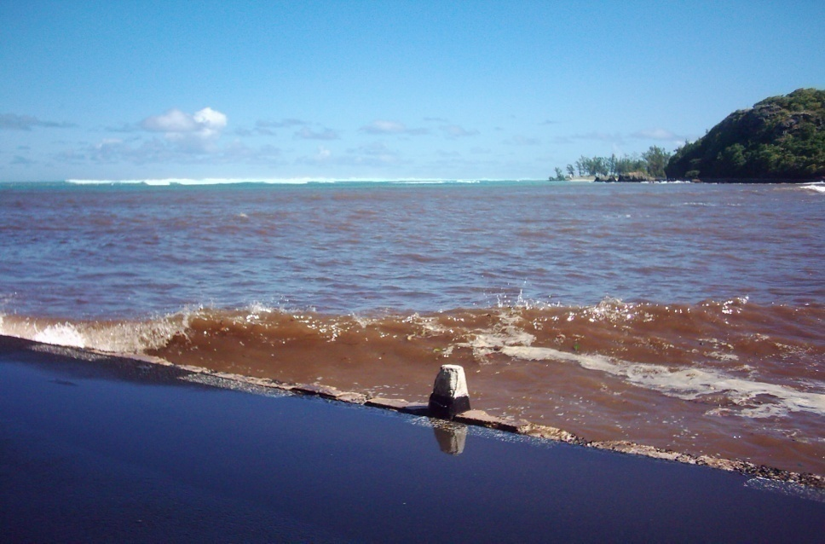
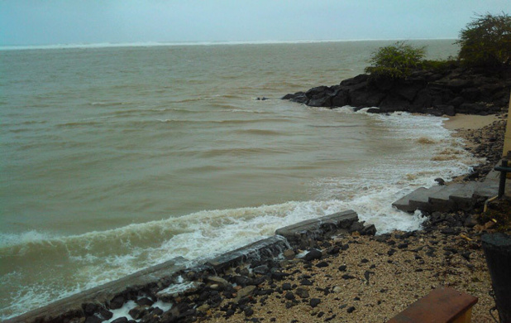
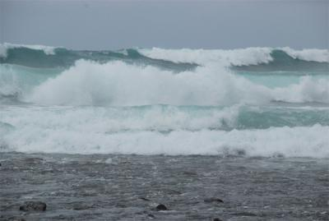
High Waves
Due to swell waves generated far in the extra tropical region.
Waves travel for days to strike the coasts of our islands.

Slide 28
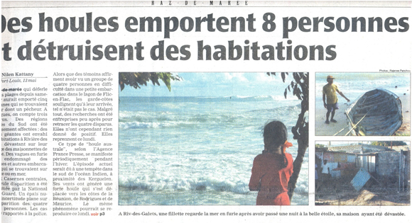
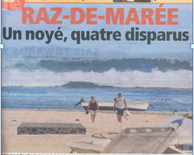
High Waves 13-14 May 2007

Slide 29
Drought
Drought classified mainly into
Meteorological Drought: A situation arising from deficiency of precipitation over an extended period of time.
Hydrological drought: A deficiency in surface and subsurface water supplies
Agricultural drought: Deficiency in soil moisture affecting crop production
Sociological drought
Mauritius prone to droughts of different severity.
Meteorological drought is the more common during the period September to November.
Drought of the century (Sep 98-Jun99): hydrological and agricultural droughts. Stage of socio-economic drought almost reached.

Slide 30
Drought
Meteorological Drought Condition

Slide 31
Drought 98-99
Extreme Drought Condition

Slide 32



Drought 98-99
Hydrological Drought:
Agricultural Drought:

Slide 33


Emerging Hazards
Funnel Clouds/Mini tornadoes: this has been observed due to severe convection or embedded in tropical cyclone.
Most Likely due to warming of the climate?

Slide 34

Emerging Hazards
Violent Thunderstorm/Electric Storm
  Damages to infrastructure .
  Already caused isolated casualties.

Slide 35
Conclusions
Mauritius has moved from the long-standing history of natural calamity in the form of cyclones.
Mauritius is now highly prone to different hydro-meteorological hazards.
Effect of urbanisation and man made features have modified the way several hazards are impacting the life of people.
Improper action is likely to turn various hazards into disasters.

