Slide 1
Federal hydrometeorological service Bosnia and Herzegovina Sarajevo Almir Bijedić, director almir.bijedic@fhmzbih.gov.ba Bakir Krajinovic, expert associate bakir.krajinovic@fhmzbih.gov.ba
REGIONAL STAKEHOLDERS WORKSHOP TO IMPLEMENT THE WMO STRATEGY FOR SERVICE DELIVERY FOR NMHSs IN SOUTH-EAST EUROPE
TIRANA, ALBANIA, 17-21 OCTOBER 2016

Slide 2
History
Duties and regulations
Organizational structure
Products
Users
Only 20 slides

Slide 3
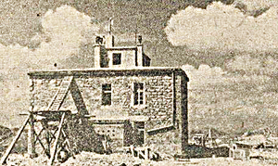
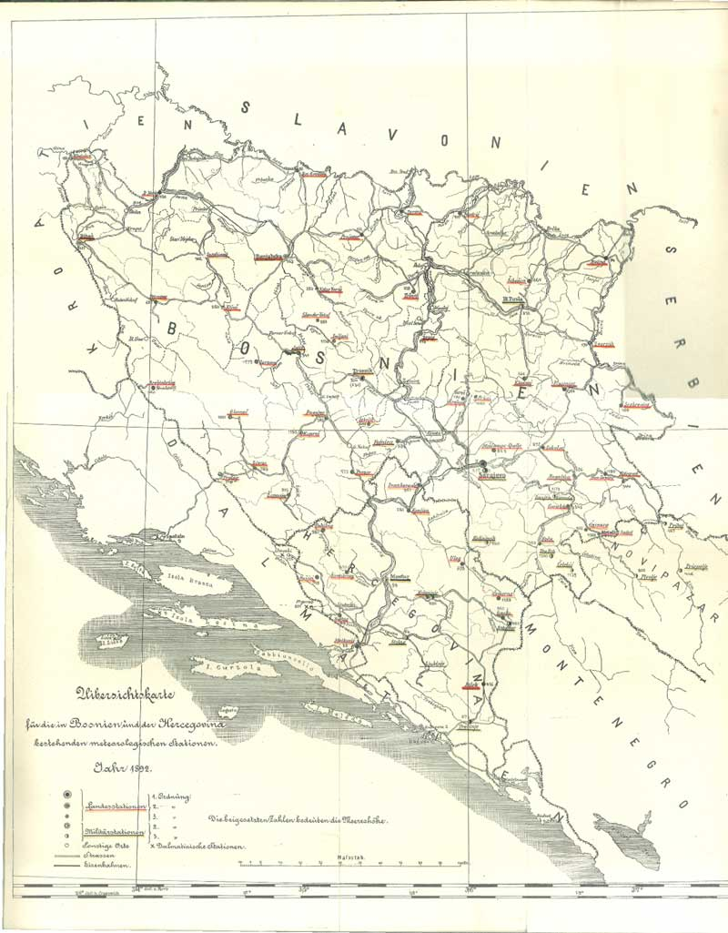
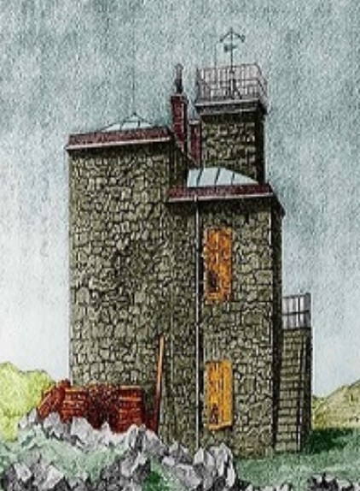
History of FHMS
The history of meteorological service in Bosnia and Herzegovina began in the end of the 19th century during the Austro Hungarian occupation. The military, for its own needs, set up weather stations in several cities…
Sarajevo – 1892
Mostar -1898
Tuzla – 1898
Next year we will celebrate 125 years of service…..

Slide 4
The scope of work of the Federal Hydrometeorological Service (FHMS):
FHMS performs professional and other activities within the competence of the Federation referring to:
development and functioning of meteorological, hydrological, seismic activities and environmental quality;
exploration of atmosphere, water resources, environmental quality (air, water and soil) and seismological processes;
collecting, processing and publishing data from the scope of interest for the Federation BH and other tasks in the field of meteorology, hydrology, environmental quality and seismology.
The Law on Federal Ministries and other bodies of the Federal Administration
conducting operations of FHMS stipulated in accordance with applicable laws and regulations of the Federation and in accordance with the standards and guidelines of the World Meteorological Organisation, the European Environment Agency and other professional international organizations.
Rulebook on Air Quality Monitoring ("Off. Gazette of F BiH, 12/05"), FHMS is authorized institution for:
establishment, organization and management of the air quality monitoring system in the FBiH, as part of the monitoring in Bosnia and Herzegovina,
establishment an information system for air quality in FBiH
Rulebook on the method of air quality monitoring and defining the types of pollutants, limit values and other air quality standards (Off. Gazette F BiH, No. 1/12)
Federal Environmental Protection Strategy 2008 -2018.
The Federal government decision Nr 341/2013 ("Off. Gazette of F BiH" no. 41/13) - FHMS is declared as Federal reference center for air. With this decision, the Institute has become the authority for air quality and air emission data verification in FBiH.

Slide 5
Directly under the government of the Federation of BiH

Slide 6
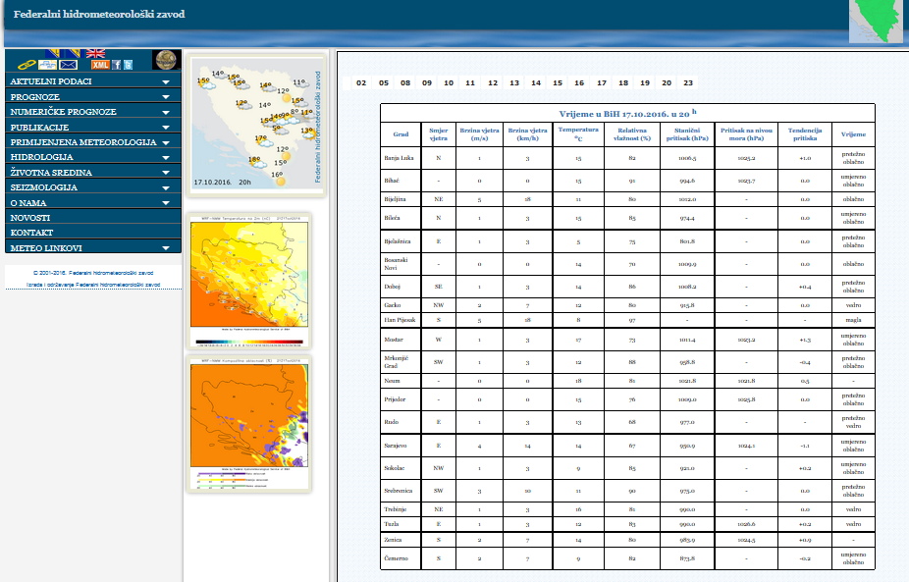
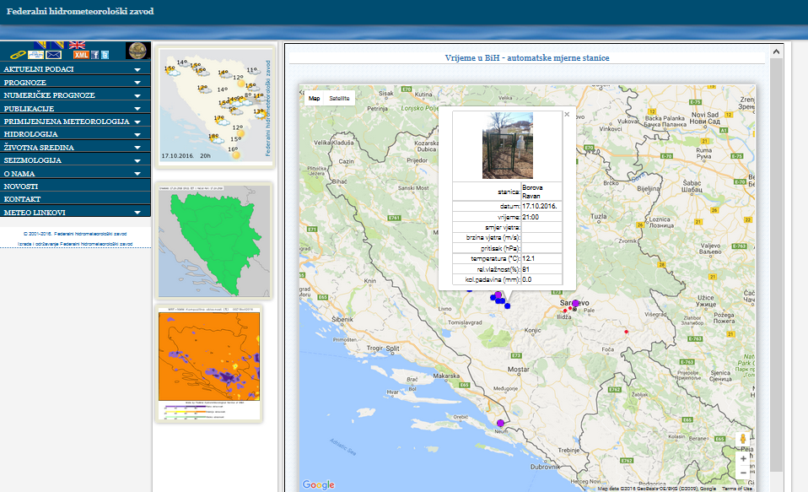
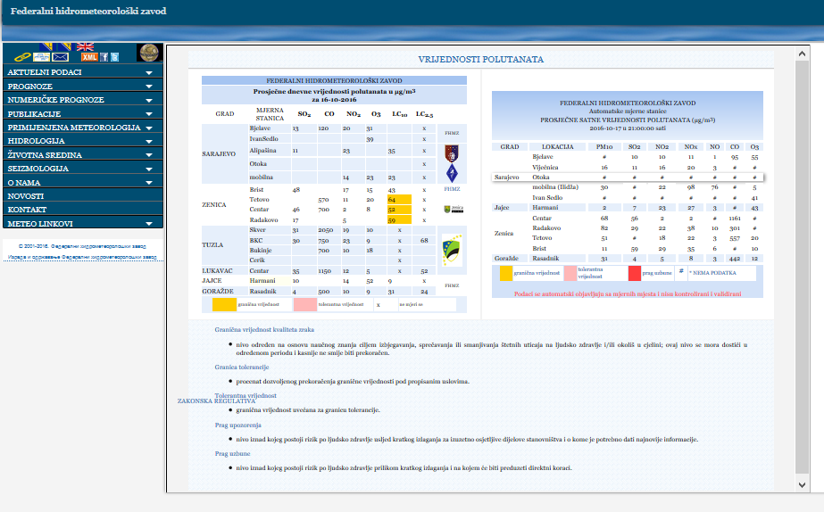
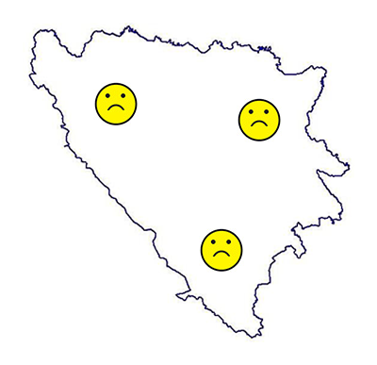
Our products:
On hourly basses update all data…
Meteorological
Hydrological
For all users….

Slide 7
New products - interactive forecast
Fire Weather Index - FWI

Slide 8
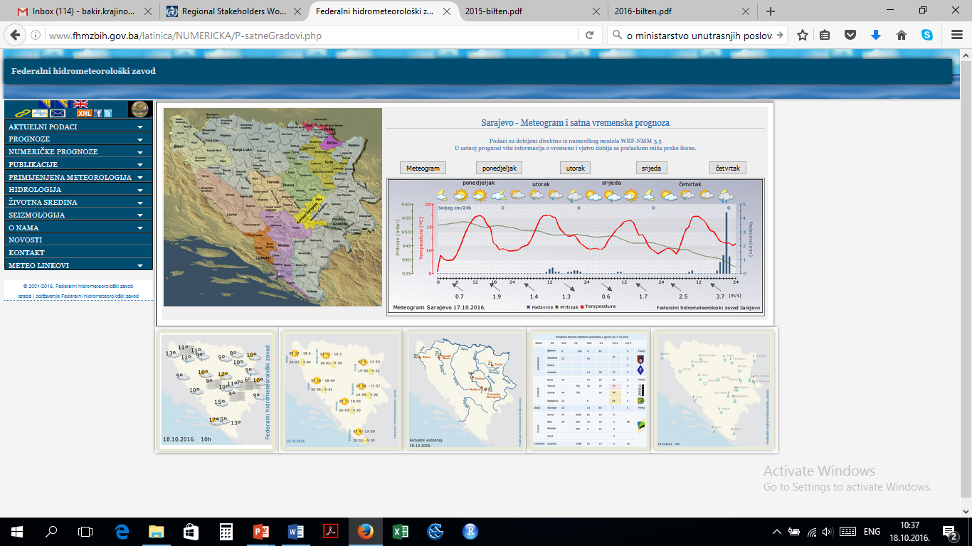
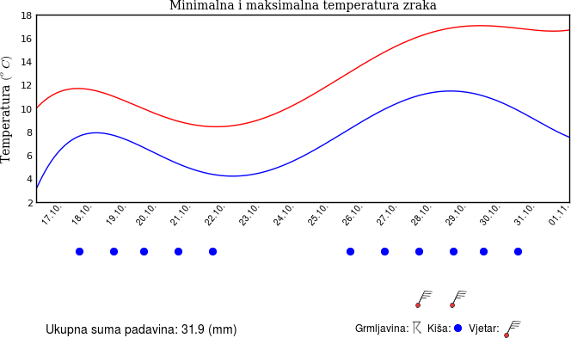
Our products:
Forecast:
Short range
LRF
Seasonal
All users…

Slide 9
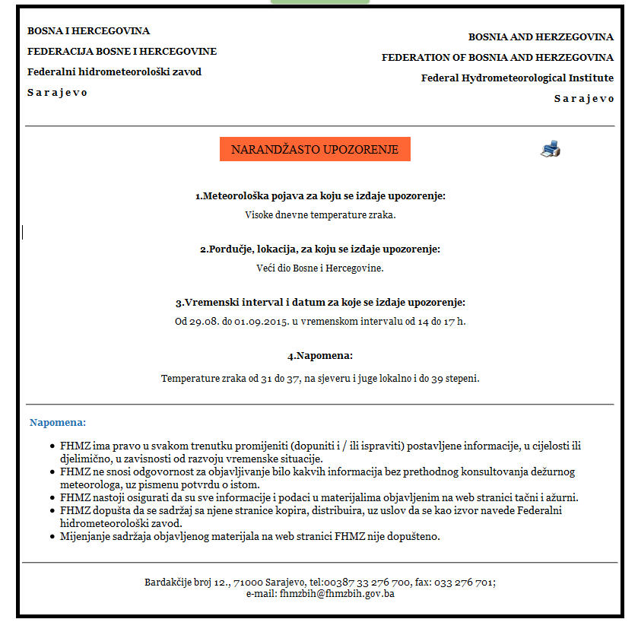
The role hydro-meteorological Institute in the system of protection and rescue
PROTOCOL IN PLACE FOR EVERY SITUATION
Delivery timely and reliable weather forecast
early warning to dangerous meteorological phenomena
raising the awareness of citizens
interpret weather information
co-operation with institutions and organizations involved in the process of protection and rescue with the aim to protect the human life and property
Regular and extraordinary bulletins and warnings which are developed are published on the web site, and shall be submitted to all relevant stakeholders especial to:
Civil Protection administration-Federation of Bosnia and Herzegovina
Civil Protection administration - Canton Sarajevo
Relevant ministries on Federal level and cantons
Public Companies: Rodes of the Federation of Bosnia and Herzegovina, Motorways of the Federation of Bosnia and Herzegovina etc.

Slide 10
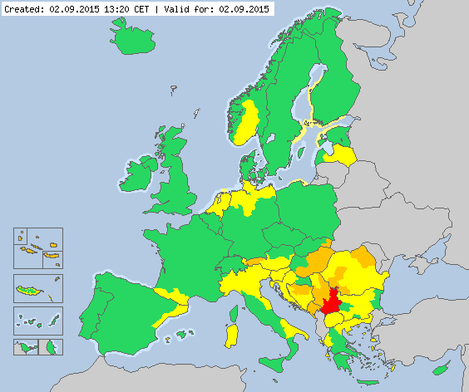
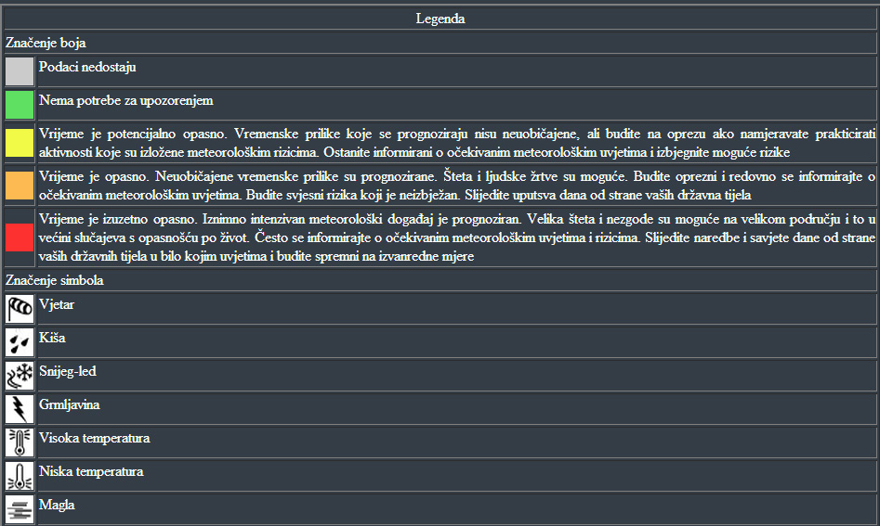
Meteoalarm
METEOALARM is the service, which combines the forecasts of dangerous meteorological phenomena in Europe for the next 48 hours.
Dangerous meteorological phenomena are presented in a simple and understandable way and are easily accessible to the public. Indicated by different symbols, and their intensity colors.
Within the EMMA (European Multiservice Meteorological Awareness) Federal Hydrometeorological Institute 01.02.2013.g. become a member of METEOALARM.
http://www.meteoalarm.eu/

Slide 11
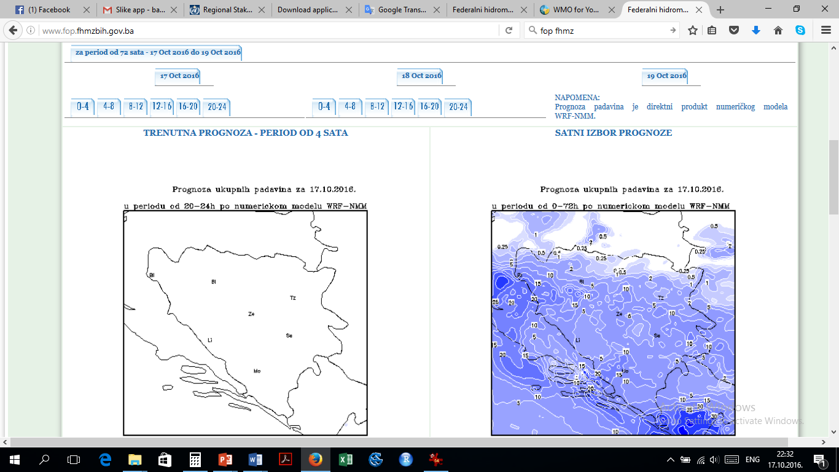
Hydrological monitoring and reports

Slide 12
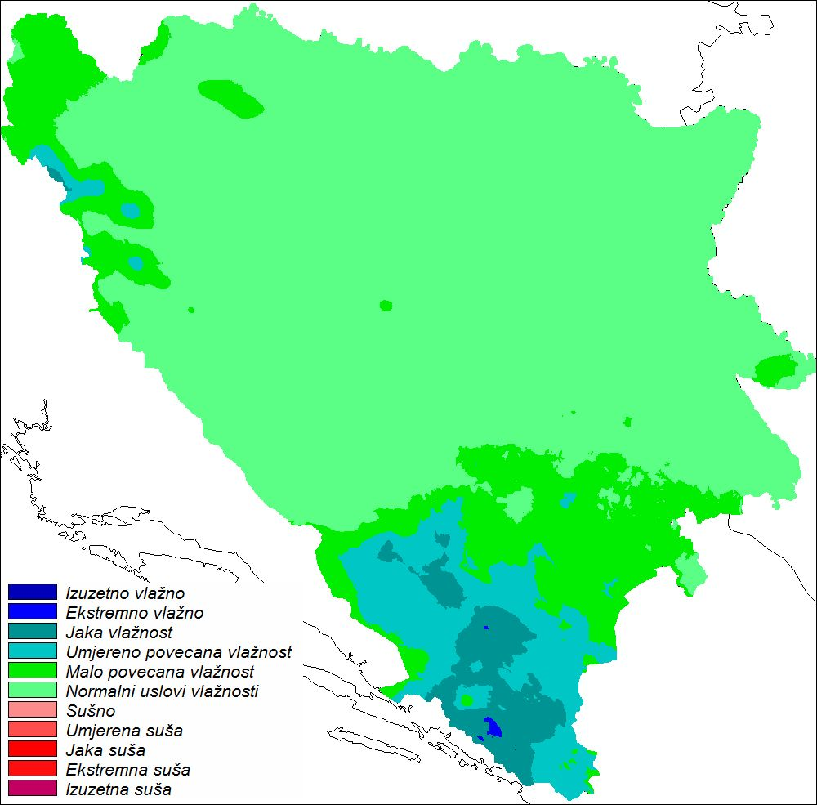
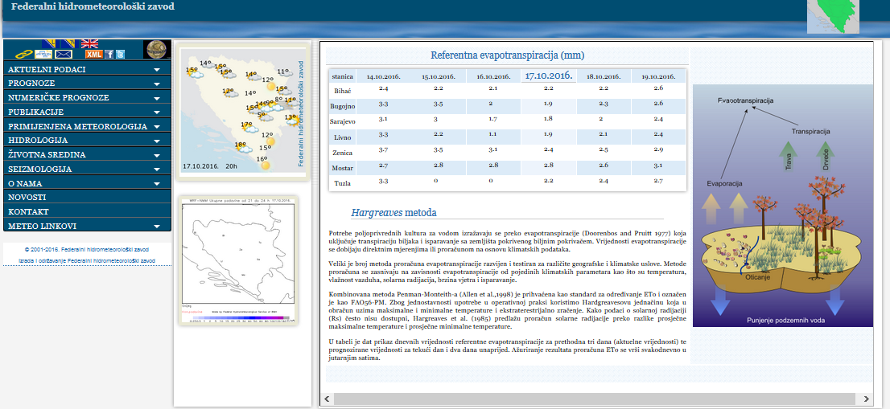
SPI monitoring and outlook
Monitoring and prediction of evapotranspiration using Hargreaves metod

Slide 13
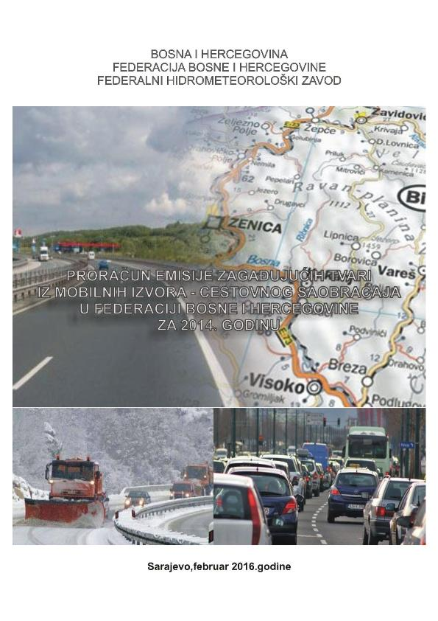
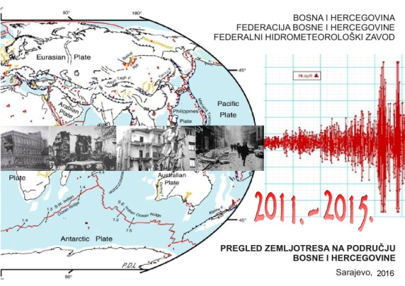
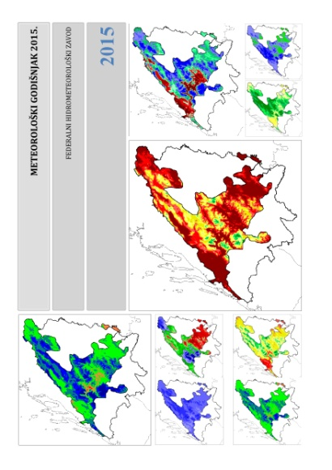
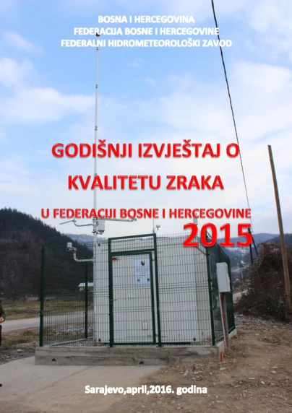
Monthly, seasonal and annual bulletins
Air quality monitoring in BiH 1955-1992, historical data transmitted in a digital format
Report of air pollutant emission from mobile sources in FBiH in 2014.
Catalogue of Earthquaces for period 2011. - 2015.
Hydrological annual
Annual air quality report in FBiH 2015.
Meteorological annual
Phenological annual

Slide 14
Air quality monitoring and reporting

Slide 15
Phonological observations and publications
3 international phonological gardens in Sarajevo, Ivan Sedlo and Mostar

Slide 16
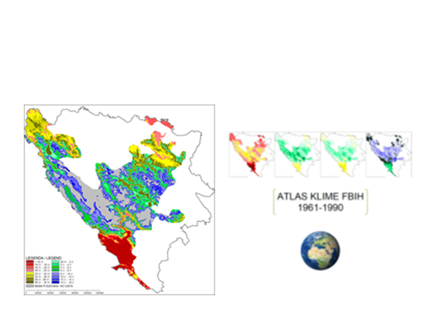
Climate monitoring system

Slide 17
Archive

Slide 18
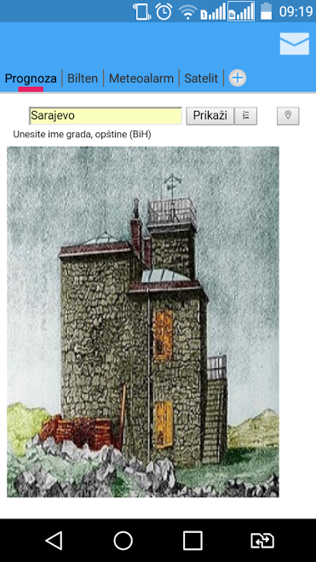
All our products are available on website
We have mob app for the all types of forecast
Feedback information by email, phone and face to face with users…

Slide 19
List of sectors which use our products …
Civil protections on Federal and canton level
Public authorities on Federal, canton and municipality level
The Ministry of Internal Affairs of the Federation of Bosnia and Herzegovina
Agriculture, private and public
Infrastructure, public companies roads and motorways of FBIH
Water agencies
Environment agencies
Energy sector
heating companies
Media, TV, Radio, etc.
General public
Insurance companies
Health sector
Neighboring NMHSs and other similar agencies on international level
Research and universities
Primary and secondary schools for educational purposes

Slide 20
Thank you for attention.

