Slide 1
Flash Flood Guidance and Early Warning System
WMO; CLW/HWR

Slide 2
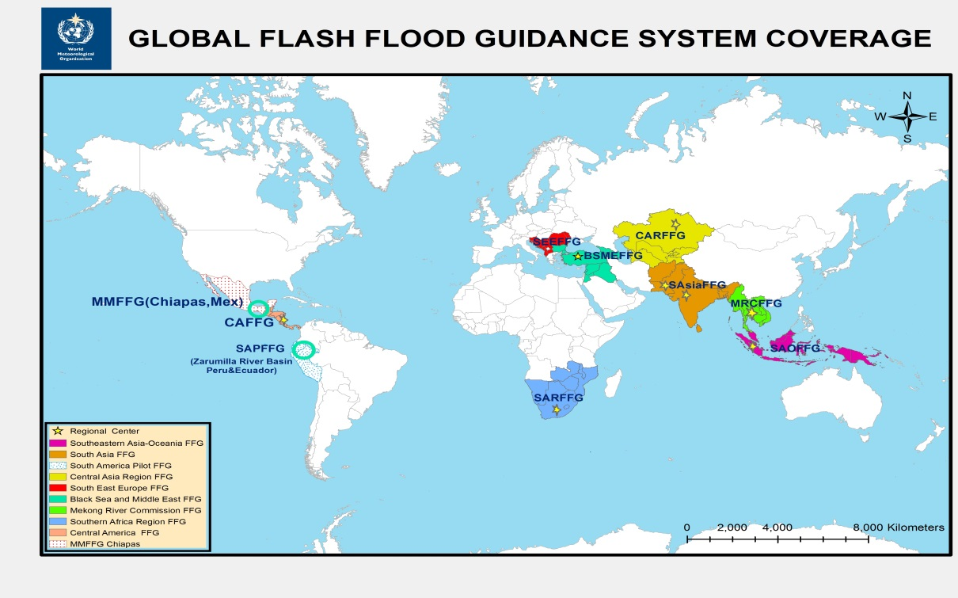
Flash Flood Guidance System (FFGS)
The WMO Commission for Hydrology (CHy) jointly with the WMO Commission for Basic Systems (CBS) and in collaboration with the US National Weather Service, Hydrologic Research Center (HRC), and USAID/OFDA have developed the concept of the Flash Flood Guidance System (FFGS) with global coverage. The concept has been endorsed by the Fifteenth WMO Congress and is being implemented through a series of regional projects with funding from USAID.
Flash Flood Guidance System with global coverage enhances early warning capabilities of the NMHSs, currently covers fifty two (52) countries and more than two billion people around the world saving lives and decreasing economic losses.

Slide 3
FFGS Regional Projects
The following regional Flash Flood Guidance (FFGS) projects are implemented or under implementation:
Central America FFG (CAFFG) (Operacional): Costa Rica (Regional Centre (RC)), Belize, El Salvador, Guatemala, Honduras, Nicaragua, and Panama;
Southern Africa Region FFG (SARFFG): (Operational) Botswana, Lesotho, Malawi, Mozambique, Namibia, South Africa (RC), Swaziland, Zambia, and Zimbabwe;
Mekong River Commission FFG (MRCFFG) (Operational): Cambodia (RC), Lao People's Democratic Republic, Thailand, and Viet Nam;
Black Sea and Middle East FFG (BSMEFFG) (Operational): Armenia, Azerbaijan, Bulgaria, Georgia, Jordan, Lebanon, and Turkey (RC);
South East Europe FFG (SEEFFG) (under implementation): Albania, Bosnia-Herzegovina, Croatia, Moldova, Montenegro, Romania, Serbia, Slovenia, The Former Yugoslav Republic of Macedonia, and Turkey (RC);

Slide 4
GFFGS Regional Projects (cont.)
South Asia FFG (SAsiaFFG) (under implementation): Afghanistan, Bangladesh, Bhutan, India (RC), Nepal, Pakistan (RC), and Sri Lanka;
Central Asia Region FFG (CARFFG) (under implementation): Kazakhstan, Kyrgyzstan, Tajikistan, Turkmenistan, and Uzbekistan;
South America Pilot FFG (under implementation): Zarumilla River Basin (Peru and Ecuador);
Haiti-Dominican Republic FFG (HDRFFG) (being upgraded): Dominican Republic and Haiti;
South Eastern Asia Oceania FFG (SAOFFG) (under implementation): Brunei, Indonesia, Malaysia, Papua New Guinea, Philippines, Singapore, and Timor-Leste.

Slide 5
Objectives
The main objectives of the Flash Flood Guidance System with global coverage are to:
Enhance NMHSs capacity to issue flash flood warnings and alerts to mitigate the adverse impacts of hydrometeorological hazards, by:
  Generating flash flood early warning products using state-of-the-art hydrometerological forecasting models;
  Providing extensive training to the hydrometeorological forecasters;
  Enhancing collaboration between NMHSs and Emergency Management Agencies;

Slide 6
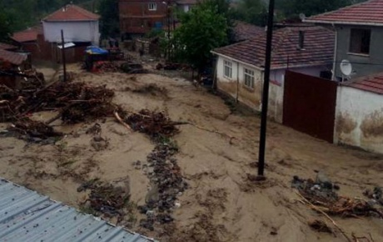
What is Flash Flood? and Needs
A flood of short duration with a relatively high peak discharge usually having less than 6 hours between the occurrence of the rainfall and the peak
Short fuse, hard to predict events
Lack of flash flood warning capabilities and capacities of NHMSs,
Lack of local expertise and regional cooperation,
Ineffectiveness of riverine flood warning systems for flash floods.
Flash floods causes annually an average of 5,000 deaths and inflict heavy economical losses worldwide,

Slide 7
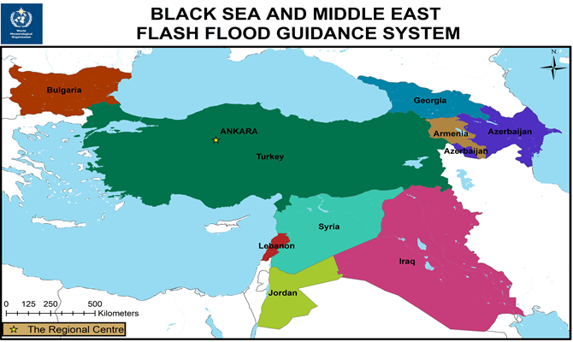
Regional Components
The Regional Centre:
Provide forecast products and data to the participating countries,
Collaborate with WMO to implement flash flood hydrometeorologist training programme,
Evaluate FFG products from the regional perspective and conduct verification study in collaboration with participating countries,
Have good internet connection to download and exchange data.
Participating NMHSs:
Prepare and issue flash flood warnings and alerts to the public and national agencies including Emergency Management Authorities,
Provide historical and in-situ local data to the FFG system developer through the RC,
Participate in the Flash Flood Hydrometeorologist Training Programme (Steps 1-5),
Conduct verification studies.

Slide 8
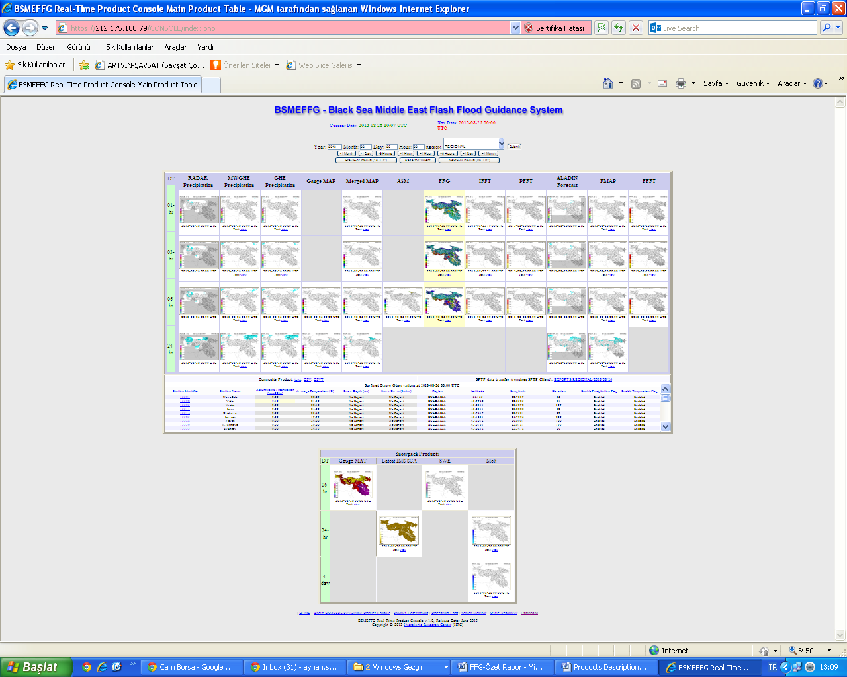
FFGS Forecaster Console
Products, Date and Time Selection Toolbar
FFGS
Products
Time Interval
Surface Met. Observations
Snow Products
Products Dsc.& System Monitoring Toolbars

Slide 9
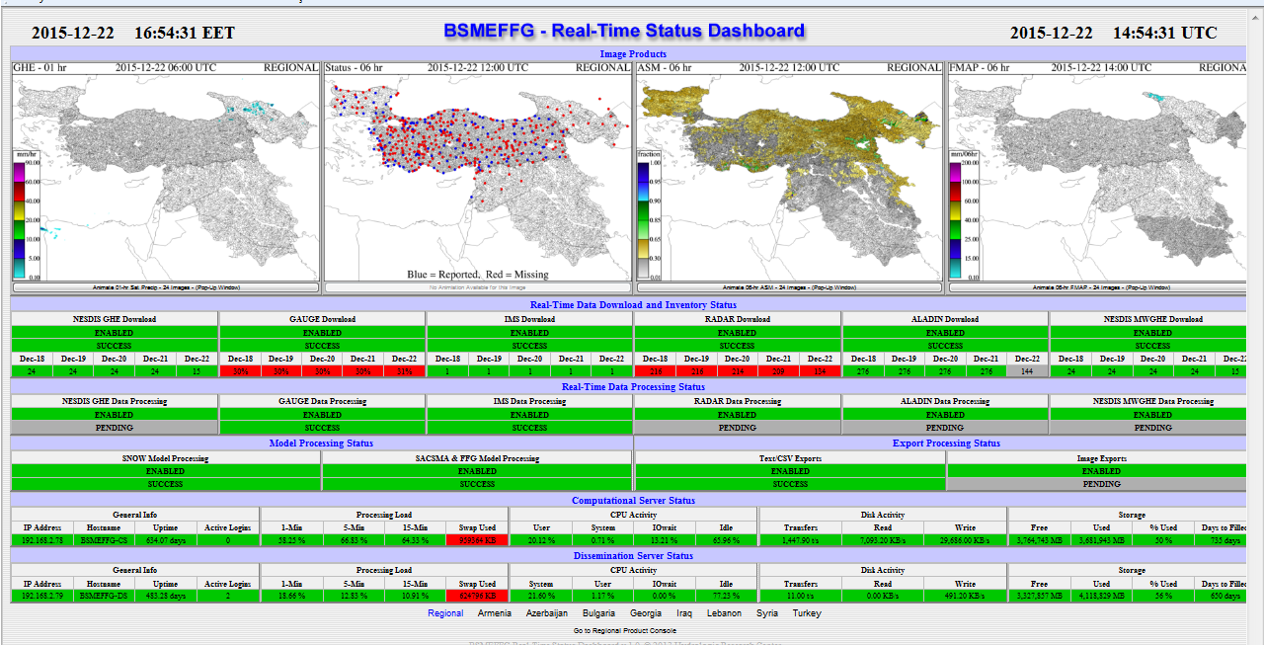
FFGS Dashboard
Dashboard is designed to monitor server processes:
(1) Quick-look;
(2) Real-Time data downloads and inventory status;
(3) Real-Time Data processing status;
(4) Computational server status; and
(5) Dissemination server status.
1
Animation Button
2
3
4
5

Slide 10
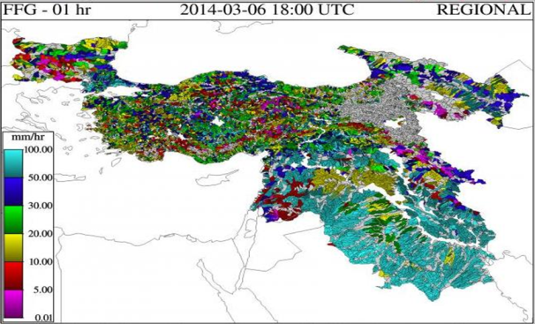
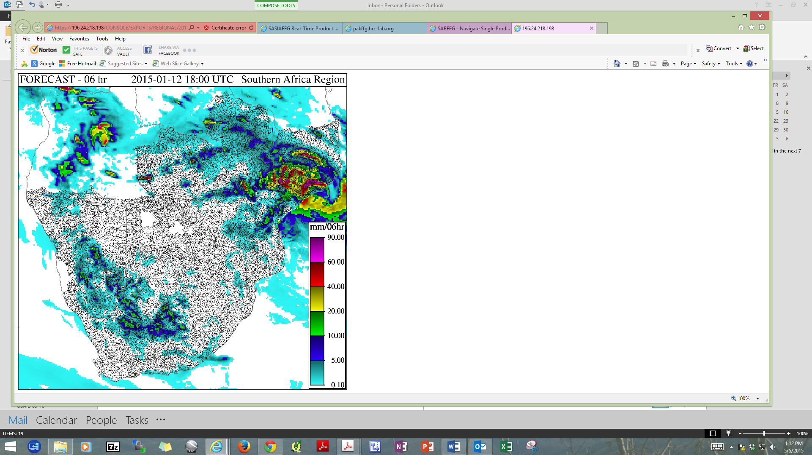
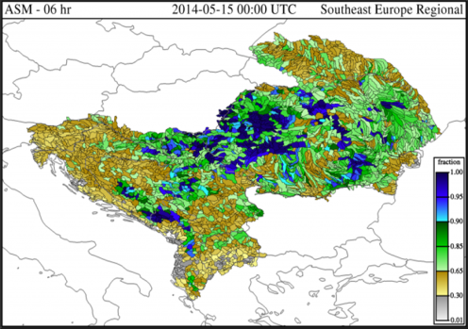
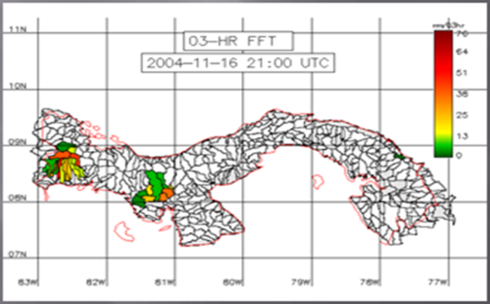
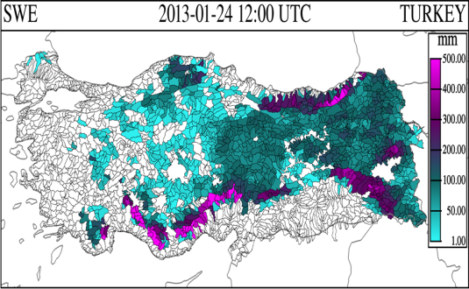
Flash Flood Guidance System (FFGS) Products
Flash Flood Guidance for Black Sea and Middle East FFGS.
GHE Satellite precipitation for Southern Africa Region FFGS.
Average Soil Moisture for South East Europe FFGS.
Flash Flood Threat for Central America FFGS
Snow Water Equivalent (SWE) for Turkey.
Forecast Mean Aereal Precipitation for Black Sea and Middle East FFGS.
Notes:
Global Hydro-Estimator (GHE)

Slide 11
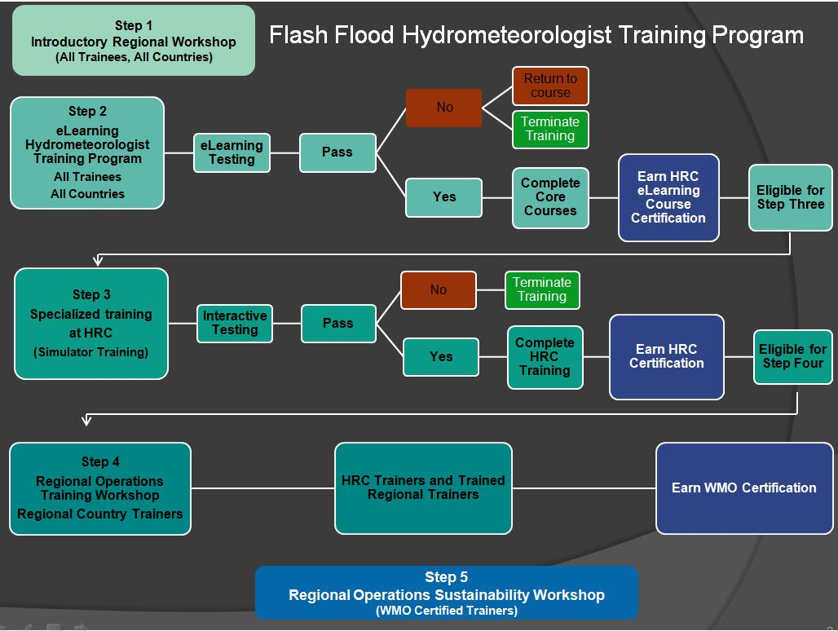
Flash Flood Hydrometeorologist Training Programme
Training is and integral part of regional FFG Systems and consists of five steps:
Step-1: Introductory in-country workshops and meetings such as Steering Committee Meetings;
Step-2: On line eLearning comprises elements of meteorology, hydrology, flash flood guidance, GIS, and remote sensing;
Step-3: Advanced operations and interactive simulator training at the Hydrologic Research Center (HRC), USA;
Step-4: Regional operations training workshop toward qualification of WMO flash flood trainer certificate;
Step-5: Regional operation sustainability workshop provided by the WMO certified trainer.

Slide 12
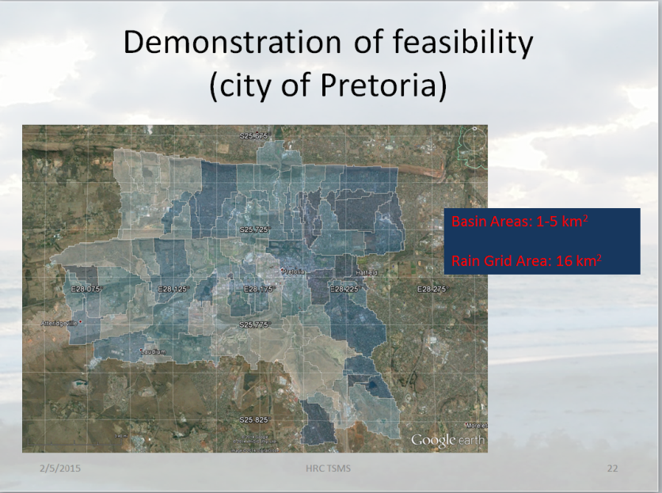
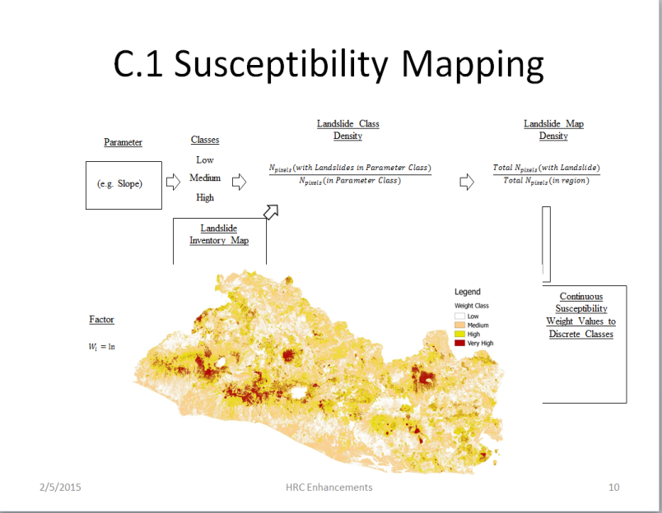
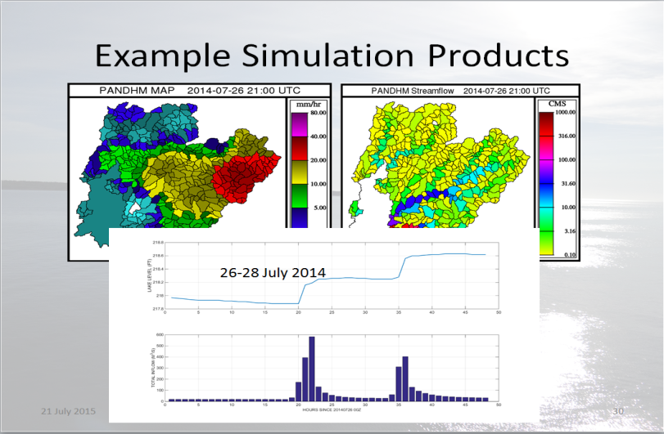
Advances
Urban Flash Flood Early Warning System
Landslide Susceptibility Mapping
Expandable and Scalable Riverine Routing

Slide 13
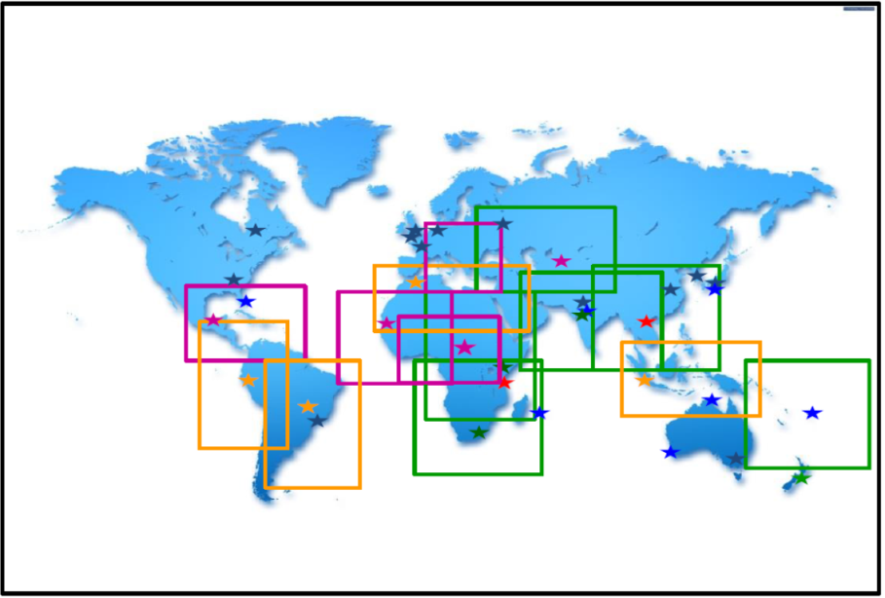
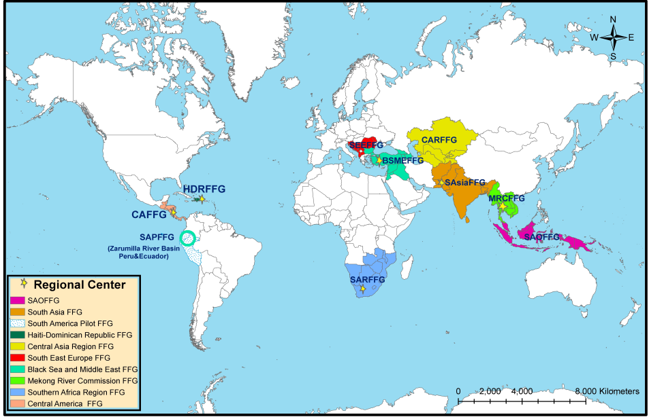
Possible Linkages Between SWFDP and regional FFG Systems
SWFDP
FFGS
SAOFFGS-SWFDP-SAO
MRFFGS-SWFDP-SEA
SAsaiFFGS-SWFDP-BoB
CARFFGS-SWFDP-CA
BSMEFFGS-SWFDP-SEE
SARFFGS-SWFDP-SA
CAFFGS-SWFDP-Caribbean

Slide 14
Twinning of SWFWP-SA and SARFFG Systems
Objectives:
Mitigate the adverse impacts of hydrometeorological hazards by:
  Improving forecasting of severe hydrometeorological events by National Meteorological and Hydrological Services (NMHSs);
  Enhancing user interfaces and expand the suite of products available to forecasters;
  Developing products and information that addresses needs of users to reduce loss of lives and livelihoods due to extreme hydrometeorological events.

Slide 15
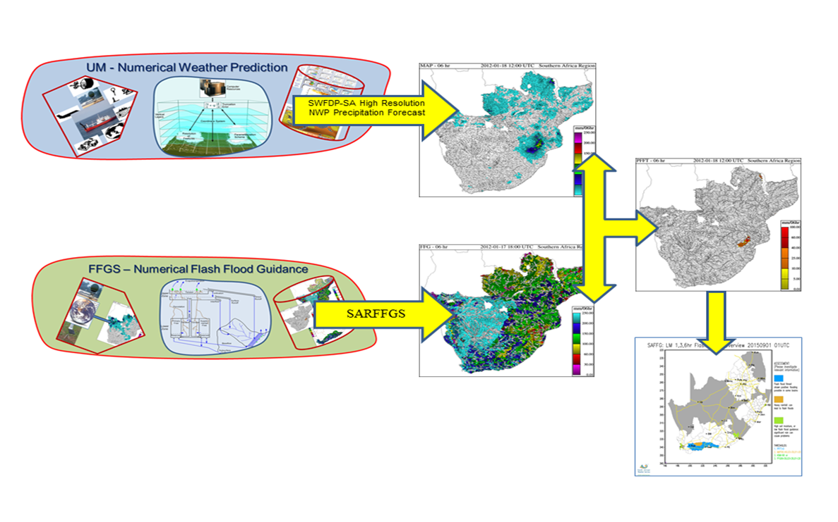
Twinning of SWFWP-SA and SARFFG System

Slide 16
Further Information
More information about the regional implementations of the FFG system is available at the following WEB portals:
http://www.wmo.int/ffgs and http://www.hrcwater.org

Slide 17
Thank you for your attention
Paul Pilon
ppilon@wmo.int
Ayhan Sayin
asayin@wmo.int

