Slide 1
Earthquake Monitoring & Tsunami Warning
Maldives Meteorological Service
STAKEHOLDERS WORKSHOP TO INITIATE THE IMPLEMENTATION OF IMPACT-BASED FORECASTING AND RISK-BASED WARININGS
Ibrahim Humaid
Seismologist
Male’, Maldives, 26-28 September 2016

Slide 2
Contents
Capacity
Possible threat areas
Monitoring
Warning

Slide 3
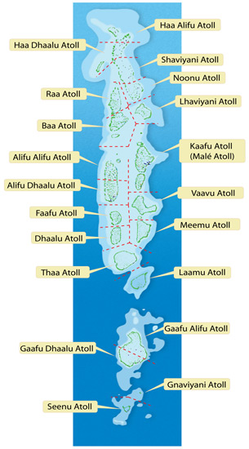
Capacity
SEISMOMETERS
After the 2004 Tsunami, Maldives Meteorological Service started to develop its early warning system.
Introduced seismology in the Centre.
Two broadband seismometers were installed in Hdh Hanimaadhoo and Gdh Kaadedhhoo.
SeiscomP3 SYSTEM
SeiscomP3 was installed in Maldives Meteorological Service in early 2008 for the real time earthquake monitoring.
The system displays real time seismic waves and is capable of automatically calculating earthquakes within a few minutes.

Slide 4
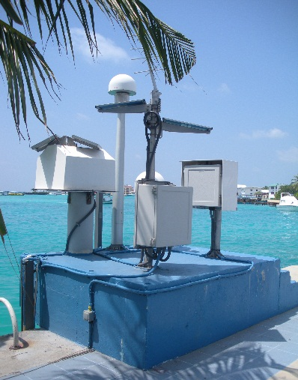
Capacity
TIDEGUAGES
Three tide gauges are installed throughout the Maldives.
Latest upgrades are installed and the station data are available globally.
HOTLINES
Hotlines are established between major stakeholders, namely NDMC, POLICE, MNDF, Public Media and Airport Emergency.

Slide 5
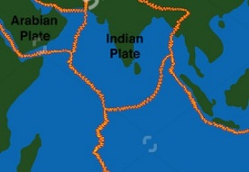
Possible threat areas
Earthquakes of large magnitude are not common in the Maldives.
Maldives is in the proximity of several faults and ridges, namely;
1. Carlsberg Ridge (Normal fault)
2. Owen Fracture Zone (Subduction zone) including Gulf of Oman, Gulf of Aden and Makran
3. Northern and Southern Sumatra Zone (Subduction zone)
4. South Indian Ridge
Courtesy of NDMC

Slide 6
Possible threat areas
The eastern side of the Maldives is more likely due to the high possibility of huge earthquakes in the Sumatra Region of Indonesia.
Courtesy of NDMC

Slide 7
Monitoring
SeiscomP3 SYSTEM
SeisComP is a seismological software for data acquisition, processing, distribution and interactive analysis that has been developedby the GEOFON Program at GFZ German Research Centre for Geosciences.
1. Scesv displays all the information of that particular event
2. Scrttv is the trace (wave) view from all the stations in the network.
3. Scmv is the map view of all the seismic stations in the network.

Slide 8
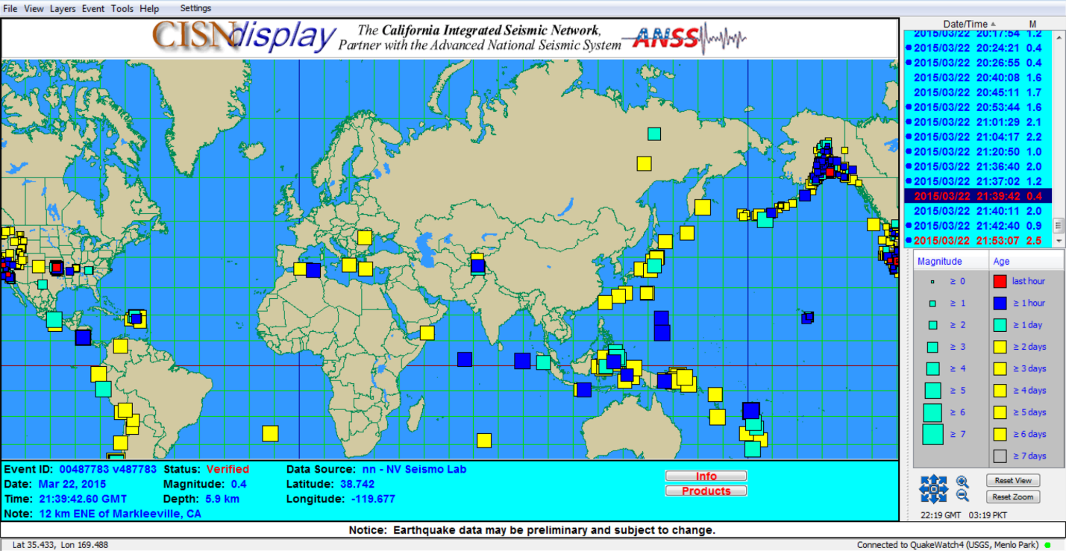
Monitoring
CISN
CISN (California Integrated Seismic Network) is seismological software for displaying the earthquakes across the globe, developed by a partnership among federal, state, and university agencies involved in California earthquake monitoring.

Slide 9
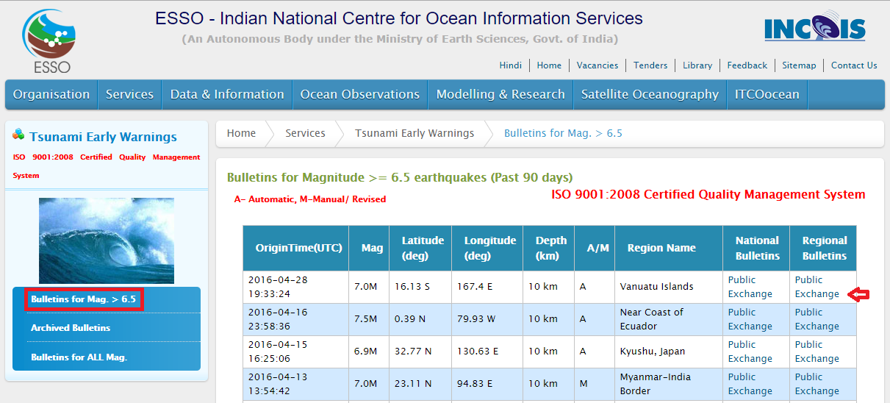
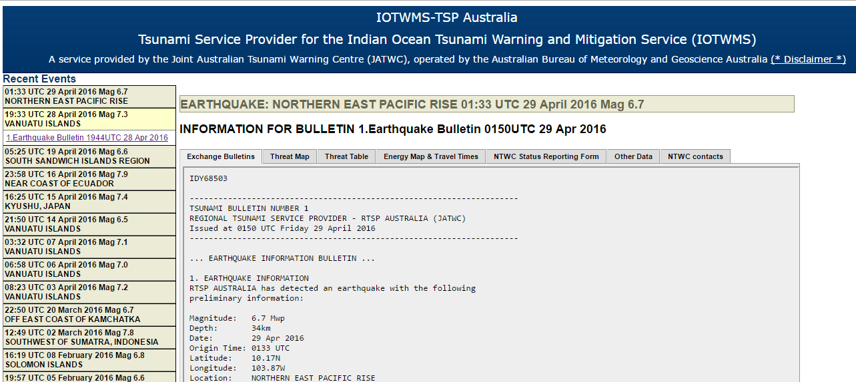
Monitoring
Through RTSP’s
Regional tsunami service providers provide earthquake and tsunami advisories and bulletins through their website.
This is also receives via GTS, FAX and selected SMS focal points.

Slide 10
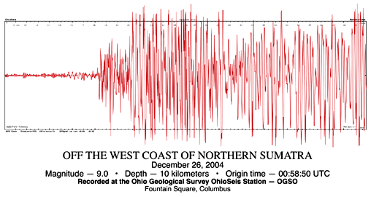
Warning
DISSEMINATION METHODS
Earthquake and Tsunami information will be provided to the focal points and public via the following methods
Web SMS
Fax
Hotlines
Emails
MMS website
Social Media (Facebook/Twitter)

Slide 11
Warning
WARNING CRITERIA
If the magnitude of the event is between 6.0 and 6.9 in Richter scale, information about the event will be updated via social media.
If the magnitude of the event is between 7.0 and 7.9 in Richter scale, issue a White Alert as an information. No action required.
If the magnitude of the event is above 8.0 in Richter Scale, issue a Yellow Alert as Tsunami Advisory. Preparatory actions are required.
If the magnitude of the earthquake is above 7.0 and there is an ocean wide Tsunami formed in the Indian Ocean confirmed by the RTSP bulletins, issue a RED Alert for Tsunami warning. Take immediate action and evacuate if required.

Slide 12
Thank you

