Slide 1
Workshop on the Implementation of New Numerical Weather Prediction(NWP) and Impact Based forecast and Warning Techniques
“DMH Vision for Meteorological Forecasting and Warning Services in Myanmar”
Presented by
Ms. Han Swe
Staff Officer
Department of Meteorology and Hydrology
Myanmar
6.9.2016 Naypyitaw

Slide 2
CONTENTS
Vision of Meteorological Services
Observation Network System
Current forecast and warning System in DMH
Ongoing Activities
Needs and Challenges

Slide 3
Department of Meteorology and Hydrology (beyond 12.3.2013)
Director General-1
Deputy Director General-1
Director-1
Met
Director-1
UM
Director-1
Admin
Director-1
LM
Director-1
Hydro
DD-1
Agromet
DD-1
Avia
DD-1
Met
DD-1
Admin
DD-1
Budget
CE-1
Engg:
DD-1
Hydro
DD-1
RS-GIS
DD-1
Seismo
AD
(2)
AD
(2)
AD
(2)
AD
(5)
AD
(3)
AD
(2)
EE
(3)
AD
(9)
AD
(2)
AD
(2)
AD
(2)
MO -3
24
HMA -
SO -
JO -
MO -7
35
HMA -
SO -
JO -
MO -8
48
HMA -
SO -
JO -
MO -39
HMA - 4
SO -5
JO -8
MO -5
UD -4
LD -6
MO -4
UD – 2
LD - 9
AE -5
JE 1 – 3
JE 2 - 6
MO - 43
HMA -4
SO - 9
JO - 3
MO -7
23
HMA -
SO -
JO -
MO -6
20
HMA -
SO -
JO -
MO -6
30
HMA -
SO -
JO -

Slide 4
Our Vision for meteorological services
To upgrade weather observations system
To develop capacity building for weather forecasting, climate & climate change research activities
To achieve the provision of quality weather and climate services
To improve existing EWS

Slide 5
Meteorological Observation Network
(50) WMO Register (3)hourly Synoptic Observation Stations
(1) Upper Air Observation Global Meteorological Observation System
Reporting Stations - 50
RBCN - 5
Agro meteorological Stations - 17
Upper Air Station - 1
Aviation Weather Station - 8
Observatory
SSB
Telephone
Main Center
(NayPyiTaw)
GTS
Bangkok &
New Delhi
Observatory
Observatory
SSB
IP/VPN(Internet)
Telephone
Backup Center
(Yangon)
GTS
Bangkok &
New Delhi
Observatory

Slide 6
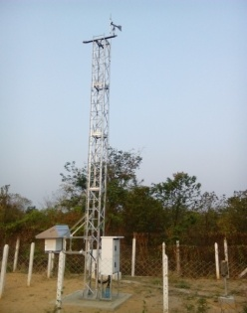
Network of AWOS in DMH-Myanmar
30 AWOS(JICA)
8 AWOS
(DMH)
17AWOS
(RIMES-AGRO)
5 AWOS
CMA

Slide 7
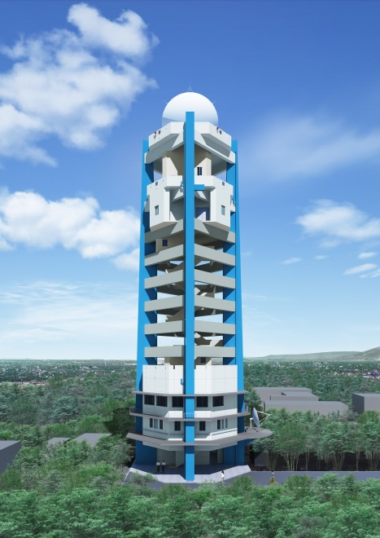
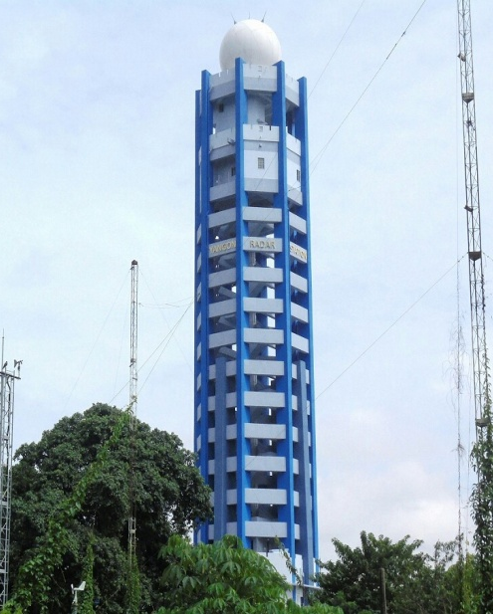
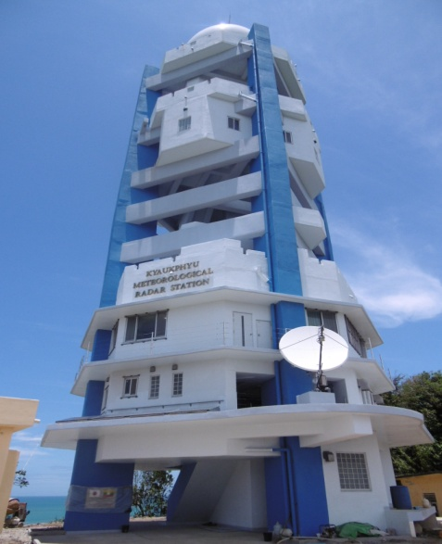
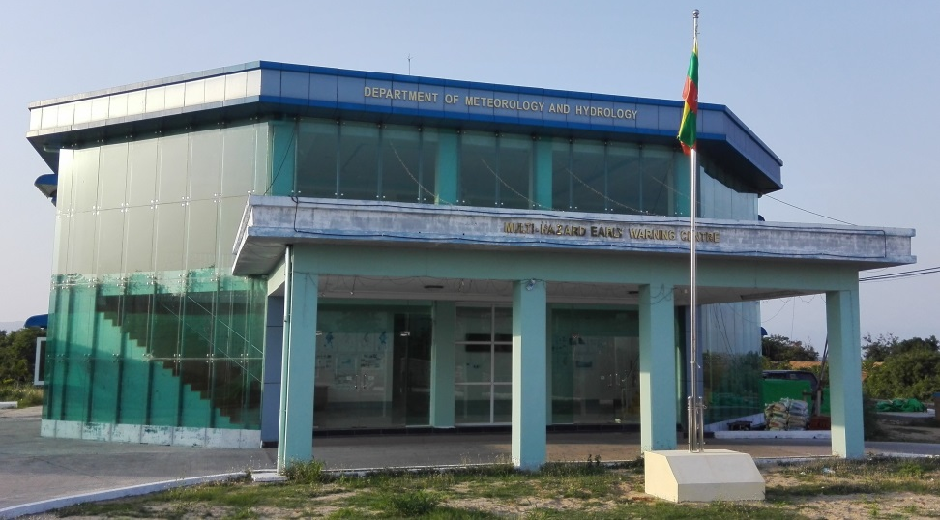
Radar Network
Mandalay
Yangon
Nay Pyi Taw
Kyauk Phyu
Notes:
yangon=18 fl (75)
Kpu=9 fl (45)
Mandalay=12 fl (45-50)

Slide 8
Climate Information Timeline
Type of Forecast | Time of Issuance | Forecast Validity
Daily Weather Forecast | 7:00Am/12:00noom/2:00pm/ 4:00pm/7:00pm | 24 hours
Sea Route Forecast | 10:30 Am/1:30Pm | 24 hours
Special weather forecast | As per request and weather conditions | Depend on duration
Cyclone/surge | 24-36 Hr before | -
Untimely Rainfall | Weather disturbance.... | -
Strong Wind Warning | March (15)(31)/April(1) | Pre Monsoon Period
significant day & night temperature | If necessary | -
Heavy Rainfall/ Scarcity Rainfall Warning | If necessary | -
New Records (Rainfall/Max/Min) | when new record occur.. | -
(10)Day Weather Forecast | Every Month of 8/18/28 | (10)Days
Monthly Weather Forecast | Every Month of 28 | (1) Month
General Weather Outlook for (SW/NE)Monsoon Season | April 28/October 28 | Monsoon Season
Seasonal Weather Forecast | April 28, June 28, August 28 | Early, Peak, Late Monsoon

Slide 9
Type of Warning and Forecast
Cyclone Warning
Storm Surge Warning
Flood Warning
Untimely Rainfall Warning
Fog Warning
Heavy Rain Warning
Aviation weather warning
Low flow water level
Tsunami
Port Warning
Squall Warning
Agro-meteorological Bulletin
Bay Bulletin
Flood Bulletin
Special Weather Bulletin
Daily Weather/water level
Dekad Weather/water level
Monthly Weather/water level
General Weather Outlook for Monsoon season
Seasonal Weather/water level Forecast
Aviation Weather Forecast
Marine Weather Forecast
Special Forecast
Rainfall/Temperature New Records
Cyclone News
Condition of Southwest Monsoon Onset and withdrawal

Slide 10
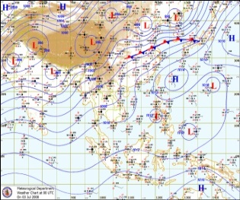
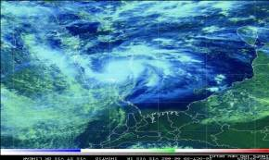
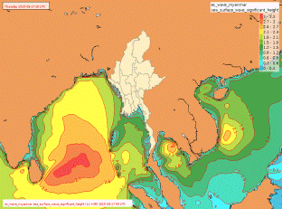
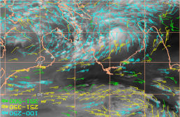
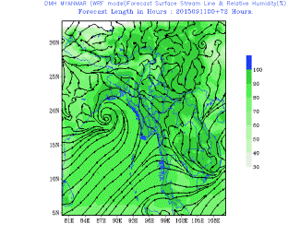
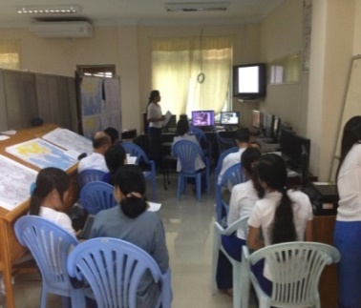
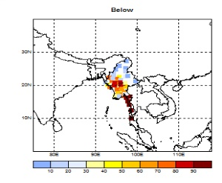
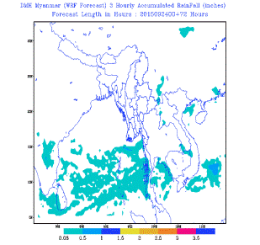
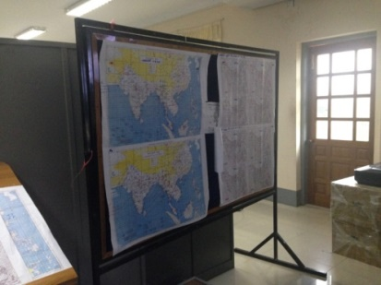
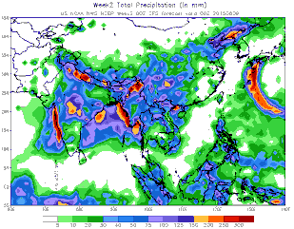
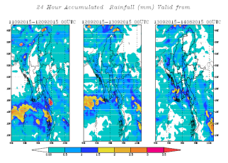

Slide 11
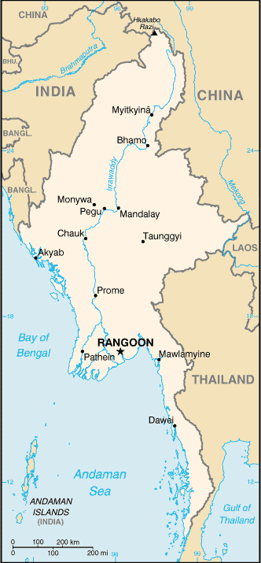
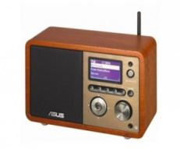
Forecast Dissemination System
Forecast Dissemination System
Radio
Newspaper
Local Met. Office
TV
Higher Authority
Local Authority
Public
Public
Public
www.dmh.gov.mm
Facebook
Padoukmaya service

Slide 12
Area Divisions of Myanmar
From Meteorological point of view
14 Regions & States+Nay Pyi Taw Concil Zone
Sub Region:
Upper Sagaing & Lower Sagaing Regions
Northern, Eastern & Southern Shan States
Nay Pyi Taw
Myanmar Coastline
Off and along Rakhine coast
Deltaic Coast
Gulf of Mottama
Off and along Mon, Taninthayi coast

Slide 13
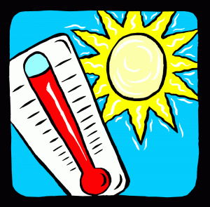
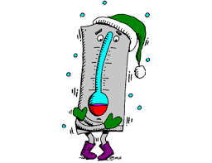
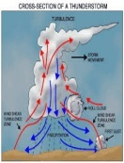
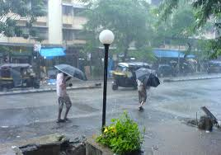
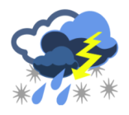
Meteorological Hazards Calendar
Hazards | Jan | Feb | Mar | Apr | May | Jun | Jul | Aug | Sep | Oct | Nov | Dec
Cyclone
High Temperature
Low Temperature
Drought
Squalls& Thunderstorm
Flood
Heavy Rain
Monsoon Depression
Hail
1

Slide 14
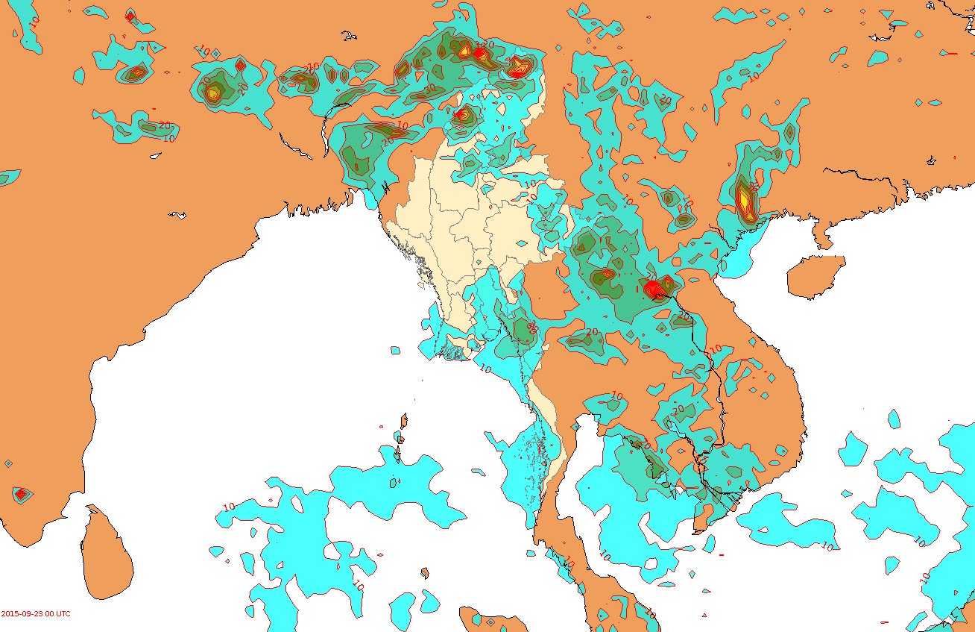
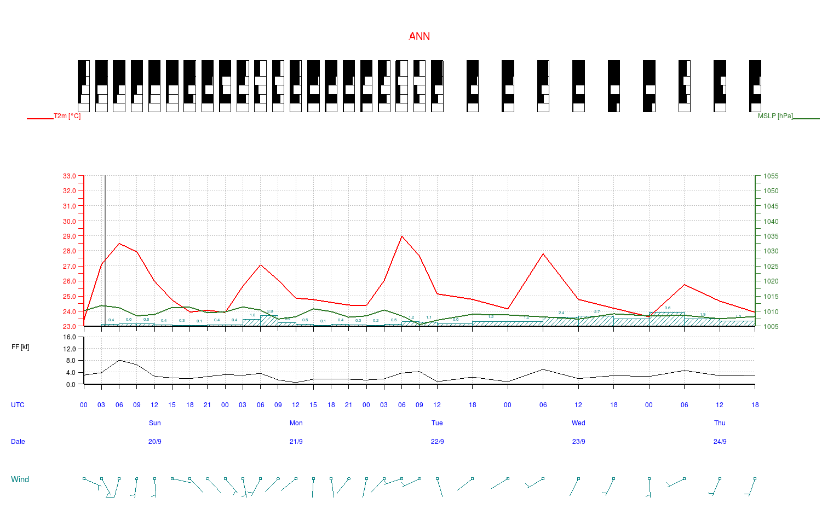
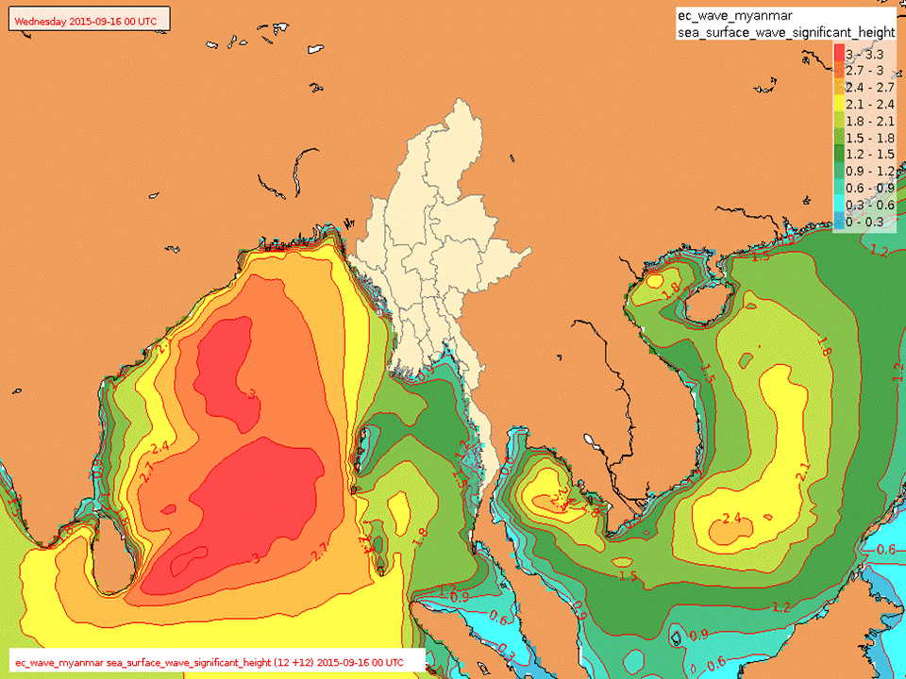
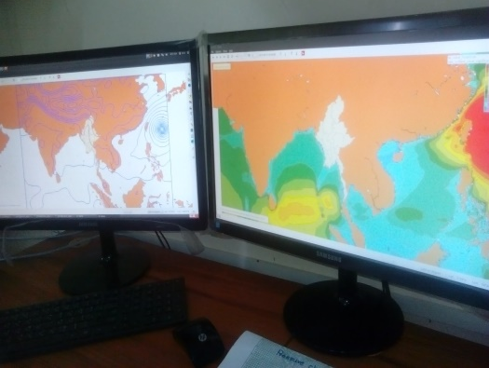
Data assimilation | Numerical model | Production data
Input data : GFS model output ( GRIB data) ECMWF (Net CDF) | WRF regional model, DIANA tools(Norway, Met. N0.) Purchase high-performance PC | Forecast elements Max/Min. Temp. Humidity Sea level pressure Surface / Upper wind(speed, dir.) Precipitation & Meteorogram + Other parameters
Met.no

Slide 15
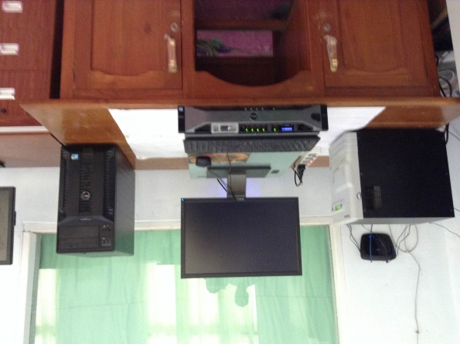
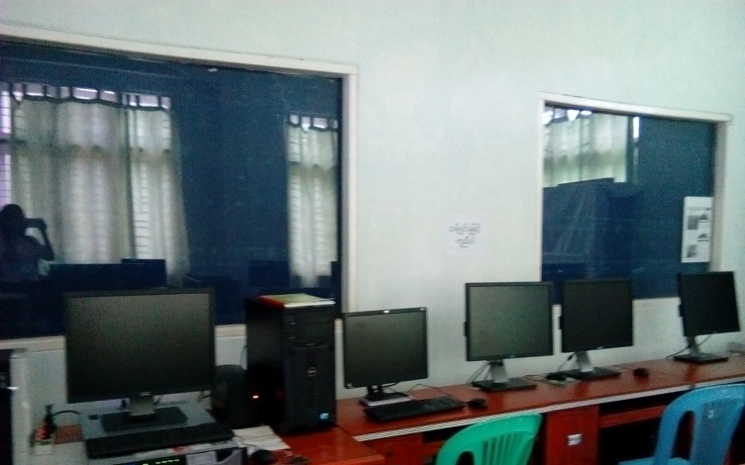
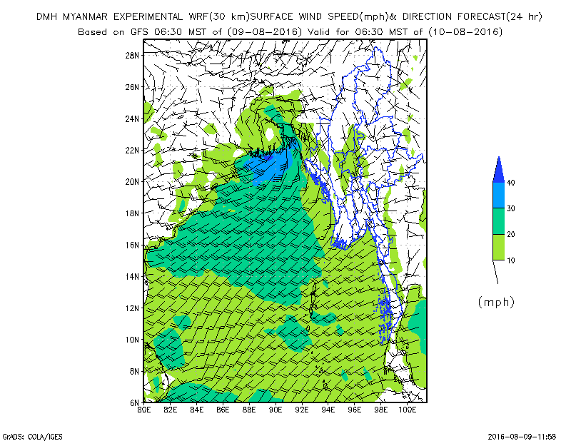
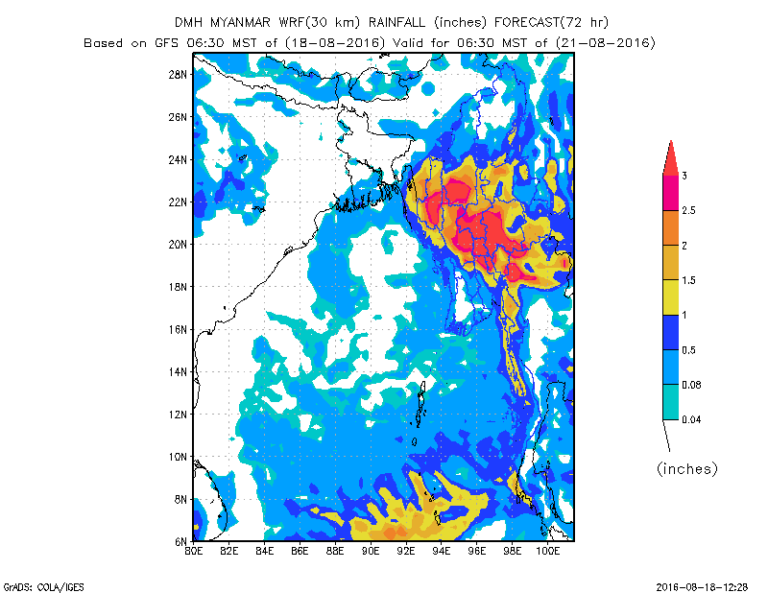
WRF OUT PUT IN DMH

Slide 16
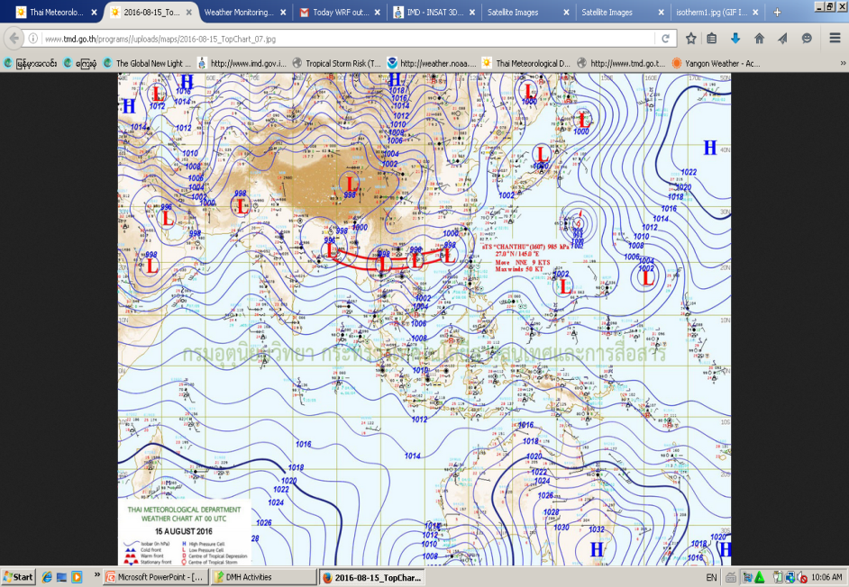
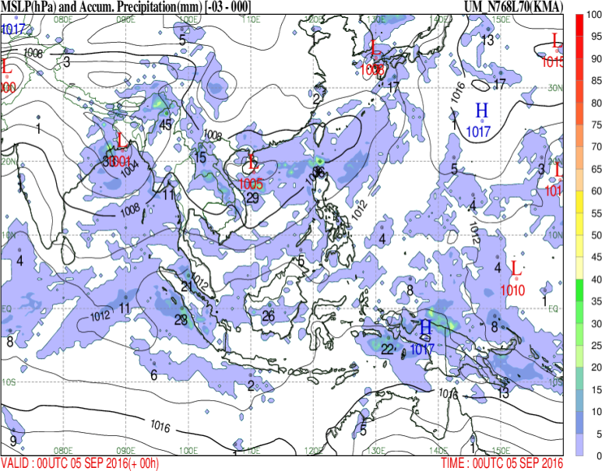
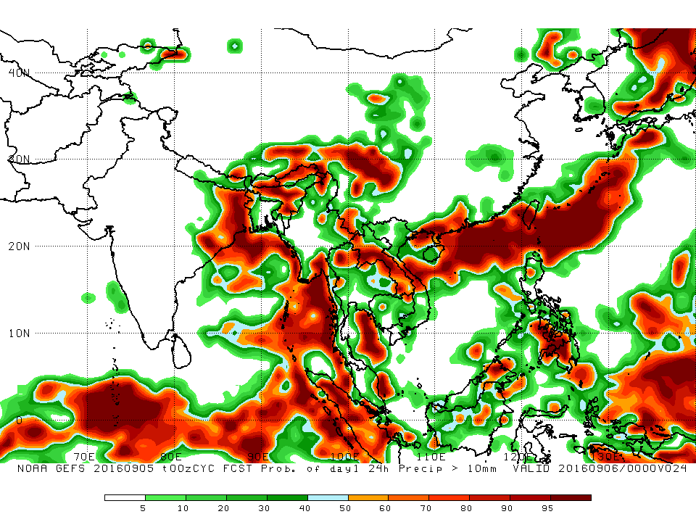
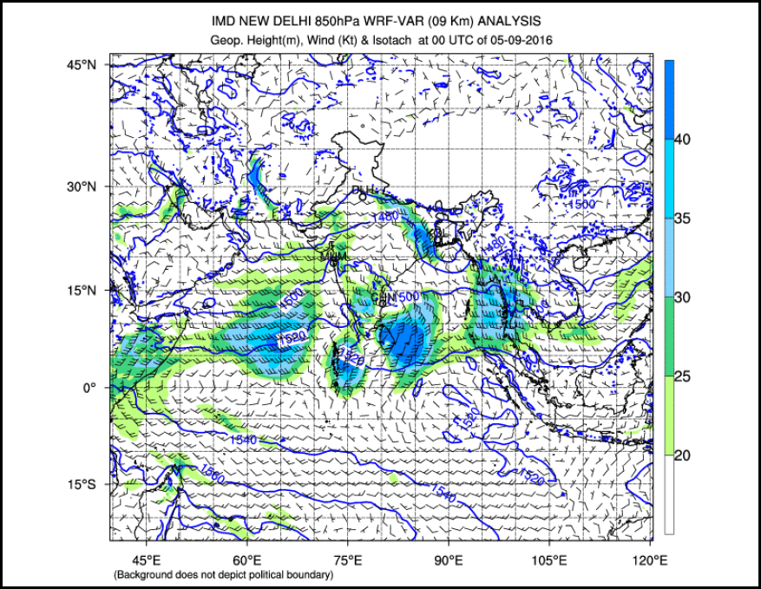
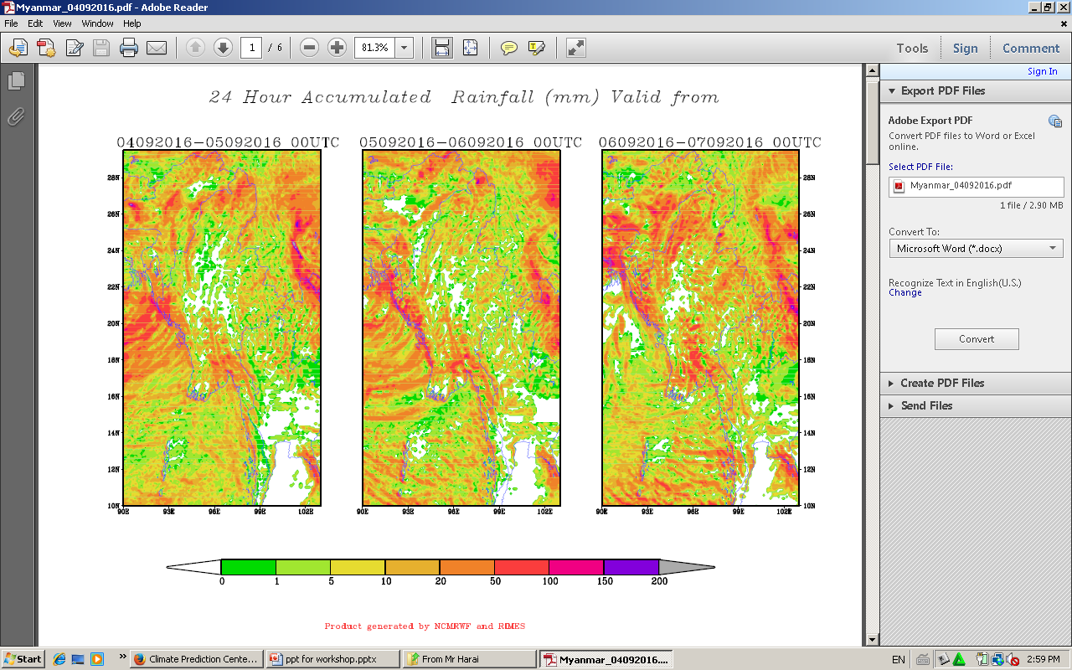
NWP weather Forecasting Method from the NMHSs
(JMA,TMD,KMA, NOAA, IMD, RIMES…etc.)

Slide 17
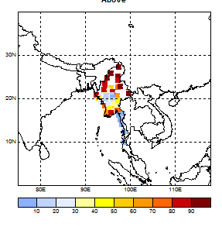
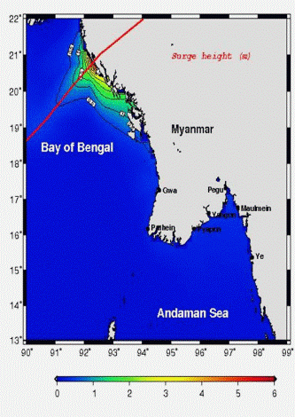
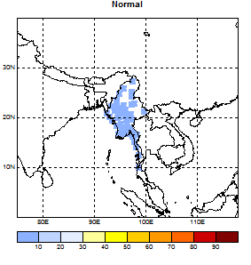
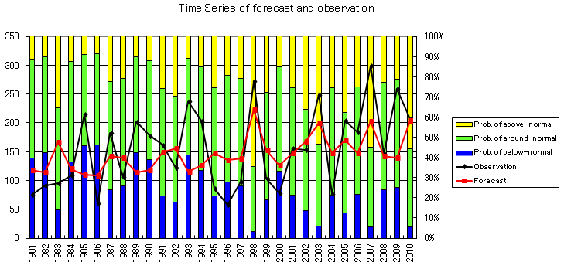
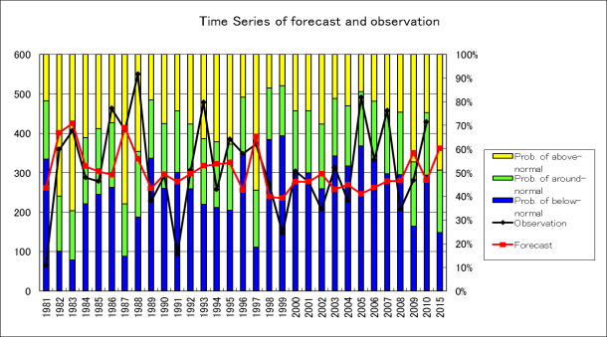
Model output for Forecasting tools:
IIT and JMA Storm Surge Model
JMA Storm Surge Model
Based on IIT Storm Surge Model
TCC Guidance
CPT output

Slide 18
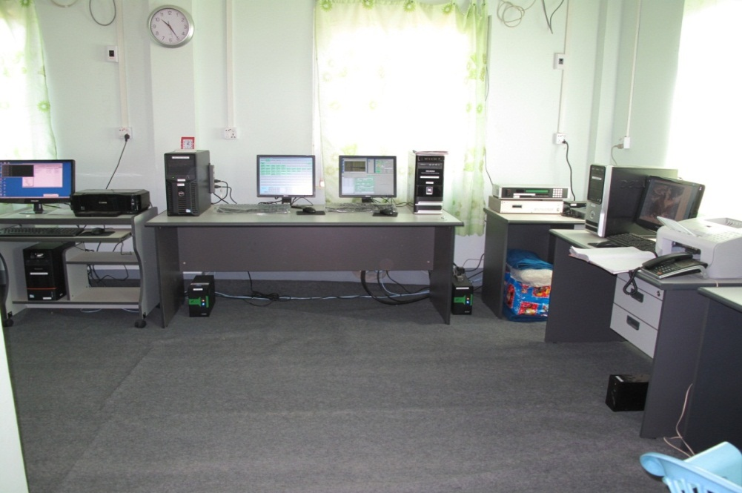
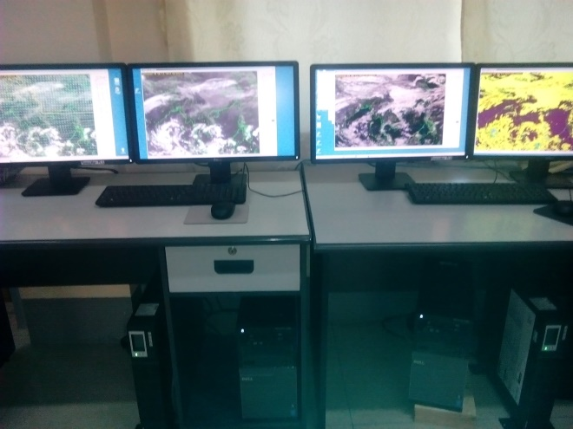
Installation of Himawari cast and SATAID (JICA)
Himawari cast Direct Receiving Antenna
MTSAT/HRIT Data Processing System in DMH, Nay Pyi Taw
Installation of MTSAT and SATAID are started from 2010 December, donated by JICA . Preparing Himawari 8 (MTSAT) received November, 2015)

Slide 19
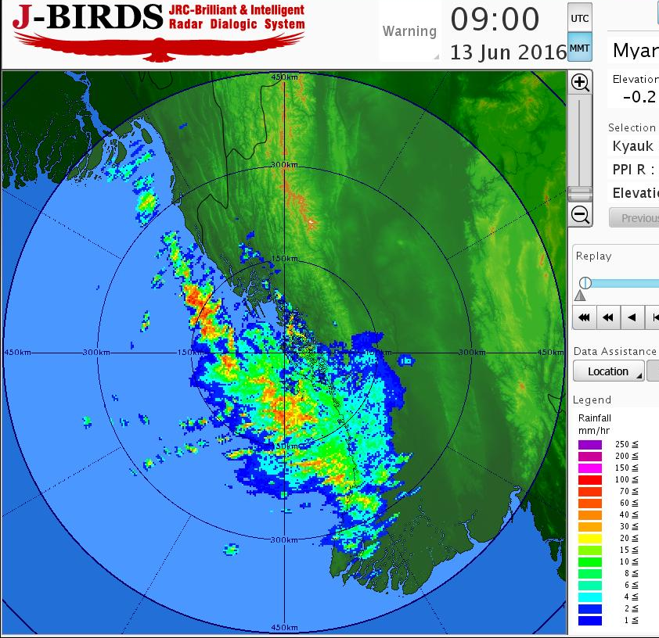
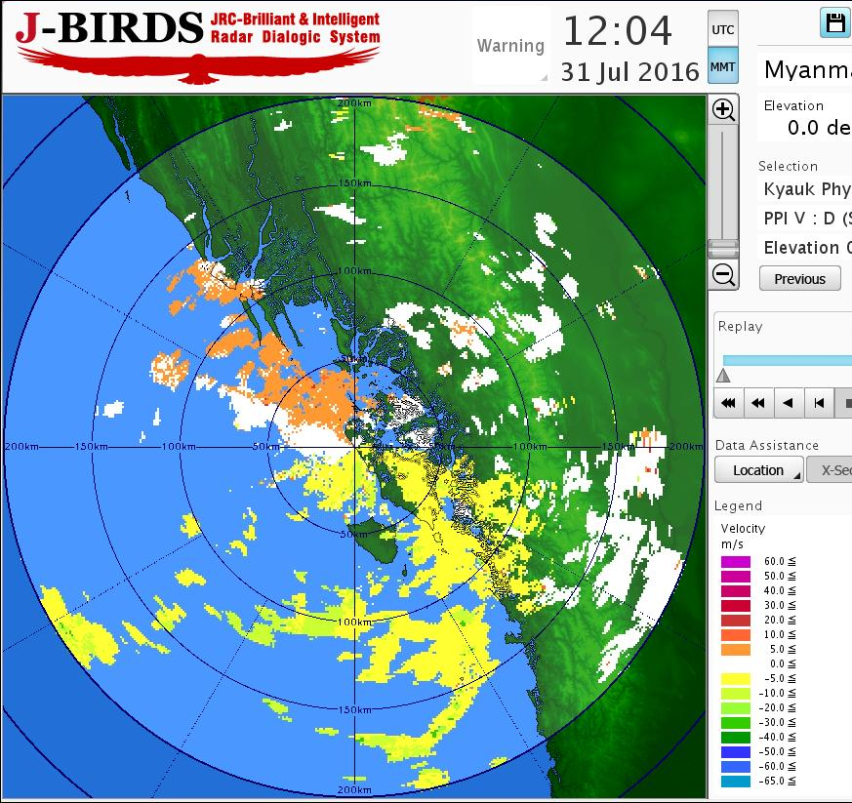
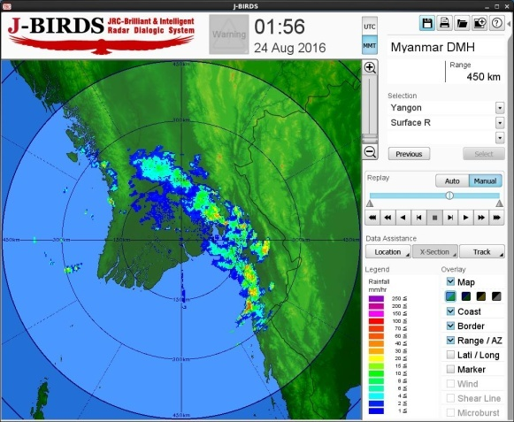
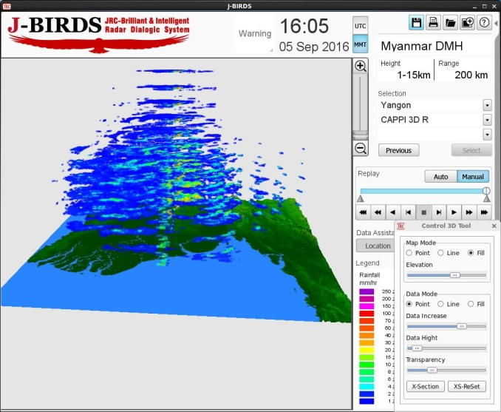
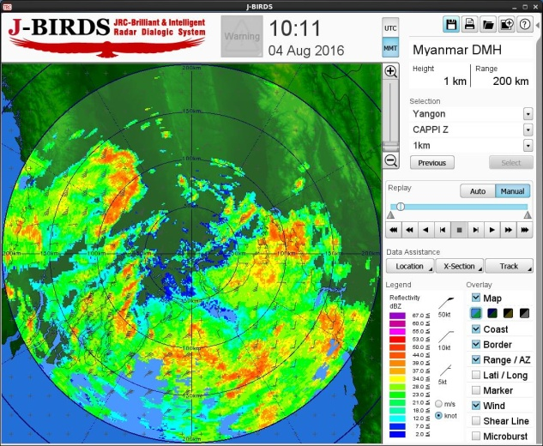
Using Radar Product

Slide 20
Ongoing Activities
DMH actively cooperate with the regional partners- WMO, Norwegian Government, TMD, JMA,JICA, KOICA, KMA, CMA. UNESCAP, IMD, ADPC, and RIMES to develop the skilled man power in weather forecasting.
JMA, JICA, KOICA, KMA, RIMES, TMD and ADPC provide technical assistance and instruments to improve weather forecast, climate and climate change, disaster risk reduction and communication.
Strengthening Capacity Development Program with Norwegian Meteorological Institute and technical assistance from ADPC.
DMH cooperate with World Bank(WB) to develop Hydro-meteorological Services

Slide 21
Ongoing Activities
Establishment of Master Plan for the Advancement of National Meteorological System in Myanmar with KMIPA
Establishment of End to End Early Warning System for Natural Disaster (Connection between MRTV & DMH HQ with cable link )
The installation of Meteorological (3)Radar System and (30)AWOS with Japan Gov.
UNESCAP- RIMES Project on reducing risks of tsunami, Drought, Capacity Building for NWP

Slide 22
Key Capacity Needs….
Extend advanced observations instruments/ tools/system.
Enhance technical capabilities of DMH Staffs/
Forecasters/Observers/ICT Engineers.
Upgrade observations networks for weather, water and climate activities.
Improve knowledge on advanced weather, climate, climate change, radar, NWP.
Develop international and regional cooperation for sharing technical expertises.

Slide 23
Needs and Challenges
Observing and monitoring system
Data Processing and Management
Forecasting & Prediction
Now-casting system ( Numerical Weather Prediction, Satellite application and Radar Technology
Policies and guidelines on specialized technicians and professionals for each sectors of Meteorology
Meteorological Services Law
Instrument Calibration Lab
Modernization of operations centers, data management and communications/IT systems, engineering and calibration facilities

