Slide 1
www.meteo.hr
Meteorological and Hydrological Service of Croatia

Slide 2
CROATIA

Slide 3
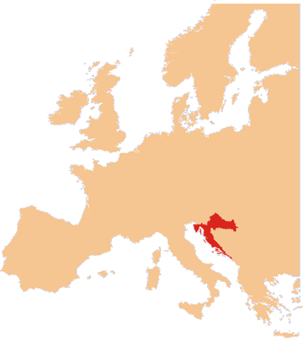
Area:
total: 56,594 sq km
land: 55,974 sq km
water: 620 sq km
Population:
4.253 mil (2014)
urban population: 58.7%
of total population (2014)
ZAGREB (capital) 687,000
(2014)
Natural resources:
oil, gas, bauxite, natural asphalt, clays, salt, hydropower
CROATIA
Source: CIA World Factbook; Croatian Bureau of Statistics

Slide 4
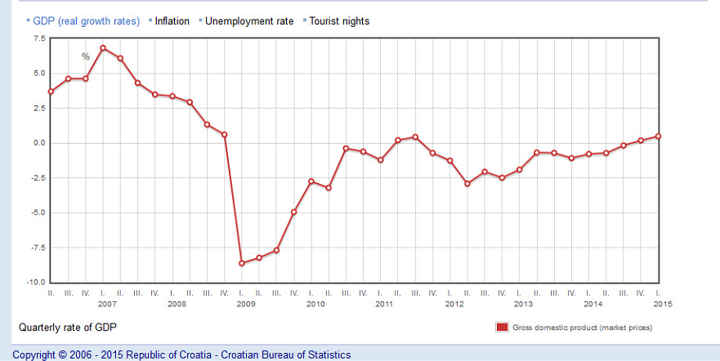
www.meteo.hr
Annual Gross Domestic Product in Croatia:
GDP 43,110 mil EUR = 48,419 mil $ (2014)
GDP per capita 10,129 mil EUR = 11,376 mil $ (2014)

Slide 5
www.meteo.hr
GDP - composition by sector:
agriculture: 5% industry: 25.8% services: 69.2% (2013 est.)
Source: http://www.indexmundi.com/croatia/economy_profile.html
Branches of the economy:
Services account for about two-thirds of Croatian GDP. Major industries include shipbuilding, construction, petrochemicals, and food processing. Most important of all is the tourism industry, with about 10 million foreign visitors per year and accounting for 15% of GDP.
Source: Croatia.eu

Slide 6
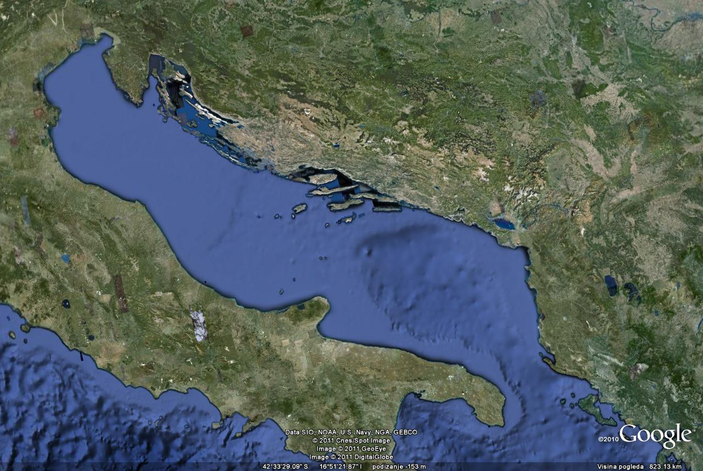
CROATIA - MARITIME COUNTRY
Total population 4,25 million / 30.000 seafarers
Lenght of coastline 6287 km
1246 islands of which 47 populated
Semi-closed sea basin
6 major ports, 98 ports with ship lines, 407 small ports and marines
Ship lines traffic: 11 mil. passengers, 2.8 mil. vehicles
Total number of passengers: 12 mil. maritime transport, ship cruisers, recreational ships
539 yachts and 103.945 boats registered
visit of 54.000 foreign yachts /year for recreational tourism
Search & rescue /year: ~800 rescued persons,~200 rescued vessels

Slide 7
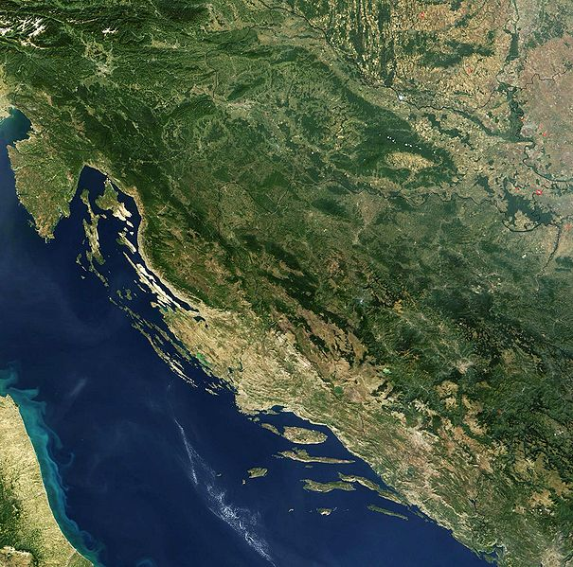
WEATHER AND CLIMATE IN CROATIA
The Alps
Pannonian Valley
CLIMATE:
Mediterranean and continental; continental climate predominant with hot summers and cold winters; mild winters, dry summers along coast
The Dinaric Alps
Adriatic Sea

Slide 8
Hazards list
Tornado (rotational high winds)
Strong winds
Storm surge
River flooding
Coastal flooding
Flash flood
Thunderstorm or lightning
Heavy snow
Hailstorm
Freezing rain
Dense fog
Heat wave
Cold wave
Drought
Marine hazards (storm, sea ice, icebergs, etc.)
Landslide or mudslide
Airborne hazardous substances (i.e., nuclear, biological, chemical, etc.)
Waterborne hazards (i.e., nuclear, biological, chemical, oil spills, etc.)
Hydrometeorological hazards to aviation (i.e., turbulence, icing)
Forest or wild land fire
Smoke, Dust or Haze
Earthquakes

Slide 9
Economic losses (%) caused by different natural
hazards in Croatia, 1981 - 2012
Source: Ministry of Finance

Slide 10
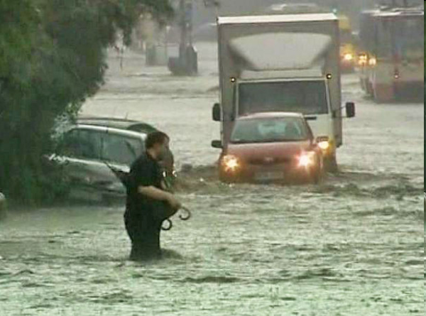
Floods are threat for ~15% of Croatian continental territory!
(DUZS, 2009: Assesment of Natural and Technological Hazards in Republic Croatia)

Slide 11
Meteorological and Hydrological Service
www.meteo.hr

Slide 12
Meteorological and Hydrological Service of Croatia
is a national centre of exellence based on high standards of scientific, professional and technical resources for the production, collection and dissemination of high-quality meteorological and hydrological information
the basic tasks are stipulated by the Law on meteorological and hydrological activities in Croatia (to provide support to economic development, environment protection, to act towards the preservation of life and material goods from natural hazards and disasters and to mitigate their consequences)
DHMZ represents Republic of Croatia at the World Meteorological Organization (WMO) and the Joint WMO-IOC Technical Commission for Oceanography and Marine Meteorology (JCOMM).

Slide 13
DHMZ official duties
DHMZ operates several ranges of observation networks (meteorological, climatological, hydrological, marine), at more than 600 observation sites with automated and human operated programs.
DHMZ provides wide range of products toward national and international partners and authorities, based on high end achievements in data analyses and forecasts, provided by well trained experts and scientists.
DHMZ runs call centers dedicated to meteo, hydrological and marine information services.

Slide 14
DHMZ official duties
DHMZ hold official membership at intergovernmental and international organisations as are: WMO, EUMETNET, ECMWF, EUMETSAT and GEO.
DHMZ is also member of many international projects as are: EU IPA and FP7 projects, CLIM-RUN, COST, ECLAIRE, EMEP, EUMeTrain, HyMex, projects, as well is a member of ALADIN and LACE NWP research groups.
DHMZ holds several ISO Accreditation Certificates for calibration of measurements

Slide 15
Structure of Meteorological and Hydrological Service:
Weather Analysis and Forecast Division
Weather and Climate Observation Division
Research and Development Division
Air Quality Division
Remote Sensing Division
Hydrology Division
IT Division
International and Customers Relation Division
Personnel, Legal and Finance Division
Independent Departement for Measurements Calibration

Slide 16
Staff: 375 (end of 2014)
Budget: 14.3 mil EUR (2015)
Estimated costs: 14.3 mil EUR (2015)
Main funding sources for operations and capital equipment:
state budget
R&D projects
special national program
DHMZ commercial activities

Slide 17
DHMZ Users/Customers:
Public
Government; State Administration, Local Authorities
Civil Protection – National Protection and Rescue Directorate
Media (radio, television, newspapers)
Croatian Waters, Croatian Electricity Company
Croatian Roads (traffic sector in general)
tourism & nautical tourism
DHMZ Products:
meteorological , hydrological and air quality data
meteorological and hydrological forecasts and warnings
numerical modelling
climatological analyses
climate predictions

Slide 18
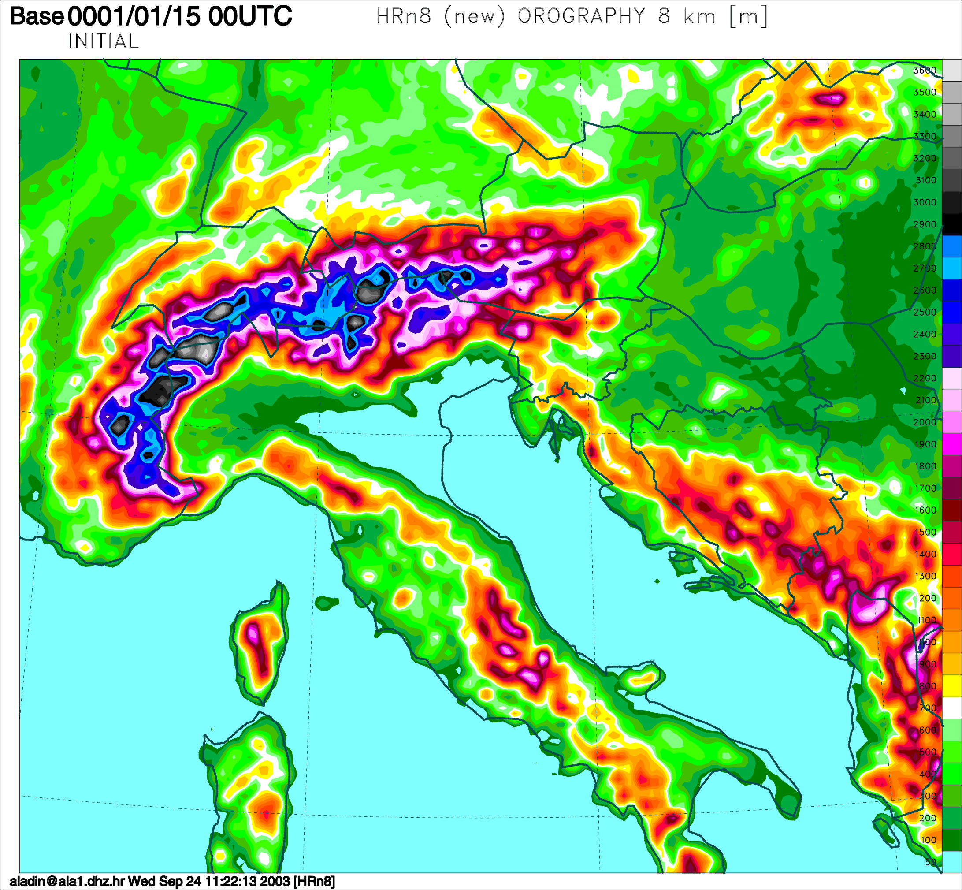
ALADIN/HR meteo mesoscale numerical model
Horizontal resolution: 4 km
Coupling model: ECMWF
Coupling frequency: 3 hours
Forecast range: +72 hours
Output every: 1 hour
Run: 00, 06, 12 and 18 UTC

Slide 19
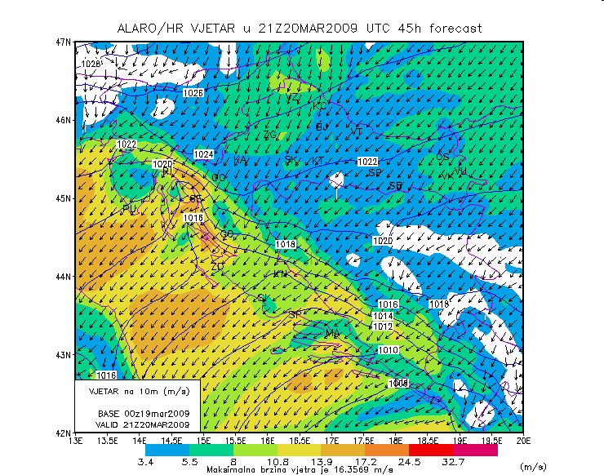
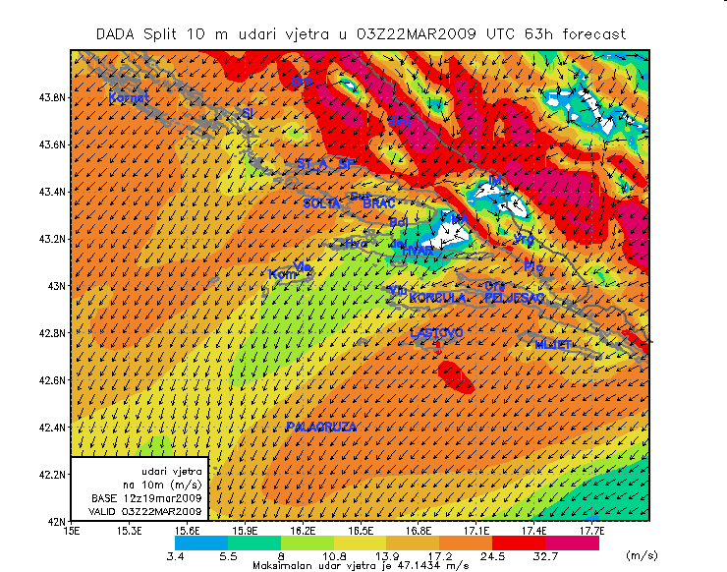
ALADIN/HR
www.meteo.hr
Dynamical adaptation
Resolution 2 x 2 km

Slide 20
WEATHER and MARINE FORECASTS
Nowcasting - (0 – 3 hours)
Short range forecast and warnings –(up to 72 hours)
Medium range forecasts – (up to 10 days)
Long-range seasonal forecast– (up to 6 months)
CLIMATE FORECAST
Regional climate modeling – (up to 100 years)

Slide 21
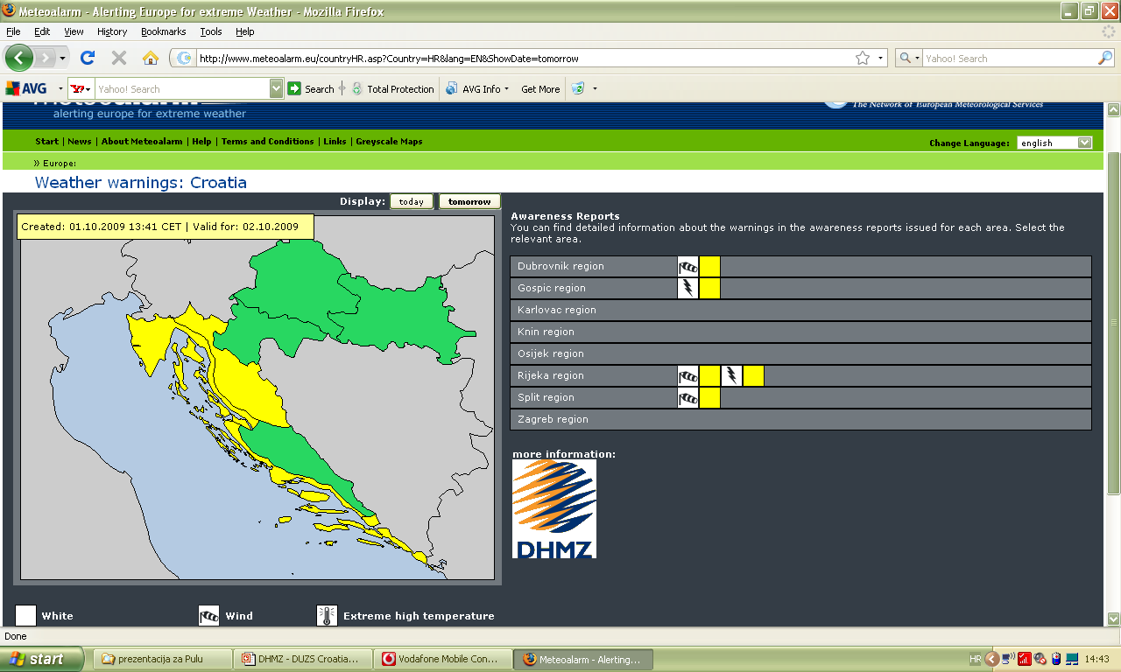
www.meteoalarm.eu
since 17 July 2009
climatological areas!

Slide 22
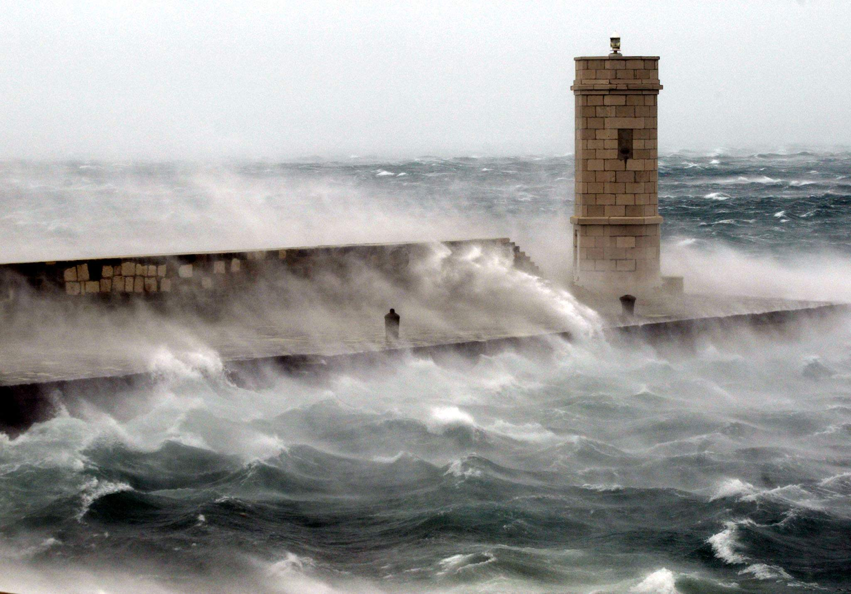
THANK YOU!

