Slide 1
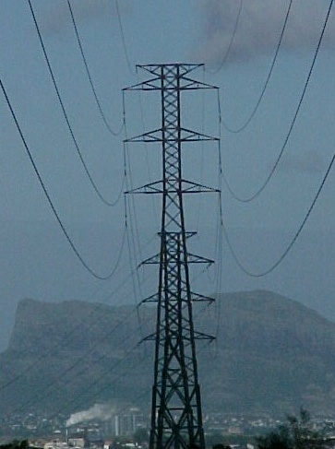
Coping with hazards in day-to-day operations and activities
Central Electricity Board
Mauritius

Slide 2
Outline Of Presentation
Role and Objectives of CEB
Generation of electricity in Mauritius
Demand Pattern
Variation of demand throughout a year
Analysis of the daily load profile curve
Transmission and Distribution network profile
Hazards
Conclusions

Slide 3

Role and Objectives of CEB
CEB is responsible for the generation, transmission, distribution and sale of electricity in Mauritius and Rodrigues island
In Mauritius, CEB operates 4 thermal power stations and 10 hydroelectric plants and has PPA contracts with IPPs so as to provide an affordable, safe and reliable electricity supply to its customers
To maximize the use of renewable energy and to undertake its business in an environmentally responsible manner
To meet the energy requirement of the country today and in the future

Slide 4
How is Electricity Generated in Mauritius?
Renewable Energy
  Hydroelectricity
  Bagasse
  Solar (PV farm)
  Landfill Gas
  Wind Farm
Non Renewable Energy
  Coal
  Heavy Oil

Slide 5
CEB GENERATING CAPACITY
 | TYPE | GENERATING STATION | EFFECTIVE CAPACITY (MW)
CEB | THERMAL (FUEL) | FORT GEORGE | 134.00
 |  | ST LOUIS | 66.60
 |  | FORT VICTORIA | 107.00
 |  | NICOLAY | 75.00
 | HYDRO | CHAMPAGNE | 28.00
 |  | FERNEY | 10.00
 |  | TAMARIND | 9.50
 |  | LE VAL | 4.00
 |  | A.I.A (REDUIT) | 1.00
 |  | CASCADE CECILE | 1.00
 |  | LA NICOLIERE FEEDER CANAL | 0.35
 |  | MAGENTA | 0.90
 |  | MIDLANDS | 0.35
 |  | LA FERME | 1.20
TOTAL - CEB |  |  | 438.90

Slide 6
IPP GENERATING CAPACITY
 | TYPE | GENERATING STATION | EFFECTIVE CAPACITY (MW)
IPP | COAL/ BAGASSE | CTSAV | 74.00
 |  | CTBV | 62.00
 |  | CEL | 22.00
 |  | FUEL | 27.00
 | COAL | CTDS | 30.00
 | BAGASSE | MEDINE | 6.00
 | SOLAR | SARAKO | 15.00
 | LANDFILL GAS | SOTRAVIC | 3.00
 | WIND | AEROWATT | NYC (9.35)
 |  | PADGREEN | NYC (29.40)
TOTAL - IPP |  |  | 239.00

Slide 7
Demand Pattern
Consumers of electricity at large who dictate variations in the daily demand
To match demand CEB relies on its own plants and those owned by IPPs
2 types of Generation facilities required:
1. Base facilities that operate around the clock
2. Peak facilities that can be called upon at short notice to meet extra demand
Energy production: IPPs (60%) and CEB (40%)
Renewable energy represents approximately 20% of the total Production of energy. CEB is targeting an amount of 25% renewable energy by 2025.

Slide 8
TOTAL MONTHLY GENERATION

Slide 9
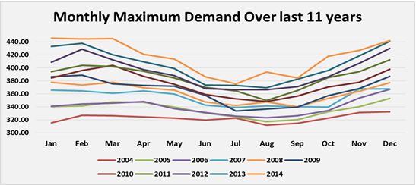

Slide 10
DAILY LOAD PROFILE
Morning Peak
MAX DEMAND TO DATE : 456.8MW on 3 March 2015 at 10.50a.m
Evening Peak

Slide 11
Peak Periods In A Day
A peak is defined as the maximum demand measured during a day
Usually there are two peaks in the daily load profile, namely the Morning Peak and the Evening Peak
The evening peak, in Summer, takes place at around 7:30pm whereas in Winter the evening peak occurs at around 6:30pm

Slide 12
Why Does The Demand Vary?
Period 1: 04:00 – 07:00
Increase in demand
People wake up and getting ready for work, school
(Preparation of breakfast, morning shower etc..)
Period 2: 07:00 – 16:00
Steep increase in demand
Economic activities start (industries, commercial centers, shops, offices, supermarkets)
Electrical equipment on, Computers on, Air Conditioning on
Slight decrease in load at noon due to lunch time
Period 3: 16:00 – 18:00
Decrease in demand
Closing time of some industries, shops, commercial centers, offices..
Electrical equipment, Computers and Air Conditioning switched off
People outside their homes (sports, shopping, driving, gardening…)

Slide 13
Why Does the Demand Vary?
Period 4: 18:00 – 20:00
Sharp increase in load
People switching lights on, Starting to cook food, Taking Shower, Watching TV
Street Lighting, Air Conditioning turned on
Period 5: 20:00 – 04:00
Load start to decrease gradually
People go to sleep
Some equipment still consume energy at home, Ex fridge, exterior lighting, AC, fans
Some services continue their operations, Ex airport, hotels, Bakeries, night life, Hospitals, call centers…
Few industries work 24hrs a day, Ex steel manufacturing industries
Street lighting

Slide 14
ORGANISATION SET UP
DEPT
CORPORATE
PRODUCTION
HR
CUSTOMER SERVICE
FINANCE
ADMINISTRATIVE
AUDIT
T&D
SECTIONS
METERING
TRANSFORMER
DISTRICT
PLANNING
S.CONTROL

Slide 15
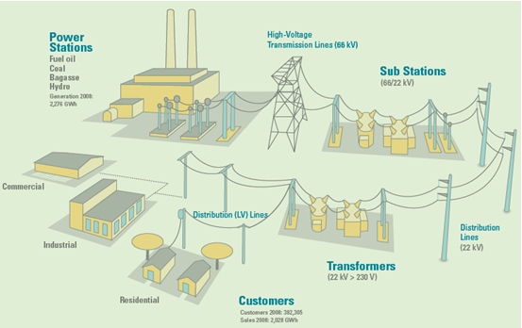
Typical System Network

Slide 16
2014/2015 Facts and Figures
Total Energy Generated in 2014 is 2661 GWh.
The grid length as at August 2015 is as follows:
CEB Transmission and Distribution network consists of approximately 93% overhead network and 7% underground.
Approximately 50% of the MV overhead distribution and approximately 75% of the LV overhead distribution network consists of insulated conductors
441,263 Customers (as at June 2015) are being supplied through 5,527 distribution transformers
Data | Transmission | Distribution MV | Distribution LV
Voltage levels (kV) | 66 | 22/6.6 | 0.400/0.23
Length of overhead cables (km) | 291.5 | 2976 | 5500
Length of underground cables (km) | 20.2 | 450 | 236

Slide 17
Hazards
Lightning and Electric Storms
  Direct strike, lightning induced overvoltage resulting in flashover, lines tripping (sometimes resulting in partial black-outs), damage to electrical and electronic equipment. Mitigating procedures: Installation of lightning arrestors on distribution networks, erection of shield wire on transmission lines
Fire in Sugar Cane field
  Controlled fire during Cane Harvest period, however fire could be caused by arson or due to strong gusts resulting in uncontrolled fire
  Conductors burnt, lines tripping due to lowering of insulation, Material damage requiring repairs
Sea level rise/Tsunami/flooding
  Access for repairs, Flooding of underground cabins and transformers
  Concentration of CEB generation Power plants in vicinity of Port Louis
Weather Predictability
  Renewable energy depends on predictability of Wind, Solar.
  CEB is considering installation of Battery Electrical Storage System of 18 MW capacity

Slide 18
Hazards
Cyclone
  Tree lopping, replacement of rotten poles, replacement of tower members, design and construction of lines, Post-cyclone reinstatement plan already set-up
Landslide
  Clearance problem, pole leaning
Change in precipitation
  Heavy, continuous rain over several days may result in soggy soil i.e. increased fragility of network as poles/network are less resistant to mechanical forces e.g wind pressure
  Drought – No Hydro generation
  Insulators are self-cleaning. However, Mauritius being surrounded by sea, salt is deposited on insulators and in case of severe drought, may result in tracking and flash-over

Slide 19
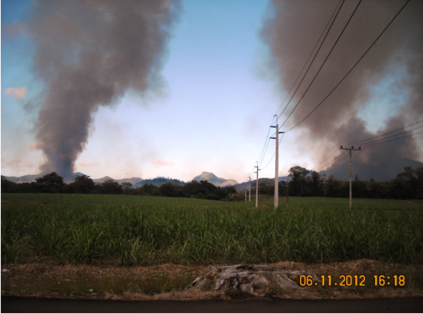
Fire in sugar cane fields of Riche en Eau S.E on 06 Nov 12 and which resulted in the tripping of the 66 kV line Champagne – Union Vale.

Slide 20
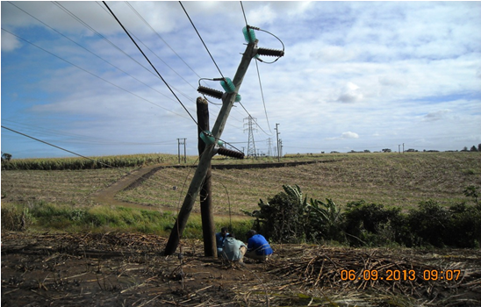
Pole damaged by fire in sugar cane field of Alteo Ltd on 06 September 13 and which resulted in the tripping of the 66 kV line FUEL – FUEL Alteo group.

Slide 21
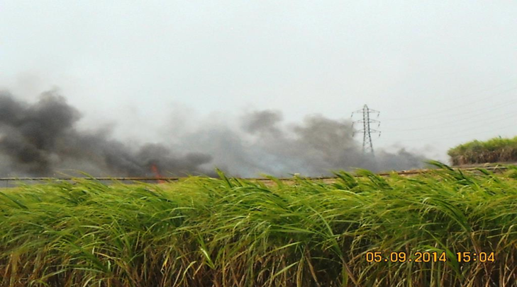
Fire in sugar cane field at Belle Vue on 05 September 14 and which resulted in the tripping of the 66 kV line Belle Vue – Amaury 1, Dumas – Belle Vue 1 & 2.

Slide 22
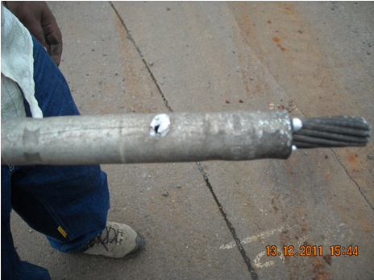
Melted compression joint (damaged by high fault current caused by lightning strike on 13th December 2011 on 66 kV line St Louis – Chaumiere 2)

Slide 23
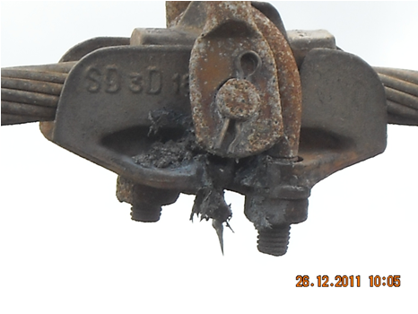
Damaged suspension clamp on St Louis Chaumiere (associated with lightning strike of 13th December 2011) replaced on 26th December 2011 during maintenance.

Slide 24
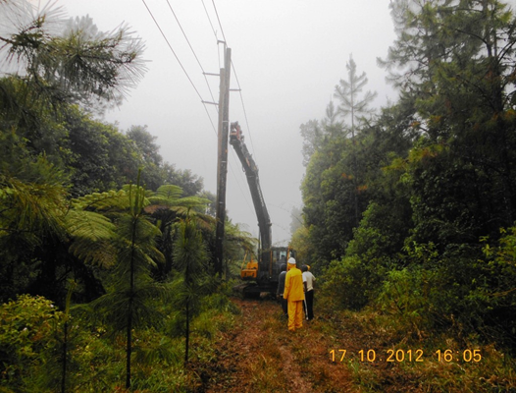
Utilisation of chain-wheel tractor during replacement of rotten pole at Grand Bassin

Slide 25
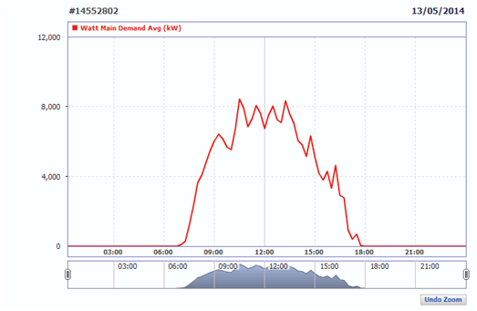
Sarako PV farm: Typical production curve which is being exported on the CEB 66kV grid at La Chaumiere stn. Approximately 20 GWhr generated during the period February 2014 to end December 2014 which represents around 0.8% of total units generated for 2014.

Slide 26
Conclusion
Electricity plays a crucial role in Mauritian Society. The CEB network, due to Mauritius being an insular country, is not connected to any big network. There is thus less flexibility in terms of supply/demand and more vulnerability to climatic factors.
A coordinated effort must be undertaken to ensure electricity systems remain reliable and grid resilience is protected in light of climate change
Communication with all stakeholders so as to raise awareness regarding climate risks and allow for pooling of research and planning resources
Financial impact on customers and pressure to keep electricity rates low

Slide 27
Thank you for your kind attention
END SHOW

