Slide 1
The WMO SWFDP-Sea Regional Training Workshop on Delivery of Warning Service. From 26-30 March 2018, in Hanoi of Vietnam.
Cambodia.
Mr. Sam Oeurn Soknara.
Email: sam.soknara@gmail.com.
Tel: (855) 976333635

Slide 2
Outline
Biographical location and population of Cambodia.
Climate of Cambodia.
Current Weather Dissemination warning System in Cambodia.
Challenges, Concerning, Pressure and Gaps
Conclusions.

Slide 3
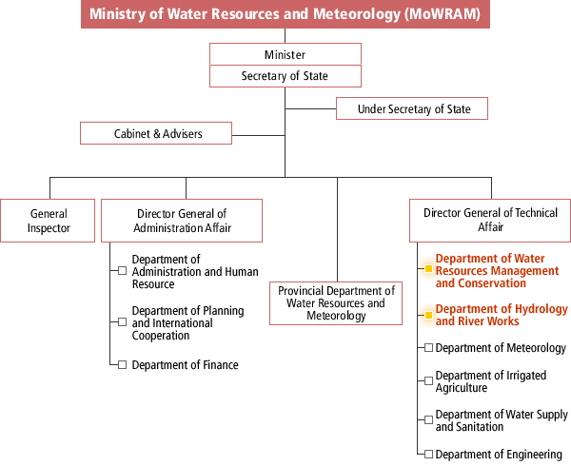
Ministry of Water Resources And Meteorology (MOWRAM)

Slide 4
Current Weather Dissemination warning System in Cambodia.
Currently, we have the intention to launch the
warning system in all relevant institutions, so
the warning information out to summit to the understood, clear, useable and take care with the weather.

Slide 5
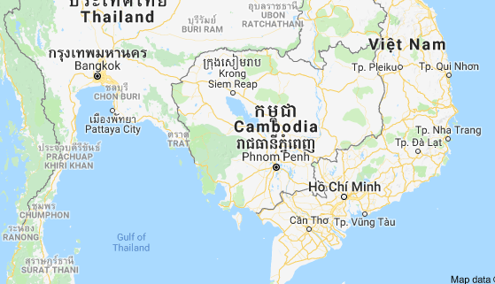
Biographical location & Population
Cambodia is a SE Asia, bordering Thailand, Laos, Vietnam, the Gulf of Thailand and covers a total area of 181,035 km²
Population : about 15.76 million (2017).

Slide 6
Climate of Cambodia
Climate : Is the process variability as well as
-Cold wet, Cold dry.
-Hot wet, Hot dry.
And divide two season:
2/Wet Season:
June-November, (SW monsoon).
Hot wet, Bring more rainfalls, thunderstorms, Floods, Flash floods…
1/Dry Season
December-May,
( NW Monsoon)
Brings cool air and mostly dry air between December and February, and next after hot dry.

Slide 7
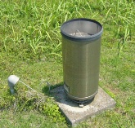
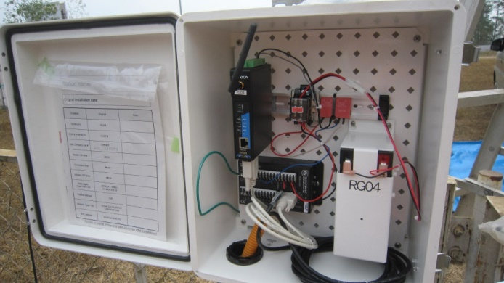
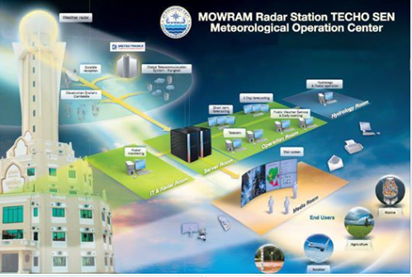
Meteorological Operation Center
AWS observed data are reported to headquarters 1time perday
Parameter:
-Air Tem Avg (deg C)
-RH Avg (%)
-Wind speed Avg (Km/h)
-Wind Direction
-Vector(Degree)
-Solar radiation (mm)
-Total precipitation(mm)
-Max 1min rainfall (mm)
-pressure (hpa)
Automatic rain gauge data are transmitted to headquarters every 1 hour.
Weather Warnings - The National Weather Service posts all available severe weather warnings: tropical storms, floods, flash floods, drought, severe thunderstorms, and special marine conditions..etc

Slide 8
Current Weather Warning dissemination System in Cambodia
-Department of Meteorology( DOM)
-Department of Hydro and River Works
(DHRW)
www.cambobdiameteo.com
www.dhrw-cam.org
Public
Announcement
Cabinet Minister
of Water Resources and Meteorology (MOWRAM)
By Fax, Phone, Email, Facebook and Website to relevant institutions and all partners.
Cabinet
Prime minister
www.cambobdiameteo.com
www.dhrw-cam.org
Medea (Radio, TV,
New paper)
Local Authorities and
Non Gov. Agencies
National Committee
Disaster Management
Ministry of Interior
Ministry of National Defense

Slide 9
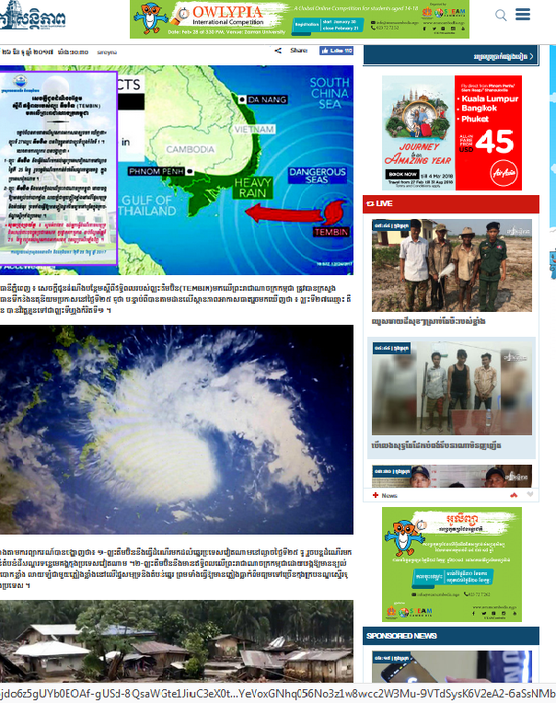
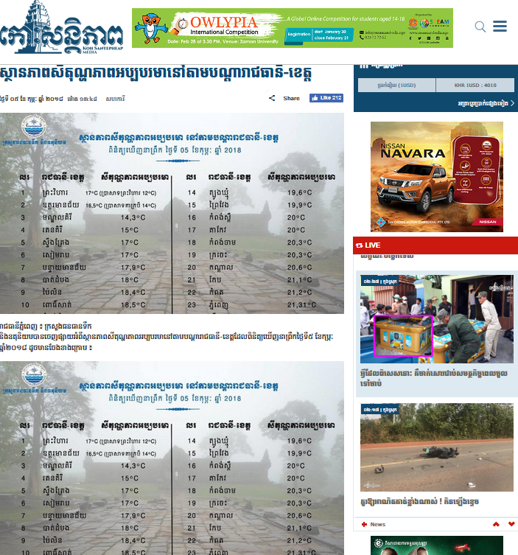
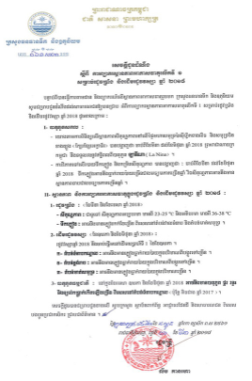
Weather warning
Announcement letter are issued by Minister of MOWRAM

Slide 10
Challenge
With all the information and announcements EWS for reducing the vulnerabilities of communities, they are so not take care with the weather dissemination.
The warning system and communication network to public is limited to get awareness service and experiences.
The weather warning service carried out at the national, provincial, district and community (commune) level is limited in risk reduction.

Slide 11
Pressure
Complaining, lose on believing and blaming.
Concerns
Capacities building and human resources.

Slide 12
Gaps in warning
Basically caps assessment:
The accuracy of weather forecast varies significantly, if comparing with the obviously action of weather, (rainfall…).
Furthermore, the coordination between MOWRAM and NCDM was found to be weak as NCDM uses its own network from national to commune level to disseminate warnings.

Slide 13
Strategy improvement
-To establish and manage the Cambodian meteorological stations.
-To provide weather forecast in short and long time range for all concerned sectors.
-To predict meteorological phenomenon and emit alert to enable the setting up of protective procedures.
-To raise knowledge and communicate with national and international actors on meteorology technologies.
-To strengthen and broaden Cambodian cooperation on meteorology with meteorological organizations, United Nation agencies and World Meteorological Organization, quarterly report as well.
-To prepare annual reports on the situation of meteorology in Cambodia.

Slide 14
Conclusions.
While little can be done to prevent the increased frequency of natural disasters, informed populations can lessen disaster impacts. By doing this, we can help reduce the loss of life disasters cause and help promote best practices for future generations to follow.

Slide 15
Thanks you !

Slide 18
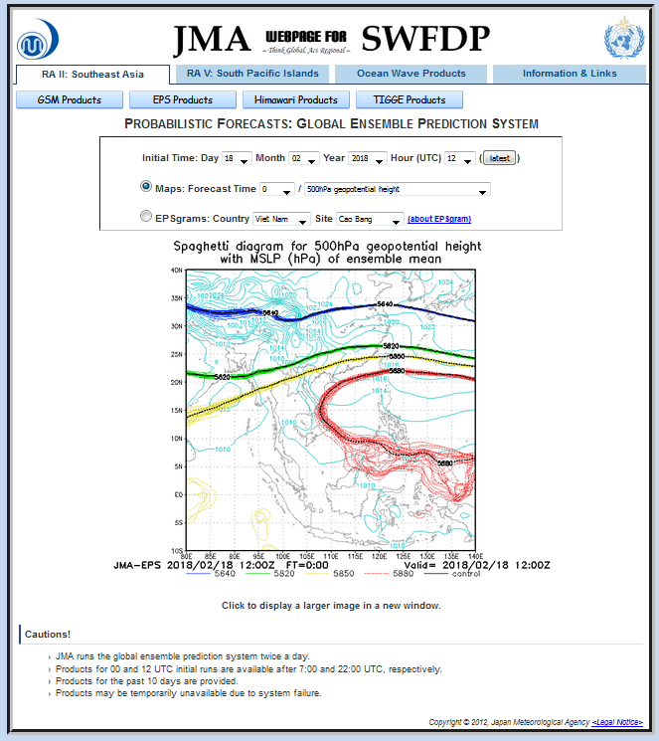
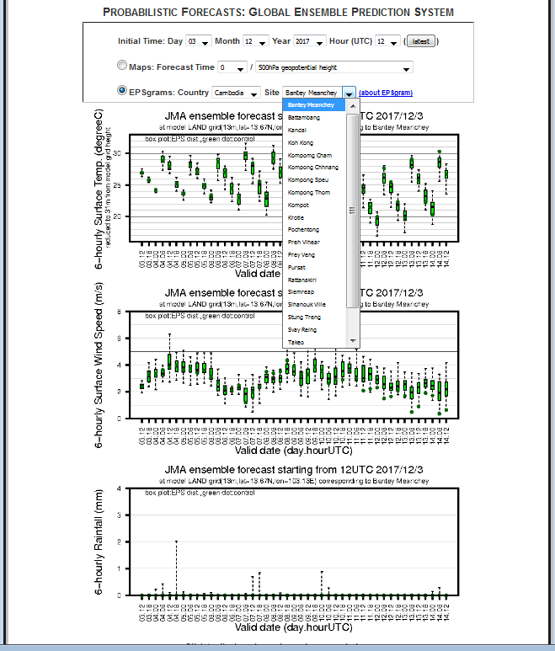
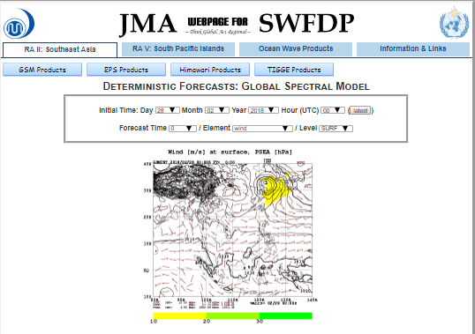
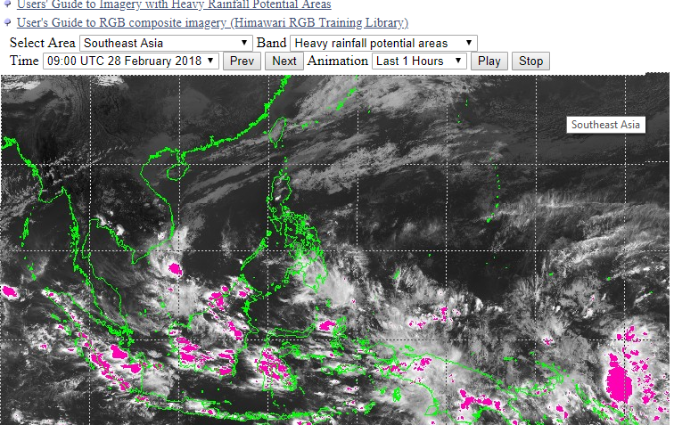

Slide 19
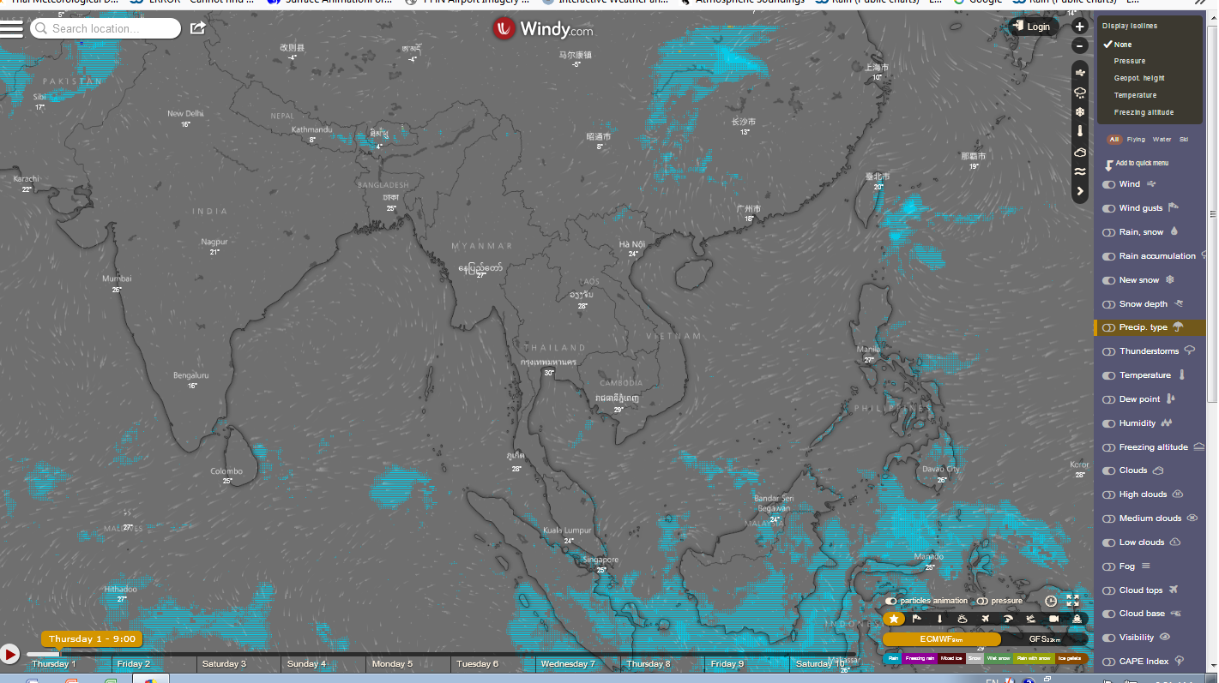
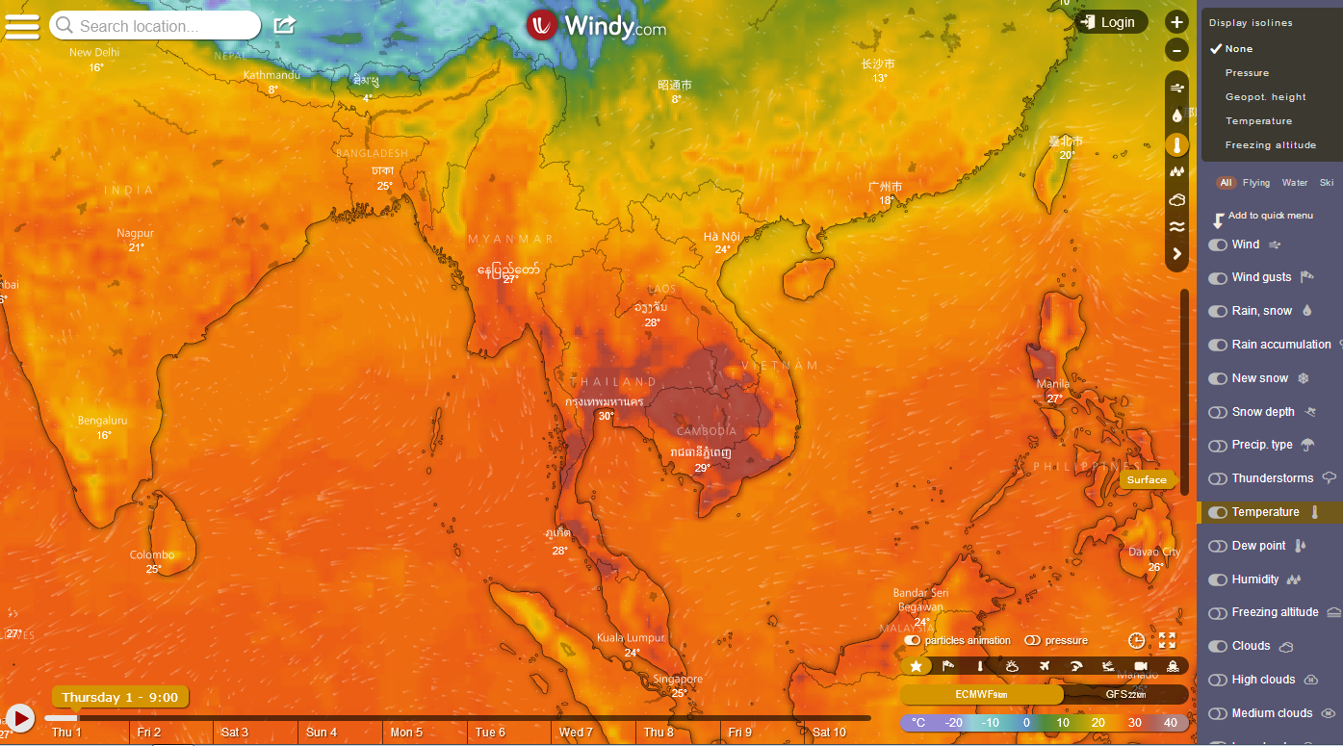
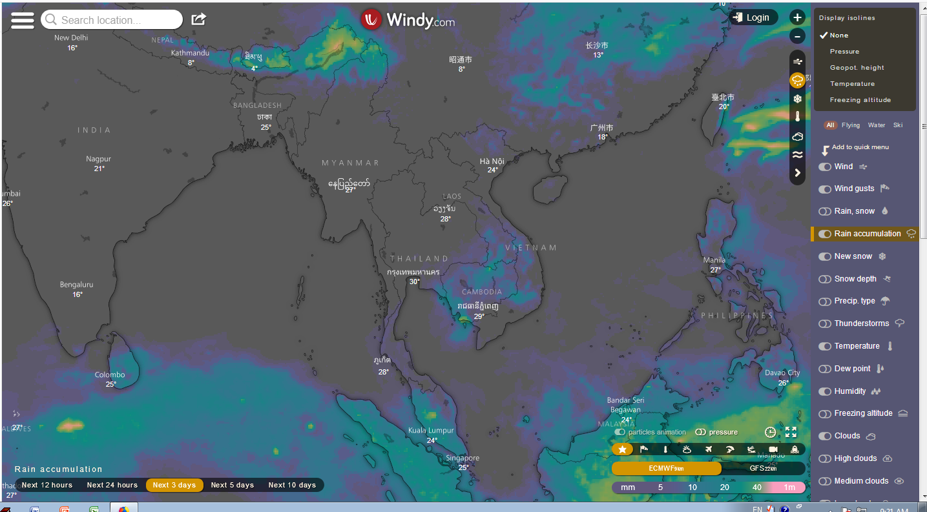
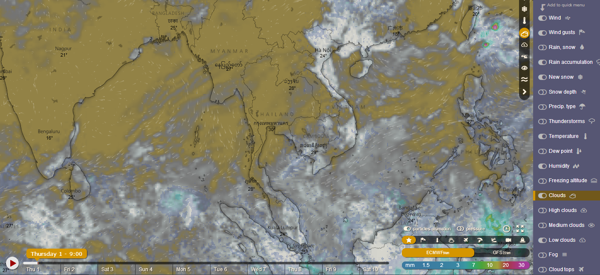
Additional guidance products

Slide 20
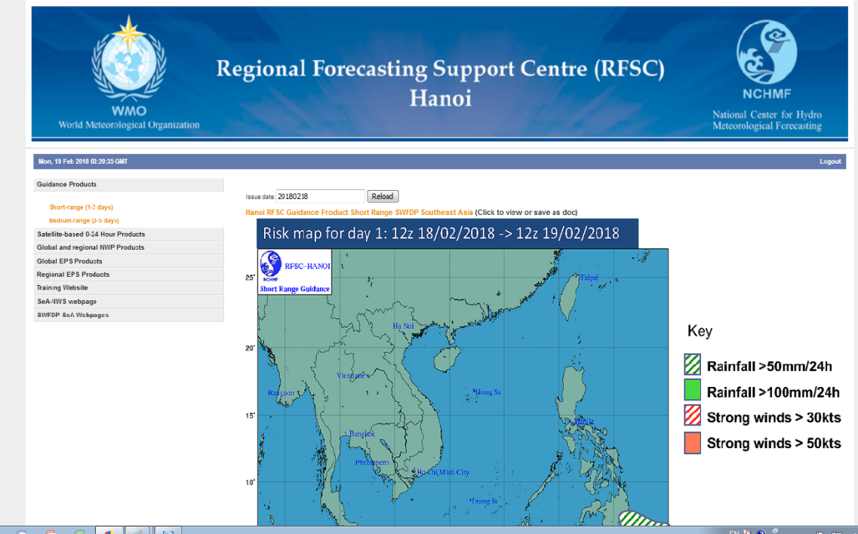
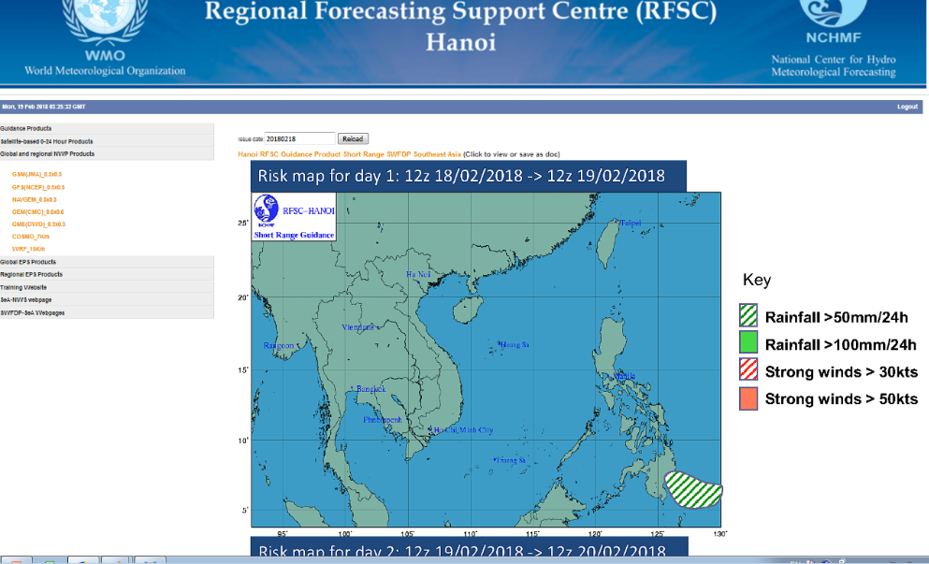
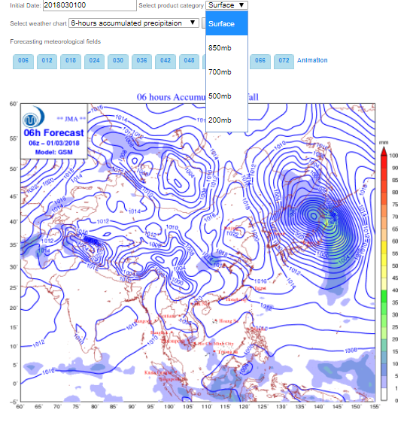
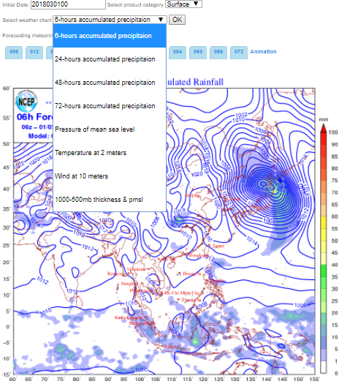
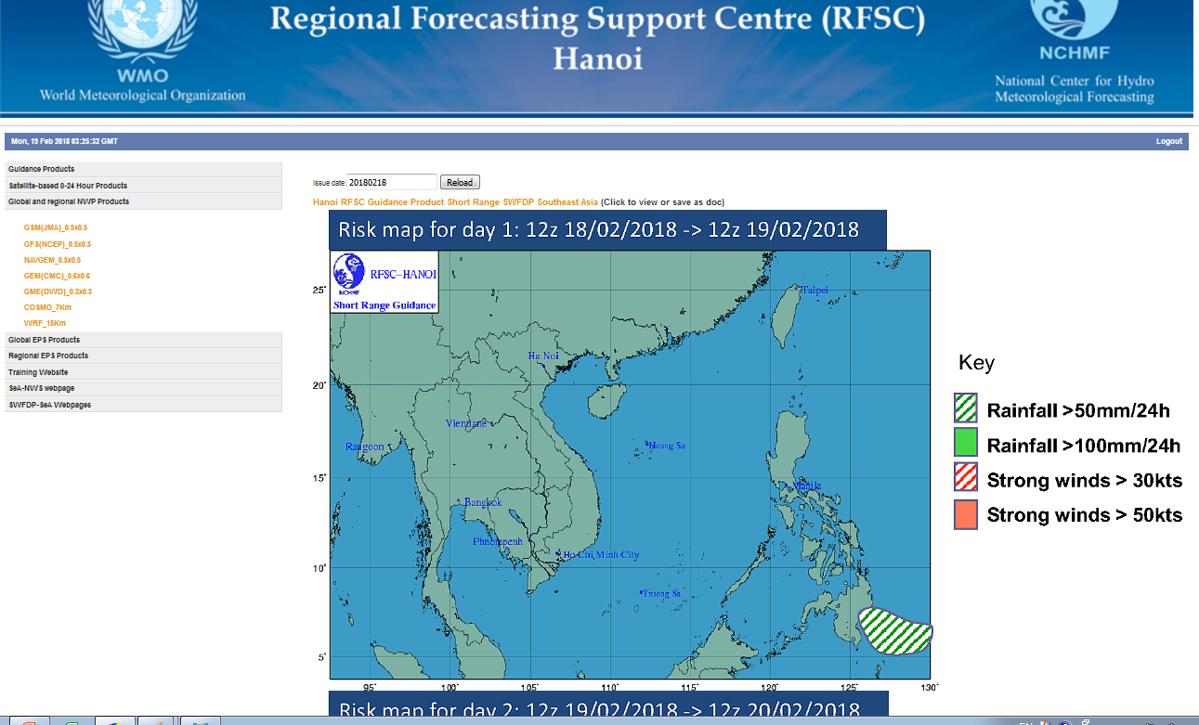
guidance products by SWFDP-sea

