Slide 1
The WMO SWFDP-Sea Regional Training Workshop on Delivery of Warning Service. From 25 February to 01 Mach 2019, in Vientiane of Laos PDR.
Department of Meteorology, Cambodia
Presenter: PHAN Sambath
Email: sambath.ph@gmail.com

Slide 2
Outline
Biographical location and population of Cambodia
Climate of Cambodia
Current Weather Dissemination warning System in Cambodia
Challenges, Concerning, Pressure and Gaps
Strategy Improvement
Conclusions
1

Slide 3
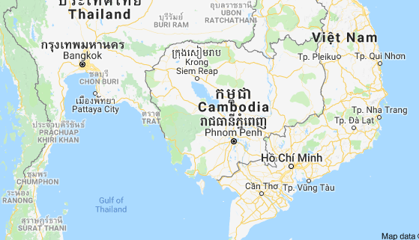
Biographical location & Population
Cambodia is a SE Asia, bordering Thailand, Laos, Vietnam, the Gulf of Thailand and covers a total area of 181,035 km²
Population : about 15.76 million (2017).
2

Slide 4
Climate of Cambodia
Climate : Is the process variability as well as
-Cold wet, Cold dry.
-Hot wet, Hot dry.
And divide two seasons:
2/Wet Season:
May-November,
(SW monsoon).
Hot wet, Bring more rainfalls, thunderstorms, Floods, Flash floods…
1/Dry Season
December-April,
( NE Monsoon)
Brings cool air and mostly dry air between December and February, and next after hot dry.
3

Slide 5
Current Weather Dissemination warning System in Cambodia.
Currently, we have the intention to launch the
warning system in all relevant institutions, so
the warning information out to summit to the understood, clear, useable and take care with the weather.
4

Slide 6
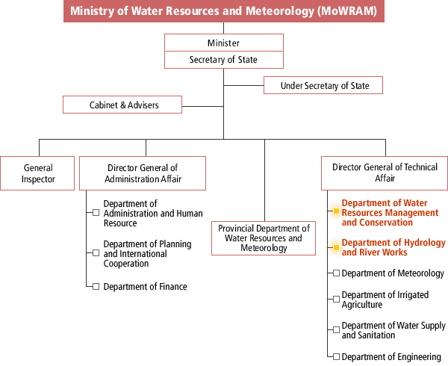
Ministry of Water Resources And Meteorology (MOWRAM)
5

Slide 7
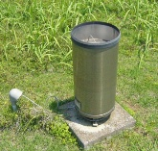
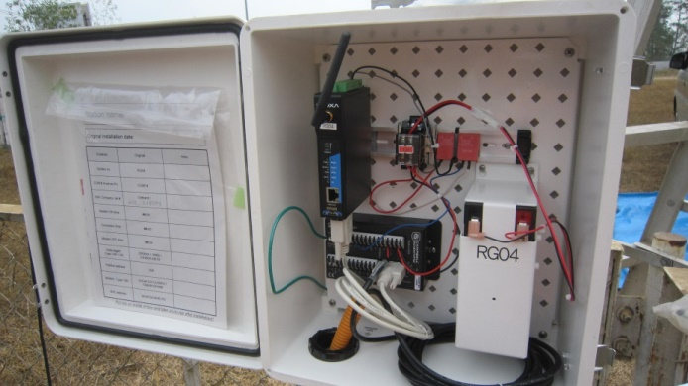
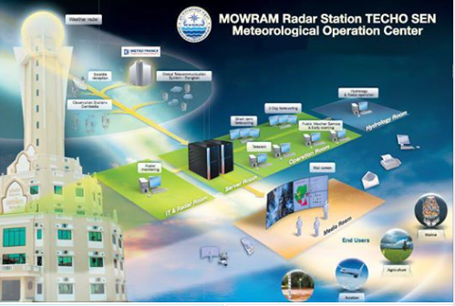
Meteorological Operation Center
AWS observed data are reported to headquarters every1 hour
Parameter:
-Air Tem Avg (deg C)
-RH Avg (%)
-Wind speed Avg (Km/h)
-Wind Direction
-Vector(Degree)
-Solar radiation (mm)
-Total precipitation(mm)
-Max 1min rainfall (mm)
-pressure (hpa)
Automatic rain gauge data are transmitted to headquarters every 1 hour.
Weather Warnings - The National Weather Service posts all available severe weather warnings: tropical storms, floods, flash floods, drought, severe thunderstorms, and special marine conditions..etc
6

Slide 8
Current Weather Warning Dissemination System in Cambodia
-Department of Meteorology( DOM)
-Department of Hydro and River Works
(DHRW)
www.cambobdiameteo.com
www.dhrw-cam.org
Public
Announcement
Cabinet Minister
of Water Resources and Meteorology (MOWRAM)
By Fax, Phone, Email, Facebook and Website to relevant institutions and all partners.
Cabinet
Prime minister
www.cambobdiameteo.com
www.dhrw-cam.org
Medea (Radio, TV,
Newspaper)
Local Authorities and
Non Gov. Agencies
National Committee
Disaster Management
Ministry of Interior
Ministry of National Defense
7

Slide 9
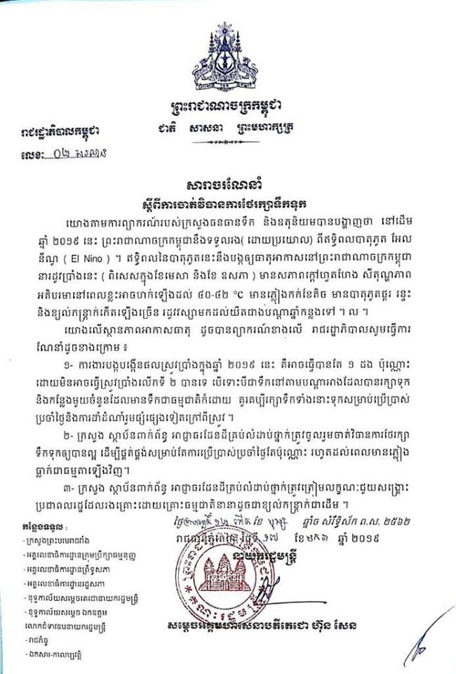
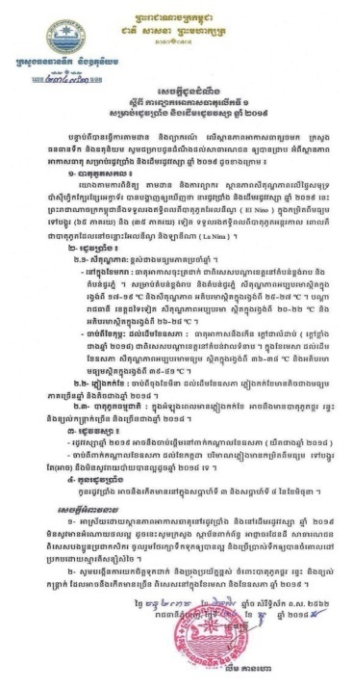
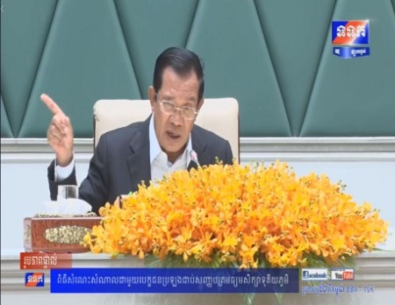
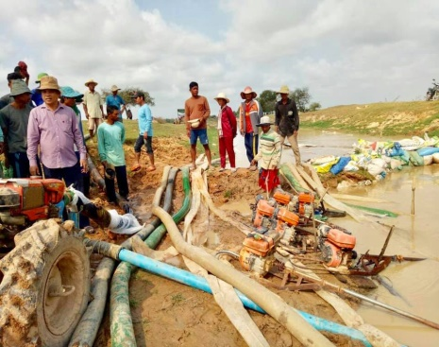
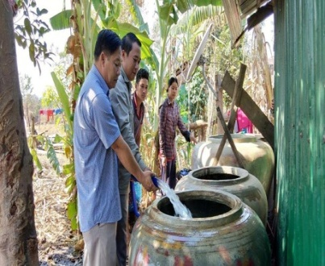
Weather Warning (cont.)
In 2016 Cambodia faced drought from January to April indirect impact of El Nino.
Announcement letter are issued by Minister of MOWRAM
8

Slide 10
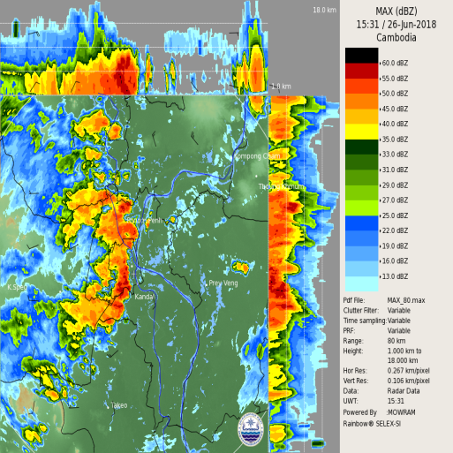
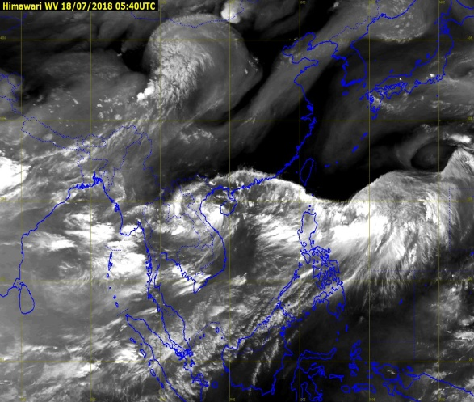
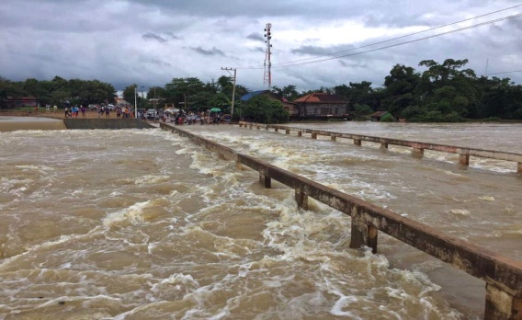
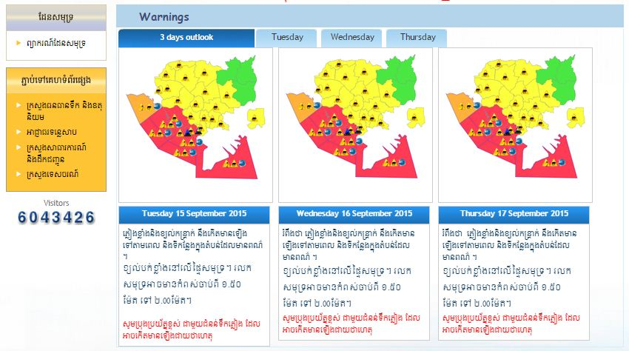
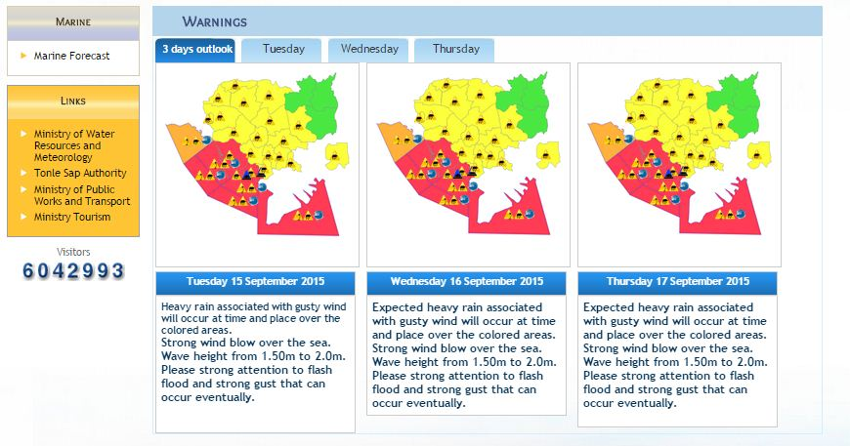
Weather Warning
Afterward May Cambodia got normal rain again from August to September which impact from ITCZ.
Website: Cambodiamete.com
9

Slide 11
Challenges
With all the information and announcements EWS for reducing the vulnerabilities of communities, before they were so not take care with the weather dissemination but they have been awareness of necessary daily forecast to public nowadays.
The warning system and communication network to public is limited to get awareness service and experiences.
The weather warning service carried out at the national, provincial, district and community (commune) level is limited in risk reduction.
10

Slide 12
Pressure
Complaining, lose on believing and blaming.
Concerns
Capacities building and human resources.
11

Slide 13
Gaps in warning
Basically gaps assessment:
The accuracy of weather forecast varies significantly, if comparing with the obviously action of weather, (rainfall…).
Furthermore, the coordination between MOWRAM and NCDM was found to be weak as NCDM uses its own network from national to commune level to disseminate warnings.
12

Slide 14
Strategy improvement
-To establish and manage the Cambodian meteorological stations.
-To provide weather forecast in short and long time range for all concerned sectors.
-To predict meteorological phenomenon and emit alert to enable the setting up of protective procedures.
-To raise knowledge and communication with national and international actors on meteorology technologies.
-To strengthen and broaden Cambodian cooperation on meteorology with meteorological organizations, United Nation agencies and World Meteorological Organization, quarterly report as well.
-To prepare annual reports on the situation of meteorology in Cambodia.
13

Slide 15
Conclusions.
While little can be done to prevent the increased frequency of natural disasters, informed populations can lessen disaster impacts.
By doing this, we can help reduce the loss of life disasters cause and help promote best practices for future generations to follow.
14

Slide 16
Thank you very much for your kind attention!!!

Slide 19
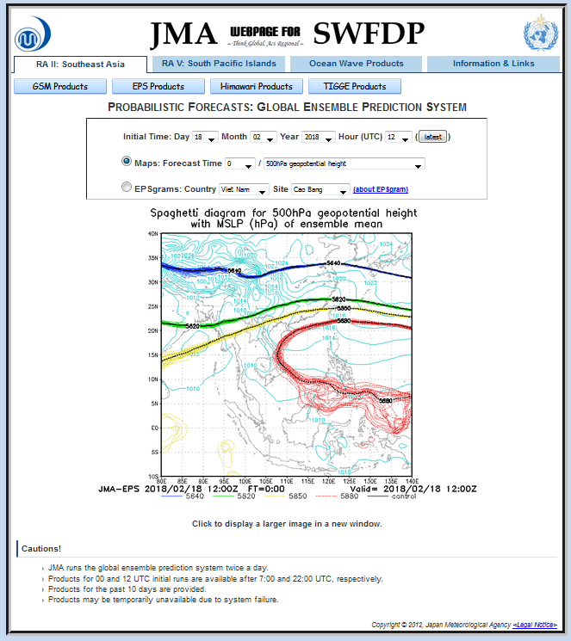
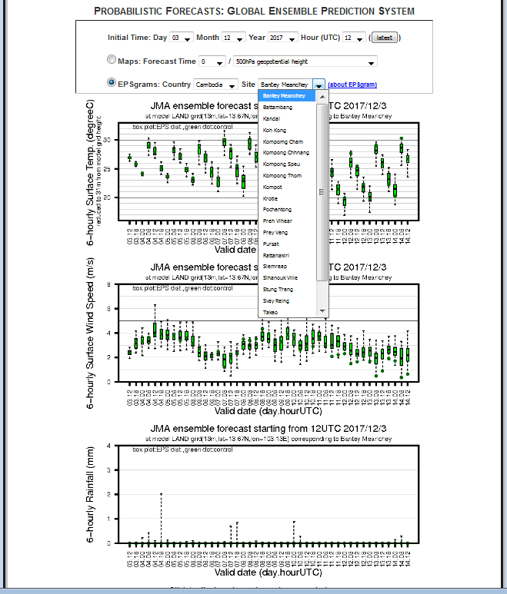
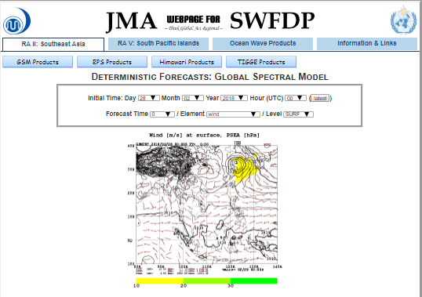
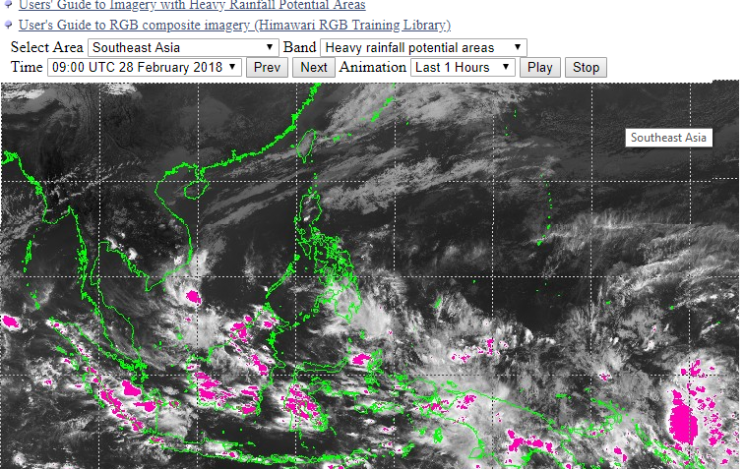

Slide 20
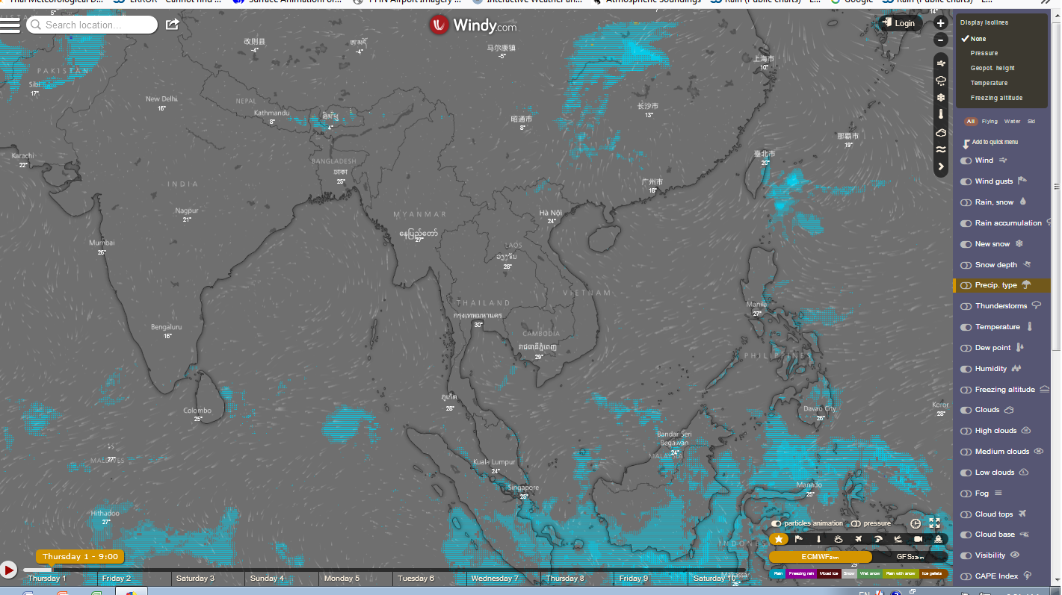
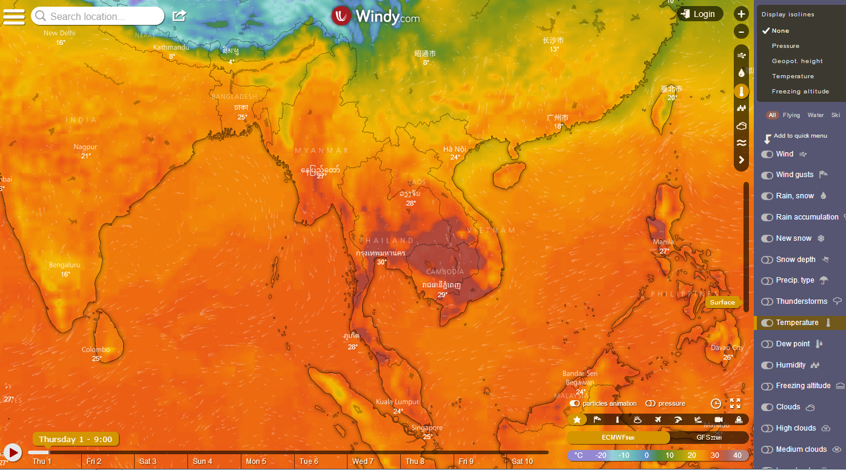
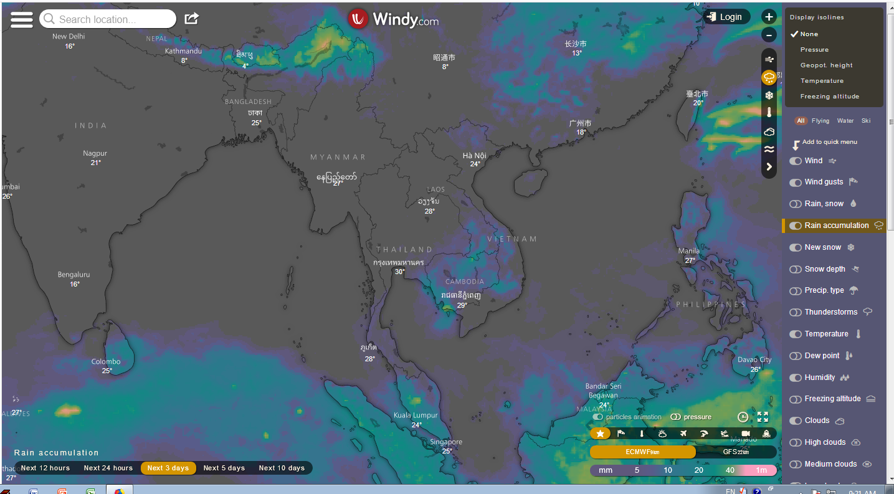
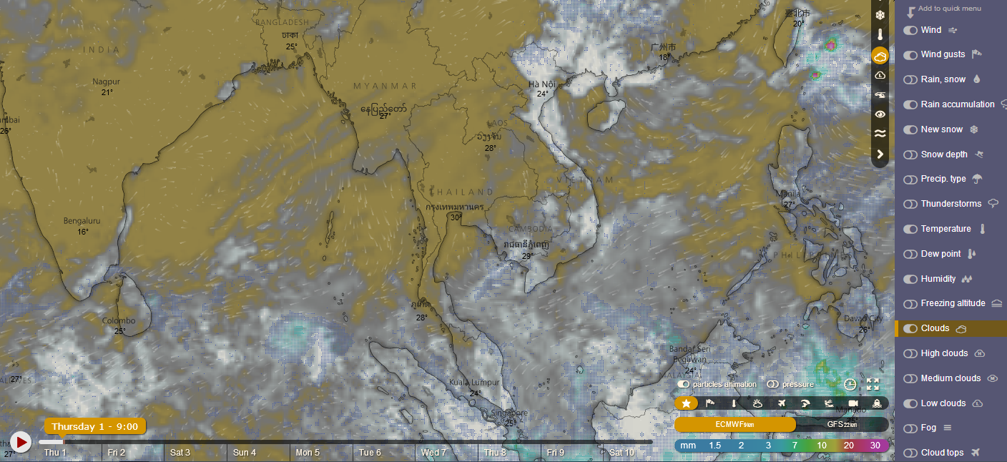
Additional guidance products

Slide 21
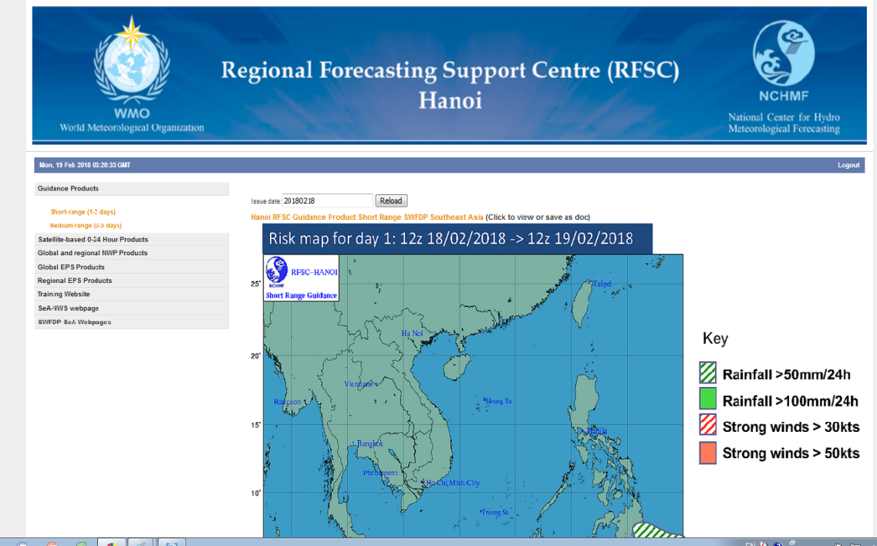
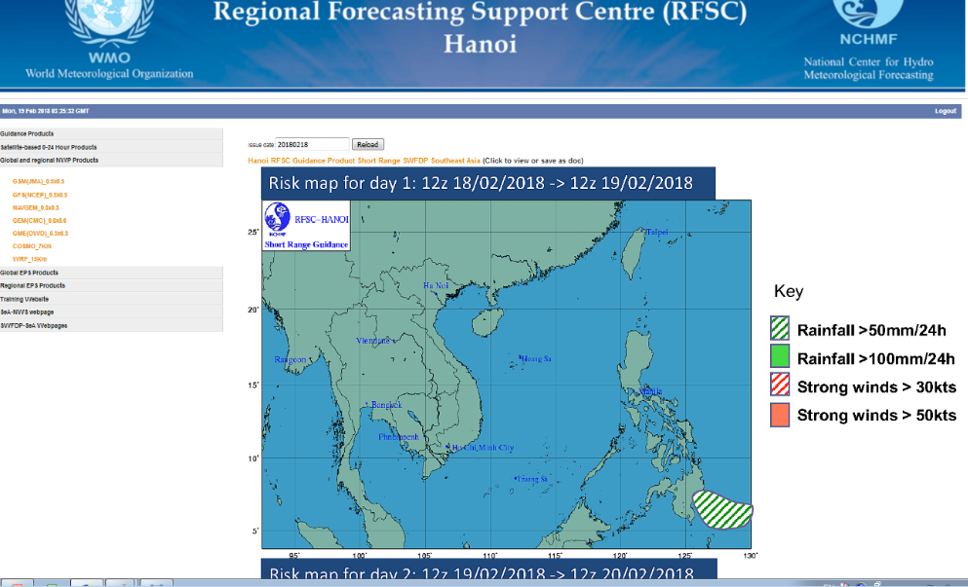
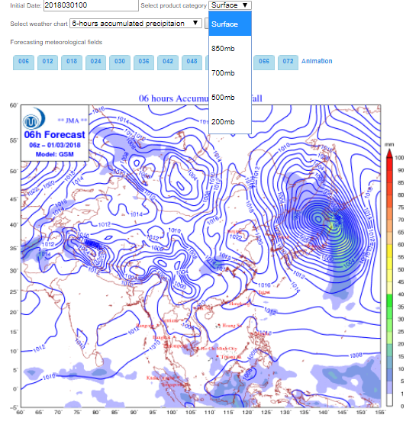
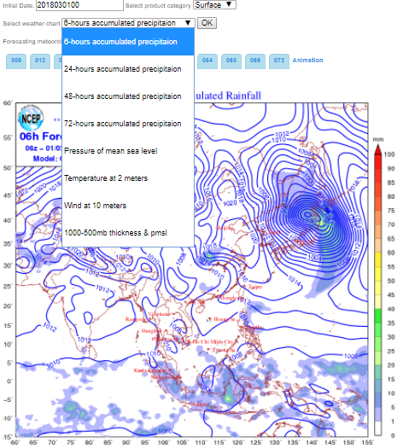
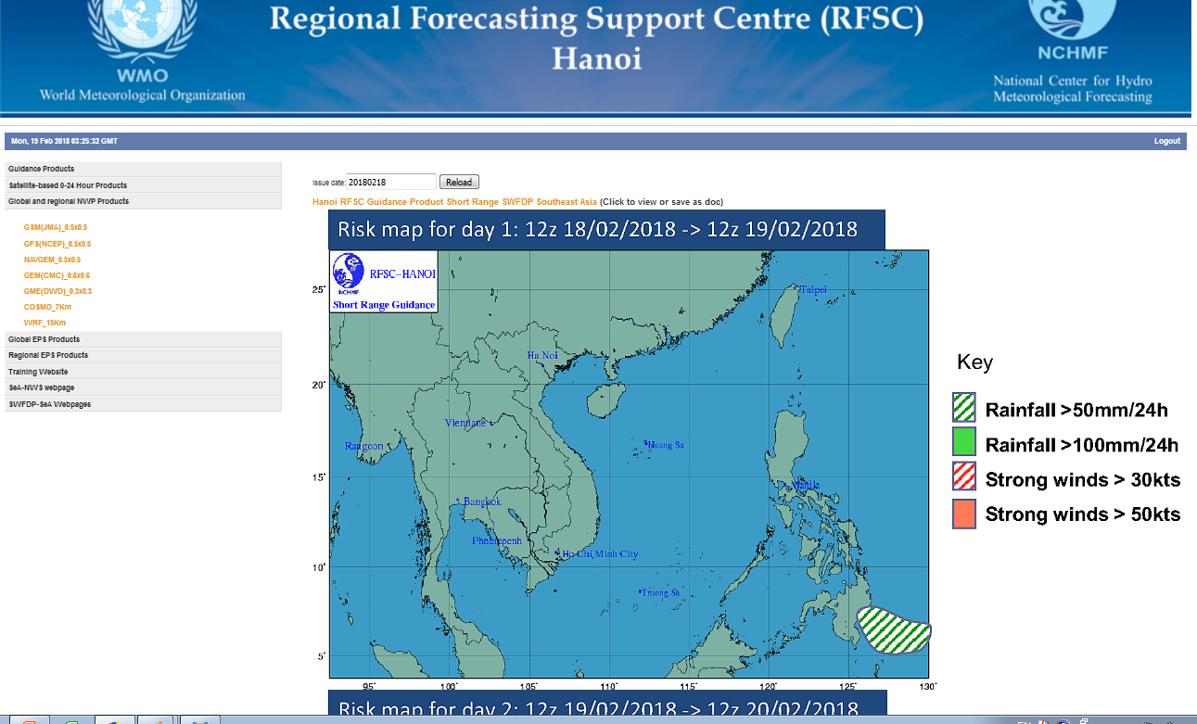
guidance products by SWFDP-sea

