Slide 1


CAP Implementation in Kenya
KENYA
METEOROLOGICAL
SERVICE
Presented by
PHILLIP OKELLO OCHIENG
Meteorologist/Research Scientist
Geosciences and Tsunami Information Services
Kenya Meteorological Service
Email: pokello@meteo.go.ke

Slide 2


Introduction (1)
KENYA
METEOROLOGICAL
SERVICE
KMS is a public service in the Ministry of Environment, Water and Natural Resources;
KMS is responsible for the organization and operational management of meteorological services in Kenya;
Generating Weather Advisories, Alerts & Warnings is the business of KMS;

Slide 3
Introduction (2)
KENYA
METEOROLOGICAL
SERVICE
CAP was introduced to KMS in late 2012;
CAP is installed in the server system and two other platforms and currently being tested, however, full implementation process is going on;
Challenges of implementation…my view
KMS has been working on an integrated solution of Alerts/Warning production & dissemination;
This integrated solution will target CAP and all those who will subscribe to it;

Slide 4
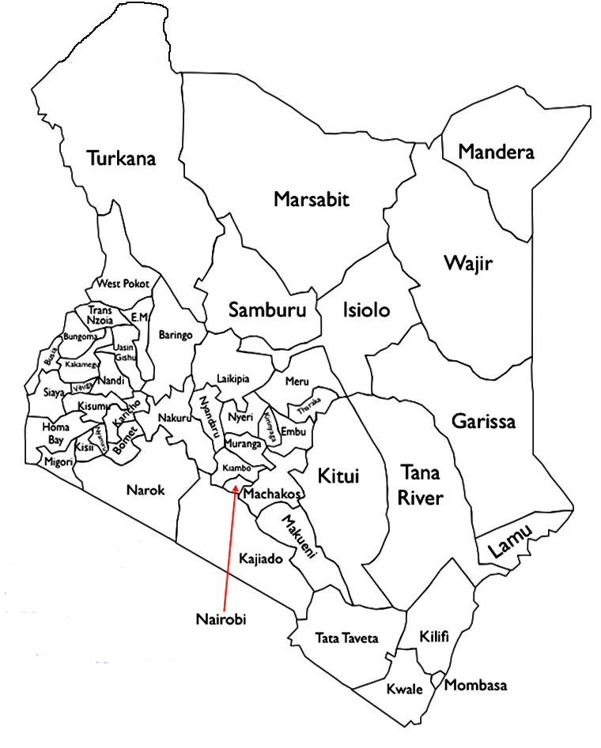
Administrative Areas
KENYA
METEOROLOGICAL
SERVICE
Kenya Comprises of 47 Counties;
Each County headed by a County Meteorological Officer or Meteorologist and;
Each County has its own Disaster Management committee.

Slide 5
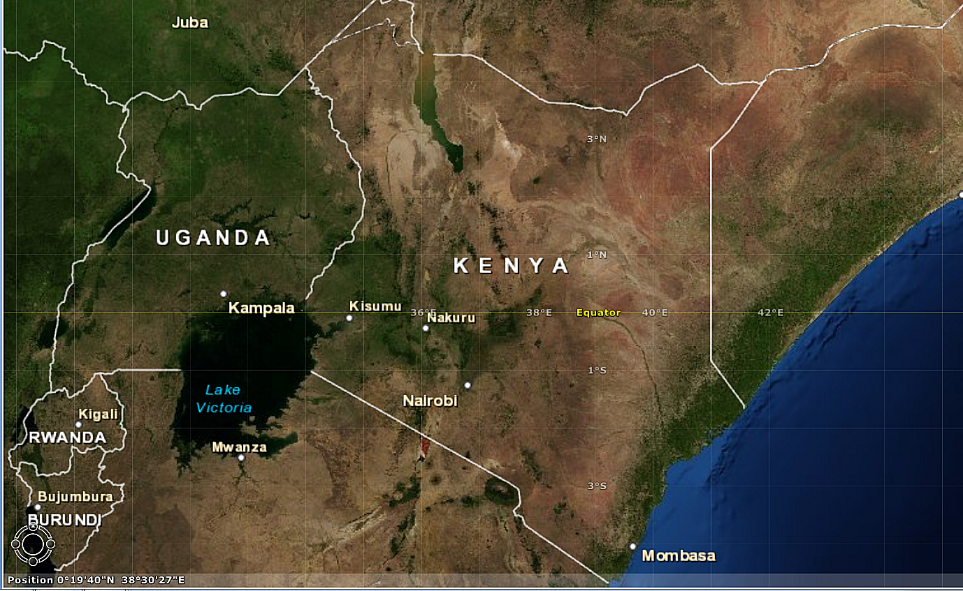
The Scope & Climate
KENYA
METEOROLOGICAL
SERVICE

Slide 6
Early Warning
KENYA
METEOROLOGICAL
SERVICE
SWFDP EW
Tsunami & Seismic EW
Flood EW
EW in the Health Sector
EW in Agriculture & Food Security

Slide 7


NMC & RSMC Early Warning
KENYA
METEOROLOGICAL
SERVICE
( For Hazards such as Floods, Heavy Rains, strong Winds and Waves)
National
TV & Radio
Local Media
Networks
RANET Radio Station
County Meteorological Officer(s)
Local Disaster Management Committee & Others
Advisories, Alerts & Warnings
Office of the President
(Advisory Committee)
Red Cross
SWFDP, RSMC-Nairobi

Slide 8

Flood Early Warning
KENYA
METEOROLOGICAL
SERVICE
( For Floods in the Bundalang’i plains- Western Kenya)
Local Media
Networks
Bundalangi RANET FM Radio Station
Flood Warnings
Busia County Meteorological Officer
Office of the President
(Advisory Committee)
Flood Diagnostics & Forecasting Centre,
FDFC-Nairobi
Disaster Management Committee (Busia County)
Red Cross

Slide 9


Tsunami & Marine Early Warning
KENYA
METEOROLOGICAL
SERVICE
Siren & Loudspeakers
National TV/Radio Networks
RANET Radio & Local Media
Beach Management Units
Local Disaster Management Committee
Tsunami Alert or Warning
County Met. Officer(s)
Hotel Operators
Kenya Maritime Authority
Office of the President
(Advisory Committee)
Kenya Ports Authority
Security Agencies
National Tsunami Warning Centre,
Nairobi
Red Cross

Slide 10
Food & Agri. Early Warning System
KENYA
METEOROLOGICAL
SERVICE
National
TV & Radio
Local Media
Networks
RANET Radio Station
Food &
Agriculture Advisories
Ministries in charge of Agriculture, Livestock, Arid lands…etc
Updates
County Met. Officer(s)
Local Disaster Management Committee & Others
Seasonal Forecaster, NMC-Nairobi
Agricultural Extension Officers
Office of the President
(Advisory Committee)
Red Cross

Slide 11
Health Early Warning System
KENYA
METEOROLOGICAL
SERVICE
National
TV & Radio
Local Media
Networks
RANET Radio Station
Health Advisories
County Met. Officer(s)
Ministry of Health
Updates
Local Disaster Management Committee
Seasonal Forecaster, NMC-Nairobi
Local Health Centers
Office of the President
(Advisory Committee)
Red Cross

Slide 12



Proposed Flow of Info thro’ CAP
KENYA
METEOROLOGICAL
SERVICE
Mobile Phone Networks
TV / Radio Networks
Local Radio Stations
NMC
HydroMet
Email / RSS feeds
County Meteorological Officer(s)
AgroMet
CAP
RSS feeds
Disaster Managers & Responders
Health
Email
Automatic Recorders
Google Public Alerts
Email / SMS
Twitter
Office of the President
(Advisory Committee)
Meteofactory
Facebook
Forecasting Centre, KMS Nairobi

Slide 13
KENYA
METEOROLOGICAL
SERVICE
Challenges in Message Categorizing

Slide 14
Aspects of Alert Message Structure
KENYA
METEOROLOGICAL
SERVICE
 | CAP | KMD
Headline/Title
Category
Response Type
Urgency
Severity
Certainty
Message Description
Instruction
Area Description

Slide 15
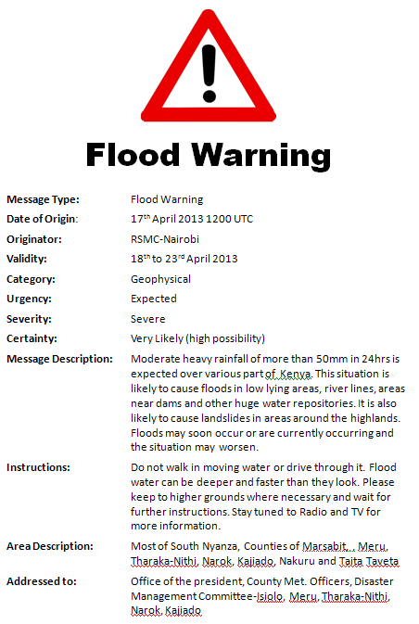
KENYA
METEOROLOGICAL
SERVICE
Why CAP?

Slide 16

Message Types
KENYA
METEOROLOGICAL
SERVICE
Before a message is constructed and disseminated, we need to classify message type based on severity and urgency ...especially if it was not done previously
Watch
Advisory
Alert
Warning

Slide 17

Message Types(1)
KENYA
METEOROLOGICAL
SERVICE
Watch
A message issued to inform vulnerable population to allow time for preparation and planning for weather threats that are expected, but will take time to arrive. They generally cover longer time periods and underline the possibility of a threat that is likely to develop in the future.

Slide 18
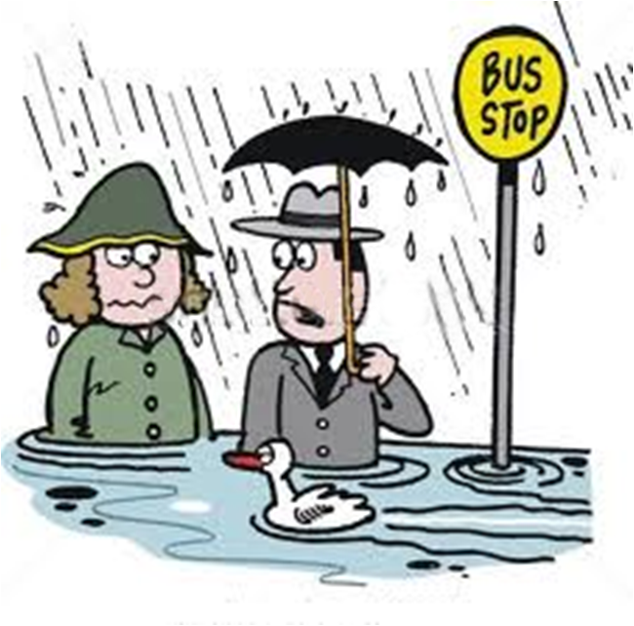
Message Types (2)
KENYA
METEOROLOGICAL
SERVICE
Advisory
A Message that is issued when weather conditions impact on the population in ways that are not a direct threat to life and property but ignoring it may lead to hazardous conditions. These conditions may be brought about by the secondary effects of the impacts that may not be obvious before the threat.

Slide 19



Message Types (3)
KENYA
METEOROLOGICAL
SERVICE
Alert
A Message issued when a threat is imminent with little time for preparation, and quick action is needed to inform vulnerable populations to avert the menace

Slide 20
Message Types (4)
KENYA
METEOROLOGICAL
SERVICE
Warning
A message issued when a threat is occurring or imminent, and immediate action to evacuate is needed to protect life and property.

Slide 21
Severity of the Hazard
KENYA
METEOROLOGICAL
SERVICE
(Generated from SWFDP Forecast Products & Others)
HAZARD | Moderate | Severe
Heavy Rainfall | > 30 mm | > 50 mm
Wave Heights (Indian Ocean) | > 1.5 meters | > 2.0 meters
Wave Heights (Lake Victoria) | > 1.5 meters | > 2.0 meters
Hot Conditions | 35 - 40ºC | > 40ºC
Cold Conditions | < 10ºC | < 5ºC
Wind Gusts (Wind Speed) | 25-35 Knots | > 35 knots

Slide 22
Severity of the Hazard
KENYA
METEOROLOGICAL
SERVICE
(Generated from SWFDP Forecast Products & Others)
HAZARD | Moderate | Severe
Agricultural Drought | >10 days dry spell | >15 days dry spell
Health | ----- | ----
Tsunami | ----- | ----
Thick Fog | ---- | ----
Lightning | ---- | ----
Hailstorm | ---- | ----
Frost | ---- | ----

Slide 23


Alerts & Warnings
(Generated from River Gauge Levels)
KENYA
METEOROLOGICAL
SERVICE
 | ALERT | WARNING
River Gauge | 4 to 5 meters | > 5 meters
Remarks | Get prepared to leave to higher & Safer grounds | Above this point flooding can occur depending on strength of the dykes. Evacuate immediately.

Slide 24

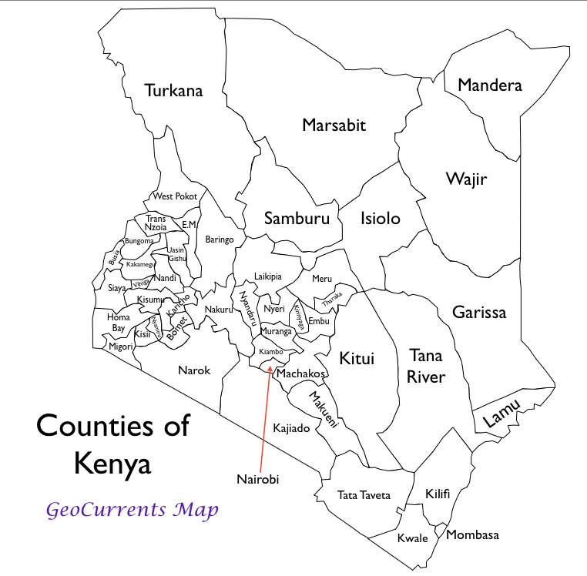

Disaster Management Org. 15
Media (Radio) 116
Media (RANET Radio) 4
Media (TV ) 20
County Meteorologists 47
Mobile Phone Networks 5
Internet-Data Networks 2
KENYA
METEOROLOGICAL
SERVICE
Who are the Potential CAP Message Users & Aggregators ?

Slide 25
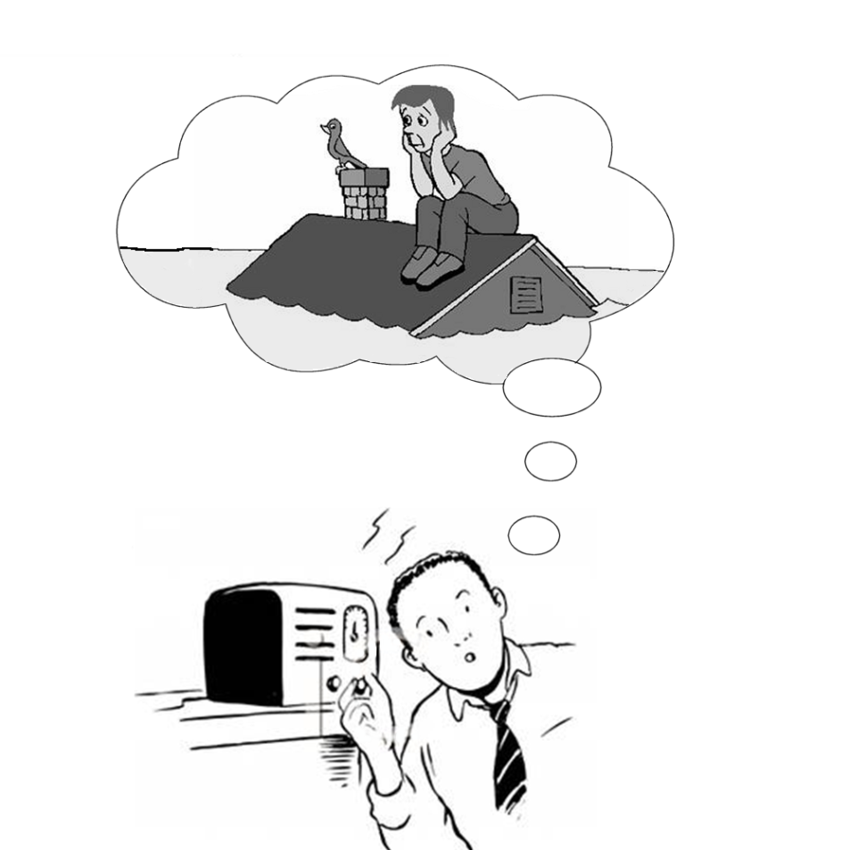
Media Exposure
KENYA
METEOROLOGICAL
SERVICE
Why More Emphasis on FM Radio ?
Radio 74%
Mobile Phones 63%
TV 28%
Computers(Internet) ~4%
(based on population census, 2009)

Slide 26
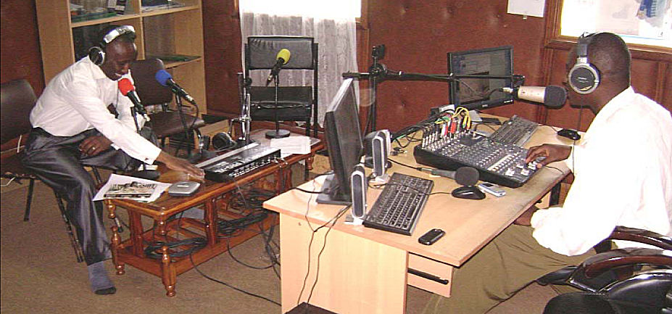
Alerts & Warnings thro’ RANET Radio
KENYA
METEOROLOGICAL
SERVICE
Community based Radio Stations
4 operating in vulnerable population areas
Effective in Alerts & Warnings dissemination
To be part of the CAP community

Slide 27

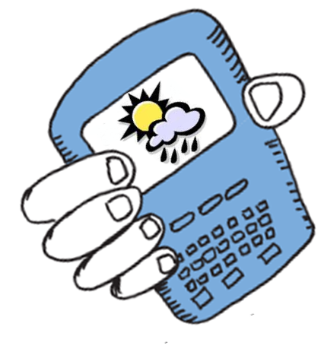
Alerts thro’ Mobile Phone Networks
KENYA
METEOROLOGICAL
SERVICE
Currently we are working with one of the networks to give daily weather forecasts
Alerts and Warnings are about to be included
We intend to extend to other Networks

Slide 28
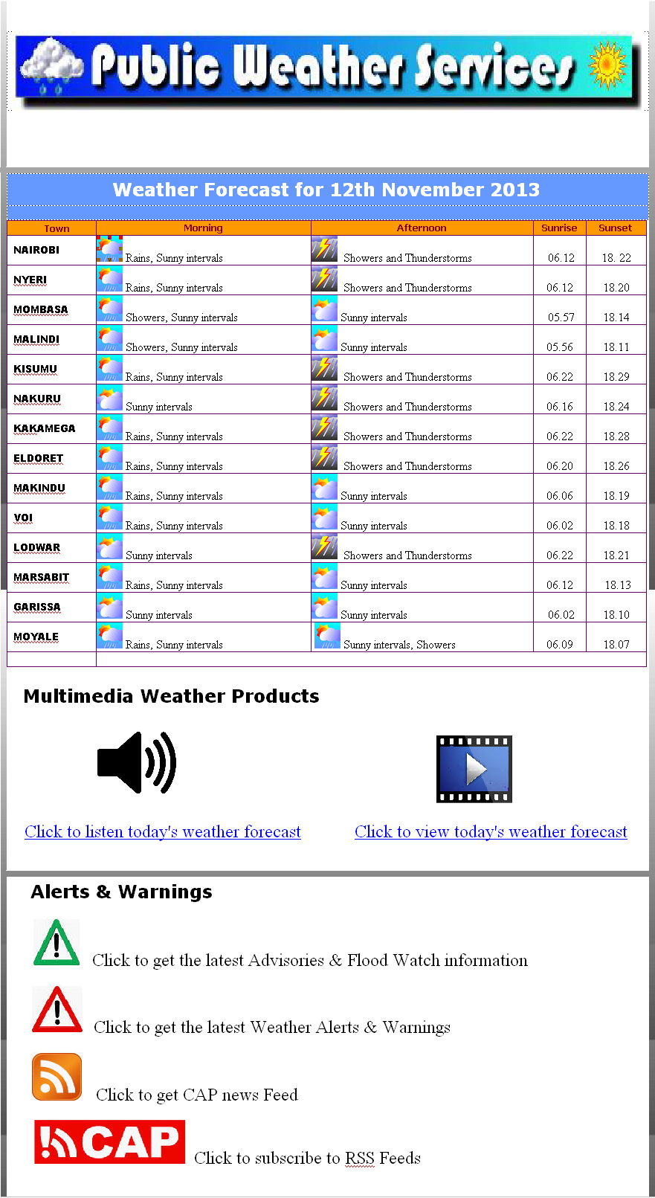
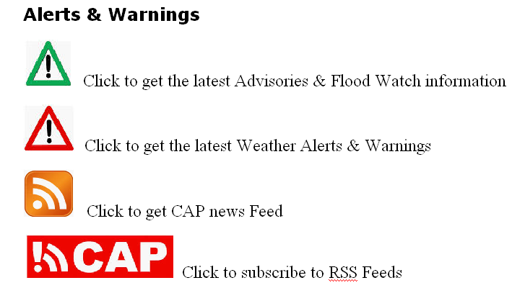
Publishing CAP Messages
KENYA
METEOROLOGICAL
SERVICE

Slide 29
Way Forward…
KENYA
METEOROLOGICAL
SERVICE
Activity | Period
Complete Translation of the KMD Messages to the CAP Format | May 2013
Complete list of possible CAP Community Affiliate in Kenya | Sep 2013
CAP Identifiers & Registration | Dec 2013
Google Alerts & Mapping Tools | Dec 2013
CAP Trial Period | 1st half of 2014
Full Implementation of CAP | 2nd half of 2014

Slide 30


Slide 31
Thank You !

