Slide 1
TANZANIA METEOROLOGICAL AGENCY
CAP in TZ: Success and Challenges
Common Alerting Protocol (Cap) Implementation Workshop Negombo, Sri Lanka, 17-18 June 2014
By
Victor J. Massam
Victor.massam@meteo.go.tz

Slide 2
OUTLINE
Success
Challenges
Recommendations
Notes:
0767416215
ore knowledge of data-set is required because of some technical concepts (Backups, Updating Data, Change to swahili, Create New maproom with new dataset) D. Policy of data usage from National to district level 1. observations(Upper Air, AWS, Operational stations) 2. data transmissions(Telephones, Internet, Networking) 3. Processing (Cluster computer, Satellite imaginary, Models comparisons, Data catalogs--> Maproom ) 4. Dissemination (TV, Radios, SMS, Website, RSS Feeds, Weather apps, Maproom)

Slide 3
Tanzania Meteorological Agency is the Government institution dealing meteorological services at the United republic of Tanzania
Notes:
0767416215
ore knowledge of data-set is required because of some technical concepts (Backups, Updating Data, Change to swahili, Create New maproom with new dataset) D. Policy of data usage from National to district level 1. observations(Upper Air, AWS, Operational stations) 2. data transmissions(Telephones, Internet, Networking) 3. Processing (Cluster computer, Satellite imaginary, Models comparisons, Data catalogs--> Maproom ) 4. Dissemination (TV, Radios, SMS, Website, RSS Feeds, Weather apps, Maproom)

Slide 4
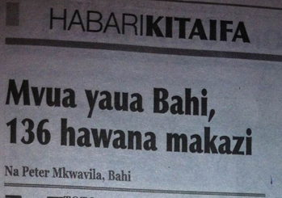
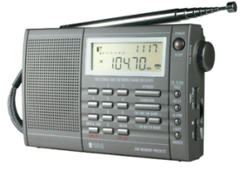
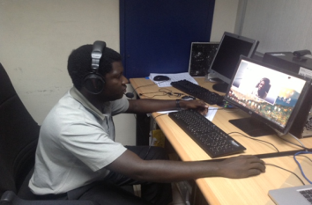
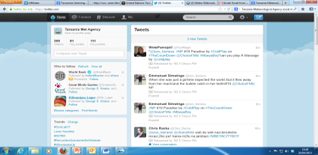
Timely Dissemination Information, Alert / Advisory and Warning to the Public for the Protection of Life and Property
Television
Radio/
Newspaper
Common Alerting
Protocol (CAP)
Alerting Source
Phone/SMS
Teleconferencing
Social
Media
Disaster Recovery Department
Red Cross , DCs, RCs
Website; E-mails; Google
PWS Alert/ Advisory/ Warning System
4
Notes:
This concept enhances alerting capability in two critical ways:
1 – increases the reliability that a citizen will receive an alert via at least one path
2 – increases likelihood that citizen seriously considers the alert because alert information available for verification/corroboration via multiple media paths

Slide 5
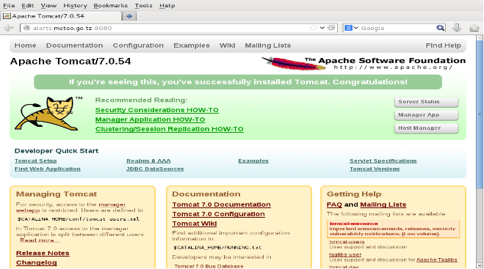
Success
Full Installation, Customisation and Upgrade in Linux environment as well as https certificate installation (https://alerts.meteo.go.tz)
CAP Can be edited world wide if the internet access exists because tomcat is at http://alerts.meteo.go.tz:8080
Notes:
0767416215
ore knowledge of data-set is required because of some technical concepts (Backups, Updating Data, Change to swahili, Create New maproom with new dataset) D. Policy of data usage from National to district level 1. observations(Upper Air, AWS, Operational stations) 2. data transmissions(Telephones, Internet, Networking) 3. Processing (Cluster computer, Satellite imaginary, Models comparisons, Data catalogs--> Maproom ) 4. Dissemination (TV, Radios, SMS, Website, RSS Feeds, Weather apps, Maproom)

Slide 6
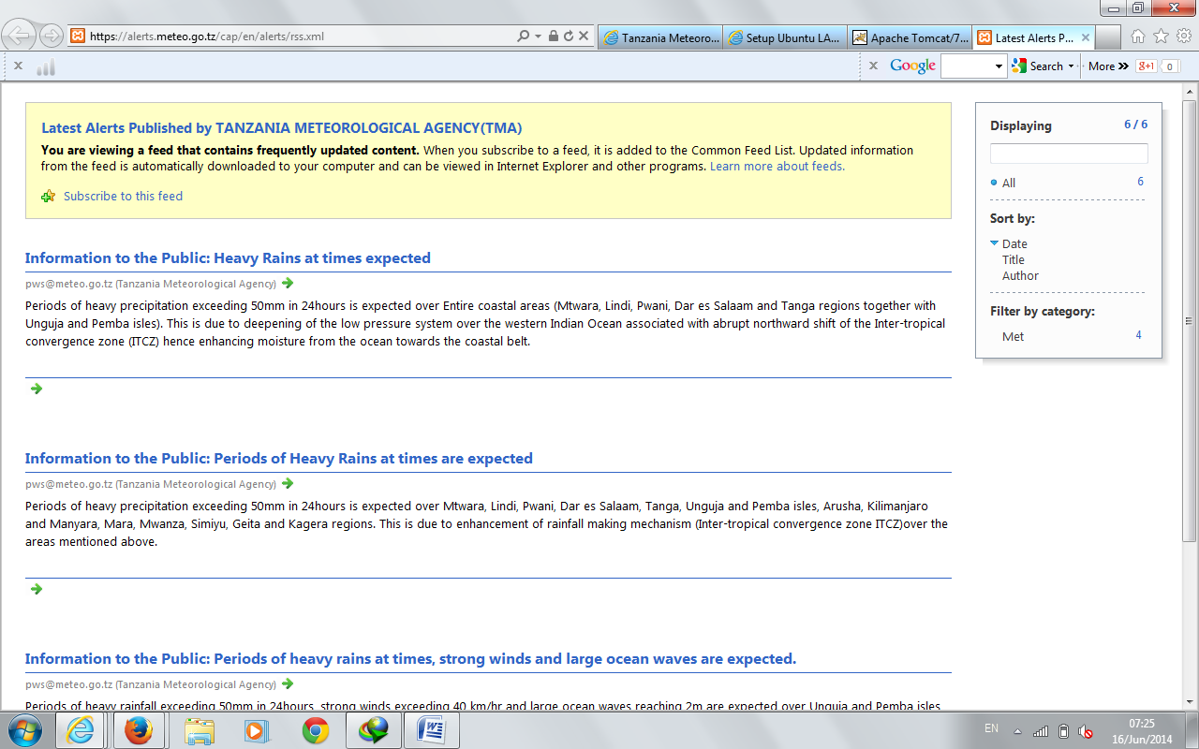
Success
Once warning is posted, They appear on the website where RSS installation (https://alerts.meteo.go.tz)
Any type of Weather warning are posted here
Notes:
0767416215
ore knowledge of data-set is required because of some technical concepts (Backups, Updating Data, Change to swahili, Create New maproom with new dataset) D. Policy of data usage from National to district level 1. observations(Upper Air, AWS, Operational stations) 2. data transmissions(Telephones, Internet, Networking) 3. Processing (Cluster computer, Satellite imaginary, Models comparisons, Data catalogs--> Maproom ) 4. Dissemination (TV, Radios, SMS, Website, RSS Feeds, Weather apps, Maproom)

Slide 7
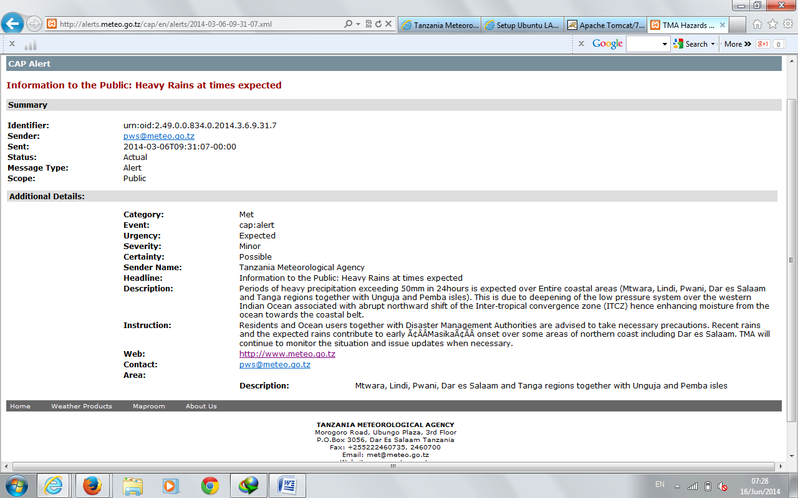
Success
Information to users
Notes:
0767416215
ore knowledge of data-set is required because of some technical concepts (Backups, Updating Data, Change to swahili, Create New maproom with new dataset) D. Policy of data usage from National to district level 1. observations(Upper Air, AWS, Operational stations) 2. data transmissions(Telephones, Internet, Networking) 3. Processing (Cluster computer, Satellite imaginary, Models comparisons, Data catalogs--> Maproom ) 4. Dissemination (TV, Radios, SMS, Website, RSS Feeds, Weather apps, Maproom)

Slide 8
Success
Creating mail list; once alert is published to RSS feeds on the website information is also published to the e-mail pws.gmail@gmail.comt and finally the message send to the particular group
Users
Sample Message to users
Notes:
0767416215
ore knowledge of data-set is required because of some technical concepts (Backups, Updating Data, Change to swahili, Create New maproom with new dataset) D. Policy of data usage from National to district level 1. observations(Upper Air, AWS, Operational stations) 2. data transmissions(Telephones, Internet, Networking) 3. Processing (Cluster computer, Satellite imaginary, Models comparisons, Data catalogs--> Maproom ) 4. Dissemination (TV, Radios, SMS, Website, RSS Feeds, Weather apps, Maproom)

Slide 9
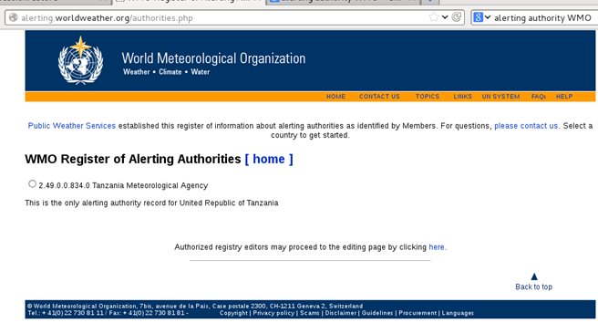
Success
Registration to alerting authority has been done
Notes:
0767416215
ore knowledge of data-set is required because of some technical concepts (Backups, Updating Data, Change to swahili, Create New maproom with new dataset) D. Policy of data usage from National to district level 1. observations(Upper Air, AWS, Operational stations) 2. data transmissions(Telephones, Internet, Networking) 3. Processing (Cluster computer, Satellite imaginary, Models comparisons, Data catalogs--> Maproom ) 4. Dissemination (TV, Radios, SMS, Website, RSS Feeds, Weather apps, Maproom)

Slide 10
Success
System testing exercise has been conducted for a period of 3 months
Internal training on how to edit warning templates and publishing has being conducted
Up to now 4 Actual warnings has been published “Information was expected proved successfully”
Notes:
0767416215
ore knowledge of data-set is required because of some technical concepts (Backups, Updating Data, Change to swahili, Create New maproom with new dataset) D. Policy of data usage from National to district level 1. observations(Upper Air, AWS, Operational stations) 2. data transmissions(Telephones, Internet, Networking) 3. Processing (Cluster computer, Satellite imaginary, Models comparisons, Data catalogs--> Maproom ) 4. Dissemination (TV, Radios, SMS, Website, RSS Feeds, Weather apps, Maproom)

Slide 11
IMPLANTATION STATUS
S/N | ACTIVITY | STATUS
1 | Installation and Customization | Completed
2 | Purchase and Install HTTPS certificate | Completed
3 | Make available to Users(Accessibility) | Completed
4 | Enable World Wide CAP editing | Completed
5 | Registrations: Alerting Authority | Completed
6 | Internal User Training (CAP Editor) in CAP Jump workshops | Completed
7 | Summarize CAP message to suit standard GSM messages and enable reach to users | On Progress
8 | Customize Swahili Version | On Progress
9 | Receive feedback from users(Trough Magazines, Social network sites, and E-mails) | Continuously
10 | Include multimedia effect on CAP message | Continuously
11 | System Maintenances | On Progress
12 | Observe bellow challenges | Not Completed
Notes:
0767416215
ore knowledge of data-set is required because of some technical concepts (Backups, Updating Data, Change to swahili, Create New maproom with new dataset) D. Policy of data usage from National to district level 1. observations(Upper Air, AWS, Operational stations) 2. data transmissions(Telephones, Internet, Networking) 3. Processing (Cluster computer, Satellite imaginary, Models comparisons, Data catalogs--> Maproom ) 4. Dissemination (TV, Radios, SMS, Website, RSS Feeds, Weather apps, Maproom)

Slide 12
Challenges
Frequency Power cuts (Sometimes system is offline)
Web knowledge is need
CSS some browsers can not open
Google polygons to appear on users view, It appears only coordinates
Plotting multiple location on Google image (How can shed multiple points)
Notes:
0767416215
ore knowledge of data-set is required because of some technical concepts (Backups, Updating Data, Change to swahili, Create New maproom with new dataset) D. Policy of data usage from National to district level 1. observations(Upper Air, AWS, Operational stations) 2. data transmissions(Telephones, Internet, Networking) 3. Processing (Cluster computer, Satellite imaginary, Models comparisons, Data catalogs--> Maproom ) 4. Dissemination (TV, Radios, SMS, Website, RSS Feeds, Weather apps, Maproom)

Slide 13
Challenges
Make CAP on the smart phones version not applicable regard of its importance
ICT infrastructure
RSS shall be linked to the website, Website is hosted by ISP it was difficult to access document root for installation and Configuration(JAVA, Tomcat, Apache e.t.c). TMA has decided to use dedicated PC, Make all necessary installation and Configurations and Linked to the website
“The Common Alerting Protocol (CAP) provides an open, non-proprietary digital message format for all types of alerts and notifications” How can CAP reach to all other sectors – Transport, Tourism, Fisheries etc (In Tanzania CAP is adopted only on met services)
Notes:
0767416215
ore knowledge of data-set is required because of some technical concepts (Backups, Updating Data, Change to swahili, Create New maproom with new dataset) D. Policy of data usage from National to district level 1. observations(Upper Air, AWS, Operational stations) 2. data transmissions(Telephones, Internet, Networking) 3. Processing (Cluster computer, Satellite imaginary, Models comparisons, Data catalogs--> Maproom ) 4. Dissemination (TV, Radios, SMS, Website, RSS Feeds, Weather apps, Maproom)

Slide 14
Recommendations
Cloudy installation would eliminate the issue of power cuts
Deep knowledge on Web tools and Google is vey essential
Awareness of CAP to other sectors within the country(e.g. Transportation Sector) and Other countires in Africa too
Notes:
0767416215
ore knowledge of data-set is required because of some technical concepts (Backups, Updating Data, Change to swahili, Create New maproom with new dataset) D. Policy of data usage from National to district level 1. observations(Upper Air, AWS, Operational stations) 2. data transmissions(Telephones, Internet, Networking) 3. Processing (Cluster computer, Satellite imaginary, Models comparisons, Data catalogs--> Maproom ) 4. Dissemination (TV, Radios, SMS, Website, RSS Feeds, Weather apps, Maproom)

Slide 15
With CAP, Information reach to many users very quickly THANK YOU
Notes:
0767416215
ore knowledge of data-set is required because of some technical concepts (Backups, Updating Data, Change to swahili, Create New maproom with new dataset) D. Policy of data usage from National to district level 1. observations(Upper Air, AWS, Operational stations) 2. data transmissions(Telephones, Internet, Networking) 3. Processing (Cluster computer, Satellite imaginary, Models comparisons, Data catalogs--> Maproom ) 4. Dissemination (TV, Radios, SMS, Website, RSS Feeds, Weather apps, Maproom)

