Slide 1
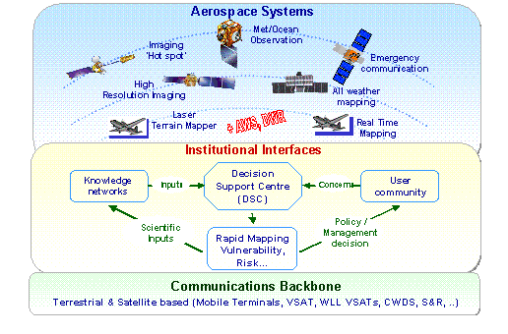
CAP Implementation;
In
Developing World Perspective
Azmat Hayat Khan
Director PMD
director@pmd.gov.pk
1

Slide 2
Implementation of Effective CAP alerting requires a road map
What available with targeted communities
Since CAP is a protocol for exchanging messages between alerting technologies
Mobile / Cell broadcast /Radio /TV presentation
How CAP alerting be integrated with their system
What freeware / applets may be promoted to achieve CAP implementation.
How CAP may digest ALERTING NEEDS
Message Content
2

Slide 3
Implementation of Effective CAP alerting requires a road map
PC based templates for CAP compliant customized message
Appropriate and Convincing Effective Alert /Warning Messages
Issuing authority be able to customize ALERT
3

Slide 4
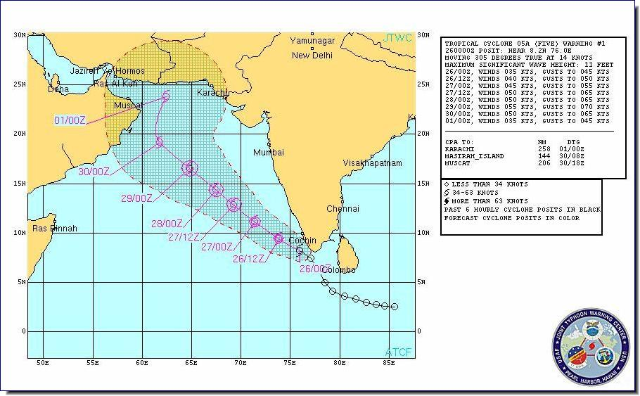
Implementation of Effective CAP alerting requires a road map
Cyclone WARNING
in effect
Alert Message | Supplementalry Info
Headline | Wave Height
SMS text | Cyclone Arrival Time
 | 07:11 am
TV crawler | Arrival Direction
PASNI
Cyclone warning for PASNI
06 meters
WARNING: Cyclone will hit PASNI
WARNING: Cyclone will hit PASNI at 07:11 am. Mover to safer place
From 210 degrees SW
4

Slide 5
Recommendation
FOCUS more around the
Message Content
and
Public Alerting Tools
to achieve the goal of “Resilient Society“
5

Slide 6
UNDERSTAND the Risks of Climate Change
COMMUNICATE the Risks of Climate Change
THANKS
dirndmc@gmail.com

