Slide 1
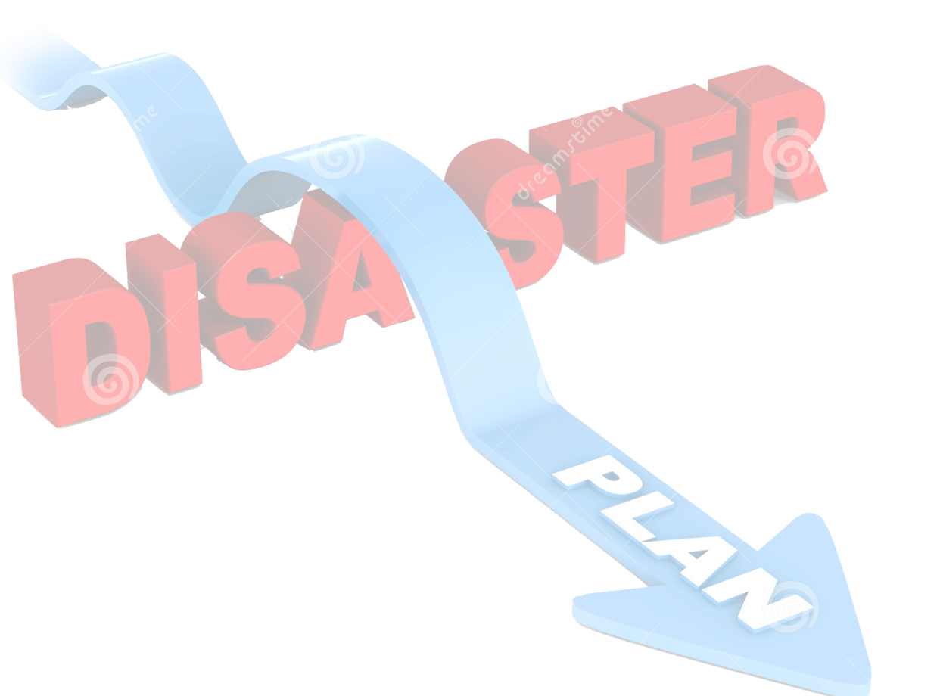
Common Alerting Protocol (CAP) Implementation Workshop – 2014
ArcGIS Geotrigger for
CAP Implementation
18th June 2014
by
Nalaka Kodippili
Geo Technical Manager
GIS Solutions (Private) Limited

Slide 2
Technology?
“Technology is always ahead of the organization’s ability to use it effectively” (Carmi)
Here’s Why …

Slide 3
GIS Is Changing How We Think & Act?
Integrating Geographic Science into What We Do
Design
Evaluate
Plan
Decide
Prepare
Act
Predict
Analyze
Manage
Measure
We Need to Embrace This Approach . . . Making It Pervasive
Involving Our Organizations and All of Us

Slide 4
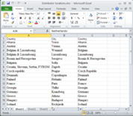
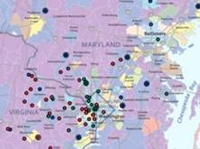
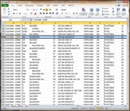
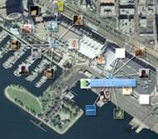
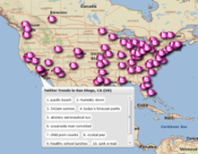
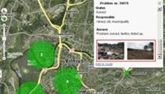
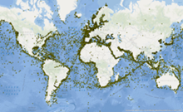
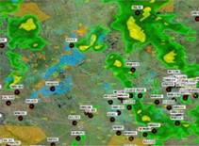
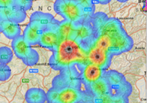
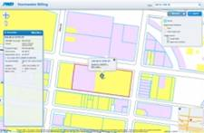
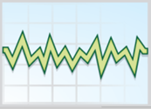
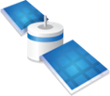
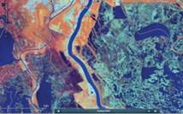
ArcGIS Integrates All Types of Information
Maps
Spreadsheets
Social Media
Big Data
Services
DBMS
Sensor
Networks
Imagery
Web Maps Normalize The Information . . .
. . . And Make It Accessible Widely
Notes:
Cloud GIS integrates all types of geospatial information. Maps, of course, and data, imagery, the new dimensions of social media, and crowdsourced information, and sensor networks. As we wire up the world, we can bring this together in a platform which is accessible. And web maps, this new media that we're working with, make this information widely accessible in simple forms.

Slide 5
Real-time GIS Data
Real-time GIS data is a continuous stream of events flowing from sensors, where each event represents the latest state of the sensor.
Emergency response
Utility networks
Defence
Environmental
Challenge #1
Features
Police Car
Police Person
Ambulance
Network Sensor
Applications
Warehouse Item
Storm
Wind
110°
Temperature
Earthquake
Wild Fire
Notes:
GT
So what is Real-time GIS data? Well, we can characterized it as a (read slide)…
Let’s explore some examples of how real-time GIS data could be utilized:
- Emergency responders might want real-time map of their assets in the field
Each vehicle may be equipped with an in-vehicle GPS device
officers may have a radio that transmits their location
- Utility companies may want to visually represent the live status of their network, with information that’s captured by sensors in the field
While the sensors on the network don’t move, their status can update and change very rapidly.
- RFID can be used in wide variety of environments to keep track of items of interest
Warehouses use RFID to monitor inventory levels
Hospitals track equipment to make sure it’s gone through proper cleaning procedures before entering patients room
Can also be used to Keep track of personnel in volatile workplace environments, such as an on oil rig
- There’s a wealth of Volunteered Geographic Information (VGI) available. It can be leveraged for additional context for situational awareness.
CLICK
Modeling each of these with features in ArcGIS is easy, the challenge comes in when we try to integrate it as real-time GIS data.
- Reason – so many different kinds of data sources, devices, and sensors and each communicates with different protocols and with widely varying formats
- So, connecting and receiving the real-time data from this wide variety of sources is the 1st Challenge of real-time GIS.

Slide 6
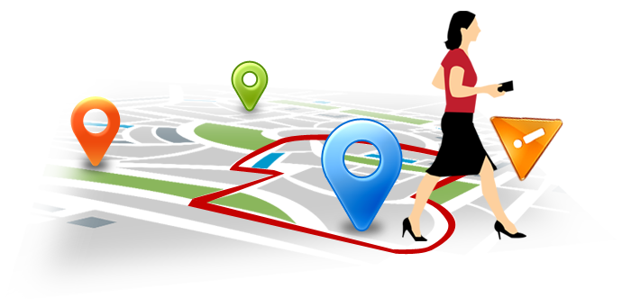
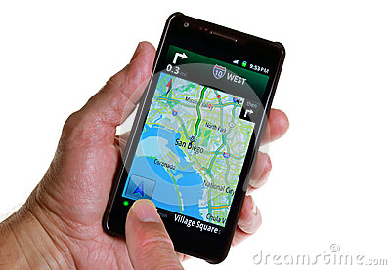
Geotrigger?
Geotrigger: An invisible button or geofence that will execute an action when a condition is satisfied. When the mobile device enters (or leaves) the trigger area, the Geotrigger Service will send a notification to the device or to your server.
It is composed of two components:
Condition : a geometry (polygon or circle) and a direction (enter or leave)
Action : message, callback URL or change tracking profile
The Esri Geotrigger Service provides real-time location tracking, geofencing, and messaging tools for developers working on location based apps

Slide 7
Advantages
Battery-safe geofencing
Automatically adjusts GPS checks to optimize for accuracy while minimizing battery consumption, or rough tracking profile.
Flexible API - JavaScript, Ruby, Python or Go
For a variety of use cases in government, tourism, public safety and marketing.
Less work for you
Develop for iOS and Android on a common platform, no need to manage the frequency of GPS checks, and use tags to simply control which devices will set off which triggers.
Improvements over native geofencing
Complex polygon geofences and easily add unlimited triggers, all while remaining on par with native iOS and Android performance.
The Geotrigger Service runs in the cloud
The Geotrigger Service provides a new level of functionality for your apps
The sky is the limit

Slide 8
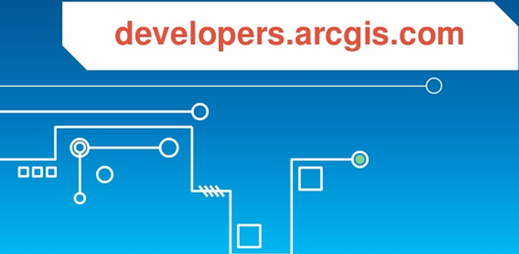
Getting Started
1. Create an account at:
developers.arcgis.com or sign in if you already have an ArcGIS account
2. Create an application:
developers.arcgis.com/en/applications/
For: Mobile SDKs
Web APIs
Battery Management
Tracking Profiles
Add the power of location to your app with the Geotrigger Service. With your free developer account, add the Geotrigger SDK to your iPhone or Android app and start creating trigger locations and actions.

Slide 9
Geotrigger APIs
All requests to the Geotrigger API must be made with an access token.
An access token can be obtained using the ArcGIS Portal API.

Slide 10
API requests to the Geotrigger API are made to geotrigger.arcgis.com.
API requests to the Geotrigger API are made to geotrigger.arcgis.com.
Geotrigger Tools
Geotrigger Editor
Geotrigger Faker
Geotrigger.js4
Geotrigger Python
Geotrigger Ruby
Geotrigger Golang
The Geotrigger Editor is a browser tool for creating and editing triggers within the Geotrigger Service.
Features
Draw trigger boundaries on a map
List all of an application’s triggers
Create, Edit and Delete trigger conditions, actions, and boundaries
Search for triggers by tag, title, or ID
For more Details: https://developers.arcgis.com/documentation/

Slide 11
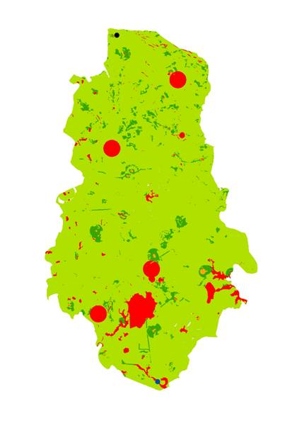
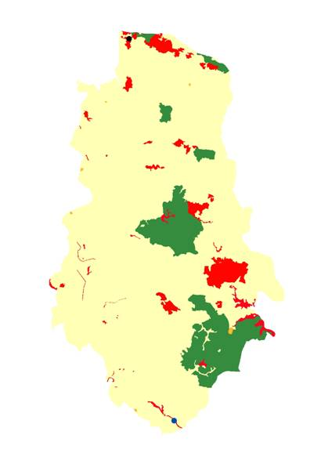
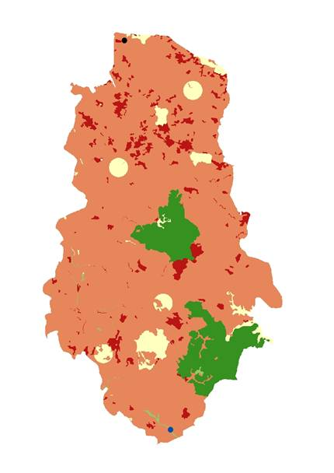
Importing Available Spatial Data
You may already have geographic data in a Feature Service and wish to use those features as triggers in the Geotrigger Service.
There is an open source command line script available on GitHub that you can use to import data from your publically available feature services into the Geotrigger Service.

Slide 12
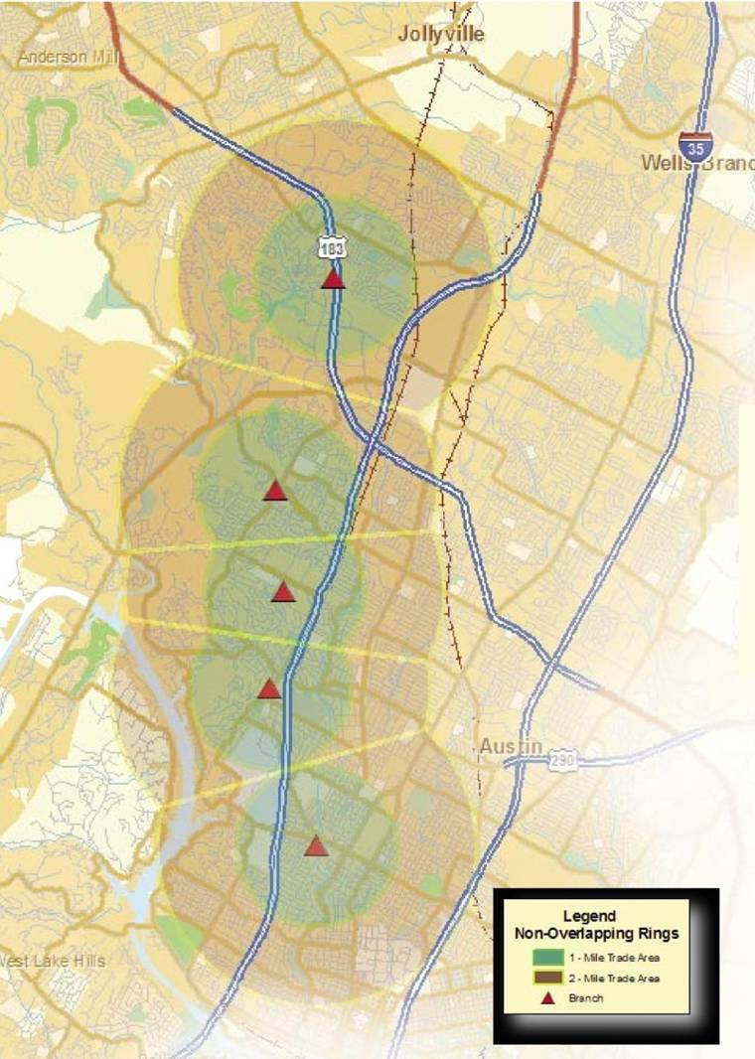
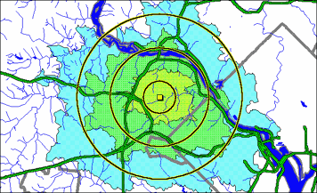
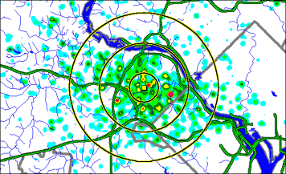
Location Analysis
5 min.
10 min.
15 min.
Travel time…
Buffering and breakpoints…
Incidents data…

Slide 13
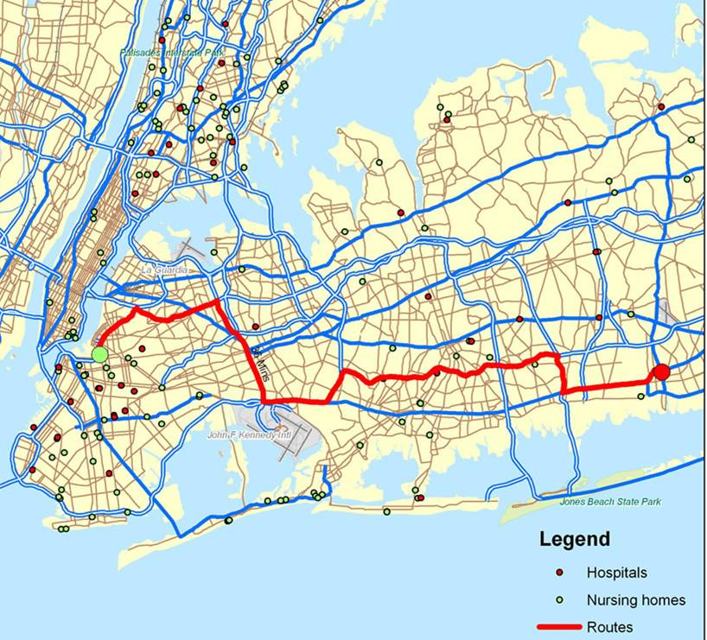
Defining the Quickest Path
Could be used to,
New Route Planning
Any Incident
Risk Management
(Fire, disaster, Flooding etc.)

Slide 14
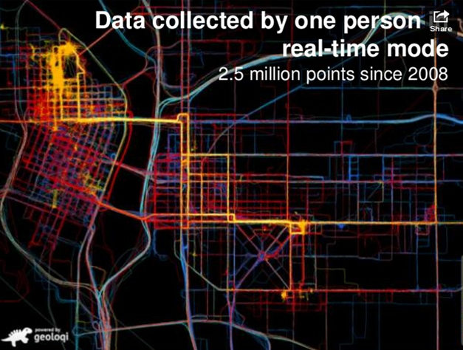
Tracing Profiles
Real –time mode
Sends accurate location as fast as possible
Least battery efficient
Logging
Tracks location data in areas of low connectivity
Sends to the server later or when a connection re-occurs

Slide 15
ArcGIS: A Complete System
A Complete Geospatial Platform
Online
Apps & Applications
Web
Back Office
Infrastructure
Devices
Server
Desktop
Content & Services
For both the Internet and secure government networks
Easy, Open and Cloud Enabled . . .
. . . Providing Transformational Opportunities

Slide 16
Questions & Answers
Thank you
nalaka@gislk.com
+94 714 951 928

