Slide 1


Slide 2

HOW CAN WE WORK TOGETHER IN AN UNPRECENDENTED WAY TO PROVIDE LIFE-SAVING INFORMATION AROUND THE WORLD?
The FIA was started in 2013 through an ad tech partnership with
the National Center for Missing and Exploited Children in 2011.

Slide 3
FIA’S MISSION STATEMENT
Our mission is to be a facilitator for Internet technology and services collaboration among companies, non-governmental organizations, and alerting authorities to promote standards-based, all-hazards, all-media, authoritative alerting to individuals in societies worldwide.

Slide 4

A MISSION TO SAVE LIVES
On April 7th, 2014, John Ryan, President and CEO of the National Center for Missing and Exploited Children, hosted the first FIA Forum. The event was attended by leading internet technology companies and alerting authorities.

Slide 5

AMBER ALERTS

Slide 6

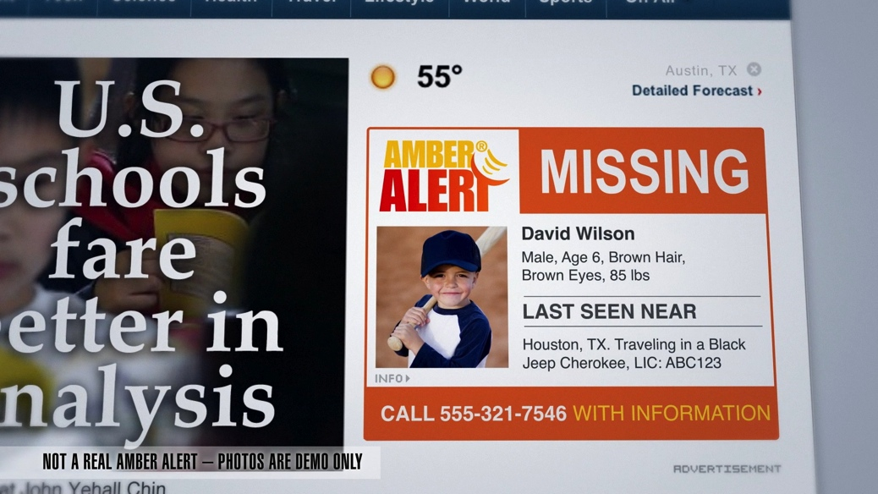
WEATHER ALERTS
NOT A REAL AMBER ALERT- PHOTOS ARE DEMO ONLY
AMBER ALERTS

Slide 7

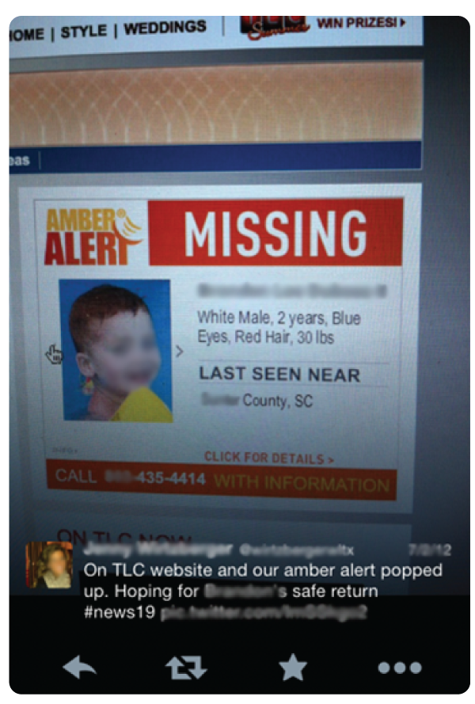

AMBER ALERTS

Slide 8
MESSAGED VISITS
TO AMBER ALERT’S WEBSITE DURING ABDUCTIONS.
3.2 M
ALL TRAFFIC IS GEO-TARGETED.
MORE THAN
430 MILLION
AMBER ALERTS IMPRESSIONS SERVED
93
MILLION UNIQUES

Slide 9

WEATHER ALERTS

Slide 10

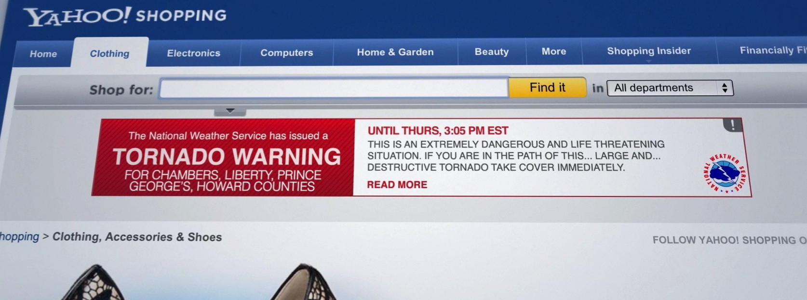
WEATHER ALERTS

Slide 11
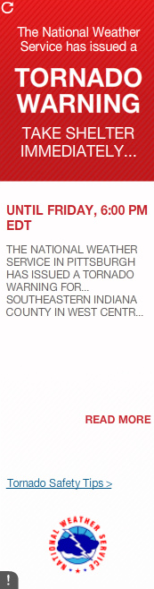
March 3rd, 2013
Dear Honorable Representatives,
I am a husband, a father of three children and am the writer of the online blog Plus Five Gear.
I am writing this letter to share with you my personal experiences and thoughts on
the Emergency Messaging System.
My family, like many others, is finding great value in using online services. We do not watch television, so systems like the Emergency Alert System (EAS) presently in place do not generally reach us. One rainy night, my wife noticed a rumor going around on a social media site that there was a tornado watch for our area. While attempting to investigate further, I discovered a banner ad from the National weather Service with information about the tornado warning for our immediate area. This gave me far more detailed information than that which we had heard over social media. With that information, we were able to take precautions, and were able to contact those people we know that might have been in the affected area. Eventually, the tornado did come within 2 miles of our home. Thanks to the early warning we also were able to reach out to others we know that may have been in the path to ascertain their situation and help where needed.
This system is of great value to the modern connected masses: the earlier we know about a possible natural disaster, the more of a chance we have to prepare ourselves for it. Please give the Emergency Messaging system all the support you can, this system has the potential to save many lives.
Sincerely,
Jeffrey C. Anthony
PO Box 123. Murrysville, PA 15668-0132

Slide 12
P
P
XML
XML
P
NCMEC
CNVR
ALERT
P
P

Slide 13
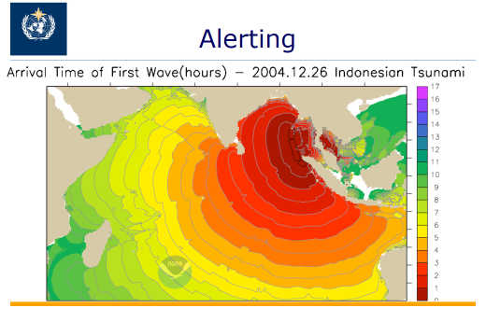
What if devices had built-in responsive technologies that were flexible, could support message continuity, creativity, and cross device capability with both legacy and new devices in the future?
The FIA understands how to collaborate on these issues and seeks to help alerting authorities reach the public at the right time, in the right location, and with the right message.

Slide 14
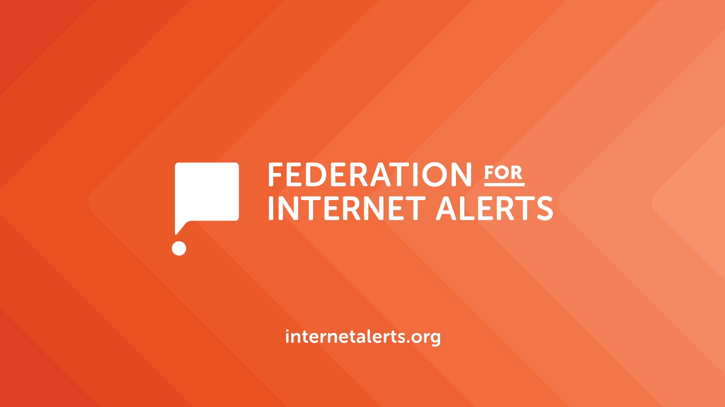
REAL-TIME FIA ALERTS
Imagine this situation for an alerting authority: the Indian Ocean Tsunami in December 2004. An alerting authority becomes aware of a killer event, with thousands of lives at risk, but there is no way to get out the alert. You don't even know who is in charge of alerting in all the threatened countries. Even when you do connect, how can those authorities alert everyone at risk?
The map above shows the path of the first Tsunami wave, with each color representing an hour of time for the Tsunami to move. With proper alerting in place, hundreds of thousands of casualties could have been avoided.
- Eliot Christian, World Meteorological Organization & Founder of Common Alerting Protocol (CAP)
FIA MESSAGING WILL BE GLOBAL

Slide 15
REAL-TIME FIA ALERTS
Imagine this situation for an alerting authority: the Indian Ocean Tsunami in December 2004. An alerting authority becomes aware of a killer event, with thousands of lives at risk, but there is no way to get out the alert. You don't even know who is in charge of alerting in all the threatened countries. Even when you do connect, how can those authorities alert everyone at risk?
The map above shows the path of the first Tsunami wave, with each color representing an hour of time for the Tsunami to move. With proper alerting in place, hundreds of thousands of casualties could have been avoided.
- Eliot Christian, World Meteorological Organization & Founder of Common Alerting Protocol (CAP)
FIA MESSAGING WILL BE GLOBAL
Notes:
15

Slide 16
REAL-TIME FIA ALERTS
Imagine this situation for an alerting authority: the Indian Ocean Tsunami in December 2004. An alerting authority becomes aware of a killer event, with thousands of lives at risk, but there is no way to get out the alert. You don't even know who is in charge of alerting in all the threatened countries. Even when you do connect, how can those authorities alert everyone at risk?
The map above shows the path of the first Tsunami wave, with each color representing an hour of time for the Tsunami to move. With proper alerting in place, hundreds of thousands of casualties could have been avoided.
- Eliot Christian, World Meteorological Organization & Founder of Common Alerting Protocol (CAP)
FIA MESSAGING WILL BE GLOBAL
Notes:
16

Slide 17
WHICH ORGANIZATIONS
JOIN FIA?
SUPPORTING AUTHORITIES
AND PARTNERS

Slide 18
WHICH ORGANIZATIONS
ARE CURRENTLY INVOLVED?
GROUPM/XAXIS
SPECIFIC MEDIA
AOL
OASIS
NATIONAL CENTER FOR MISSING & EXPLOITED CHILDREN
xAd
CONVERSANT
QUANTCAST
ROCKETFUEL
TURN
U.S. NATIONAL WEATHER SERVICE
APPNEXUS
CHINA’S PUBLIC WEATHER SERVICE CENTER

Slide 19
HOW WILL YOUR
ORGANIZATION BENEFIT?
HELP SHAPE POTENTIALLY LIFE-SAVING FIA TECHNOLOGY STANDARDS
JOIN THE PUBLIC/PRIVATE PARTNERSHIP TO CREATE MESSAGE CONTINUITY
STREAMLINE INTERNET ALERTING
INCREASE GENERAL PUBLIC USE OF, AND RELIANCE ON, THE INTERNET

