Slide 1
Developments in MeteoAlarm for Europe
Dr. Alexander Beck
alexander.beck@zamg.ac.at

Slide 2
Outline
About MeteoAlarm
Who we are
What we do – meteoalarm.eu
How we do it (so far)
From MeteoAlarm-xml to CAP
Phase 1: CAP-MeteoAlarm on the basis of present xml-files
Phase 2: meteoalarm.eu utilizing CAP
Summary

Slide 3
MeteoAlarm – Who we are
MeteoAlarm is a project of EUMETNET
strong support from WMO
Phase I (Feasibility) completed in 2004, operational since 2006
National (hydro-)meteorological services from 34 countries
33 different languages
Mission: “Alerting Europe for extreme weather”
Events: Rain and/or Flooding, Lightning, Snow and Ice, Wind, Fog, Storm surge, Heat spells, Cold spells, Avalanches, Forest-fire risk
warning thresholds should be linked as close as possible to potential impact and damage
ensuring coherent interpretation as widely as possible throughout Europe (harmonization of warning strategies and thresholds)

Slide 4
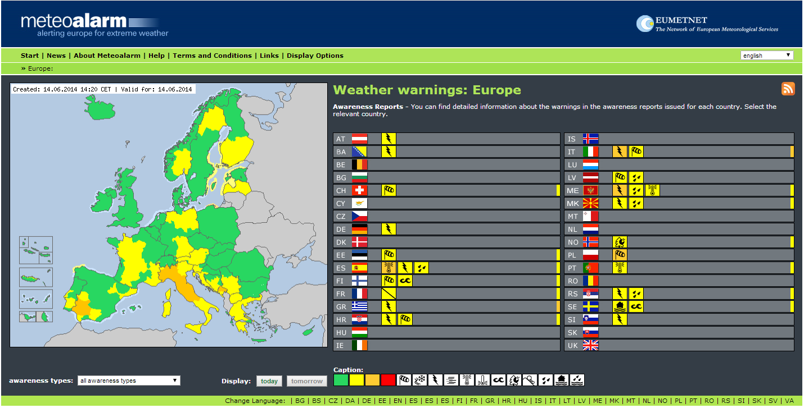
Project website: www.meteoalarm.eu
2006
2014

Slide 5
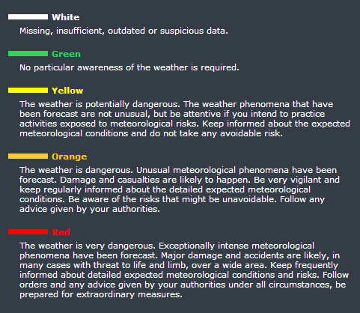
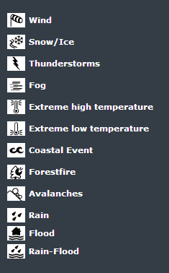
Awareness levels and awareness types
Four color-coded warning levels with general description of potential damage and instructions.

Slide 6
MeteoAlarm – technical aspects
MeteoAlarm xml-format has been developed
Partners upload warnings in standardized xml-format
xml-files are processed, stored in database and visualized
Warning situation for today and tomorrow is shown
Three levels: European level, national level, regional level
About 700 partner regions

Slide 7
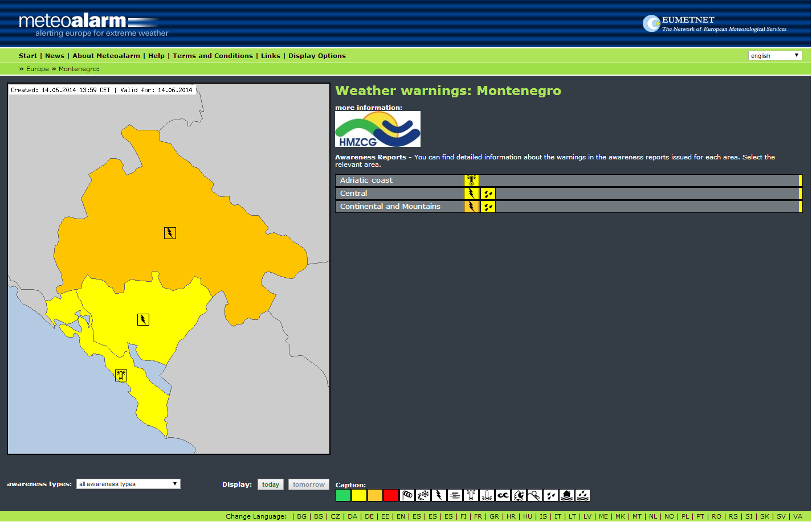
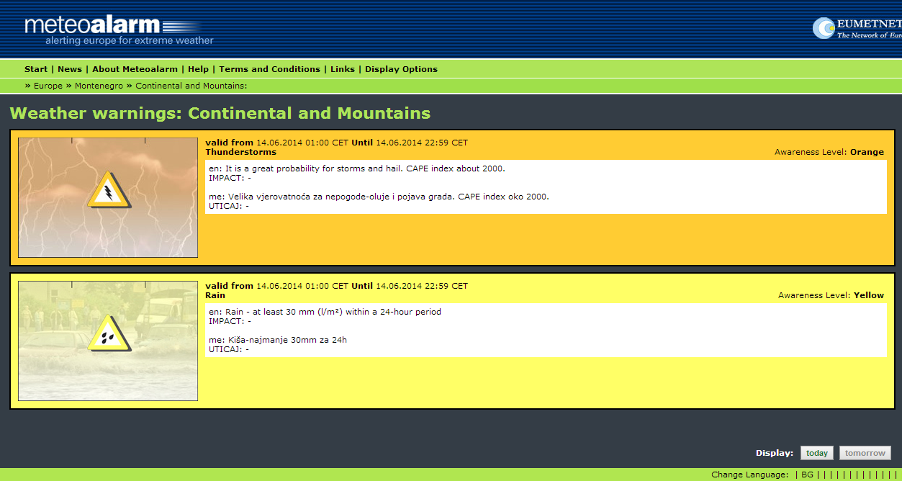
www.meteoalarm.eu
European level – country level – regional level

Slide 8
From MeteoAlarm-xml to CAP
CAP-MeteoAlarm based on CAP 1.2
CAP feed implemented as secured Atom-Feed
Approach: Populate CAP-elements with content from xml-files
No or only minor adaptions necessary for partners!
Content for most elements available from xml-files
Additional elements
<description> = warning text
<instruction> very important, but might not be easy though …

Slide 9
<instruction> element
Ideally, a warning provides a “tangible and understandable description of an expected damage scenario and a clear advice what to do”
Not possible for all partners (e.g., legal restraints)
Partners decide how the <instruction> segment will be populated:
general recommended actions provided by MeteoAlarm
specific recommended actions provided by partner
no recommended actions at all

Slide 10
Guidelines for awareness levels
Color | One word | Damage / Impact | What to do? | Used how often? | Meteo Treshholds e.g. Rain (area + impact related)
Green | Weather report | - - - | usual phenomena | usual phenomena | Examples
yellow | Be aware! | exposed objects (avoidable) | caution with exposed activities | > 30 per year | > 54 mm/24h
orange | Be prepared! | general damages (not avoidable) | keep informed in detail, follow advice of authorities | 1 to 30 per year | > 70 mm/24h
red | Take action! | extreme damage and /or casualties extreme damage (mostly) on large areas, threatning life and properties (not avoidable, even in otherwise safe places) | follow order of authorities under all circumstances be prepared for extraordinary measures | less then 1 year + large (5000km2) scale phenomena | > 100 mm/24h

Slide 11
<severity> element
severity | cap. alertInfo. severity. code | The code denoting the severity of the subject event of the alert message (REQUIRED) | (1) The <urgency>, <severity>, and <certainty> elements collectively distinguish less emphatic from more emphatic messages. (2) Code Values: “Extreme” - Extraordinary threat to life or property “Severe” - Significant threat to life or property “Moderate” - Possible threat to life or property “Minor” – Minimal to no known threat to life or property “Unknown” - Severity unknown
(OASIS CAP 1.2)
Is the CAP “minor” suitable for the MeteoAlarm “green” ?
Not precisely, but we decided to go for it
“No particular awareness” vs. “Minimal to no known threat”
(A code such as “nominal” would suit better)

Slide 12
<info> blocks for different languages
info | cap. alertInfo. info. group | The container for all component parts of the info sub-element of the alert message (OPTIONAL) | Multiple occurrences are permitted within a single <alert>. If targeting of multiple <info> blocks in the same language overlaps, information in later blocks may expand but may not override the corresponding values in earlier ones. Each set of <info> blocks containing the same language identifier SHALL be treated as a separate sequence. In addition to the specified sub-elements, MAY contain one or more <resource> blocks and/or one or more <area> blocks.
(OASIS CAP 1.2)
Partners are encouraged to provide warning information in their native language and English whenever possible.
Two or more <info> blocks for individual languages

Slide 13
<area> & <geocode> elements
geocode | cap. alertInfoArea. geocode. code | The geographic code delineating the affected area of the alert message (OPTIONAL) | (1) Any geographically-based code to describe a message target area, in the form: <geocode> <valueName>valueName</valueName> <value>value</value> </geocode> where the content of “valueName” is a user-assigned string designating the domain of the code, and the content of “value” is a string (which may represent a number) denoting the value itself (e.g., valueName ="SAME" and value="006113"). (2) Values of “valueName” that are acronyms SHOULD be represented in all capital letters without periods (e.g., SAME, FIPS, ZIP). (3) Multiple instances MAY occur within an <area> block. (4) This element is primarily for compatibility with other systems. Use of this element presumes knowledge of the coding system on the part of recipients; therefore, for interoperability, it SHOULD be used in concert with an equivalent description in the more universally understood <polygon> and <circle> forms whenever possible.
(OASIS CAP 1.2)
MeteoAlarm regions do not change frequently
Use <geocode> instead of <polygon>
NUTS (Nomenclature of Territorial Units for Statistics) codes are used wherever possible

Slide 14
Phase 2: CAP aggregation & export
Under development, could be ready in autumn 2014
Some additional mandatory elements
Validator will be available for the CAP-MeteoAlarm profile
Only a limited number of partners will be able to provide CAPs in the beginning
Both versions (xml and CAP) will likely exist for some time

Slide 15
<parameter> element
parameter | cap. alertInfo. parameter. code | A system-specific additional parameter associated with the alert message (OPTIONAL) | (1) Any system-specific datum, in the form: <parameter> <valueName>valueName</valueName> <value>value</value> </parameter> where the content of “valueName” is a user-assigned string designating the domain of the code, and the content of “value” is a string (which may represent a number) denoting the value itself (e.g., valueName ="SAME" and value="CIV"). (2) Values of “valueName” that are acronyms SHOULD be represented in all capital letters without periods (e.g., SAME, FIPS, ZIP). (3) Multiple instances MAY occur within an <info> block.
(OASIS CAP 1.2)
For a smooth transition to CAP awarness type and level shall be provided as <parameter> elements.

Slide 16
Summary
MeteoAlarm is a successful collaboration of 34 European public weather services
Collaborative Decision Making together with Civil Protection agencies
CAP-feed based on xml-files provided by partners
Timeframe: pretty soon, summer 2014 (together with Google team)
CAP-MeteoAlarm to follow afterwards
Each partner is free to choose either xml or CAP upload
MeteoAlarm will assist partners in the transition to CAP
How to handle “all clear messages” in CAP?

Slide 17
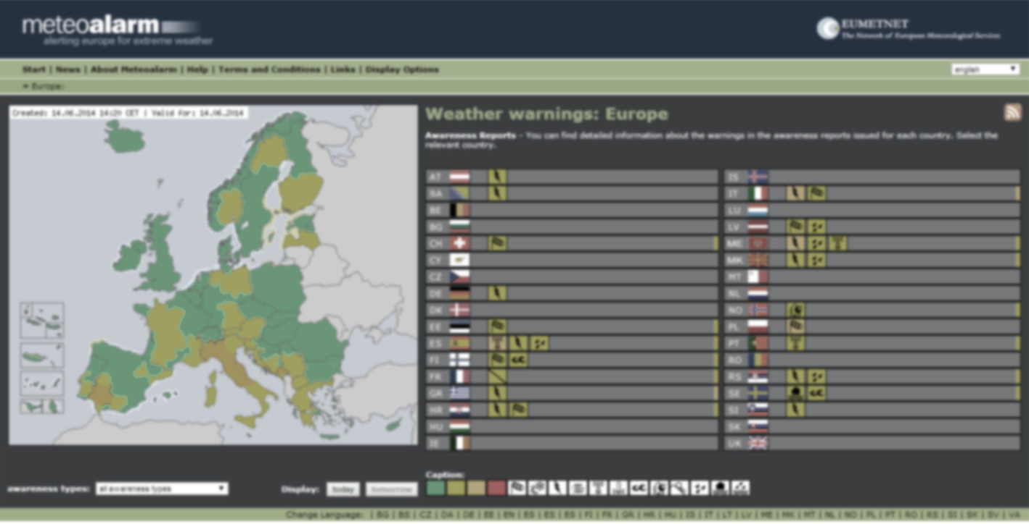
www.meteoalarm.eu
Thank you!

