Slide 1
IOTX: Public-Private Cooperation in Leveraging CAP
17 June 2014
Karan Bains | Regional Information Manager – Asia
Global Risk Group (GRG)

Slide 2
Content
1.1 Introduction
1.2 Private Company Organization – Security and Crisis Management
1.3 Pinkerton Usage - CAP
1.4 Relavence of CAP for Private Sector
1.5 Use Cases for CAP
1.6 New Technology for using CAP
Notes:
2
Pinkerton corporate presentation 2010
2

Slide 3
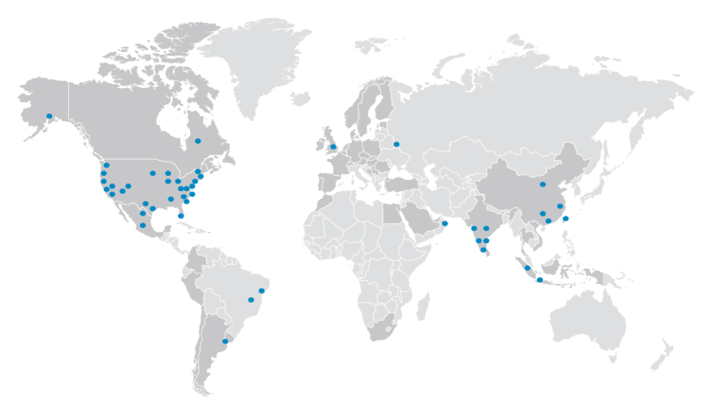
Introduction
Pinkerton
Services
Investigations
Protective
Services
Employment Screening
Intelligence/
Information
Services
Intellectual Property Protection
Crisis Management & Response Services
Security & Safety Services

Slide 4
Typical Private Company: Security and Crisis Management Organization
Leadership
Location
Leaders
IT Security
Physical
Security
Employee
Safety
BCP
Information
Security
Boots
On Ground
Command and
Control
OHSAS
Business
Recovery
Crisis
Management
Intelligence
Services

Slide 5
Pinkerton Usage | CAP
GRG – Organized in Hubs
Dedicated team of Alert specialists in all Hubs
Information Sourced through Online Media and Boots on ground

Slide 6
Pinkerton Usage | CAP
Monitoring and aggregation of Information through web based tool - Threat Monitor
Twitter RSS
Facebook RSS
Alerts + GPS + Locations + Overlays
Local News

Slide 7
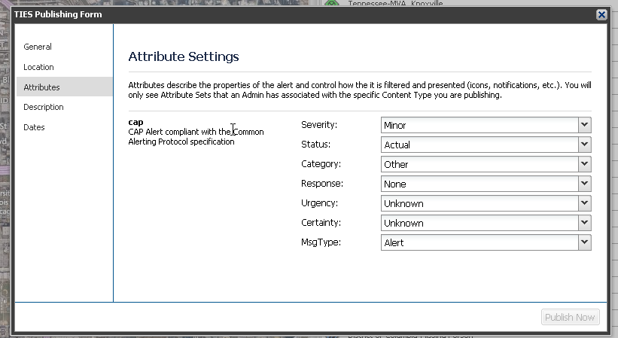
Pinkerton Usage | CAP
Important Information processed and made relevant by adding Geo-location and CAP
By utilizing these CAP qualifiers we allow our alerts to fall in line with other major organizations.

Slide 8
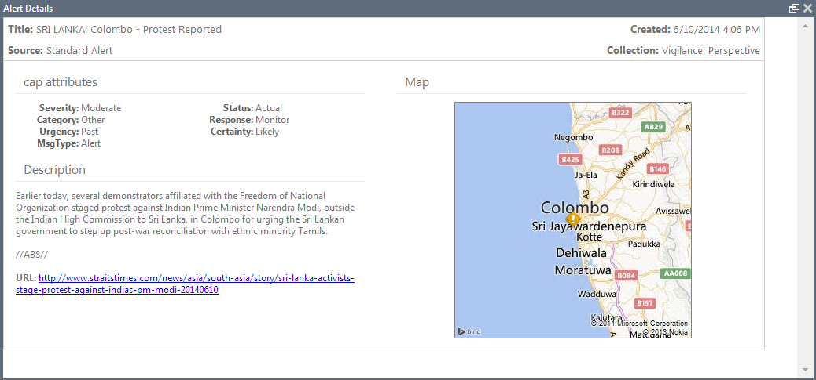
Pinkerton Usage | CAP
Screen View of an Alert with Description of an incident, Geo location and CAP

Slide 9
Relevance of CAP in the Private sector
Example of Alerts received with CAP and Location filtration - Targeted Alerts
Location Filter
CAP Filter
No Filters

Slide 10
USE CASES I Private Sector Alerting

Slide 11
2014 FIFA World Cup, Brazil
June 12 to July 13, 2014
12 Host cities
52 Member associations
500,000 Fans expected
Practical intelligence and expert analysis focused on the World Cup delivered every day to clients computer and Smartphone.
Daily reports and analysis
Timely alert notifications
Aggregated web access

Slide 12
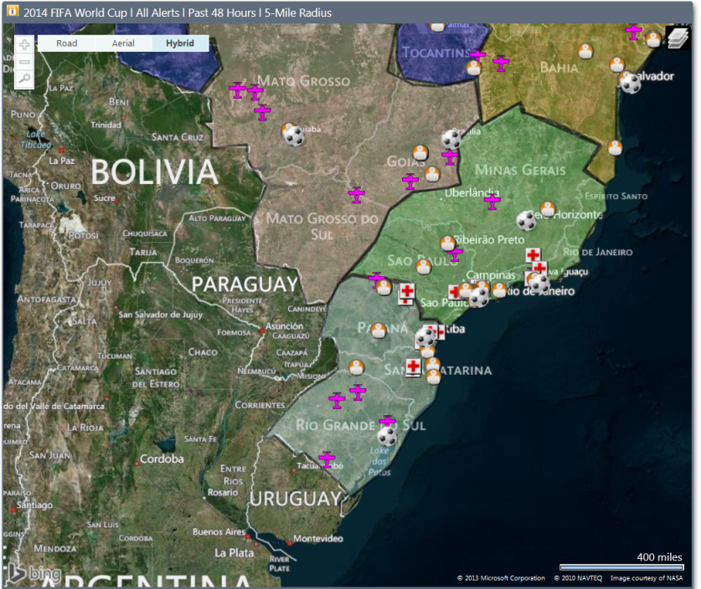
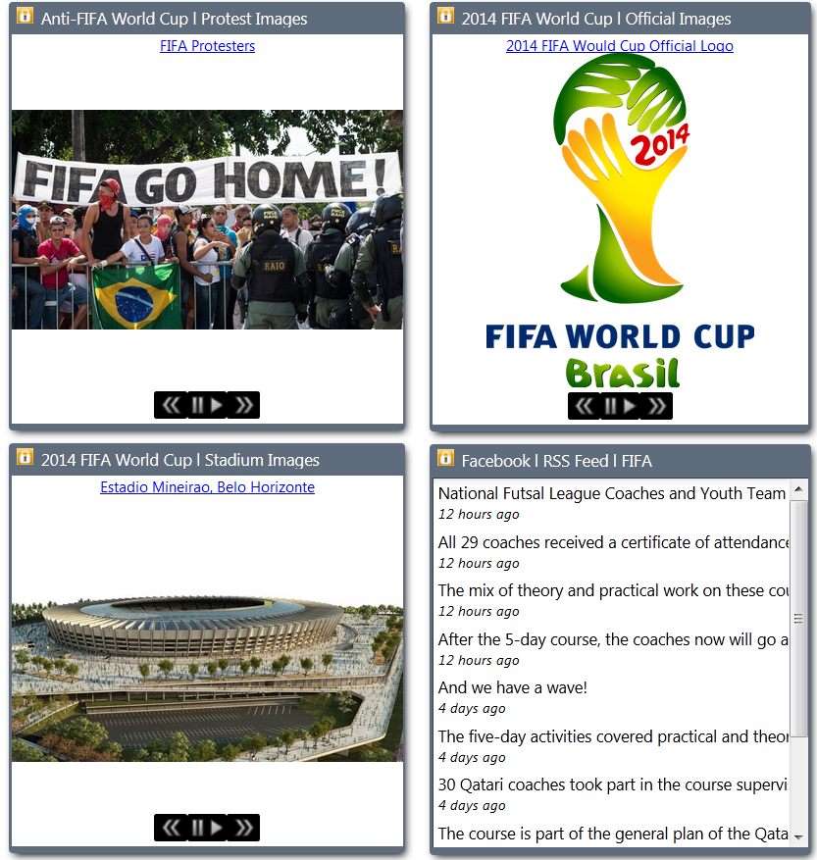
2014 FIFA World Cup : Intelligence Hub
Threat Monitor created as a protective intelligence hub, providing one-stop access to updated information.
Maps plot sporting venues, hospitals, airports, hotels, and other locations of importance
Continuously updated feeds for local, international, and social media
Weather, news, and travel warnings
Alert notifications mapped to street level
Daily reports linked for download
https://pinkerton.tieslink.com/

Slide 13
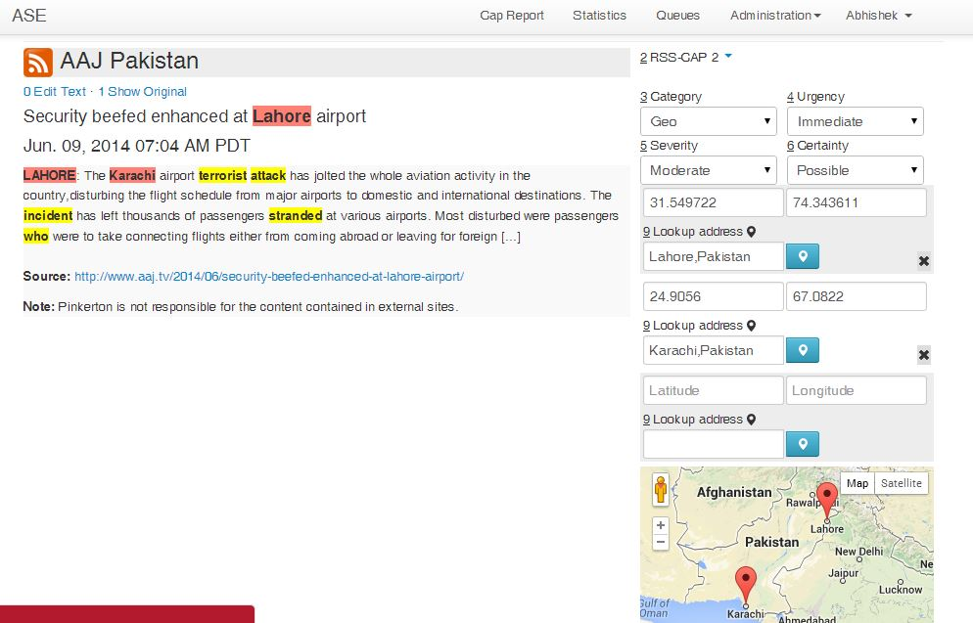
New Technology in CAP - AI
CAP is a wonderful tool for data mining of web-based Information and speeds up finding and dissemination of relevant information as Alerts.
Proprietary and patented technology converts unstructured XML into CAP alerts
Opens up thousands of previously untapped resources in an efficient, expedient, and reliable format

Slide 14
New Technology in CAP – Mobile Alerting
Mobile Alerting
- Allows alert publishing in the field.
Ability to quickly submit and distribute near real-time alerts.
A unique “boots on the ground” perspective and highly targeted for unique client needs.

Slide 15
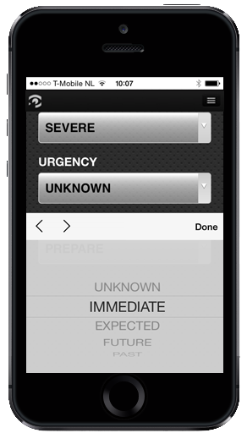
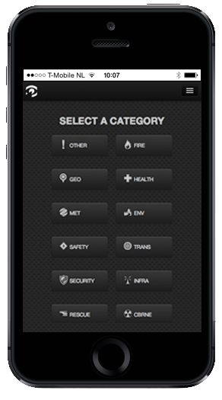
New Technology in CAP – Mobile Alerting
The publisher selects the type of risk
Applies Cap categories like Urgency, Severity, and Response.

Slide 16
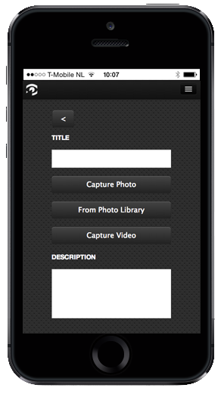
New Technology in CAP – Mobile Alerting
After describing the nature of the alert, the publisher then:
Provides a title (required)
Can choose to attach an existing video or image already stored on the device
Can take a picture or record a video
Writes text describing the alert

Slide 17
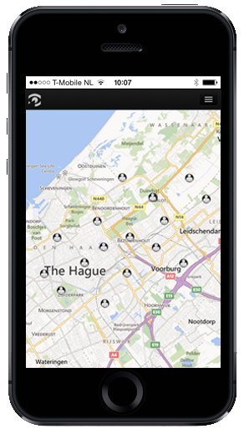
Additional Features – Map Overview
On the “Map” page, the publisher is given a birds-eye-view of the alerts coming in real-time from his or her team.

Slide 18
Questions ??
Please do not hesitate to contact me at anytime if you have questions or would like further information:
Karan Bains
Regional Information Manager - Asia
Global Risk Group
+91 999 959 7917
Karan.bains@pinkerton.com

Slide 19
We never sleep.
pinkerton.com

Slide 20
2012 NATO Summit
North Atlantic Treaty Organization (NATO)
Chicago, IL, USA
May 20 and 21, 2012
28 Member countries
22 Non-member countries
Approximately 2,000 international journalists
Several thousand protestors for NATO and G8
Large scale presence of private sector:
International Financial Service Institutions
Retail Companies
Building Management and Realty Companies
Infrastructure - Telecommunications and Transportation
Academic Institutions

Slide 21
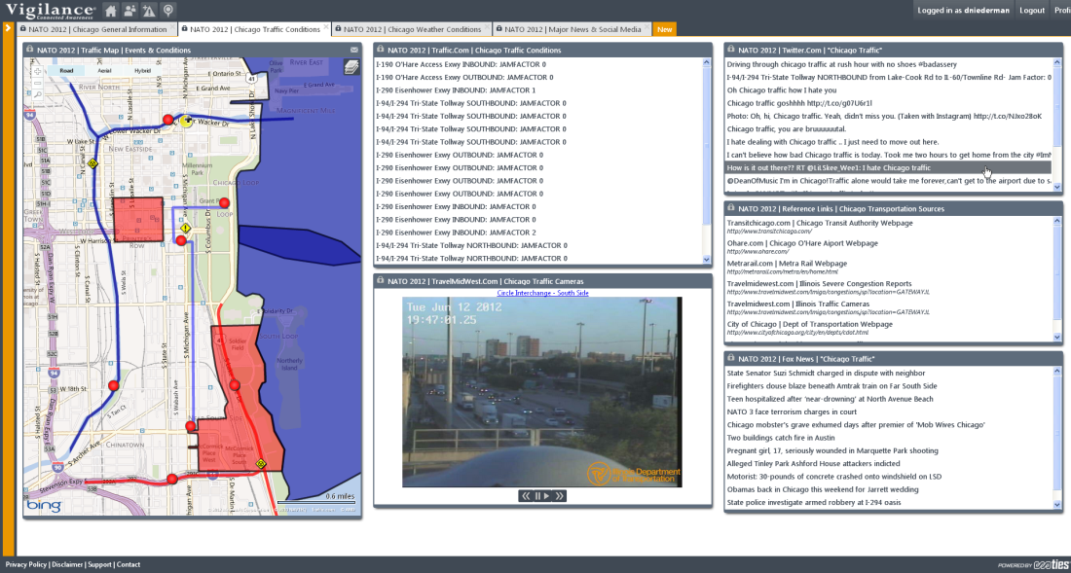
2012 NATO Summit | Information Feeds
1.1
1.2
1.3
1.4
1.5
1.6
1.7
Traffic Information, Live Cameras, Handheld feeds, Maps, Online News and Social Media
Notes:
21
Pinkerton corporate presentation 2010
21

Slide 22
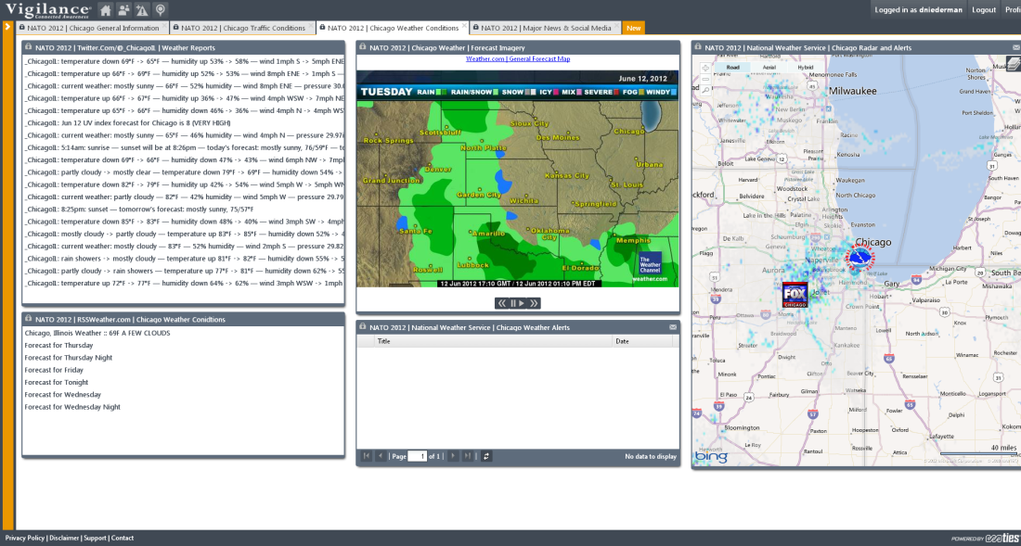
2012 NATO Summit | Information Feeds
1.1
1.2
1.3
1.4
1.5
1.6
1.7
Geographical and Meteorological – For weather and natural calamities
Notes:
22
Pinkerton corporate presentation 2010
22

Slide 23
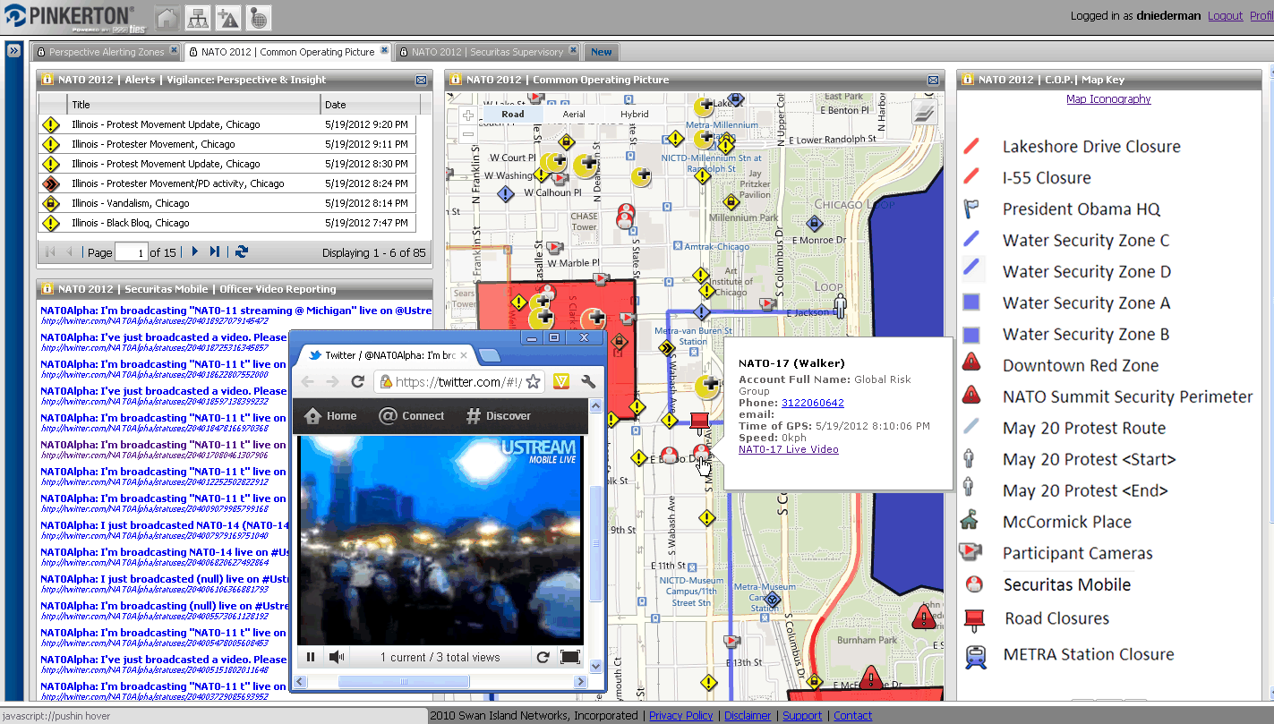
2012 NATO Summit | Common Operating Picture
1.1
1.2
1.3
1.4
1.5
1.6
1.7
Notes:
23
Pinkerton corporate presentation 2010
23

