Slide 1
“Training Workshop on the Design of Socio-Economic Benefits Studies of Meteorological / Hydrological Services and Products for Members in Regional Association VI (RA VI, Europe)”, in Zagreb, Croatia, from 29 June 29 to 3 July 2015.
Country presentation
Bosnia and Herzegovina

Slide 2
Brief self-introduction
Name: Esena Kupusović
Organization: Federal Hydro-Meteorological Institute (HMI)
Current role: Assisstant Director
Brief background:
At the Faculty of Civil Engineering, University of Sarajevo, acquired degree in hydro-technic engineering, then a master's degree in technical sciences, in the field of water management. At the HMI began working as a research hydrologist, and for several years headed the Department of hydrology. Engaged as a lecturer at the Faculty of Health Studies in Sarajevo, within the course of recreational waters management. Authored or co-authored 20 published scientific and expert papers, 7 of which were registered in WorldCat.
Email: kupusovic.e@fhmzbih.gov.ba

Slide 3
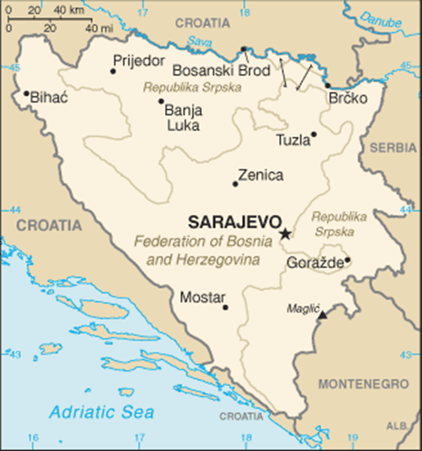
Official name: Bosna i Hercegovina (BiH)
Flag and coat of arms
Geographic location: western part of Balkan peninsula.
Surrounding countries: Republic Srbija (north-east), Republic Crna Gora - Monte Negro(south-east), Republic Hrvatska-Croatia (north, west and south).

Slide 4
Some information on BiH
Administrative division: BH is divided into two entities: Federation of Bosna and Herzegovina (F BiH) and Republic of Srpska (RS), and Brčko District.
Entitety structure: F BiH is devided to 10 cantons (79 municipalities). RS has 62 municipalities.City of Brčko is a separate administrative unit - District.
Area: Bosnia and Herzegovina has 51 209,2 km² (Land: 51 197 km² and sea: 12,2 km²)
Climate: Mostly continental, mediteranian at the south.
Population: 3.843.126 - estimated (30.06.2010)
Capital: Sarajevo
2013 GDP millions of KM 26.297 (15.157 M $)
GDP/C in KM 6. 862 (3.955 $)

Slide 5
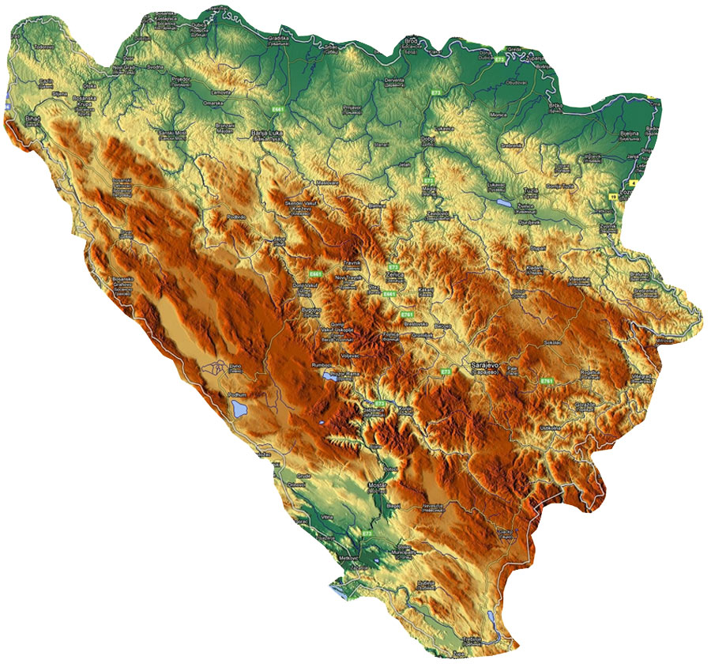
Relief of BiH
Total area :
51.197 km²
lowland area
(up to 300 masl)
13,3%
hilly-mountainous area
(300-700 masl)
26,3%
mountainous area
(above 700 masl)
57,2%
Mediterranean area
(below 500 masl)
5,2%
Large percent of hilly terrain, with over 83% of area having a slope of 13% or greater.

Slide 6
BiH Water resources
The total annual water resources from precipitation in BiH amount to 63.9 km3/yr, while internal renewable water resources amount to 36.4 km3/yr.
Taking into account the quantity of water flowing in from other countries (Sava and Drina r.), the total annual renewable water resources amount to 64.5 km3/yr.

Slide 7
BiH Water resources
BiH ranks among the better-watered and largely spring-fed countries, with a dense river network in the Sava River Basin, a less developed network of surface waters in the Adriatic Sea Basin and significant karstic underground flows
Due to various geological characteristics, topography and climate, the total quantity of water is not equally distributed either spatially or temporally. Great differences in the quantity of precipitation between areas in the west and those in the east of the country cause regular and frequent floods in some places, while other areas are faced with a lack of water and droughts.

Slide 8
GDP in BiH by activity, current price
ACTIVITY | 2005 | 2006 | 2007 | 2008 | 2009 | 2010
Agriculture, hunting and forestry | 1.454.504 | 1.613.051 | 1.735.435 | 1.842.644 | 1.759.391 | 1.734.973
Fishing | 3.206 | 4.662 | 7.289 | 8.036 | 10.546 | 6.720
Mining and quarrying | 335.456 | 356.941 | 432.479 | 512.295 | 500.558 | 493.750
Manufacturing | 1.753.065 | 2.015.400 | 2.472.159 | 2.848.826 | 2.624.924 | 2.793.633
Production and supply of elek.energijom, water and gas | 849.473 | 826.193 | 761.748. | 1.022.046 | 1.061.498 | 1.098.299
Construction | 752.308 | 829.412 | 1.058.668 | 1.340.151 | 1.269.079 | 1.076.319
Wholesale and retail | 2.039.902 | 2.336.996 | 2.699.737 | 3.299.962 | 3.143.085 | 3.257.269
Catering | 397.476 | 427.040 | 468.597 | 496.686 | 484.537 | 520.797
Catering, storage, communications | 1.278.519 | 1.352.634 | 1.492.607 | 1.661.487 | 1.648.936 | 1.694.003
Financial intermediation | 631.943 | 694.765 | 854.345 | 893.645 | 915.915 | 935.156
Real estate | 1.806.895 | 1.850.450 | 1.922.577 | 2.038.110 | 2.121.418 | 2.183.451
Education | 682.645 | 782.763 | 900.944 | 1.114.566 | 1.160.528 | 1.181.404
Health and social work | 669.947 | 730.445 | 832..401 | 1.091.845 | 1.095.379 | 1.140.041
Total of activities | 14.459.344 | 15.825.064 | 17.928.032 | 20.835.420 | 20.639.701 | 20.910.13
GDP basic price | 14.051.319 | 15.356.473 | 17.301.161 | 20.152.475 | 19.963.868 | 20.235.208
GDP market price (KM) | 17.218.422 | 19.333.005 | 21.835.878 | 24.758.993 | 24.050.878 | 24.583.905
1 $ = 1.74 KM
Source : BiH Agency for Statistics, http://www.bhas.ba/

Slide 9
GDP in BiH by activity, current price
In the basic activities (agriculture, fishing, mining, manufacturing, electricity and construction) is made 34,2% of value added in services activities 65.8%.
The largest share in GDP has value added of trade (13.3%), manufacturing (11.2%), public administration (9.3%) and real estate (9.1%). Concerning the economic activities decline in gross value added was recorded in construction (15.2%), public administration (3.2%), fishing (36.3%), agriculture (1.4%) and mining (1.4%) .
The biggest growth in gross value added was recorded in hotels and restaurants (7.5%), and manufacturing industry (6.2%).
The largest contribution to GDP growth rate of 2.2% were Trade (13.5%), manufacturing (11.4%), public administration (9.5%), real estate (9.3%).

Slide 10
GDP in BIH (source: CIA https://www.cia.gov/library/PUBLICATIONS/the-world-factbook/fields/2004.html#bk
GDP (purchasing power parity )
$38.08 billion (2014 est.)
$37.7 billion (2013 est.)
$36.93 billion (2012 est.)
note: data are in 2014 US dollars
Per capita:
$9,800 (2014 est.)
$9,700 (2013 est.)
$9,500 (2012 est.)
note: data are in 2013 US dollars

Slide 11
Federal Hydro-Meteorological Institute
Organizational Structure
Sector of Meteorological Measuring and Forecasts
Sector of Applied Meteorology
Sector of Hydrology
Sector of Environment
Sector of Common Affairs
Centre for Astronomy
Centre for Seismology
Center for Information Technologies
Scope of Activity
The Institute, according to the applicable laws, performs professional and other activities relating to permanent monitoring in the field of meteorology, hydrology, environment quality, seismology and astronomy; conducts researches of atmosphere, water resources, environment (water, soil, air), seismologic processes and astronomic events; collects, processes, analyses and publishes data from its scope for the Federation BiH; issues on daily basis weather bulletins and forecasts, and actively cooperates with the World Meteorological Organization applying its standards in data exchange and improvement of this service.

Slide 12
Federal Hydro-Meteorological Institute
Number of staff: 87
Annual budget: TOTAL 2. 730. 077 KM (cca 1.563.089. $)
VISION:
To be modern HM service, equipped with modern instrumentation and other equipment to conduct activities within its jurisdiction, with qualified personnel, who will be able to comply with international standards to respond set goals and requirements of the community, and accepted international obligations.
FHMI contribute to sectors:
Environemnet, Water management, Energy , Urban planning, Education, Civil security...
Key actors:
PUBLIC!
The Government of the Federation of Bosnia and Herzegovina, with all its administrative bodies and offices;
Administrative bodies (all levels of government);
The legal entities in the area of physical planning, urban planning, civil engineering, architecture, environmental protection;Water agencies, Scientific and educational institutions;The legal entities in the field of public information; Non-governmental organizations and other

Slide 13
ACTUAL PROJECTS
Improvement of Joint Flood Management Actions in the Sava River Basin (WBIF1 project proposal, coordination Sava Commission)
WBIF / GEF / SCCF projects on the Drina River Basin: Implementer World Bank
UNDP /GEF 'Integrating climate change and reducing the risk of flooding in the Vrbas River basin'
IPA II BOSNIA AND HERZEGOVINA Support to Flood Protection and Water Management; Component 1- Hydrological forecasting system for Sava River Basin in Bosnia and Herzegovina (Phase 1. Bosnia River)
Finnish Foreign Aid Programme of the Ministry for Foreign Affairs of Finland Rehabilitation and Modernization of the Hydrological and Meteorological Observing Network and Data Exchange Procedures in Serbia and Bosnia and Herzegovina

Slide 14
Expectations from the workshop
If we look at the last 25 years, HM services in BiH did not have priority. When we add here the war damages of the HM services during nineties, it is clear that HM service had little opportunity for advancement.
In recent years, the situation is slowly changing, and interest in strengthening the service appeared, especially after the devastating floods last year - Several projects are currently underway, in which the FHMI is beneficiary.
Now it is very important to get support from the government to institute strengthen its human resources and to provide financial resources for the sustainable operation of the service, and for the new projects in order to strenghtening of the HM services.

Slide 15
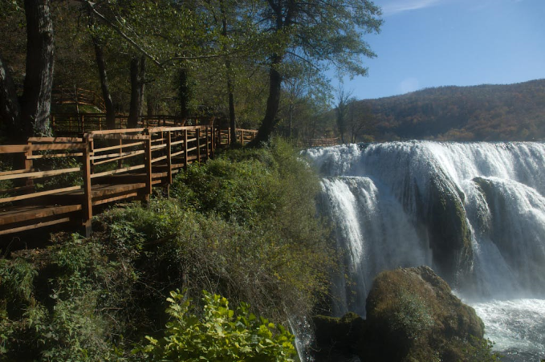
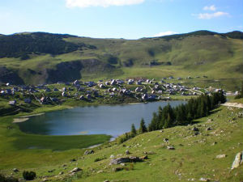
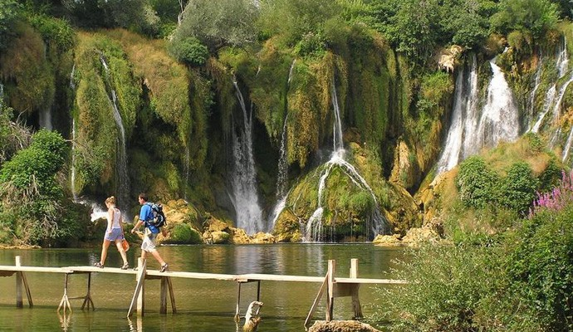
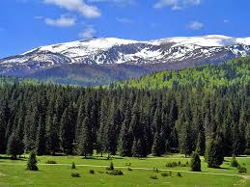
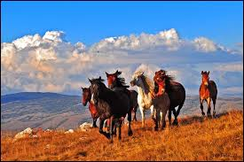
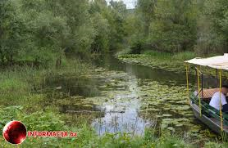
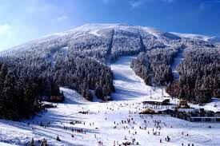
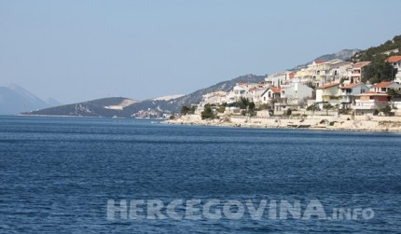
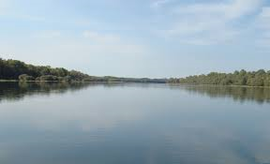
All this is Bosnia and Herzegovina! Thank you!

