Slide 1


The Hydrometeorology Service of the Republic of Belarus
Training Workshop on the Design of Socio-Economic Benefits Studies of Meteorological / Hydrological Services and Products,
Zagreb, Croatia
June 29 – July 3 2015
by Korzun Eugene (mad.eugene89@gmail.com)
engineer of hydrological forecasts department
The Center of Hydrometeorology and Radioactive Contamination Control and Environmental Monitoring of the Republic of Belarus

Slide 2
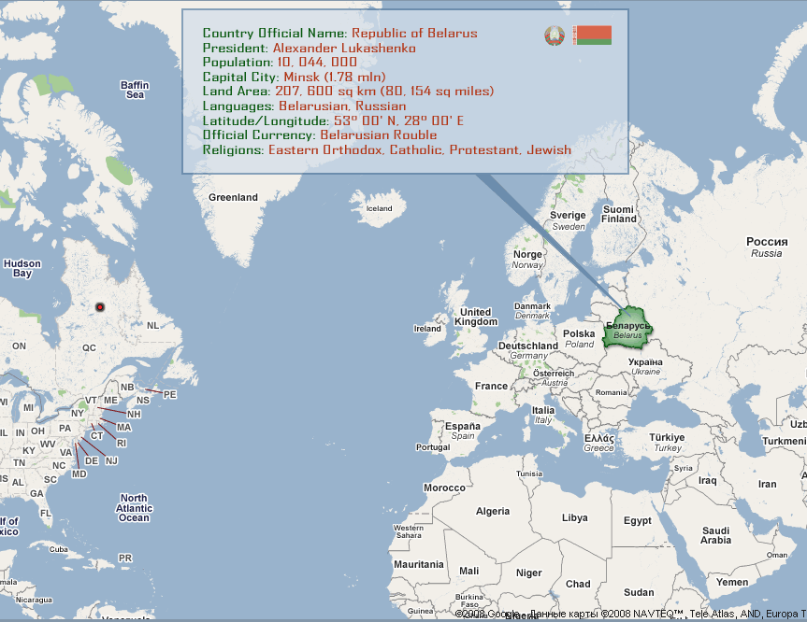


Official Name: Republic of Belarus
President: Alexander Lukashenko
Total area: 207,600 sq km (80,154 sq miles) (86th in the World)
Population: 9,608,058 (July 2014 est.) (93th in the World)
Capital City: Minsk, 1.905 million (2014)
Languages: Belarusian, Russian
Latitude/Longitude: 53°00` N, 28°00` E
Official Currency: Belarusian Rouble
Religions: Eastern Orthodox, Catholic, Protestant, Jewish

Slide 3

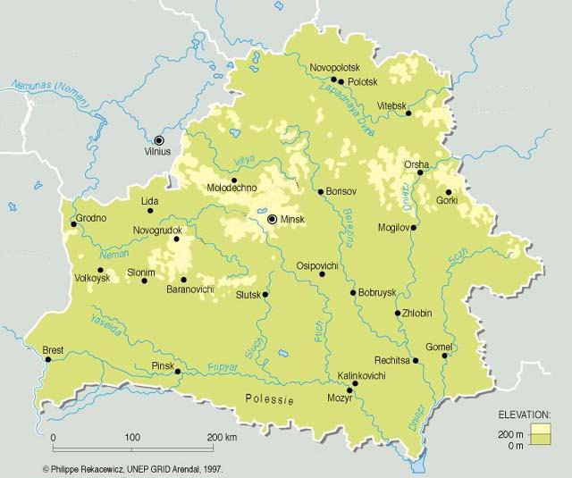


Slide 4

GDP (purchasing power parity): $171.2 billion (2014 est.)
GDP - real growth rate: 0.9% (2014 est.)
GDP - per capita (PPP): $18,200 (2014 est.)
GDP - composition, by sector of origin: agriculture: 7.3%, industry: 37%, services: 55.7% (2014 est.)
main industries: metal-cutting machine tools, tractors, trucks, earthmovers, motorcycles, televisions, synthetic fibers, fertilizer, textiles, radios, refrigerators

Slide 5
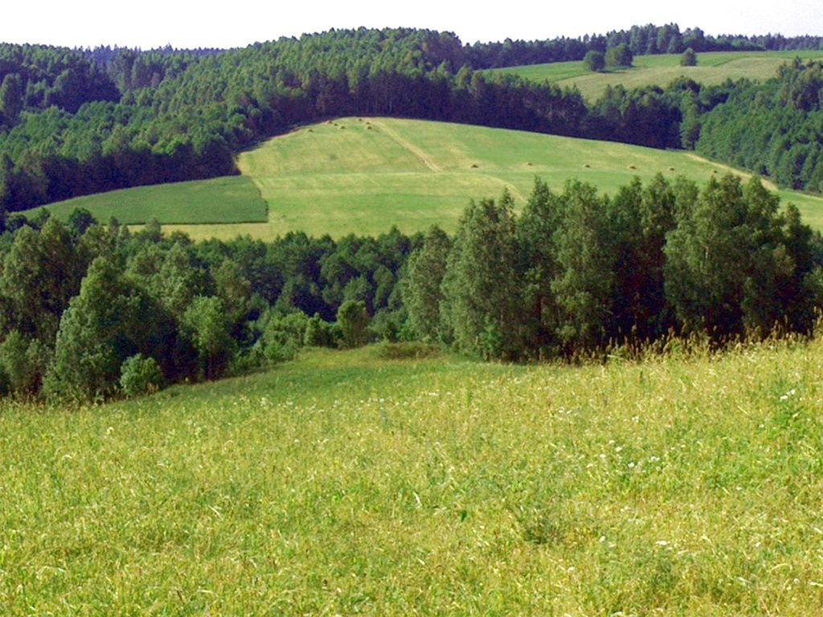
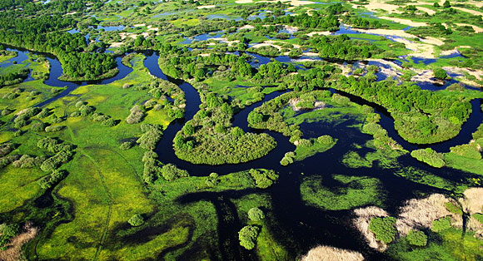
The Relief
The country’s relief is predominantly flat and hilly, with the average height of 160 m over the sea level. The highest point is Dzierzhinsky Hill (345 meters above the sea level) in the Minsk Oblast. The country's lowest place is the Neman Valley in the Grodno Oblast (80-90 meters above sea level).
Agricultural lands occupy 44% of the republic’s territory, forests constitute 36 % of the country’s area.
Typical landscape of Belarus
Pripyat`s lowlands

Slide 6
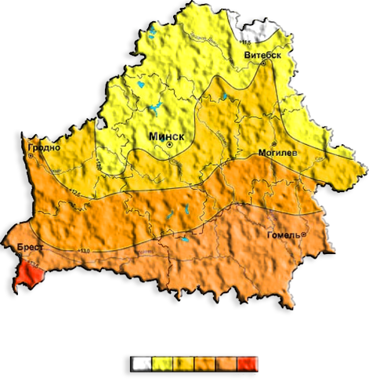
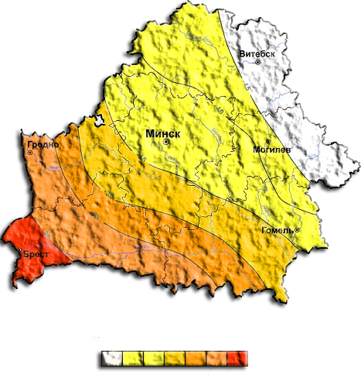
Average temperature in July (°C)
Average temperature in January (°C)
Less 11,5 12,0 12,5 13,0 13,5 more
Less -2,0 -2,5 -3,0 -3,5 -4,0 4,5 more
The average July temperature is +17 +19ºC.
The average January temperature varies from -4ºC in the south-west to -8 ºC in the north-east.

Slide 7
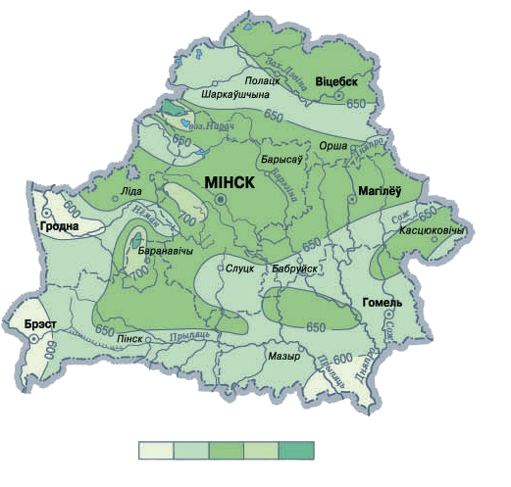
Annual rainfall (mm)
The annual rainfall is 550-650 mm in lowlands and 650-750 mm on plains and uplands. The most wet regions are the North-West and the Central part of the country.
The vegetation period lasts on average about 184-208 days.
Less 600 650 700 750 more

Slide 8
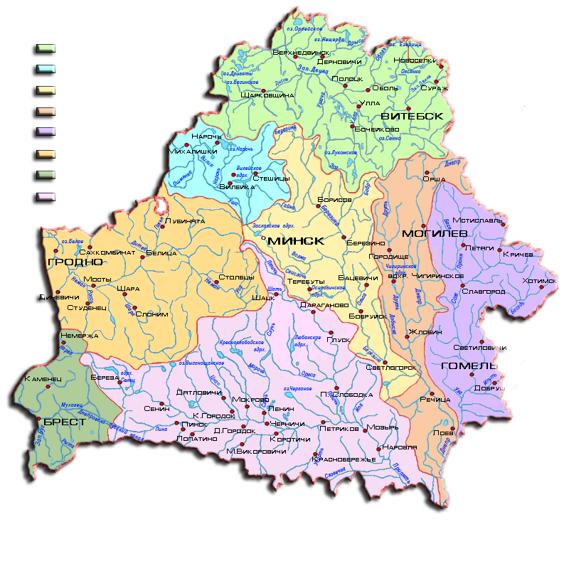




Drainage basins of Belarusian rivers
Latvia
Western Dvina (Daugava)
Viliya (Neris)
Berezina
Dnepr
Sozh
Neman (Nemunas)
Western Bug
Pripyat
There are 20.800 rivers and brooks in Belarus (94% of them are shorter than 10 km).
About 55% of the river flow falls on the rivers of the Black Sea basin (red arrows) and 45% belong to the Baltic Sea basin (green arrows).
Lithuania
Name | Length in Belarus (km) | Full length (km)
Dnepr | 690 | 2145
Berezina | 613 | 613
Pripyat | 500 | 761
Sozh | 493 | 648
Neman (Nemunas) | 459 | 937
Ptich` | 421 | 421
Western Dvina | 328 | 1020
Poland
Russia
Ukraine

Slide 9
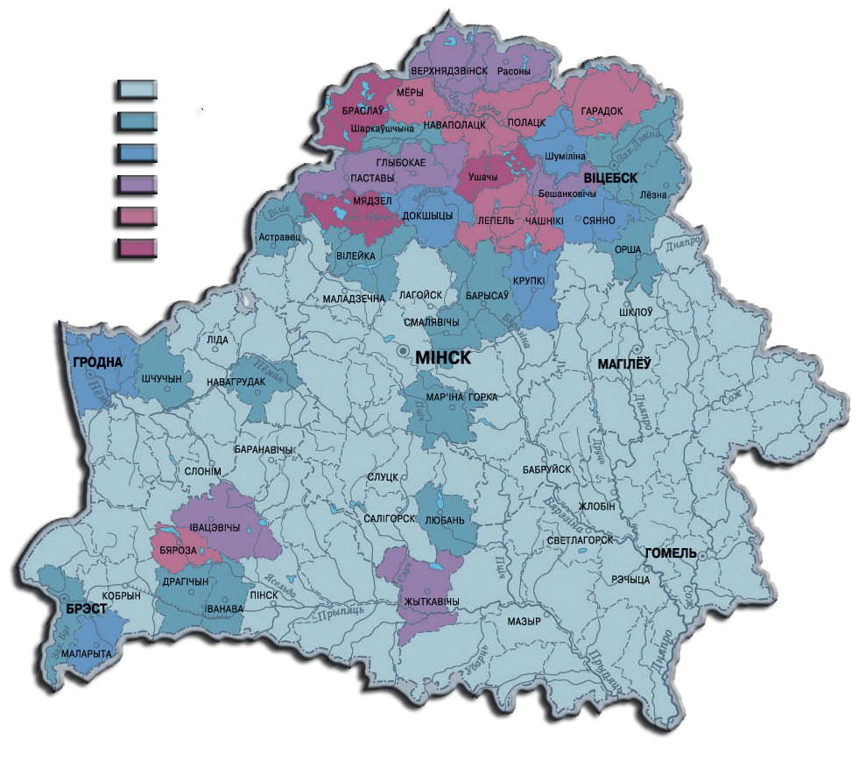
Lake percentage by districts
Lake percentage
(% of the total district`s area)
the Osveja
the Drysvjaty
Belarus is a lake-country. There are about 10,800 lakes here (3/4 of them are smaller than 0,1 sq km). The lakes are particularly numerous in the north.
The biggest lakes are the Naroch` (79,6 sq km), the Osveja (52,8 sq km) and the Drysvjaty (44,5 sq km). The deepest lakes are the Dolgoe (53,7 m) and the Richi (51,9 m).
< 0,1%
0,1 – 0,5%
0,5 – 1,0%
1,0 – 2,0%
2,0 – 4,0%
> 4,0%
the Richi
the Dolgoe
the Naroch`
River`s drainage basin | Amount of lakes | Total area of lakes (sq km)
Western Dvina | 1061 | 939,44
Neman (Nemunas) | 80 | 218,25
Dnepr | 77 | 56,46
Pripyat | 53 | 103,57
Western Bug | 13 | 11,36
Lovat` | 11 | 9,95

Slide 10
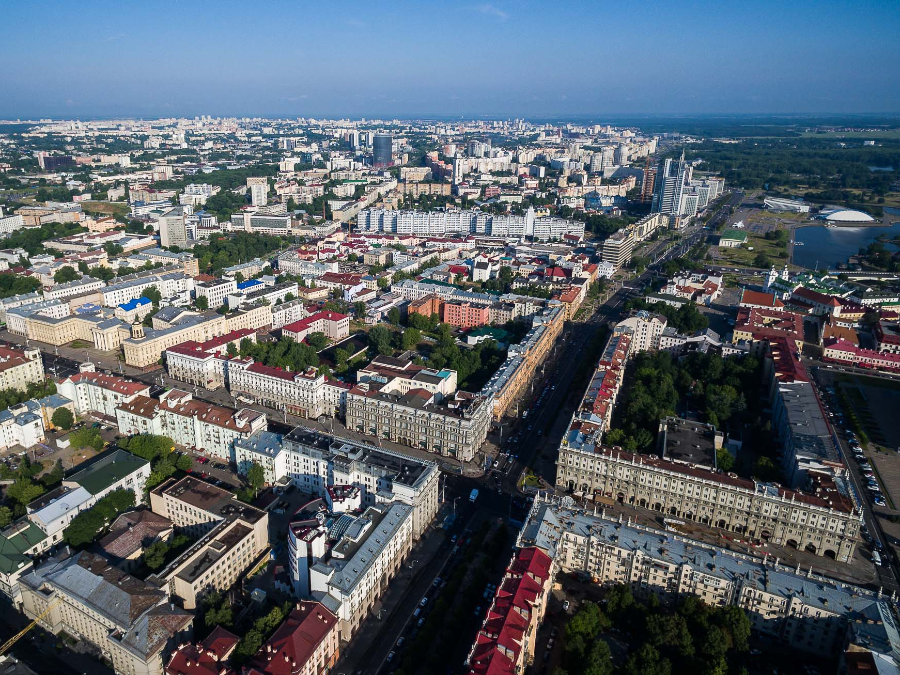
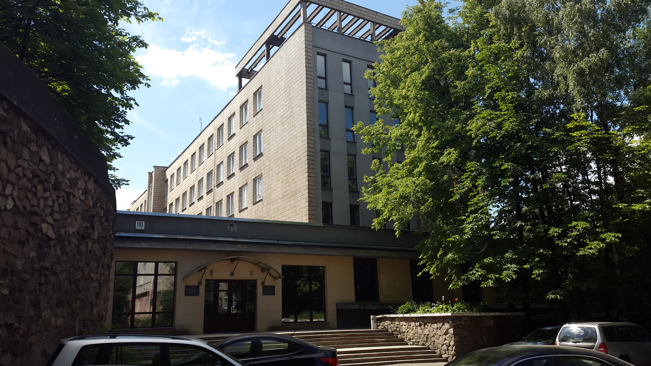
The Center of Hydrometeorology and Radioactive Contamination Control and Environmental Monitoring
of the Republic of Belarus

Slide 11
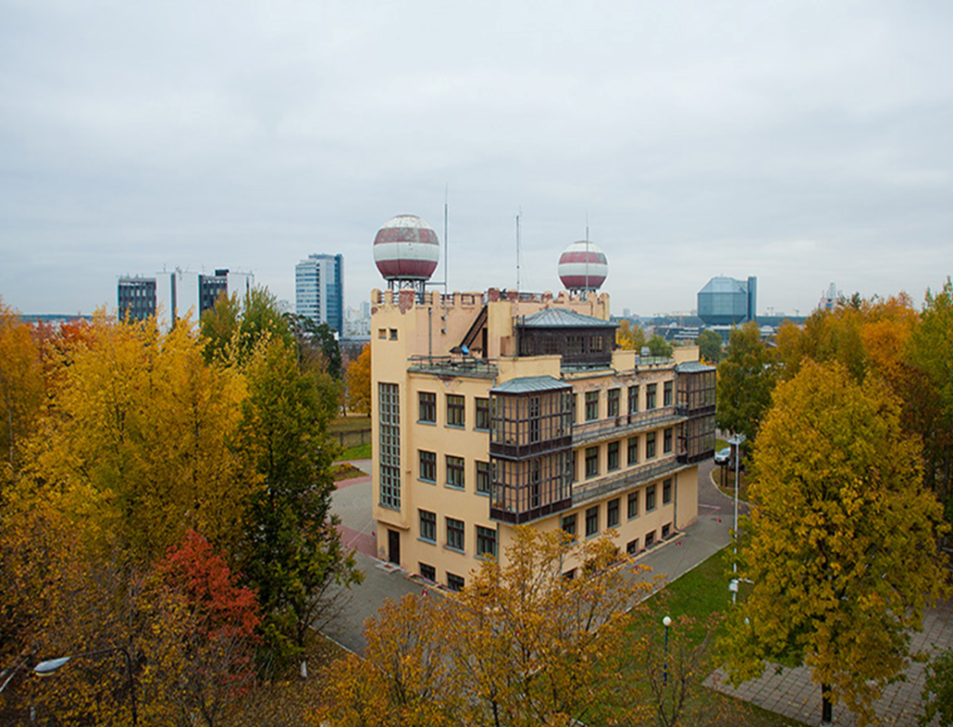
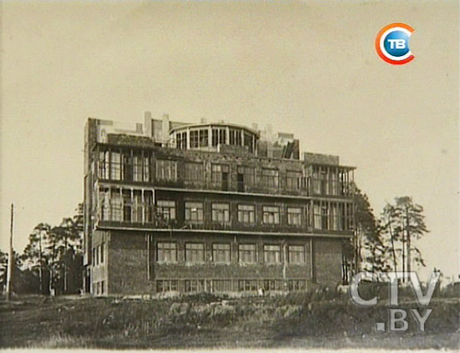
First instrumental hydrometeorological activities began in Mogilev in 1808. The official date of birth of the Hydrometeorological Service of Belarus - 1924.
Hydrometeorological activities of the state and international importance are carried out by the Center of Hydrometeorology and Radioactive Contamination Control and Environmental Monitoring of the Republic of Belarus. It was formed by integration of the State Hydrometeorological Service and the State Center of Radiation Control and Environmental Monitoring in 2014.
Number of staff – 530 (2015)
47,1 billion rub (2,9 billion $) comes from the state budget
3,5 billion rub (0,21 billion $) comes from the local budget
9 billion rub (0,5 billion $) are earned by the Center
Observatory of Minsk meteorological station
nowadays
in 1934

Slide 12
The structure of the Center of Hydrometeorology and Radioactive Contamination Control and Environmental Monitoring of the Republic of Belarus
the Ministry of Natural Resources and Environmental Protection
the Center of Hydrometeorology and Radioactive Contamination Control and Environmental Monitoring
Brest
Gomel`
Grodno
Vitebsk
Mogilev
Minsk
Regional Hydrometeorological Centers
Hydrological, Meteorological, Agrometeorological and Aviation Stations
and Environmental Monitoring Centers

Slide 13

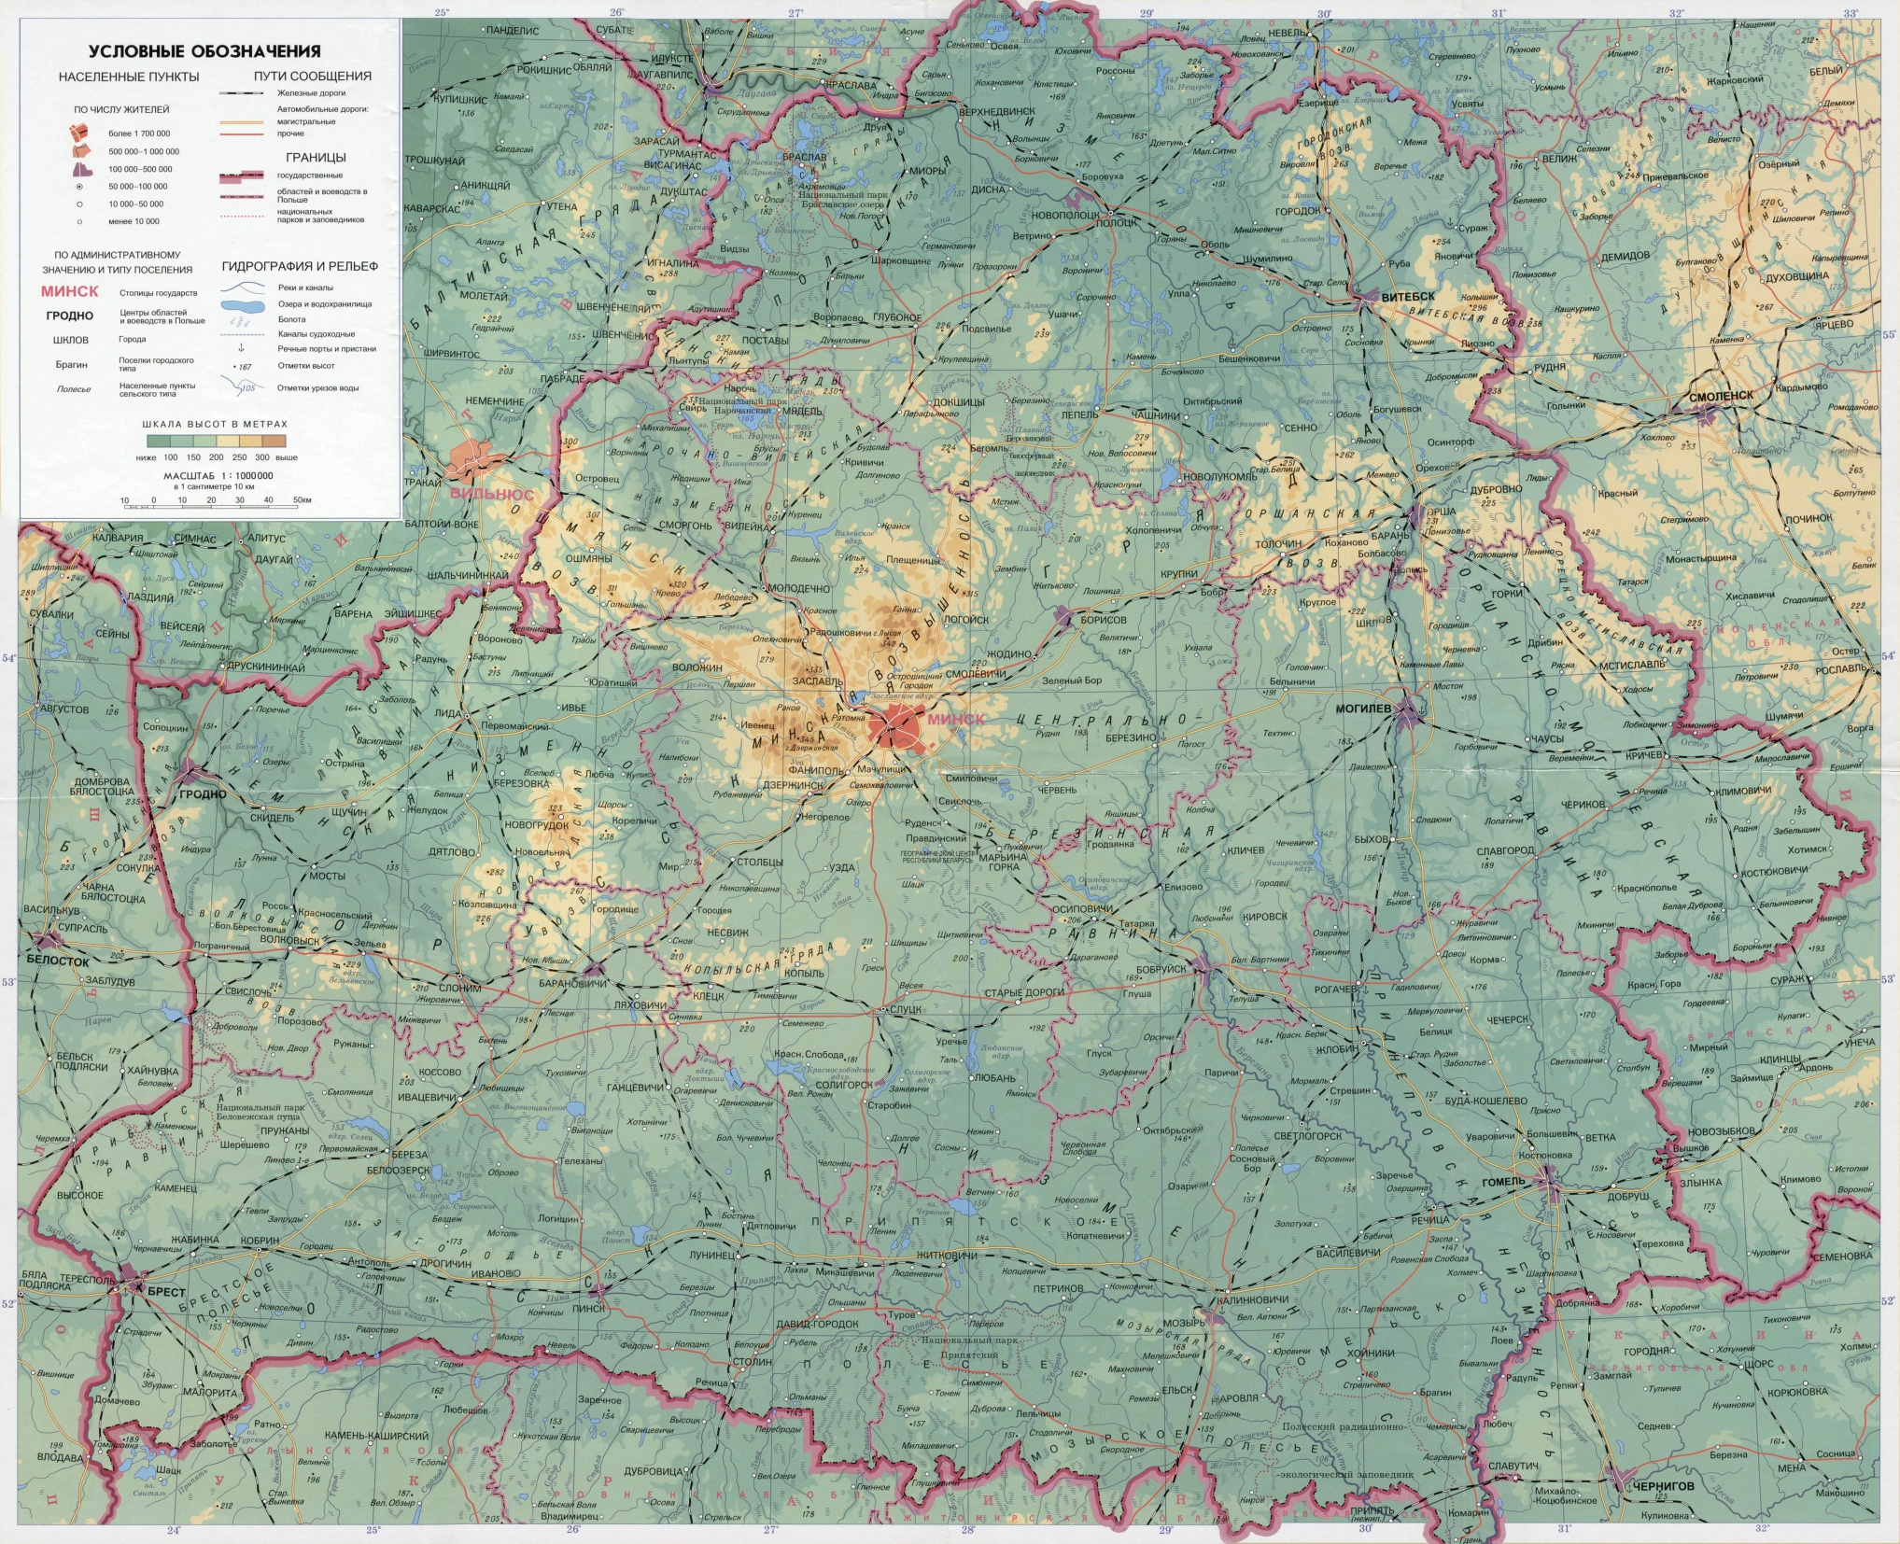





The Center of Hydrometeorology
Regional centers
Meteostations w/ agro observations
Meteostations w/o agro observations
Aviation meteorological stations
Hydrological informative stations
Hydrological lake stations
Sampling stations of:
snow cover
atmospheric precipitation
atmospheric air
Station of background monitoring
Station of transboundary transfer

Slide 14
The main objectives of the Center of Hydrometeorology and Radioactive Contamination Control and Environmental Monitoring of the Republic of Belarus are as follows:
primary data collection at the state hydrometeorological monitoring network;
collection, processing, analysis, maintenance and provision of information from the state hydrometeorological monitoring network;
hydrometeorological forecast, agricultural crop capacity forecast, analysis of regional climate changes;
provision of hydrometeorological information to state agencies, other entities and individuals in line with the established procedures;
environmental monitoring and radioactive contamination control.

Slide 15
Weather-compensated sectors of the economy are main users of services, provided by our organization.
Sector of economy
% of GDP
Agriculture | 9
Forestry | 1,5
Construction | 6,5
Transport | 7,5
Energy Complex | 11,3
Communal services | 5,8
41,6 % of GDP is produced by weather-compensated sectors

Slide 16
The estimated costs of met/hydro services
№ | Name | Cost in $ USA
1 | Forecast of the maximum possible flood on river on one hydrological station | 40 $
2 | Forecast of the minimum water stage on the river on one hydrological station during navigation period | 33 $
3 | Forecast of the rivers` ice break-up in spring | 44 $
4 | Forecast of the expected average daily air temperature in regional centers for 1-3 days | 9 $
5 | Professional consultation about the current hydro/meteorological conditions in the requested area | 11,5 $
6 | Forecast of meteorological conditions of the country (region, city) during the upcoming week | 16 $
7 | Forecast of the expected adverse hydro/meteorological phenomenon in the country (region, city) | 5 $
8 | Systematization of the hydro/meteorological data of the decade of the network offices | 25$

Slide 18
Amount of severe hydrometeorological events registered in the Republic of Belarus between 2000-2013 and their division on 3 types

Slide 19
Share of hydrological products in total hydrometeorological information, provided on a paid basis

Slide 20
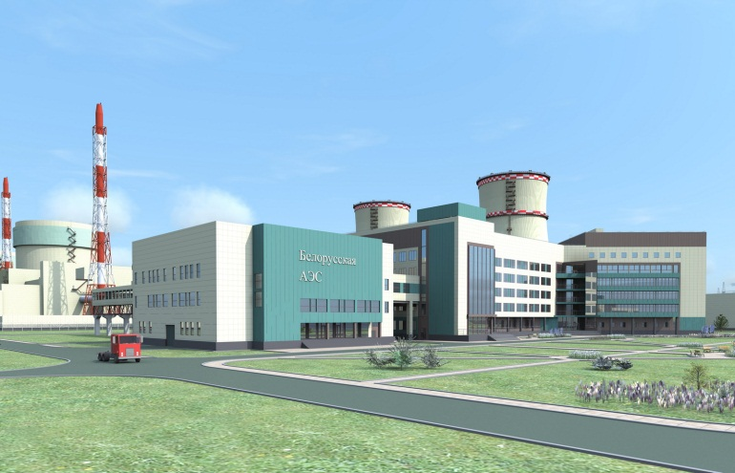
Plans for future
Surface weather observations:
technical re-equipment of all stations and installing automated weather systems with a set of sensors for main meteorological parameters (temperature, humidity, soil surface temperature, atmospheric pressure, wind parameters); equipping autonomous sources of electric power.
Weather radar observations:
purchase and installation of automatic rain gauges, their integration into the national system of storm warnings; the integration of the Belarusian network of weather radars to the international system of national meteorological networks
Upper-air observations:
restoration of radiosonde ascents in Minsk.
Hydrological observations:
modernization and automation of network of hydrological observations and installation of automated hydrological stations by 17 existing stationary observation points; translation of all hydrological stations for information, providing them with modern communication systems;
Radiation monitoring of air:
creation of a unified automated system of radiation monitoring of atmospheric air across the territory of the Republic of Belarus.
One of the main goals — hydro/meteorological observations in the area of influence of Belarusian NPS, that is under construction.

Slide 21

Support from WMO
As the part of the WMO Voluntary Cooperation Programme in the State Hydrometeorological Center was established workstation for hydrologist forecasters in 2009, which is the technological element of the complex GIS Meteo for the sum of $ 10 000 USA.
The equipment for the reception of satellite data - station EUMETSAT was delivered in 2010 (cost 8200 dollars USA), as well as software for processing satellite data "Meteogamma" worth $ 10 000 USA.
In 2012-2013 was performed the project "The Supply of technical equipment and combined software technologies "MITRA - GIS Meteo" in the State Hydrometeorological Center" with the help of the WMO Voluntary Cooperation Programme in the amount of 25,812 dollars USA.

Slide 22
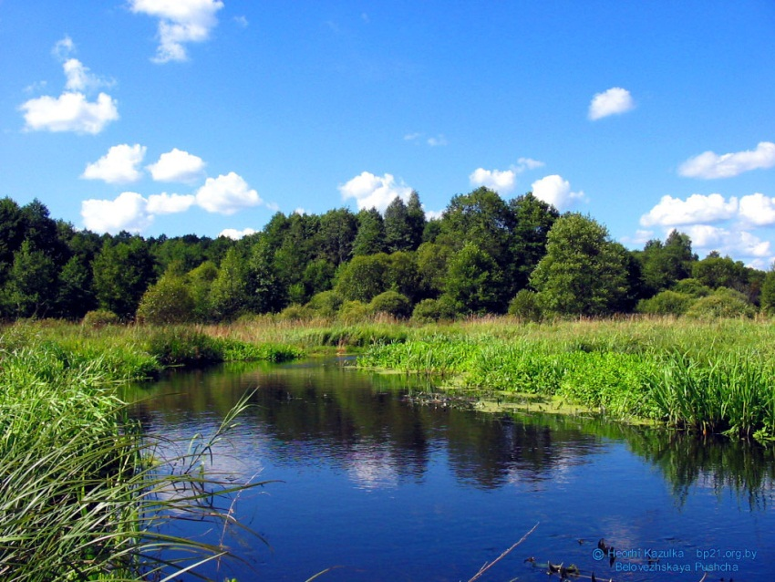
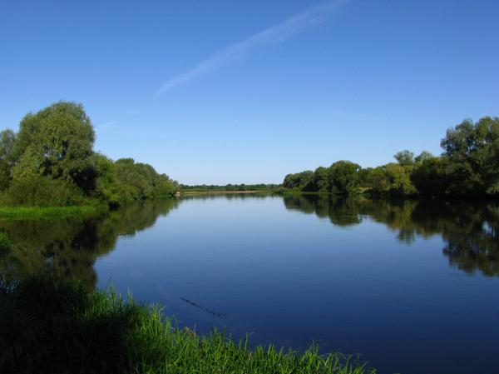
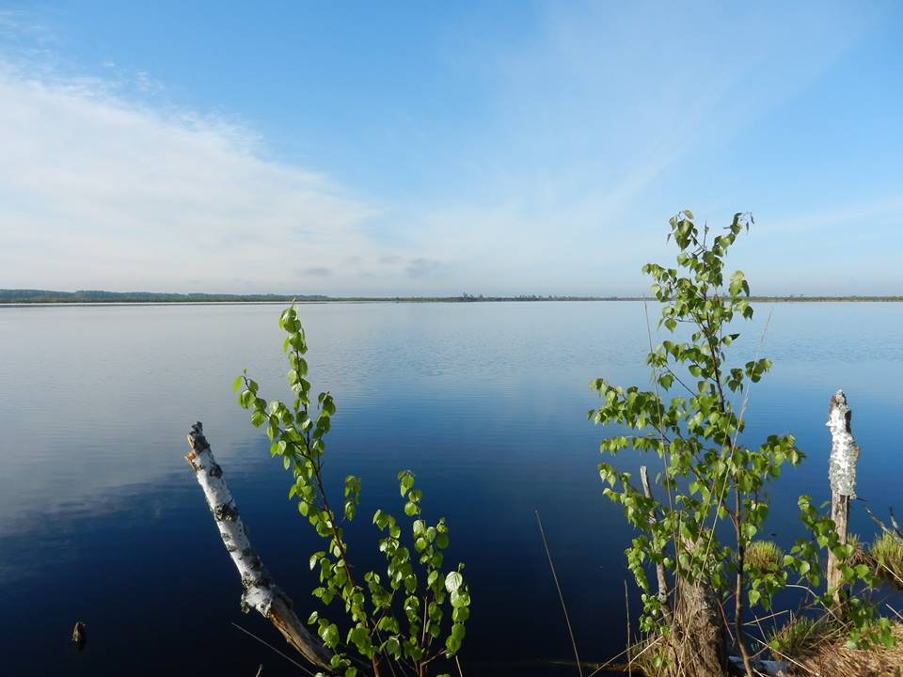
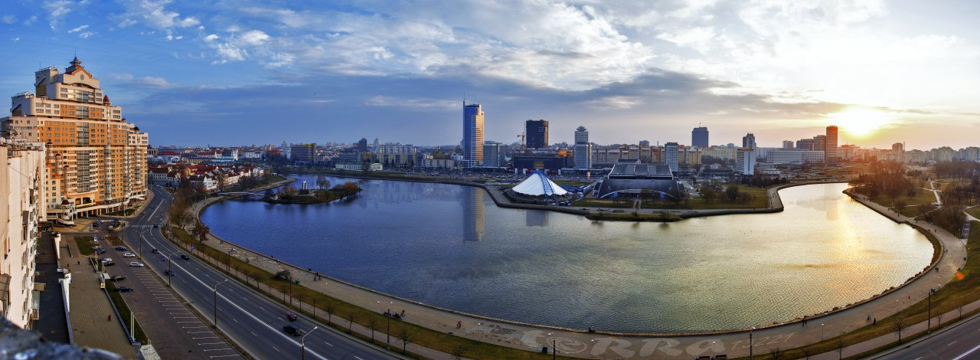
Thank you for attention!

