Slide 1
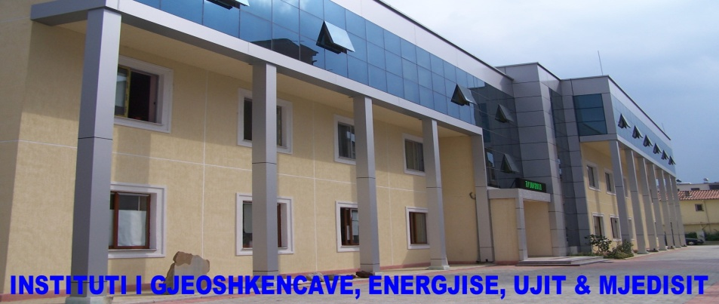
Training Workshop for National Meteorological and Hydrological Services (NMHSs) on Designing Socio-Economic Benefits Studies of Meteorological/Hydrological Services and Products for Members in Regional Association VI (Europe)
Zagreb, Croatia, 29 June - 3 July 2015
Hydrometeological service
ALBANIA
Prof.Dr. Petrit ZORBA
Head of the Department of Climate & Environment
UPT - I G E W E
Tirana, ALBANIA

Slide 2
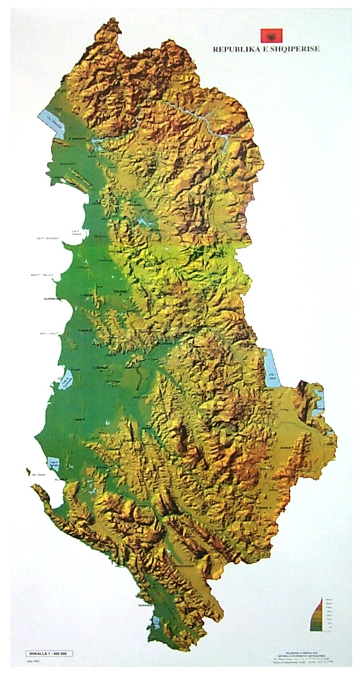
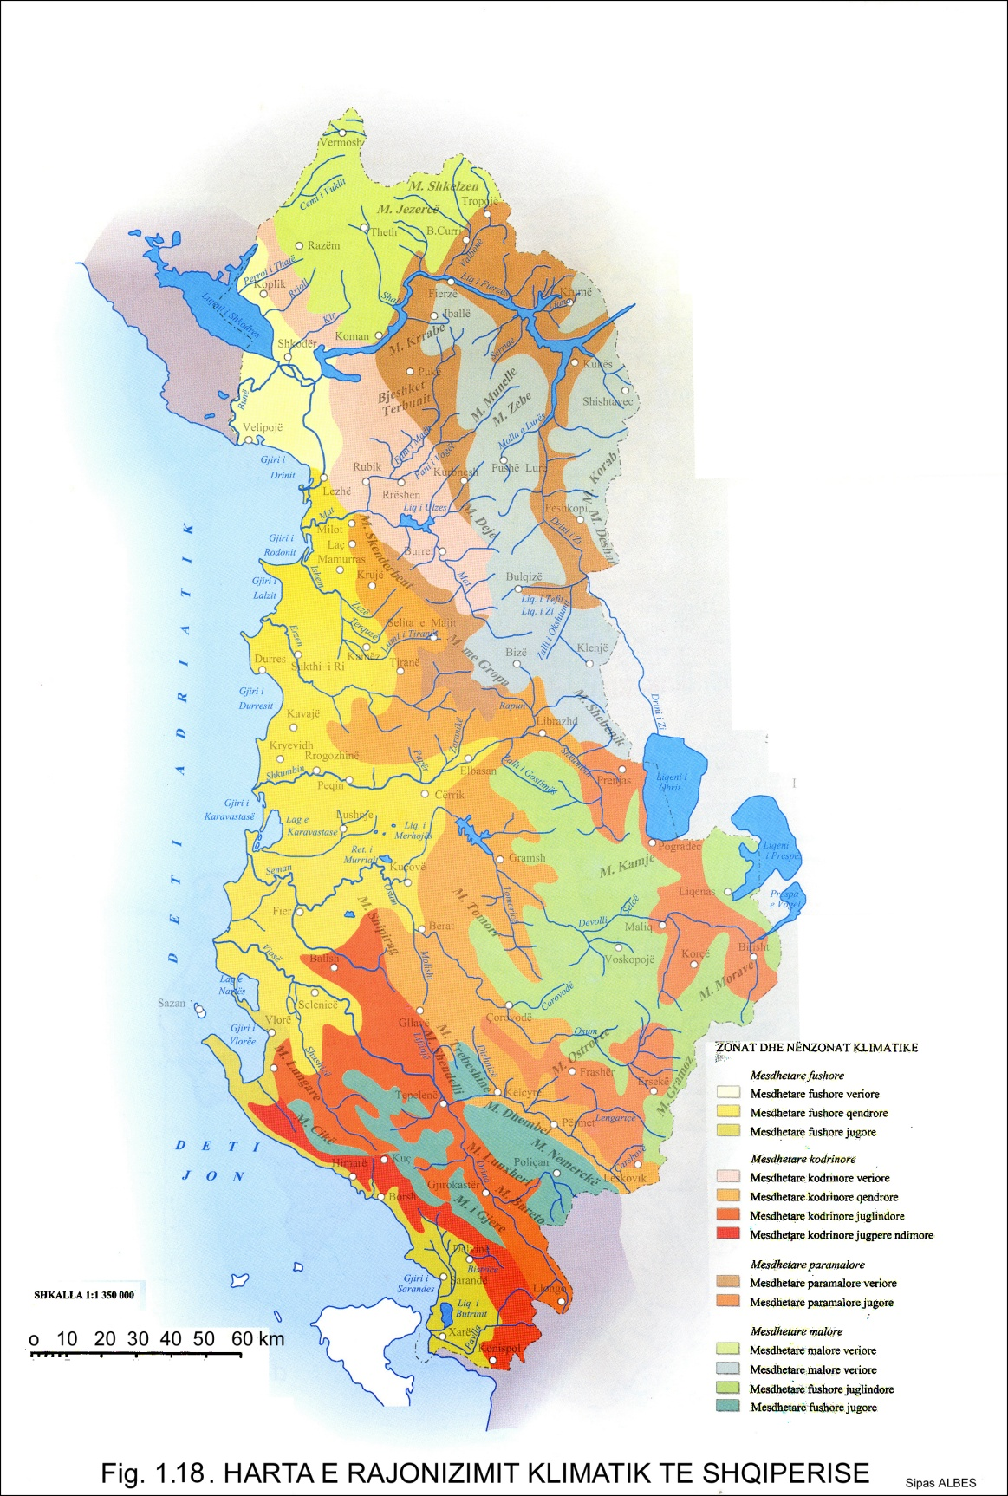
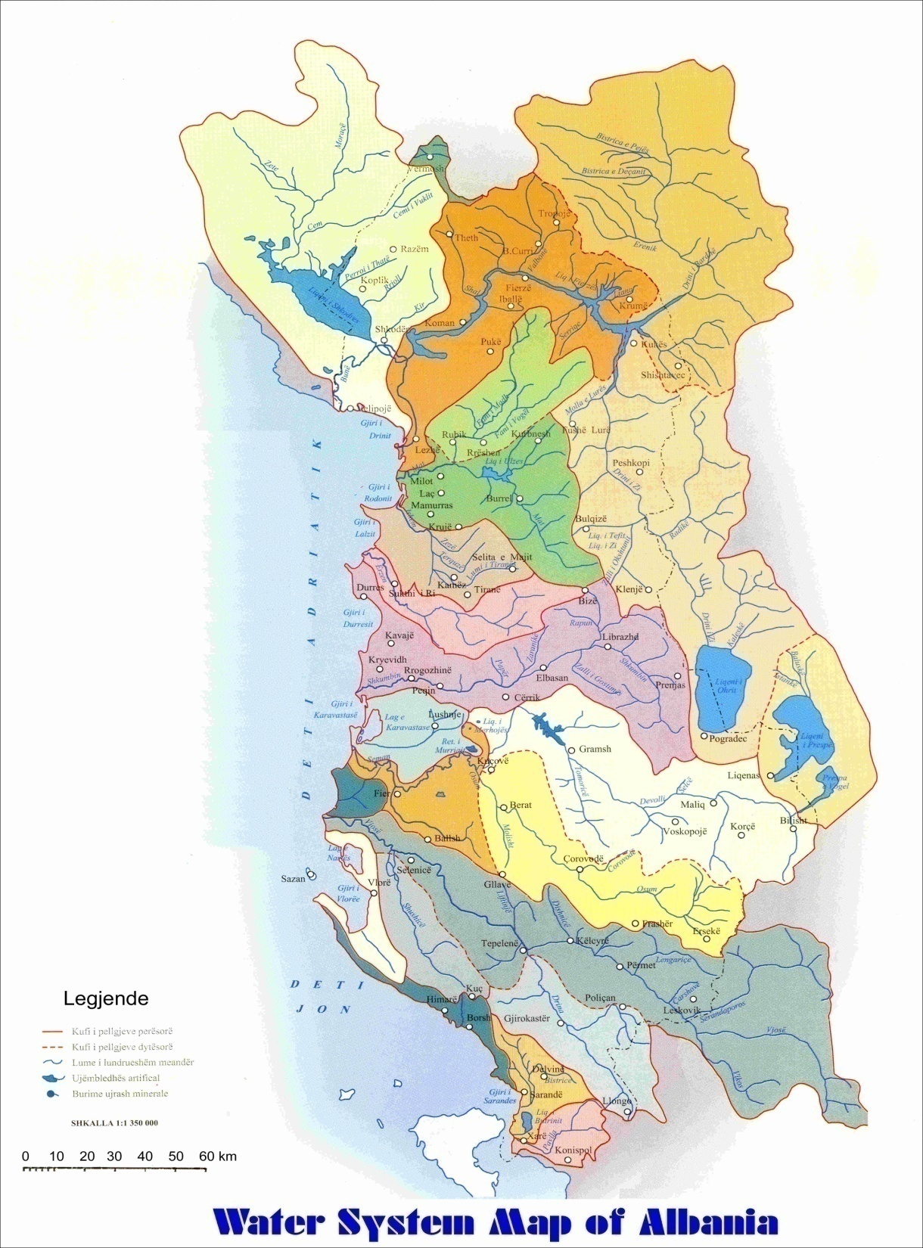
Climatic Zones of Albania
A L B A N I A
(estimate) 2015
Surface: 28,748 km²
Population: 2,9 million
GDP: Total $32.259 billion
Per capita $11,700
Capital: Tirana 0.7 million
Seaside line: 476 km
TIRANA

Slide 3
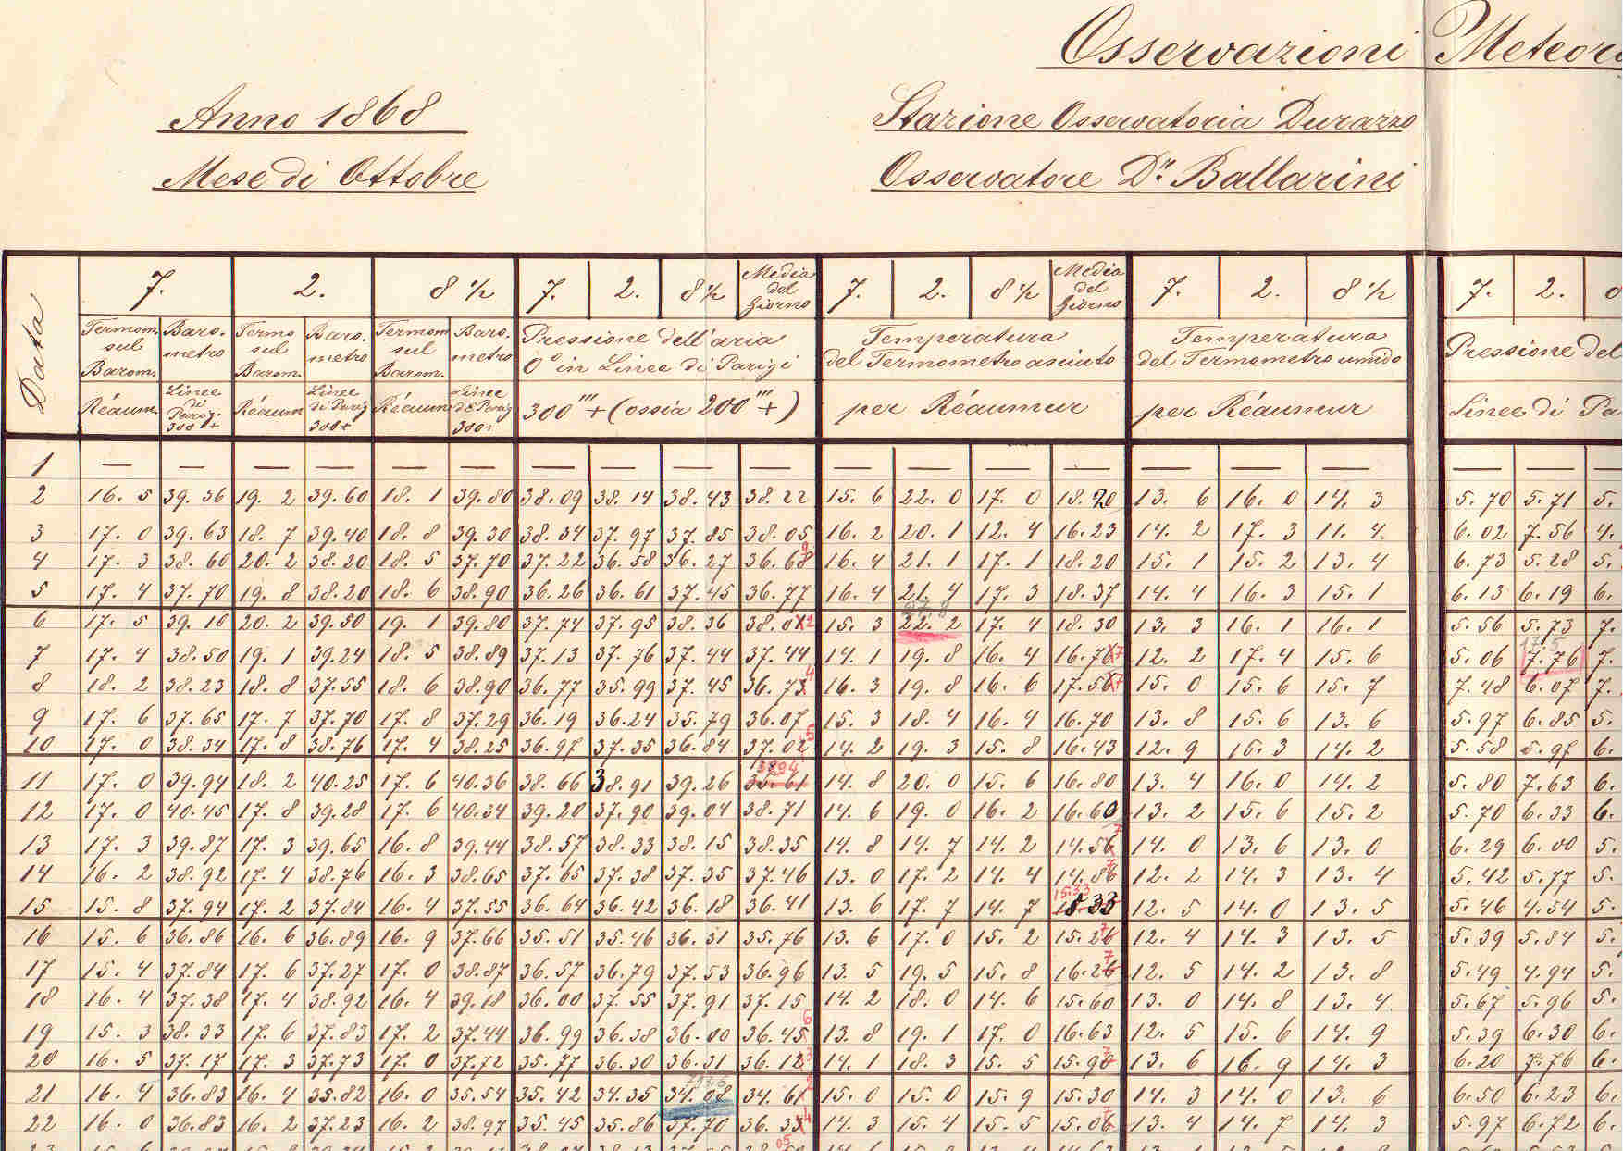
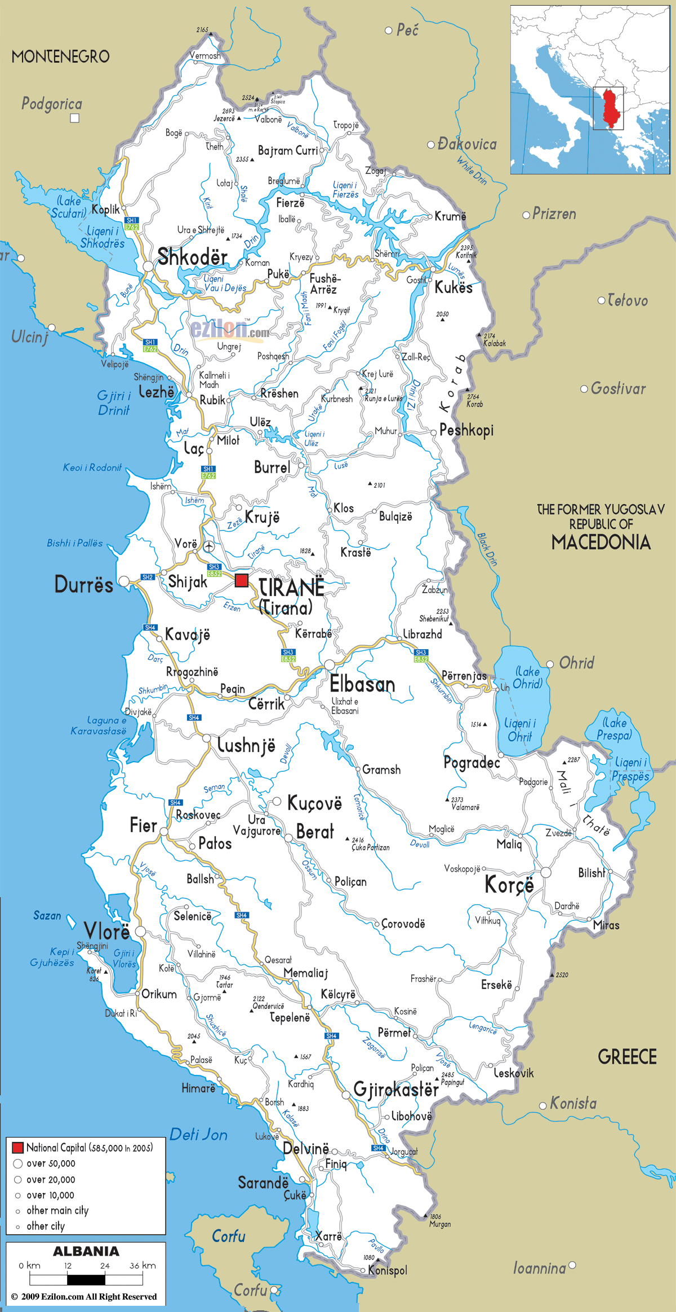
Short history
about hydrometeorological monitoring
1868 - The first meteorological observation in Albania
1949 - Directorate of Hydrometeorological Service,
under the jurisdiction of the Institute of Sciences of Albania.
1957 – WMO member (29 July 1957).
1962 - Hydrometeorological Institute (HMI)
is founded (G.R Nr.172, 14 May 1962).
1973-2007 - HMI - under the jurisdiction of
Academy of Sciences of Albania.
2008 - IEWE - under the jurisdiction of
Polytechnic University of Tirana (UPT)– Albania
2012 - IGEWE – Institute of Geosciences, Energy Water & Environment
under the jurisdiction of UPT – Tirana, ALBANIA
1868
Durrës
ALBANIA

Slide 4
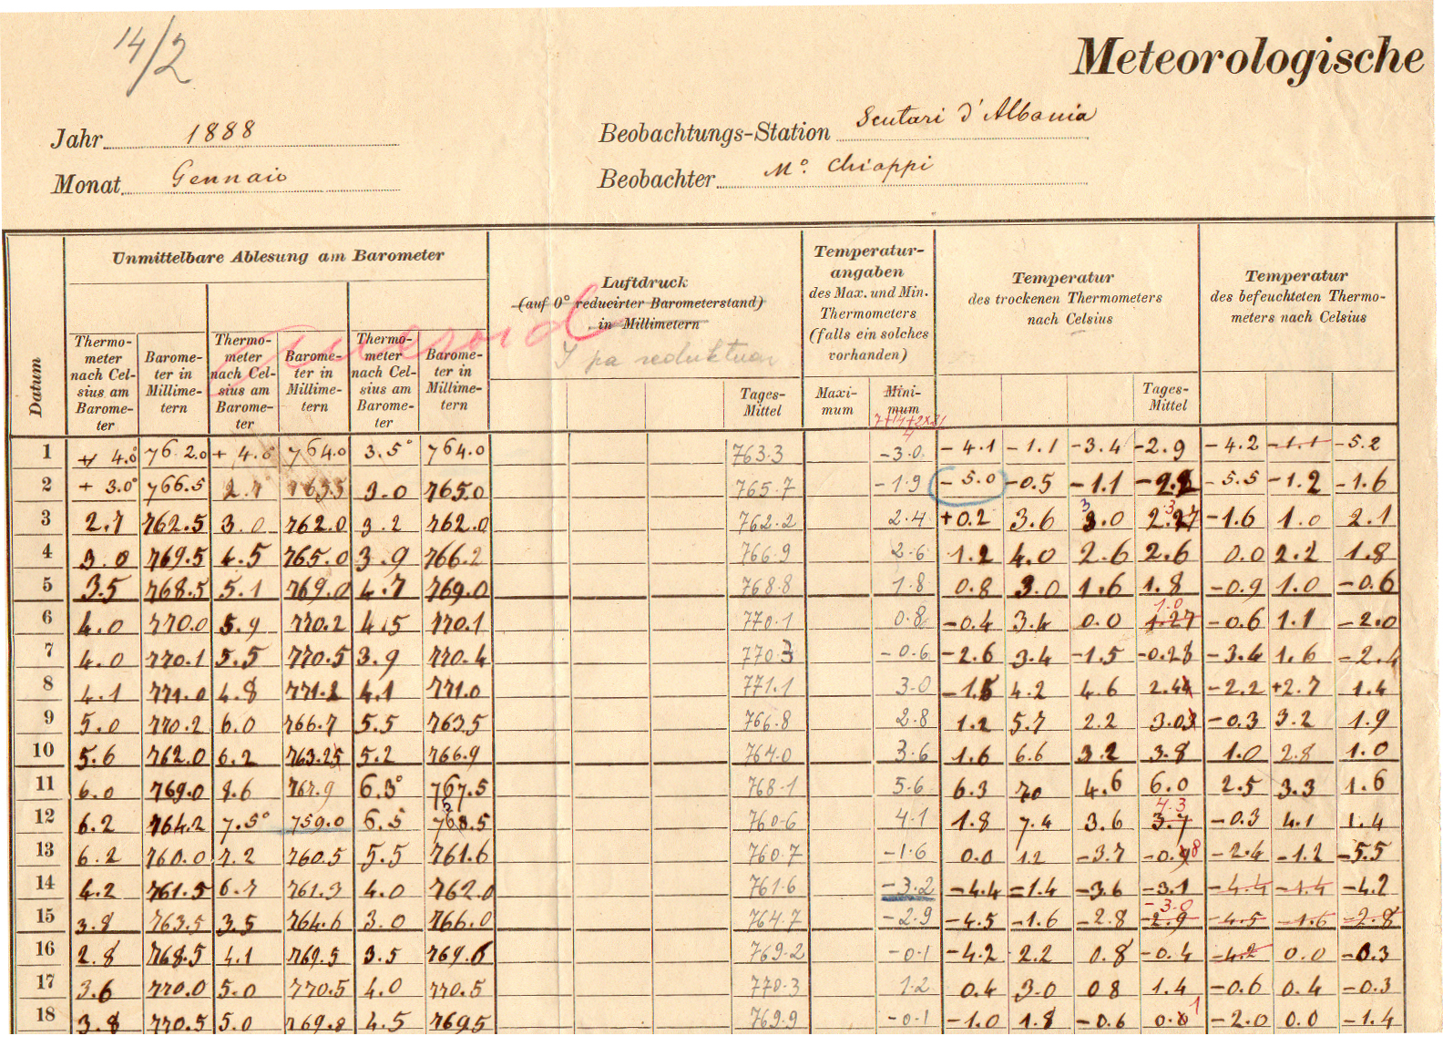
First Meteorological
observation
1888
Shkodër - ALBANIA
Shkodër
ALBANIA

Slide 5
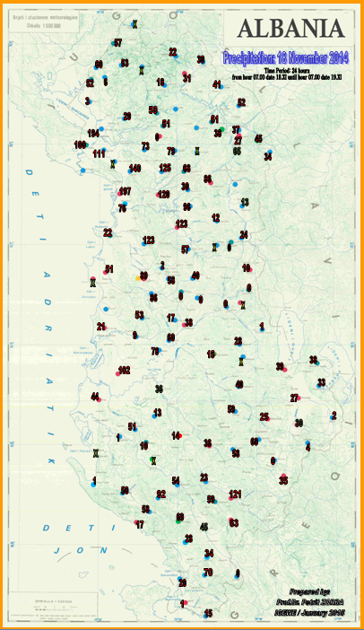
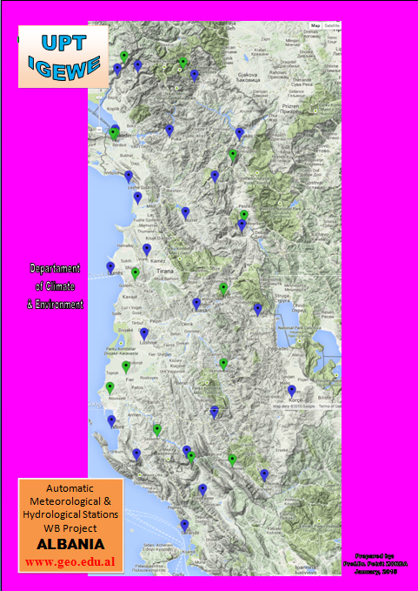
2015
20
Meteorological
Stations
(automatic)
135
Meteorological
Stations
(manual)

Slide 6
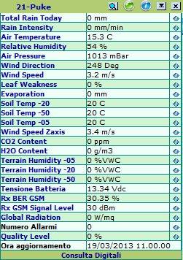
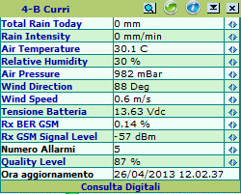
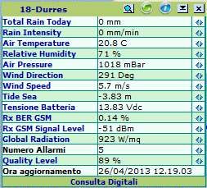
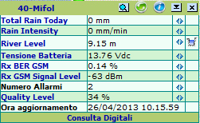
4
16
Agrometeorological
Stations
Meteorological
stations
Word Bank Project
Marine
Stations
Hydrological
Stations
16
4

Slide 7
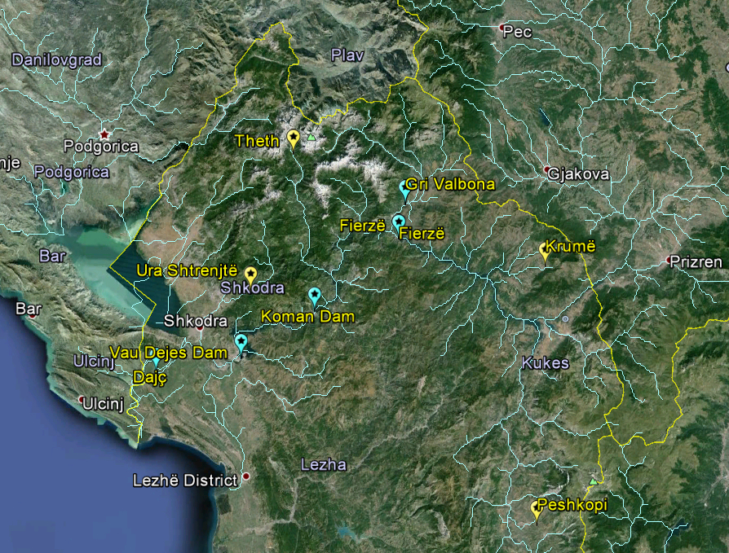
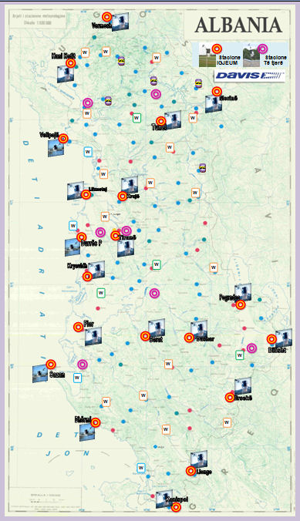
20
Meteorological
Stations (DAVIS-USA)
Ministry of
Education & Science
ALBANIA
5 Meteorological
5 Hydrological
Stations
(GIZ - project)

Slide 8
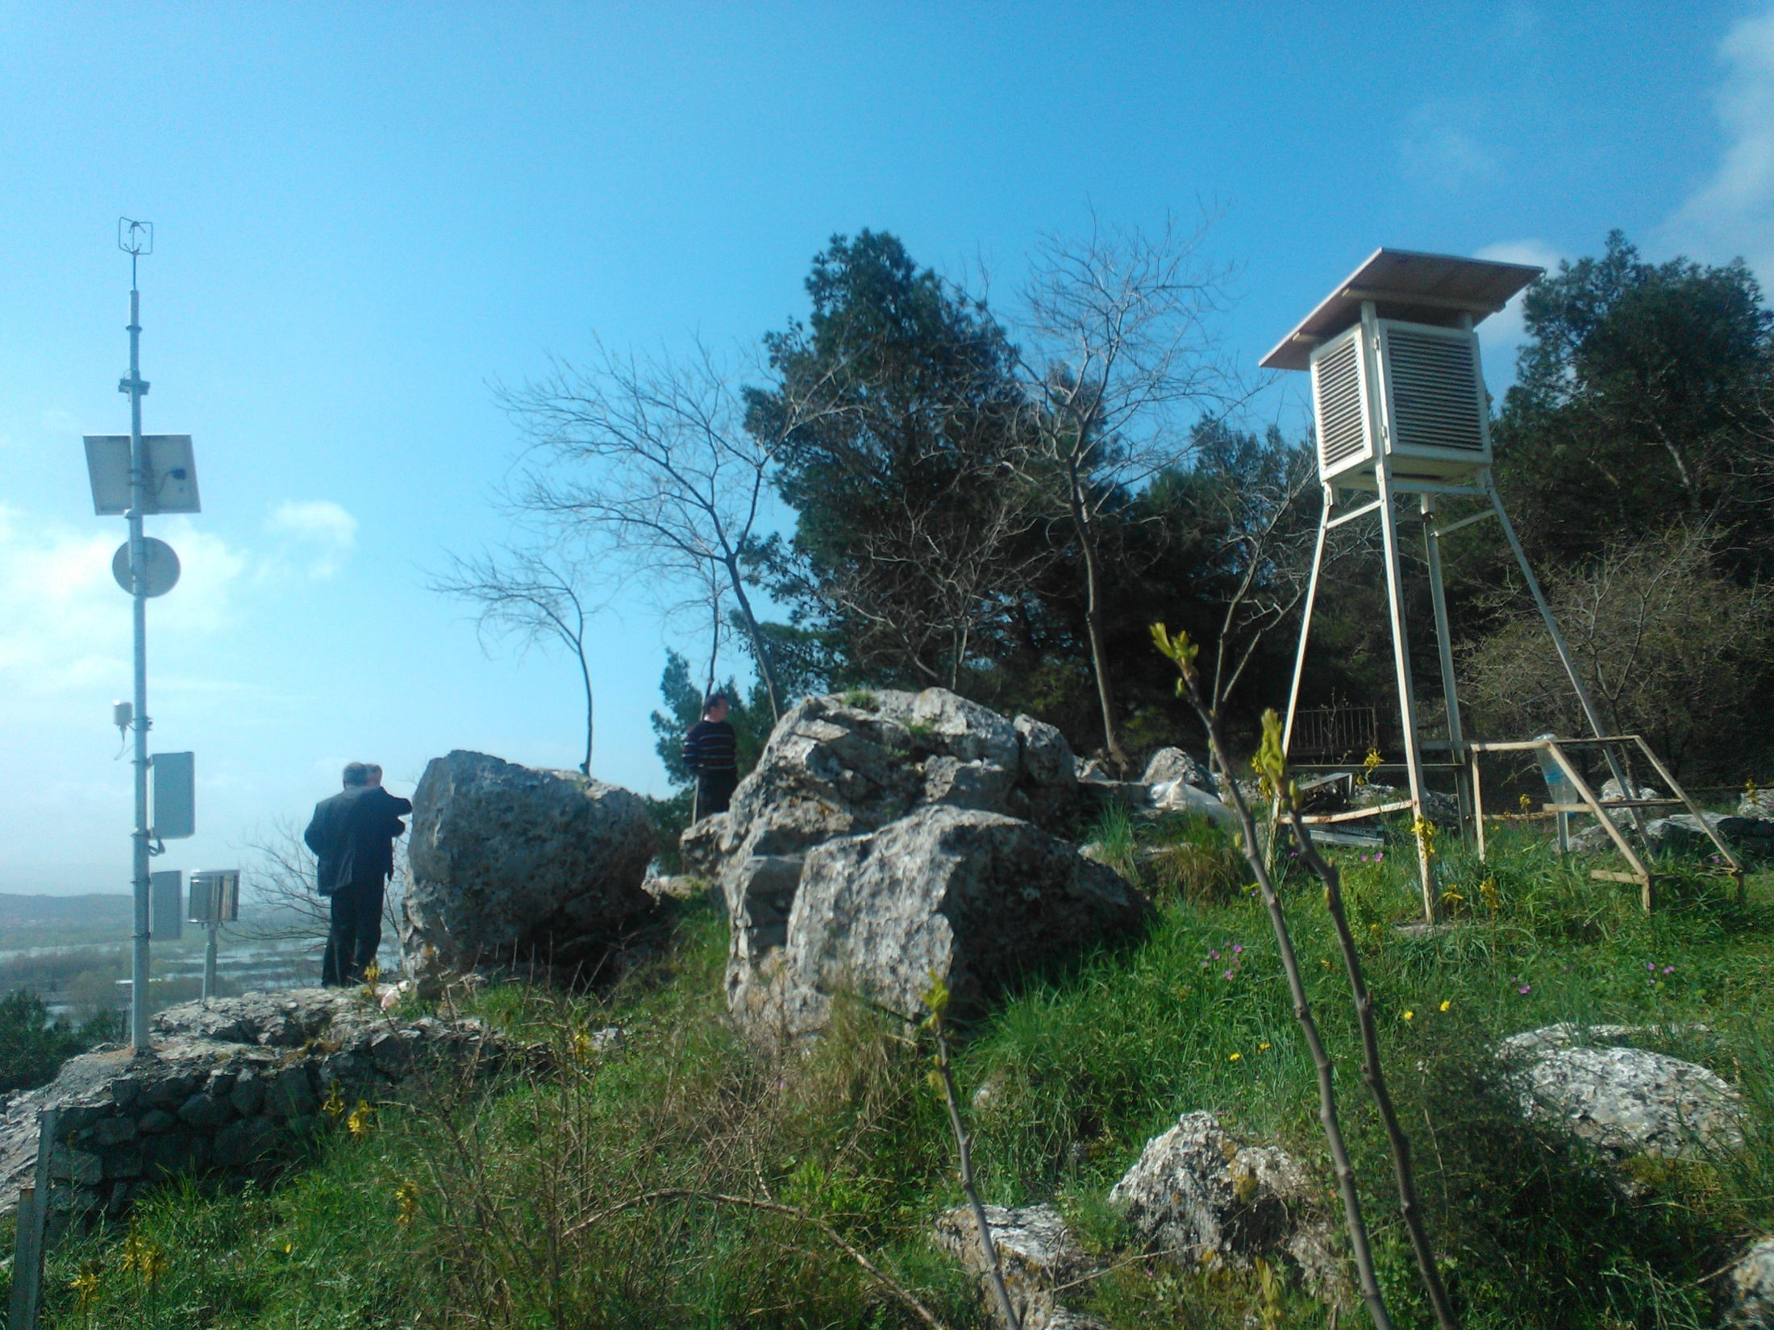
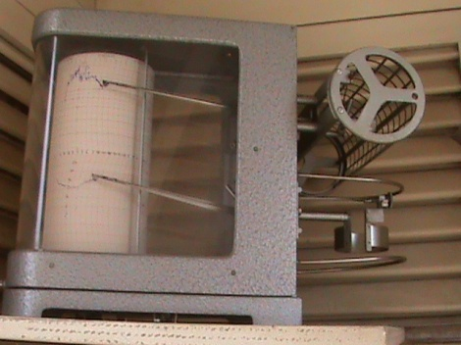
Shkodër
Fshati i Paqes
20
Automatic
Meteorological
stations
W

Slide 9
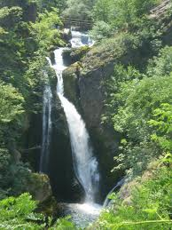
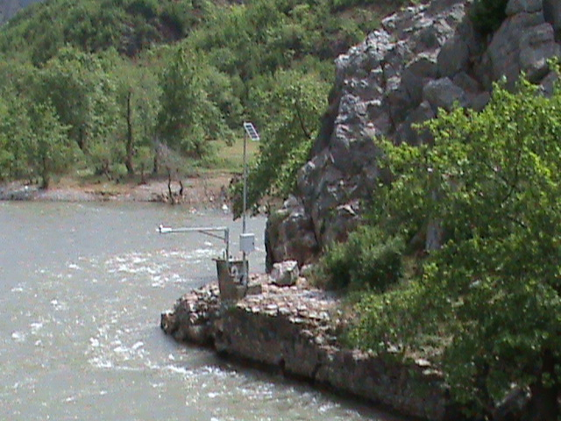
20
Automatic
Hydrological
stations

Slide 10
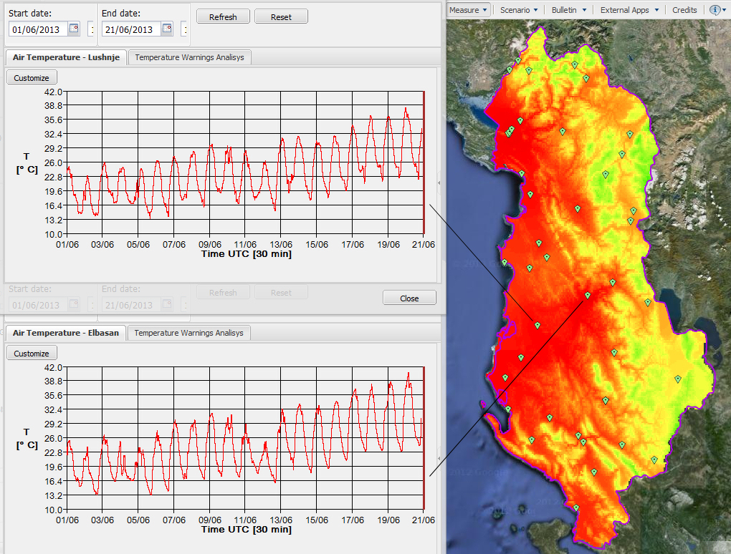

Slide 11
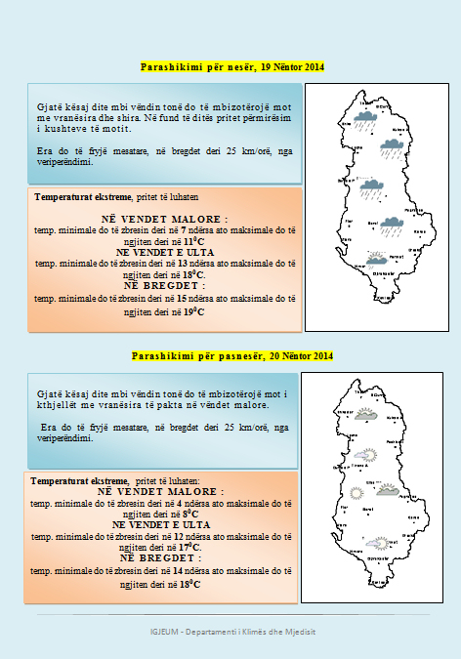
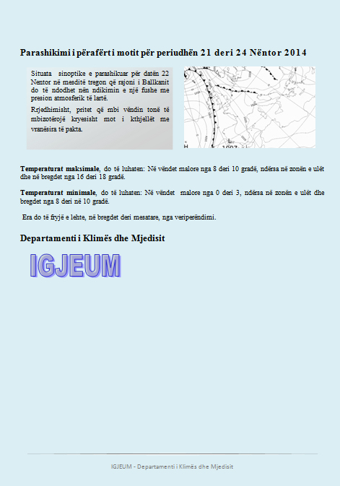
Daily
Meteorological
Bulletin
Issued at 09:00 AM

Slide 12
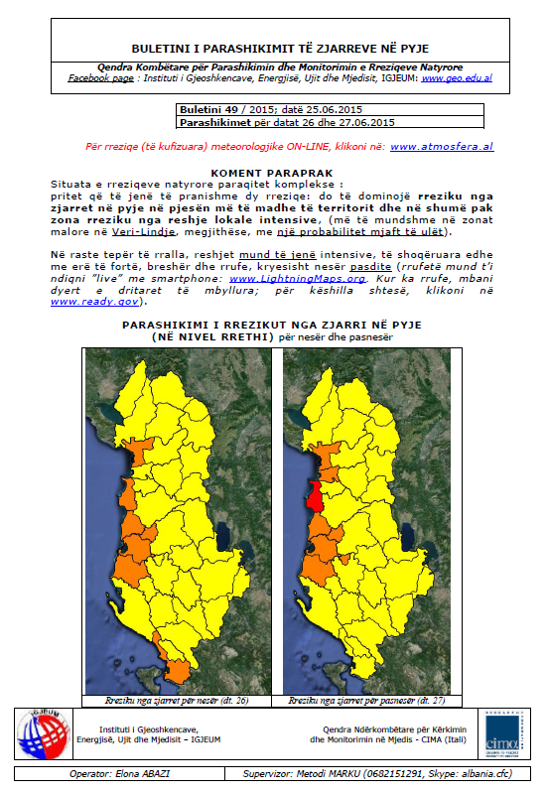
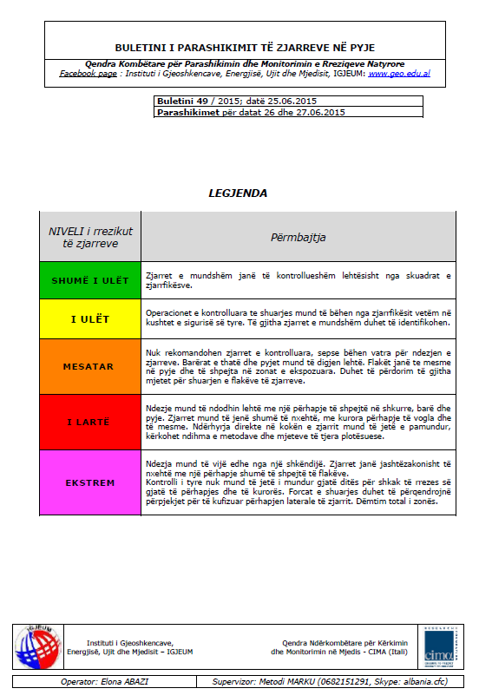
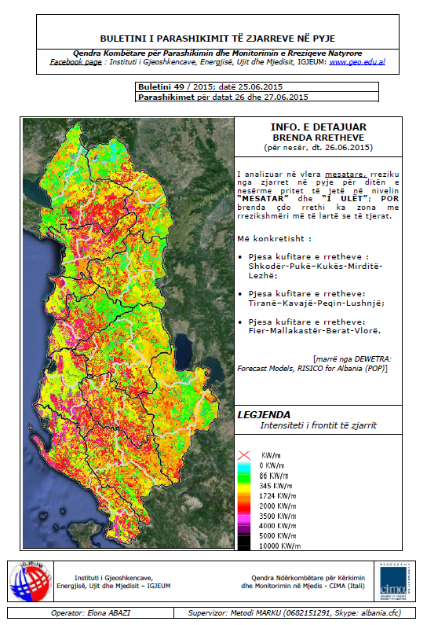
Daily Bulletin
on
Hydro-Meteorological
Hazards
Issued at 10:00 AM

Slide 13
PRE-WORKSHOP SURVEY
ALBANIA

Slide 14
1. Brief self-introductions of each representative, including at least:
a. Name; Petrit ZORBA
b. Organization; IGEWE
c. Current role; Head of the Department of Climate and Environment
Supervisor of National Meteorological Network of Albania
d. Brief background
Head of the Department of Climate and Environment, Institute of Geosciences, Energy, Water and Environment of Polytechnic University of Tirana.
Part time Lector at the Polytechnic University of Tirana (Environmental Engineer branch), Tirana University, Shkodra University and Elbasan University for the matter of Climatology at the Department of Geography and for the matter of “Risk evaluations”.
Participant in different national and international projects, such as World Bank Project for the Improvement of National Network of Hydro Meteorological Observations, GIZ project related to better monitor the flooding and minimising the impacts from natural disasters at the Buna and Drina river areas, and project related to the modernisation and implementation of new technology at the institute by the Ministry of Education and Sciences. Focal point for different IPA regional projects. Representative of Albania at the Project Coordination Committee for the South East Europe Flash Flood Guidance System.
Main expertise in application and use of meteorological and climatological information in different branch of economy, risk management, climate change, renewable energy and agrometeorology. Member of international organizations like: AMS, CMS, INSAM, WASWC, SMF, etc. Representative of Albania to WMO – CAgM commission in Geneva.
Last publications are the books: “Klimatologjia – Tirana, 2009 and the “Dukurite e demshme atmosferike ne aviacion” (Aviation Hazards) in 2013, Tirana. Also participant in different national and international conferences, workshops, etc.
The last one is the contribution as a co-organiser for the “EUMETSAT Information Day”, 18-19 March 2015 in Tirana, Albania.
Institute of Geosciences Energy, Water & Environment (IGEWE) Rr. Don Bosko, Nr.60, Postal code: 1024, P.O.Box: 219, Tirana, ALBANIA E-mail: petrit.zorba@gmail.com Web site: http:www.geo.edu.al Tel:++355 42 250 601 Mob. Phone:++355 68 21 51 684

Slide 15
I G E W E - ALBANIA
National activity of our institute is based to the work done by the staff of 71 persons. (9 Professors, 37 with other scientific degree and 8 technicians, as well as the administrative staff of 17 persons. The network has 257 observers.
The annual state budget is: 999 200 USD
Total salary of the staff and observers: 149 500 USD
Operative costs: 849 700 USD
The total value of the capital of Hidmet: 2.64 million USD
Annual profit from various activities: 25 000 USD
National and International Projects:
Ministry of Education & Science: 200 000 USD
UPT Excellence projects: 34 000 USD
Word Bank: 700 000 USD
AdriaRadnet (EU): 150 000 Euro
IPA – EU: 140 000 Euro
NATO: 130 000 USD
GIZ: 150 000 Euro
Italian cooperation: (in progress) 216 000 Euro
Department of Meteorology
(Climate & Environment)
Staff: 8 persons
Department of Hydrology
(Water economy)
Staff: 14 persons

Slide 16
2. Background on the representatives’ country, including at least:
a. Map/location; Tirana, ALBANIA
b. Population; 2.9 million
c. Latest annual Gross Domestic Product (GDP) in USD; $32.259 billion
d. Composition of GDP (% agriculture, services, industry); Agriculture: 18.4%, Industry: 16.3%,
Services: 65.3%
e. Main industries; Mine and metallurgy,
f. Main climate - and weather-related hazards;
The climate on the coast is typically Mediterranean with mild, wet
winters and warm, sunny, and rather dry summers.
Weather hazards: flooding, forest fires, droughts, etc.
g. (Hint: much of this info is available on the US CIA World Factbook)
Agriculture
The agricultural sector, which accounts for almost half of employment but only about one-fifth of GDP, is limited primarily to small family operations and subsistence farming, because of a lack of modern equipment, unclear property rights, and the prevalence of small, inefficient plots of land.
Technical and non-technical losses in electricity - including theft and non-payment - continue to undermine the financial viability of the entire system, although the government has taken steps to stem non-technical losses and begin to upgrade the distribution grid.
ENERGY
Also, with help from international donors, the government is taking steps to improve the poor national road and rail network, a long-standing barrier to sustained economic growth.
TRANSPORT

Slide 17
GDP - real growth rate:
2.1% (2014 est.)
0.4% (2013 est.)
1.1% (2012 est.)
Meteo airport
One of 4 main tools of air traffic of each country is the
Meteorological service at the airport.
- Preparation and transmitting of various bulletins likes:
METAR, MET/REPORT, MET/REPORT SPECIAL, SPECI, AERODROME WARNING, WIND SHEAR WARNING, TAF, LAF, etc.
The air companies for that service pay a bill that is around 5-10 % of landing bill.
Also are produced messages for the space air of the country (FIR ALBANIA) for aviations hazards SIGMET & AIRMET, that are paid by the air companies flying on our air space.
This and other services above mentioned surpass the costs for the staff and equipments that are used.
GDP - composition,
by sector of origin:
agriculture: 18.4%
industry: 16.3%
services: 65.3%
Agriculture - products: wheat, corn, potatoes, vegetables, fruits, sugar beets, grapes; meat, dairy products; sheep
Industries: food and tobacco products; textiles and clothing; lumber, oil, cement, chemicals, mining, basic metals, hydropower.
Industrial production growth rate: 3.7% (2014 est.)

Slide 18
3. Background on the representatives’ met/hydro services organization, including at least:
a. Brief description of the organization; State organization (UPT - Ministry of Education)
b. Number of staff; 71
c. Annual budget: 999 200 USD USD
d. Range of products and services provided, and the main sectors that use them;
Daily meteorological bulletin and for Civil emergencies. Weather forecast.
Studies, reports, data, etc. are main outputs for our clients.
e. To the extent possible, the estimated costs of your met/hydro services, broken
down into areas such as observing systems, forecasting, climatology, tech
support, admin, etc.; Support the private companies or state institutions to choose the right one
hydro-meteorological stations or data for their purpose.
f. One sector where you feel your organization is strong (i.e. makes a significant
contribution to societal or economic benefit) and one sector where you feel
your organization is weak; Civil emergencies, Agriculture, Aviation and Hydropower's companies.
g. Significant funding gaps or new products/services you are seeking funding to
develop/implement; and For: maintenance, setting up new equipments and data management.
Qualified staff for meteorology and hydrology is highly requested because every year get in pension different qualified people, but not replaced with new generation.
h. Main funding sources for operations and capital equipment (e.g. have you
received support from donors or MDBs to purchase capital?).
We get support from the Albanian state, Ministry of Education and Science, IPA projects, EU, Bilateral country projects, NATO projects, WB project, GIZ, Italian cooperation, etc.

Slide 19
Based and referring to the information presented at the book:
"Valuing Weather and Climate: Economic Assessment of Meteorological and Hydrological Services (WMO-No. 1153)"
The World Bank Group, with a current hydrometeorological investment portfolio of
around US$ 500 million, estimates that globally improved weather, climate, and water observation and forecasting could lead to up to US$ 30 billion per year in increases in global productivity and up to US$ 2 billion per year in reduced asset losses.
!
Properly planned investments in hydrometeorological services provide significant benefits relative to their costs.

Slide 20
4. Expectations from workshop
a. Each representative should speak briefly about what they hope to learn or gain
from the workshop, and how they plan to use this in their future work.
How to improve the performance for project implementation by different organizations, respecting first of all the meteorological standards of WMO .
How to increase the publicity of hydrometeorological service, other than traditional ways.
Any information how are integrated the new technology of communication for dispatching of hydrometeorological product for the large public and for the institutions.
By a better understanding how to calculate the benefits evaluations from hydrometeorological service; can be more easy to convince the government for the importance of our service and get more support.

Slide 21
Who benefit from our service in
ALBANIA :
- Agriculture economy
- Energy sector &
Water management
Air transport
Civil emergencies
Tourism sector
Construction industry
Insurance companies
Education system
etc.
Some considerations about our
service and information:
Sensibility of people is increased on now days
All the enterprises that collaborate with international partners need our service.
Civil emergencies have a god cooperation
Media generally during hazard events
Airport has to be main collaborator soon
Agriculture and Energy sector are
expressing more interest recently

Slide 22
By implementing right projects in right time and by right people !
We should
protect
the climate of our planet
Thank you
Prof.Dr. Petrit ZORBA
Head of the Departament of Climate & Environment
IGEWE – Tiranë ©2015
E-mail: petrit.zorba@gmail.com
Mob Phone:00355682151684

