Slide 1
Measuring Benefits
Jeffrey K .Lazo, PhD
Director – Societal Impacts Program
National Center for Atmospheric Research
Mahe Island, Seychelles
Wednesday, 6 May 2015
0900 - 0945

Slide 2
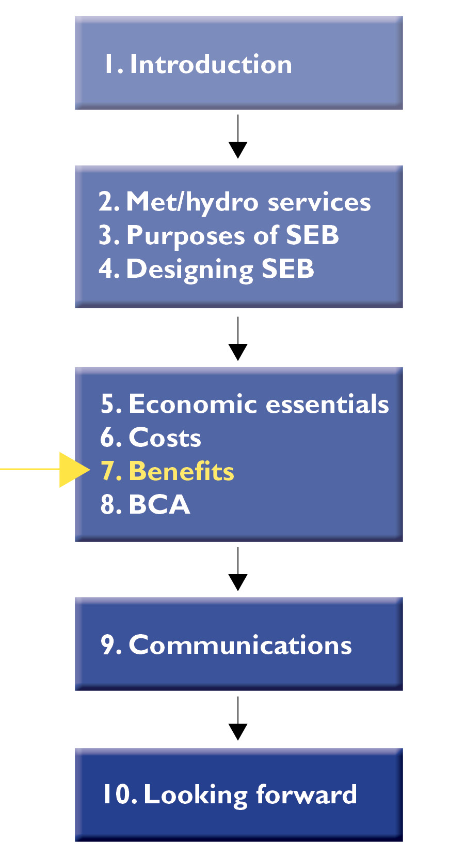
Purpose and Desired Outcome
Purpose
Basic idea of methods for measuring benefits
Understand some major issues in measuring benefits
Desired Outcome
Identify methods for estimating benefits of hydrometeorological products and services

Slide 3
What I will cover
Understanding the value chain – some relevant concepts and general categories of benefits
General process for conducting benefits analysis
Quantify and monetize the value of benefits
Qualitatively describe and analyze benefits that aren’t monetized
Deal with uncertainty surrounding benefit estimates
Conclusion

Slide 4
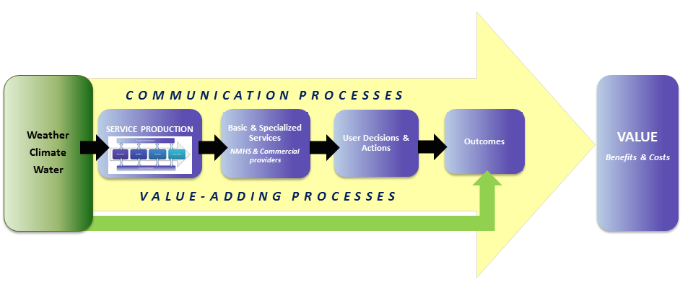
Value Chain Concepts
Triple Bottom Line accounting
Market vs. non-market benefits
Marginal vs. non-marginal benefits
Ex-ante and ex post analyses

Slide 5
General categories of benefits
Economic sectors:
Increased profits
Cost savings (e.g., for energy utilities)
Avoided or minimized losses (e.g., responding to a drought forecast in agriculture, protection of property in storms and floods)
Individuals and households:
Increased welfare from decision-making on improved information
Avoided loss of life, illness, or injury
Reduced loss of property

Slide 6
TBL benefits of met/hydro services
Social | Reduced loss of life/injuries/illnesses from natural disasters Improved information and data to the scientific community Contribution to the day-to-day safety, comfort, enjoyment and general convenience of citizens, including recreation and travel and commuting
Environmental | Long-term monitoring of basic indicators of the state of the environment Minimization of release of toxic substances and other pollutants Support for addressing major global environmental issues Water savings
Economic | Avoidance of crop losses from frost, hail or drought Reduced transportation fuel costs through route planning Minimization of drought relief costs More efficient planning of energy production and delivery

Slide 7
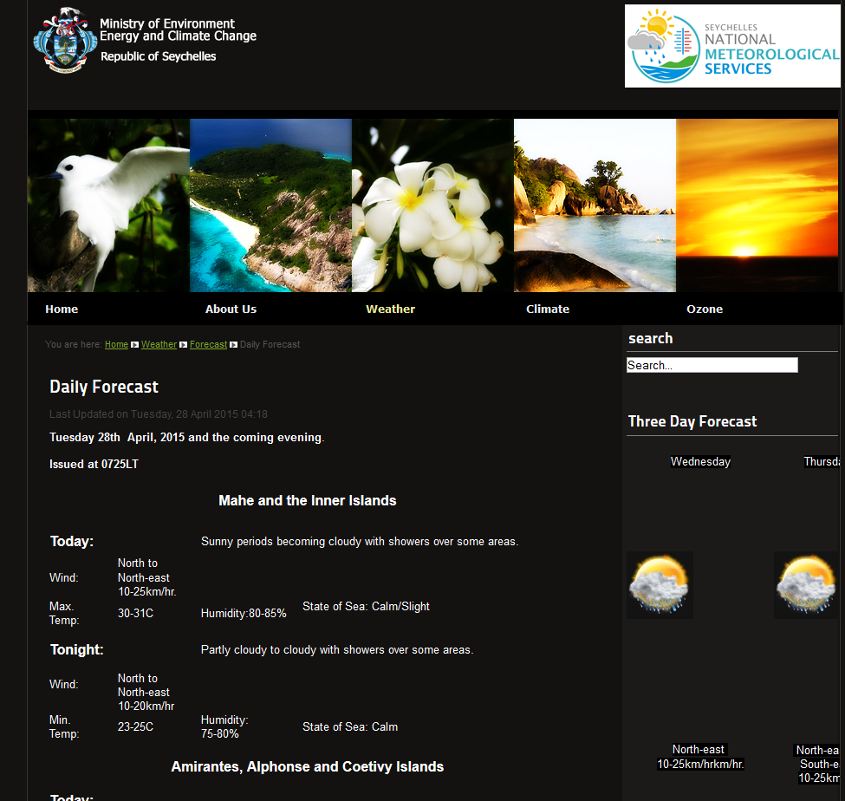
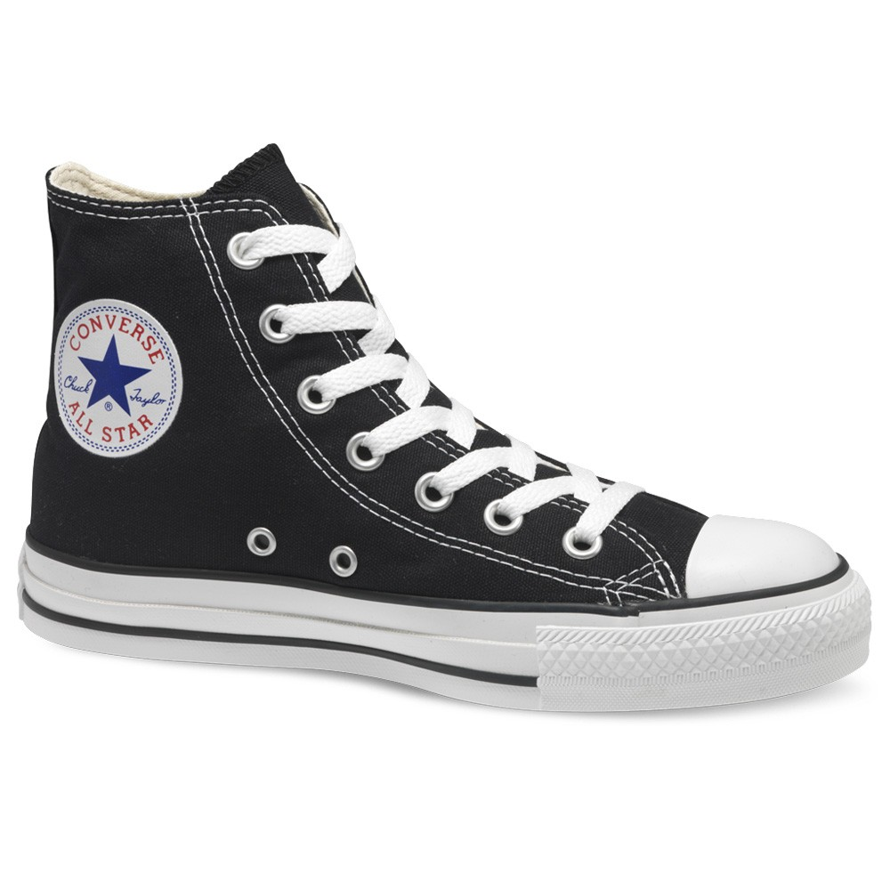
Market vs. non-market benefits
What is the price?

Slide 8
Value Chain Concepts
Triple Bottom Line accounting
Market vs. non-market benefits
Marginal vs. non-marginal benefits
Ex-ante and ex post analyses

Slide 9
General process for benefits analysis
Identify the full suite of economic, social and environmental;
Screen benefits and select the analytical approach;
Quantify and monetize the value of benefits identified;
Qualitatively describe and analyze benefits that aren’t monetized;
Deal with uncertainty surrounding benefit estimates.

Slide 10
Identify full suite of benefits
Marine resource
mgt. benefits
New
supercomputer
Agriculture
benefits
Private sector
benefits (e.g.,
highways)
Marine
transportation
benefits
Improved
environmental
modeling
International
benefits
Total Benefits
Household benefits
Improved
operational
forecasts
Retail
benefits
Energy benefits
Aviation
benefits
Air Force
benefits
Energy benefits
(temps, wind)
Army
benefits

Slide 11
Select analytical approach
Benefits Transfer
Marine resource
mgt. benefits
Agriculture
benefits
Econometric models
Private sector
benefits (e.g.,
highways)
Marine
transportation
benefits
New
supercomputer
Improved
environmental
modeling
International
benefits
Total Benefits
Household benefits
WTP Survey
Improved
operational
forecasts
Retail
benefits
Energy benefits
Aviation
benefits
Value of statistical life
Air Force
benefits
Energy benefits
(temps, wind)
Army
benefits

Slide 12
General process for benefits analysis
Identify the full suite of economic, social and environmental;
Screen benefits and select the analytical approach;
Quantify and monetize the value of benefits identified;
Qualitatively describe and analyze benefits that aren’t monetized;
Deal with uncertainty surrounding benefit estimates.

Slide 13
Quantify / monetize benefits identified
Sector Specific / Benchmarking / Expert Elicitation
Non-market valuation techniques
Stated preference methods
Revealed preference methods
Economic decision modelling
Decision analysis
Equilibrium models
Econometric models
Avoided cost/damage assessments
including avoided mortality and morbidity impacts
Benefits transfer

Slide 14
Quantify / monetize benefits identified
Sector Specific / Benchmarking / Expert Elicitation
Non-market valuation techniques
Stated preference methods
Revealed preference methods
Economic decision modelling
Decision analysis
Equilibrium models
Econometric models
Avoided cost/damage assessments
including avoided mortality and morbidity impacts
Benefits transfer

Slide 15
Sector Specific / Benchmarking
Compare order-of-magnitude benefits of reducing damages from weather-related events to the costs associated with improving met/hydro services
Direct and Indirect economic losses
Direct economic losses - caused by direct destruction, breakdown or damage to any types of property and tangible assets
Indirect economic losses - losses that a business entity or economic sector suffers because of decreased revenues or additional expenditures on production cycles
Sector-specific Approach: Uses available country data and surveys of national experts from NMHS and weather-dependent sectors to:
estimate current sectoral losses from weather events and
mean annual level of direct losses from met/hydro hazards and unfavorable events varies between 0.1% to 1.1% of GDP
determine the potential reduction in losses that modernization would achieve.
share of prevented losses may vary from 20% to 60% of total weather and climate-related losses

Slide 16
Benchmarking
assesses the losses caused by earlier events and estimates the reduction in losses that could be achieved with improved services
relies on expert opinion and readily available data to assess the vulnerability of the country’s overall economy to weather-related events
direct damages caused by weather impacts.
Benchmarking is carried out in two stages:
Determining benchmarks – Using data and estimates from other countries and expert judgment, the authors define and adjust the following two benchmarks for each country:
The level of annual direct economic losses caused by met/hydro hazards and unfavorable weather events, expressed as a share of GDP; and
The level of annual prevented losses, with and without modernization, expressed as a percentage of the total level of losses.
Correcting benchmarks
Data adjusted to benchmarks according to country-specific estimates of weather and climate conditions, structure of the economy and other factors

Slide 17
Sector Specific / Benchmarking
Limitations:
rely heavily on expert opinion
neither approach assesses households’ values of met/hydro information
Benchmarking
does not take into account indirect weather-related losses
limited amount of data used to establish its parameters

Slide 18
Expert Elicitation
Expert elicitation:
“Synthesis of opinions of authorities of a subject where there is uncertainty due to insufficient data or when such data is unattainable because of physical constraints or lack of resources.
Expert elicitation is essentially a scientific consensus methodology.
Often used in the study of rare events
Allows for parametrization, an ‘educated guess’, for the respective topic under study”
http://en.wikipedia.org/wiki/Expert_elicitation

Slide 19
Quantify / monetize benefits identified
Sector Specific / Benchmarking / Expert Elicitation
Non-market valuation techniques
Stated preference methods
Revealed preference methods
Economic decision modelling
Decision analysis
Equilibrium models
Econometric models
Avoided cost/damage assessments
including avoided mortality and morbidity impacts
Benefits transfer

Slide 20
Valuation methods
Valuation methods
Market Methods
Non-Market Methods
Revealed Preference / Indirect Methods
Stated Preference / Direct Methods
Travel Cost Model
Cost of Illness
Contingent Valuation
Open Ended
Bid Game
Payment Card
Dichotomous Choice
Other …
Hedonic Methods
Wage Differential
Replacement Cost
Avoiding Expenditure
Conjoint

Slide 21
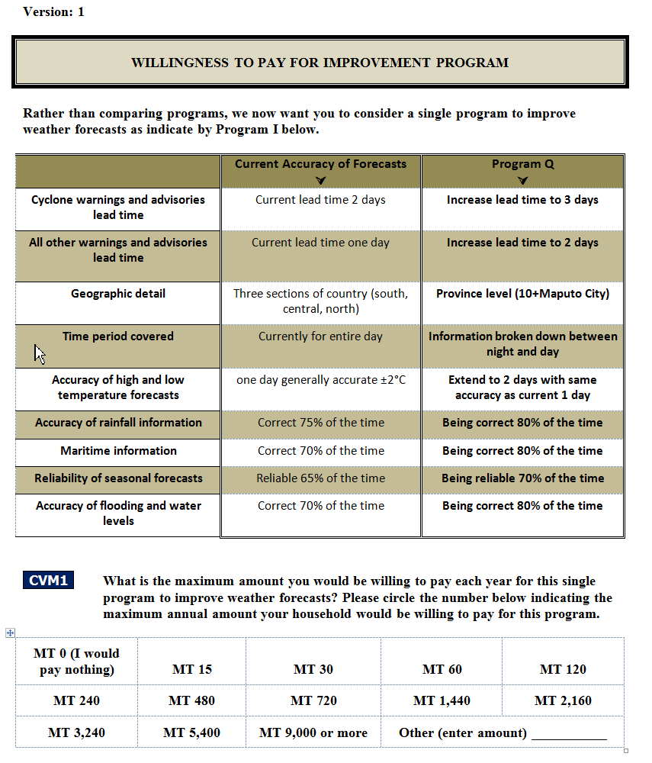
Methods: Payment Card CVM Question – one of two Randomly assigned programs –
moderate improvement
maximal improvement

Slide 22
Quantify / monetize benefits identified
Sector Specific / Benchmarking / Expert Elicitation
Non-market valuation techniques
Stated preference methods
Revealed preference methods
Economic decision modelling
Decision analysis
Equilibrium models
Econometric models
Avoided cost/damage assessments
including avoided mortality and morbidity impacts
Benefits transfer

Slide 23
Economic decision modelling (1)
A. Modeling
Building a quantitative relationship between “input” and “outcome”
Identifying and quantifying relationships (similar to most methods of weather modeling)
What to model?
Modeling of the value of forecasts
Modeling of the value of outcomes related to weather information
Types of Economic Models
Partial equilibrium
Individual markets – limited interactions between markets
Relatively direct effects of information
General equilibrium
Multiple market interactions

Slide 24
Economic decision modelling (2)
A. Modeling
Decision analysis
Cost-loss model
Range of models and methods in economics for measurement
Compliance cost models
Partial equilibrium models
Linear programming models
Input-output models
Input-output econometric models
Computable general equilibrium models

Slide 25
Economic decision modelling (3)
B. Data analysis
Regression analysis
Data on relationships between forecasts and outcomes
C. Direct elicitation
Expert elicitation
Used when significant uncertainty and data sparcity
Survey
Can gather primary data on other socio-economic aspects of value
In reality – generally some combination of approaches / methods / tools

Slide 26
Quantify / monetize benefits identified
Sector Specific / Benchmarking / Expert Elicitation
Non-market valuation techniques
Stated preference methods
Revealed preference methods
Economic decision modelling
Decision analysis
Equilibrium models
Econometric models
Avoided cost/damage assessments
including avoided mortality and morbidity impacts
Benefits transfer

Slide 27
Averting Expenditures
Indication of value of avoiding an impact
Household production function
Changes in averting expenditures with improved weather, water, climate information is a potential benefit of that information
Money spent to mitigate future impacts
Changes in costs of flood control system based on improved information on the likelihood of future flooding

Slide 28
Avoided Costs
Avoided “costs” are essentially benefits
avoided costs of natural disasters (benefit of reduced impacts)
reduced loss of life with heat wave warning system (Ebi et a. 2004)
mortality data for Philadelphia during heat waves that occurred 1995-1998 (four years)
mortality lower when authorities declared a heat wave warning and took actions to mitigate the effects of extreme heat
117 premature deaths avoided with heat wave warnings and associated actions
dollar benefit estimated to be $468 million over 4 years
vastly exceeds the modest cost of the actions taken

Slide 29
Quantify / monetize benefits identified
Sector Specific / Benchmarking / Expert Elicitation
Non-market valuation techniques
Stated preference methods
Revealed preference methods
Economic decision modelling
Decision analysis
Equilibrium models
Econometric models
Avoided cost/damage assessments
including avoided mortality and morbidity impacts
Benefits transfer

Slide 30
Benefits Transfer
Estimate of an economic value derived by transferring available information from studies conducted in another location and/or context
goal is to estimate benefits for one context by adapting an estimate of benefits from some other context
used when it is too expensive, there is too little time, it is too difficult to conduct an original study, yet some measure is still needed
accuracy can only be as good as the original study

Slide 31
Benefits Transfer
Advantages
typically less costly than conducting an original valuation study
usually faster than an original valuation study
can be used as a screening technique to determine if a more detailed, original valuation study should be conducted
Issues and Limitations
may not be accurate unless the sites share all of the site, location, and user specific characteristics
good studies for the policy or issue in question may not be available
difficult to track down appropriate studies, since many are not published
reporting of existing studies may be inadequate to make the needed adjustments
adequacy of existing studies may be difficult to assess
extrapolation beyond the range of characteristics of the initial study is not recommended
original study value estimates can become dated

Slide 32
Benefits Transfer
Step 1
identifying existing studies
same region, similar meteorological phenomena, similar socioeconomic status?
Step 2
decide whether or not the existing values are transferrable
is the variable measured comparable to existing values in the original study?
are the target populations involved in the studies comparable?
is it possible to adjust the data to reflect the differences?
Step 3
evaluate the quality of the studies that are being transferred
“professional judgment” likely required
Step 4
adjust the values from the study site to reflect the values of the policy site using whatever information is available and deemed relevant
determine if it is necessary to collect and apply supplemental data

Slide 33
General process for benefits analysis
Identify the full suite of economic, social and environmental;
Screen benefits and select the analytical approach;
Quantify and monetize the value of benefits identified;
Qualitatively describe and analyze benefits that aren’t monetized;
Deal with uncertainty surrounding benefit estimates.

Slide 34
General process for benefits analysis
Identify the full suite of economic, social and environmental;
Screen benefits and select the analytical approach;
Quantify and monetize the value of benefits identified;
Qualitatively describe and analyze benefits that aren’t monetized;
Deal with uncertainty surrounding benefit estimates.

Slide 35
Conclusion
there is a well-established toolkit of economic valuation approaches
may be necessary to apply several different methods
different methods often address different subsets of benefits
use of multiple methods can provide for comparison of alternative measures of value
may not have the resources or expertise to complete an original benefits study -> benefits transfer
double counting a concern when applying more than one method

