Slide 1
Example of
Public Weather Service Delivery:
DHMZ Croatia
Meteorological and Hydrological Service
Republic of Croatia
Workshop on Service Delivery Strategy for NMHSsto be held in Tirana, Albania, Oct. 17-21.

Slide 2
Legal framework of DHMZ in Croatia
Meteorological and Hydrological Service
is a national centre of exellence based on high standards of
scientific, professional and technical resources for the production, collection and dissemination of high-quality meteorological and hydrological information the basic tasks are stipulated by the Law on meteorological and hydrological activities in Croatia (to provide support to economic development, environment protection, to act towards the preservation of life and material goods from natural hazards and disasters and to mitigate their consequences)

Slide 3
Mission of Meteorological and Hydrological Service
to provide support to economic development, environment protection and quality of life
to act towards the preservation of life and material goods from natural and social hazards and disasters and to mitigate their consequences
to maintain and develop the national meteorological and hydrological observation system

Slide 4
Present structure of Meteorological and Hydrological Service:
Weather Analysis and Forecast Division
Weather and Climate Observation Division
Research and Development Division
Air Quality Division
Hydrology Division
Remote Sensing Department
IT Department
Independent Departement for Measurements Calibration
Administration and Finance Division

Slide 5
Strategic Partners:
1. State Administrative Organizations:
National Protection and Rescue Directorate
Croatian Waters
Environmental Agency
Croatian Energy Regulatory Agency
State Office of Nuclear Safety
State Institute of Radiation Protection
2. Universities and Scientific Institutes
3. Ministries:
Ministry of Sea, Transport and Infrastructure
Ministry of Environmental Protection and Energetics
Ministry of Forestry and Water Management
Ministry of Health and Social Welfare
Ministry of Defense
Ministry of Interior
Ministry of Science
Ministry of Health

Slide 6
International colaboration
Meteorological and Hydrological Service
Membership in International Organisations:
WMO
ECMWF
EUMETNET
EUMETSAT
ALADIN/RC LACE
GEO
ECOMET
MONGOOS / EUROGOOS
EFAS
SAVA Commision
International Projects:
MAP – D PHASE
EMEP
EU FP 6/7, COST
MEDEX
EUMETSAT/CEI projects (SATREP, EUMeTrain, Nowcasting....)
WB/ISDR/WMO Sava project
INTERREG
Some projects in preparation (meteo, hydro, air quality) ... EU cohession funds

Slide 7
The list of most important stakeholders at national level:
Public
Civil protection - National Protection and Rescue Directorate (DUZS), State Office for Radiological and Nuclear Safety (DZRNS), National Headquarter for Search and Rescue at Sea (MRCC)
Public/governmental institutions
National media (HRT)
Energy providers: Croatian Electricity Company (HEP)
Croatian Waters (Hrvatske vode)
Traffic authorities (land, sea, air)
Research/university

Slide 8
3 QUESTIONS:
how the sector is impacted by the weather
how they get information and services from NMHSs
What improvements in NMHSs services they require.

Slide 9
PUBLIC (INIVIDUALS, SOCIETY)
how the sector is impacted by the weather
- for personal /family/social planning, e.g.:
- what to wear / take or not to take umbrella / important info for any aoutdoor actions like favorable weather for family picnic, weddings
2. how they get information and services from NMHSs
- meteo.hr
- via public (national and local) media
3. What improvements in NMHSs services they require.
- more & free of charge applications for mobile phones, tablets
- user friendly designed information for any location & medium range time period
- very detailed visual information for next 24 to 48 hours

Slide 10
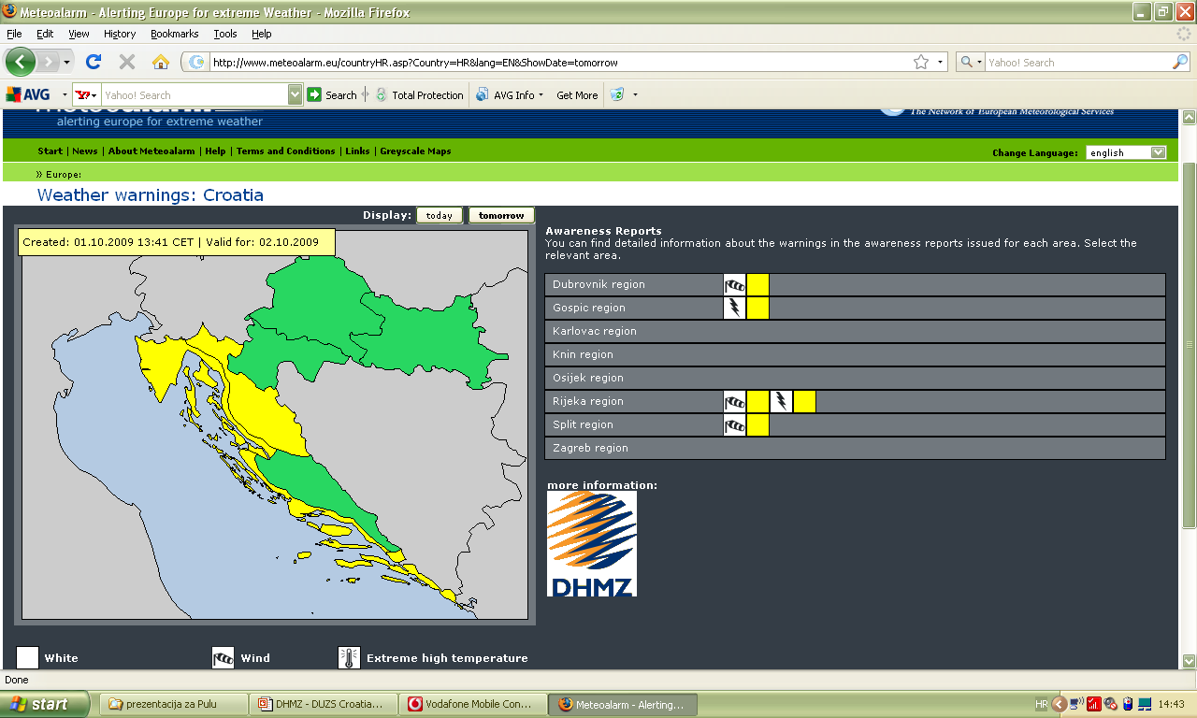
since 17 July 2009
www.meteoalarm.eu
www.meteo.hr

Slide 11
PUBLIC / GOVERNMENTAL INSTITUTIONS
how the sector is impacted by the weather
- weather info as important logistic information for planning any impending action (e.g. Journeys of the President and staff of Government, for police protection of international meetings, public manifestations etc)
- climate and weather info as important component in short and medium range planning and especially in strategic plans
2. how they get information and services from NMHSs
- meteo.hr
- inquiry /order for specific tasks (sporadically )
- service level agreements (e.g. For Ministry of Health special warnings on extreme warm /cold weather )
3. What improvements in NMHSs services they require.
- more user defined products for specific tasks of state institutions

Slide 12
WEATHER FORECAST
Nowcasting - (0 – 3 hours)
short range forecast –(up to 72 hours)
Medium range forecasts – (up to 10 days)
Long-range seasonal forecast– (up to 6 months)
CLIMATE FORECAST
Regional climate modeling – (up to 100 years)

Slide 13
NATIONAL MEDIA
how the sector is impacted by the weather
- important part of the program on regular basis (actual weather & forecast , weather warnings)
- additional source of important info for breaking news (e.g. During severe weather or any other natural or technical catastrophes)
how they get information and services from NMHSs
- service contracts
What improvements in NMHSs services they require.
- to be on complete disposal whenever, whatever or from whoever they need the latest or any important info in simple and visually acceptable form for the general public, possibly free of charge

Slide 14
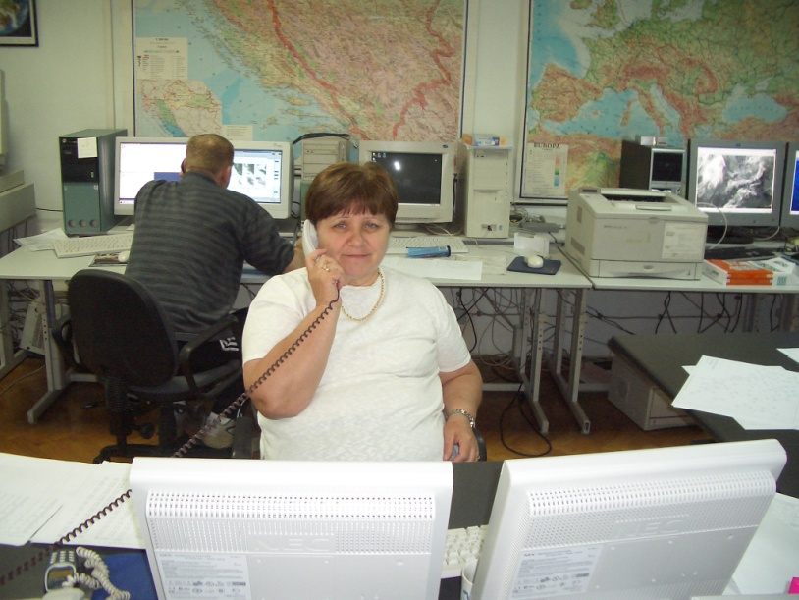
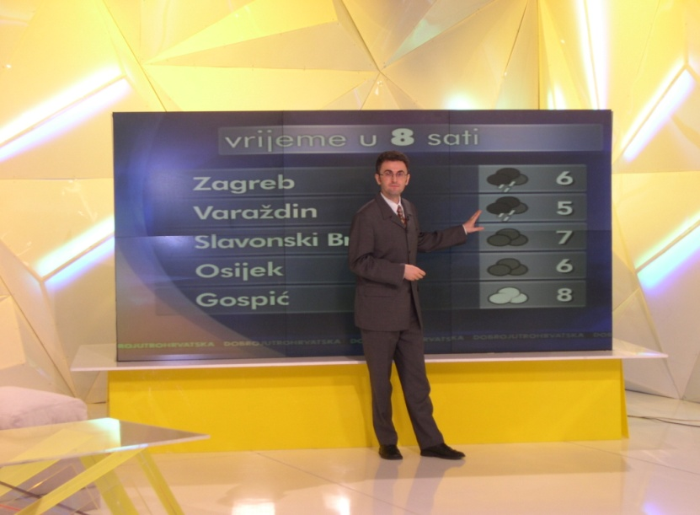
DHMZ = single official voice for weather warnings

Slide 15
CIVIL PROTECTION
how the sector is impacted by the weather
- weather info as important logistic information for planning any impending action (e.g. During natural or technical catastrophes)
- climate and weather info as important component in short and medium range planning and especially in strategic plans
2. how they get information and services from NMHSs
- service level agreements - customized web link (pass) & direct personal contacts between forecasters and DUZS staff
- inquiry /order for specific tasks (sporadically )
- meteo.hr
3. What improvements in NMHSs services they require.
- more user defined products for specific tasks
- involment of DHMZ forecasters in specific tasks which perform DUZS teams (e.g. Regular EU firefighting reporting)
- 24/7 service and EWS
DUZS = National Protection and Rescue Directorate

Slide 16
NEED FOR FURTHER DEVELOPMENT OF
EARLY WARNING SYSTEM (EWS) !
A complete and effective early warning system supports four main functions:
risk analysis
monitoring and warning
dissemination and communication
a response capability.
early warning systems can be used to detect a wide range of events, such as vehicular collisions, missile launches, disease outbreaks, floods, flash floods, droughts, tropical storms, severe snow storms, forest fires, etc. etc....

Slide 17
SERVICE
LEVEL
AGREEMENT:
All operative
activities are
governed by
SOP

Slide 18
And when there is expected exceptionally severe hazard weather or technological event with possible high impact, higher level personal contacts are recommended.
Phone links DHMZ – DUZS related to the severity of expected/possible events:
Chief of Weather forecast office – Shift leader of National 112 center
Head of Weather forecast analysis and forecast department – Head of National 112 center
Assistant Director of Weather forecast analysis and forecast division – Assistant Director of 112 Sector

Slide 19
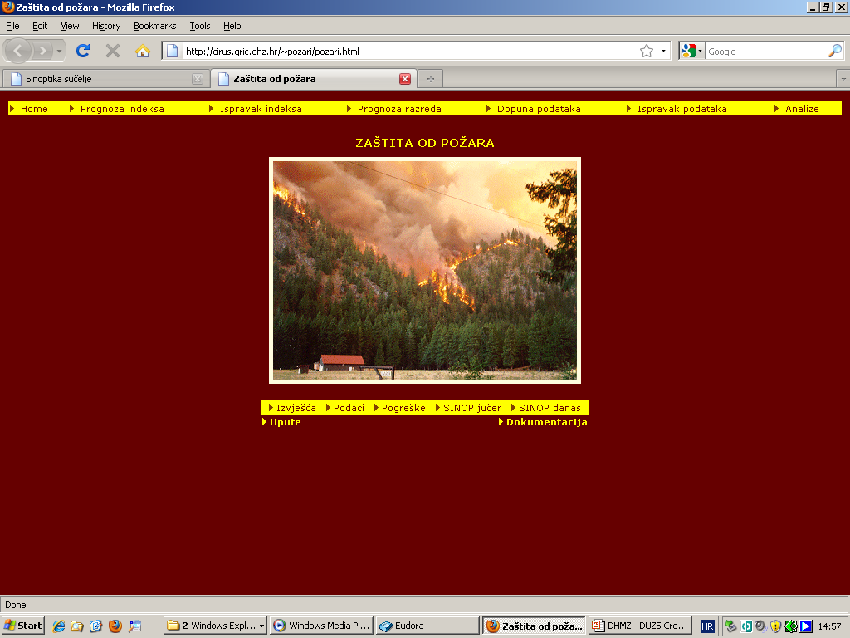
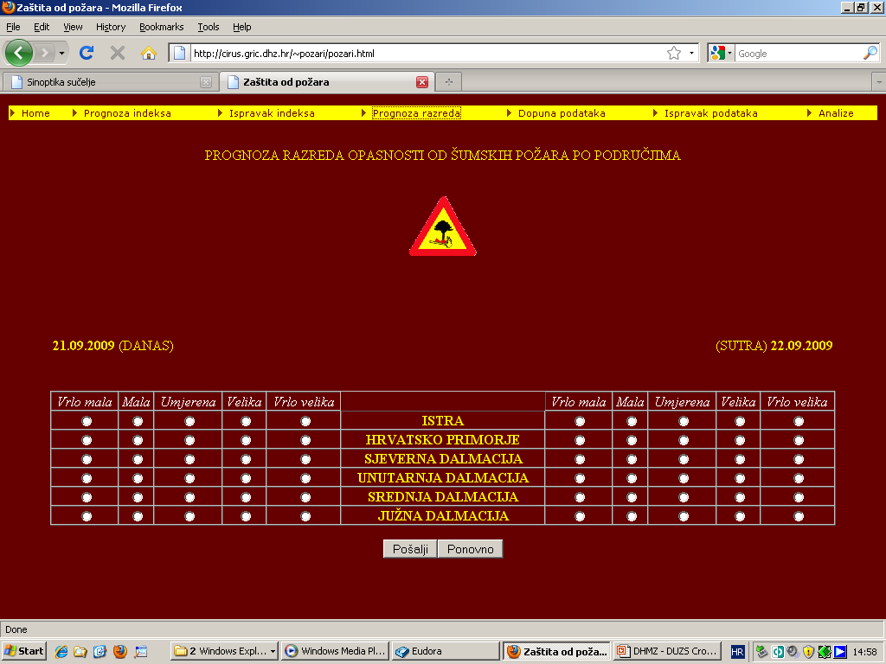
Weather forecast for Fire Fighting Sector

Slide 20
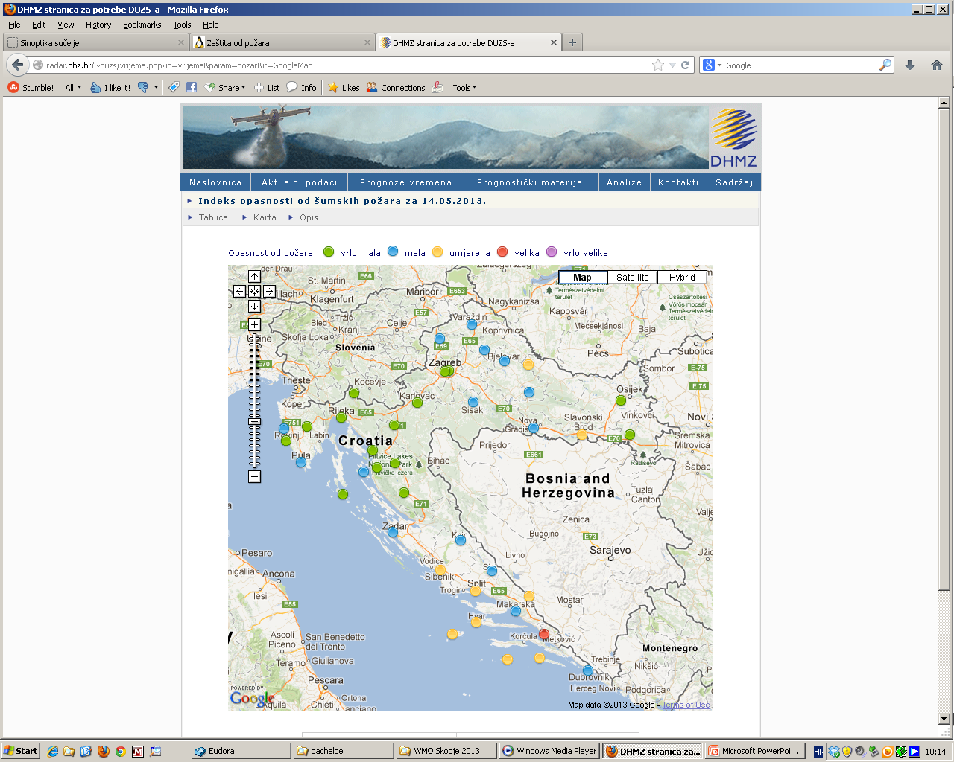
Weather forecast for Fire Fighting Sector

Slide 21
ENERGY SECTOR
how the sector is impacted by the weather
- weather info as important logistic information for planning any impending action (e.g.during expected extreme cold weather episodes)
- climate and weather info as important component in short and medium range planning and especially in strategic sectorial plans
2. how they get information and services from NMHSs
- service contracts- customized web link (pass) or ftp
- inquiry /order for specific tasks (sporadically )
- meteo.hr
3. What improvements in NMHSs services they require.
- more data & complete remote sensing coverage of the region
- improved regional short-range numerical model output
- more user defined products for specific tasks
- need for 24h disposal of DHMZ forecasters for additional advisories

Slide 22
CROATIAN WATERS
how the sector is impacted by the weather
- weather info as important logistic information for planning any impending action (e.g.during expected extreme precipitation episodes)
- climate and weather info as important component in short and medium range planning and especially in strategic sectorial plans
2. how they get information and services from NMHSs
- service contracts- customized web link (pass); ftp
- inquiry /order for specific tasks (sporadically )
- meteo.hr
3. What improvements in NMHSs services they require.
- more user defined products for specific tasks
- need for 24h disposal of DHMZ forecasters for additional advisories
more data & complete remote sensing coverage of the region
- improved regional short-range numerical model output

Slide 23
TRAFFIC AUTHORITIES
how the sector is impacted by the weather
- weather info as important logistic information for planning any impending action (e.g.during expected snowfall episodes)
- climate and weather info as important component in short and medium range planning and especially in strategic sectorial plans
2. how they get information and services from NMHSs
- for land & sea: service contracts - customized service for specific traffic routes
- for air: service level agreement with HKZP for supplying of data and products needed for their aeronautical service
- inquiry /order for specific tasks (sporadically )
- meteo.hr
3. What improvements in NMHSs services they require.
- more user defined products for specific tasks
- need for 24h disposal of DHMZ forecasters for additional advisories
- more data & complete remote sensing coverage of the region
- improved regional short-range numerical model output

Slide 24
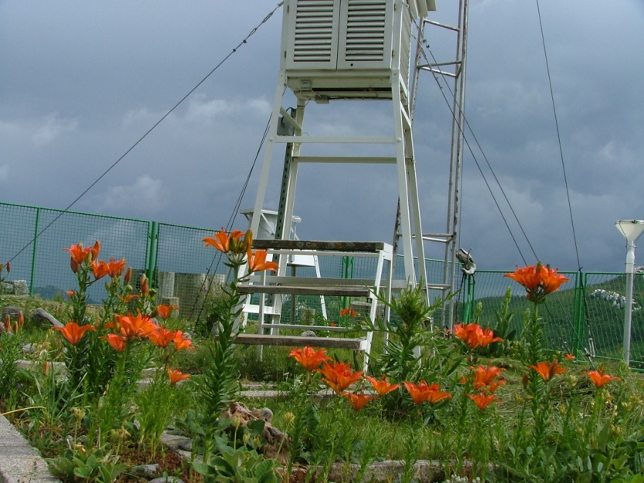
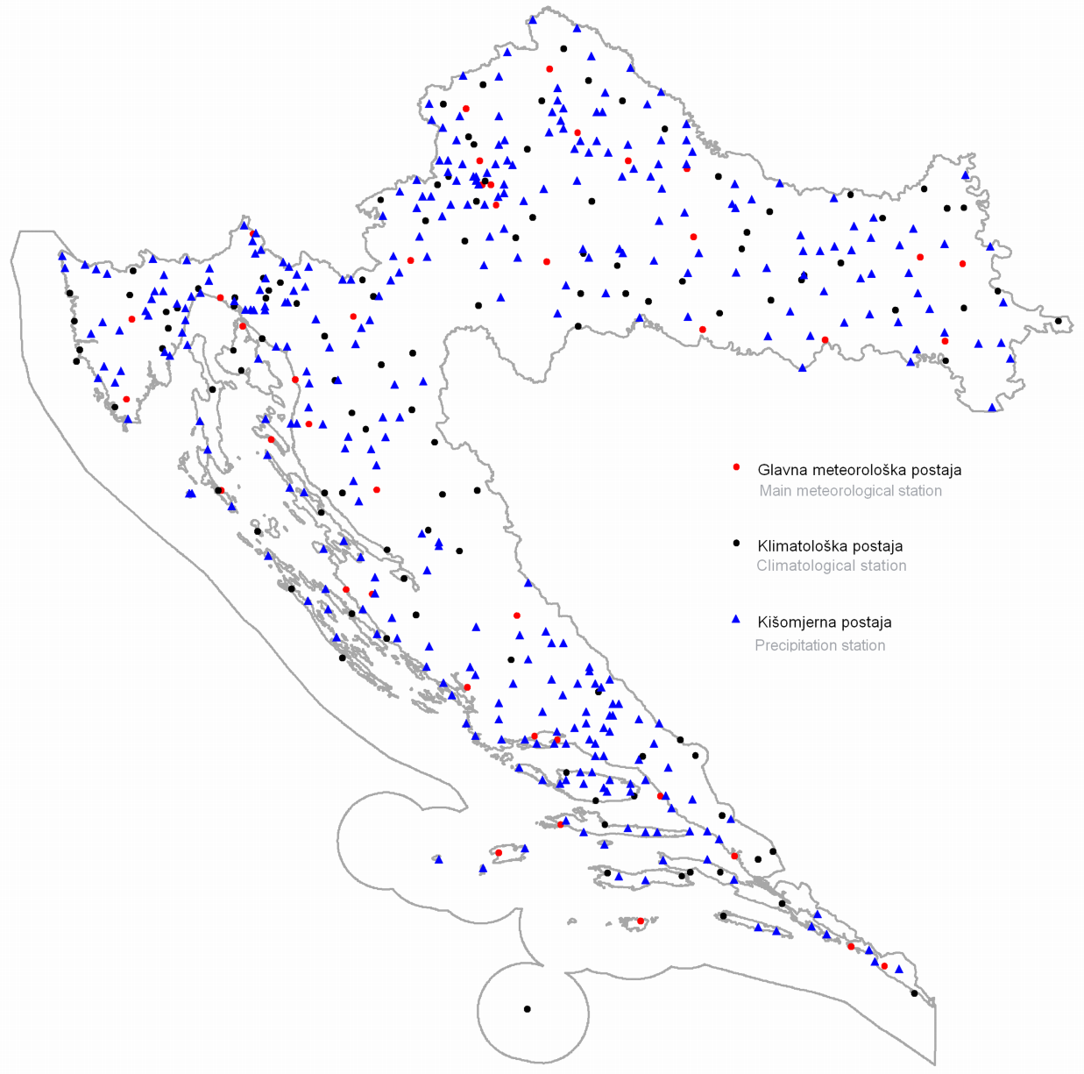
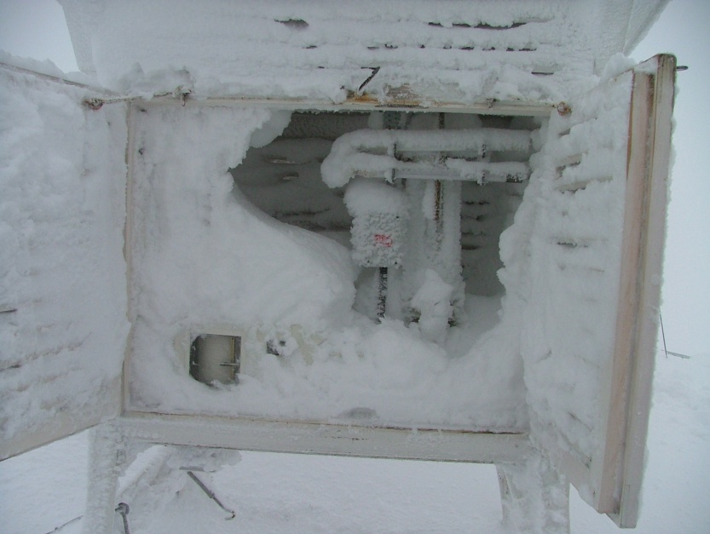
Observational classical meteorological network
Summer at Zavizan
41
117
336
Winter at Zavizan

Slide 25
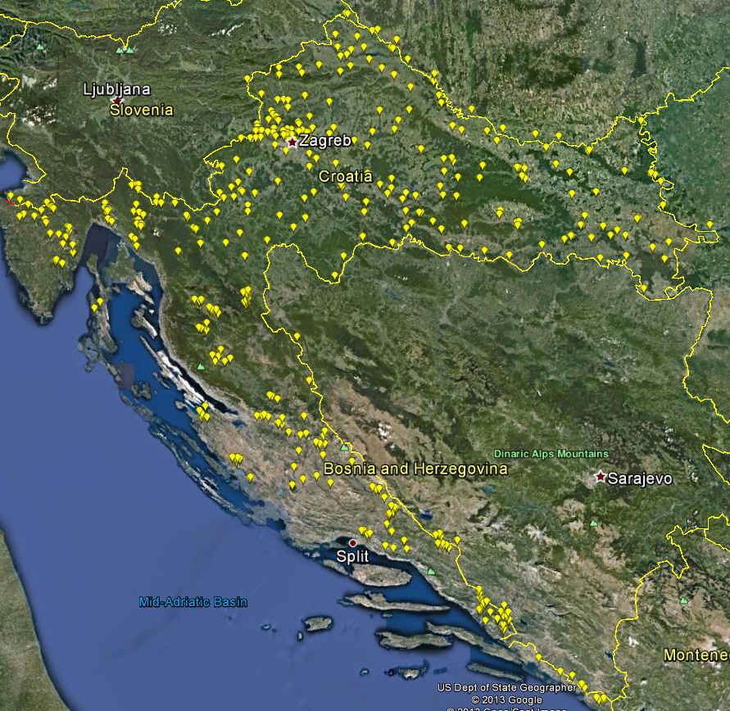
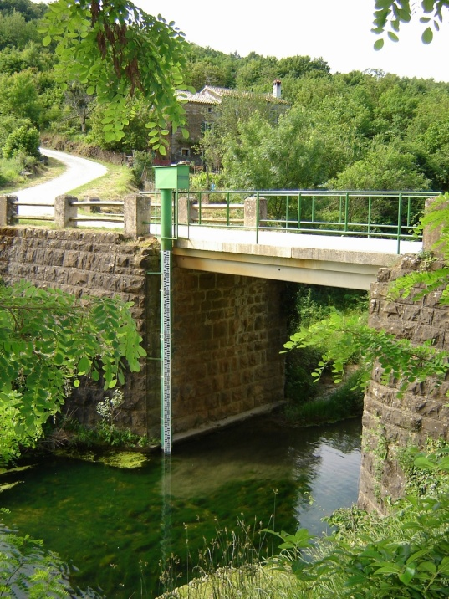
HYDROLOGICAL NETWORK
510 Water Gauge Hydrological Stations

Slide 26
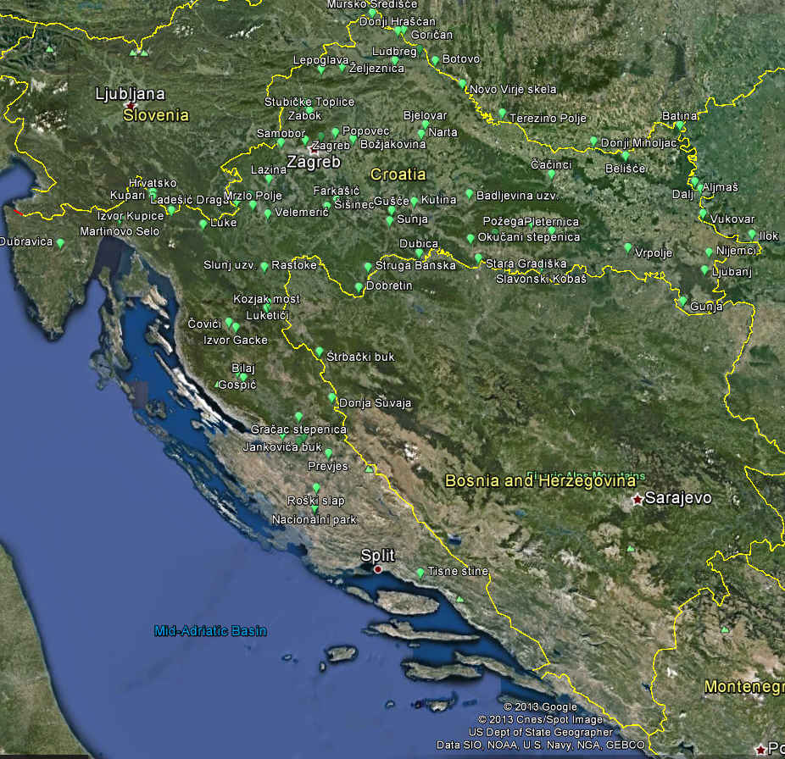
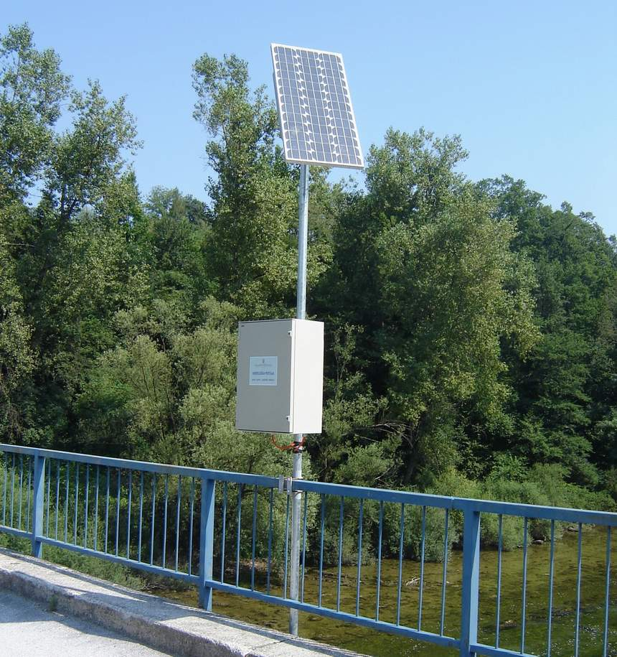
AUTOMATIC HYDROLOGICAL NETWORK
85 Automatic Water Gauge Hydrological Stations

Slide 27
CONCLUSIONS
For improvements in NMHSs services there is a strong need in:
more highly educated staff (with more insight in applications during university education)
more data coverage (in situ & remote)
more interdisciplinary collaboration for defining better user designed products
improving customer relations capabilities (education of staff involved in design and production of services, monitoring the quality of service, defined data policy, internaly consolidated and unisonic communication with customers in defined legal and administrative NHMS-friendly surrounding, skilled negotiators)

Slide 28
THANK YOU!

