Slide 1
Overview of Economic Concepts and Methods
Jeffrey K .Lazo, PhD
Director – Societal Impacts Program
National Center for Atmospheric Research
Mahe Island, Seychelles
Tuesday, 5 May 2015
1330 - 1400

Slide 2
Economics Concepts and Terminology
What is Economics?
The social science study of how individuals, governments, firms and nations make choices to allocate scarce resources to satisfy unlimited wants
Scarcity: property of being in excess demand at a zero price. This means that in equilibrium the price of a scarce good or factor must be positive. Scarce goods or services are limited in availability.
Tradeoffs: balance achieved between two desirable but incompatible features; a sacrifice made in one area to obtain benefits in another; a bargain, a compromise.
Opportunity costs: cost of something in terms of an opportunity forgone. Opportunity cost is given by the benefits that could have been obtained by choosing the best alternative opportunity.

Slide 3
Micro vs Macro - economics
Macroeconomics
branch of economics that deals with large-scale economic factors
economics of a national economy as a whole
money, prices, employment, inflation
Microeconomics
decision-making of individuals
analyses the choices of consumers (who can be individuals or households) and firms in a variety of market situations
Benefit assessment and benefit-cost analysis is primarily based in micro-economic theory and methods
Neo-classical microeconomics

Slide 4
Theory - Basic Concepts
Benefits
Costs
Public Goods
Market and Nonmarket Values
Value of Information

Slide 5
Theory - Basic Concepts
Benefits – quantified gain of an action
Demand - desire and ability to acquire a good or service, or the quantity of a good or service that economic agents are willing to buy at a price.
Marginal benefits - additional benefit from an increase in an activity
Willingness to pay (WTP) - maximum amount someone is willing to pay to acquire a specific good or service

Slide 6
Theory - Basic Concepts
Costs - value of the inputs needed to produce any good or service measured in some units or numeraire (generally money)
Supply - amount of a good or service offered for sale - usually increases with higher prices
Loss
expenditures exceed receipts
unexpected costs
Social cost - total societal cost of any activity including private costs which fall directly on the person or firm conducting the activity, as well as external costs outside the price system which fall on other people or firms

Slide 7
Theory - Basic Concepts
Public Good - good that no consumer can be excluded from using if it is supplied (see “non-excludability), and for which consumption by one consumer does not reduce the quantity available for consumption by any other (see “non-rivalry”).
Non-excludability: property of a good or service that exists when no individual or group can be excluded from enjoying the benefits a good or service may confer, whether they contribute to its provision or not.
Non-rivalry: property of a good or service that exists when consumption by one consumer does not reduce the quantity available for consumption by any other.

Slide 8
Theory - Basic Concepts
Competitive equilibrium – if all the assumptions of production and consumption and markets are met … a good or service will be bought and sold in a completive market so supply equals demand and marginal benefits equal marginal costs and prices indicate value
Market Values – products and services produced, bought, and sold in organized competitive markets – the price reveals the marginal value of that good or service
Nonmarket Values – some goods and services are not bought and sold in markets (e.g., public goods) but still have economic value (i.e., generate utility)

Slide 9
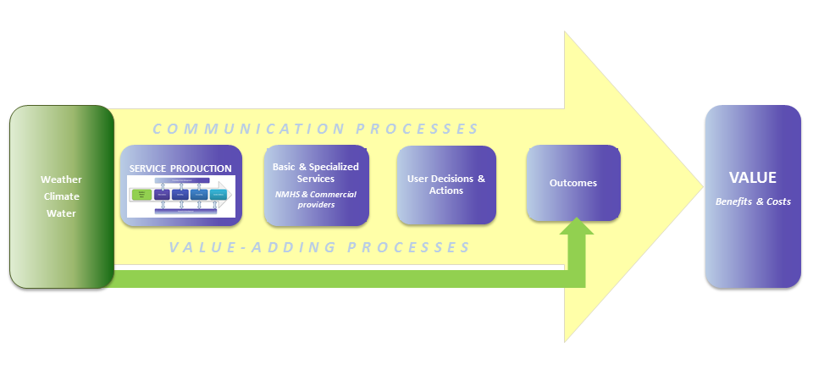
Theory - Basic Concepts
Value of Information - value of the outcome of action taken with the information less its value without the information.
Value of Outcome (with info) – Value of Outcome (without info)
Value chain – process or activities by which information is transformed to an end product, good, or service using the information in a decision that results in economic value

Slide 10
Some more concepts you’ll be hearing!
Discounting
Discounting – placing a lower value on future receipts than on the present receipt of an equal sum. The fundamental reason for discounting the future is impatience: immediate consumption is preferred to delayed consumption.
Discount rate – interest rate at which future benefits or costs are discounted to find their present value.
Present Value (PV) – value today of a future payment, or stream of payments, discounted at some appropriate compound interest—or discount—rate.
Net Present Value (NPV) – present value of a security or an investment project, found by discounting all present and future benefits and costs at an appropriate rate of discount. If the net present value calculated is positive, it is worthwhile investing in a project.

Slide 11
Some more concepts you’ll be hearing!
Benefits Methods
Avoided cost method - assesses actual or imputed costs for preventing losses (e.g., measuring the benefits of reduced air pollution by assessing the cost of installing indoor air purifiers)
Benchmarking
Benefits transfer - transferring benefits estimates developed in one context to another context as a substitute for developing entirely new estimates.
Non-market valuation - economic valuation of goods and services not distributed through markets.
Revealed preference methods - based on actual observable choices and from which actual resource values can be directly inferred
Stated preference methods - respondents are directly asked about their willingness to pay for a good or service.
Contingent valuation. A survey method used to ascertain WTP

Slide 12
Some more concepts you’ll be hearing!
Economic Analysis Methods
Cost-effectiveness - achievement of results in the most economical way
Benefit-cost analysis - quantification of the total social costs and benefits of a policy or a project, usually in money terms
Discounting
Sensitivity analysis

Slide 13
Issues and Value Concepts
Double counting - error when a total is obtained by summing gross amounts instead of net amounts
Triple Bottom Line - using ecological and social criteria for measuring organizational success, in addition to financial performance.
Whole-of-services assessment. A comprehensive assessment of all of the services provided by a given entity, as opposed to an assessment of one or more specific services
Ex ante assessment: Assessment or economic evaluation "before the event" (prospective).
Ex post assessment: Assessment or economic evaluation "after the event" (retrospective).

Slide 14
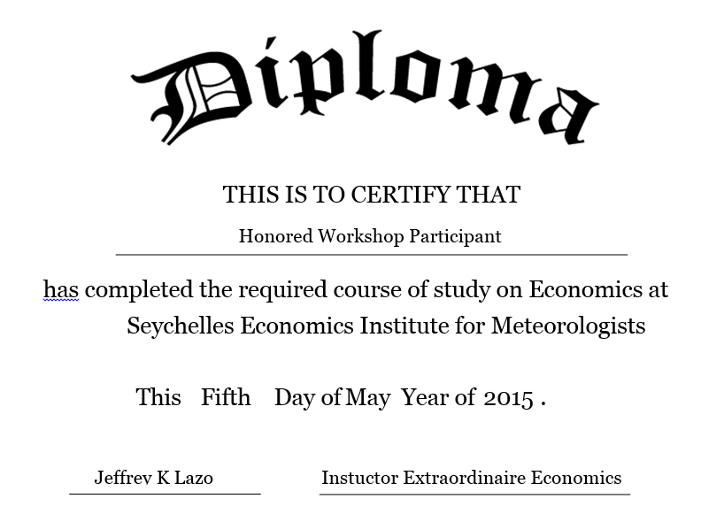

Slide 15
Exercise 6: Econ concepts & methods
Step 1: Benefit or Cost … or?
Step 2: Private Good or Public Good … or?
Step 3: Your NMHS Product or Service – Public or Private
Step 4: Your NMHS Product or Service – Costs
Step 5: Your NMHS Product or Service - Benefits

