Slide 1
Social and Economic Benefit Studies
Non-Economic Social Science Methods
Assessing the Uptake of Services
Gerald Fleming
Chair, OPAG/PWS
Mahé, Seychelles, 5th May 2015
WMO - Public Weather Services, WDS

Slide 2
Social Sciences
Social science is a major branch of science, and a major category of academic disciplines, concerned with society and the relationships among individuals within a society.
Social science dates from the Age of Enlightenment, and attempts to use scientific methods to examine social behaviour and characteristics.

Slide 3
Social Sciences
Some of the Social Sciences:
  Sociology
  Human Geography
  Economics
  Political Science
  Psychology
  Demography
  Anthropology
  etc etc...

Slide 4
Social Sciences
Some of the Social Sciences:
  Sociology
  Human Geography
  Economics
  Political Science
  Psychology
  Demography
  Anthropology
  etc etc...

Slide 5
“Assessing the Uptake of Services”
What does this mean?
It’s much easier to assess the uptake of Products
Trial new products
Refine them
Put them on sale
Measure the uptake (sales)

Slide 6
“Assessing the Uptake of Services”
How do we measure Services?
NMHSs have historically been very good at producing forecasts and warnings.
Once they are issued – what happens to them?
Do we know HOW people use them?
Often we have no clue about this

Slide 7
Weather Warnings
What ways can we assess these?
Measure accuracy of the warnings
Measure number of warnings issued
Measure whether warnings reached intended users
Measure whether or not the warning was understood

Slide 8
Weather Warnings
What ways can we assess these?
Measure whether the consequences of the likely weather were understood
Measure the intended behaviour of the user before and after receiving the warning
Measure the warning outcomes
Measure the satisfaction of the users

Slide 9
Weather Warnings
What ways can we assess these?
Measure accuracy of the warnings
Measure number of warnings issued
Measure whether warnings reached intended users
Measure whether or not the warning was understood
√
√
X
X

Slide 10
Weather Warnings
What ways can we assess these?
Measure whether the consequences of the likely weather were understood
Measure the intended behaviour of the user before and after receiving the warning
Measure the warning outcomes
Measure the satisfaction of the users
X
X
X
√

Slide 11
Weather Forecasts and Warnings
We need to know more about the behaviour of those who receive the warnings
Especially – decision-making
  Was it rational?
  Was it logical?
  Was it intuitive?

Slide 12
Weather Forecasts and Warnings
Decision-making by Users
What are the constraining factors?
Are there options?
Were these options weighed-up in an appropriate manner?
How did other peoples behaviour influence the decision-maker?
What were the uncertainties?
All-in-all, a complex area for study.

Slide 13
Weather Forecasts and Warnings
How can we get to understand users – individually and collectively?
Surveys
Focus Groups
Seminars
Field Research

Slide 14
Weather Forecasts and Warnings
Surveys
Can be random (e.g. telephone surveys) or self-selecting (e.g. users of websites)
Can be Closed (questions with a limited range of answers) or Open (invite free text / comment)
Were the questions properly designed (e.g. not asked in a leading manner)
Were the number of respondents statistically significant?

Slide 15
Weather Forecasts and Warnings
Field Surveys
Can entail close collaboration with decision-makers, to observe their activities and processes at first hand (intrusive)
Can use other data sets
  Health statistics
  Traffic information
  Consumer behaviour
  Agricultural inputs and outputs
  Communication / Social Media data

Slide 16
Weather Forecasts and Warnings
All surveys
Must be careful to recognise the differences between “Stated Preference” (what people say they will do) and “Revealed Preference” (what they actually do, as indicated by the evidence.
Understanding user needs is much more complex than just asking them!
A research area in itself.

Slide 17
Weather Forecasts and Warnings
In this context...
Economics can be seen as the study of social behaviour as revealed by financial evidence
Social Sciences encompass a broader, more holistic view of social behaviour

Slide 18
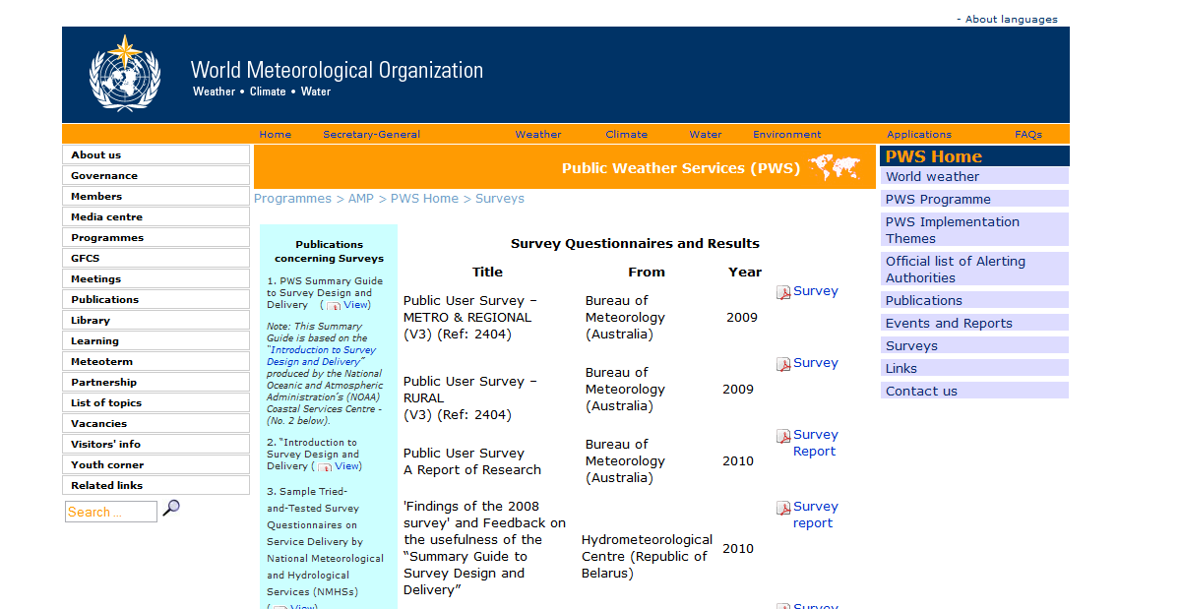

Slide 19
Surveys of Users
Need to know the profile of the survey respondents
Male / Female
Age group
Occupation
Location
etc etc..

Slide 20
Surveys of Users
A recent example from Met Éireann
Survey conducted of users of the website met.ie
Therefore not a random survey, but self-selecting
Website users could choose whether or not to take the survey
Each user asked only once (minimise the nuisance value)
Mix of Closed and Open questions

Slide 21
General information
Current survey
Previous Survey
Survey period | 13.01.2015 – 13.02.2015
Questionnaire views | 497,699
Number of answers | 50,221
Response rate | 10.1%
First time visitors | 2,864
Open answers | 18,125
Survey period | 21.01.2013 – 22.02.2013
Questionnaire views | 364,414
Number of answers | 37,891
Response rate | 10.4%
First time visitors | 2,161
Open answers | 11,246
Benchmark
Content
Benchmark Group | Meteorological benchmark
Survey Period | 25.11.2013 – 13.02.2015
Number of Websites | 4
Total Number of Answers | 215,108
Demographics
User feedback
Benchmark
Summary
About the survey

Slide 22
General information
Swedish Meteorological and Hydrological Institute
Finnish Metrological Institute
Survey period | 03.03.2014 – 31.03.2014
Questionnaire views | 1,180,762
Number of answers | 53,199
Response rate | 4.5%
First time visitors | 2,024
Open answers | 11,082
Survey period | 25.11.2013 – 23.12.2013
Questionnaire views | 2,074,919
Number of answers | 100,814
Response rate | 4.9%
First time visitors | 2 ,076
Open answers | 19,599
Danish Meteorological Institute
Survey period | 14.12.2014 – 22.12.2014
Questionnaire views | 794,330
Number of answers | 23,204
Response rate | 5.5%
First time visitors | 433
Open answers | 6,378

Slide 23




Who Are Your Users?
Gender – Device
Number of answers: 5,172
Women
41%
Number of answers: 38,857
Men
59%
Number of answers: 44,029
Gender - Website
Number of answers: 37,863
Number of answers: 92,193
Number of answers: 48, 204
Number of answers: 33,138
Number of answers: 44,029
Note: Percentages are rounded to the closest whole number.

Slide 24
Occupation
Device
Number of answers: 6,509
Number of answers: 41,515
Number of answers: 48,024
Website
Number of answers : 41,977
Number of answers: 97,815
Number of answers: 52,111
Number of answers: 34,963
Number of answers: 48,024
Note: Percentages are rounded to the closest whole number.

Slide 25
Age - Device
Number of answers: 48,152
Number of answers: 41,613
Number of answers: 6,539
Note: Percentages are rounded to the closest whole number.

Slide 26
Frequency
Device
Number of answers: 6,728
Number of answers: 42,584
Number of answers: 48,005
Website
Number of answers: 42,147
Number of answers: 98,599
Number of answers: 51,787
Number of answers: 36,852
Number of answers: 48,005
Note: Percentages are rounded to the closest whole number.

Slide 27
Device Type
Met Éireann 2015
Number of answers: 49,312
Note: Percentages are rounded to the closest whole number.

Slide 28
Exciting/Boring
«
Desktop
more interactive features
More detail for the areas of interest. Maybe live stats for particular areas around the country.
Add 5 to 15 day location forecast for specific locations. And product more images with animations
more interactive and county specific illustrations
More interactive, the radar option is very good.
Some Video ?
Take a look at how other Weather Sites do it. No need to re-invent the wheel. But you are so so so boring :)
Pictures are always interesting to look at. More pictures would break up the text better. Pictures of today's weather?
Number of answers: 43,620
«
Tablet
Look at other providers, I like rainfall radar and thing that are more integrated with users
Perhaps more interactive regarding maps at regional level.
Strategic webcams would be interesting and more info about why a aprticular forecast has been made.
Your website could have better graphics and more interesting content. I have always found met.ie quite boring however it does supply what's important and that's the weather.
More local information. I especially like yr.no and the detailed local info that it gives. More graphical info as opposed to text might also be good
Would like more responsive elements in it
Some video forecast
Note: Percentages are rounded to the closest whole number.

Slide 29
Attractive/Ugly
«
Desktop
Make it slightly more visually appealing.
I really like the short range and 5 day forecasts. However, I think thye could be jazzed up a bit and be more prominent on the site. Also often the time on the scale does not reflect the time on the map - thye can be out of synch.
rainfall radar is brilliant but it could always be better more information or improved animation would be nice
the image of the website could be brightened up.A little bit more user friendly,
I humbly suggest that it should be more graphical. Include Animations for Forecasts as well as last few hours. (Similar to rain radar, but also projected into the future.) Include Wind Speed, Temperature and Rain fall in animations. Have a look at www.theyr.com to get ideas.
would be nice to have the animated forecast screen bigger, it's all a bit small
maybe a little more visual
Number of answers: 43,818
«
Tablet
I would Maybe change the Back ground Colours but other the That always very Professional
Make the map on the right hand side a littlebigger. I always zoom in.
More colour, bigger print
Please make the website a little more attractive and educative for the kids as well!!
surely you can design a better, more attractive website?
It could be significantly updated to look more attractive and make gathering information more intuitive
Larger text; more interaction; more colour
Better graphics of current and incoming weather.24hr,48hr72hr.
Note: Percentages are rounded to the closest whole number.

Slide 30
Language
Text is written in a language that is easy to understand
«
Desktop
Please use more paragraphs when describing the weather. Bick chunks of text are too difficult to read.
Leagan as GAEILGE le do thoil! Irish Language versions please.
Content in Irish language is incomplete, this should be addressed.
Its old and not user friendly, also its difficult to get just a simple weather forecast for your town or county. You should take a look at how BBC Weather do it. Much simpler and in layman terms. Use less of the isotopes language, keep it simple.
at times some charts and information do not correspond and scattered. Language is too vague.Tidy it up.
Easier language please
A link to explaining key meterological terms to people of modest understanding
Number of answers: 43,943
Tablet
«
Please set the regional forecasts with a more laymans language with a more friendly site‘
Content and language over technical for common usage.
Avoid lengthy sentences. Short punchy key points are more effective. Language used is often more conversational than professional.
Speak in a language that the average citizen can understand, not just those with 3rd level education or a professional qualification. Also, with regard to compatibility with tablets, the site needs serious attention.
Short range forecast into charts or words easier yo understand. Precipitation in charts defined as rain, sleet or hail if possible.
Ambiguous language used to describe forecast
Make able to use the site in other languages ​​, such as Russian , Polish , German.
Note: Strongly disagree had a 0.34% response rate
Number of answers: 38,873
Number of answers: 5,070
Note: Percentages are rounded to the closest whole number.

Slide 31
Trust
The website gives an impression that the organization
behind it is professional and trustworthy
«
Desktop
Some of the comments never get updated and hence lose their message (Water Safety bulletin as example)
Gives me what I want and I trust it.
How about slicker images! I'm thinking along the lines of 3D. Having said that, I'd rather the content to remain as accurate and professional as it is.
Sometimes the graphics suggest weather different to the text. Maybe on the home page there should be three maps depicting morning, afternoon and evening and including temps and wind on the one map.
There should be proper editing of the written forecast on the home page. It is unusual not to find several typos/errors on any given day. This looks unprofessional and could easily be eliminated.
If it was possible to have a rainfall radar with a predictive sequence for 3/6 hrs ahead it would be super as I use this every day for work and fully depend on this
Number of answers: 44,051
«
Tablet
As a teacher I use the website occasionally as a teaching tool perhaps some simplified links for children to help them read weather update sect more easily
Keep it professional/technical, don't simplify it in an effort to modernise/attract larger audiences. For the outlook forecast, breaking it out more clearly by day would make it easier to follow - eg Monday - showers... Monday night -...
Avoid lengthy sentences. Short punchy key points are more effective. Language used is often more conversational than professional.
It could look a bit more modern and professional but otherwise I feel its a very good website for updated weather warnings and of course regional weather warnings.
More information please and a more professional appearance. But I like its simplicity so don't lose that. Define the terms and phrases used in the forecasts. For example I don't know what winter showers are as opposed to showers. Anyone I ask guesses but don't know either. thanks and good luck.
Note: Percentages are rounded to the closest whole number.

Slide 32
Design index - benchmark
Modern/outdated
Modern/outdated
Overall assessment
Attractive/ugly
Overall assessment
Attractive/ugly
Well-organised/messy
Exciting/boring
Well-organised/messy
Exciting/boring
Note: Percentages are rounded to the closest whole number.

Slide 33
Usability index - benchmark
Navigation
Navigation
Trust
Relevance
Trust
Relevance
Speed
Communication
Speed
Communication
Note: Percentages are rounded to the closest whole number.

Slide 34
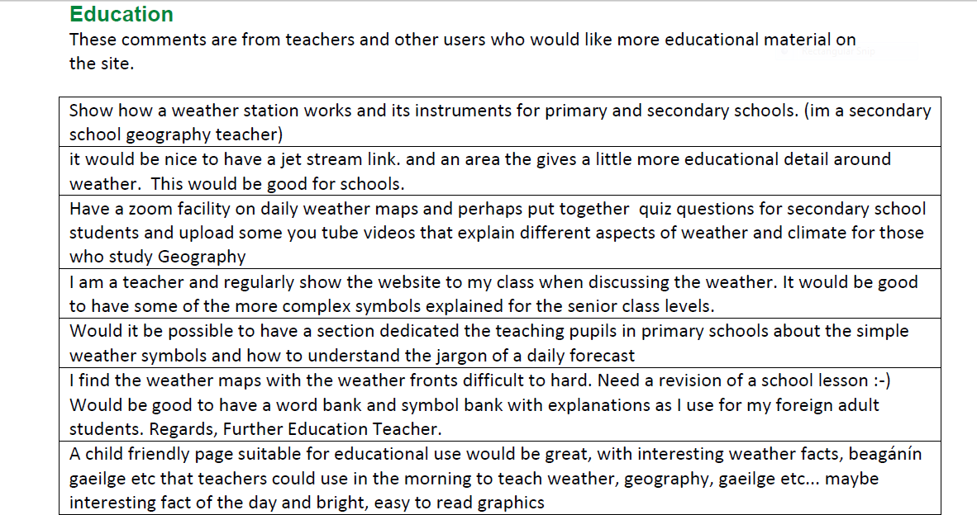
Open Survey Answers

Slide 35
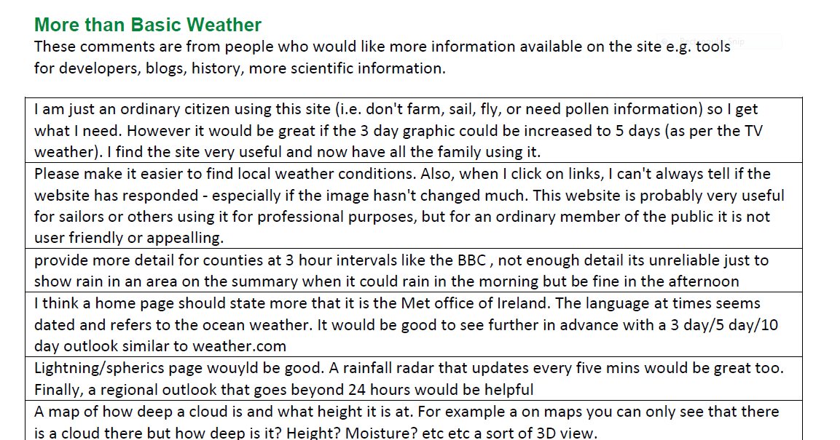
Open Survey Answers

Slide 36
WMO Service Delivery Strategy
36
One of the key strategic thrusts of WMO
  Helping NMHSs to better deliver their products and services to users
  Incorporates an Implementation Plan
  Designed to be a practical guide to the steps we must all take to improve our services
  Incorporates the “Service Delivery Progress Model”
  A technique to help us find out how good (or bad) we are at Service Delivery, and how to improve.

Slide 37
Service Delivery Progress Model
Defines five different stages of development for NMHSs (each over a number of elements)
  Undeveloped
  Development Initiated
  Development in Progress
  Developed
  Advanced

Slide 38
Service Delivery Progress Model
Defines six elements of development
  Evaluate user needs and decisions
  Link service development and delivery to user needs
  Evaluate and monitor service performance and outcomes
  Sustain improved service delivery
  Develop skills needed to sustain service delivery
  Share best practices and knowledge

Slide 39
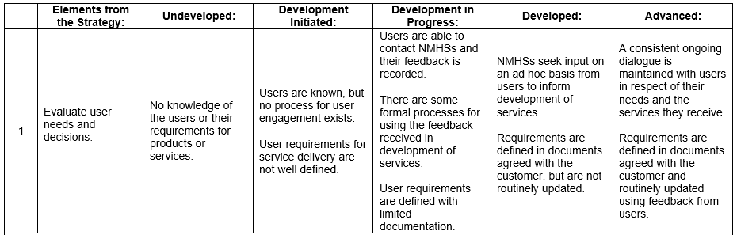
Service Delivery Progress Model

Slide 40
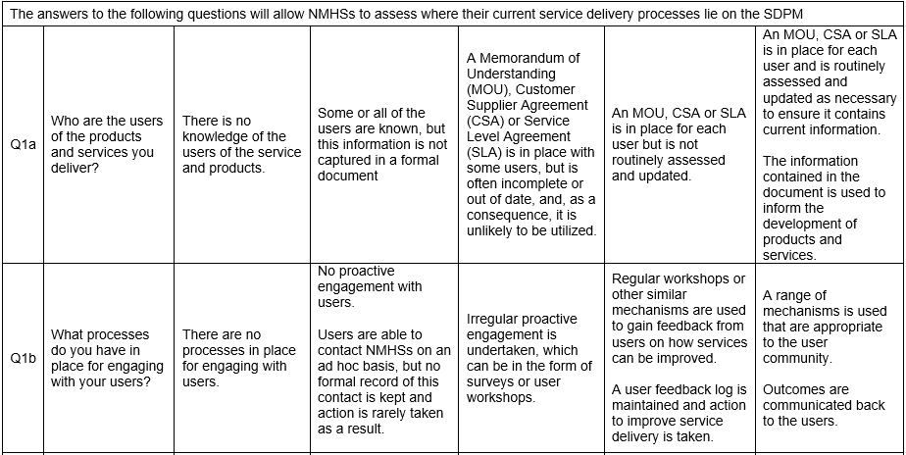
Service Delivery Progress Model

Slide 41
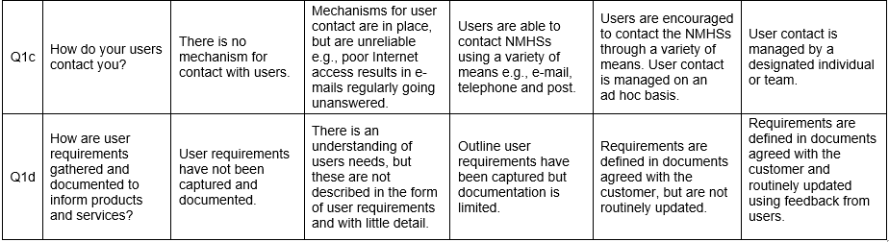
Service Delivery Progress Model

Slide 42
 | Undeveloped | Development Initiated | Development in Progress | Developed | Advanced
Evaluate user needs, decisions |  | √
Link SD and delivery to user needs |  |  | √
Evaluate and monitor service performance and outcomes | √
Sustain improved SD |  | √
Develop skills needed to sustain SD | √
Share best practices and knowledge | √

Slide 43
Social Sciences and Met Services
Its all about the users!
Improving our knowledge and understanding of those who use forecast and warnings services
Helping users to get more from our forecast and warnings services
Trying to understand decision-making, in all its complexity
Try to get to some measure of the ultimate outcomes for society of the services provided by NMHSs

Slide 44
