Slide 1
Uptake of Met/Hydro Services
Glen Anderson, Chief of Party, CCRD
Mahe Island, Seychelles
May 5 2015

Slide 2
Met/hydro Services Value Chain
Once the service is produced and delivered, it can undergo several changes before it taken up by users:
Tailoring for specific users
Translation into a form understandable by users
Combined with other types of information to create a new product

Slide 3
Uptake of Met/Hydro Services
Uptake of met/hydro services requires:
Access
Interpretation, translation, and understanding
Actions/Decision-making based on the services by users
Met/hydro services will not generate benefits unless user communities are observed (or potentially expected) to take decisions that result in improved outcomes compared to those resulting from previous or no products
A key to deciding what benefits are to be estimated in SEB studies is to understand how met/hydro services might inform decisions to be taken by user communities

Slide 4
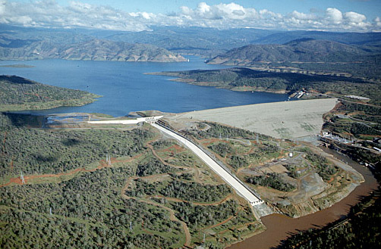
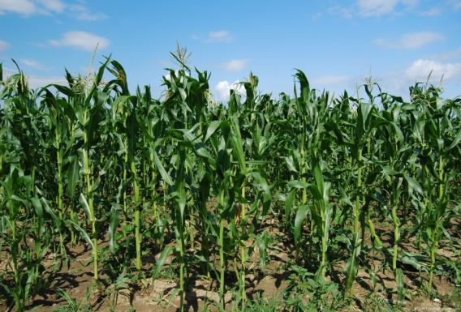
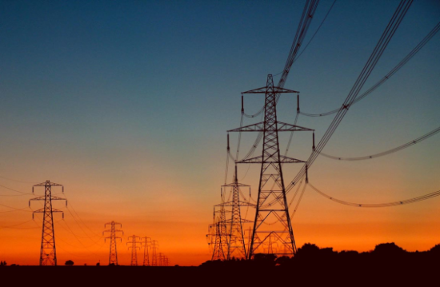
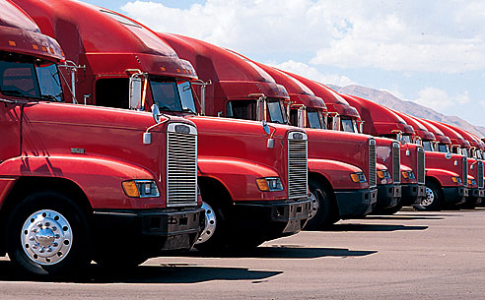
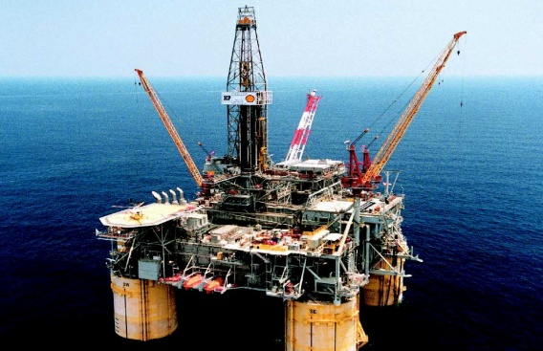
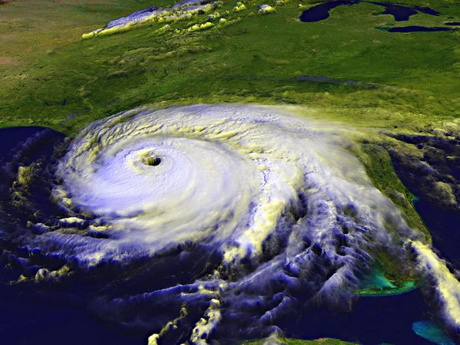
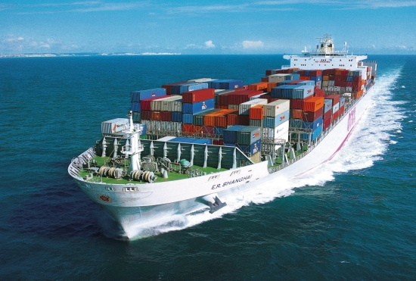
Water utilities
Farmers
Airlines
Power companies
Investors
Trucking companies
Resource companies
Disaster managers
Shipping industry
Notes:
Slide c/o Bob Rauber, University of Illinois. The slide lists some of the key user communities that benefit from climate services. Notably missing are individuals and households.

Slide 5
Example 1: Daily and Multiple Day Weather Forecasts
Individuals and households:
How to dress, how to travel to work
Planning weekend activities
Schools and government agencies:
Decisions on closures, late arrivals and early departures
Power companies:
Preparations for peak demand

Slide 6
Example 2: Flood Early Warning System
Decision support tool – met/hydro service based on both met forecasts and hydrologic monitoring information
Flood EWS may provide information
Users may need product to be mapped according to elevation to better take actions based on the information
User decisions might include:
Evacuation of people and livestock
Movement of vehicles and machinery to higher ground
Water authorities may lower reservoir levels in advance of flooding, divert water to other river basins or catchments and reservoirs designed for emergencies

Slide 7
Example 3: Crop Planting Decisions
Farmers’ decisions during crop season:
What to plant
When to plant
When and whether to fertilize, protect against pests and diseases
When to harvest
Potential role of met/hydro services:
Daily/multiple day forecasts – protection of crops (e.g., citrus from freezing temperatures)
Monthly/seasonal forecast – timing of planting, selection of crops
Multiple products – adding drought information, soil moisture levels, snow melt information to monthly/seasonal forecasts

Slide 8
Example 3: Crop Planting Decisions
Can farmers interpret information and make planting decisions?
Corporate farmers with professional agronomists on staff might be able to decide when to plant
Family farmers might require agricultural extension agents to assess information and provide recommendations
In Kazakhstan, extension services provides farmers with recommended planting dates for wheat

Slide 9
Example 3: Crop Planting Decisions
Benefit to farmer mainly expected to be better yields, however:
Could farmers benefit to greater extent if they could also change the selection of varieties or even shift to other crops?
Do higher yields necessarily translate into higher profits?
If other types of information are required for farmers to make decisions, it will be difficult to attribute all benefits to the improved monthly/seasonal forecast (see value chain on next slide).

Slide 10
Value chain linking climate services to crop production
Data Collection and Management
Service/ Product Development
Service/ Product Delivery
Farm-Level Decision-making (Crop timing, selection, cultivation methods)
Production Information
Market Information
Climate Services Value Chain
Production Inputs
Crop Production Value Chain
Production
Crop Yield Forecast
Storage/Processing
Market Information
Crop Yield Forecast
Distribution, Trade and Consumption
Market Information
Notes:
This is a value chain we developed to guide the analysis of the potential benefits of climate service improvements in Kazakhstan that would allow farmers to use forecasts and other weather and climate products to make better decisions related to the crop calendar, which covers planting schedule and selection of crops.
Already, you can see that the value added in the crop production value chain relates to different types of information as well as the decision-making skills of farmers to interpret information and select profit-maximizing decisions.

