Slide 1
Meteorological/Hydrological Value Chains
Jeffrey K .Lazo, PhD
Director – Societal Impacts Program
National Center for Atmospheric Research
Mahe Island, Seychelles
Monday, 4 May 2015
1530-1600

Slide 2
NMHS Mission and Functions
UK Met Office (2013)
Protecting lives; Improving quality-of-life and well-being; Enabling UK economic growth and international competitiveness.
Kenya Meteorological Service (2013)
Improved Quality of Life … Spur Socio-Economic Growth and Development
National Meteorological Service (NMS) of Seychelles (n.d.)
The provision of weather forecasts, warnings, recommendations of response and related information for the general public in a timely and usable manner, in order to ensure the safety of life and property.

Slide 3
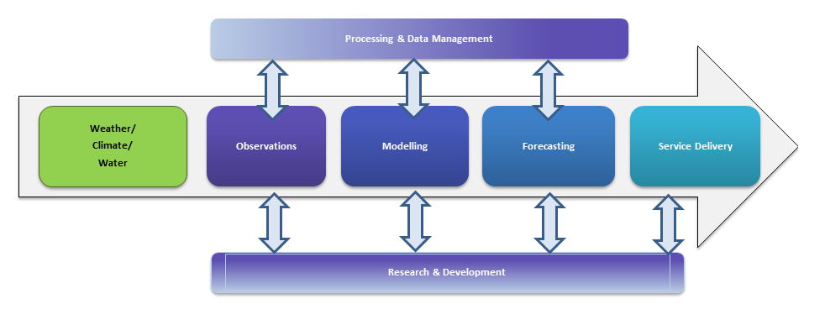
NMHS Service Production and Delivery

Slide 4
Service Production and Delivery
Necessary for economists to have some basic understanding of the information process to be able to “value” information
Whole of services versus specific products or services
All activities creating all products and services to all users and decision makers
Specific step in the process, hydro/met event, end-user, …
Need to understand process and context for specific activities with the process as well as specific products or services including:
Relevant spatial and temporal scales
Competing or complementary production activities

Slide 5
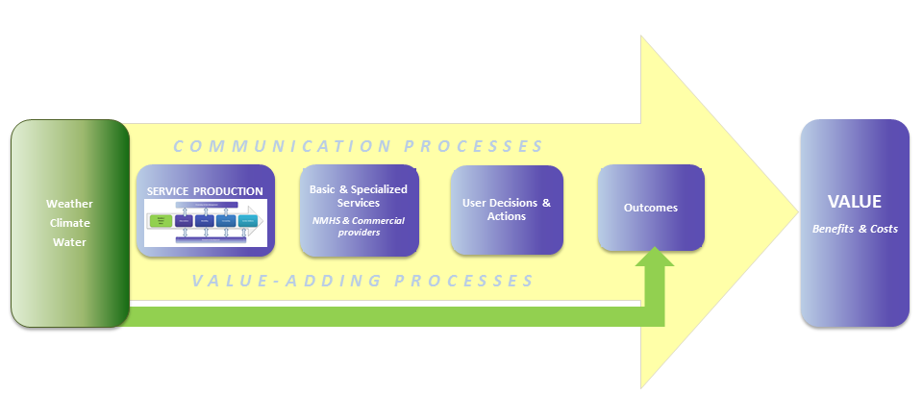
Met/hydro service value chain
Service production and delivery embedded within larger process of creating value

Slide 6
Met/hydro service value chain
NMHS Service Production and Delivery

Slide 7
Met/hydro service value chain
Private sector
Media – television, radio, internet, newspaper …
Non-traditional “channels”

Slide 8
Met/hydro service value chain
“End-users”
Economic sector / individual firms
General public / specific populations
Public agencies

Slide 9
Met/hydro service value chain
Decision making
constraints
resources
psychology of decision making - affect / cognition

Slide 10
Met/hydro service value chain
Outcomes
Dependent on weather outcome, information, decisions made, resources and constraints of decision context
personal well-being – death/injury/illness/inconvenience
“economic losses” – lost output, wages, taxes

Slide 11
Met/hydro service value chain
Valuation
Benefits of improved decisions with information
Costs of creating, communicating, using the information
e.g., cost of evacuation

Slide 12
Examples of Value Chains
Illustrate the role of different social sciences in understanding the value chain
Articulating the value of comprehensive research all along the value chain – Example from THORPEX
Conceptualizing the value chain of improved forecasting for utility scale solar power generation
Identifying gaps in the forecast and warning process to improve communication

Slide 13
Weather Information Value Chain
Emergency Managers / Public Officials
Media /
Broadcasters
National Hydro-Meteorological Services (e.g., NWS)
Vendors / Private Sector Meteorology
Economic Sectors / Stakeholders
Weather
Dissemination
Communication
Perception
Interpretation
Information Use / Decision Making
Economic Values
Monitoring
Observation
Modeling
Forecasting
Sociology
Economics
Communication
Cognitive Task Analysis
Risk Communication
Decision Analysis
Cognitive Psychology
Geography / Anthropology
Notes:
Cognitive Task Analysis – how weather forecasters interact with work stations to process information for warning decisions
Communication – what channels do people access for hurricane forecast information and why
Geography – what information affected warning message receipt in a flash flood in Fort Collins flood that killed 144
Anthropology – cultural aspects of interpretation and meaning of climate change and sea level rise inundation in Tuvalu
Risk Communication – what mental models do members of the public of storm surge that cause inappropriate responses in hurricanes
Sociology – how do institutions (forecasters, broadcasters, emergency managers) interact in the creation of flash flood warnings
Decision Analysis – what is the decision process through which a supercomputer for basic research to improve weather forecasts can generate societal benefits
Economics - what specific attributes of a potentially improved weather forecast are most valued by members of the public

Slide 14
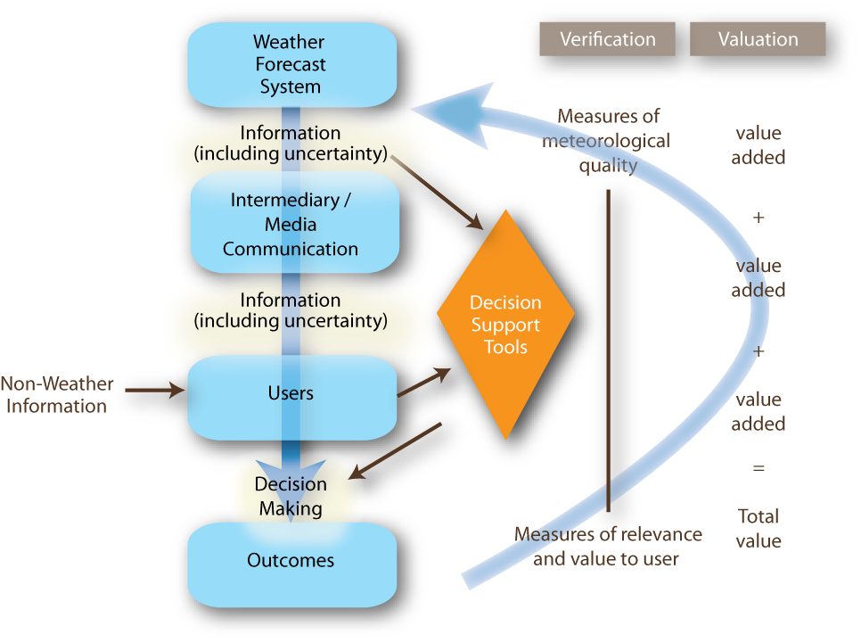
Value Chain – another perspective …
Basics – what should be valued?
Morss, Lazo, Brown, Brooks, Ganderton, & Mills – BAMS 2008
Notes:
The “Value Chain” can be presented in any number of different ways depending on what questions and issues are of interest … This is simply anpther graphical representation of a value chain emphasizing:
Value-added along intermediate steps
User-relevant verification
3) Flow of uncertainty through the process

Slide 15
Forecasting for Utility Scale Solar

Slide 16
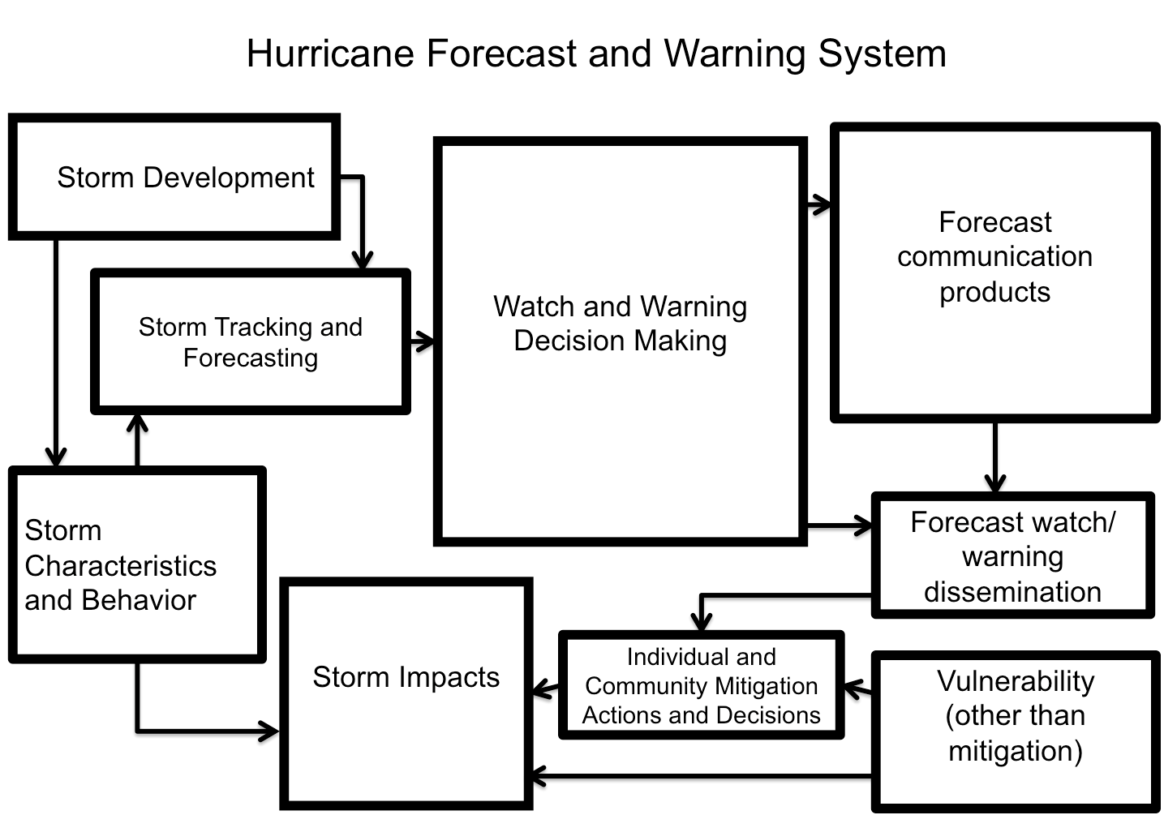
Hurricane information appraisal and response model (Part 1)

Slide 17
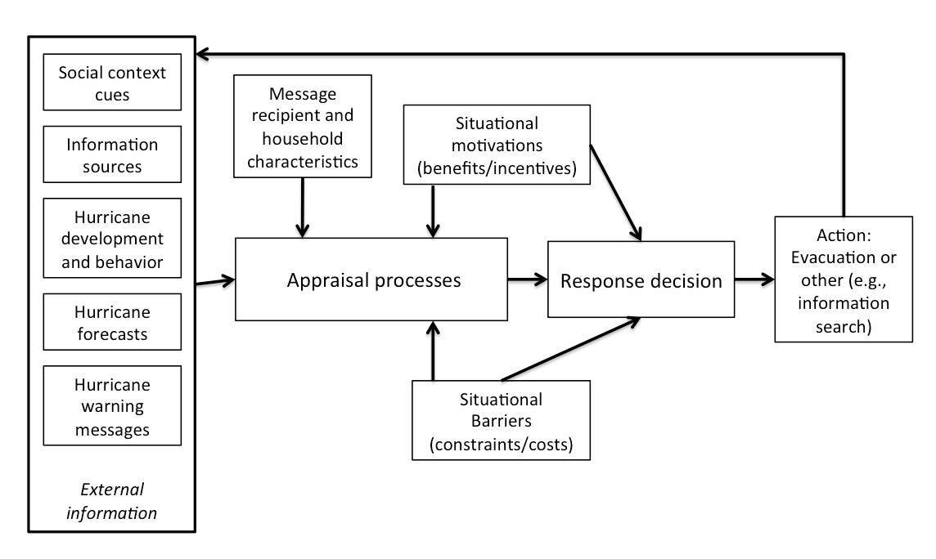
Hurricane information appraisal and response model (Part 1)

Slide 18
Example: Flash Flood Warning Value Chain
Weather
Dissemination
Communication
Perception
Interpretation
Information Use / Decision Making
Economic Values
Monitoring
Observation
Modeling
Forecasting
Large rain system moving slowly over mountains west of Boulder, CO
Doppler Radar / Rain Gauges / Soil Moisture Data
River Flow Modeling / Flash Flood Warning Issued
Emergency Broadcast System / Television / Radio / Reverse 911 / FF Warning Siren
Driving down Boulder Canyon …
Individual hears siren
Is it a drill?
Turns on radio and hears emergency message
Parks car and climbs to higher ground
Value of a life saved

