Slide 1
Examples of Socio-Economic Benefit Studies
Jeffrey K .Lazo, PhD
Director – Societal Impacts Program
National Center for Atmospheric Research
Mahe Island, Seychelles
Monday, 4 May 2015
1115 - 1145

Slide 2
Overview of session …
Quick review of three of the case studies from the book to give a taste of what this type of economic analysis is and some differences and possibilities with respect to economic analysis …

Slide 3
Examples of Socio-Economic Benefit Studies
Case Study 1: Ethiopia
Case Study 2: Kenya
Case Study 3: Mozambique

Slide 4
Benefits of Ethiopia’s LEAP Drought Early-Warning and Response System - Ethiopia
Dr. Anna Law – Oxford University
Funded by:
World Food Programme (WFP)
UK Department for International Development (DFID)
Netherlands Directorate-General for International Cooperation (DGIS)
Objectives: evaluate the benefits and costs of Ethiopia’s “Livelihoods, Early Assessment and Protection” (LEAP) system
better understand the role of met-hydro services in disaster risk reduction
demonstrate benefits and costs of preventive versus reactive humanitarian assistance
inform strategic-level investment decision-making

Slide 5
Ethiopia
Overview:
“Livelihoods, Early Assessment and Protection” (LEAP)
integrated drought early-warning action system developed in 2008 by the Government of Ethiopia, with the support of WFP and the World Bank.
designed to scale up Ethiopia’s existing national food and cash safety net (the PSNP) in case of drought, by triggering an established contingent fund

Slide 6
Ethiopia
Sectors/beneficiaries analyzed
households affected by drought
providers of humanitarian food assistance (government, humanitarian agencies, donors)
Analysis Scenario: compared three scenarios
conventional response (i.e. a baseline scenario) – response triggered 8 months after the first early warning of an impending drought
delayed LEAP-activated response – 5 months after the early warning
ideal LEAP-activated early response – 2 months after the early warning

Slide 7
Ethiopia
Methods:
cost benefit analysis to quantify avoided livelihood losses for households and decreased assistance costs associated with LEAP
hazard analysis to determine the frequency of severe droughts
exposure analysis to determine the number of beneficiaries affected by a severe drought event
average number of emergency food beneficiaries identified in the HRDs for the three droughts: 2008, 2009 and 2011
an average of 5.1 million beneficiaries per drought (increasing by 1% a year)
benefit and cost monetization:
Benefits transfer to assign monetary values to per capita losses from drought
Expert input to identify project costs
benefit-cost analysis
analysis implemented in Excel

Slide 8
Ethiopia
Benefits monetized:
avoided livelihood losses for households, including losses related to stunting, reduced adult food and non-food consumption, and the “distress sale” of productive assets
lifetime earnings lost by stunted children: $10 per capita
lower household income growth: $216 per capita
total: $226 per capita
decreased assistance costs for government, humanitarian agencies, and donors providing food aid
savings from reduced food assistance = $77, which is WFP’s per capita cost of food aid delivery in Ethiopia.
cost of non-food assistance: Added 30% to the cost of food assistance.
total $100/beneficiary
Costs monetized:
cost of setting up and maintaining the LEAP system for 20 years - $567,790

Slide 9
Ethiopia
Results:
Delayed LEAP-activated early response: 2.3 billion USD NPV benefits over 20 years, compared to conventional response
Very early LEAP-activated early response: 2.8 million USD NPV benefits over 20-years, compared to conventional humanitarian emergency drought response
Resources:
About three months working time and less than $10,000 USD for study – including Dr. Law’s internship and travel
Communication:
Preliminary results presented to representatives of the Govt of Ethiopia

Slide 10
Ethiopia
Resources:
About three months working time and less than $10,000 USD for study – including Dr. Law’s internship and travel.
Communication:
Preliminary results presented to representatives of the Govt of Ethiopia

Slide 11
Examples of Socio-Economic Benefit Studies
Case Study 1: Ethiopia
Case Study 2: Kenya
Case Study 3: Mozambique

Slide 12
Potential Value of GCM-based Seasonal Rainfall Forecasts for Crop Management - Kenya
James W. Hansen et al., 2009
International Research Institute for Climate and Society at Columbia University
Objectives:
Understand the potential value of seasonal forecasts in a context characterized by high-risk smallholder agriculture and relatively high predictability
Understand the potential use and value of seasonal forecasts downscaled from a GCM

Slide 13
Kenya
Overview:
studied two semi-arid regions in Kenya where agricultural output is highly sensitive to rainfall
using seasonal rainfall forecasts from a downscaled global climate model (GCM)
forecasts fed into a crop growth and a decision model to assess the potential value to maize farmers located in two areas of semi-arid Kenya
evaluate

Slide 14
Kenya
Sectors/beneficiaries analyzed
individual farmers
Analysis Scenario
developed seasonal “hindcasts,” simulating what the seasonal forecast would have been in each year of a 34-year simulation period (1968–2002) for two different GCM-based forecast types
(1) the optimal management strategies selected for the forecast without downscaled rainfall information
(2) the optimal management strategies selected for the forecast with downscaled rainfall information
(3) and for a perfect weather forecast (actual weather)

Slide 15
Kenya
Methods:
assumed that value of the forecast a function of
management variables that maximize expected gross revenues,
the cost of production associated with the management strategies and
climate and environmental variables (seasonal rainfall forecasts)
crop modelling and prescriptive decision model to evaluate how changes in maize crop management in response to met/hydro information increase gross margins - gross margins for a scenario in which the farmer had perfect knowledge of daily weather conditions
determined gross margins using agricultural enterprise budgets developed based on local cost data for production inputs and market price data for maize

Slide 16
Kenya
Results:
value of perfect information represented 24–69% of gross margin - farmers could potentially increase their average income substantially with the use of seasonal forecasts
Resources:
requires significant expertise related to local agricultural production, crop growth and economic optimization models

Slide 17
Kenya
Resources:
About three months working time and less than $10,000 USD for study – including Dr. Law’s internship and travel.
Communication:
Preliminary results presented to representatives of the Govt of Ethiopia

Slide 18
Examples of Socio-Economic Benefit Studies
Case Study 1: Ethiopia
Case Study 2: Kenya
Case Study 3: Mozambique

Slide 19
Household WTP for Improved Met/hydro Services – Mozambique
Jeffrey K. Lazo
Funded by:
The World Bank - Strategic Program for Climate Resilience (SPCR)
Objectives:
estimate costs and benefits of improving hydro-met services for households
help obtain funding for met/hydro improvements that would reduce damages from future extreme weather events
improve methods for hydro-met program evaluation in the Bank
assess public’s sources, uses, perceptions, and preferences for hydro-met information

Slide 20
Mozambique
Overview:
Mozambique has experienced major flooding in recent years, resulting in numerous deaths, and displacement of populations and destruction of infrastructure.
The World Bank and other organizations are supporting enhancements of the water sector to reduce these damages from future extreme weather events, including improvements to hydro-met data, forecast, and warning services

Slide 21
Mozambique
Sectors/beneficiaries analyzed
households (choice experiment and contingent valuation)
private sector stakeholders (not reported here)
Analysis Scenario: compared two scenarios
value for current services
value for moderately improved forecast accuracy
value for maximally improved forecast accuracy

Slide 22
Mozambique
Methods:
Contingent valuation, benefits transfer, expert elicitation
focus here on the contingent valuation portion
Public survey
Willingness to pay question for two different potential forecast improvement programs
Analyzed responses as a function of socio-demographics, use and impact of weather information etc.
Also gathered significant information on sources, uses, perceptions, and preferences for weather information

Slide 23
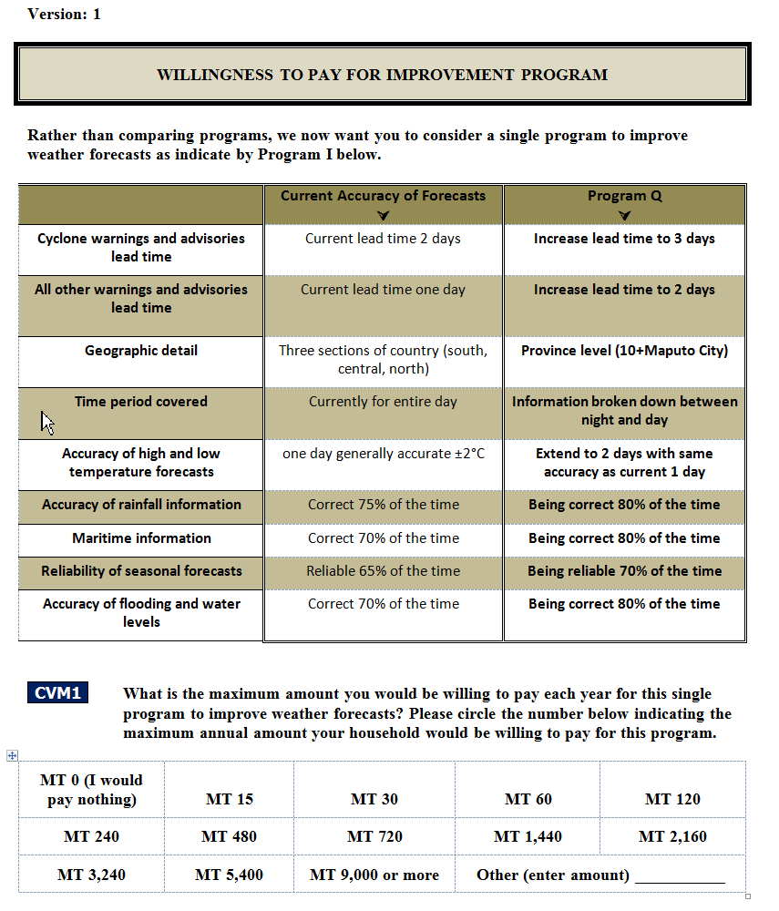
Mozambique
Methods: Payment Card CVM Question – one of two Randomly assigned programs –
moderate improvement
maximal improvement

Slide 24
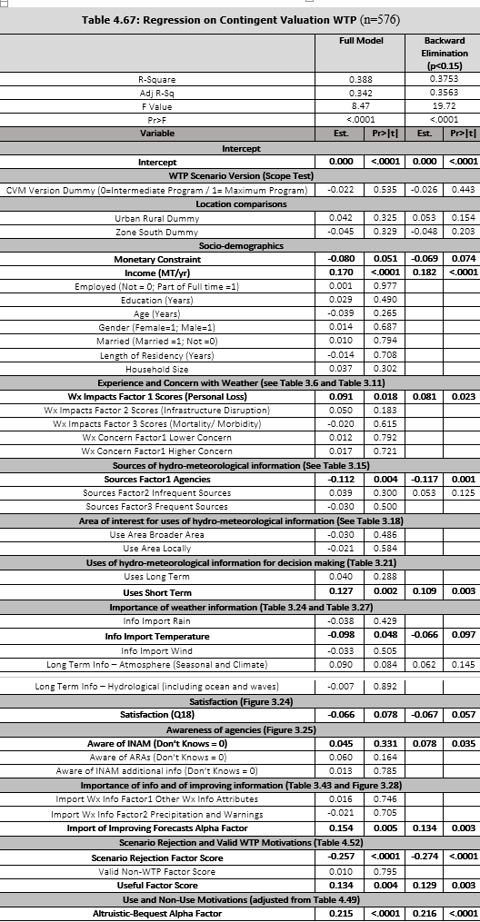
Mozambique
Analysis / Results:
regression analysis on stated WTP
special care taken with respect to
income constraints
scenario rejection
altruistic / bequest values
fitted individual values using regression model
best estimate of potential maximal improvements to the hydro-meteorological products and services
40.89 (18.57-91.79 95% CI) MT/respondent/year
$1.16 ($0.53-$2.62 95% CI)

Slide 25
Mozambique
Resources:
survey research company and economists, statistical analysis
cost probably about $100k with surveys, economist, analysis, report editing, etc.
could be completed in about 4-6 months with a focused work plan …
Communication:
initial benefits transfer was part of Bank “PAD”
final report to be shared online and published

Slide 26
Summary
Case studies illustrate range of:
products and services evaluated
objectives of the studies
methods for “filling the value chain”
methods used for economic analysis
use and communication of the results

