Slide 1
WMO SWFDP Workshops Hanoi, Vietnam
Advising for Severe Weather Communicating and collaborating with stakeholders

Slide 2
John Hammond
Met Office Advisor (Civil Contingencies)
Joined the Met Office in 2001
Background in Observing and Forecasting Support, including communications
WMO workshops in South Africa and Philippines, Press Office for six years
Now part of a team of 19 Advisors spread across the UK
Liaison between the Advisor team and the Chief Operational Meteorologist in Met Office HQ
Responsible for communications with emergency responders in the East of England

Slide 3
Coming up…
Communicating and collaborating with stakeholders
How we do it in the UK
The Met Office’s Public Weather Service Advisors
How the Advisor role works in practise
Could a similar role be set up in your country?
Notes:
How to get to know your customer so that you can work with them to provide the best possible information, what other ways we use partnerships in the UK in order to support the public and responder community.
We will then look more closely later today at how the PWSA role works in practise, and how you may be able to do something similar in your country

Slide 4
What services do the customers need?
How do we find out what our customers need?

Slide 5
Customers
Get to know them
What does your organisation do?
What issues does your organisation face?
What is your role within the organisation?
How bad does the weather have to be to affect your job?
What types of weather affect your job?
How does the weather affect your job?

Slide 6
Customers
Get to know them
Involve them
Notes:
But how do you do that?

Slide 7
met office ADVISOR

Slide 8
Civil Contingencies Act (2004)
Met Office:
no legislative responsibilities
specialist supplier to emergency responders
Specific duty to warning and inform the public
National Severe Weather Warning Service
Specialist Advisor to emergency responders
high impact weather events
emergencies influenced by weather
Team of Advisors cover all of the UK
Notes:
In response to a number of emergencies which impacted on UK life, such as severe flooding and foot and mouth, UK Government developed and introduce the Civil Contingencies act.
The Act provides a coherent and unambiguous legislative framework
for building resilience by establishing clear roles and
responsibilities for those at the forefront of response.
A conscious decision was made by the Met Office that our involvement would not be as Cat 1 or 2 responder placing statutory duties upon us, but to be a preferred supplier of met information into emergency response. This includes support for products and services through our PWS Advisors.
Steve Barnes of the Civil Contingencies Secretariat, who has very kindly accompanied us today, has had significant involvement in the development and implementation of the act.
The Met Office did ensure it engaged the team drafting the legislation at the earliest opportunity and endeavoured to ensure meteorology was represented.

Slide 9
Met Office Public Weather Service: In the beginning...
National Severe Weather Warning Service
Public Weather Service Advisors
Used the Civil Contingency Act to help identify who the customers were
Advisors contacted emergency responders
Explained the services the Met Office could provide to emergency responders
Point of contact between the local customers and the Met Office
Established a two-way relationship to allow delivery of services and provide valuable feedback
Notes:
In 2005 the Met Office set up the role of the Public Weather Service Advisor to complement the NSWWS – the first jobs of which were to…

Slide 10
Advisors
Raising awareness and understanding of PWS across the UK resilience community
Planning and exercises
Weather & local resilience risk registers
Risk assessment, mitigation & incident support
Incident/operational support
Cabinet Office
Incident Command Centres
Notes:
Public Weather Service advisors
We have a team of regionally based Public Weather Service advisors with responsibility for Government Office regions in England and Wales, and for the Devolved Administrations of Scotland and Northern Ireland. These advisors work with regional emergency planning groups to assist in devising plans and exercises and respond to real-time emergency incidents. One of the main things they do is go out there and talk to the responders – find out what they do, what they need and so on…

Slide 11
PWS Advisors
Notes:
Now we have expanded to a team of 16 across the UK – with a lead, 3 senior advisors, 12 advisors in the regions

Slide 13
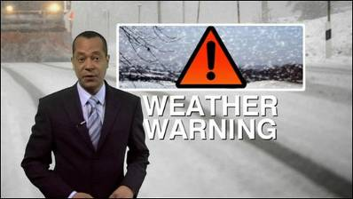
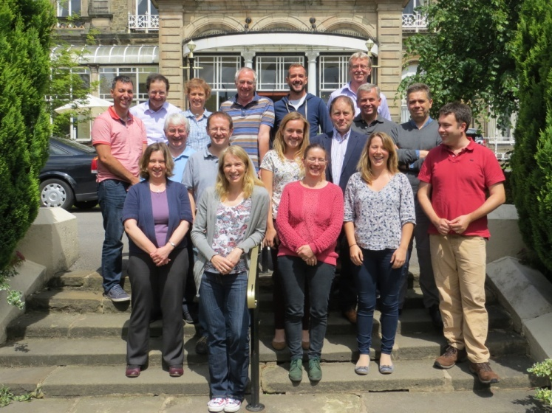
The role of the Met Office
To forecast severe weather in
advance.
Let people know about it
issue weather warnings
Keep responders updated
Regionally based Advisors
Linking in with local Cat 1 and Cat 2
responders, providing updates
Participating in Strategic
Co-ordinating Groups as required
Notes:
What does the Met Office do in severe weather?
First thing is to spot that it’s coming – by running our various forecast models and using our expertise to interpret the output
Next thing is to let people know – by issuing appropriate warning. I’ll say a bit more on the National Severe Weather Warning Service in a moment
Additionally we have our team of Public Weather Service Advisors – you may have come across them at various Local Resilience Fora meetings or exercises
They’re regionally based – 15 around country
The provide a link for Cat 1 and Cat 2 responders to the Met Office.
During severe weather they will provide their local contacts with updates which are in addition to the weather warnings.
If SCGs (or multi-agency adverse weather groups) are convened then they are available to provide updates and advice to these groups

Slide 14
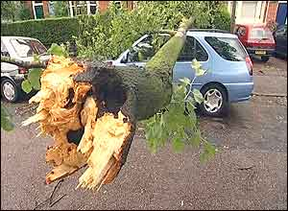
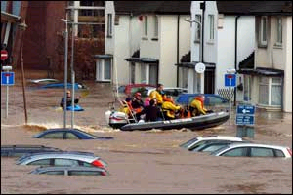
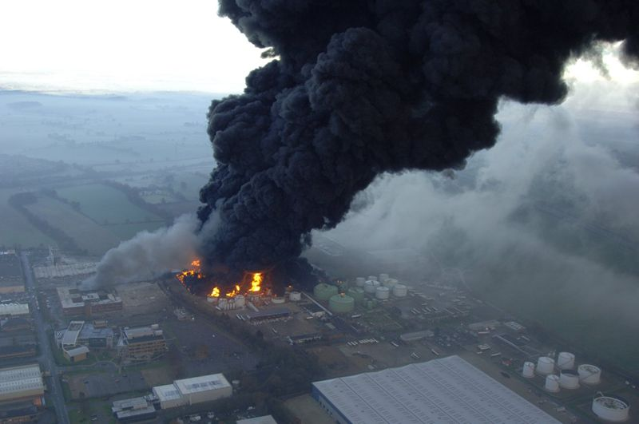
Weather impacts on Resilience in two ways
When the weather itself is the cause of the Emergency.
When the weather plays a part in the management of the hazard. For example Chemical Fires or volcanic eruptions.

Slide 15
UK Advisors
Working with:
Local Resilience Forum groups
Emergency responders
Local , Regional and National authorities
Utility companies

Slide 16
Planning for Emergencies
Raise awareness of how severe weather can create or influence emergency situations
Raise awareness of Met Office capabilities
Assisting with any weather issues in relation to risk assessments, emergency plans etc
Building strong relationships with the resilience community on a regional /local basis
Get involved in exercises, creating scenarios, providing advice, role playing…

Slide 17
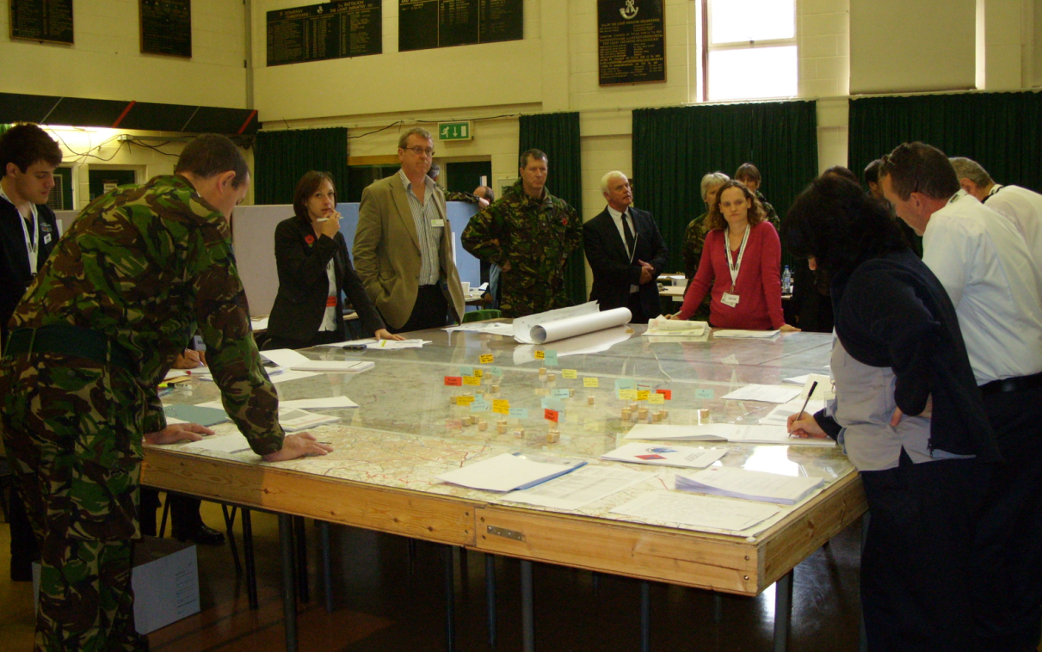
Exercises
Advice regarding scenario
Planning Meetings
Exercise Injects
Weather Warning
Exercise Briefings
Role play

Slide 18
Recent Exercises
Olympics
Heat wave
Flooding
CBRN
Exercise Watermark
National Flooding Exercise
Exercise Northern Chain
National Counter Terrorism exercise – plume forecasts

Slide 19
Planning for Emergencies
Participation in National groups
National Risk Assessment Group
Warning and Informing Group
Nuclear Emergency Planning Liaison Group
Olympic Strategic Safety and Security Risk Assessment Group

Slide 20
Responding to Emergencies
Met Office Advisors (Civil Contingencies)
Feed weather info into local multi agency groups
Facilitate access to any Met Office capability as required
Also
Provide strategic weather and scientific advice to central government departments
Notes:
Local groups eg SCGs, STACs
Govt eg COBR, SAGE, NEBR

Slide 21
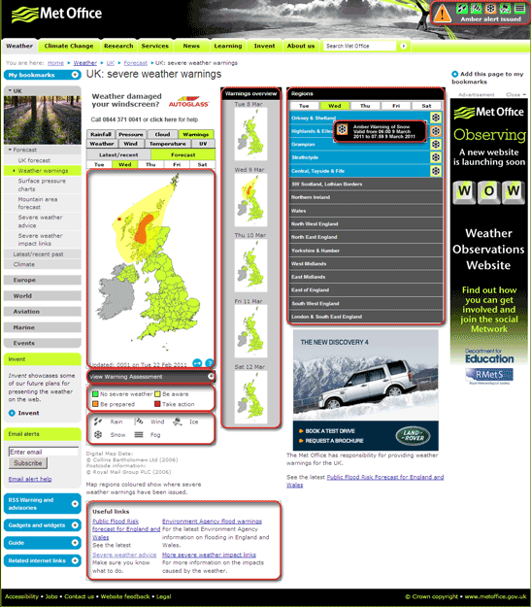
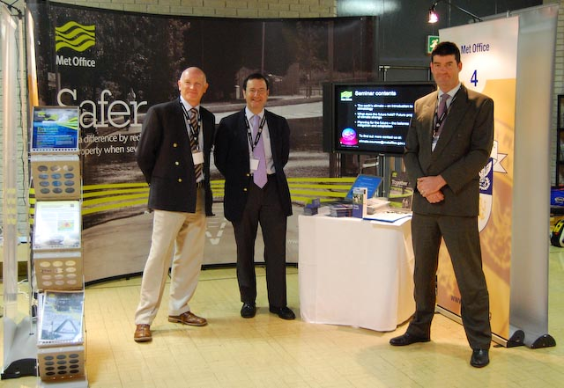
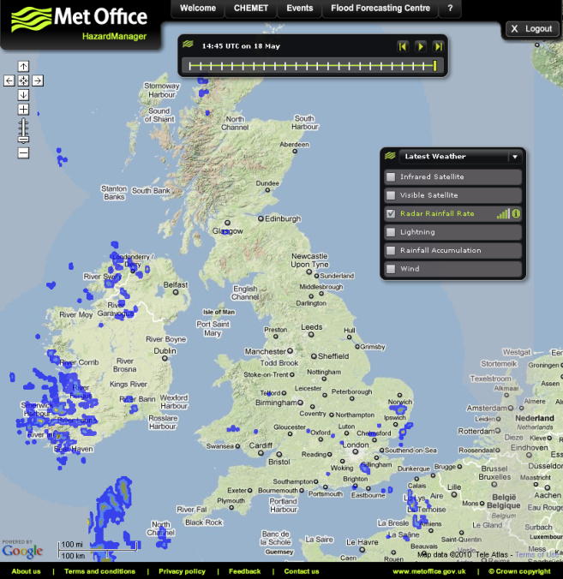
Weather services for emergency responders
NSWWS
PWS Advisors
Hazard Manager
Notes:
As well as the advisors and NSWWS we have HM

Slide 22
What is Hazard Manager?
One stop information source for responders
Password-protected web portal with personalised login for Cat 1 &2 responders
Stores Met Office, Flood Forecasting Centre and Scottish Flood Forecasting Centre information
Weather info displayed on map viewer
Notes:
What is HM
Born out of an Emergency Response website which we had running for a couple of years. We activated that when there was an incident or severe weather – but you as responders needed to apply for access each time it was activated. Although the concept of the website was well received, the need for re-registration didn’t so HM was born
Register once and it’s available 24/7
Uses Google maps

Slide 23
Hazard Manager – Weather Information
Notes:
Maps can be zoomed – so we can focus on a specific area of the UK

Slide 24
Hazard Manager – NSWWS

Slide 25
Weather and other emergencies
The weather can have an effect on other emergencies
Fires, chemical or nuclear accidents, volcanic eruptions
Where is the plume going? Wind speed & direction
Building collapse
Is it going to rain?
Will strong winds make the remaining structure more dangerous?
Many others
Notes:
Some examples

Slide 26
Dispersion Modelling Advice
Correct interpretation of the modelling output is key
Expert scientists directly provide detailed advice on the modelling capabilities and uncertainties to the Scientific Advice Group for Emergencies (SAGE)
PWS Advisors ensure appropriate information also goes to local Scientific & Technical Advice Cells (STACs)

Slide 27
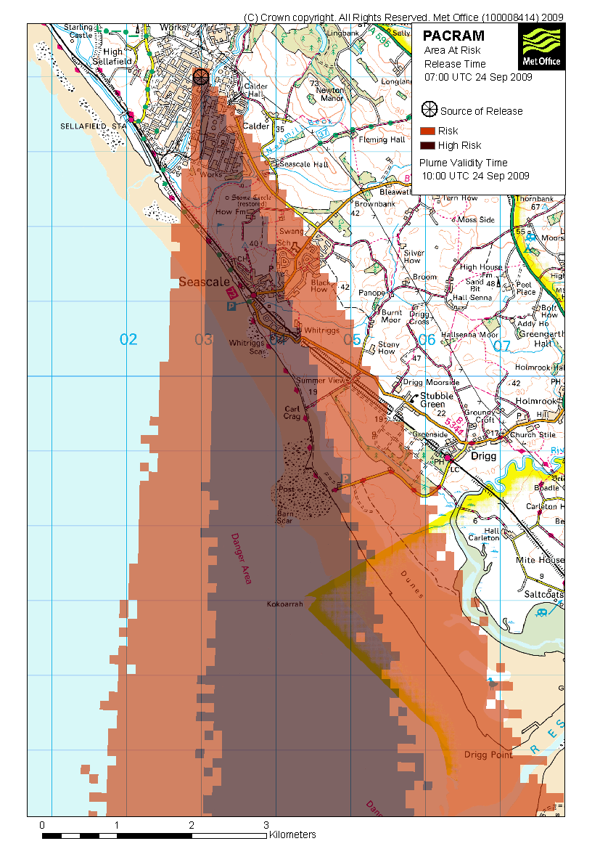
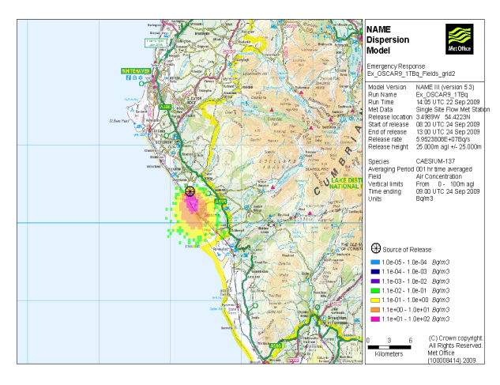
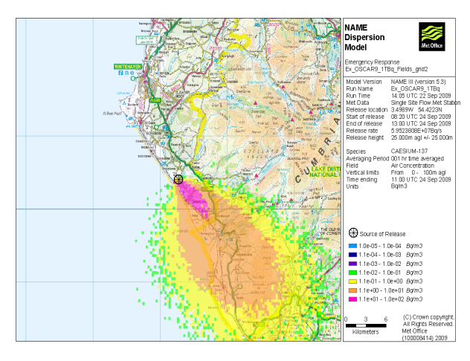
Examples of plume forecasts
PACRAM
NAME
Notes:
On LHS – basic plume which can be sent to a requesting FRS within 20 minutes of the request.
On RHS – some more detailed info – concentrations, dosage, depositions etc. which can be produced relatively quickly in qualitative form but which of course need detailed info about the source to provide quantitative info

Slide 28
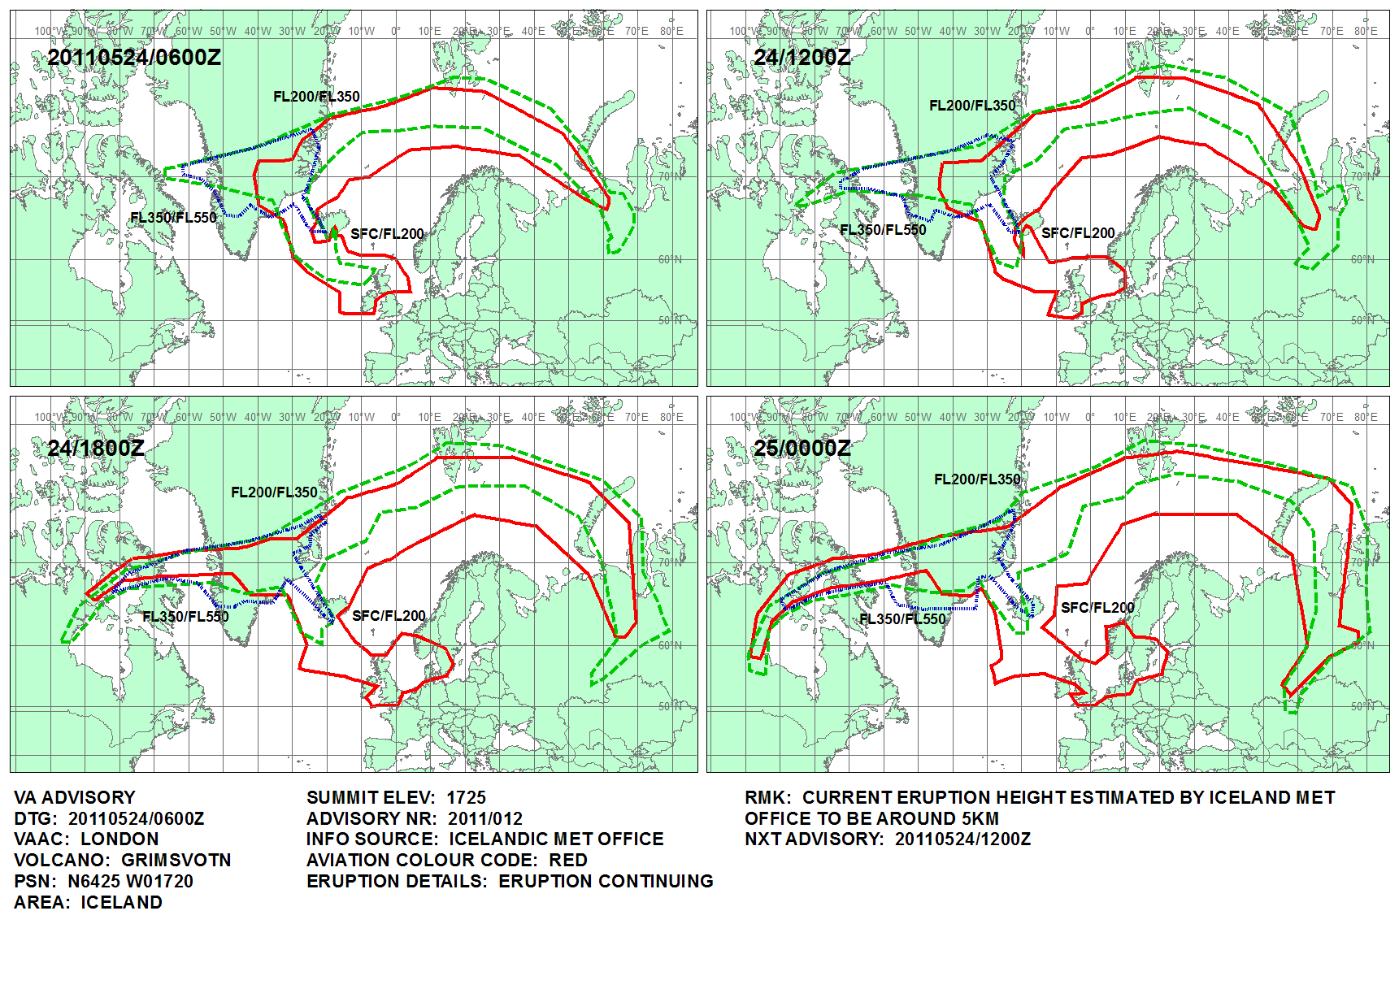
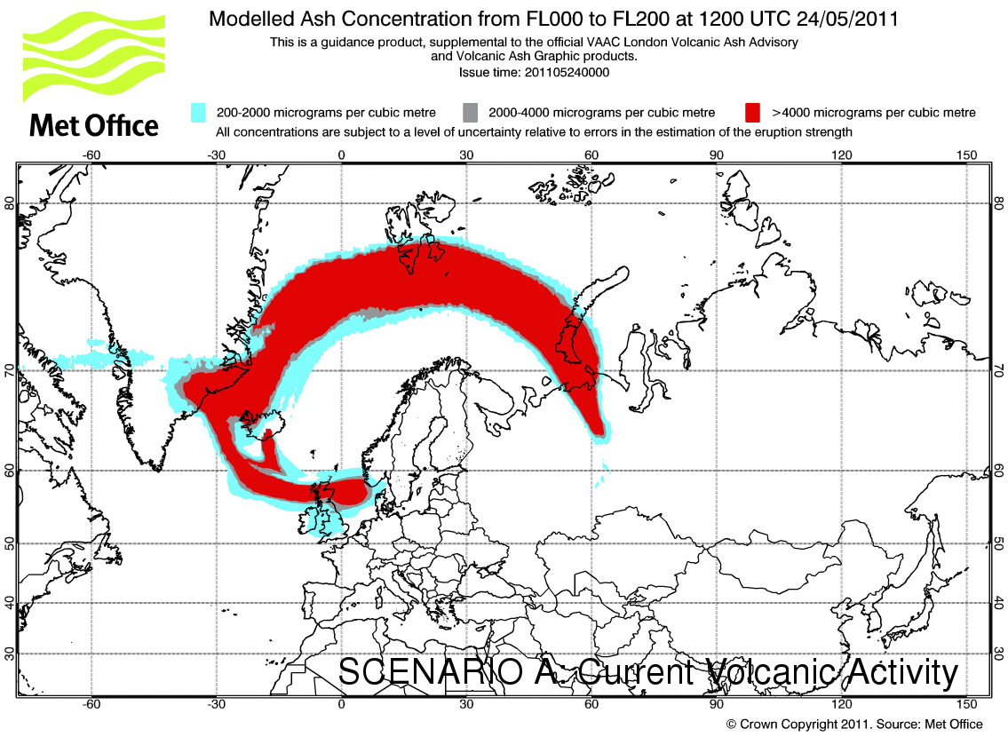
Volcanic Ash – May 2011
Notes:
Something else the NAME (Numerical Atmospheric-dispersion Modelling Enviornment) model is used for – Volcanic Ash
Met Office has an international responsibility to forecast where the ash from any volcanic eruptions in NW Europe is going
Back in 2010 – this was the basic product issued (on our website and to the airlines) – the rule (not set by us!) was no flying where there might be ash
When the enormity of the impact was realised the engine manufactures defined a so-called “safe” limit and we were asked to redefine our output to identify the different areas.
(Shows how responsive we can be to the needs of our customers especially in emergencies!)

Slide 29
Input at National and Local Level
Provide guidance on
impacts from
severe weather
Provide met input
to planning cycle
Provide met data
Into emergency planning
risk assessments to
influence policy
Provide data for
emergencies influenced
by weather
e.g. plume forecasts
Disaster
Prevention,
Mitigation
and
Adaptation
Involvement in exercises,
e.g. create scenarios, input
of forecasts and plumes,
also role playing
Raise awareness of
Met Office
capabilities
During emergencies
take media lead on
weather
Notes:
So in summary, In support of disaster prevention, mitigation and adaptation, the PWS Advisors ……
Highlight national, regional and local engagement in all of the above in in particular National and Local Risk Assessments, which influence policy.
Not all of our PWS Advisors have forecasting backgrounds, although many have. We felt the most important skills for this role were communications, although the team does have science backgrounds, some in forecasting and some hydrology. The PWS Advisor needs to be able to understand meteorology, but have the ability to explain it in layman’s terms. In particular to explain the impacts of severe weather or indeed weather which can have an influence in an emergency, such as chemical fire, has on emergency community. Therefore a deep understanding of the planning and response required by the emergency responders to fulfil their statutory duties is needed.

Slide 30
Challenges?
The science
The weather can quickly change!
All models have limitations
Expressing the uncertainties in the forecast is a huge challenge
Resources
We are a 24/7 organisation but incidents can put a tremendous strain on staff with responders, the media and the public all thirsting for information

Slide 31
Different examples of Community Advisors and Response

Slide 32
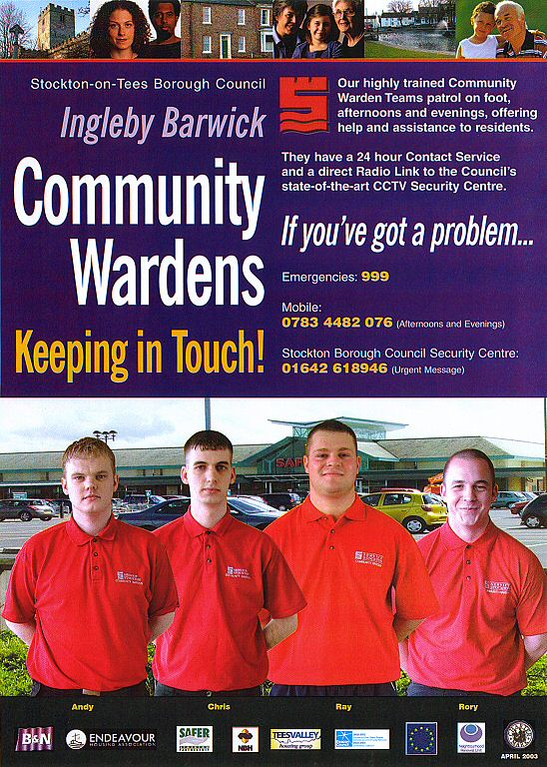
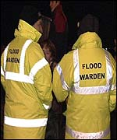
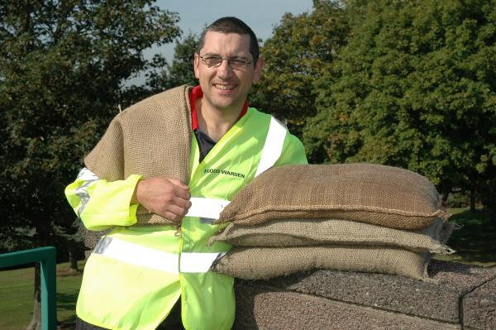
Community Flood Warden
Helps to bring the community together during difficult times and helps the community to be prepared for flooding.
Community Flood Wardens are members of the local community
Supported by the Local Resilience Forum (LRF) and the Environment Agency - who provide training.
By working together - the impact of flooding can be reduced.

Slide 33
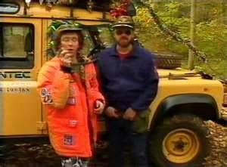
4 x 4 Volunteer Teams
During some severe weather situations - it is only possible for 4-wheel driving.
Voluntary members own a 4×4 vehicle volunteer to help during times when only a 4×4 vehicle can reach locations that other vehicles cannot.
The emergency management section of a County Council often maintains a list of volunteers.
Delivering hot meals when snow and ice makes road conditions difficult for other vehicles.
Transporting nurses and doctors to see patients in locations cut off by flood water.
Taking people from communities to health centres.
Providing transport when buses are unable to use flooded or snow covered roads.

Slide 34
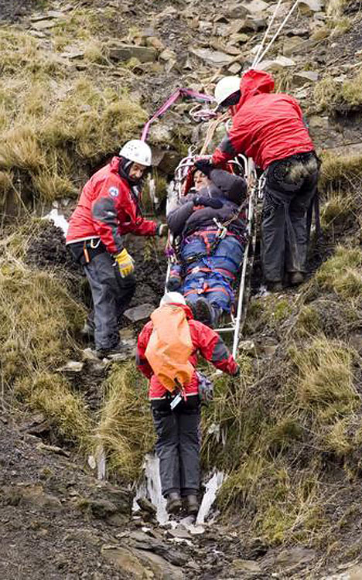
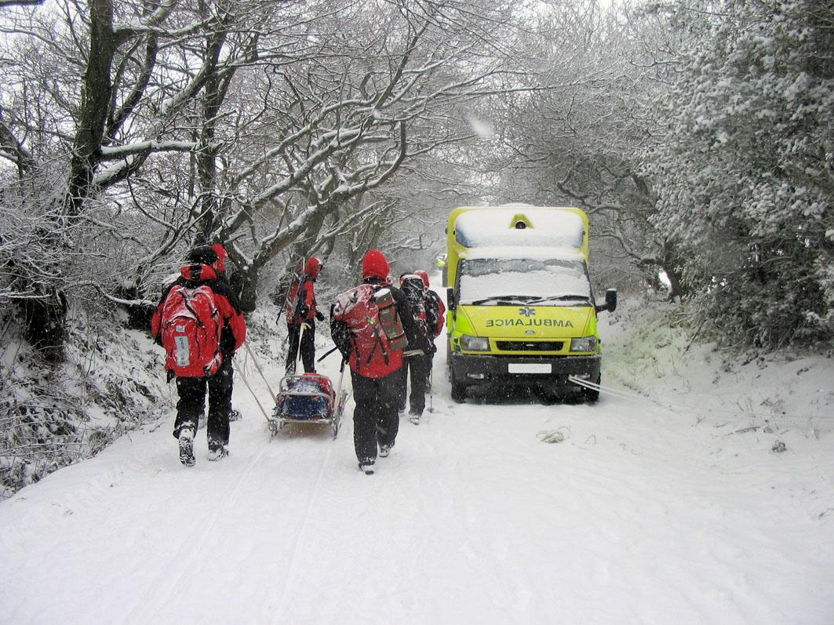
Mountain Rescue
A voluntary body and registered charity, liaises with the Government and other organisations.
Various items of equipment such as stretchers, ropes and first aid equipment, are provided from the Government, along with public liability insurance and accident insurance for team members
The mountain and cave rescue service in the UK is the responsibility of the police, under their obligation to 'protect life and property'.
Teams and search dogs are called out through the emergency system, and work with the police, ambulance or fire service depending on the nature of the incident.

Slide 35
Partnerships
Working with customers
Working with other departments
Notes:
So, we work in partnership with our customer by learning what they need to help us deliver a better product, but we cannot do this alone – we also need to work in partnership with other departments

Slide 36
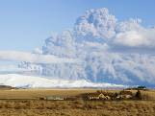
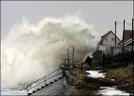
Natural Hazards Partnership
Notes:
36
We work with many different depts in the UK with the ultimate aim of disaster prevention and mitigation – but this all requires collaboration and co-ordination. We work with many different organisiations eg
BGS for landslides and volcanic eruptions
HPA for modelling air quality
EA for flooding – FFC…..

Slide 37
Get Ready for winter
Notes:
Other partnerships include the Get Ready for Winter campaign…

Slide 38
Get Ready for winter
Join up messages from Government, the voluntary sector, Local Authorities and others
Encourage individuals, families and communities to think about winter preparations to help them stay warm, healthy and safe
Better co-ordination, sign posting and ease of access
www.metoffice.gov.uk/getreadyforwinter
Notes:
Hosted on the Met Office website

Slide 39
Get Ready for Winter
raise awareness of weather impacts and the benefits of planning
highlight some very practical and straight forward advice to help individuals and communities prepare for a range of winter weathers including, cold, snow, ice, high winds & flooding
provide an opportunity to link local activities and messages to a national initiative
user friendly access of information through a central webpage which will provide links to further information
Notes:
Aims

Slide 40
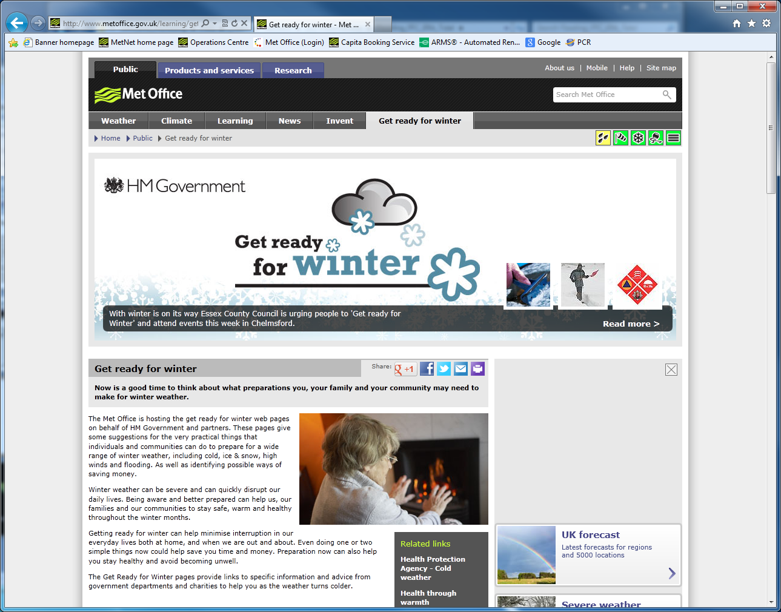

Slide 41
And so…..
“Our overall aim is to provide the maximum level of assistance to the emergency planning community and in so doing minimise the impacts on both human life and the environment during severe weather episodes”
Notes:
After the tea and coffee break it will be your turn to think about some of the things I have talked about this morning and see if you could anything similar in your country. Then, if there is time, we will look at an example of a weather event in the UK and how the Met Office dealt with it.

Slide 42
Any questions?

Slide 43
Tea and coffee break

Slide 44
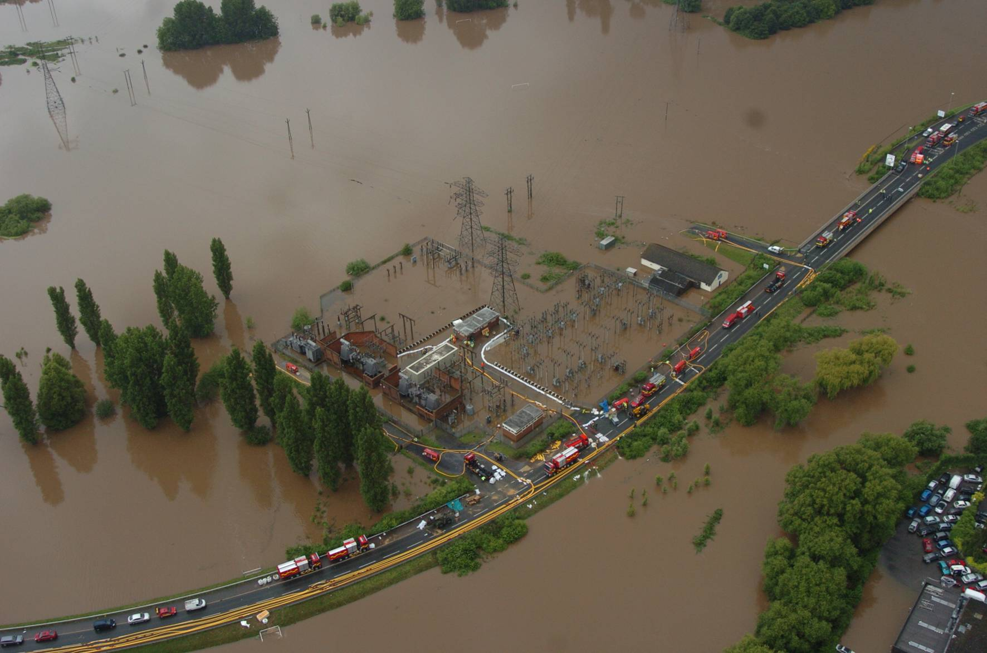
Time for you to do some work

Slide 45
Exercise – part 1
Are there any roles like the Public Weather Service Advisor which are similar to the emergency response in your country?
What are they?
How do they communicate with ministries and communities?
Are there any roles like the Public Weather Service Advisor, which are not currently used in your country that you think could work?
What are they?
Why would they be good to use?
Which parts of the Public Weather Service Advisor role would not work in your country?
Why would it not work?
Notes:
For the next 20 minutes and be prepared to feed back

