Slide 1
Joint WMO-IOC Technical Commission for Oceanography and Marine Meteorology (JCOMM) contribution to the WMO Integrated Global Observing System (WIGOS)
Second JCOMM Marine Instrumentation Workshop for WMO Regional Association IV with focus on wave measurements from moored buoys
(Gulfport, Mississippi, USA, 29 Feb – 2 March 2016)
Etienne Charpentier
(Chief, Observing Systems Division, WMO)

Slide 2
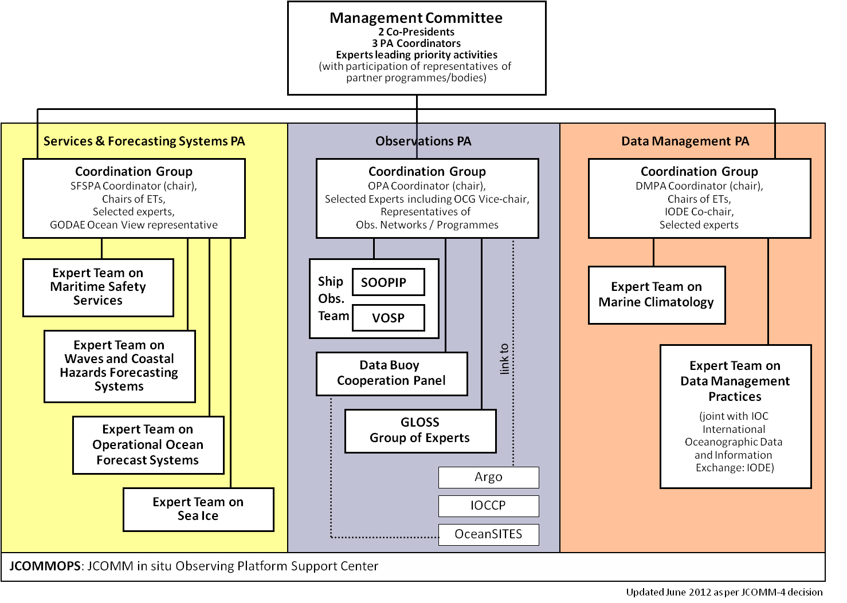
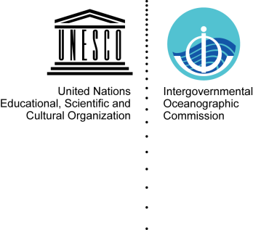
JCOMM Implementation through Programme Areas
WMO
Joint WMO-IOC Technical Commission for
Oceanography and Marine Meteorology
Notes:
JCOMM reporting /implementation is made through specific Programme Areas agreed by Members / Member States at the Commission sessions. These Programme Areas all have strong links to other WMO Technical Commissions and programmes, including CBS, CCL, CHy, WIGOS/WIS and DRR to name a few.
In view of the ultimate objective of our work as being service delivery, and in alignment with the strategic objectives of WMO and IOC, the primary focus of JCOMM is on the Services and Forecast Systems Programme Area, strongly supported by Observations and Data Management.
At JCOMM-4 the Commission considered that the existing structure and composition of the teams had been generally appropriate to make progress in the implementation of the JCOMM intersessional work plan, and therefore agreed that this structure should carry forward during the new intersessional period. In this context, the three Programme Areas and their appropriate component groups and expert teams were re-established

Slide 3
WMO Strategic Priorities 2016-2019
Disaster Risk Reduction
Global Framework for Climate Services
WMO Integrated Global Observing System
Aviation meteorological services.
Polar and high mountains regions.
Capacity Development
WMO Governance
Notes:
Then in our strategic doc you will find the Priorities for the Intersessional Implementation, strategic approach for implementation, General Principles, An Integrated Approach for Cross-Cutting Issues, Communications and Outreach, External Interactions, Performance Evaluation, Framework for Implementation, General Governance
JCOMM Structure, The Management Committee, Programme Areas, JCOMMOPS, Intersessional Activities, WMO/IOC secretariait.
TABLES on Addressing Expected Results and High-Level Objectives

Slide 4
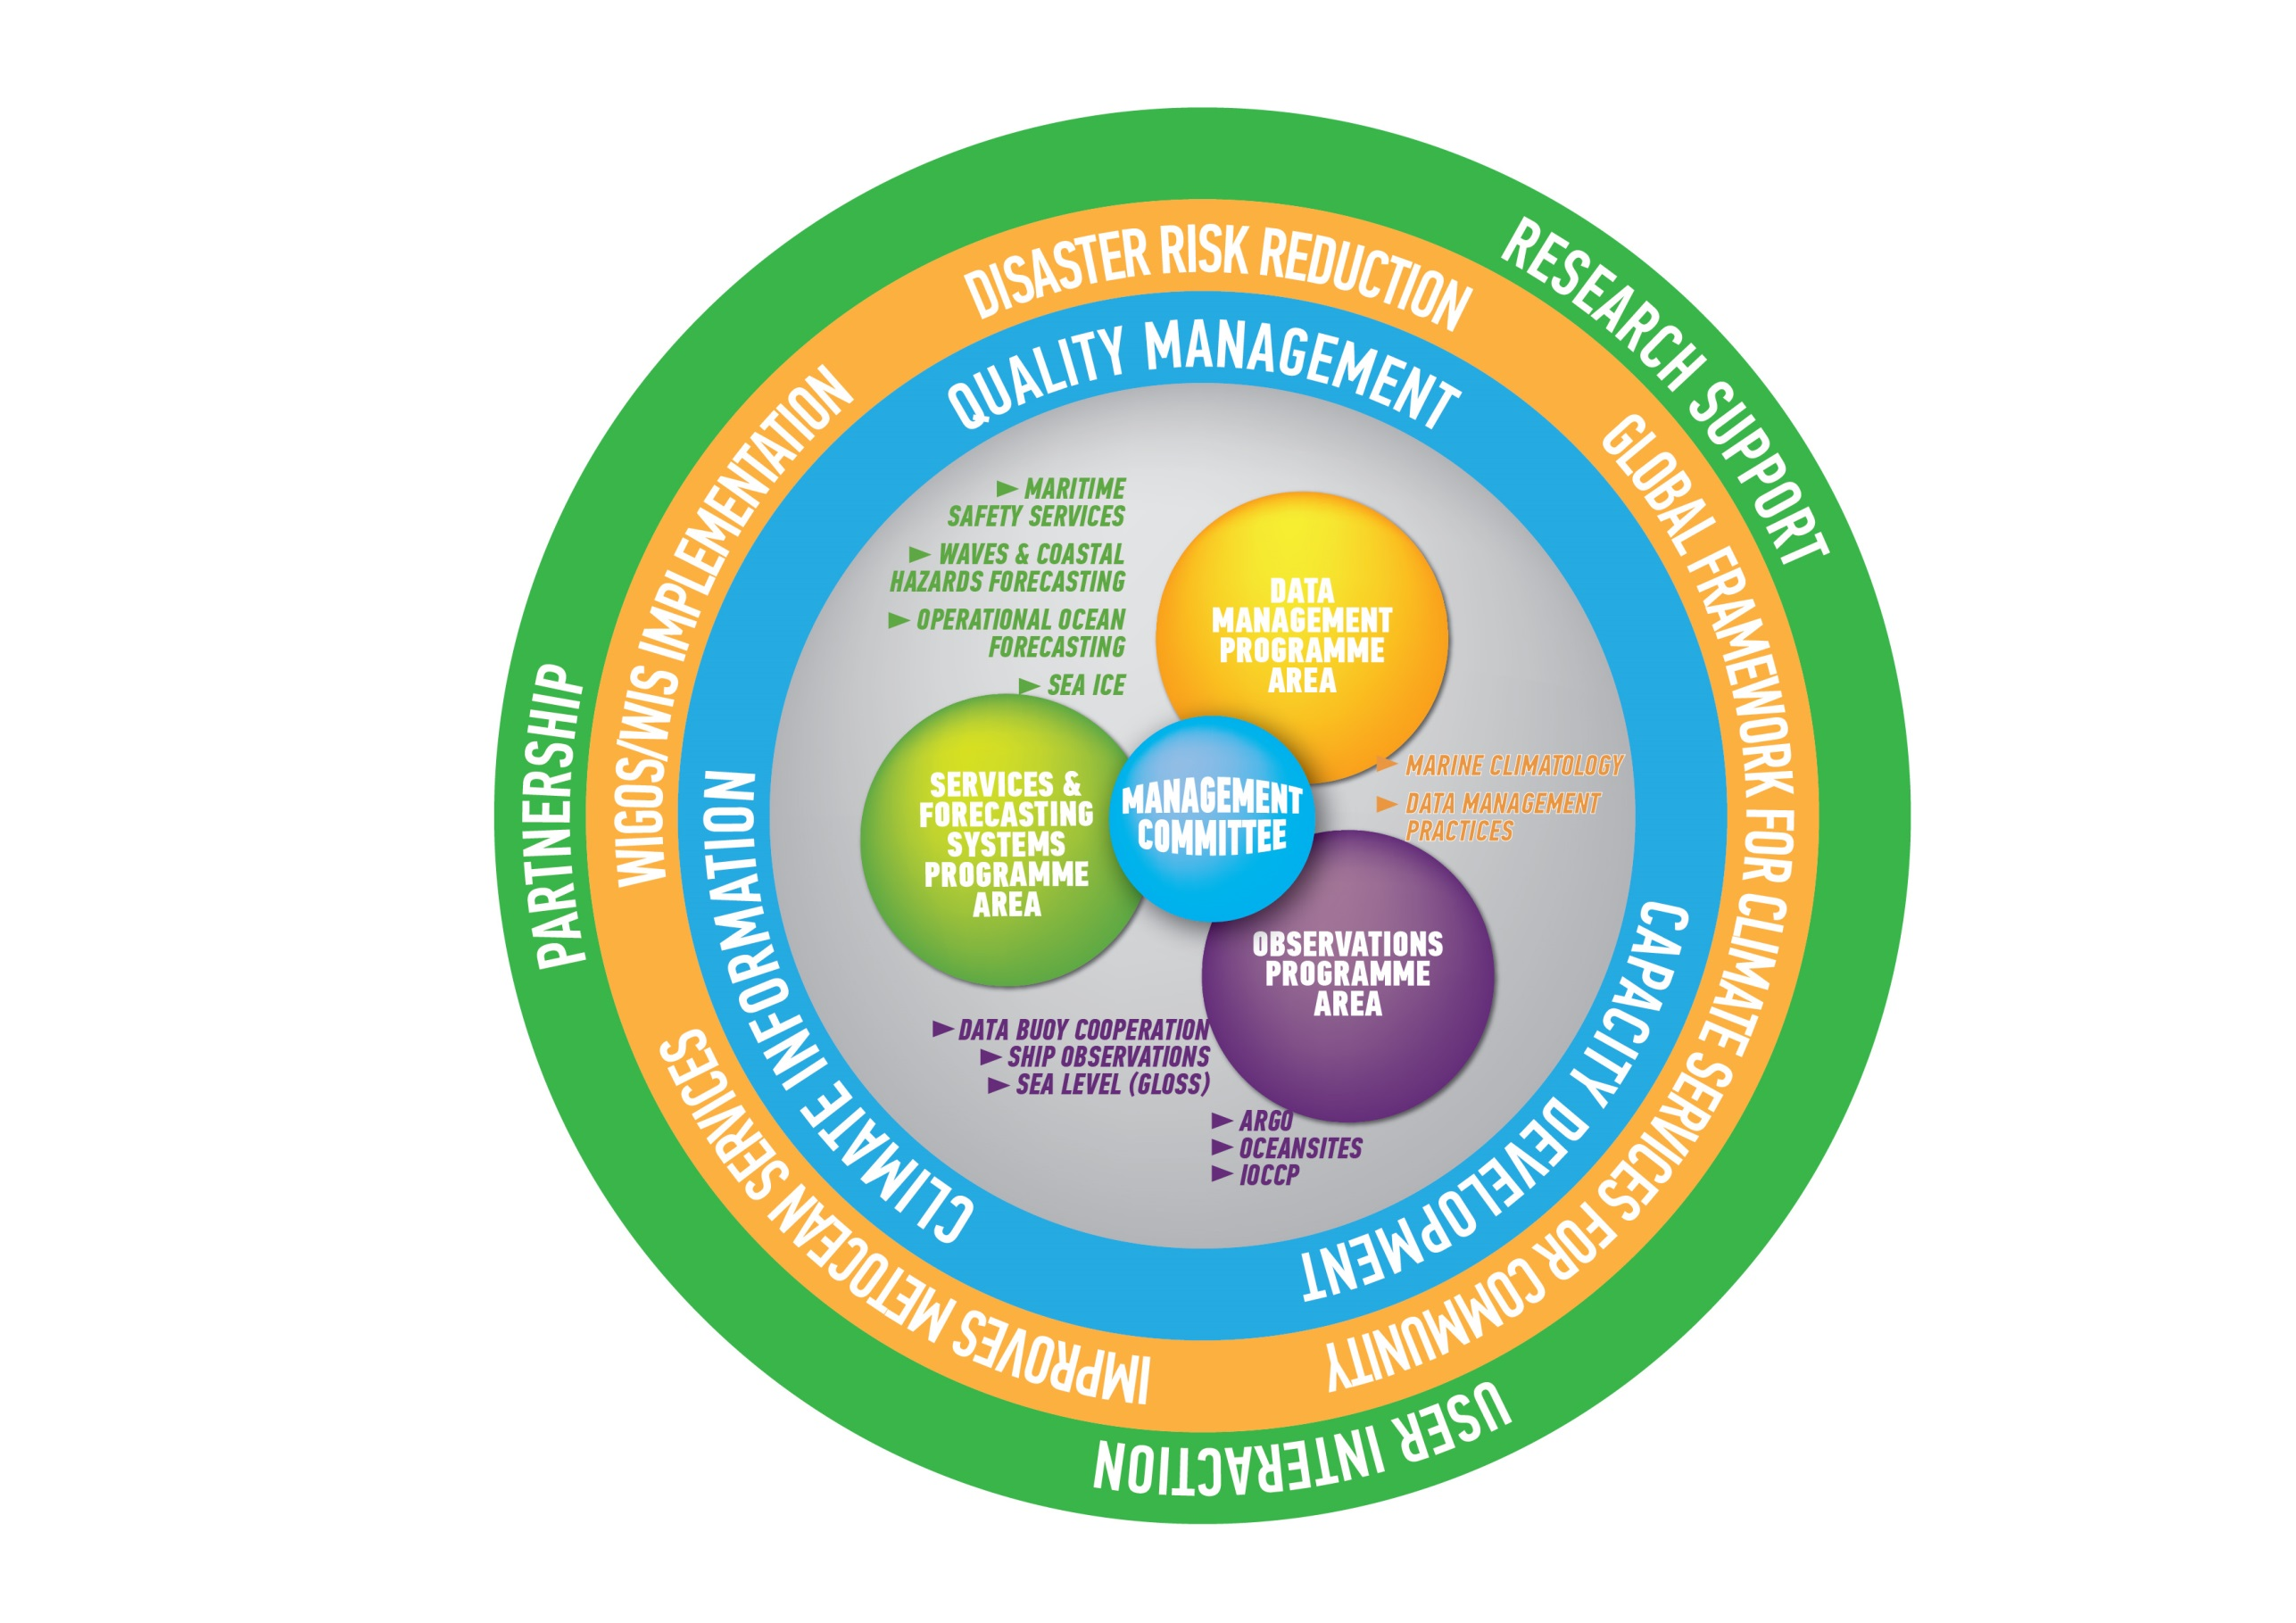
JCOMM activities
www.jcomm.info
Observations
for Improved
products and
services for
Met-Ocean
Community

Slide 5
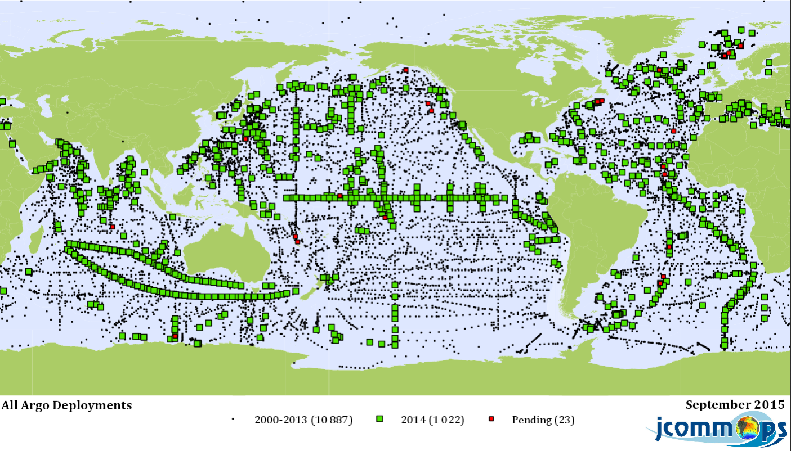
Argo (profling floats) http://www.jcommops.org/argo

Slide 6
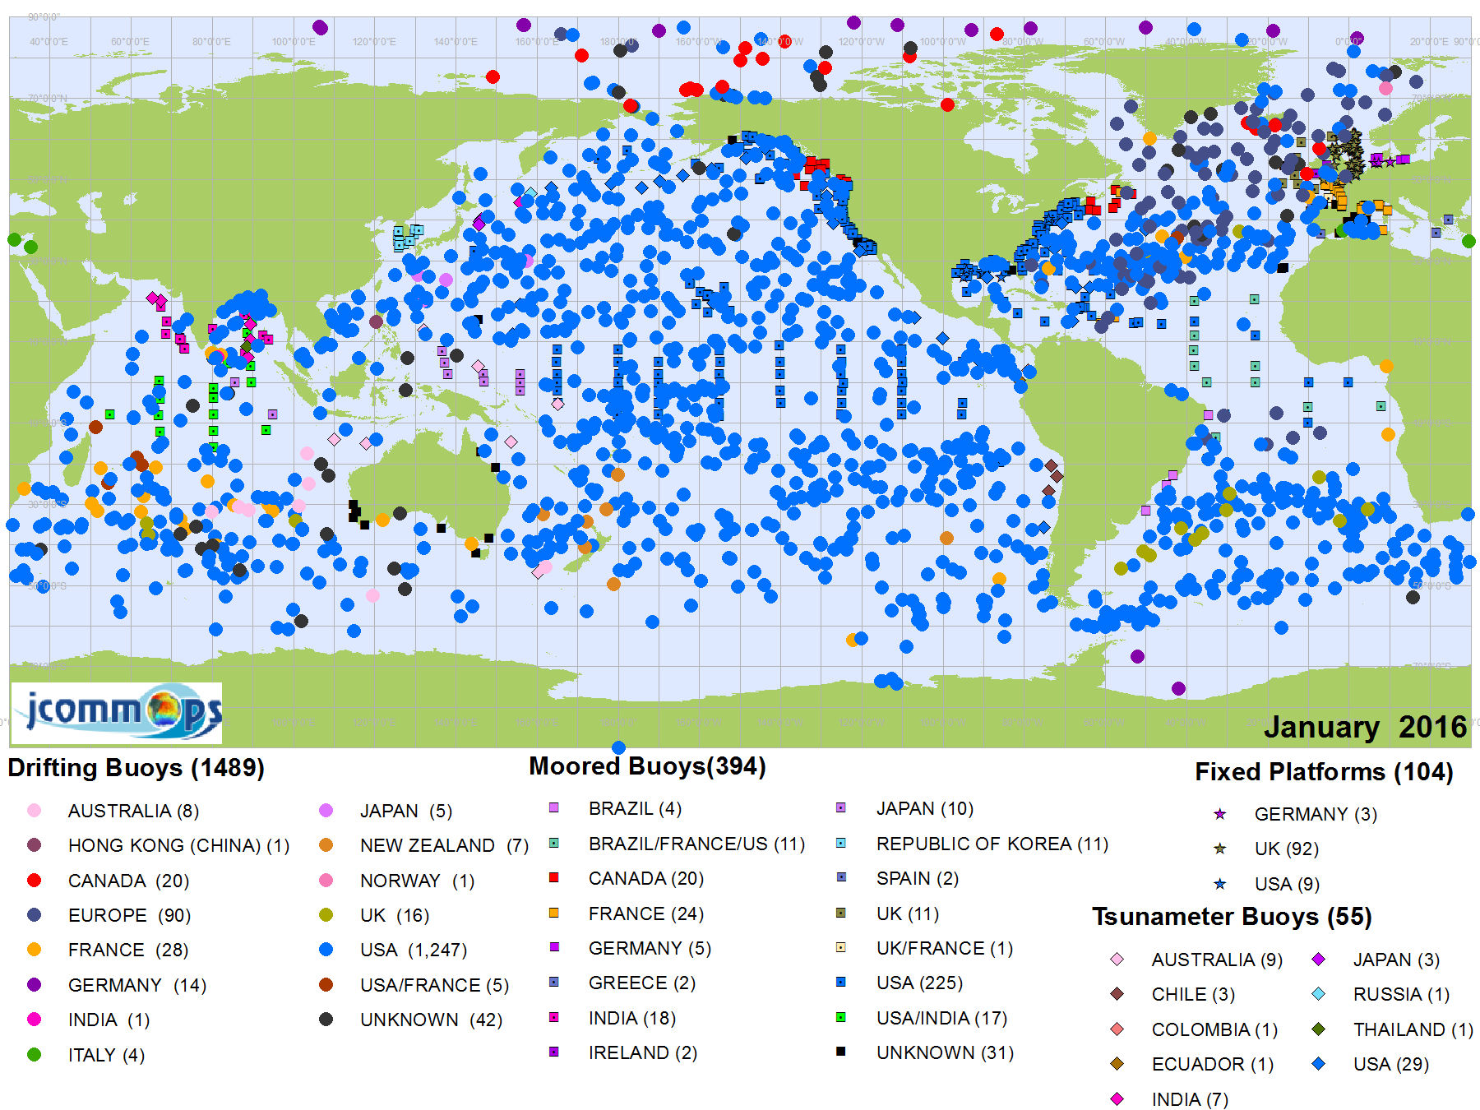
DBCP (data buoys) http://www.jcommops.org/dbcp/

Slide 7
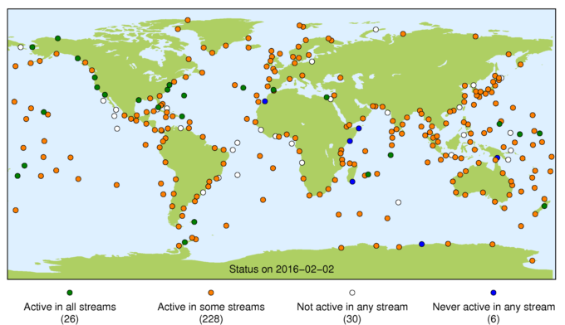
GLOSS (sea level -tide gauges) http://www.gloss-sealevel.org/

Slide 8
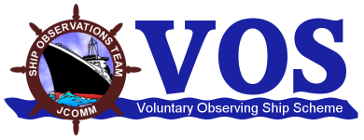
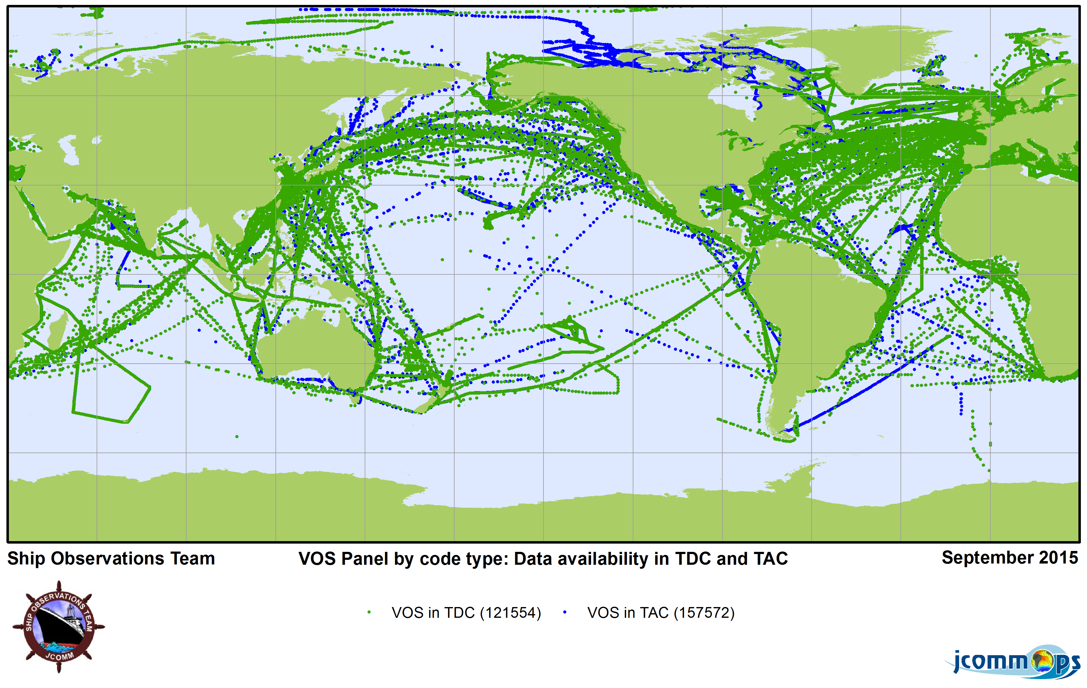
Voluntary Observing Ships http://www.jcommops.org/sot/

Slide 9
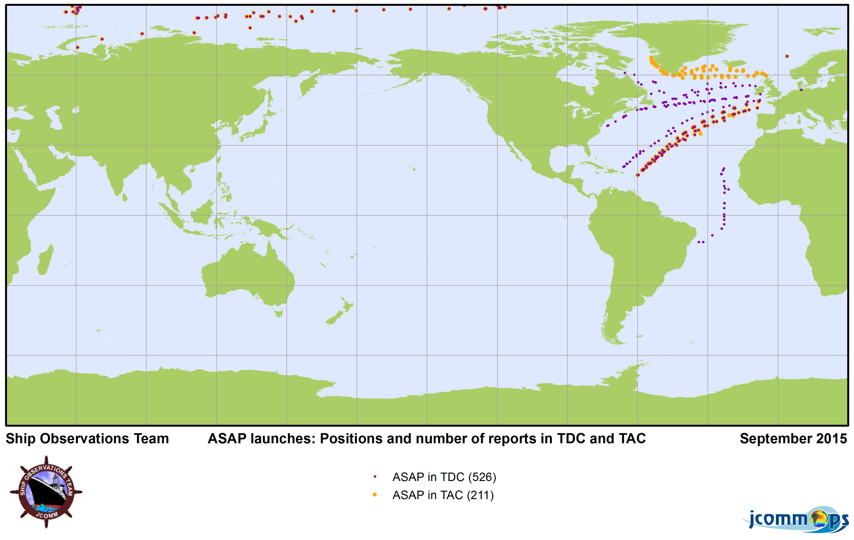
Aerological profiles http://www.jcommops.org/sot/

Slide 10
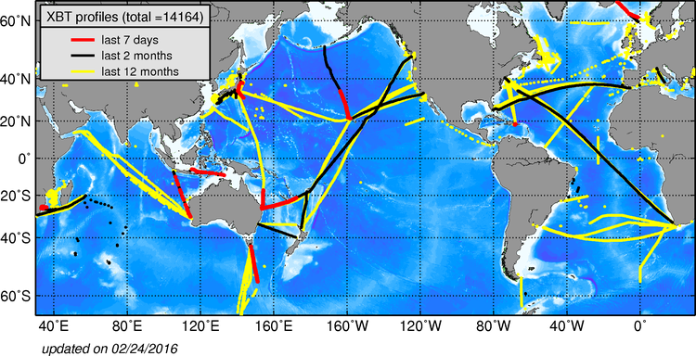
Ships of Opportunity (XBTs) http://www.jcommops.org/sot/

Slide 11
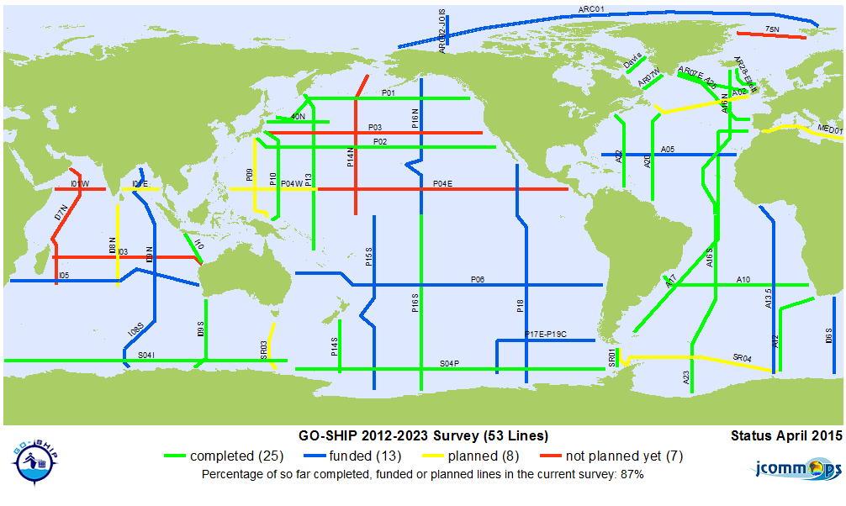
Hydrographic surveys http://www.go-ship.org/

Slide 12
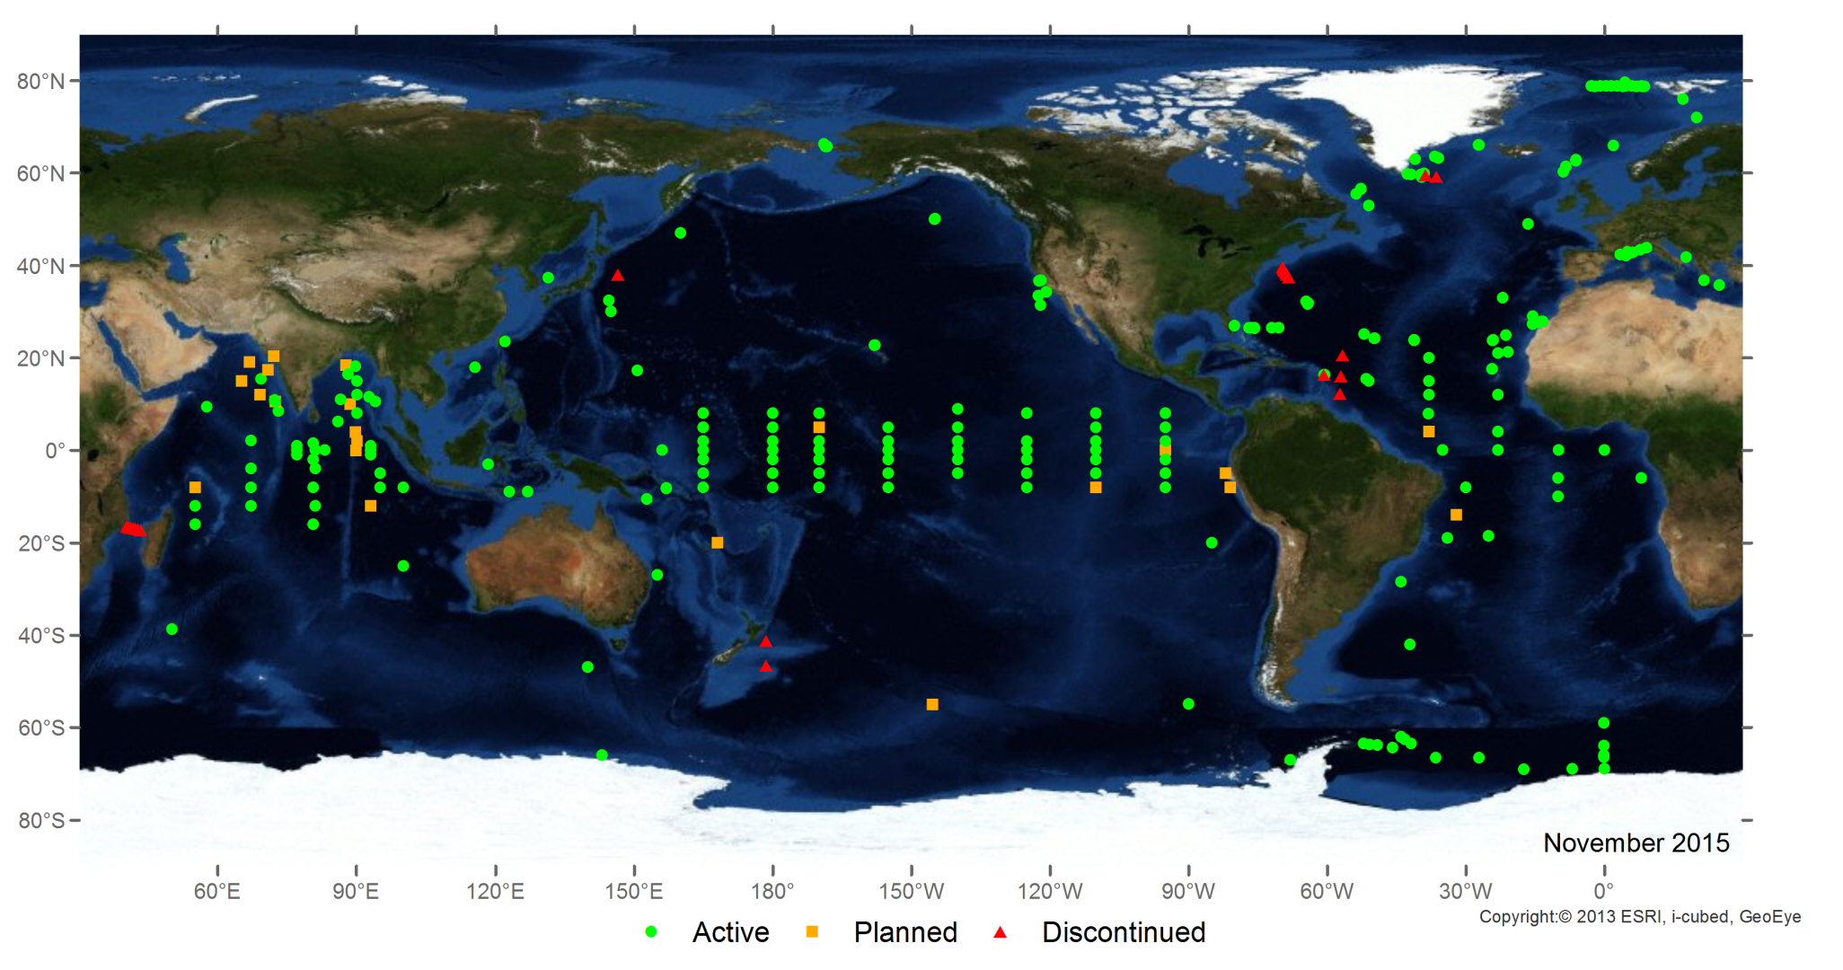
OceanSITES (deep ocean multidisciplinary time series stations) http://www.oceansites.org/

Slide 13
What is WIGOS?
An over-arching framework
For the coordination and evolution of WMO observing systems
For contributions of WMO to co-sponsored observing systems
An evolution from the WWW (weather) centric GOS to a multi-disciplinary framework supporting Weather, Water & Climate
A WMO priority & a key contribution to the climate services (GFCS)
A WMO contribution to GEOSS (with WMO Information System – WIS)
Doing more & better with what we have now
For more efficient and effective service delivery
WIGOS is not:
Replacing or taking over existing observing systems, which will continue to be owned and operated by a diverse array of organizations and programmes, national as well as international
Notes:
The change management process can allow stakeholders to buy into WIGOS concept and its implementation

Slide 14
The WIGOS Framework
The WIGOS framework is essentially about :
Documenting and implementing standard and recommended practices and procedures for making & sharing observations
Coordination & collaboration for efficiency and effectiveness
Integration and interoperability
Timely delivering observations that meet user needs in a way they can use them
Empowering NMHSs and providing them with the necessary guidance

Slide 15
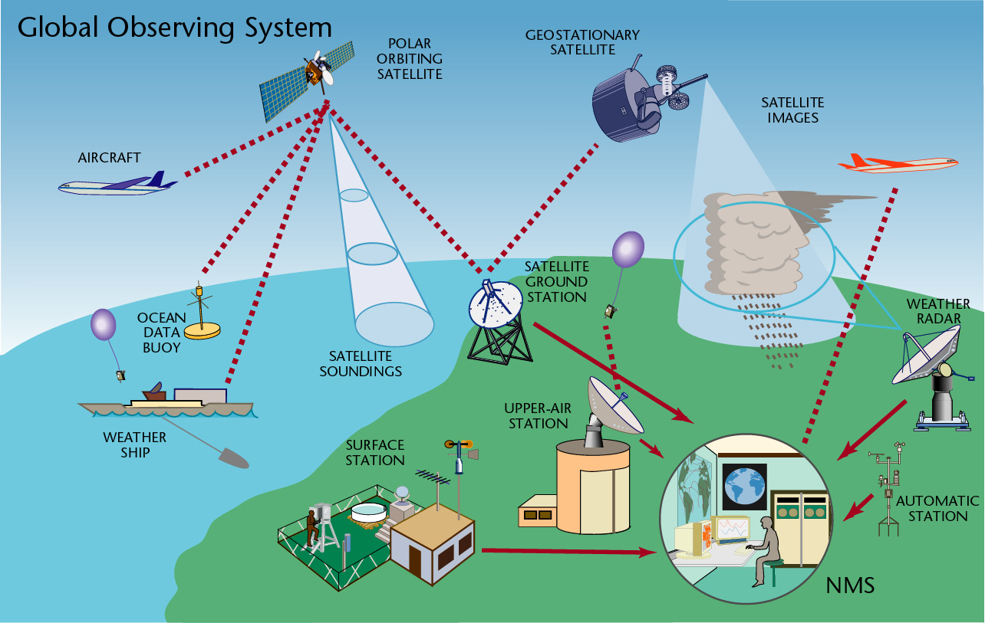
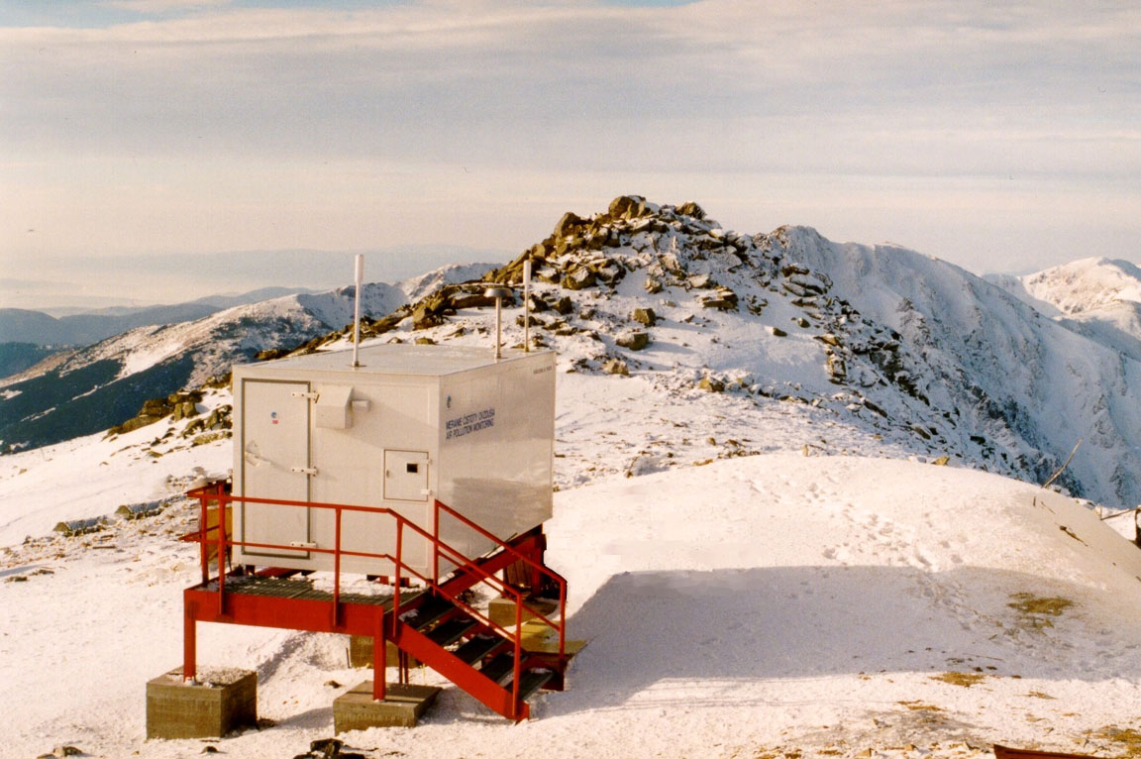
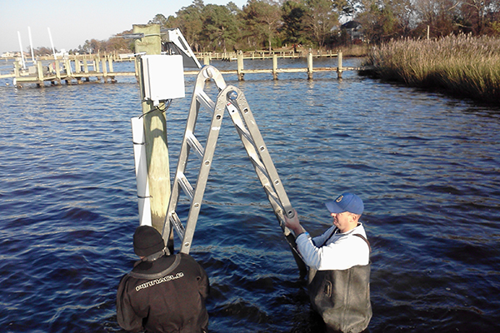
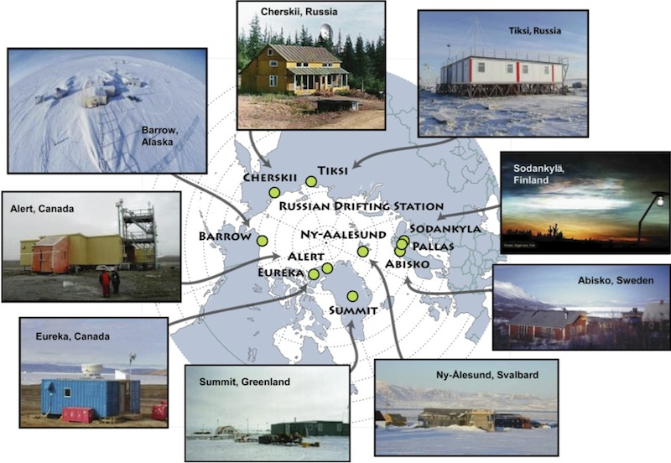
WIGOS Observing Systems
Global Observing System
(WWW/GOS)
Observing component of Global Atmospheric Watch (GAW)
WMO Hydrological Observing System (WHOS)
Observing component of Global Cryosphere Watch (GCW)
Co-sponsored Observing Systems
WMO-IOC-UNEP-ICSU Global Climate Observing System (GCOS)
IOC-WMO-UNEP-ICSU Global Ocean Observing System (GOOS)
FAO-WMO-UNESCO-UNEP-ICSU Global Terrestrial Observing System (GTOS)
Notes:
15

Slide 16
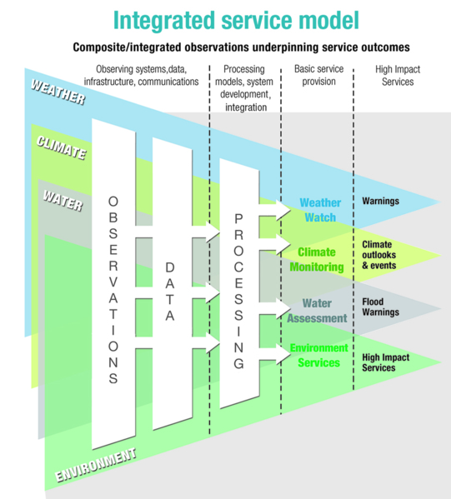
What do we mean by “integration” ?
Composite systems
'Network of networks’
Integration through:
Supporting diverse user needs
Systems designed for efficiency & effectiveness
NWP data assimilation
Partnership & collaboration
End-to-end service model
Data policy, access and exchange
Coordinated network operation & maintenance
Practices and procedures
NOT one-size-fits-all

Slide 17
WIGOS Key Activity Areas
Management of WIGOS Implementation / operation
Collaboration with co-sponsors and partners
To oversee, guide and coordinate WIGOS
Data discovery, delivery & archival
Design, planning and optimised evolution
To ensure supply of and access to WIGOS observations
To plan, implement and evolve WIGOS component systems
Observing system operation & maintenance
Quality Management
To facilitate and support the operation of WIGOS
Communications and outreach
Capacity Development
Operational Information Resource
Standardization, interoperability & compatibility
Notes:
17

Slide 18
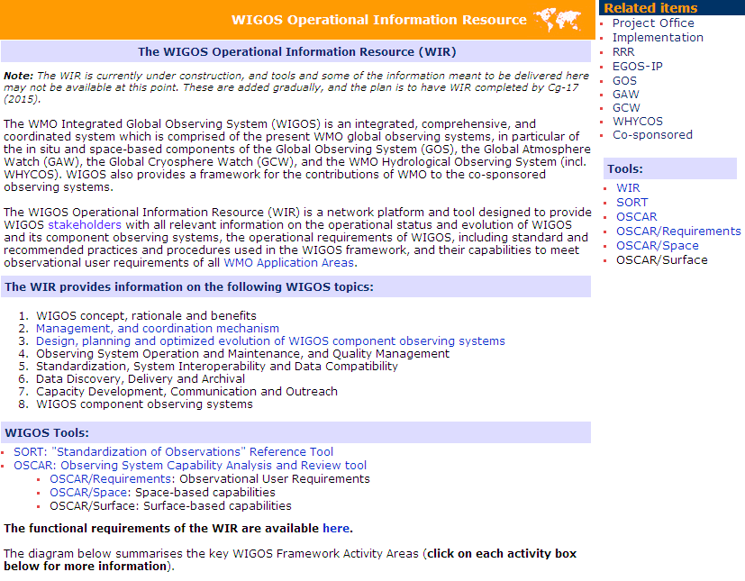
The WIR web portal - www.wmo.int/wigos/wir

Slide 19
WMO Executive Bodies decisions
with regard to WIGOS (1/3)
Decisions of the seventeenth World Meteorological Congress (Cg-17, Geneva, 25 May – 12 June 2015):
Adopted WIGOS Technical Regulations and WIGOS Manual to come into force in July 2016
WIGOS a key priority as part of WMO Strategic Planning for the next financial period 2016 to 2019
Approved Recommendation 18 (CBS-Ext. (2014)) on the support of Members to the Implementation plan of the marine meteorological and oceanographic observing system in support of NWP (incl. barometer drifters & tropical moored buoy array)
CBS taking lead for developing Vision of WIGOS in 2040

Slide 20
WMO Executive Bodies decisions
with regard to WIGOS (2/3)
Cg-17 decisions:
Adopted Resolution on pre-operational phase of WIGOS for 2016 to 2019 with aim that Members will benefit from a fully operational WIGOS from 2020 onward
Future WIGOS priorities:
Develop WIGOS guidance
Further develop WIGOS Information Resource (WIR) and OSCAR
Develop & implement a WIGOS Data Quality Monitoring System
Develop concept and establishment of WIGOS Regional Centres (WRCs)
Undertake national implementation of WIGOS

Slide 21
WMO Executive Bodies decisions
with regard to WIGOS (3/3)
Decisions of the sixty-seventh Session of the WMO Executive Council (EC-67, Geneva, 15-17 June 2015):
ICG-WIGOS re-established by the Executive Council (EC-67, June 2015)
ICG-WIGOS is tasked to develop a complete Plan for the WIGOS Pre-Operational Phase (PWPP) for approval by EC-68 in June 2016

Slide 22
WIGOS Pre-Operational Phase Priority 1/5
Develop WIGOS guidance material
Develop new WIGOS Guide
Complementing WIGOS Manual, e.g. on
Observing Network Design
WIGOS Identifiers
Collecting & submitting WIGOS metadata and using OSCAR

Slide 23
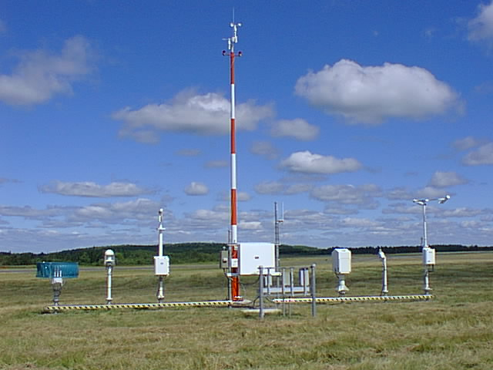
WIGOS Pre-Operational Phase Priority 1/5
Develop WIGOS guidance material - Observing Practices & Procedures
Standards and recommendations for instruments and methods of observation
All aspects of observations and observing systems:
establishment & installation
management & operation
maintenance, inspection & supervision
delivery & sharing of observations
data and metadata management (pre-processing & processing, QC, monitoring, remedial actions, …)
Data Quality: 'fit-for-purpose' ideal
Documenting known quality is key

Slide 24
WIGOS Pre-Operational Phase Priority 2/5
Further develop the WIGOS Information Resource (WIR) and the Observing Systems Capability Analysis and Review tool (OSCAR – oscar.wmo.int)
OSCAR/Requirements : Technology free observational user requirements recorded quantitatively
OSCAR/Space: capabilities of all satellite sensors, whether historical, operational or planned
OSCAR/Surface: surface-based capabilities; developed by MeteoSwiss for WMO

Slide 25
WIGOS Pre-Operational Phase Priority 2/5
WIGOS Information Resource (WIR) & OSCAR (oscar.wmo.int)
OSCAR/Surface – oscar.wmo.int/surface
Meant to become the official repository of WIGOS Metadata as of early 2016
One-stop-shop for surface- and space-based observing instruments & platforms metadata
Allows user to understanding observational data
Allows to identify potential synergies
A tool for developing countries willing to use OSCAR as their primary WIGOS metadata database
An evolution/modernization of WMO No. 9, Volume A, Observing Stations and WMO Catalogue of Radiosondes
Includes marine observing systems metadata from JCOMMOPS

Slide 26
WIGOS Pre-Operational Phase Priority 2/5
WIGOS Information Resource (WIR) & OSCAR (oscar.wmo.int)
OSCAR/Surface – oscar.wmo.int/surface
A database for recording surface-based observing systems capabilities for the purpose of the WMO Rolling Review of Requirements
Objective gap analysis / critical review
A tool for planning evolution of the observing system
Monitoring evolution of capabilities, compare with plans, look at progress
Operational as of 2 May 2016
Planned evolution of OSCAR
Add new types of stations in OSCAE/Surface (e.g. aircrafts, wind profilers)
Add gap analysis module
Enhancements of OSCAR/Space

Slide 27
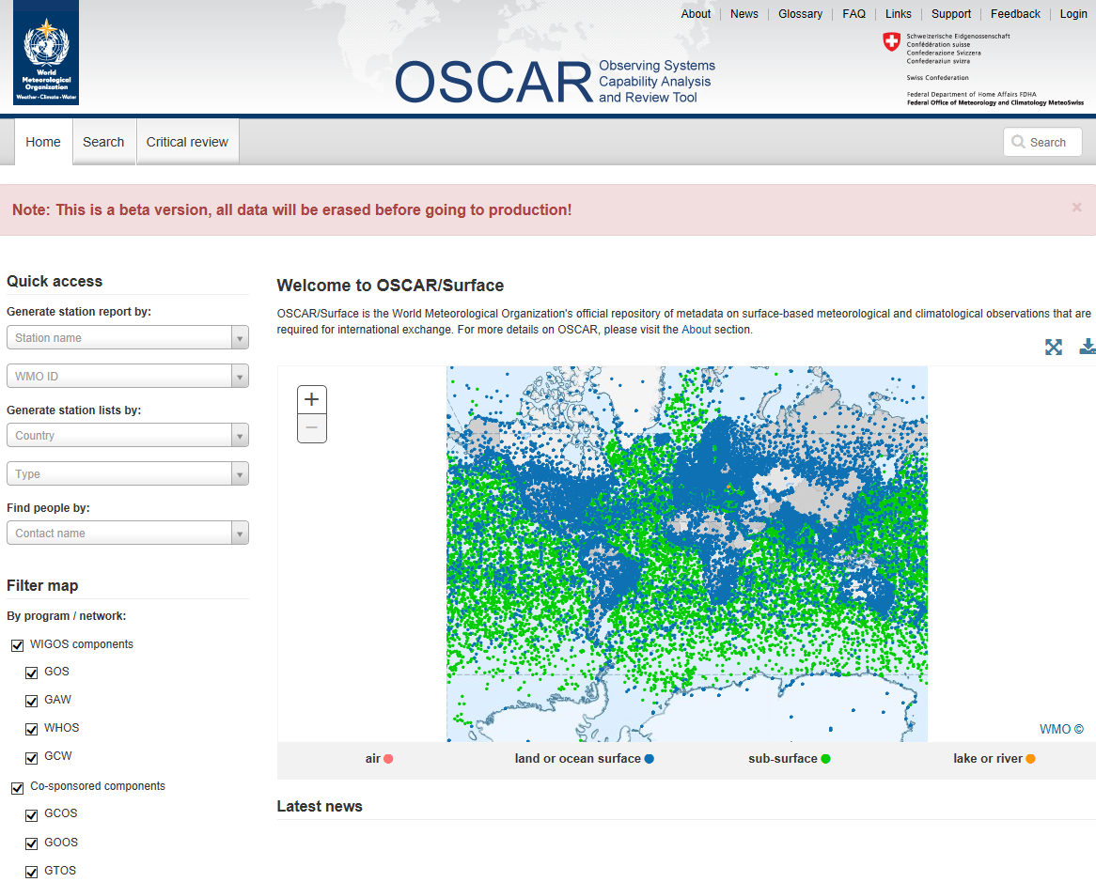
OSCAR/Surface - oscar.wmo.int/surface

Slide 28
WIGOS Pre-Operational Phase Priority (3/5)
Develop & implement a WIGOS Data Quality Monitoring System
Integrated approach but initial focus on GOS surface observing components based on pilots on
GOS Quality Monitoring (e.g. ECMWF, NCEP)
GOS Incident Management (e.g. RA-I)
Strong role of
NWP monitoring centres
CBS Lead Centres
WIGOS Regional Centres
JCOMMOPS to play a role for marine data

Slide 29
WIGOS Pre-Operational Phase Priority 4/5
Develop concept and establishment of WIGOS Regional Centres (WRCs)
Provide support & assistance to Members & Regions for their national & regional WIGOS implementation
Provide link with Secretariat, regional offices, Regional Instrument Centres (RICs), Regional Training Centres (RTCs) regarding all WIGOS related activities in the Region
Monitoring implementation of EGOS-IP
Regional performance monitoring of WIGOS networks (data availability, timeliness, quality) and feedback
Facilitate WIGOS data and metadata collection to WIS and OSCAR

Slide 30
WIGOS Pre-Operational Phase Priority 5/5
Undertake national implementation of WIGOS
Nominate National Focal Points
Consideration of EGOS-IP actions
Consideration of Observing Network Design principles
Coordination with co-sponsors (other agencies than NMHSs)

Slide 31
What does WIGOS mean at the National level?
Demonstrating national leadership in observations:
Best practices
Plan & design
Sustainability, maintenance & operation
Integration and interoperability
Compliance with WMO TR (WMO-No. 49) - standard and recommended practices and procedures, and WIGOS Manual
Culture change & change management;
Supported by collaboration at Regional/Sub-regional level
WIGOS benefits will only be delivered through commitment at a national level

Slide 32
National leadership through WIGOS
WIGOS and WIS provide means & opportunities:
To enhance national observing networks for benefit of all users
To enhance sharing and accessibility of observations
To reinforce central role of NMHS through partnerships & a network of networks
To strengthen national mandate and authority
Strong national coordination & cooperation will assist in building strong regional coordination & cooperation

Slide 33
Regional Marine Instrument Centres (RMICs)
RMIC/RA-IV (USA) & RMIC/AP (China) established
Morocco application for RMIC/RA-I pending submission of Statement of Compliance and Commitment
6 workshops organized since 2010
Pilot Project on Seawater intercomparison completed (JCOMM TR No. 84) – 22 Laboratories from 17 countries participated
RMIC/RA-IV Workshop, USA, 29 Feb. – 2 March 2016

Slide 34
International Forum of Users of Satellite Data Telecommunication System (Satcom)
Cg-17 endorsed CBS Ext. (2014) Recommendation 9 establishing the Satcom Forum
Satcom co-owned by CBS and JCOMM in WMO, and GOOS in IOC
Limited funding provided by WMO
Argos JTA to become a programme of Satcom
Michael Prior Jones (UK) new Chair
Meeting planned in Madrid, Spain, in conjunction with CIMO Technical Conference, and Meteorological Technology World Expo (Madrid, 27-29 September 2016)

Slide 35
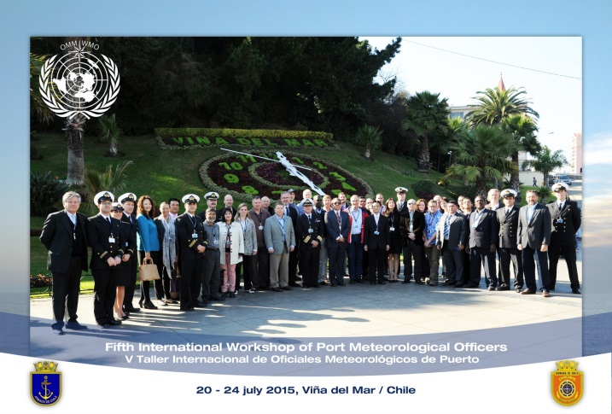
JCOMM Capacity development in WIGOS
JCOMM Capacity Building Strategy has included WIGOS implementation needs
Capacity Building & Partnerships / PANGEA
Developed countries providing training on data use as well as ocean instruments deployed in the region
Developing countries contributing to the implementation of the ocean observing system on their region (e.g. ship time)
DBCP-WIO, NPOMS & PI series of workshop are excellent examples
WMO-IOC Regional Marine Instrument Centres (RMICs) playing a key role in Capacity Development
Training workshops (2nd workshop for RA-IV planned in USA, Feb. 2016)
Liaison groups in the regions
Cost-effective calibration service
Leading intercomparison activities

Slide 36
Summary and conclusion
The implementation of the global WIGOS framework (2012-2015) has made substantial progress
The Pre-Operational Phase will focus on
Developing guidance material
Deployment and enhancement of OSCAR (WIGOS metadata)
Development of a WIGOS Data Quality Monitoring System
Regional and national activities:
Establishment of Regional WIGOS Centers
Regional/Sub-Regional Workshops and training events to support OSCAR/Surface and Regional priorities for WIGOS
Support for national WIGOS implementation efforts, in particular regarding national partnerships, data guidance, and network design and operation and maintenance
JCOMM fully engaged in WIGOS implementation

Slide 37
Thank you for your attention Questions ?

