Slide 1
Remote Vetting and Assistance to Ships Overseas
Steve Bond, PMO Southampton, UK.
5th International Port Meteorological Officers Workshop, Vina del Mar, Chile. 20-24 July 2015

Slide 2
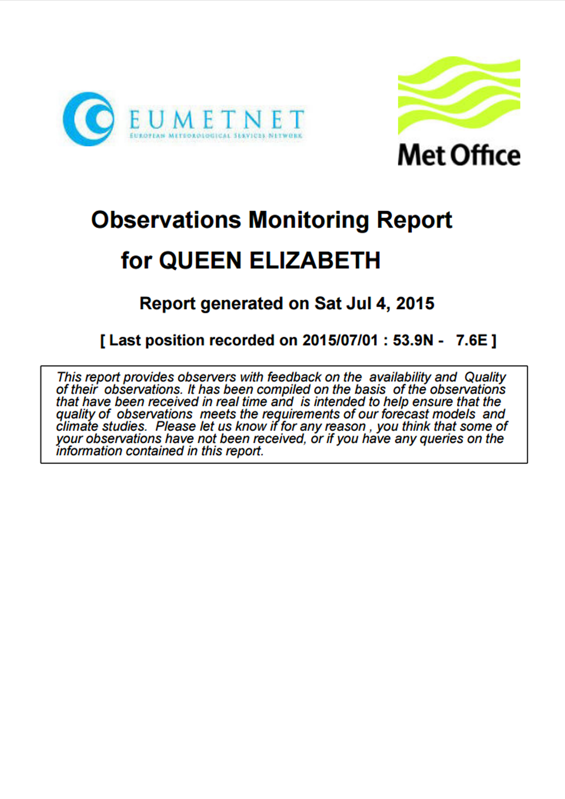
What is Remote Vetting and Assistance?
PMO’s need to maintain an open line of communication with their observers to preserve the quality and quantity of their observations.
QUARTERLY MONITORING
Check the number of observations
Provide quality feedback, advice and guidance
Arrange shipment of supplies and instruments
Arrange a visit by foreign PMO
Send muster sheet
Recover instruments from poor performing ships

Slide 3
The Benefits
Provides owners/managers with information on their fleets’ performance
Provides Captains with information on the performance of their observing officers
Enables PMO’s to keep abreast of their fleet’s performance
Maintains a regular line of communication between PMO and vessel
Greater company buy-in
Increased observations numbers
Higher quality observations

Slide 4
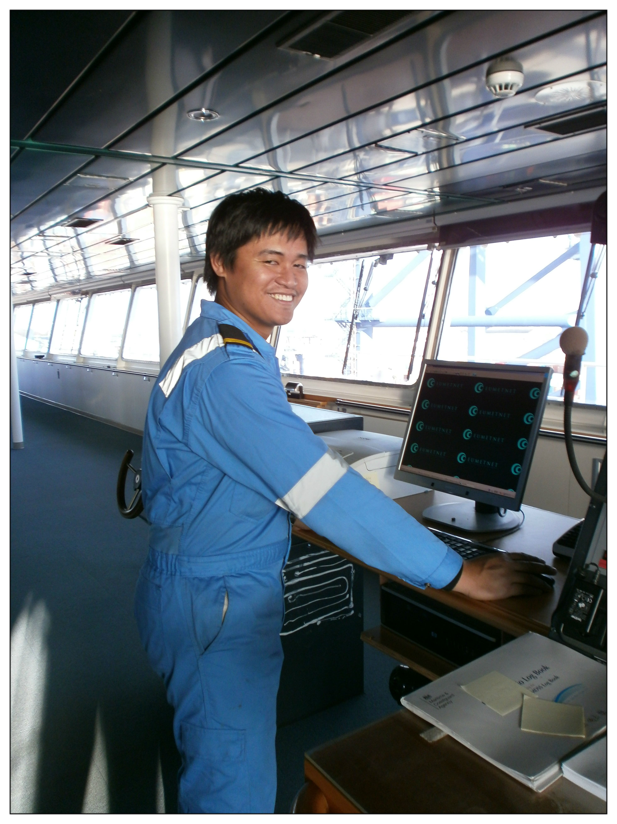
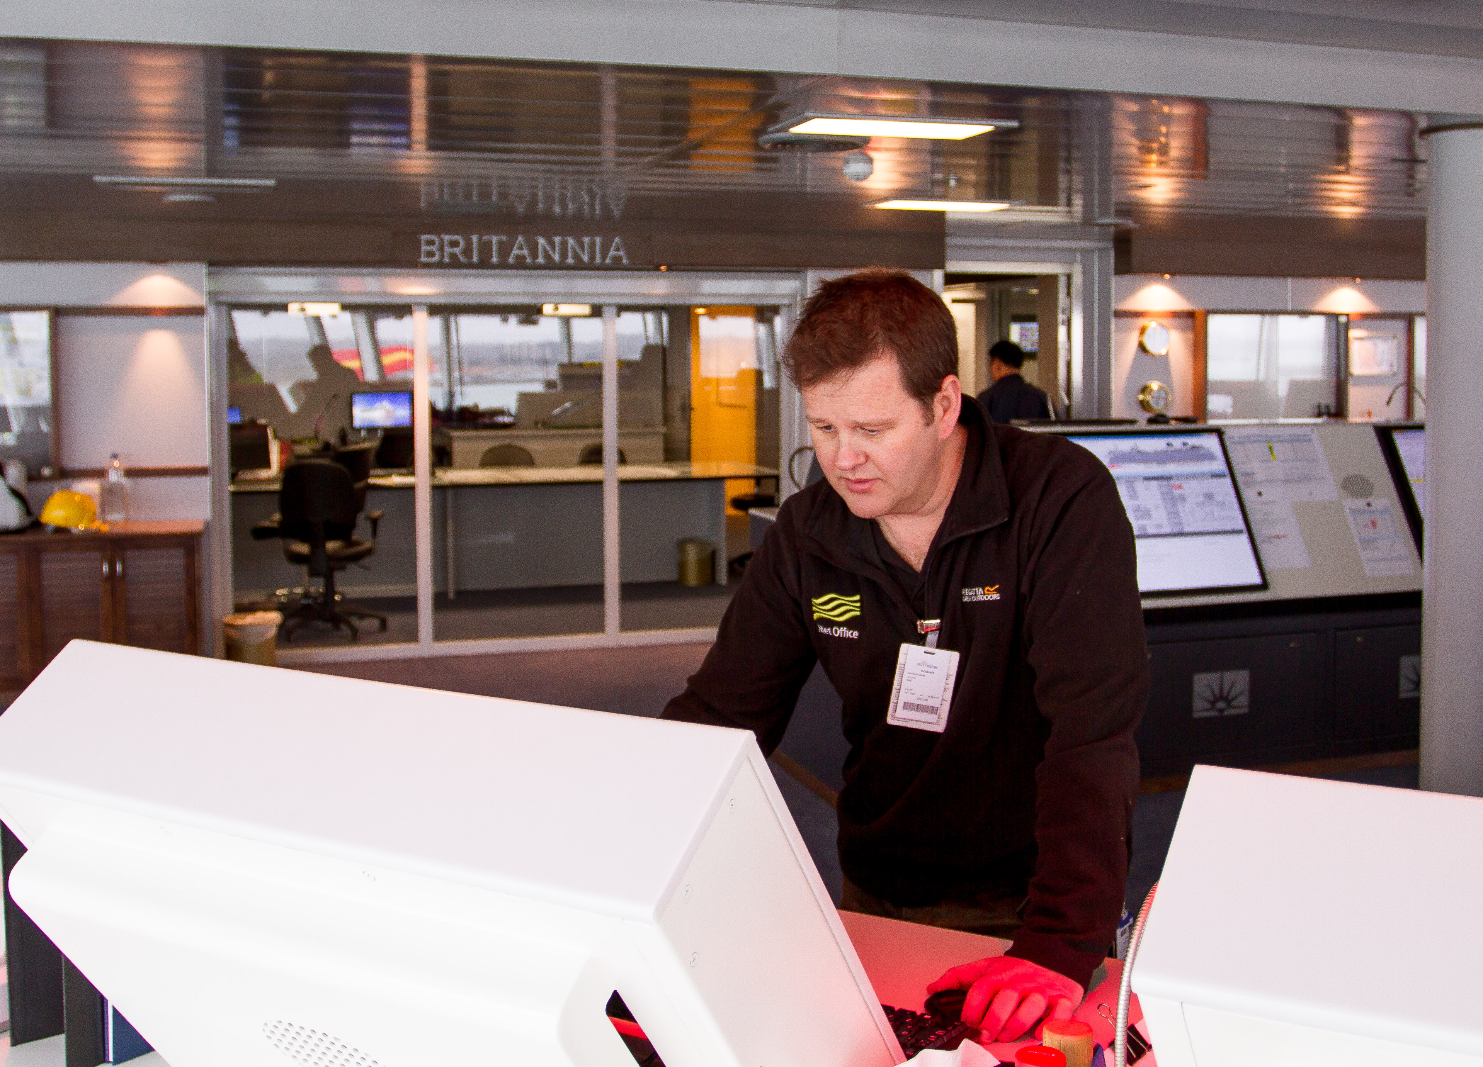
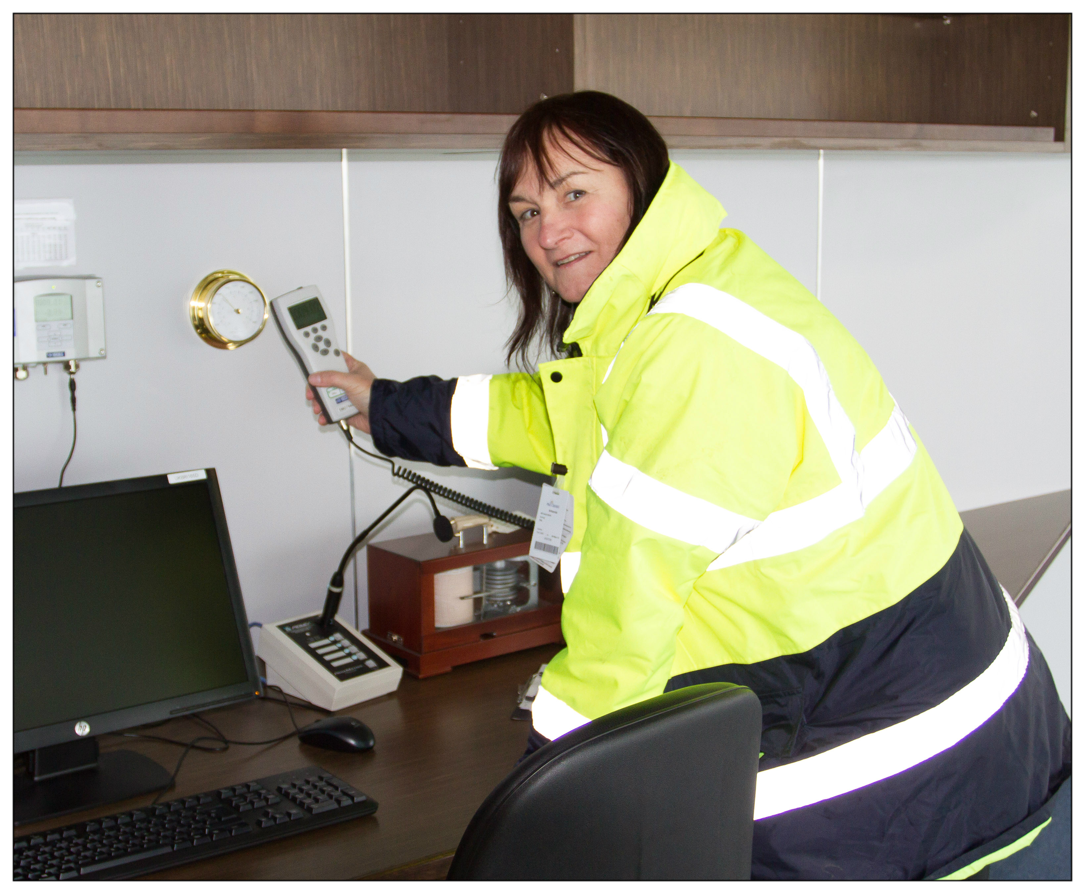
Important to remember…
Remote monitoring does not replace physical ship inspections

Slide 5
Questions?

