Slide 1
Marine Services for Ships and Ports
Zheqing Fang
Shanghai Marine Meteorological Center,
Shanghai Meteorological Service, CMA
Shanghai 200030, China
（July 22, 2015）

Slide 2
OUTLINE
Marine Services for Ships
Marine Services for Ports

Slide 3
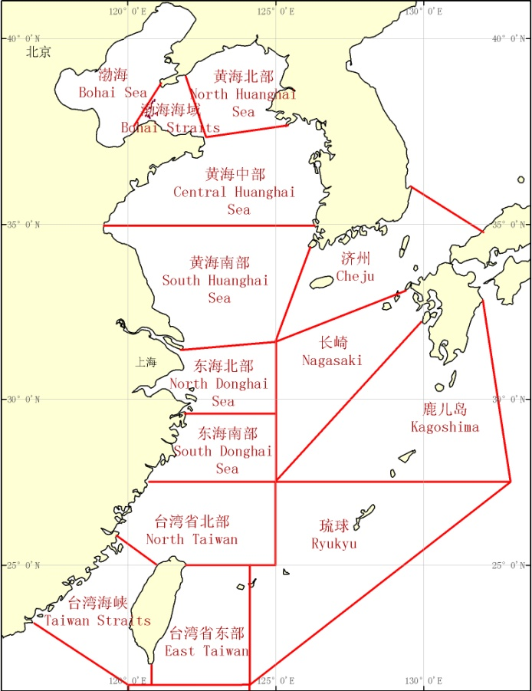
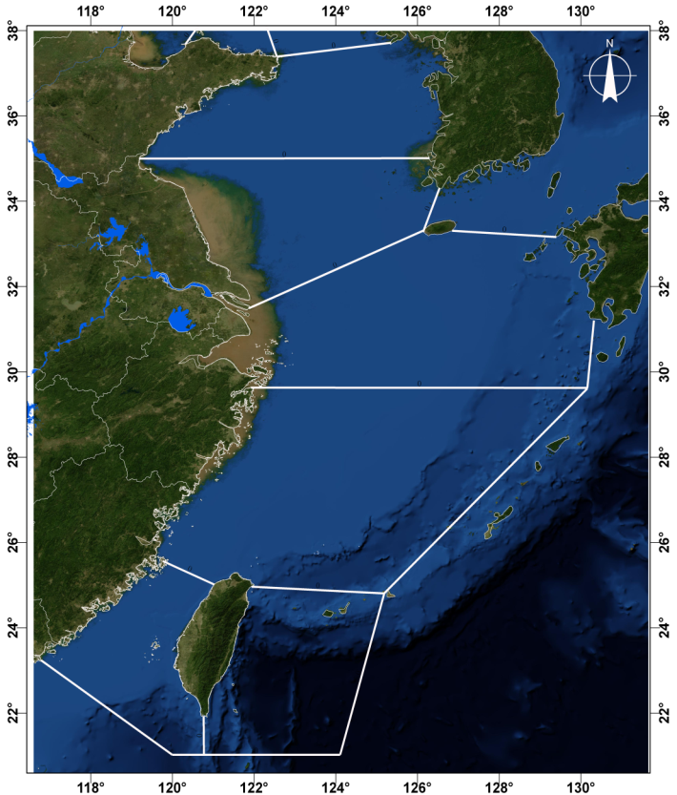
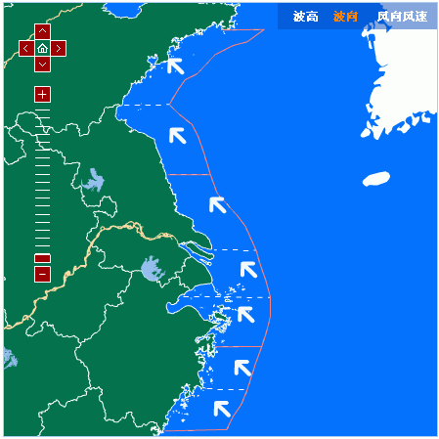
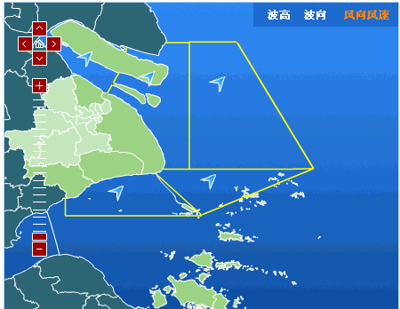
1.1 Marine Services for Ships at High Sea
Shanghai Meteorological Service has four levels of responsibility sea area, which contain high seas area assigned by IMO, East China 300km offshore sea area, East China 100km coastal sea area and Shanghai alongshore sea area assigned by CMA.
Central Huanghai
South Huanghai
North Donghai
South Donghai
Taiwan
Straits
East
Taiwan

Slide 4
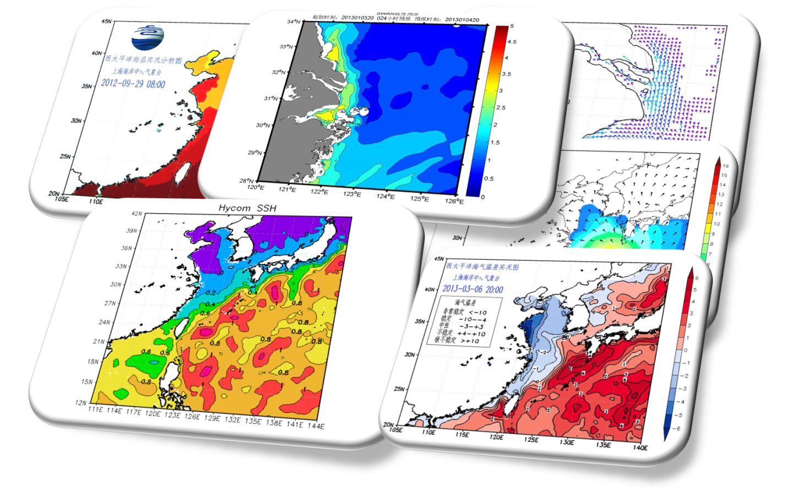
1.1 Marine Services for Ships at High Sea
Including wave steepness and sea-air temperature difference SMS have 32 analysis products in total.

Slide 5
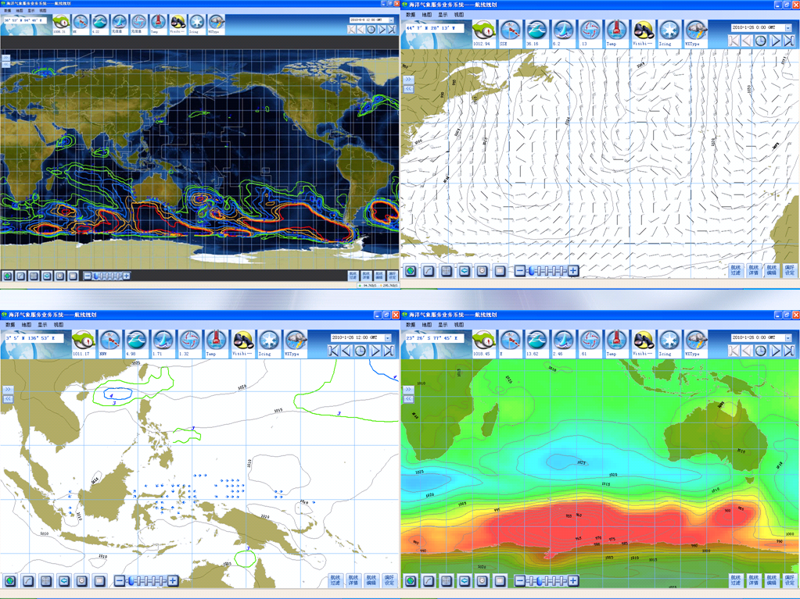
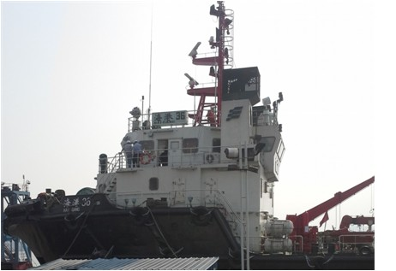
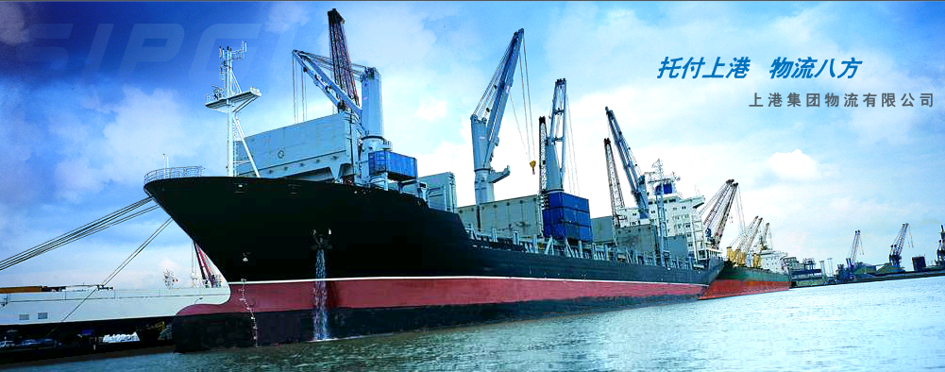
1.1 Marine Services for Ships at High Sea
SMS have several experiences on global weather routing. We have successfully carried out meteorological navigation for the ships, which went to Australia, The Republic of
South Africa, Solomon Islands,
Malaysia, Congo etc.

Slide 6
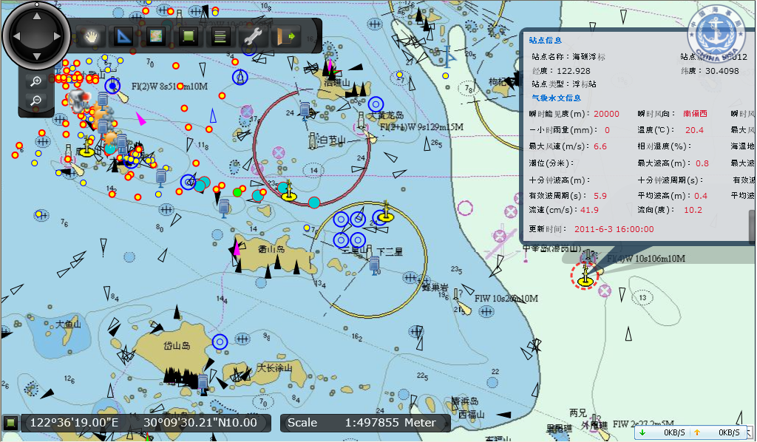
1.2 Marine Services for Ships near the Harbor
Information Dissemination though Automatic Identification System
Through AIS platform, we could analyze the ships’ responses for our warnings during a cold surge process.

Slide 7
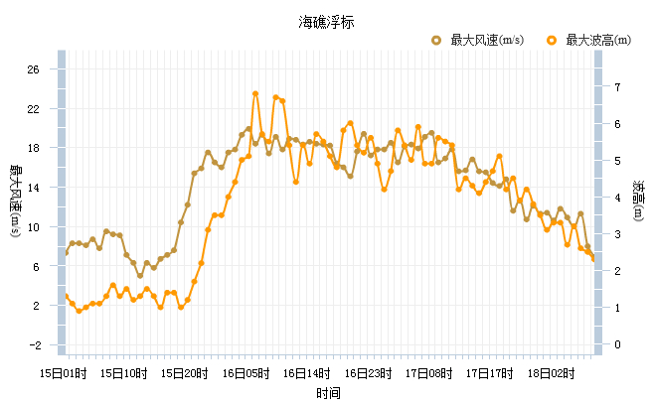
1.2 Marine Services for Ships near the Harbor
To fully understand user’s requirements, we need monitor users’ behavior.
Three Questions：
Are responses consistent to the warning?
Are responses the same for different users?
Are these responses have risk?
BUOY OBSERVATION
Wind Speed
Wave Height
17LCT 17th, decreased the warning level
14LCT 15th, issued level 2 warnings for high wind
Wind Speed
Wave Height
06LCT 16th, maximum wind speed is 19.9m/s
10LCT 18th, lifted warning
Time

Slide 8
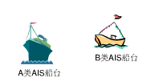
1.2 Marine Services for Ships near the Harbor
Transparent triangle indicates Type A AIS boats
Solid triangle indicates Type B AIS boats
Type B
Type A

Slide 9
1.2 Marine Services for Ships near the Harbor
12 LCT, 16th Dec. When the wind is high, type B AIS boats are located in Huangpu river, Yangshan Deep-water Port and near the islands. For those type B AIS boats not in these region, they suffered higher risk.

Slide 10
1.2 Marine Services for Ships near the Harbor
09 LCT, 17th Dec. Type B AIS boats were leaving river and ports, but at this moment the warning for high wind was not removed.

Slide 11
1.2 Marine Services for Ships near the Harbor
14 LCT, 17th Dec. Even more Type B AIS boats left Huangpu river and ports. Why?

Slide 12
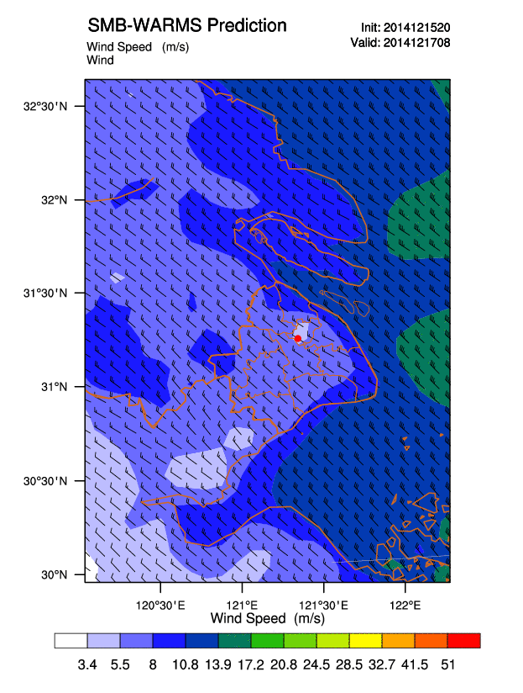
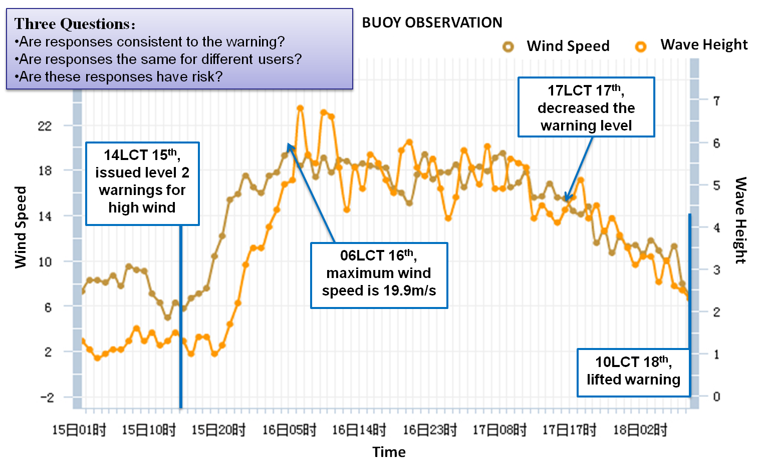
1.2 Marine Services for Ships near the Harbor
The boats’ responses were not consistent with our warning because we don’t have high resolution localized warning products.
Different types of boats have different responses, so they have different vulnerability and exposure.
These responses have many risks, we need update technique and platform to change the situation.
Type B AIS boats in the river and ports didn’t SEE the high wind outside.

Slide 13
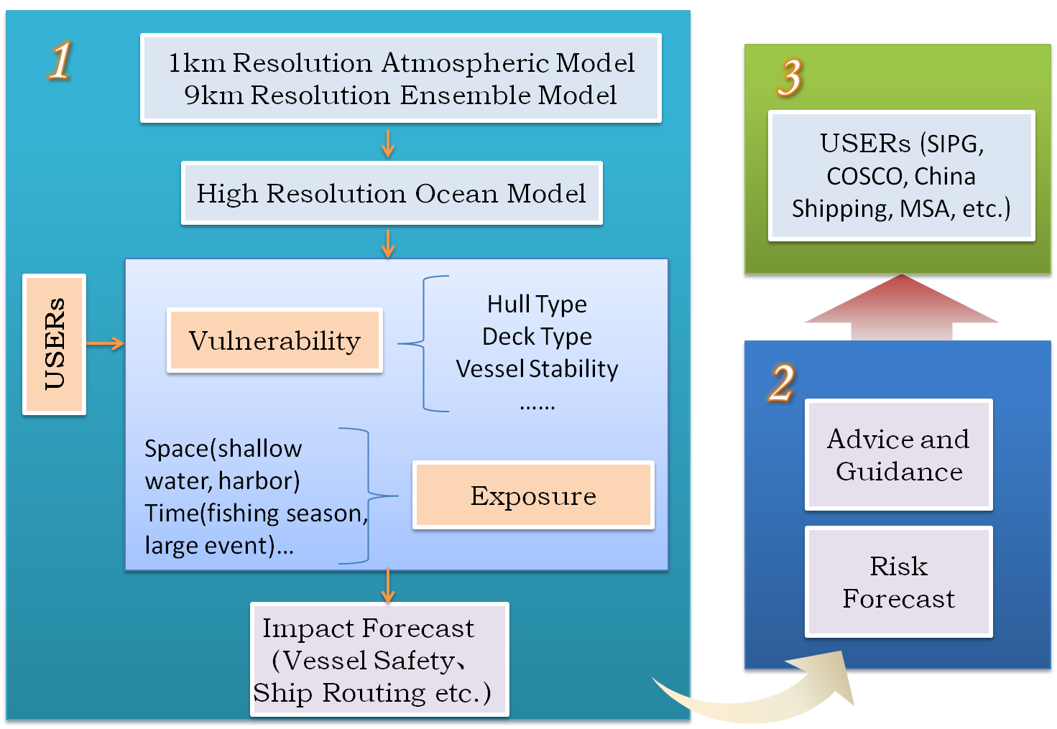
1.3 Impact Forecast for Marine Services

Slide 14
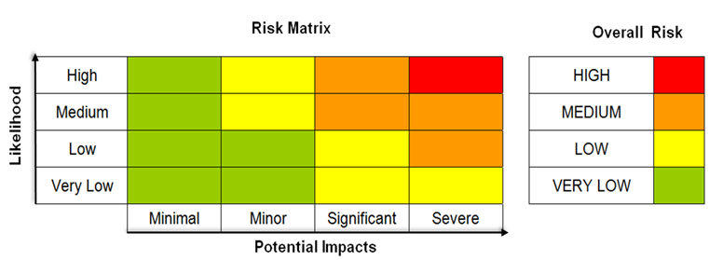
1.3 Impact Forecast for Marine Services
1.70% possibility wind speed will exceed BF Scale 8 and;
2. Displacement hull boats;
3. At shallow water
1.90% possibility wind speed will exceed BF Scale 8 and;
2. Boats at shallow water
1.30% possibility wind speed will exceed BF Scale 8 and;
2. Displacement hull boats at shallow water
1.70% possibility wind speed will exceed BF Scale 8 and;
2. Displacement hull boats;
1.50% possibility wind speed will exceed BF Scale 8 and;
2. Planning hull boats;

Slide 15
OUTLINE
Marine Services for Ships
Marine Services for Ports

Slide 16
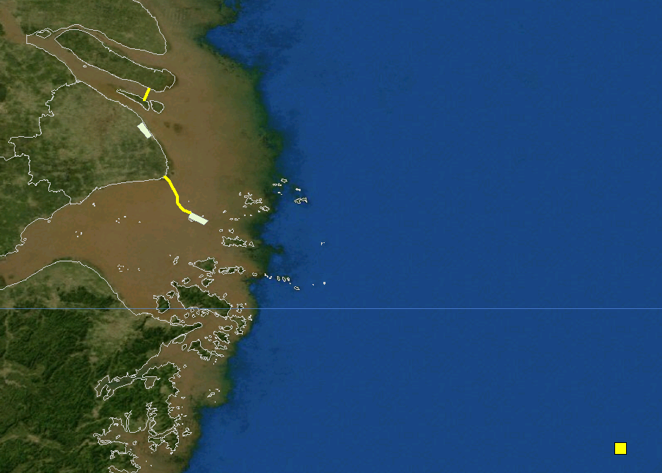
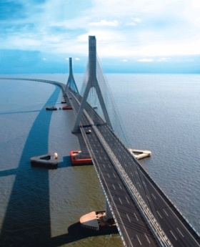
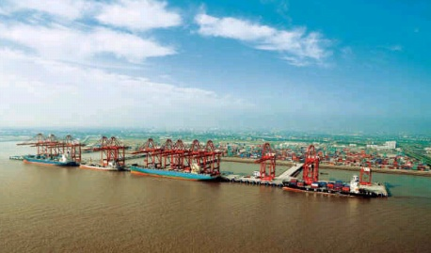
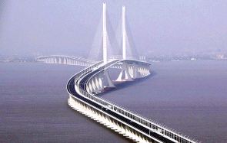
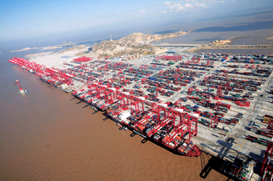
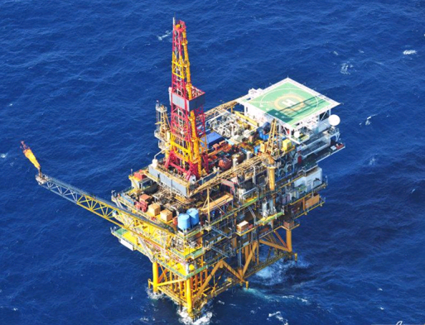
2.1 An Overview of Shanghai Port
Providing seamless and refined forecast with operations in the Yangshan Deep-water Port and Waigaoqiao Port, two cross-sea bridges and oil-gas transportation which influenced by marine and weather conditions.
Changjiang Bridge
Waigaoqiao Port
East China Sea Bridge
Yangshan Deep-water Port
Pinghu Oil & Gas Platform

Slide 17
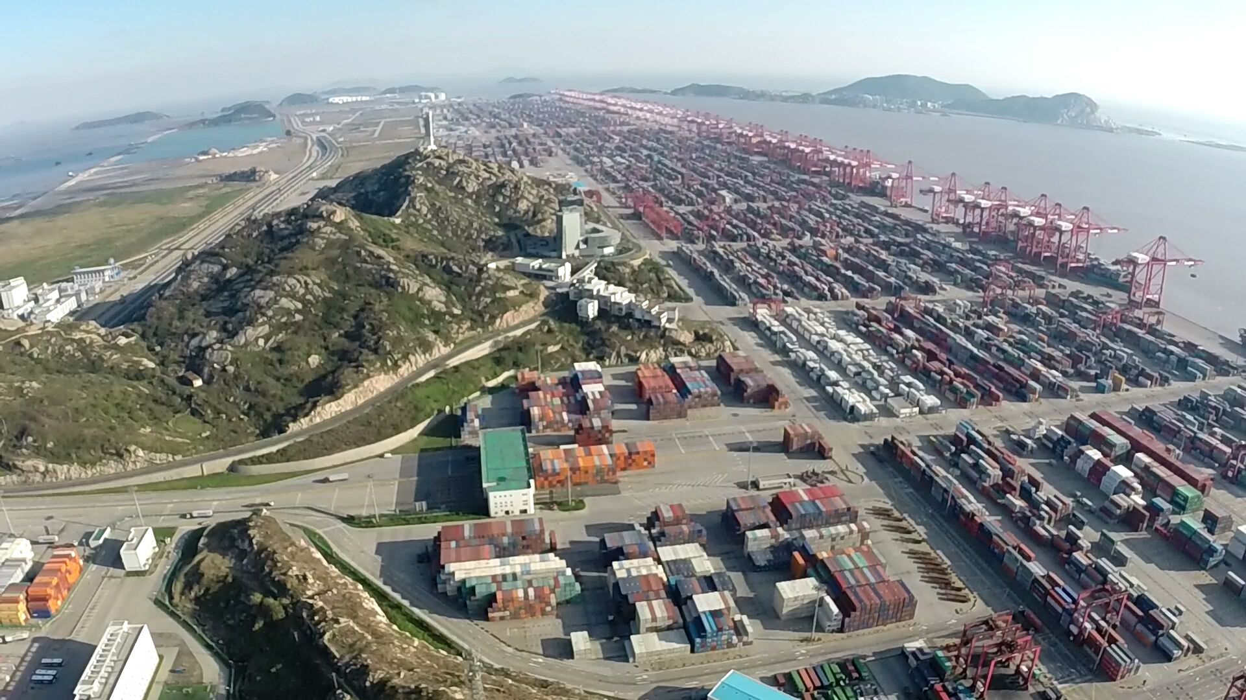
2.1 An Overview of Shanghai Port

Slide 18
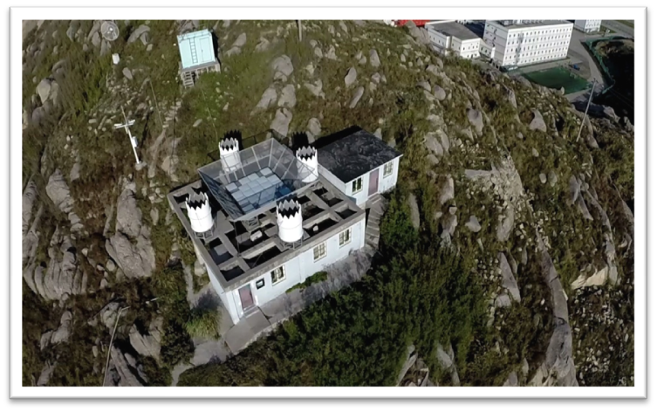
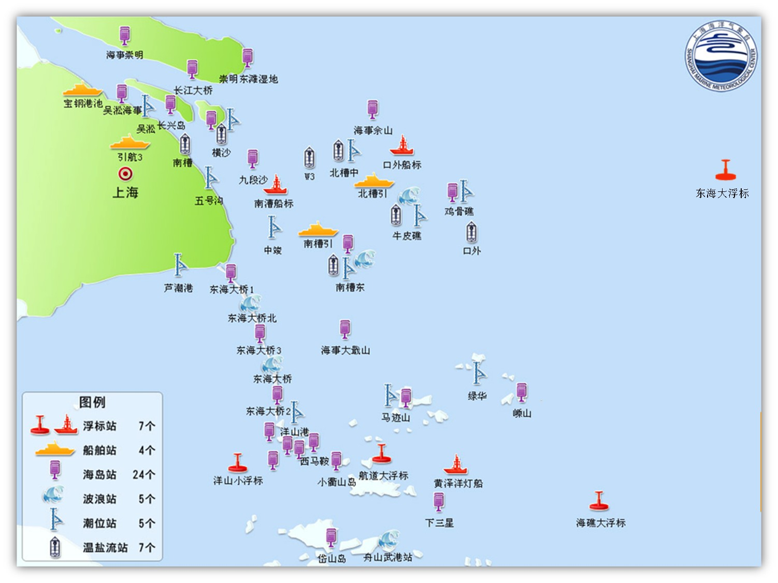
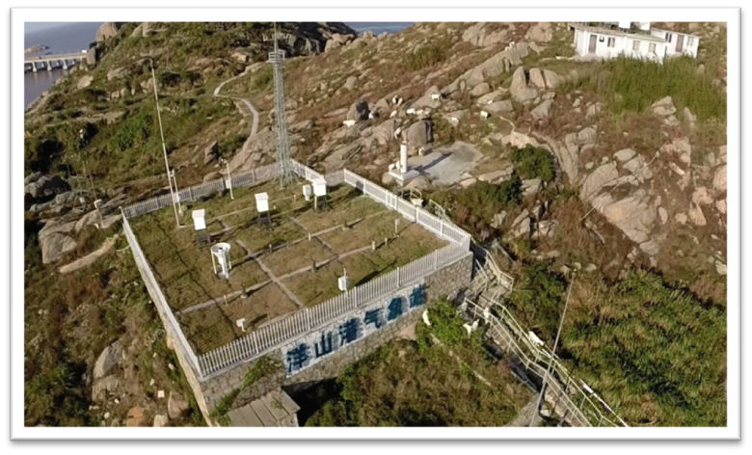
2.1 An Overview of Shanghai Port
SMS’s currently in-situ observing system consists many elements such as 7 buoys, 4 ship-type buoy stations, 24 island stations etc. After sharing with other institutions, we have accessed to more than 80 marine observations.
SMMC has integrated observation station at Yangshan Deep-Water Port which contains wind profile radars and wave observation radar. Forecasters are often appointed as consultants in special weather-sensitive operations for onsite assignments.

Slide 19
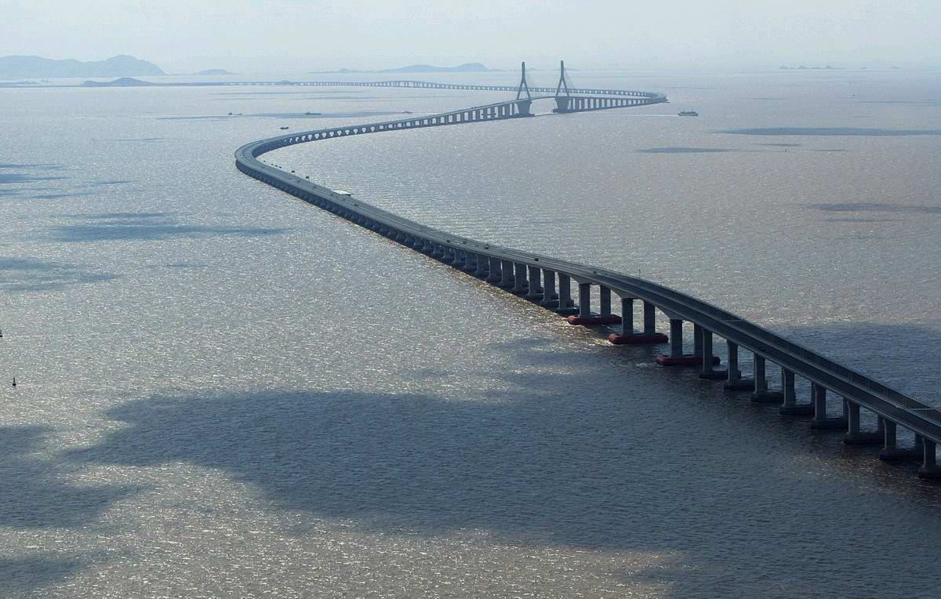
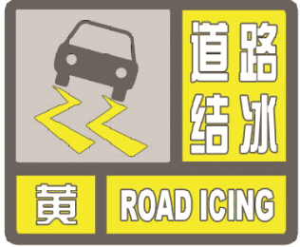
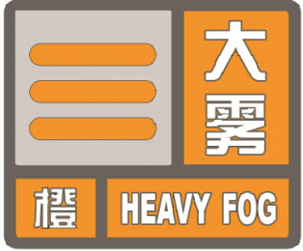
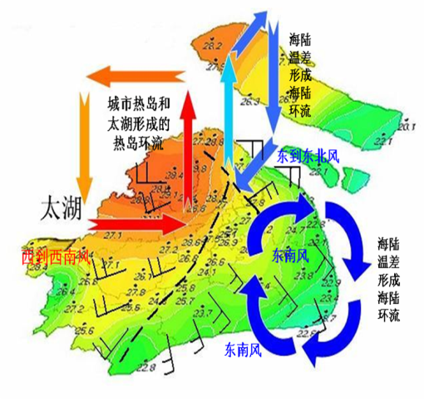
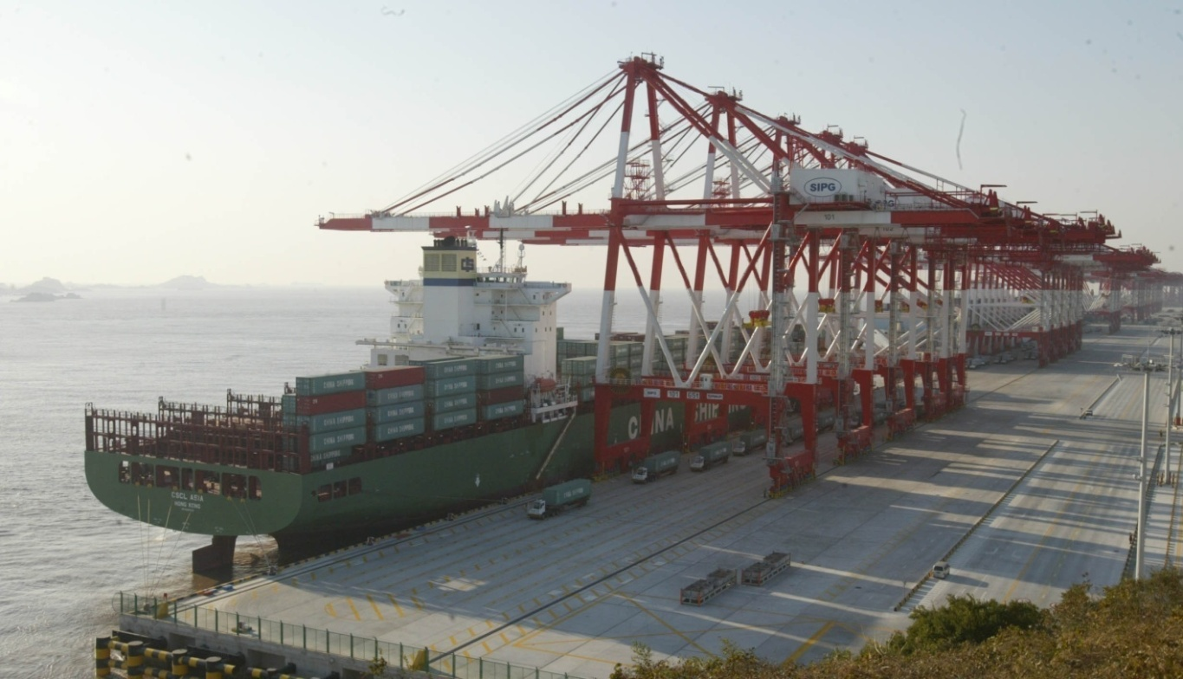
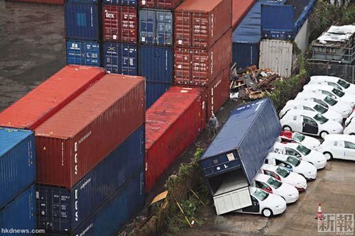
2.2 Services for Port Operation

Slide 20
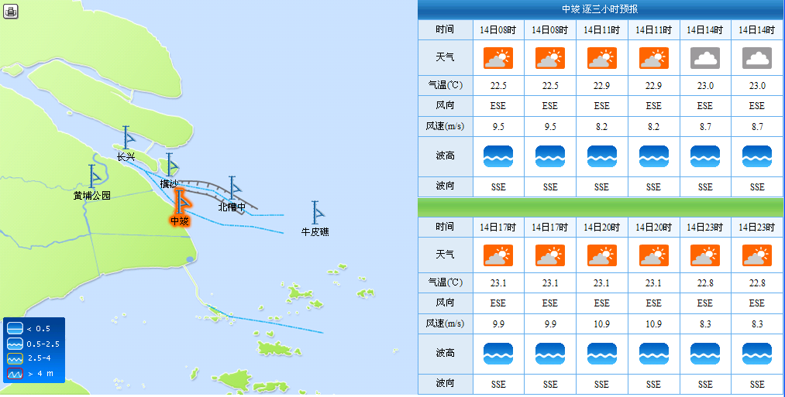
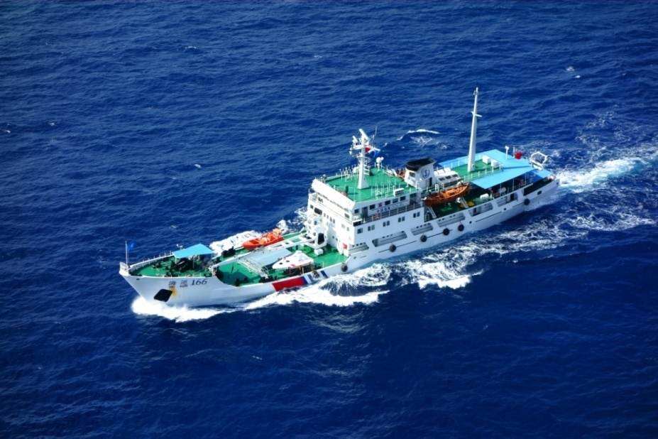
2.3 Services for Maritime Affairs
SMS have close cooperation with Shanghai Maritime Safety Administration. Except daily user-tailored marine weather forecast, we prepare for engaging in emergency event at all times to provide weather support.
Ship “Florida” crashed “Zhoushan” in 25th Mar 2013, we provided weather support for oil spilling.
Hydrographic surveying and mapping
Sea patrol

Slide 21
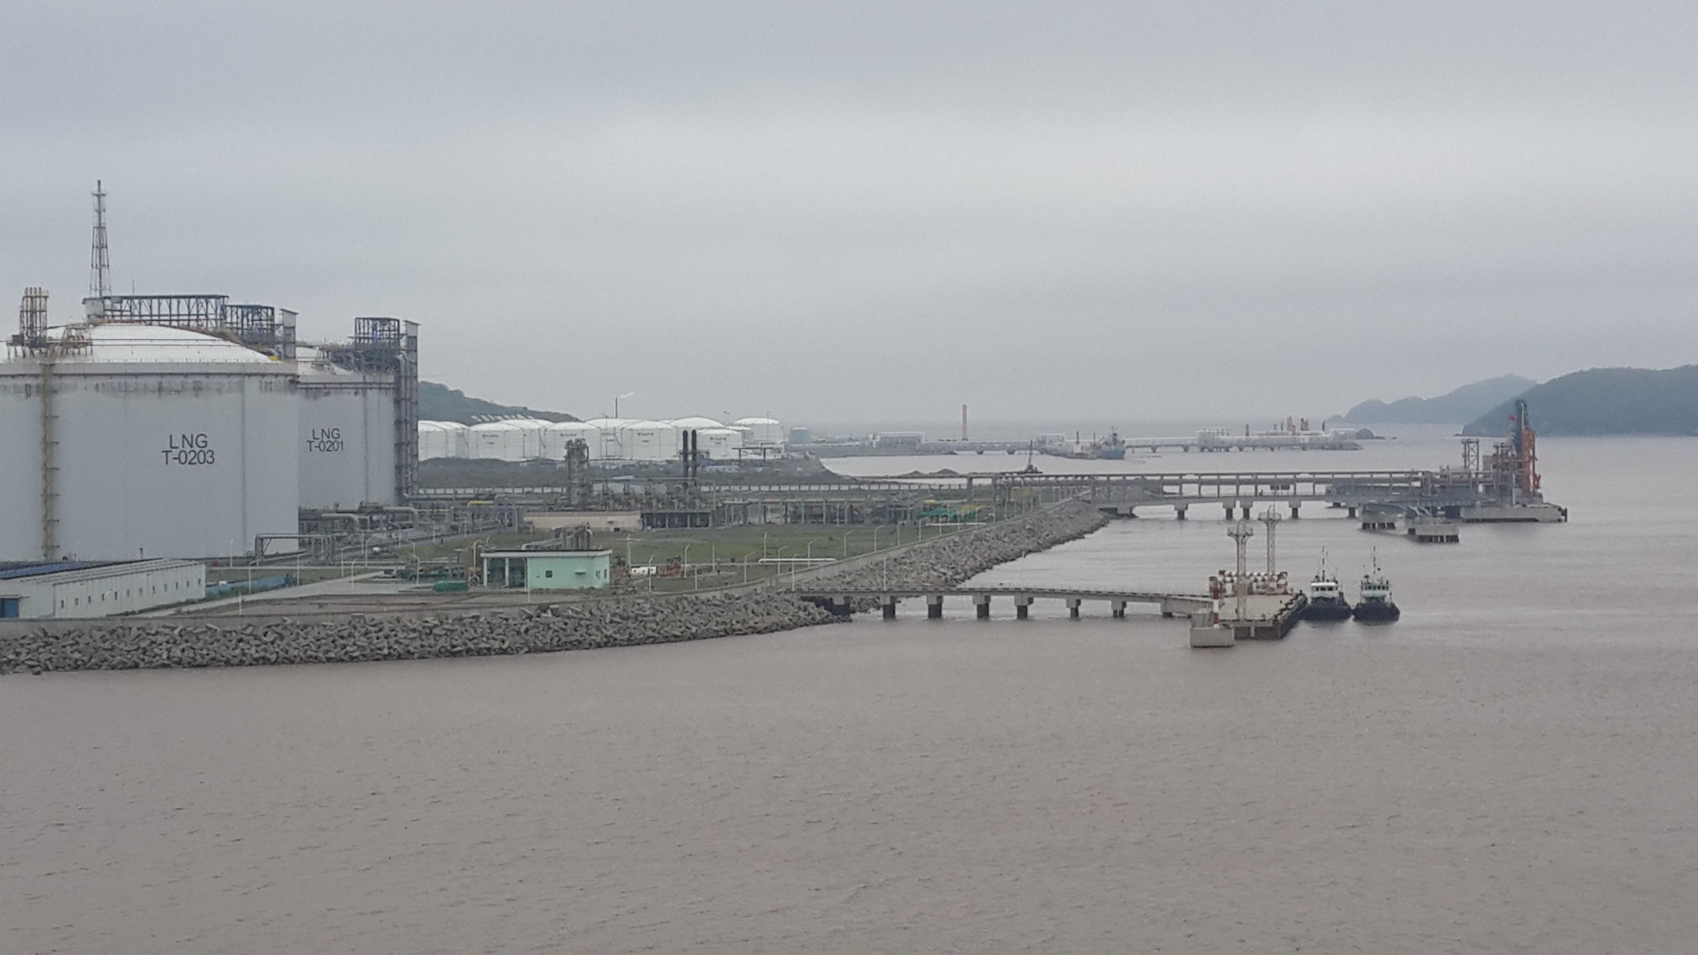
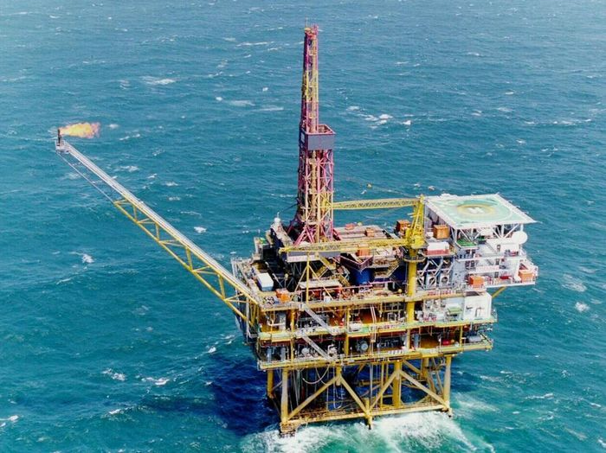
2.4 Services for Oil & Gas
Shanghai LNG Terminal Transfer Center is located in Yangshan Deep-water Port. It transfer 700 million cubic meters per day. This supply is 60% of Shanghai’s usage amount.
During winter or typhoon season, the LNG ship need marine services for decision making.

Slide 22
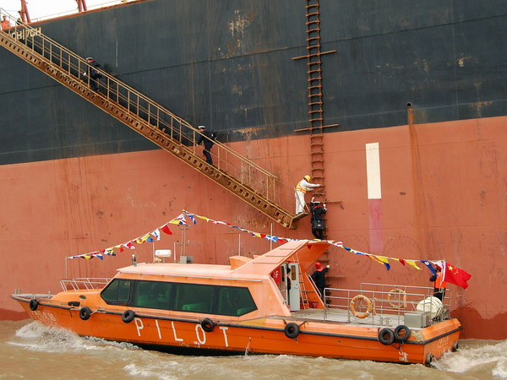
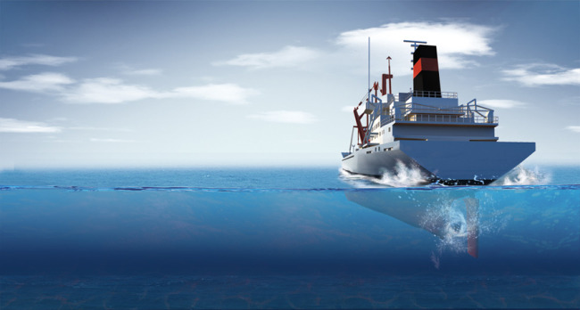
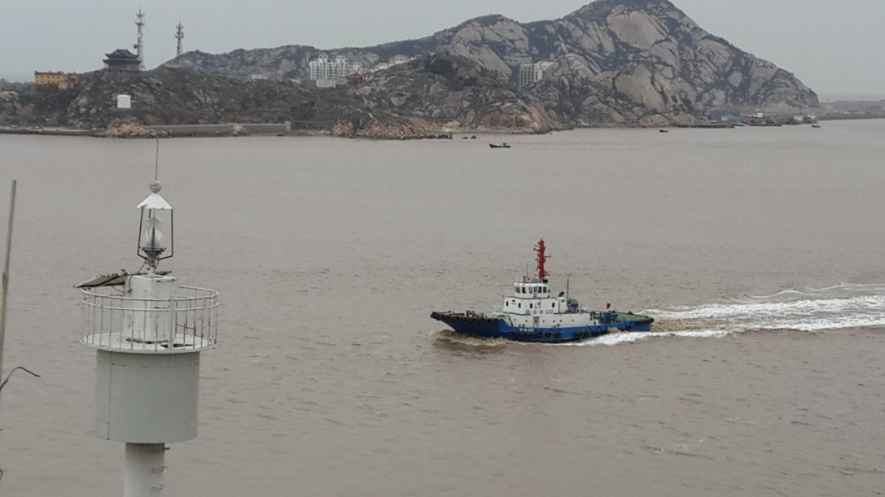
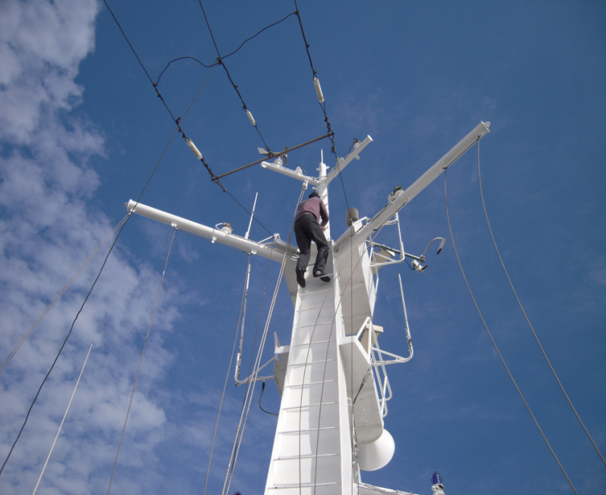
2.5 Services for Pilot
SMS provide specified forecast for 300 pilots. Shanghai has 4 pilot vessels, each vessel equipped out weather observation instruments.
Tide forecast
The height from keel to sea bottom
The ship draught

Slide 23
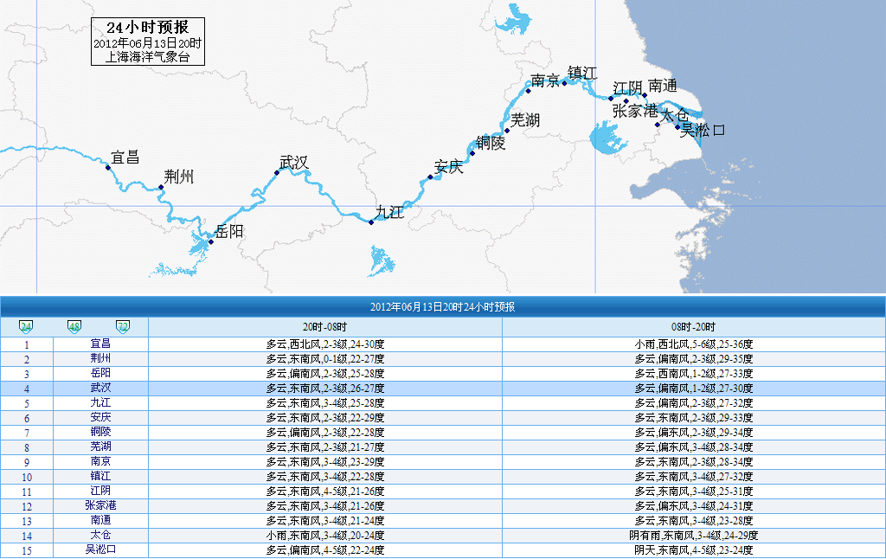
2.6 Services for Water Transport
Yangtze River Water Transport
refined forecasts for riverside cities

Slide 24
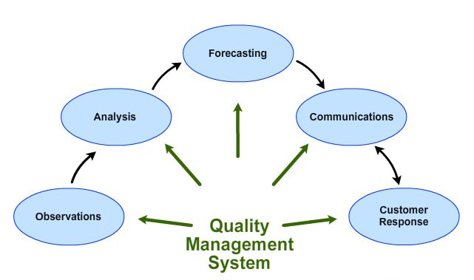
2.7 Services Quality Management
The provision of timely and accurate high quality meteorological forecasts for marine services depends on many interrelated components of a complex system.
质量管理系统

Slide 25
Thank you for your attention!

