Slide 1
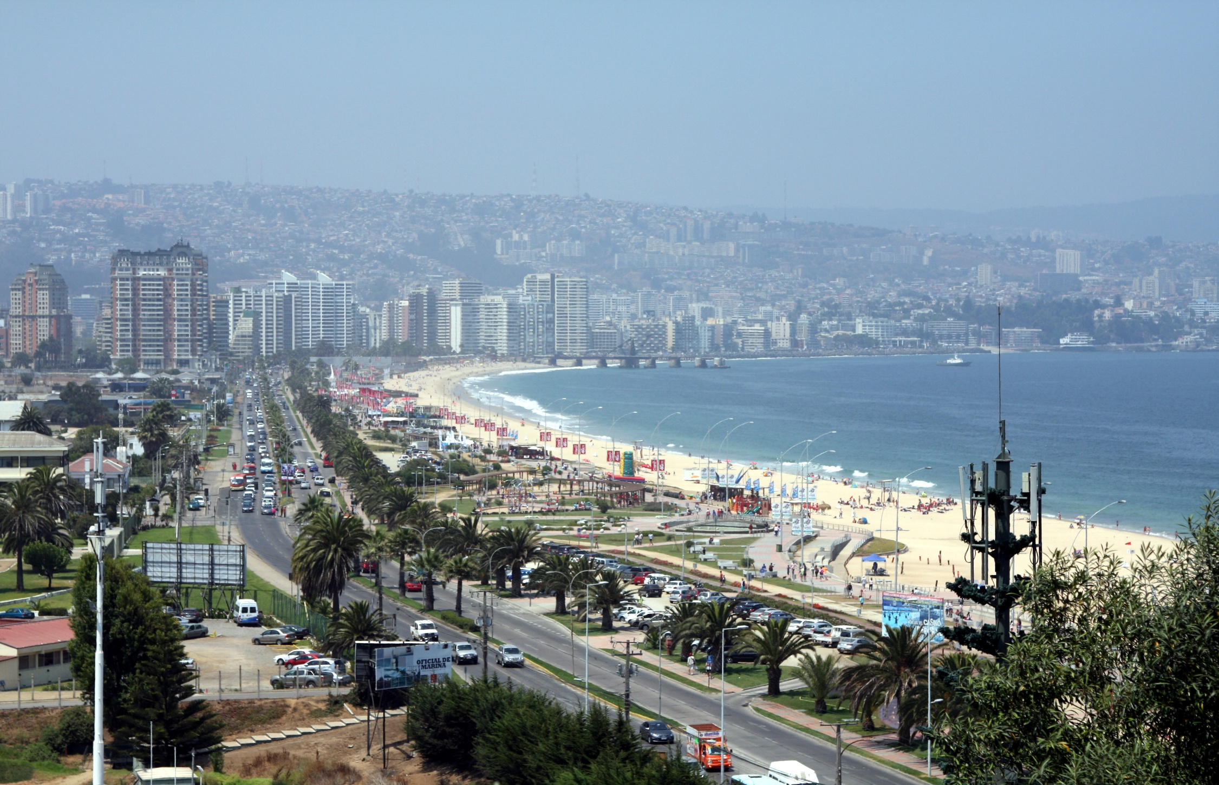
JOINT WMO/IOC TECHNICAL COMMISSION FOR OCEANOGRAPHY AND MARINE METEOROLOGY (JCOMM)
FOURTH INTERNATIONAL WORKSHOP OF
PORT METEOROLOGICAL OFFICERS (PMO-5)
ViÑa del Mar, Chile, 20-24 July 2015

Slide 2
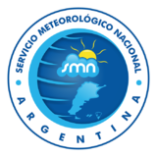
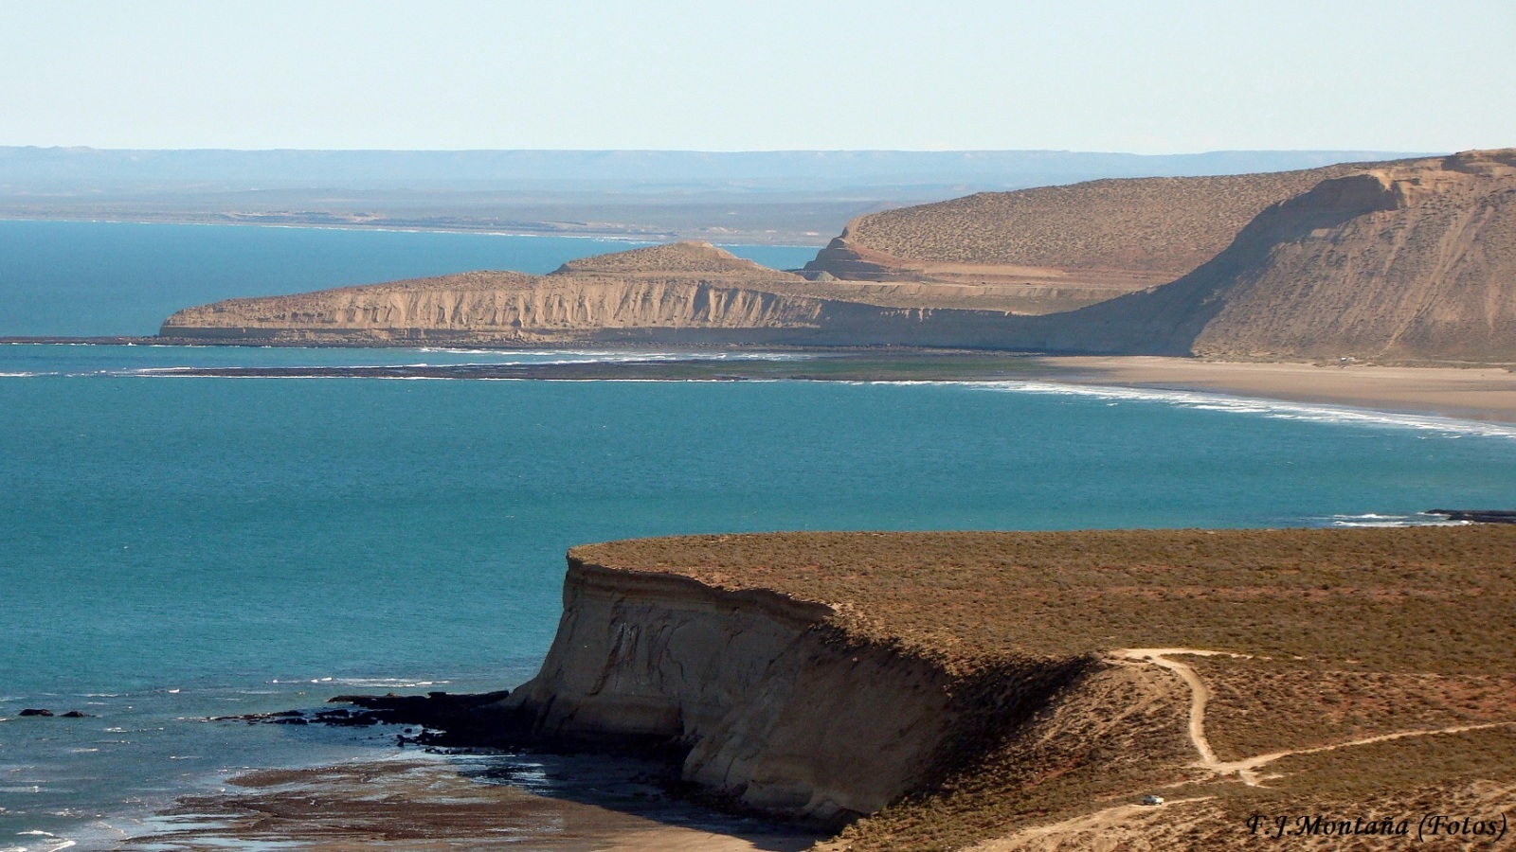
NATIONAL WEATHER SERVICE METAREA VI: MARINE WEATHER FORECASTS
Area VI: The South Atlantic and Southern Oceans south of 35°50’S,
and from 20°W to the longitude of Cape Horn, 67°16’W,
including the coastal strip to the Uruguay/Brazil frontier at 33°45’S

Slide 3
THESE INSTITUTIONS ARE IN CHARGE OF THE
MARITIME SAFETY SERVICE:

Slide 4
METAREA VI AREA OF RESPONSIBILITY
1) | Areas used in the CMRE Buenos Aires forecasts:
 | Atlantic Sections: North 35° S – 40° S and 20° W – 55° W CENTRAL EAST 40° S – 50° S and 20° W – 40° W CENTRAL WEST 40° S – 50° S and 40° W – 55° W SOUTH EAST 50° S – 60° S and 20° W – 40° W SOUTH WEST 50° S – 60° S and 40° W – 55° W DRAKE SECTION 55° S – 60° S and 55° W – 67° W
 | Coastal Areas: The Atlantic Ocean between 36º17'23"S and 55º00'00"S. Coastal area extends 300 nautical miles offshore. This extensive area is subdivided into variable, smaller coastal. RIO DE LA PLATA COAST MAR DEL PLATA COAST A From 36° 17’ S To 38° 30´ S BAHIA BLANCA COAST B From 38° 30’ S To 41° S PENINSULA DE VALDEZ COAST C From 41° S To 45° S GOLFO SAN JORGE COAST D From 45° S To 48° S PATAGONIA SUR COAST E From 48° S To 54° S FIN DEL MUNDO COAST F From 54° S To 55° S ZONA MALVINAS G
2) | Sub-areas used in the CMAVM forecasts:
 | OCEANIC AREAS: Area1. Northern Bellingshausen Sea 60° S – 66° S and 70° W – 90° W Area2. Southern Bellingshausen Sea 66° S - 73° S and 70° W - 90° W Area3. Northern Weddell Sea 60° S - 68° S and 20° W - 60° W Area4. Southern Weddell 68° S - 78° S and 20° W - 60° W | COASTAL AREAS: Drake South (south of 60ºS) Mar de la Flota coastal area Gerlache Strait Margarita Bay area Erebus and Terror Gulf area

Slide 5
METAREA VI
Sub-areas used in the CMAVM forecasts:
OCEANIC AREAS: Area1. Northern Bellingshausen Sea 60° S – 66° S and 70° W – 90° W Area2. Southern Bellingshausen Sea 66° S - 73° S and 70° W - 90° W Area3. Northern Weddell Sea 60° S - 68° S and 20° W - 60° W Area4. Southern Weddell 68° S - 78° S and 20° W - 60° W COASTAL ZONES: Drake South (south of 60ºS) Mar de la Flota Gerlache Strait Margarita Bay Erebus and Terror Gulf

Slide 6
WARNINGS ISSUED OVER METAREA VI DURING 2014

Slide 7
ISSUED WARNINGS PER LATITUDE DURING 2014

Slide 8
NUMBER OF ISSUED WARNINGS EVERY TRIMESTER ALONG THE YEAR 2014

Slide 9
MESSAGE ISSUED BY PREFECTURA NAVAL ARGENTINA
NAVTEX Coverage:
Country | Station ID | Name | Frequency (kHz)
Argentina | A | Ushuaia | 490
Argentina | B | Rio Gallegos | 490
Argentina | C | Comodoro Rivadavia | 490
Argentina | D | Bahia Blanca | 490
Argentina | E | Mar del Plata | 490
Argentina | F | Buenos Aires | 490
Argentina | M | Ushuaia | 518
Argentina | N | Rio Gallegos | 518
Argentina | O | Comodoro Rivadavia | 518
Argentina | P | Bahia Blanca | 518
Argentina | Q | Mar del Plata | 518
Argentina | R | Buenos Aires | 518

Slide 10
ARGENTINA NATIONAL WEATHER SERVICE Scheduled Bulletins By Inmarsat
Issuing Service: | Argentina
Coverage: | The South Atlantic and Southern Oceans south of 35°50'S, from 20°W to the longitude of Cape Horn, 67°16'W
Satellite Ocean Regions (scheduled bulletins): | AOR (W) | Broadcast (UTC): | 0230, 1730

Slide 11
BROADCAST
Servicio Meteorológico Nacional
The general system of dissemination of our marine meteorological services, is structured on the basis of media of the SMN and the Naval Prefecture Argentina (PNA). These systems are used as to ensure ongoing and effective reception of weather reports for a safe maritime navigation for all users who surf the METAREA VI.
In this way and for its part, the Naval Prefecture Argentina (PNA) makes the dissemination of the bulletins referred to by its coastal radio stations through NAVTEX (518 kHz).
CMRE
Buenos Aires
Boletines meteorológicos para la Navegación
CRT Buenos Aires
CMAVM
Southbury Coastal Station
EQUIP. INMARSAT

Slide 12
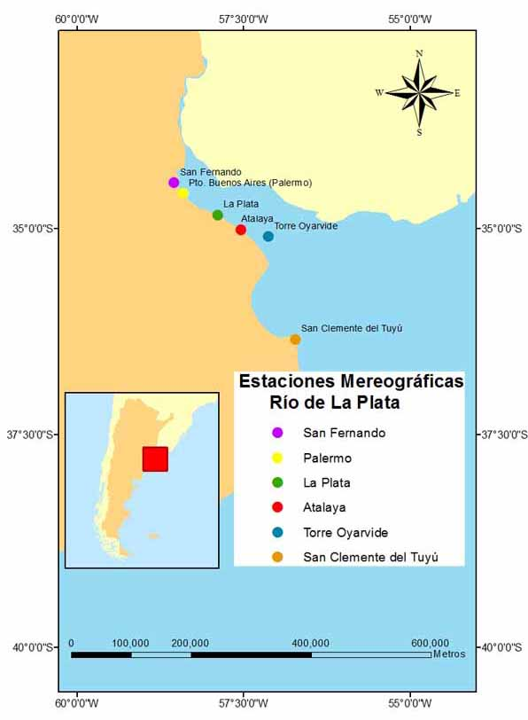
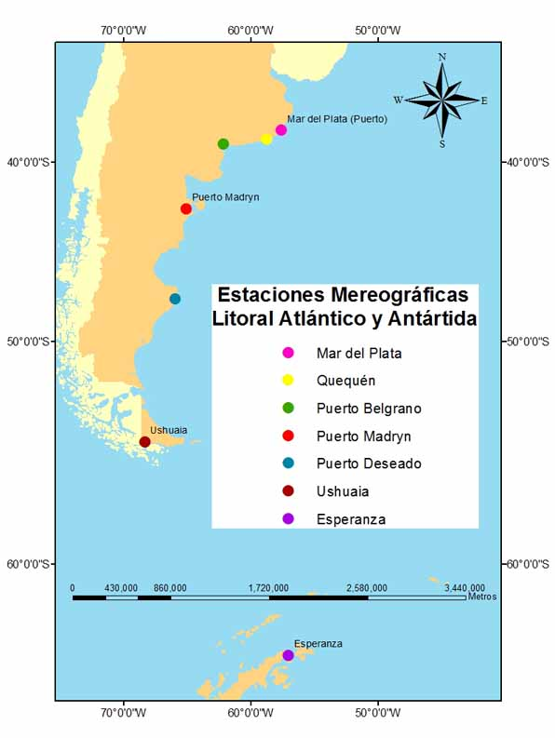
NAVAL HYDROGRAPHIC SERVICE: MAREOGRAPHIC STATIONS
Estaciones Mareográficas
Litoral Atlántico y Antártida
Estaciones Mareográficas
Río de La Plata

Slide 13
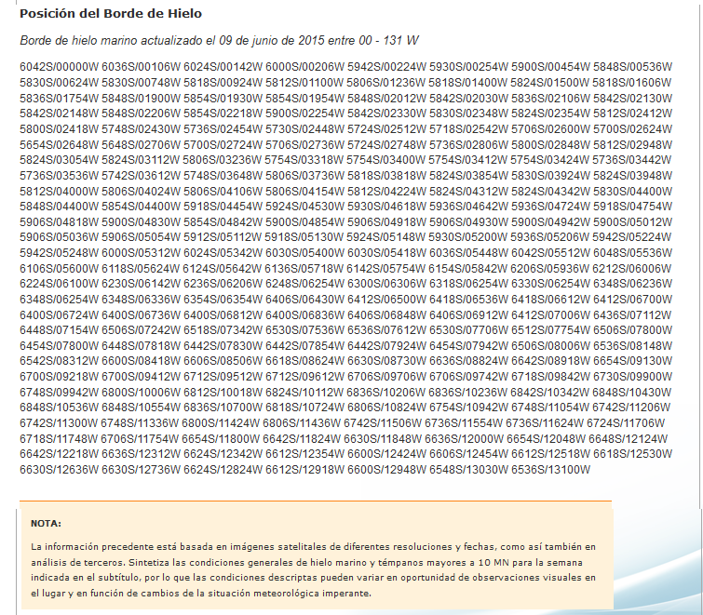
INFORMATION PRODUCED BY THE NAVAL HYDROGRAPHIC SERVICE ARGENTINA

Slide 14
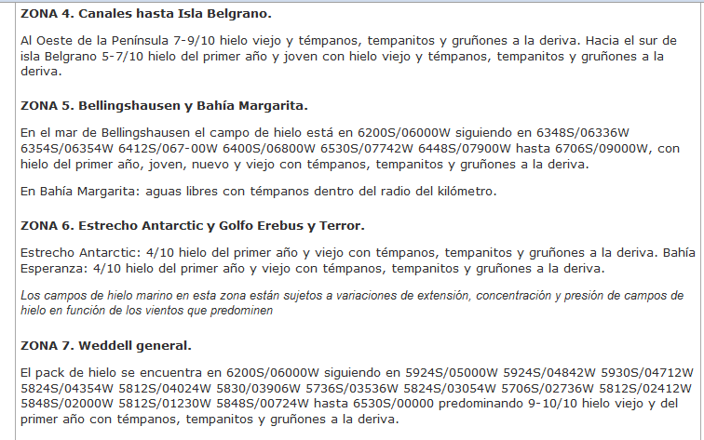
GLACIOLOGICAL BULLETINS AND WAVE FORECAST
SXST62 SABS 160615
HIGH SEAS WAVE FORECAST 160900 UTC JUNE 2014
METAREA VI
FORECAST VALID FROM 16 12 UTC TO 17 06 UTC
WARNINGS
NIL
SIGNIFICANT FEATURES AND FORECAST
40S 54W / 47S 53W / 47S 45W / 41S 46W /
WAVES 3.0M / 4.0M
SLIGHTLY DECAYING. MOVING SE
W OF THE LINE 57S 68W / 57S 65W / 60S 65W /
WAVES 2.5M / 3.5M
LITTLE CHANGE. MOVING E
E OF THE LINE 35S 37W / 39S 52W / 45S 56W / 50S 67W /
35S 57W / 60S 55W /
WAVES 2.0M / 3.0M
LITTLE CHANGE. MOVING SE
METAREA VI - Wave Forecast
The South Atlantic and Southern Oceans south of 35º50' S and from 20º W to the longitude of Cape Horn, 67º16' W. This bulletin does not include coastal areas.
Updated twice daily, 9:00 UTC and 21:00 UTC. Valid for 18 hours, from 12:00 UTC to 6:00 UTC next morning and from 0:00 UTC to 18:00 UTC, respectively.
Part 1: "Warnings". Waves above or equal to 5 m in the period, otherwise NIL.
Part 2: "Significant features sinopsis and forecast". Waves above or equal to 2.5 m.
Waves in meters, distance in nautical miles.
UTC: Greenwich Meridian Time.

Slide 15
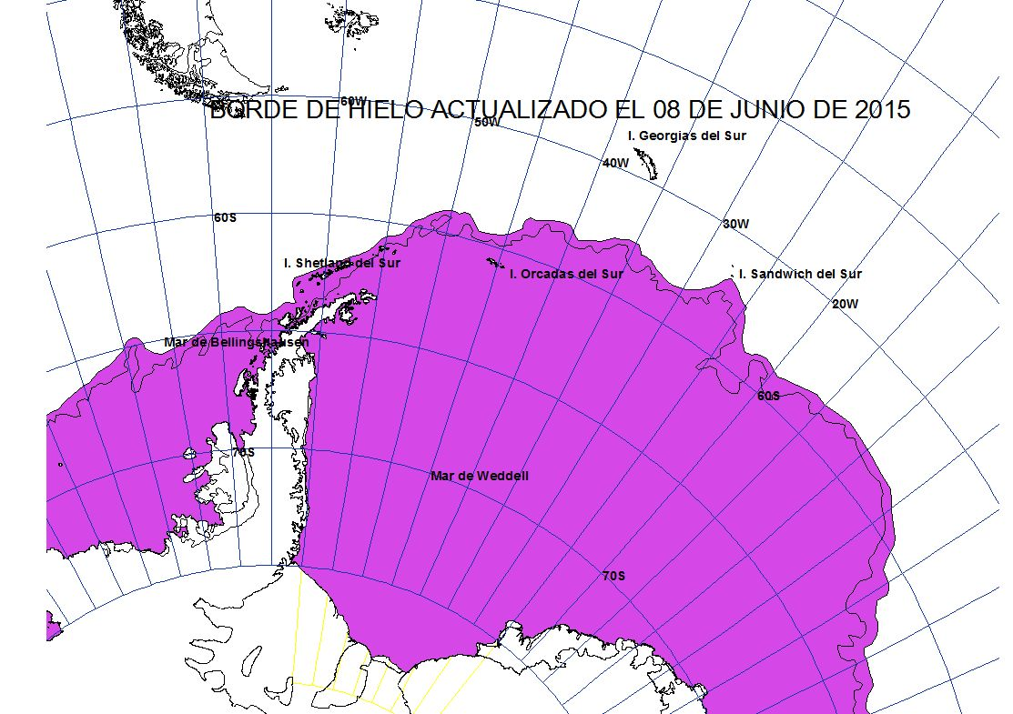
NAVAL HYDROGRAPHIC SERVICE:

Slide 16
WARNING JUNE 15-16
ISSUED BULLETINS

Slide 17
METAREA VI BULLETINS ISSUED JUNE 15, 09:00 UTC 21:00 UTC AND JUNE 16 09:00 UTC
WWST02 SABM 150900
1:31:06:01:00
SECURITE
WEATHER BULLETIN FOR SHIPPING - METAREA 6-
09:00 UTC 15, JUNE 2015
NATIONAL WEATHER SERVICE
DATE AND TIME UNIVERSAL TIME COORDINATED - UTC PRESSURE HPA BEAUFORT SCALE WINDS AND WAVE HEIGHT IN METERS
PART 1 GALE WARNING:
WARNING 137: STRONG BARIC GRADIENT PROVOKES WINDS FORCE 10 FROM SECTOR W WITH GUST VERY ROUGH SEA (4 - 6) TO HIGH (6 - 9) IN GOLFO DE SAN JORGE COASTS SOUTH PATAGONIA COASTS FIN DEL MUNDO COASTS SOUTH WEST AREA (50S- 60S AND 40W- 60W) DRAKE AREA (55S- 60S AND 60W- 67W) FROM 15/1800
WWST02 SABM 152100
1:31:06:01:00
SECURITE
WEATHER BULLETIN FOR SHIPPING - METAREA 6-
21:00 UTC 15, JUNE 2015
NATIONAL WEATHER SERVICE
DATE AND TIME UNIVERSAL TIME COORDINATED - UTC PRESSURE HPA BEAUFORT SCALE WINDS AND WAVE HEIGHT IN METERS
PART 1 GALE WARNING:
WARNING 137: LOW 961HPA AT 51S 55W MOV E NOT CHANGE PROVOKES WINDS FORCE 8 WITH GUST AROUND ITSELF HIGH SEA (6 - 9) TO VERY HIGH (9 - 14)

Slide 18
METAREA VI BULLETINS ISSUED JUNE 15, 09:00 UTC 21:00 UTC AND JUNE 16 09:00 UTC
WWST02 SABM 160900
1:31:06:01:00
SECURITE
WEATHER BULLETIN FOR SHIPPING - METAREA 6-
09:00 UTC 16, JUNE 2015
NATIONAL WEATHER SERVICE
DATE AND TIME UNIVERSAL TIME COORDINATED - UTC PRESSURE HPA BEAUFORT SCALE WINDS AND WAVE HEIGHT IN METERS
PART 1 GALE WARNING:
WARNING 137: LOW 957HPA AT 53S 63W MOV SE NOT CHANGE PROVOKES WINDS FORCE 10 AROUND ITSELF, VERY HIGH SEA (9 - 14)

Slide 19
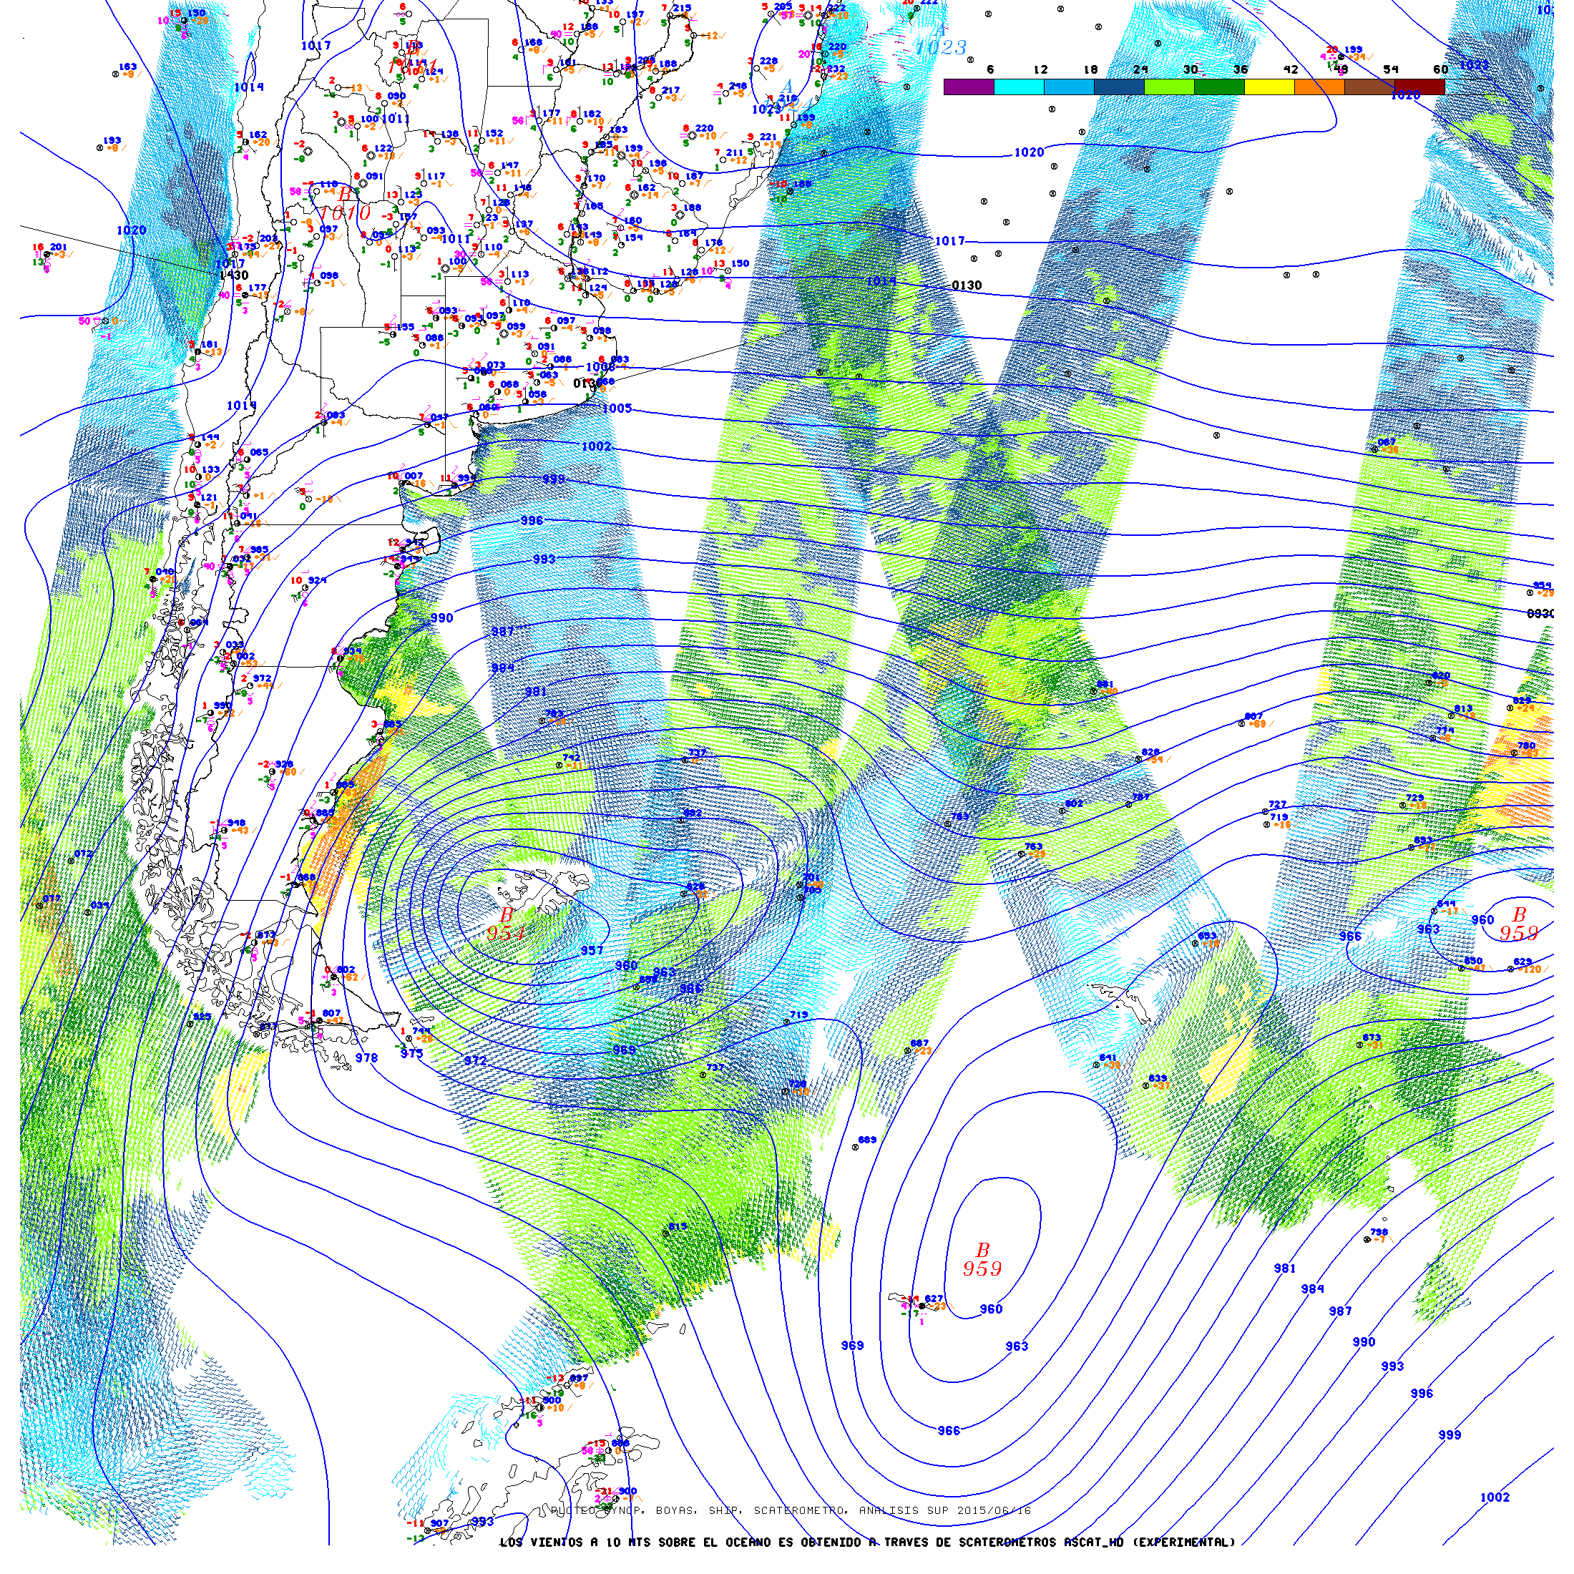
SURFACE ANALYSIS: June 15, 12:00 UTC June 16, 12:00 UTC

Slide 20
GOES-13 SATELLITE IMAGES

Slide 21
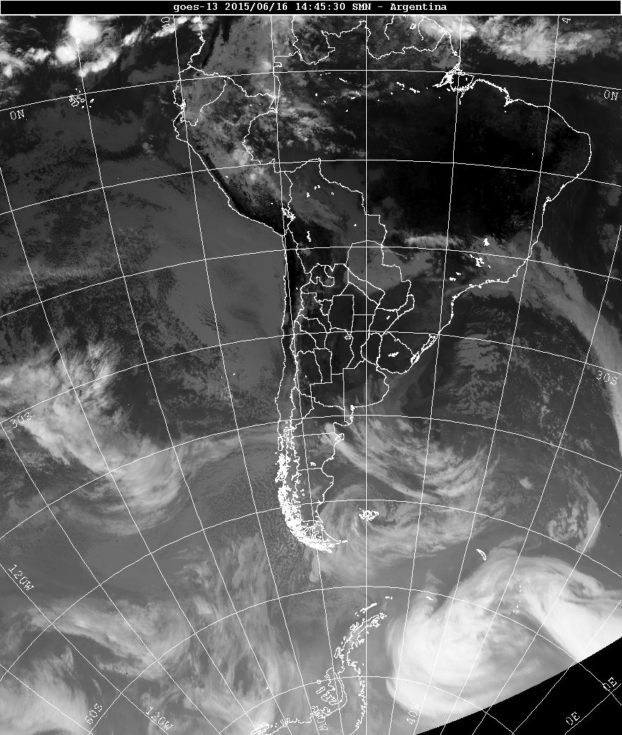
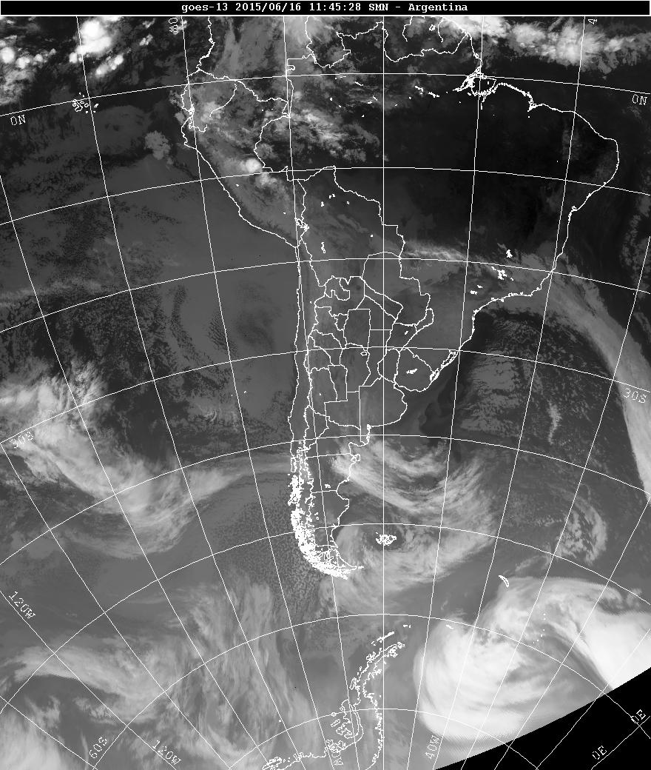
GOES – 13 2015/06/16 14:45 SMN ARGENTINA

Slide 22
SURFACE OBSERVATIONS FROM RÍO GALLEGOS

Slide 23
SURFACE OBSERVATIONS FROM USHUAIA

Slide 24
MSI INFORMATION
The provision of information of sea conditions is considered the most important parameter in Maritime Safety Information (MSI). At the moment the information on the significant wave height and direction of displacement is available in graphical form through the Website http :/ / www.smn.gov.ar
Very soon these parameters will be incorporated in the routine bulletins.

Slide 25
METAREA VI PRIORITIES:
The National Weather Service jointed with Naval Prefecture Argentine and the National Hydrographic Service, are continuosly reviewing the strategies and protocols to be followed in the near future.

Slide 26
The National Weather Service web site, www.smn.gov.ar in which all users can found instantly weather updates, satellite images, weather charts, images radar, and a numerical model of waves, made in conjunction with the Naval Hydrographic Service, among a diverse set of products.

Slide 27
Thanks for your attention.

