Slide 1
Port Meteorological Officer
Conference - Chile
Instrument Standards and Practices
Chris Fakes
PMO Houston/Galveston

Slide 2
Guide To Meteorological Instruments and Methods of Observation
(WMO-No. 8) (7th edition 2008, updated in 2010)
http://www.wmo.int/pages/prog/www/IMOP/CIMO-Guide.html
CIMO-16 approved the Provisional 2014 Edition of the CIMO Guide
http://www.wmo.int/pages/prog/www/IMOP/publications/CIMO-Guide/Provisional2014Edition.html
Guide describes most meteorological instruments, systems and techniques in use today, and provides the basis for the preparation and implementation of observing systems.
Part I Measurement Of Meteorological Variables
Part II Observing Systems
Chapter 4 Marine Observations
Part III Quality Assurance and Management of Observing Systems
This document is a good starting point in developing and starting a VOS program.

Slide 3
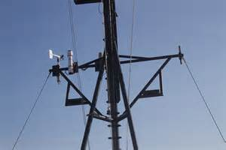
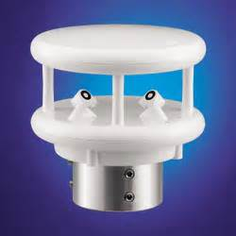
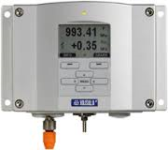
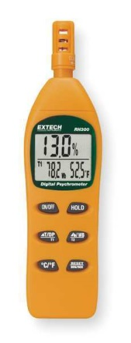
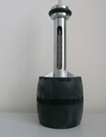
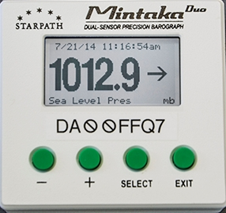
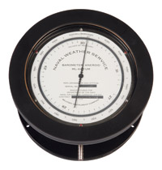
VOS Instrument Standards
Barometer
Thermometer
Anemometer
Sea Surface Temperature

Slide 4
VOS BAROMETERS
National Practices
NATIONAL VOS | BAROMETER | BAROMETER TYPE | BAROMETER SETTING | TYPE OF CORRECTION TABLES USED
Australia | Vaisala PTB220 | Digital | Station Level | Height
Australia |  | Precision Aneroid | Station Level | Pressure/Temperature, Drift & Height
Croatia | Barigo Fisher SUNDO | Ship's Aneroid Ship's Aneroid Ship's Aneroid | MSL MSL MSL | NIL NIL NIL
Ecuador |  | Aneroid | MSL | NIL
France | Vaisala PTB220 | Digital | Station Level | Height
Germany | Fuess Vaisala PTB330 | Aneroid Digital | MSL MSL | NIL NIL
Greece | Belfort | Aneroid | Station Level | Height / Temperature
Hong Kong | Hisamatsu OTA | Precision Aneroid Precision Aneroid Ship's Aneroid | MSL MSL MSL | U.K. Met. O. 740 U.K. Met. O. 740 U.K. Met. O. 740
Iceland | Fuess Vaisala PA11 | Ship's Aneroid Digital | MSL MSL | Air Pressure Dependent
Ireland |  | Ship's Aneroid Aneroid | MSL MSL | NIL NIL
Japan |  | Aneroid Digital | Station Level Station Level | Pressure/Temperature/Height Pressure/Temperature/Height
Netherlands | Fuess Vaisala PTB220 Vaisala PTB330 | Aneroid Digital Digital | Station Level Station Level Station Level | NIL NIL NIL
New Zealand | Fuess Vaisala PTB220 Vaisala PTB330 | Precision Aneroid Digital Digital | MSL Station Level Station Level | NIL Instrument & Height Height
Norway | Vaisala PTB220 | Digital | MSL | NIL
Singapore | PAB MK2 M2236 | Precision Aneroid | MSL | U.K. Met. O. 740
South Africa | Fuess | Aneroid | MSL | NIL
Sweden | Vaisala PTB220 | Digital | Station Level | Height or TurboWin
United Kingdom | Negretti & Zambra PAB MK2 Vaisala PTB220 Vaisala PTB330 | Precision Aneroid Digital Digital | Station Level Station Level Station Level | NIL NIL NIL
United States | Belfort Meteograf Mintaka Duo Precision | Aneroid Digital Digital | MSL MSL MSL | Height Height Height
http://www.bom.gov.au/jcomm/vos/national_practices_pressure.html

Slide 5
VOS Transfer Standard Barometers
National Practices
NATIONAL VOS | BAROMETER | FREQUENCY OF BAROMETER COMPARISON
Australia | Vaisala PTB220B | 4 monthly
Ecuador | OACI mercury | 6 monthly
France | None
Germany | Vaisala PTB330 Druck DPI 740 | 6 monthly 6 monthly
Greece | Belfort Aneroid | 3 -6 monthly
Hong Kong, China | Digital Aneroid Barometer | 9 monthly
Japan | Vaisala Digital Barometer Paroscientific | 6 monthly
New Zealand | Vaisala PTB220AD | 12 monthly
Norway | Digiquartz | 12 monthly
South Africa | Vaisala PA11 & Precision Aneroid | 3 -6 monthly
Sweden | Vaisala PA11A | 12 monthly
United Kingdom | Precision Aneroid Barometer Vaisala PTB330TS (also includes temp/humidity output to handheld device) | 6 monthly 6 –12 monthly
United States | Digiquartz / Portable Kestral | 6 monthly

Slide 6
BAROMETERS
Aneroid - Most common (Belfort, Fuess, Fischer)
Digital - Vaisala, Mintaka
WMO Target Accuracy Requirements
BAROMETER
Measuring Range | 500 – 1080 hPa
Aneroid Pressure Accuracy | +/- 0.3 hPa
Digital Pressure Accuracy | +/- 0.1 hPa
Reading Precision | +/- 0.1 hPa
Adjustments made to Aneroid Barometers must be within +/- .3 hPa. If the aneroid barometer is already within +/- .3 hPa an adjustment is not necessary. Barometers should be checked every six months.
Each barometer should be supplied with a certificate giving the corrections (if any) that must be applied to the readings of each individual instrument.

Slide 7
Common Problems Encountered:
Mounted in direct sunlight or near a heat source
Not at Eye level
Pressurized Bridge: A/C can cause errors up to +5 hPa
Incorrect barometer height
Some ship owned barometers no adjustment screw
PMOs should always check Air Pressure Quality Control provided by Meteo-France before each visit. This will give you a good idea if there’s a problem.

Slide 8
Barometers can be set to Mean Sea Level Pressure (MSL) or Station Pressure
MSLP Method
At dock read pressure from portable standard
Adjust reading for dock height
Adjust barometer to read MSLP
Barometer can not be adjusted; input instrument correction in TurboWin
Apply certification sticker
SLL Method
Must have accurate Barometer Metadata
Height of Barometer from SLL, Keel to SLL and Departure of Reference
Read station pressure from portable transfer standard at barometer height
Adjust barometer reading
Barometer can not be adjusted; input instrument correction in TurboWin
Apply certification sticker

Slide 9
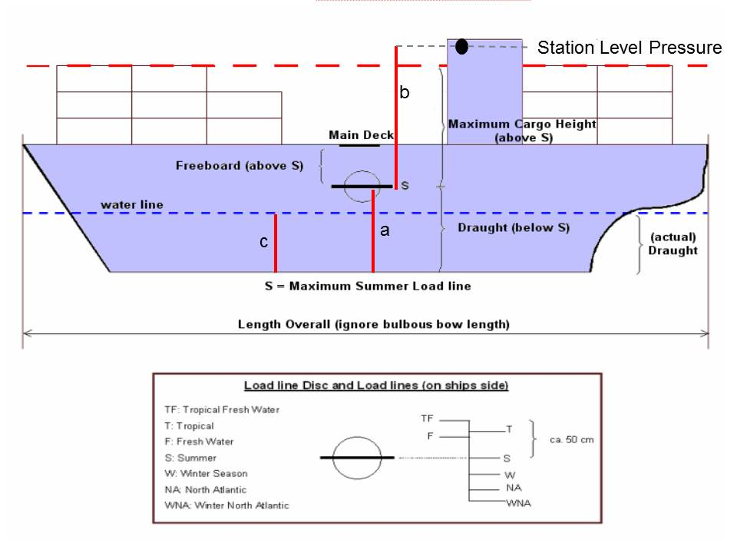
a = Height of keel to SLL (m)
b = Height of Barometer above SLL (m)
c = Mean ship’s draft (m)
Height of Barometer = a + b – c
example: a = 12 m b = 20 m c = 8 m (12 + 20 – 8 = 24 m)
Height of Barometer = 24 m Height correction for 24 m = +2.9 hPa
“ ACCURATE MEASUREMENTS ARE CRUCIAL “

Slide 10
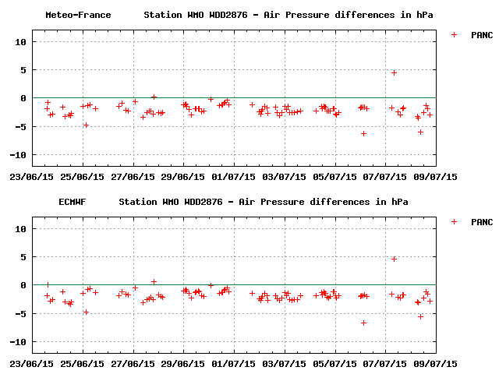
Some large vessels, such as tankers and bulk carriers will require two to three different corrections since large draft changes can cause considerable pressure difference.
If a ship is showing up on MeteoFrance Pressure Blacklist, you can send an E-Mail to correct a vessels pressure. It is strongly recommend you attach the MeteoFrance Air Pressure QC graphic to show the Mates exactly what we are seeing. This will also reaffirm to the Mates that we do in fact look at their observations.
If the ship is using TurboWin+, you can request the Mates to input the required correction on the “Barometer Reading” page under “instrument correction”. The correction will be factored in by the software until changed by the PMO. Once the PMO visits the ship, they can either adjust the barometer, or annotate a correction on the inspection sticker. Ensure the instrument correction value in TurboWin+ is changed to zero ( Ø ) when completed.

Slide 11
THERMOMETERS
Mercury discouraged for shipboard use by WMO for environmental reasons
Alcohol
Digital Hand Held
WMO Target Accuracy Requirements
THERMOMETER
Range (˚C) | –30 to 45
Maximum error (˚C) | < 0.2 °C
Max variation of correction within any interval of 10˚C | 0.1 °C
Reading Precision | +/- 0.1 °C
Read from the windward side
Best to have one set on each bridge wing
Thermoscreens (louvered shelters) required for glass thermometers (Psychrometers)

Slide 12
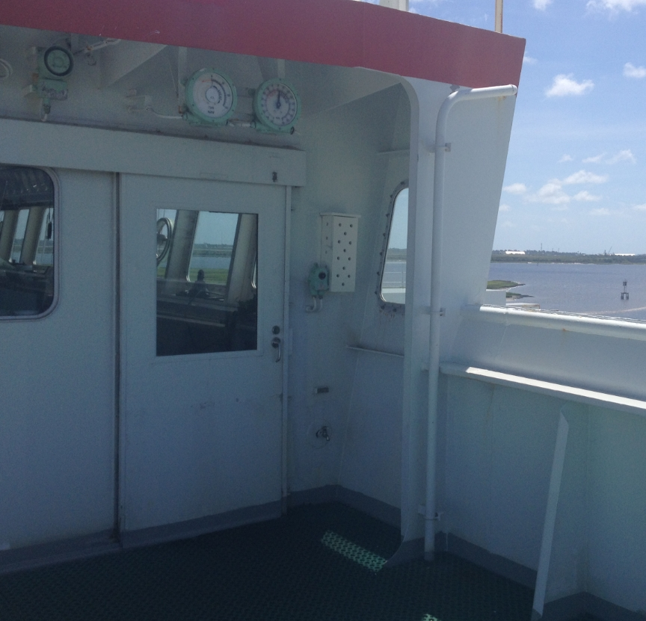
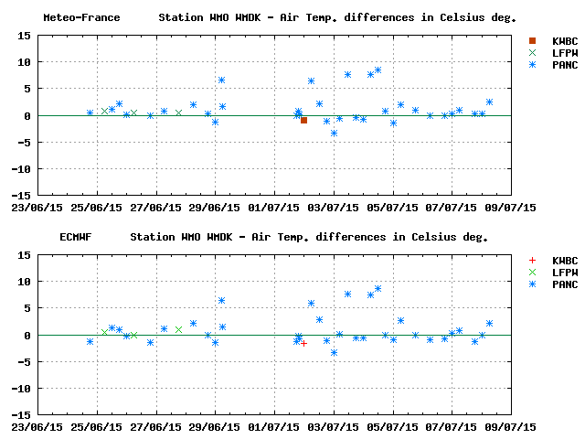
Common Problems Encountered:
Glass thermometers hard to read to the tenth
Poor mounting location (blocked from wind)
Door missing from thermoscreen
Wicking dirty
Wet bulb water container dry

Slide 13
ANEMOMETER
Propeller
Cup
Sonic
WMO Target Accuracy Requirements
ANEMOMETER
Wind Speed | less than 10 kts 1 kt more than 10 kts 10%
Wind Direction | 5 °
Reading Precision Speed | whole knot
Reading Precision Direction | whole degree
Correct Metadata is important. Most anemometers are higher than 20 m. NMS reduce winds to 10 m.

Slide 14
Observations of wind speed and direction may be made either by visual estimates or by means of an anemometer. Desirable for measured winds be made using a well-maintained and recently calibrated instrument sited in a well-exposed location away from the influence of the superstructure, mast or stacks.
Common Problems Encountered:
Never calibrated since ship was built
Poor mounting location (blocked by antennas, stacks, etc..)
Incorrect or missing Metadata
Indicators displaying apparent wind (Mates do not convert to true)
MeteoFrance QC stats good way to show Masters and Shipping Companies that their anemometer requires calibration.

Slide 15
SEA SURFACE TEMPERATURE (SST)
Intake most common method - least accurate
Bucket better accuracy - not feasible on most commercial ships.
Time, personnel and safety constraints
Hull Mounted desirable - must overcome installation/cabling problems
Radiometer IR limited - in smooth water measures first 1mm of water surface
WMO Target Accuracy Requirements
SEA SURFACE TEMPERATURE
Target Accuracy | +/- 0.1 °C
Reading Precision | 0.1 °C

Slide 16
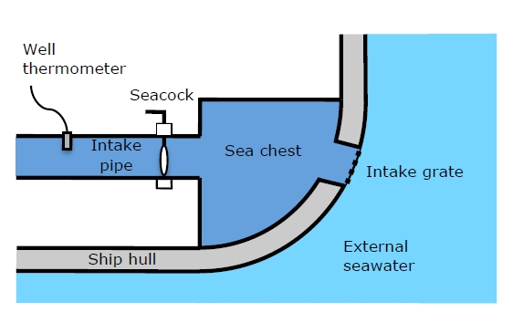
SST temperatures are usually taken from the seawater intake pipe. Quality of temperature instruments vary from ship to ship and in most part are not standardized and poorly documented.
Most intake thermometers are mounted 4 to 10m inboard of the intake grate and 2 to 4 m above the keel. On more modern vessels seawater is first piped aboard through a sea chest where the intake thermometers are sometimes mounted. Some ships could have 2 to 3 intakes or multiple lines which SST temperature can be taken.
The intake closest to Bow provides more accurate readings.

Slide 17
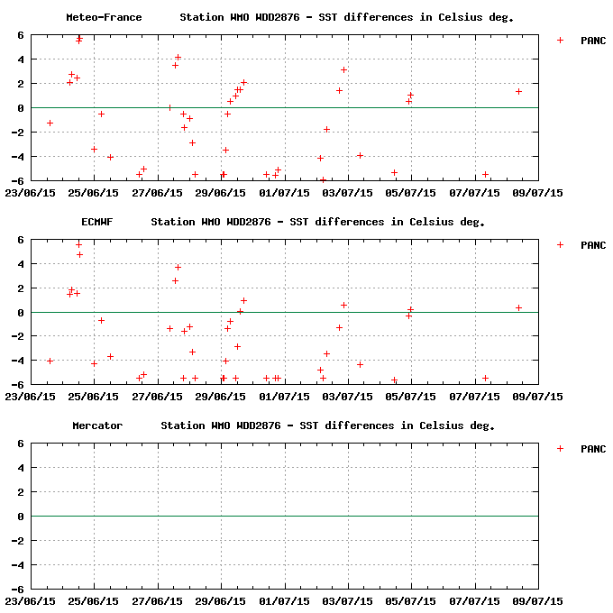
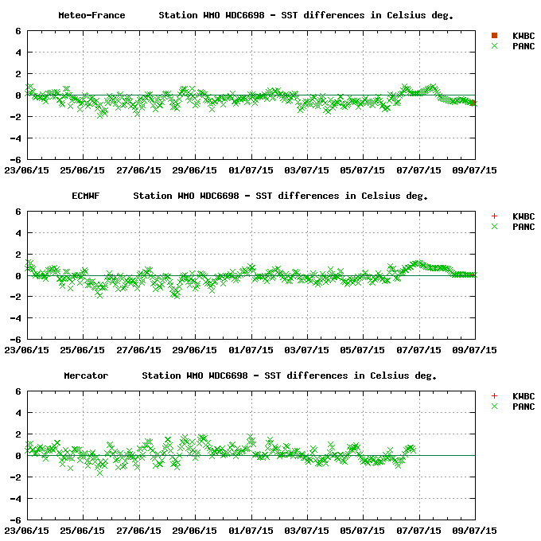
Ship’s Intake
Hull Mounted Sensor

Slide 18
VOS Challenges
Equipment Accuracy & Reliability
Vs
Fiscal Constraints
The marine environment is harsh. Higher quality equipment lasts longer.

