Slide 1



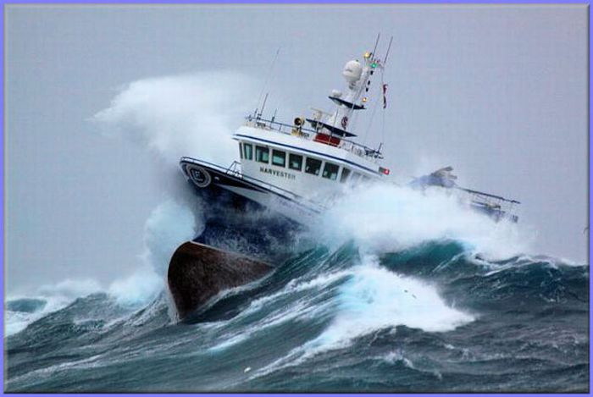
UNITED STATES VOS
INSPECTIONS
&
METADATA COLLECTION
Matt Thompson
PMO - Seattle, WA

Slide 2
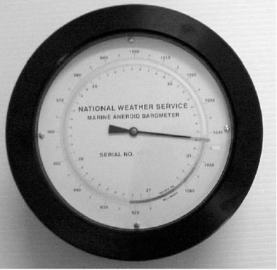
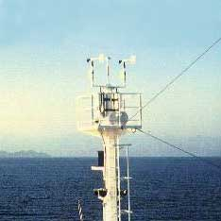
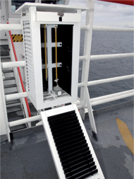
US VOS SHIP INSPECTION
Purpose:
    To ensure that all equipment and reporting
software are in good working order.
(identify discrepancies)
    Update any changes for the WMO PUB 47 Data
    Train crew on current standards of observing / reporting.

Slide 3
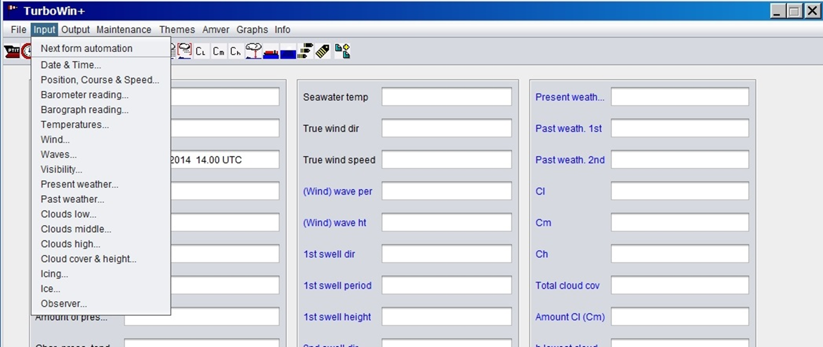
Reporting Software
TURBO WIN 5.0
&
TURBO WIN + 2.2

Slide 4
Inspection
Form
PUB 47
VOS
Meta Data
VOS META DATA
SHIP NAME:________________________________CALL:____________FLAG:_______________IMO:_________________________
SHIP CONTACT INFO: NAME______________________________________________RANK_________________________________
EMAIL:_____________________ PHONE:_______________ SATC#:______________________FAX:__________________________
AGENT:______________________ EMAIL:__________________ ADDRESS:______________________________________________
ELECTRONIC LOGBOOK\ VERSION:_______________ TRANSMISSION FORMAT: Code 41 Code 43 Email
BRIDGE HEIGHT:_________ GENERAL WIND OBSERVING PRACTICE:___________________________________________________
DESCRIPTION OF DATA ENTRY TERMINAL:________________________________________________________________________
OCEANS OF PRIMARY OPERATION:_____________________________________________________________ _________________
DATE OF SHIP IDENTITY: _____________________ VESSEL TYPE:_______________________________
YEAR OF CONTRUCTION:_____________________ GROSS TONNAGE: __________________________
OVERALL LENGTH MINUS BULBOUS BOW: _______(M) MOULDED BREADTH: ________(M) FREEBOARD: __________(M)
DRAUGHT: ___________(M) CARGO HEIGHT: _____________(M) DISTANCE FROM BRIDGE TO BOW: _____________(M)
ANEMOMETER
MAKE AND MODEL:_________________________________ANEMOMETER TYPE: ________________________________________
SERIAL NUMBER: _____________________________LOCATION:______________________________________________________
HEIGHT FROM SLL:___________(M) HEIGHT ABOVE DECK:___________(M)
DISTANCE FROM CENTERLINE: PORT SIDE______________(M) STBD SIDE:_____________(M)
DISTANCE FROM BOW:______________(M) UNITS:___________ DATE CALIBRATED:______________
DATE INSTALLED:_______________ DATE REMOVED:_______________
--------------------------------------------------------------------------------------------------------------------------------------------------
SEA SURFACE TEMPERATURE
MAKE AND MODEL:___________________________________________________________________________________________
TYPE: _______________________________________________________________________________________________________
SERIAL NUMBER: _____________________________LOCATION:_______________________________________________________
DEPTH:___________(M) UNITS:___________
DATE CALIBRATED:______________ DATE INSTALLED:_______________ DATE REMOVED:_______________
--------------------------------------------------------------------------------------------------------------------------------------------------
BAROMETER
MAKE AND MODEL:___________________________________________________________________________________________
TYPE: _______________________________________________________________________________________________________
SERIAL NUMBER: _____________________________LOCATION:_______________________________________________________
HEIGHT FROM SLL:___________(M) UNITS:___________
DATE CALIBRATED:______________ DATE INSTALLED:_______________ DATE REMOVED:_______________
BAROGRAPH
MAKE AND MODEL:________________________________________________________________________________________
TYPE: ______________________________________________________________________________________________________
SERIAL NUMBER: _____________________________LOCATION:______________________________________________________
HEIGHT FROM SLL:___________(M) UNITS:___________
DATE CALIBRATED:______________ DATE INSTALLED:_______________ DATE REMOVED:_______________
THERMOMETER AND HYGOMETER
MAKE AND MODEL: THERMOMETER________________________________HYGROMETER__________________________________
TYPE: _________________________________EXPOSURE: ___________________________________________________________
SERIAL NUMBER: _______________________LOCATION:_____________________________HEIGHT FROM SLL:___________(M) UNITS:___________ DATE CALIBRATED:______________ DATE INSTALLED:_______________ DATE REMOVED:_______________

Slide 5
BAROMETER
Adjustments
& Corrections
The US Program only adjusts, or gives corrections to barometers.
Barometers adjusted to mean sea level.
Calibrations must be carried out by certified equipment calibration lab.
Some barometers cannot be adjusted, and therefore must be given a correction only.
* Barometers must have a usable scale, compliant with WMO reporting standards.

Slide 6
CRUISE SHIPS

Slide 7
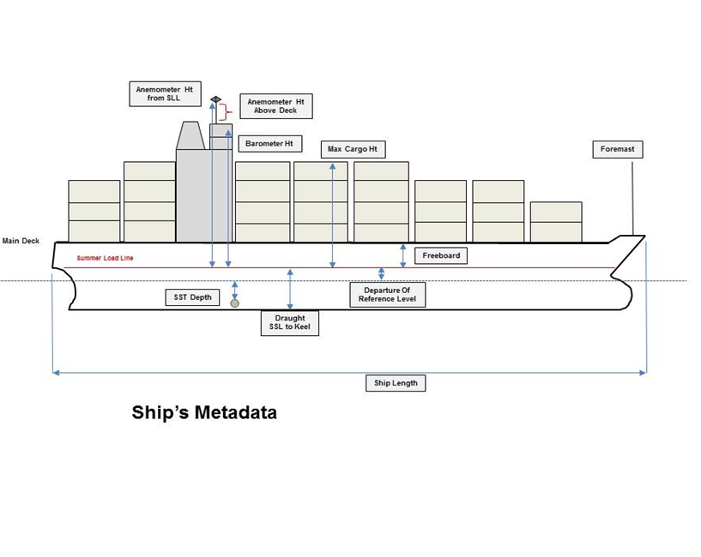
CARGO SHIPS

Slide 8
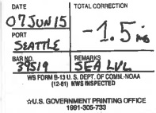
Visit Document and Adjustment Decal
Each vessel is issued a visit letter and a NWS B-13 Decal indicating any adjustment.

Slide 9
INTERNATIONAL
INSPECTIONS

Slide 10
Foreign VOS Inspections
Before visiting a Foreign VOS ship, we check the National Practice for that VOS country. A majority of VOS Countries set/adjust their barometers to Station Pressure. Ensure you follow the barometer practice for that country. See Appendix B (Official listing of National Practices) http://www.bom.gov.au/jcomm/vos/resources.html
PMOs should always check SLP Quality Control provided by Meteo-France before each visit.
After visit, complete VOSP001 – Foreign VOS Inspection Form. E-mail form to the servicing country PMO and U.S. VOS OM.

Slide 12
Remote Comparisons
Ships request via email for barometer comparisons when not in areas where any PMO is available.
Comparisons are sent back with corrections using verified sources near their position.
Short-Term Solution

Slide 13
Checklists
Ensures that you do not forget required data.
Double checks information that may need verification.
Make one that fits your tasks.

Slide 14
THANK YOU.
QUESTIONS?

