Slide 1
CREW TRAINING
Rob Niemeyer, PMO,
Jacksonville, FL, United States

Slide 2
WHAT ARE SOME OF THE CHALLENGES/BARRIERS?
TIME / SHIPS SCHEDULE
LANGUAGE BARRIERS
CREW EDUCATION/SKILLS
CREW MOTIVATION
ONLY 1 PERSON TO TRAIN PER VISIT
CREW CHANGE
CREW OVERWHELMED (MOTIVATION)

Slide 3
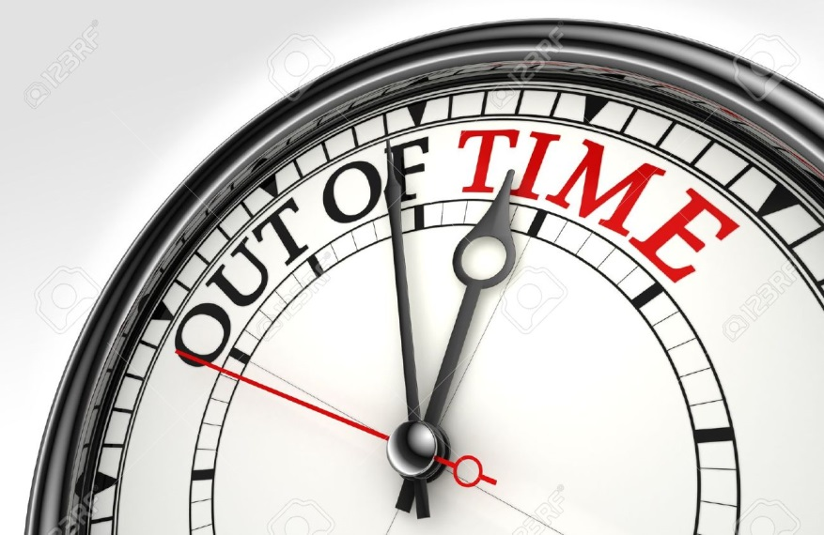
TIME AND SHIP SCHEDULE
PLAN AHEAD – Set a Date (Mutual Commitments)
- Follow-up Emails & Feedback
- Prioritize Training Topics, Building Blocks
- Maximize Your Time, Time is of the Essence
- QA Observations, know their Strengths & Weaknesses for Future Visits/Training
- Revisit Ship and Continue Training, The Training Never Ends
FOLLOW UP, FOLLOW UP, FOLLOW UP!

Slide 4
LANGUAGE BARRIERS
Utilize International PMO’s
Use Your Best Judgement and Abilities

Slide 5
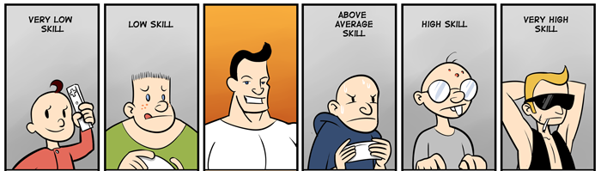
CREW EDUCATION/SKILLS Not All Mariners are Created Equal
Through Interactions With Crew, Evaluate their Level of Meteorological Knowledge/Skills
Upon Evaluation, Tailor Your Training For That Person(s)
Do Not Assume They Know How!

Slide 6
CREW MOTIVATION
Always Reinforce The Importance of Sending Meteorological Reports
Provide Feedback, Frequent Visits, & Correspondence Via Email (Weekly Observer Tips)
Patience and Persistence!
Build Strong Relationships

Slide 7
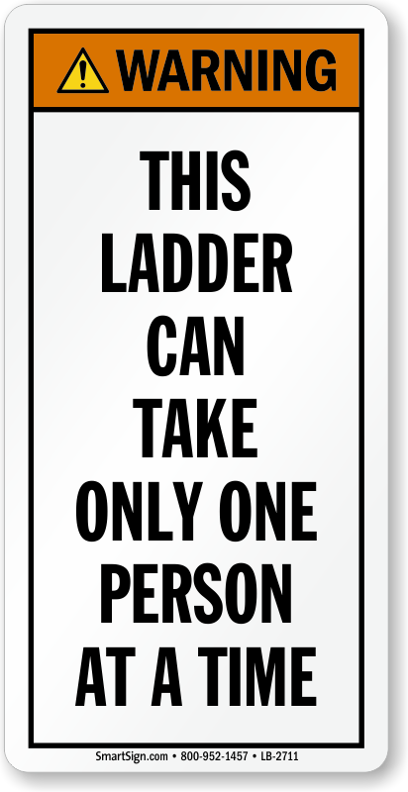
ONLY 1 PERSON TO TRAIN PER VISIT
Work With What You Have
A Well Informed & Motivated Captain Motivates his/her Crew
Attaining Senior Officer Support is Critical
Schedule Crew Training
Follow Up & Start All Over Again

Slide 8
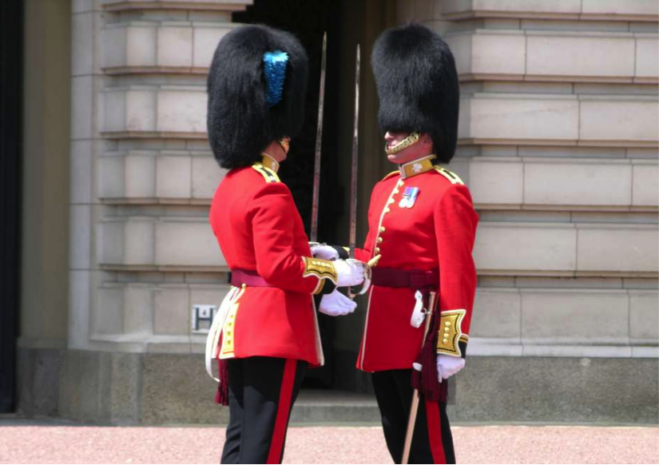
CREW CHANGE
Refer to Step 1
Continue to Follow Up & Provide Guidance and Training
This is a Continuous & Ever Lasting Cycle

Slide 9
EVIDENCE OF CREW CHANGE

Slide 10
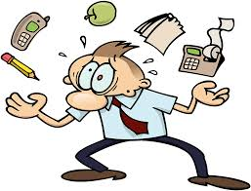
CREW OVERWHELMED
Patience and Persistence!
Build Relationships

Slide 11
Training Opportunities
Direct Contact with Ship Officers aboard Ships
Shipping Companies, Formal Training and Talks to Masters and Mates (Outreach)
Port Exchange and Coast Guard Quarterly Meetings (Outreach)
Merchant Marine Academies (Outreach)

Slide 12
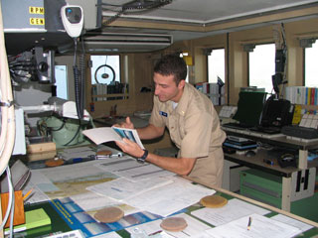
Where Do I Begin?
Crew Training, Direct Contact

Slide 13
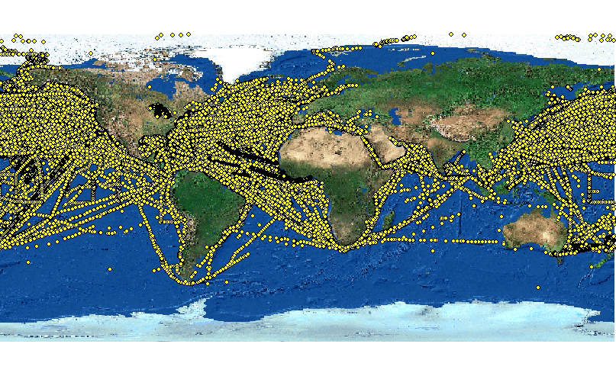
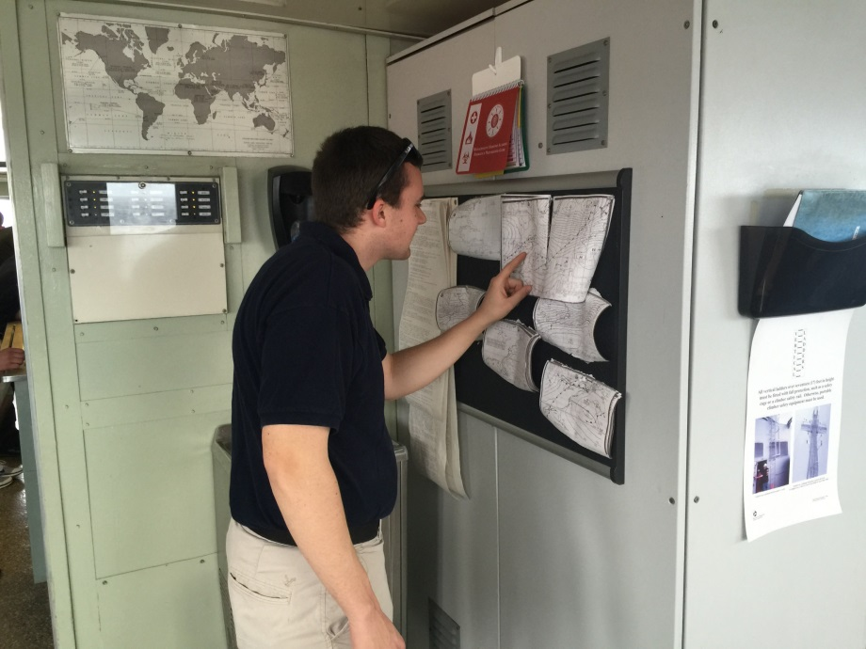
Introduction to VOS & The Big Picture
780 NM

Slide 14
Introduction to VOS Explain Their Relevance/Importance
Satellite Data
Ship Data
Model Data
Buoys
How Their Data Fits into The Big Picture

Slide 15
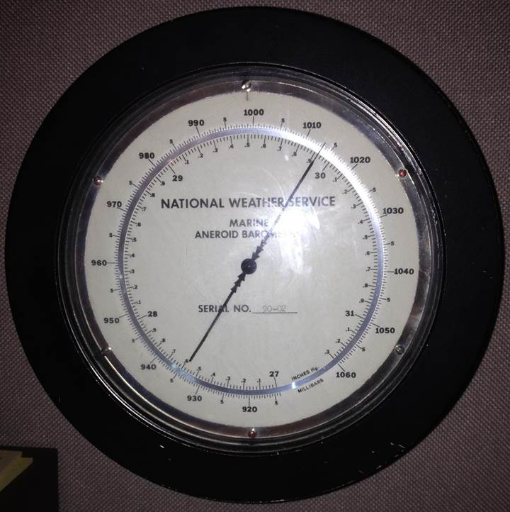
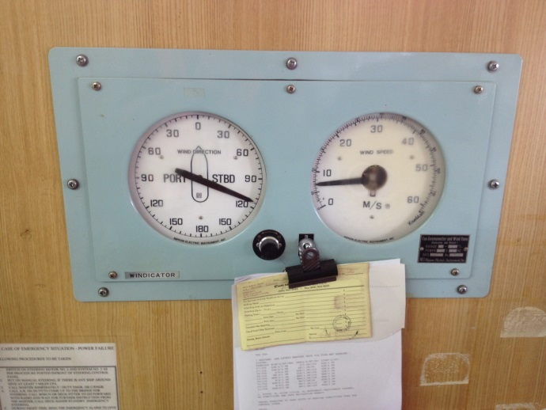
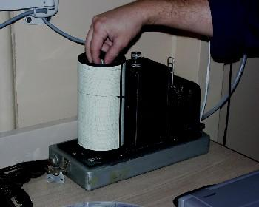
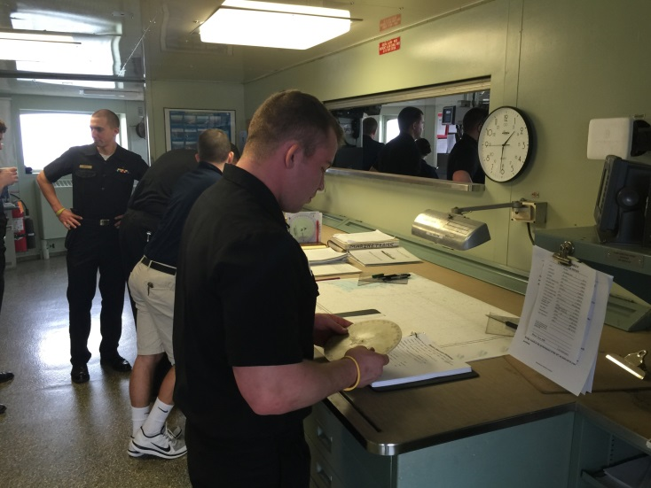
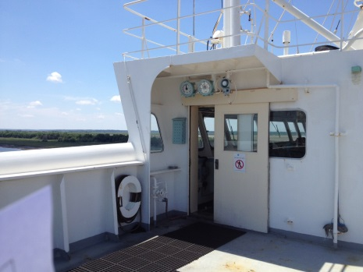
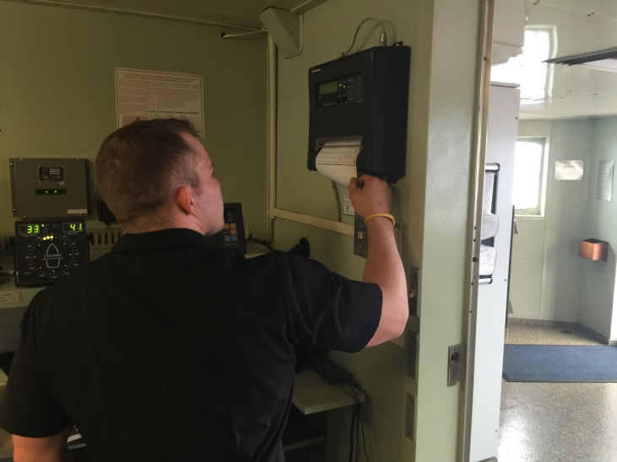
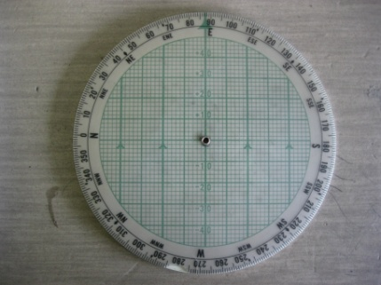
Proper Use of Instruments

Slide 16
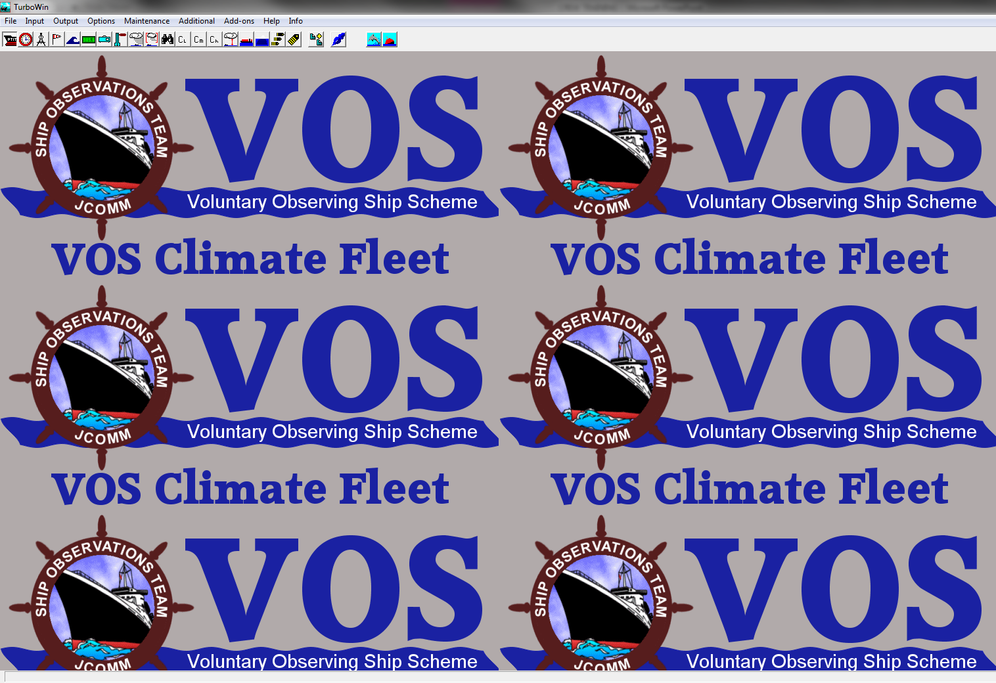
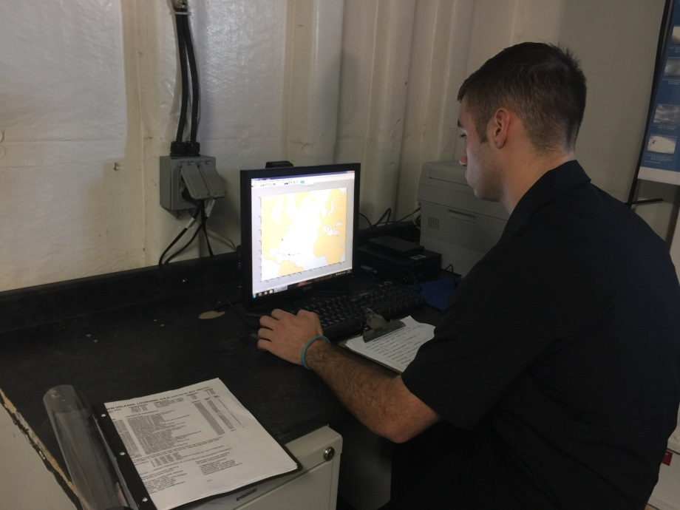
E-Logbook & Transmission Training

Slide 17
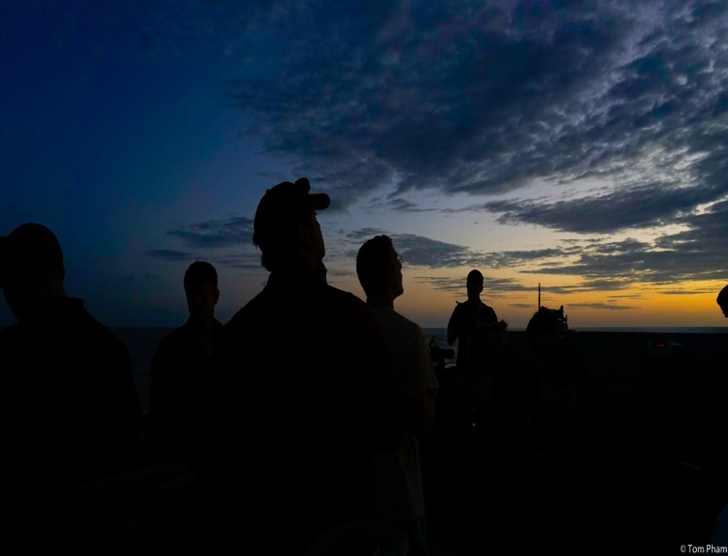
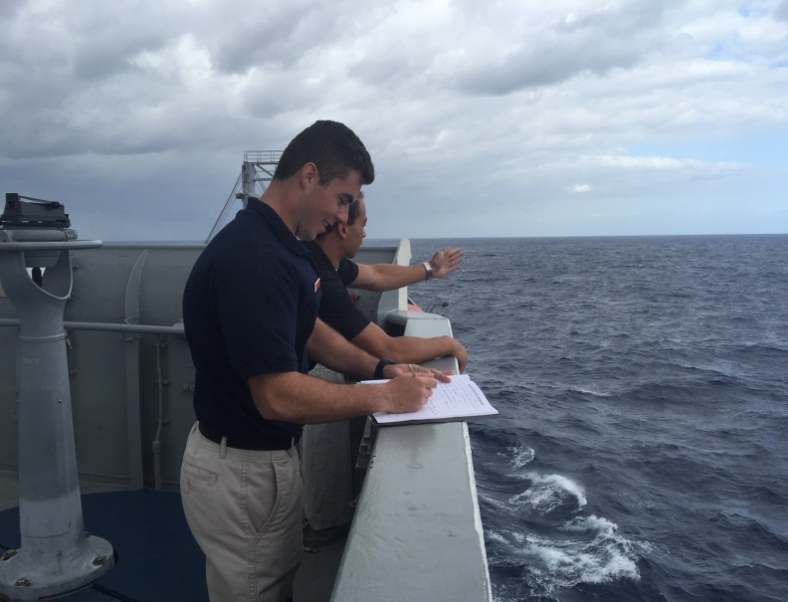
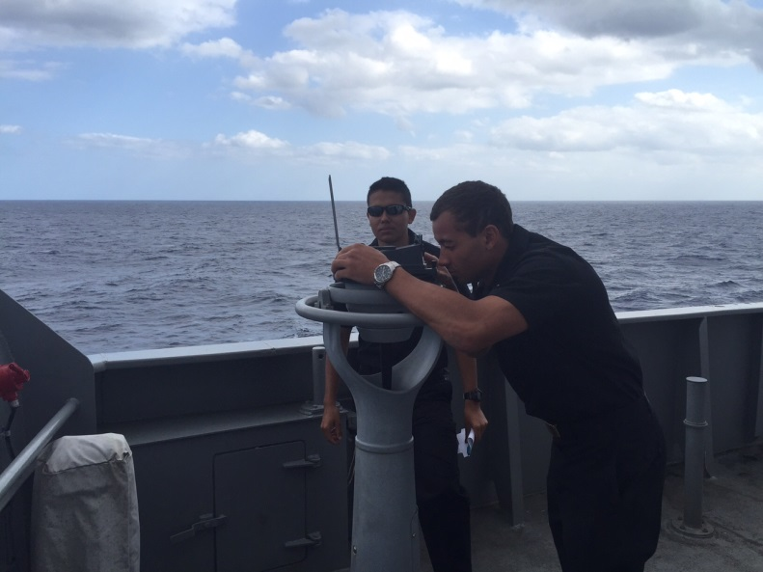
The Meteorological Observation

Slide 18
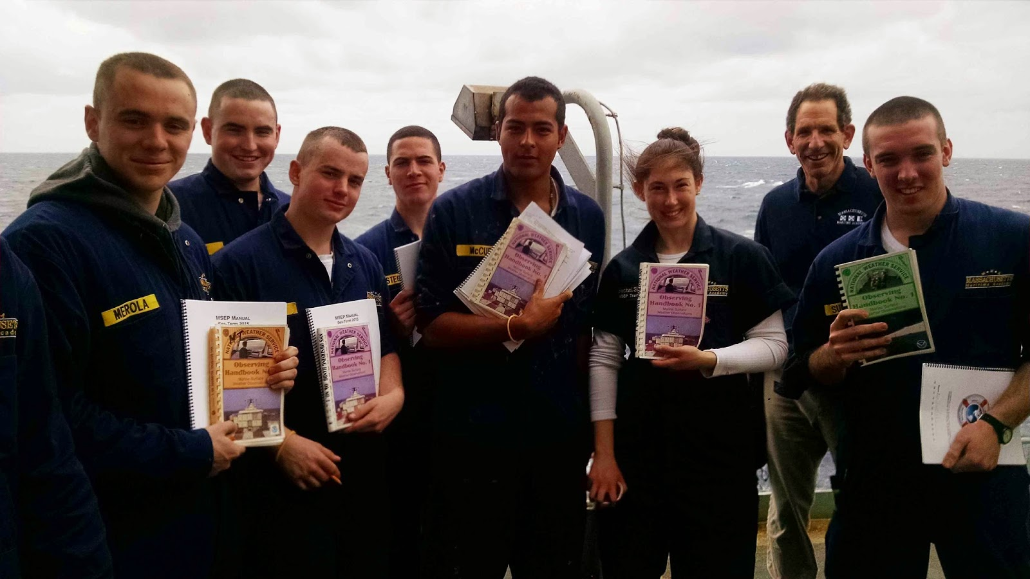
Training Aids

Slide 19
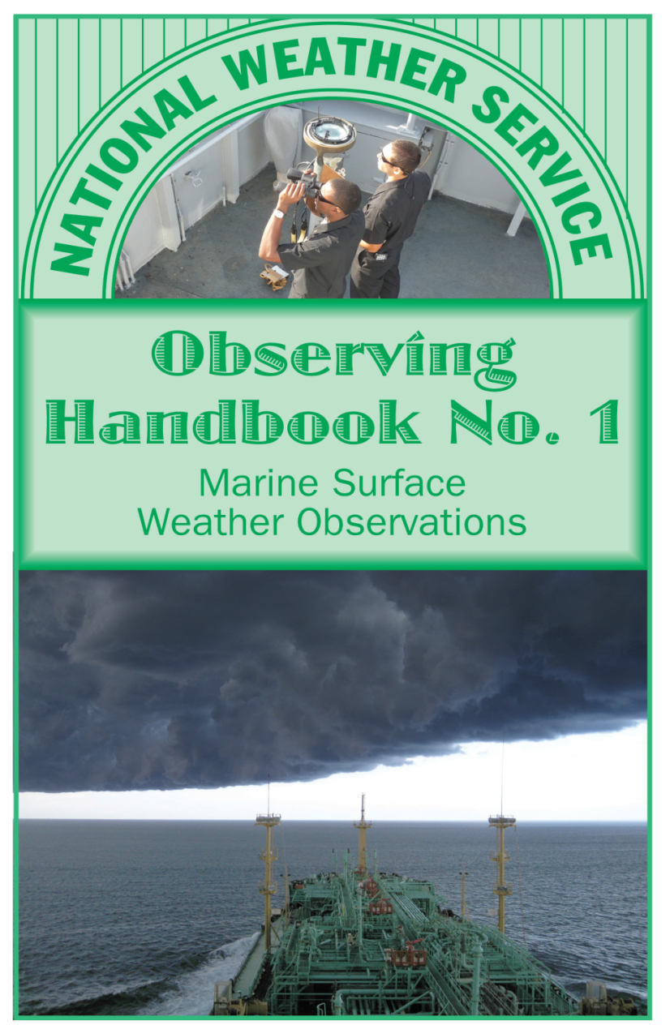
Training Aids Observing Handbook No. 1

Slide 20
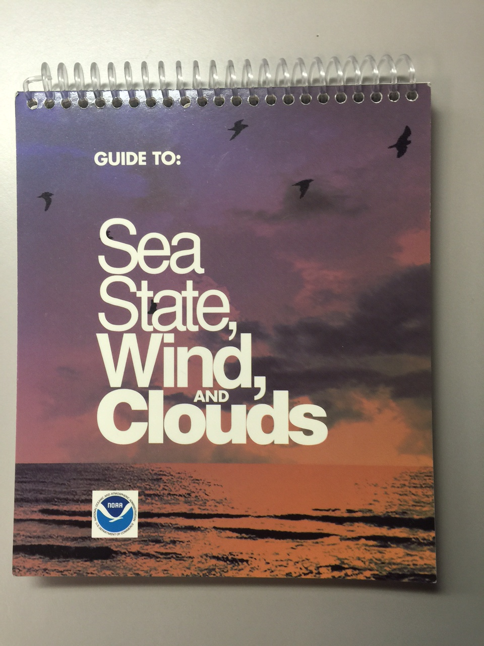
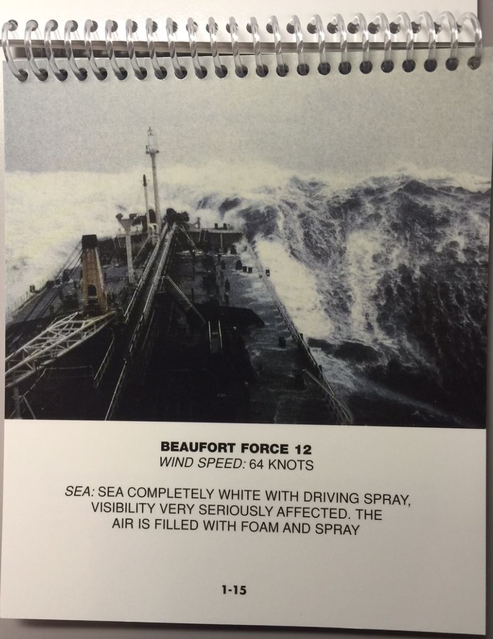
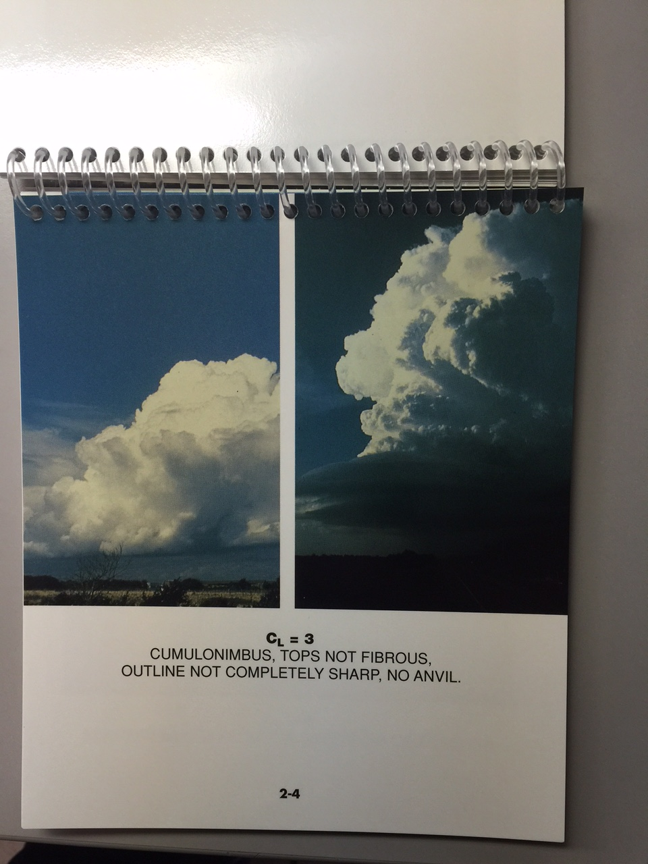
Training Aids Sea State, Wind, & Cloud Handbook

Slide 21
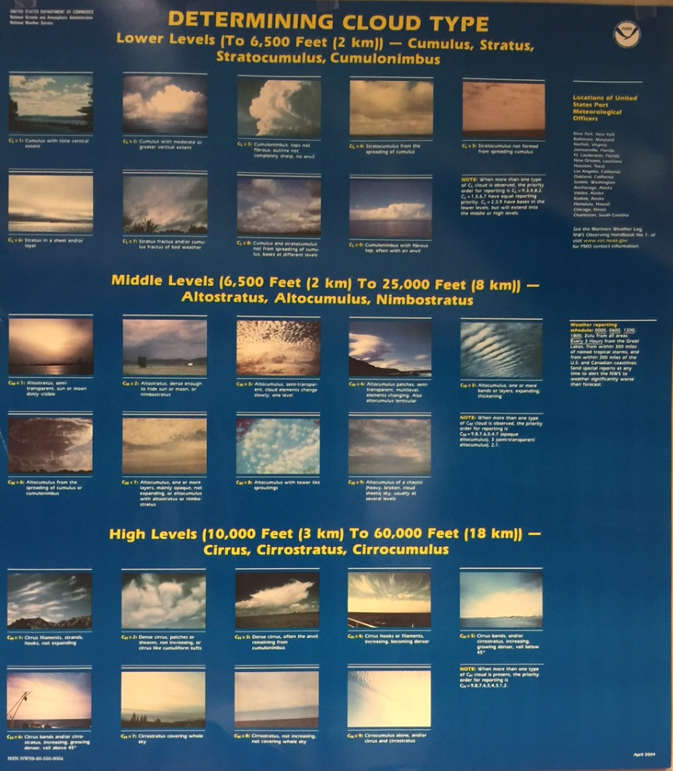
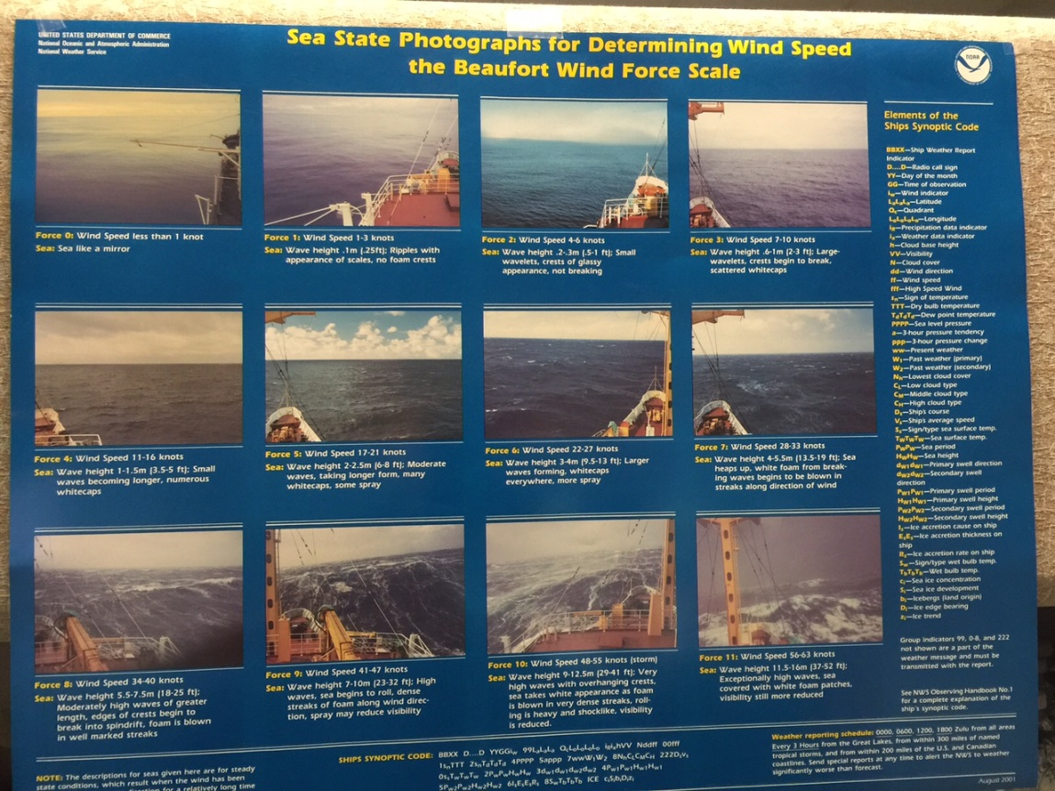
Training Aids Posters

Slide 22
Training Aids

Slide 23
Training Aids Evaluate and Provide Feedback

Slide 24
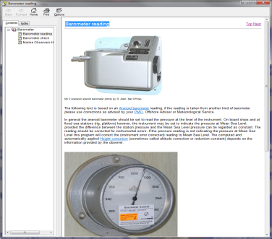
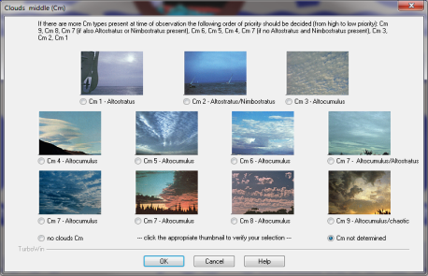
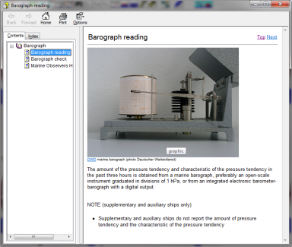
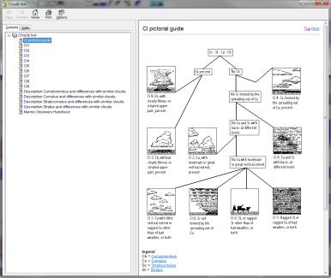
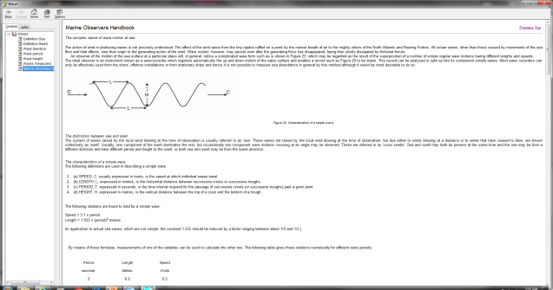
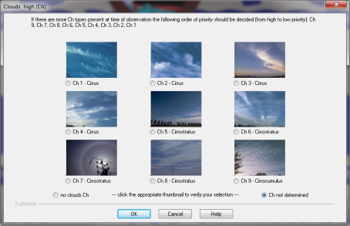
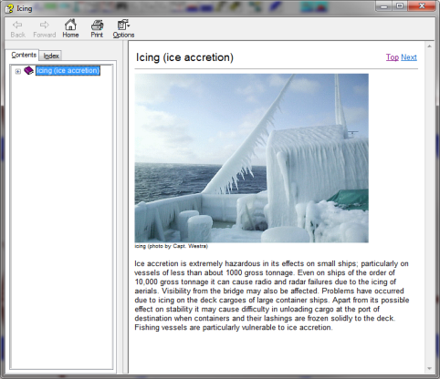
Training Aids TurboWin

Slide 25
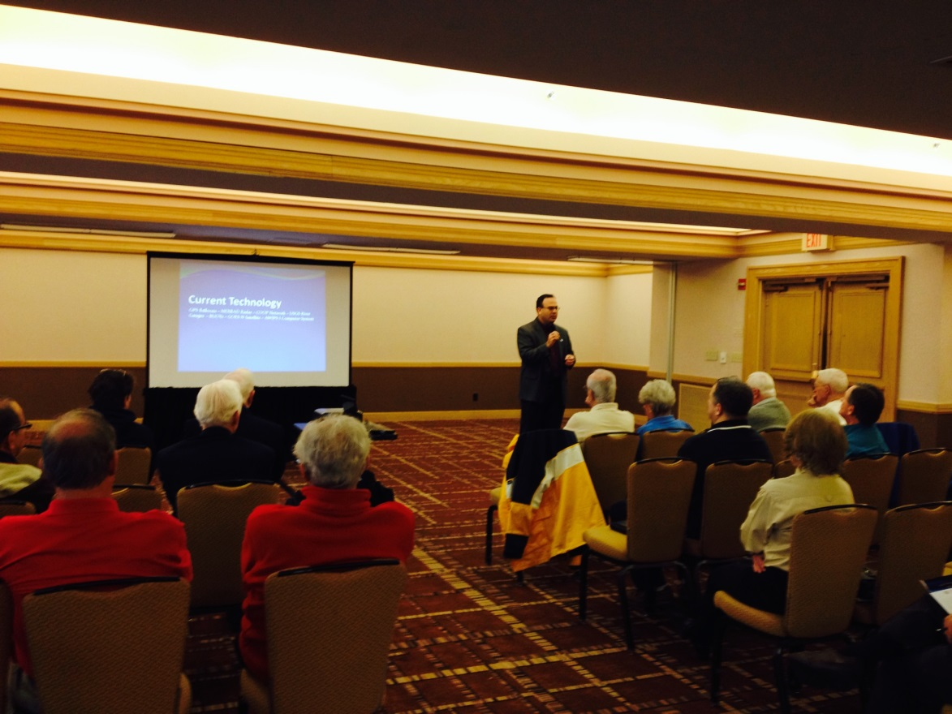
Presentations and Training to Shipping Companies, to Managers, Masters, Mates, Agents
Networking

Slide 26
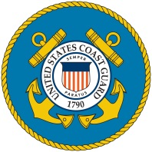
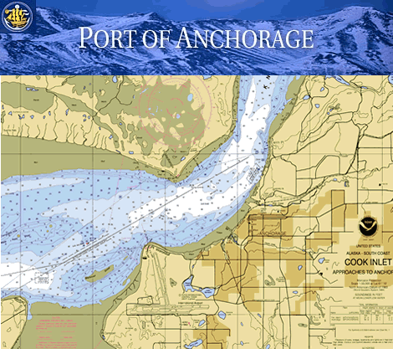
Port Exchange and Coast Guard Quarterly Meetings

Slide 27
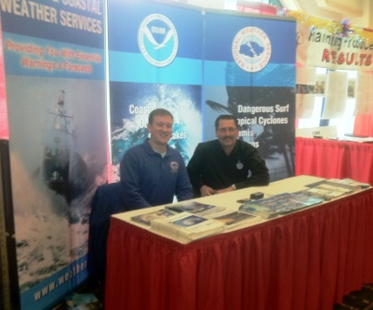
Networking Marine Tradeshows
Community Outreach

Slide 28
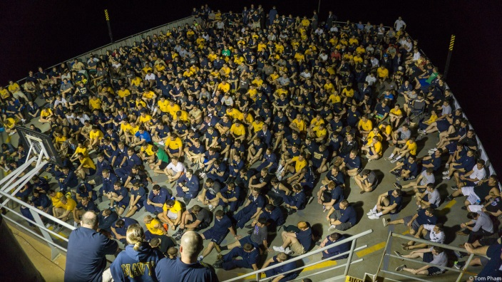
Merchant Marine Academy Training
Future Masters and Mates

Slide 29
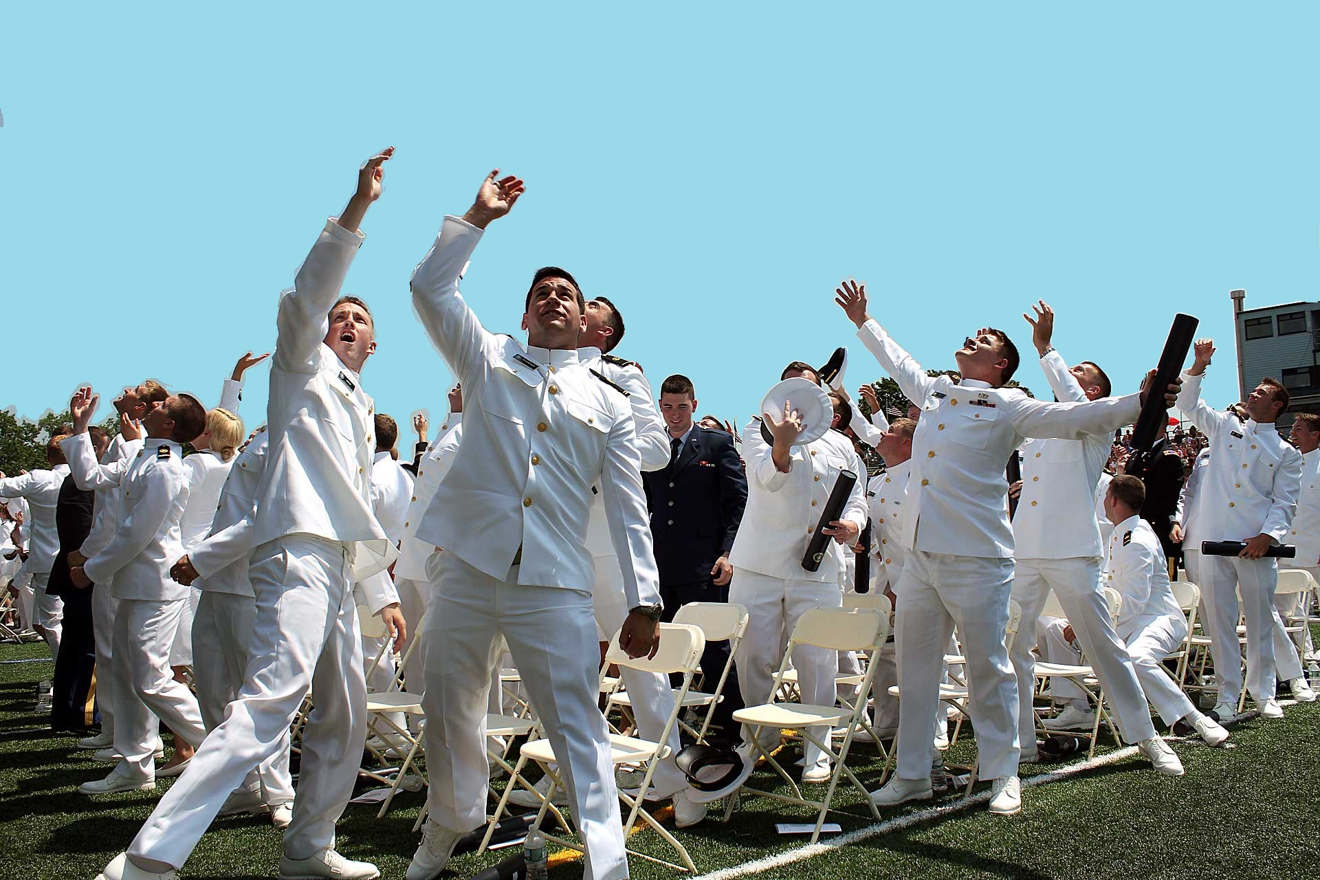
Merchant Marine Academy Training

Slide 30
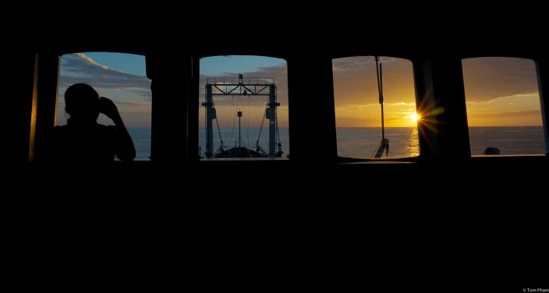

Slide 31
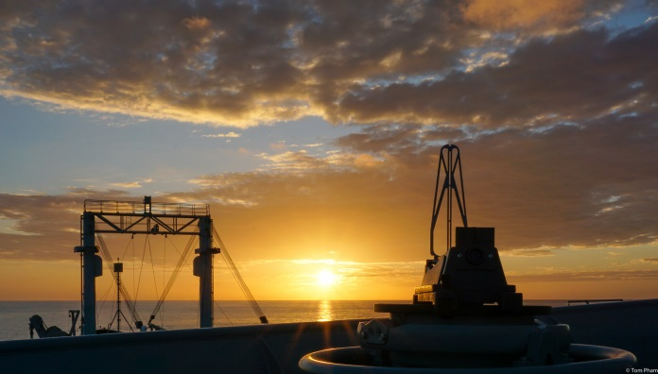
QUESTIONS

