Slide 1
Time Management
Working smarter to enhance productivity
Paula M. Rychtar
SOT Chair on the Task Team for Training
Deputy Program Manager, U.S. VOS

Slide 2
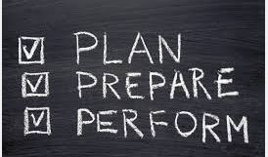
On site ship visits…
Be prepared!
Plan ahead!
Do proper investigation on your potential ship visits before you head out!
Examine your potential ships to be visited in your database to see what if anything needs top attention.
Checklists are great tools to help you stay on task and to help you “not forget”.
Is there a potential for a new recruit? Do you have the needed tools to provide to your new recruit? Will you have enough time to properly train them? Make a checklist!

Slide 3
What ships are in port today? …Before you head out the door…
Establish a list of ships scheduled to be in port within your area of responsibility.
Once you have a list of ships in port decide what ships within that list you would like/need to visit…
Are any of these ships in your VOS program?
Are any of these ships in ANY VOS program?
Are any of these ships sending in observations?
Is there a possibility to recruit a ship into VOS?
Make a list…Prioritize this list!

Slide 4
Being more effective: the benefits of Checklists…
Pilots use them
Doctors use them
Nurses use them
Surgeons use them
PMO’s use them
Why do checklists work?
Because it is easy to forget things. Using checklists
Ensures that you won’t forget anything.

Slide 5
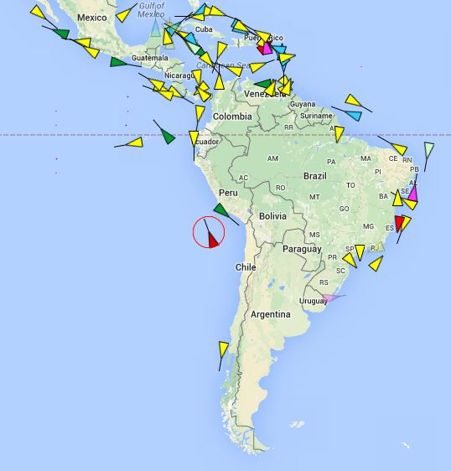
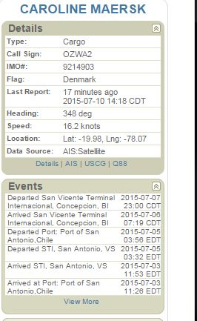
A good indication that this ship needs a visit…
This ship was on your list “to be visited”…do a check in the database to see what you need to do.
This is what you found…
*Active US VOS Ship,
*Seattle USA PMO
*sending 5 observations per day.
*No recent visits,
And is in need of a PMO visit.

Slide 6
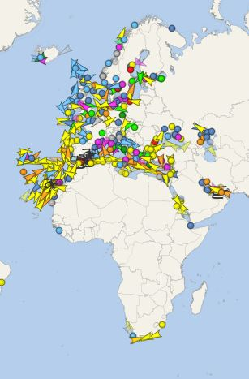
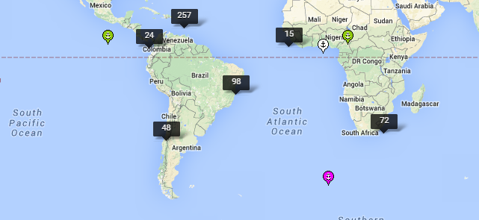
Tip: Many free available websites to find ships in port…
Vessel Finder…
https://www.vesselfinder.com/
Ship Finder…
http://shipfinder.co/

Slide 7
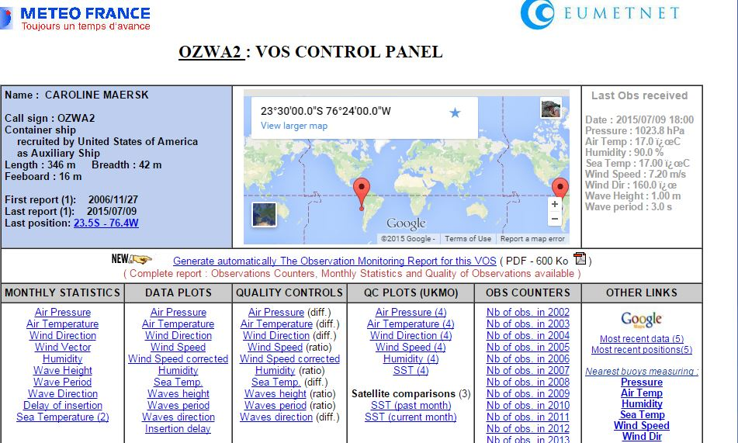
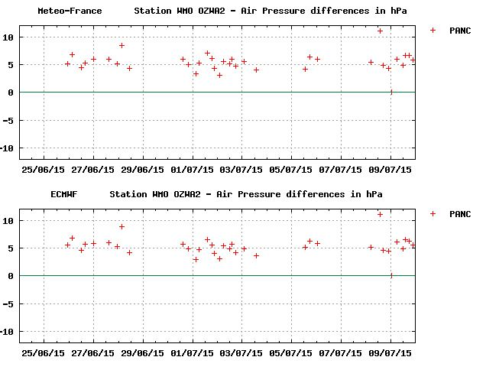
What does this ship need?
Is the ship in VOS and sending obs? INVESTIGATE!
Yes…are they of good quality? QC using available tools…
Can you help them with data quality issues?
No…how can you help them get motivated again?

Slide 8
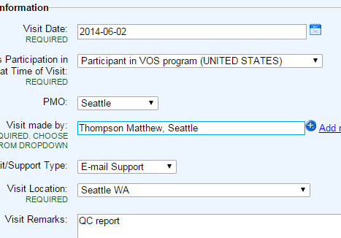
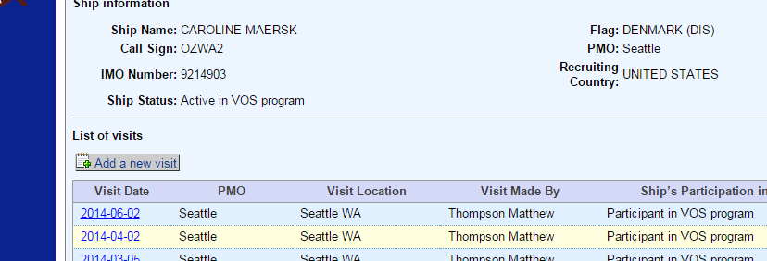
Does this ship no longer visit your local port? PMO Collaboration…
No? Maybe this ship would be better served by a country that can provide on site PMO visits to establish good quality observations and proper support?

Slide 9
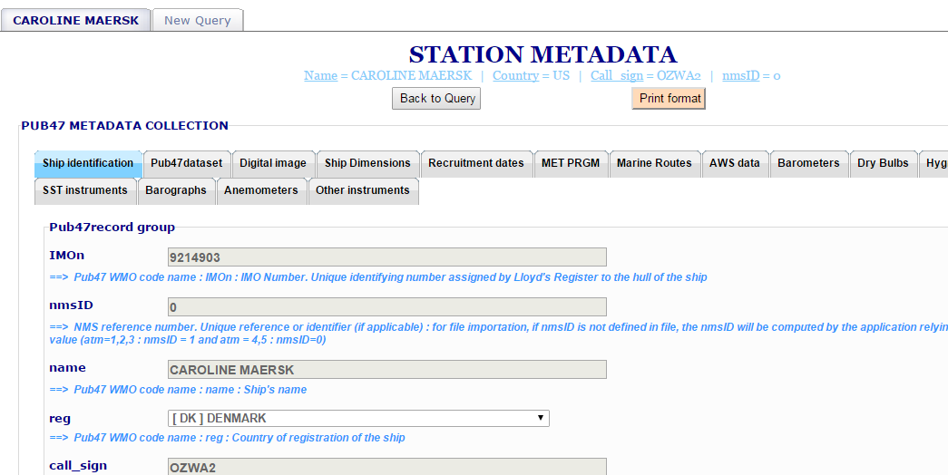
Does this ship have all the metadata?

Slide 10
Remembering everything…
Checklist, checklist, checklist….
Crew training
Ship inspections
Collection of metadata
Software updates
Installing AWS
Quality control
Support and services that we provide for ships
Following procedures to be compliant

Slide 11
Time Management…
Conclusion…
The most important part of your day is the time you take to schedule your day.
Results…
Less stress
Increased efficiency
Increased productivity
The satisfaction of knowing that you provided the best support possible to your VOS ships.

