Slide 1
Sustainable ISO Certification
Compiled and Presented by: Mardené de Villiers
South African Weather Service

Slide 2
Index
What is ISO certification
ISO 9000 family – Quality Management
Where PMO implement TQM
Standard Operation Procedures
Verification Form
Maintenance Schedule
Buoy Deployment Form
Group Leader Report
Training Evaluation Form
Implement Total Quality Management as PMO

Slide 3
What is ISO certification
ISO is an independent, non-governmental membership organization and the world's largest developer of voluntary International Standards.
ISO develop International Standards, such as ISO 9001 and ISO 14001, but are not involved in their certification, and do not issue certificates. This is performed by external certification bodies, thus a company or organization cannot be certified by ISO.
ISO management system standards provide a model to follow when setting up and operating a management system.
Different management system standards are:
ISO 50001 - Energy management
ISO 14000 family - Environmental management
ISO 9000 family - Quality management
ISO 22000 - Food safety management
ISO/IEC 27001 - Information security management
ISO 20121 - Sustainable events management

Slide 4
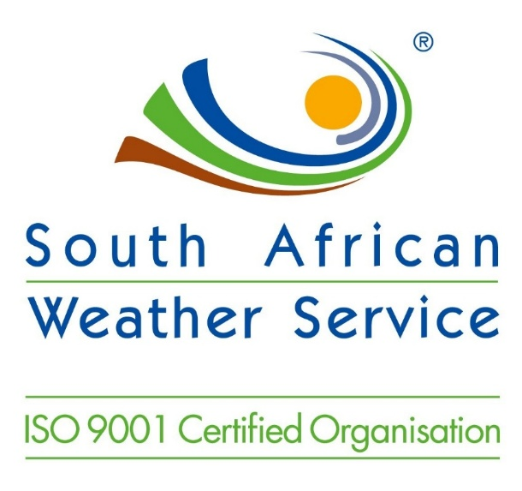
ISO 9000 family - Quality management
ISO 9001:2008 - sets out the requirements of a quality management system
Using ISO 9001:2008 helps ensure that customers get consistent, good quality products and services, which in turn brings many business benefits.
How does this influence me as a Port Meteorological Officer

Slide 5
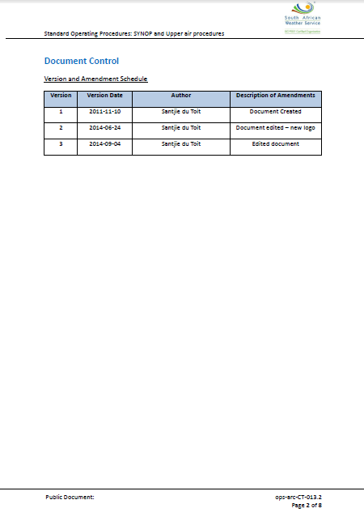
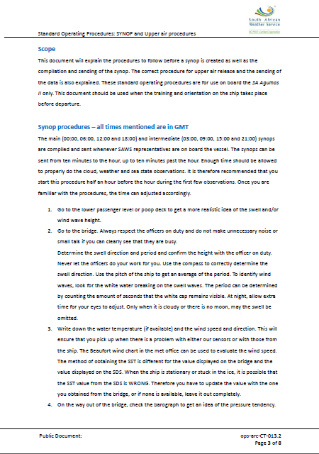
Standard Operation Procedures (SOP)

Slide 6
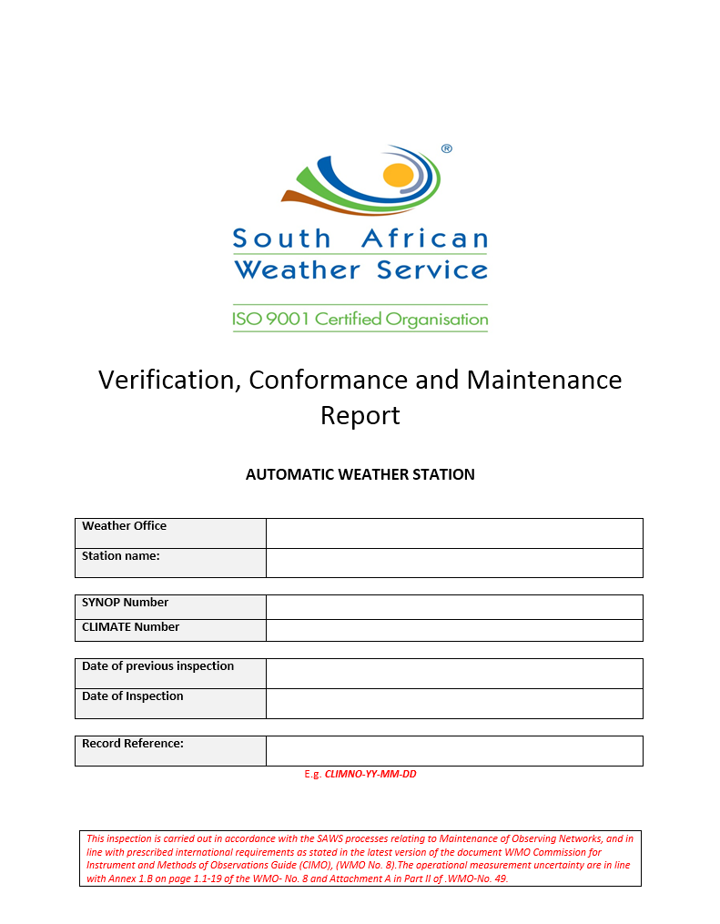
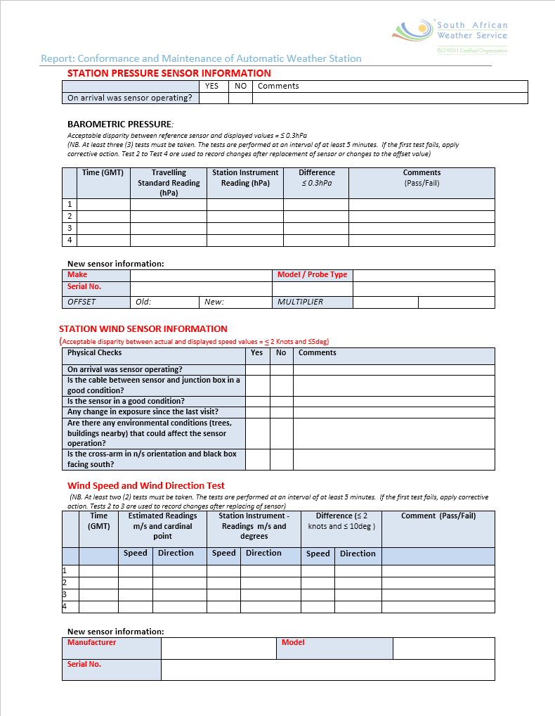
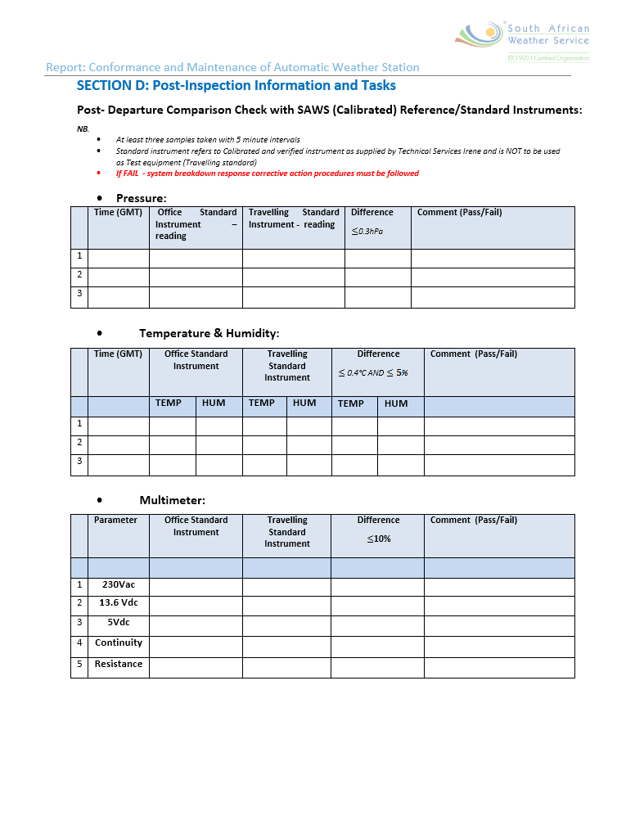
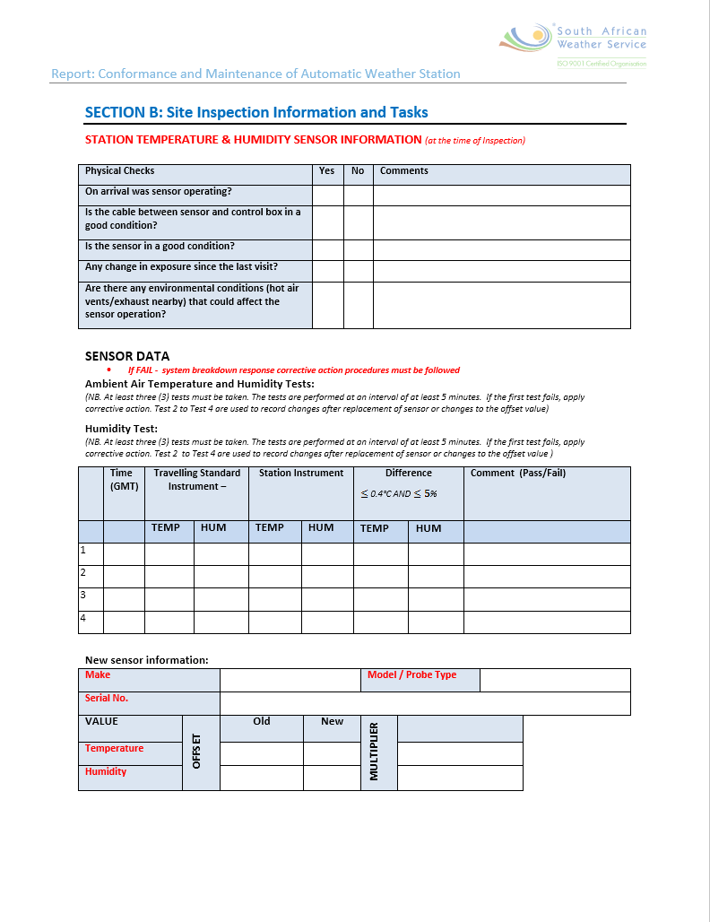
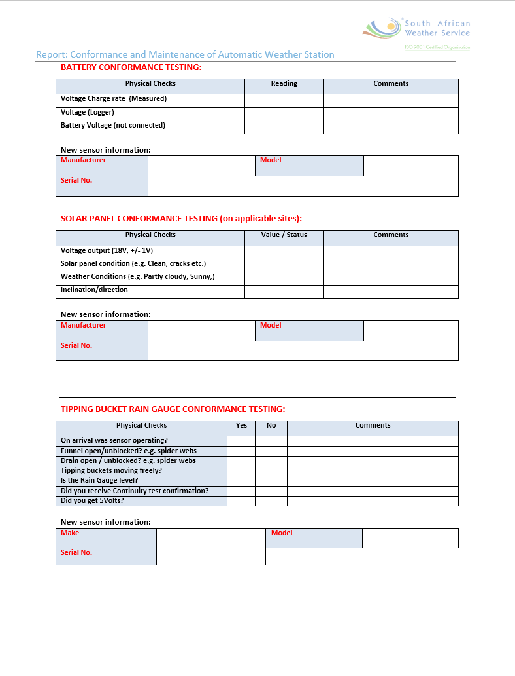
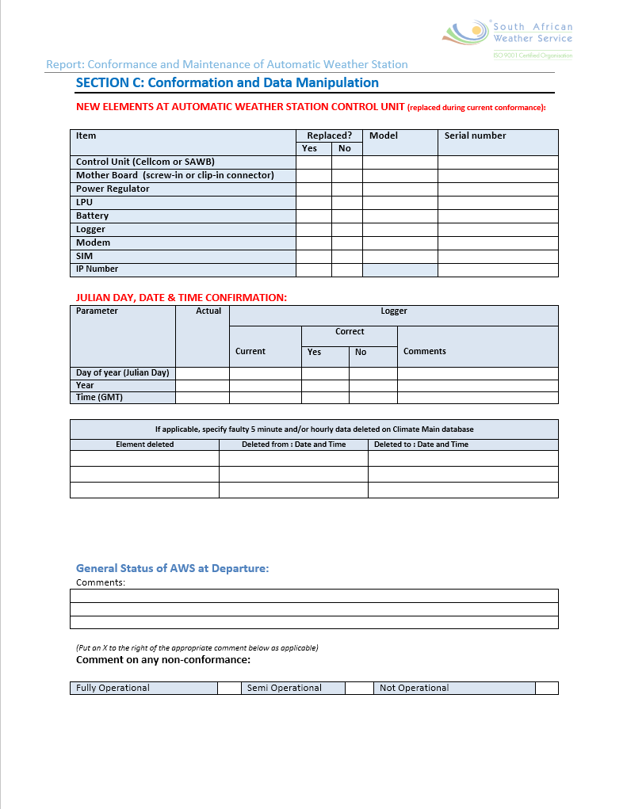
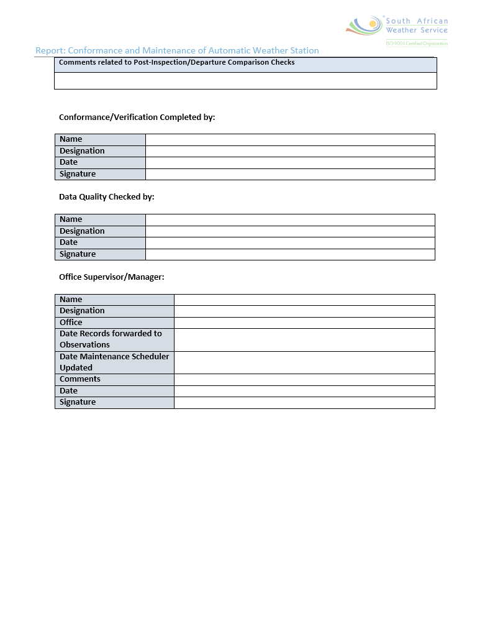
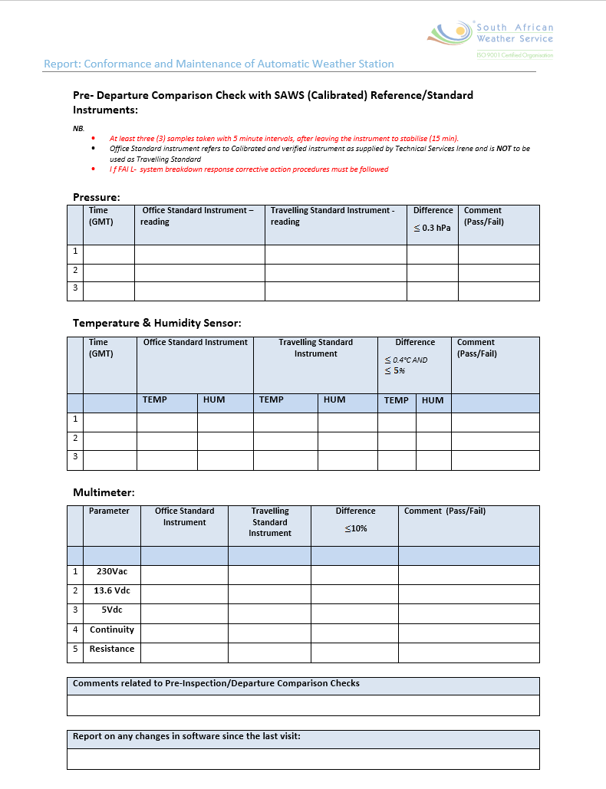
Verification forms

Slide 7
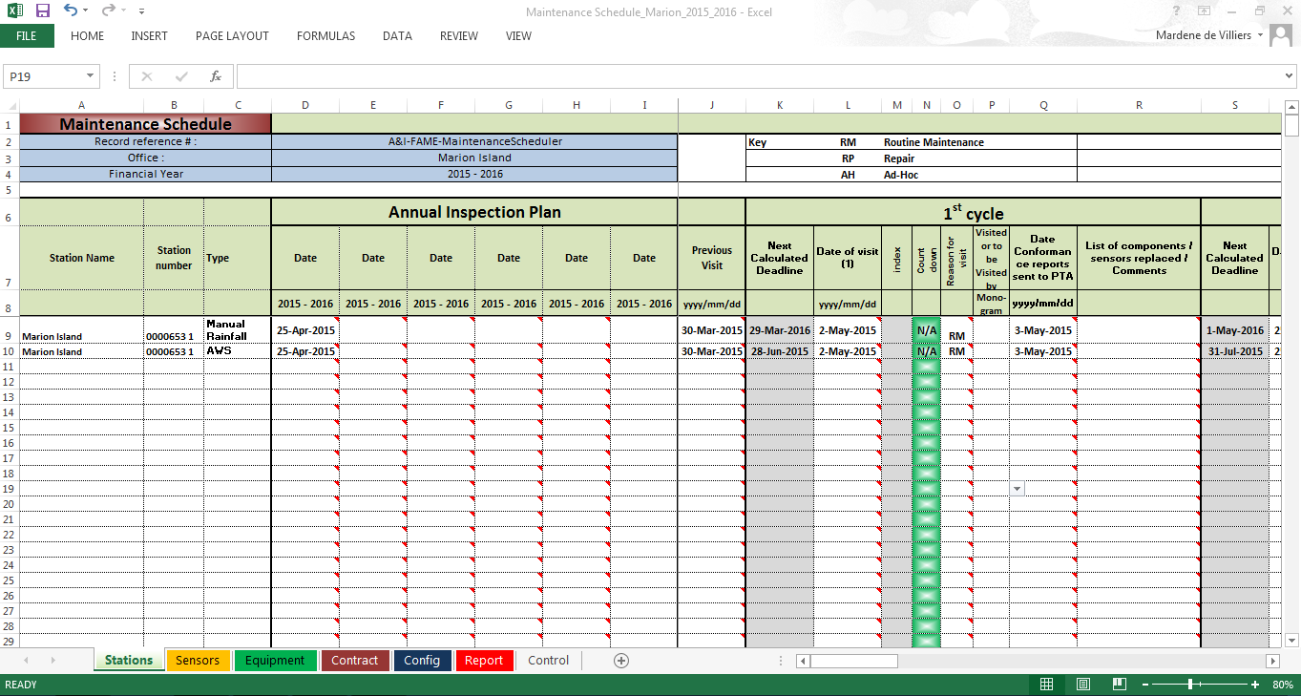
Maintenance Schedule

Slide 8
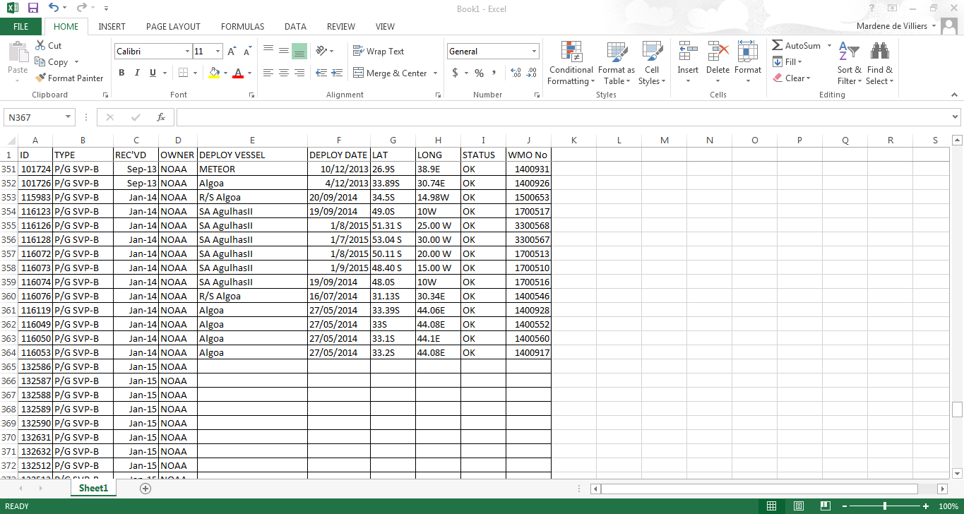
Buoy Deployment Form

Slide 9
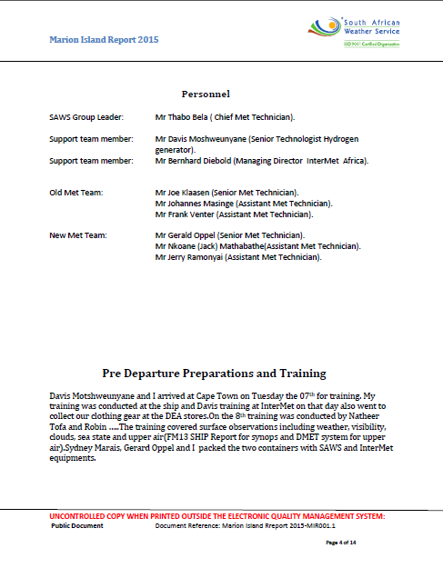
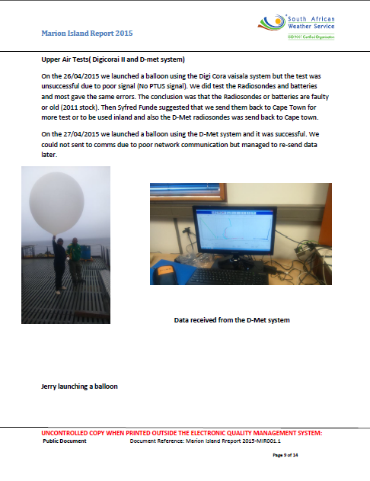
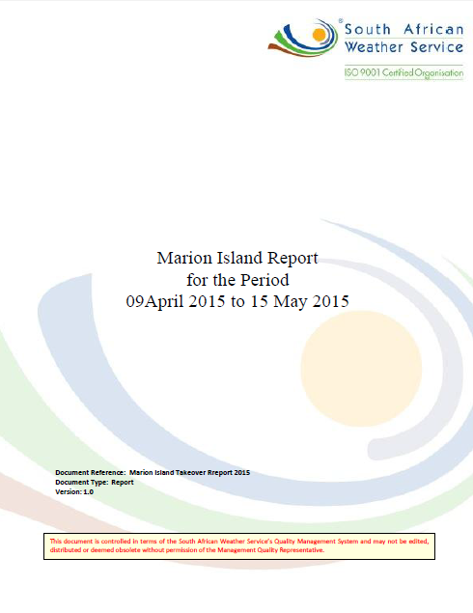
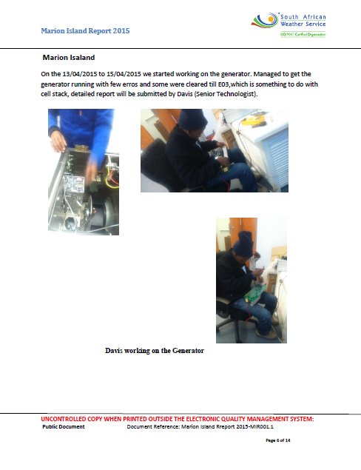
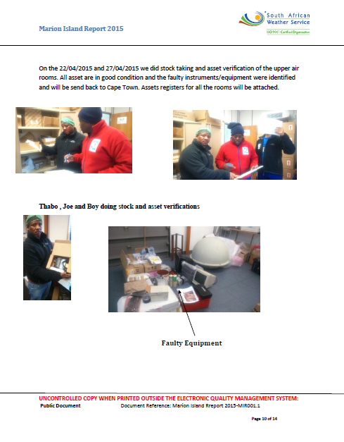
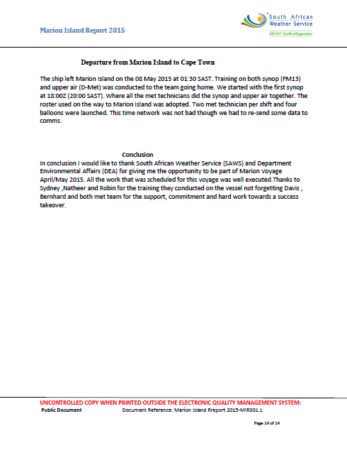
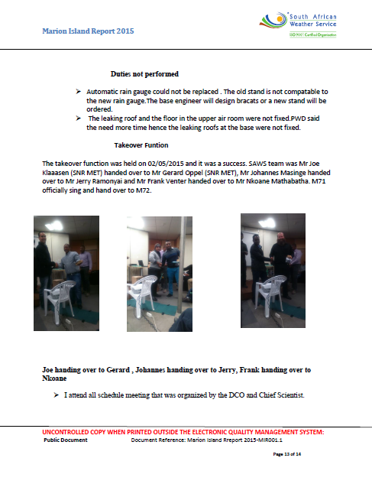
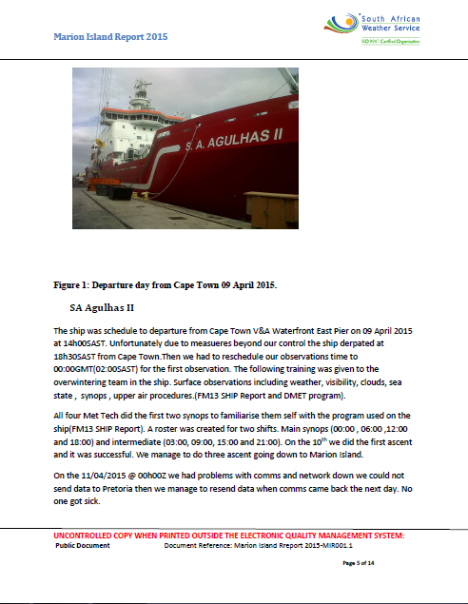
Group Leader Report

Slide 10
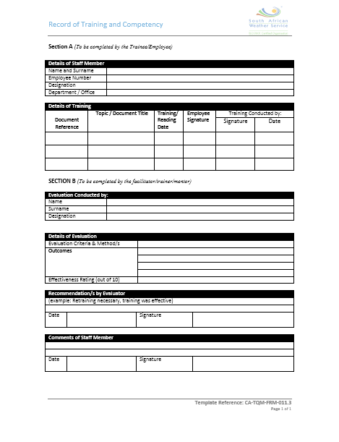
Training Evaluation Form

Slide 11
Sustainable ISO certification as a PMO by up keeping good Quality Management

