Slide 1
WMO Technical Regulations relevant to Port Meteorological Officers
Fifth International Workshop of Port Meteorological Officers (PMO-5)
(Viña del Mar, Chile, 20-24 July 2015)
(Etienne Charpentier, WMO Observing Systems Division)

Slide 2
WMO Technical Regulations
WMO Provisions
Regulatory
Standard practices and procedures (SPP)
Binding for Members (use of “shall”)
Have status of requirements in a Resolution
Recommended practices and procedures (RPP)
Non-binding for Members (use of “should”)
Have status of recommendation (highly desirable)
Non-regulatory
Practices, procedures and specifications
Appear in WMO Guides
Hierarchy of publications
Technical Regulations (SPPs & RPPs) approved by Congress
Manuals (annexes to Technical Regulations) (SPPs & RPPs) approved by Congress
Guides (non-regulatory) approved by Executive Council
Other publications (non-regulatory) approved by Technical Commissions etc.

Slide 3
WMO Publications relevant to PMO activities
WMO No. 49, Technical Regulations
Manual on WIGOS (new)
WMO No. 544, Manual on the GOS
WMO No. 488, Guide to the GOS
WMO No. 8, Guide to Meteorological Instruments and Methods of Observation (CIMO Guide)
WMO No. 558, Manual on Marine Meteorological Services
WMO No. 471, Guide to Marine Meteorological Services
WMO No. 47,

Slide 4
WMO No. 49 – Technical Regulations
Volume I – General Meteorological Standards and Recommended Practices
Part I is on WIGOS … GOS, GAW, WHOS, GCW
Volume II – Meteorological Service for International Air Navigation
Volume III – Hydrology
Volume IV – Quality Management
Annexes
WMO No. 407, International Cloud Atlas
WMO No. 306, Manual on Codes
WMO No. 386, Manual on the GTS
WMO No. 485, Manual on the GDPFS
WMO No. 544, Manual on the GOS
WMO No. 558, Manual on Marine Meteorological Services
WMO No. 2060, Manual on the WMO Information System (WIS)
WMO No. 1083, Manual on the Implementation of Education and Training Standards in Meteorology and Hydrology
New: Manual on WIGOS

Slide 5
Manual on WIGOS
Introduction, Definitions
Introduction to WIGOS
Common Attributes of WIGOS Component Systems
Requirements
Design, Planning and Evolution
Instrumentation and Methods of Observation
Members should ensure that observations and observational metadata are traceable to International Standards (SI), where these exist
Members should employ properly calibrated instruments and sensors that provide observations satisfying at least measurement uncertainties that meet the specified requirements
Operations
Observational Metadata
Members shall make available internationally and without restriction, those mandatory and conditional (whenever the condition is met) observational metadata supporting observations that are made available internationally
Quality Management
Capacity Development
3-7 Attributes specific to the Surface-based, Space-based, GOS, GAW, WHOS, GCW components of WIGOS

Slide 6
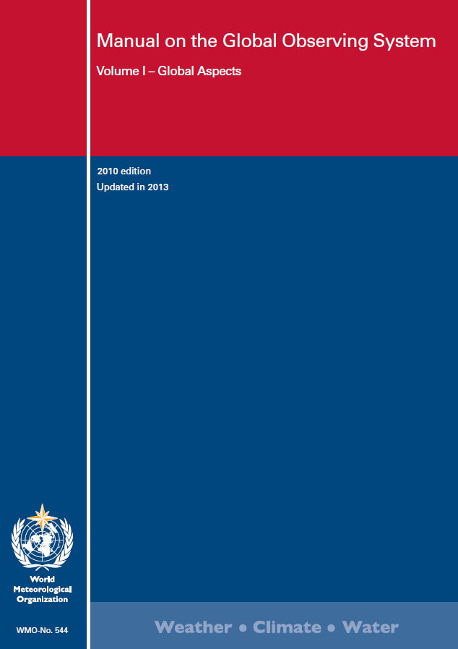
WMO No. 544 – Manual on the Global Observing System (GOS)
Introduction
General Principles Regarding the Organization and Implementation of the GOS
Requirements for observational data
Surface-based sub-system
Composition of the sub-system (... 2.3.3 sea stations, 2.7 Research and special purpose vessels)
Members shall recruit as mobile ship stations as many ships as possible that traverse data-sparse areas and regularly follow routes through areas of particular interest
Implementation of elements of the sub-system
Equipment and methods of observation
Space-based sub-system
Quality Control
Appendix - Definitions
https://drive.google.com/file/d/0BwdvoC9AeWjUV2dIQmlSUkpOYm8/edit?pli=1

Slide 7
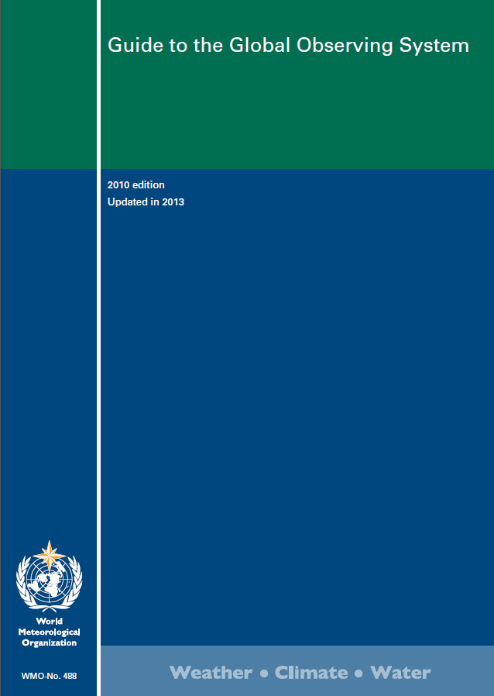
WMO No. 488 – Guide to the Global Observing System (GOS)
Introduction
Purpose, scope, requirements and organization of the GOS
Observational data requirements
The surface-based sub-system
3.2 Surface synoptic stations
3.2.1 Organizational aspects
3.2.1.3 Sea stations
Ocean weather stations, lightship, island and coastal stations, mobile sea stations (VOS) => Ref. to WMO No. 558, 471
Criteria for recruiting ships, collection of metadata (WMO No. 47)
3.2.2 Observations/measurements
3.2.2.3 Observations at sea stations
present/past weather, wind, clouds, visibility, T, U, P, SST, waves & swell, ship’s course & speed, sea-ice, special phenomena
The space-based sub-system
Reduction of Level 1 data
Data quality control
Monitoring the operation of the GOS
quality management
Annex - Acronyms
https://a0e4eb4f5e8798db398ea7bb58a9de4a6e0b4480.googledrive.com/host/0BwdvoC9AeWjURlFWdC1qSzRNdkE/wmo_488-2013_en.pdf

Slide 8
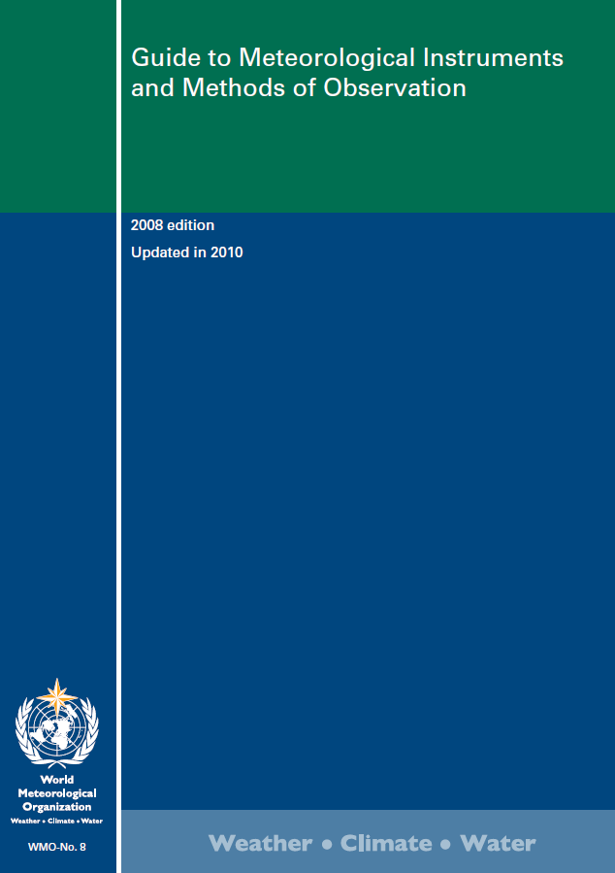
WMO No. 8 – Guide to Meteorological Instruments and Methods of Observation (CIMO Guide)
Measurement of Meteorological Variables
Meaurement of air temperature, atmospheric pressure ...
Observing Systems
1 Measurements at AWS
Marine observations
4.2 Observations from ships (17 pages)
Quality Assurance
1 Quality management
2 Sampling meteorological variables
3 Data reduction
4 Testing, calibration and intercomparison
5 Training of instrument specialists
http://www.wmo.int/pages/prog/www/IMOP/publications/CIMO-Guide/Provisional2014Edition.html

Slide 9
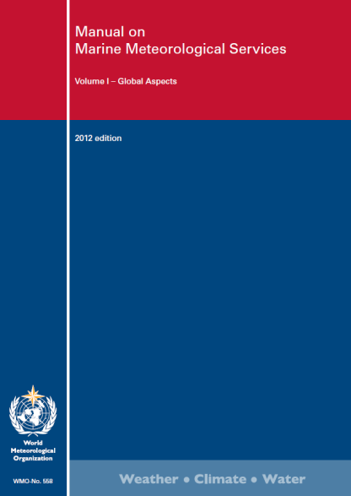
WMO No. 558 – Manual on Marine Meteorological Services
Volume I – Global aspects
Introduction
Part I Services for the high seas
GMDSS, Search and rescue
Provision of information by radio facsimile
Marine Climatological Summaries Scheme
Special marine climatological information
Provision of marine meteorological and expert advice
Appendices (Metareas, terms, Beaufort scale, symbols for facsimile, MCSS areas, IMMT format, MQCS
Part II Services for coastal and offshore areas
Part III Services for Main Ports and Harbour Areas
(General and specialized services, principles and procedures e.g. bulletins, briefing, observations …)
Marine meteorological services for main ports and harbor areas shall preferably be provided by forecasting officers located in port by the Port Meteorological Officer (PMO) or, if this is not possible, by a forecasting office located outside the port
Part IV Training in the field of marine meteorology
The objective of the meteorological training of a PMO is to keep up to date his knowledge of the principles and organization of meteorological forecasting for the marine environment, the use of marine meteorological instruments and methods of observing onboard ship, the use of codes and meteorological logbooks, as well as the procedures for recording and transmitting observations
Volume II – Regional aspects
www.jcomm.info/558

Slide 10
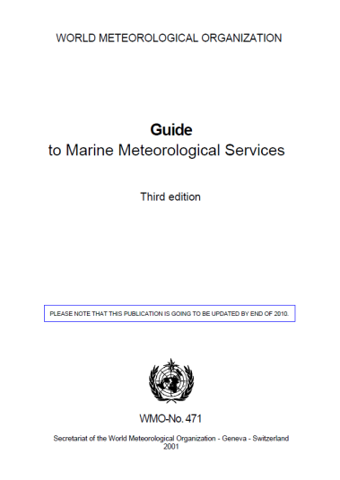
WMO No. 471 – Guide to Marine Meteorological Services
www.jcomm.info/471
Foreword, Introduction
Marine Meteorological Services
1.4.8 – Port Meteorological Officers (PMOs)
PMOs fulfil a highly important role in the liaison between NMSs and the shipping community. Their functions are truly international in nature- wherever a ship may find itself in the world, it must be able to obtain the assistance it needs to serve as a meteorological observing station, and also must be able to obtain the information about the marine meteorological services available in the country, region or abroad. International coordination is arranged by WMO.
Marine Meteorological Services for the High Seas
Marine Climatology
Marine Meteorological Services for Coastal and Offshore Areas
Marine Meteorological Services for Main Ports and Harbour Areas
5.4.1 – Port Meteorological Officers (PMOs) activities
The main functions of the PMO are concerned with assistance to the WMO Voluntary Observing Ships’ Scheme … the duties are described in Chapter 6 of this Guide.
The WMO Voluntary Observing Ship's Scheme
Training in Marine Meteorology
Appendices (list of selected publications, international marine affairs, acronyms)

Slide 11
JCOMM-4 updates of WMO No. 558 – Manual on Marine Meteorological Services
WMO No. 558, Volume I, Part I
Section 2: Dissemination of MSI on the GTS; role of the METAREA Coordinator; information on ice-edge being part of MSI for GMDSS
Section 5: Optional preparation of Marine Climatological Summaries Scheme by the Responsible Members
Section 6: Reference to Centres for Marine Meteorological and Oceanographic Climate Data (CMOCs)
Appendices I.2, I.8, I.11, I.12, I.15, I.15, I.17, I.20 (e.g. IMMT-5, MQCS-7)
WMO No. 558, Volume I, Part II
Warnings for tropical cyclones, gales & storms, ice accretion, restricted visibility, unusual and hazardous sea-ice conditions, storm induced water-level changes

Slide 12
JCOMM-4 updates of WMO No. 471 – Guide to Marine Meteorological Services
Chapter 3, Marine Climatology
IMMT-5 and MQCS-7
http://www.jcomm.info/index.php?option=com_oe&task=viewDocumentRecord&docID=4714
Chapter 6, the VOS Scheme
SOT update
http://www.jcomm.info/index.php?option=com_oe&task=viewDocumentRecord&docID=6423

Slide 13
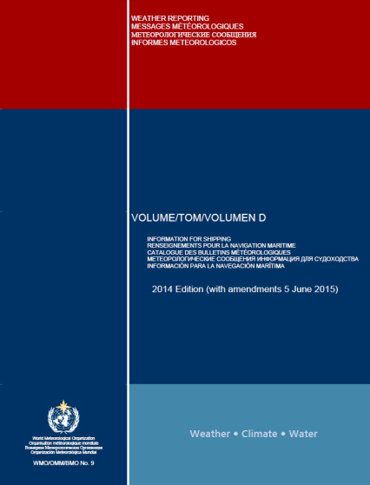
WMO No. 9, Volume D, Information for Shipping
http://www.wmo.int/pages/prog/www/ois/Operational_Information/VolumeD/VolumeD.pdf
Chapter 1 – GMDSS (METAREAS, Satellite and terrestrial communication systems)
Chapter 2 – MSI Broadcast Service (Satellites, NAVTEX, HF NBDP, Radio-Facsimile)
Chapter 3 – Visual Storm Warning Signals
Chapter 4 – Focal Point Contact Information
Part A – GMDSS Marine Broadcast Systems
Part B – Ship Weather Routeing Services and PMOs
JCOMM-4 update:
The list of Inmarsat C Land Earth Stations (LES) accepting code 41 messages is maintained by the JCOMM Ship Observations Team (SOT) and provided on the WMO website at:
http://www.wmo.int/inmarsat_les

Slide 14
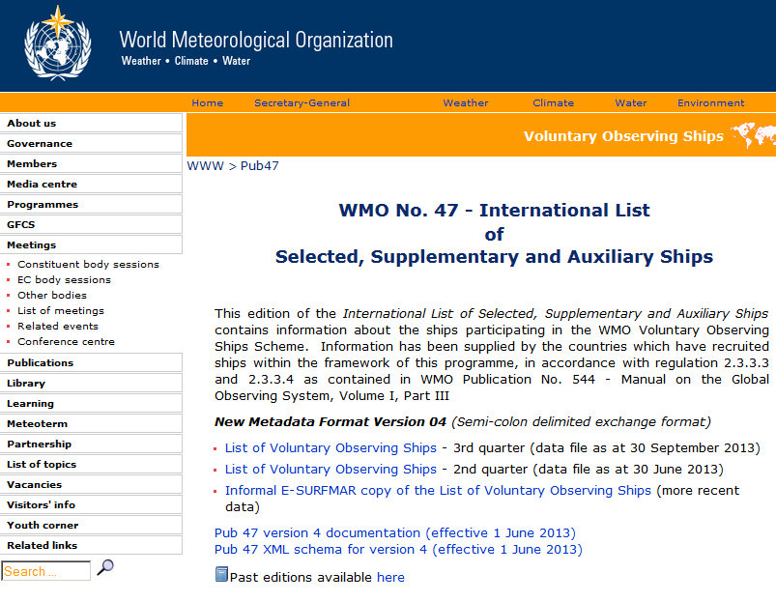
WMO No. 47 – International List of Selected, Supplementary and Auxiliary Ships
http://www.wmo.int/pages/prog/www/ois/pub47/pub47-home.htm

