Slide 1
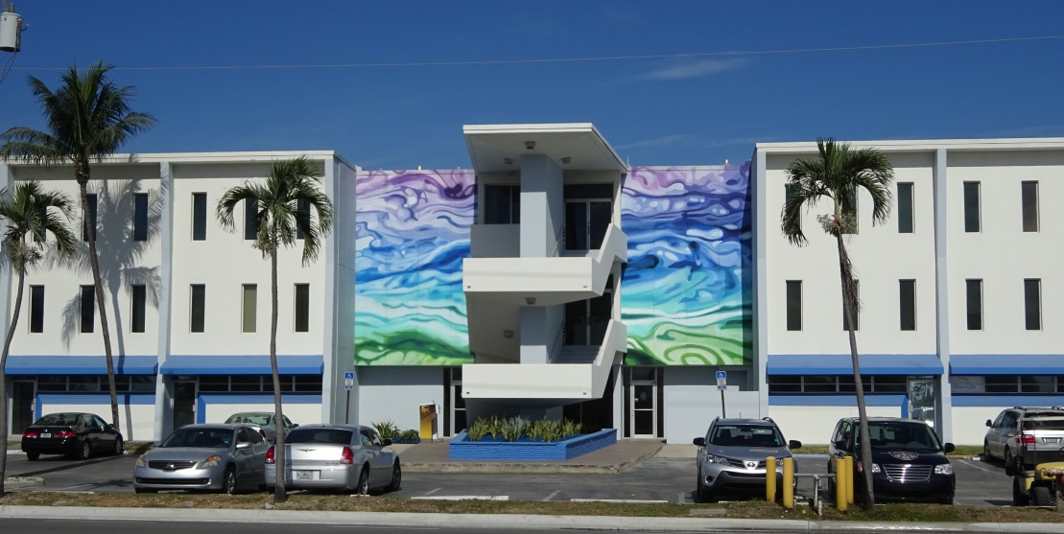
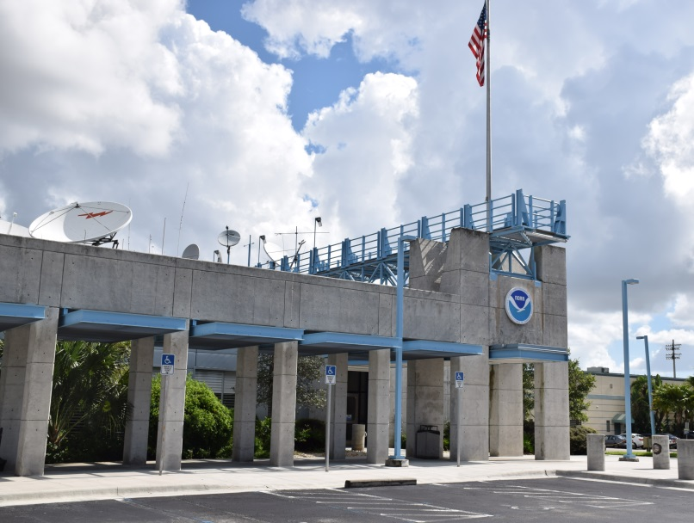
PMO SOUTH FLORIDA (MIAMI)
David Dellinger
Attached to WFO Miami, FL
MIC – Dr. Pablo Santo / SRH – Melinda Bailey
PMO Services Cover WFO’s Miami, Key West, Tampa Bay & Melbourne, FL
Satellite Office Located At Port Everglades
Assistant WFO Miami Marine Focal Point
Assist WCM In Outreach Programs & Other Office Functions Such As SVR WX/Tropical WX Outbreaks
PMO Office – Port Everglades
WFO/NHC - Miami

Slide 2
BIOGRAPHY
Port Meteorological Officer – WFO Miami 2008 – Present
Midwest Weather, Inc. 2007 – 2012
U.S. Navy 1986 – 2006
29 Years Of Weather & Ocean Forecasting, Analysis And Observing Experience
Retired U.S. Navy Veteran
Chief Aerographer’s Mate (Meteorology/Oceanography)
(4 Years As A Navy Quartermaster – Ship’s Navigator & Master Helmsman-Coxswain)

Slide 3
South Florida (Miami) Area of Responsibility
Port of Tampa Bay
Cruise-Fuel-Bulk-Container
Saint Petersburg
USCG-Research-Fisheries
Palm Beach
Container-Cruise-Private Yacht
Port Manatee
Juice-Agriculture
*(LNG/CNG)*
30nm Off-Shore
Port Everglades
Cruise-USCG-Fuel-Container-Bulk
Private Yacht
Port of Tampa Bay 270 Miles / 434 km
St. Petersburg 250 Miles / 402 km
Port Manatee 235 Miles / 378 km
*Port Key West 190 Miles / 305 km
Port Palm Beach 60 Miles / 96 km
WFO/NHC Miami 40 Miles / 64 km
Port of Miami-Dade 30 Miles / 48 km
WFO/NHC Miami
Miami-Dade
Cruise-USCG-Container-Private Yacht
Key West
Cruise-USCG-Private Yacht

Slide 4
Port Authorities
State / County Governments
Issue port credentials
Set price of credentials
Control access to most Ports/Piers
Most PMO’s operate on very limited budgets
By negotiating with local county/state officials, most credential fees can be negotiated away (reciprocity – mutual benefit between both parties.)

Slide 5
Budget Hurdles My First couple of years as a PMO
Fixed Costs To Overcome
$340 Per Year In Port Credentials & Dock Permits
$440 Per Year For USPS Box
Additional Yearly Operating Costs
$200 Tolls
$500 In Office & VOS Supplies (Printer Ink, Paper, Batteries, Tools, Etc.)
With Fixed And Daily Operating Costs (About $1,200), Very Little Was Left To Travel To My Remote Ports (Key West/Tampa $280-$380 Per Trip)
Struggled To Support Ships And USGC Units Operating In Remote Ports

Slide 6
Overcoming Budget Hurdles
Fixed Costs Negotiated Away With Port Partners
Port Credentials & Dock Permits Provided In Reciprocity
Net Savings $340 = 1 Trip To Key West
Port Tenants (NWS) Lobbied Port To Allow USPS To Allow Mail Delivery To Return To Port Everglades
Net Savings $440 = 1.3 Trips To Tampa/St. Petersburg
Yearly Operating Costs Are Already Trimmed
Budget For All Office Expenses Come Out Of $2k
Increased Travel Opportunities From 1.5 Times A Year To Up To 4, With Full Funding.
2 Trips To Tampa/St. Petersburg And 2 Trips To Key West

Slide 7
Port Authorities
Captains of the Ports
Usually run by Military or Coast Guard Commander
Generally control access to ports during severe weather (tropical/tornadic) or national disaster
Set policy on port credentials
Chair Harbor Safety Committees
This is where you as a PMO should be engaged.
Port Policies are generally announced

Slide 8
Port Authorities
Captains of the Ports
Chair Harbor Safety Committees (Continued)
Committees are made up of State/Provincial Elected Officials, Port Managers, Harbor Masters, Harbor Pilots, Tug Boat Operators, Heads of Shipping Companies, etc.
Sub-Committees are formed to review new policies and procedures and suggest new ones.
Committees generally meet semi-annually or at regular intervals to ensure all port partners are kept up-to-date on all regulations pertaining to port security and regulations
Perfect format for VOS-MET presentations to a broad range of industry experts and potential VOS Partners
Great opportunity for PMO’s to Network!!!

Slide 9
Port Authorities
Summary
By getting involved in each port’s Safety Council, making myself available to the local government officials during policy discussions or during inclement weather that impacted their facilities (Tropical in my case), I was able to show real value (Reciprocity) for reducing or eliminating fees associated with supporting my VOS Ships.
How can you get involved in your ports?

Slide 10
Collaboration with International PMO’s

Slide 11
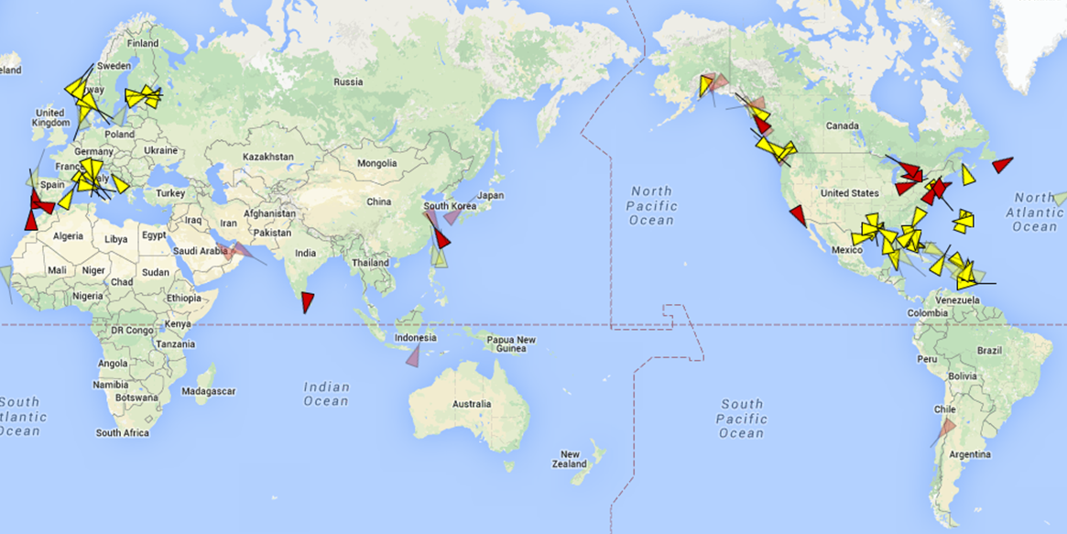
Collaboration with International PMO’s

Slide 12
Collaboration with International PMO’s
My Fleet is Seasonal (more than 75% Of Ships Are Passenger Cruise Ships in my case)
Cruise Ship Season Runs From October to May
High Number Of Ships end up On Blacklist During Off-Peak Months Due To Exotic Ports With No WMO VOS Partners
When Problems Arise, Things Become Compounded With High Rate Of Crew Turnover (Every 6-12 Weeks)
Constantly Networking Working With Global VOS/SOT/JCOMM Partners Assisting With Their Visiting Ships And Clearing Blacklisted Ships

Slide 13
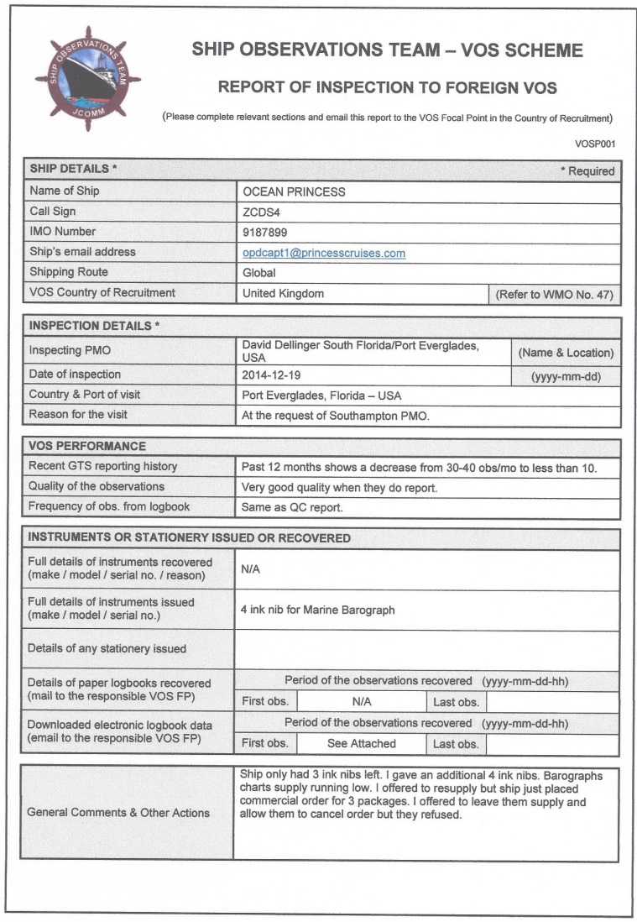
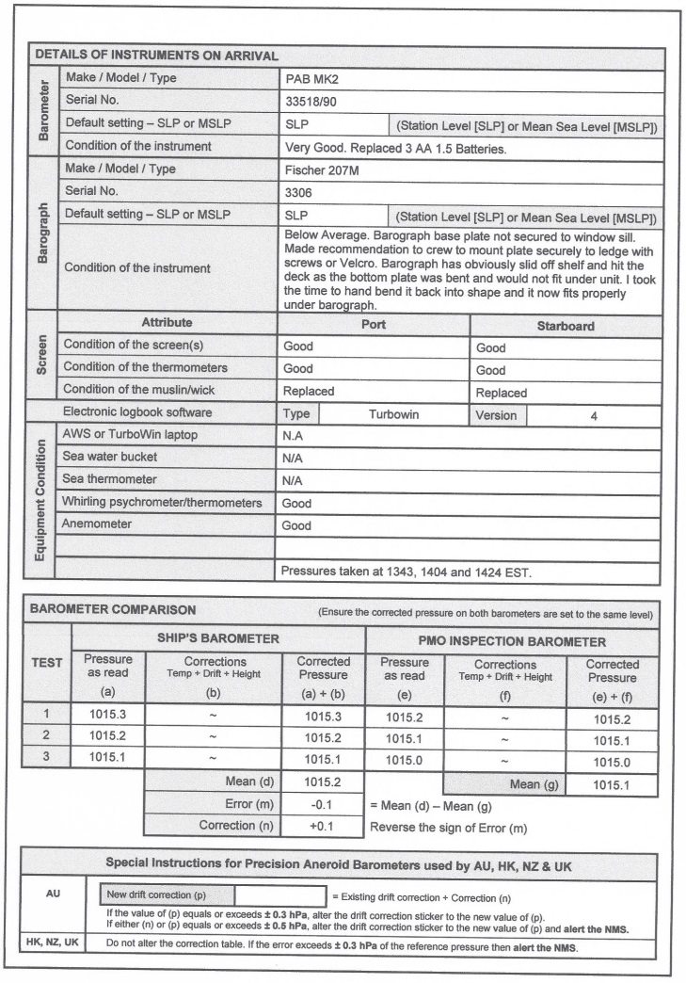
Collaboration with International PMO’s
It is vitally important that when you visit a VOS ship from another country, that you complete the REPORT OF INSPECTION TO FOREIGN VOS form.
Fill it out completely as possible
Forward it along to the country’s Focal Point and to the PMO assigned to that ship.

Slide 14
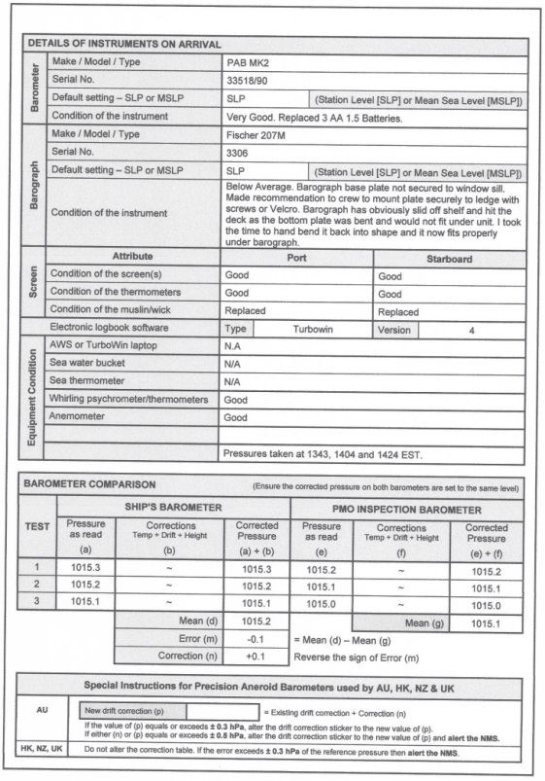
Collaboration with International PMO’s
Complete the form with as much information as possible. Document Everything!
Even the smallest detail may help the Home PMO resolve lingering issues or bring new issues to light.
Document the condition of all meteorological equipment.
Ensure you check the barometer and measure it against what the host country prefers the default setting to be. SLP/MSLP is not the same in all countries.
If you are uncertain, call or reach out to the Recruitment Country PMO.

Slide 15
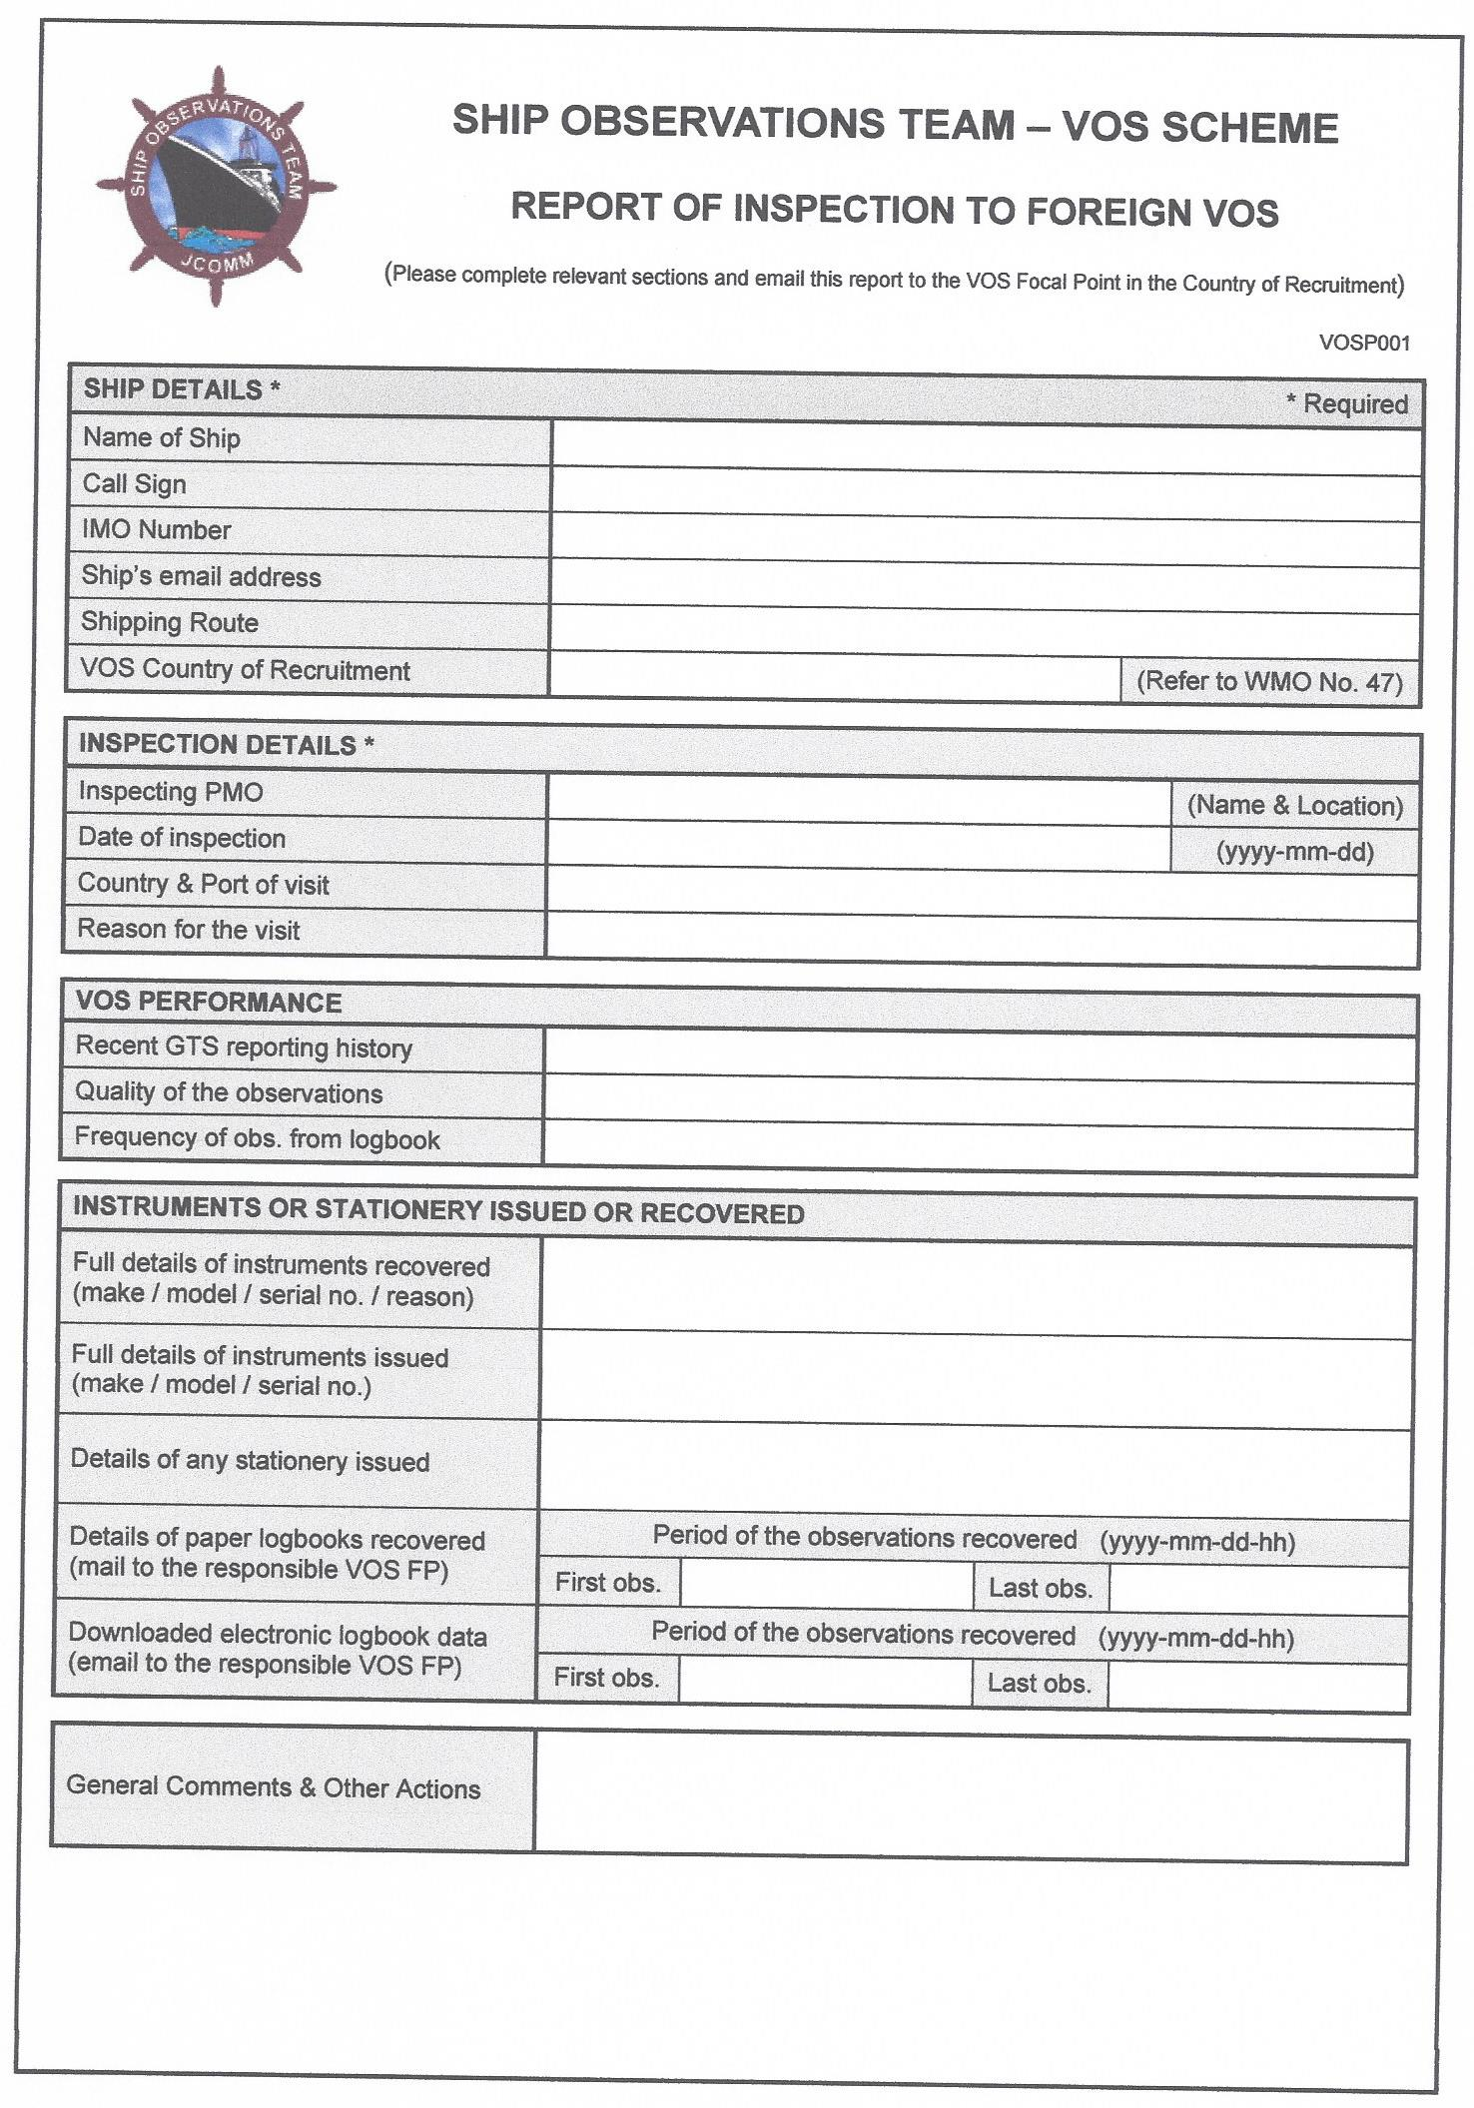
Collaboration with International PMO’s

Slide 16
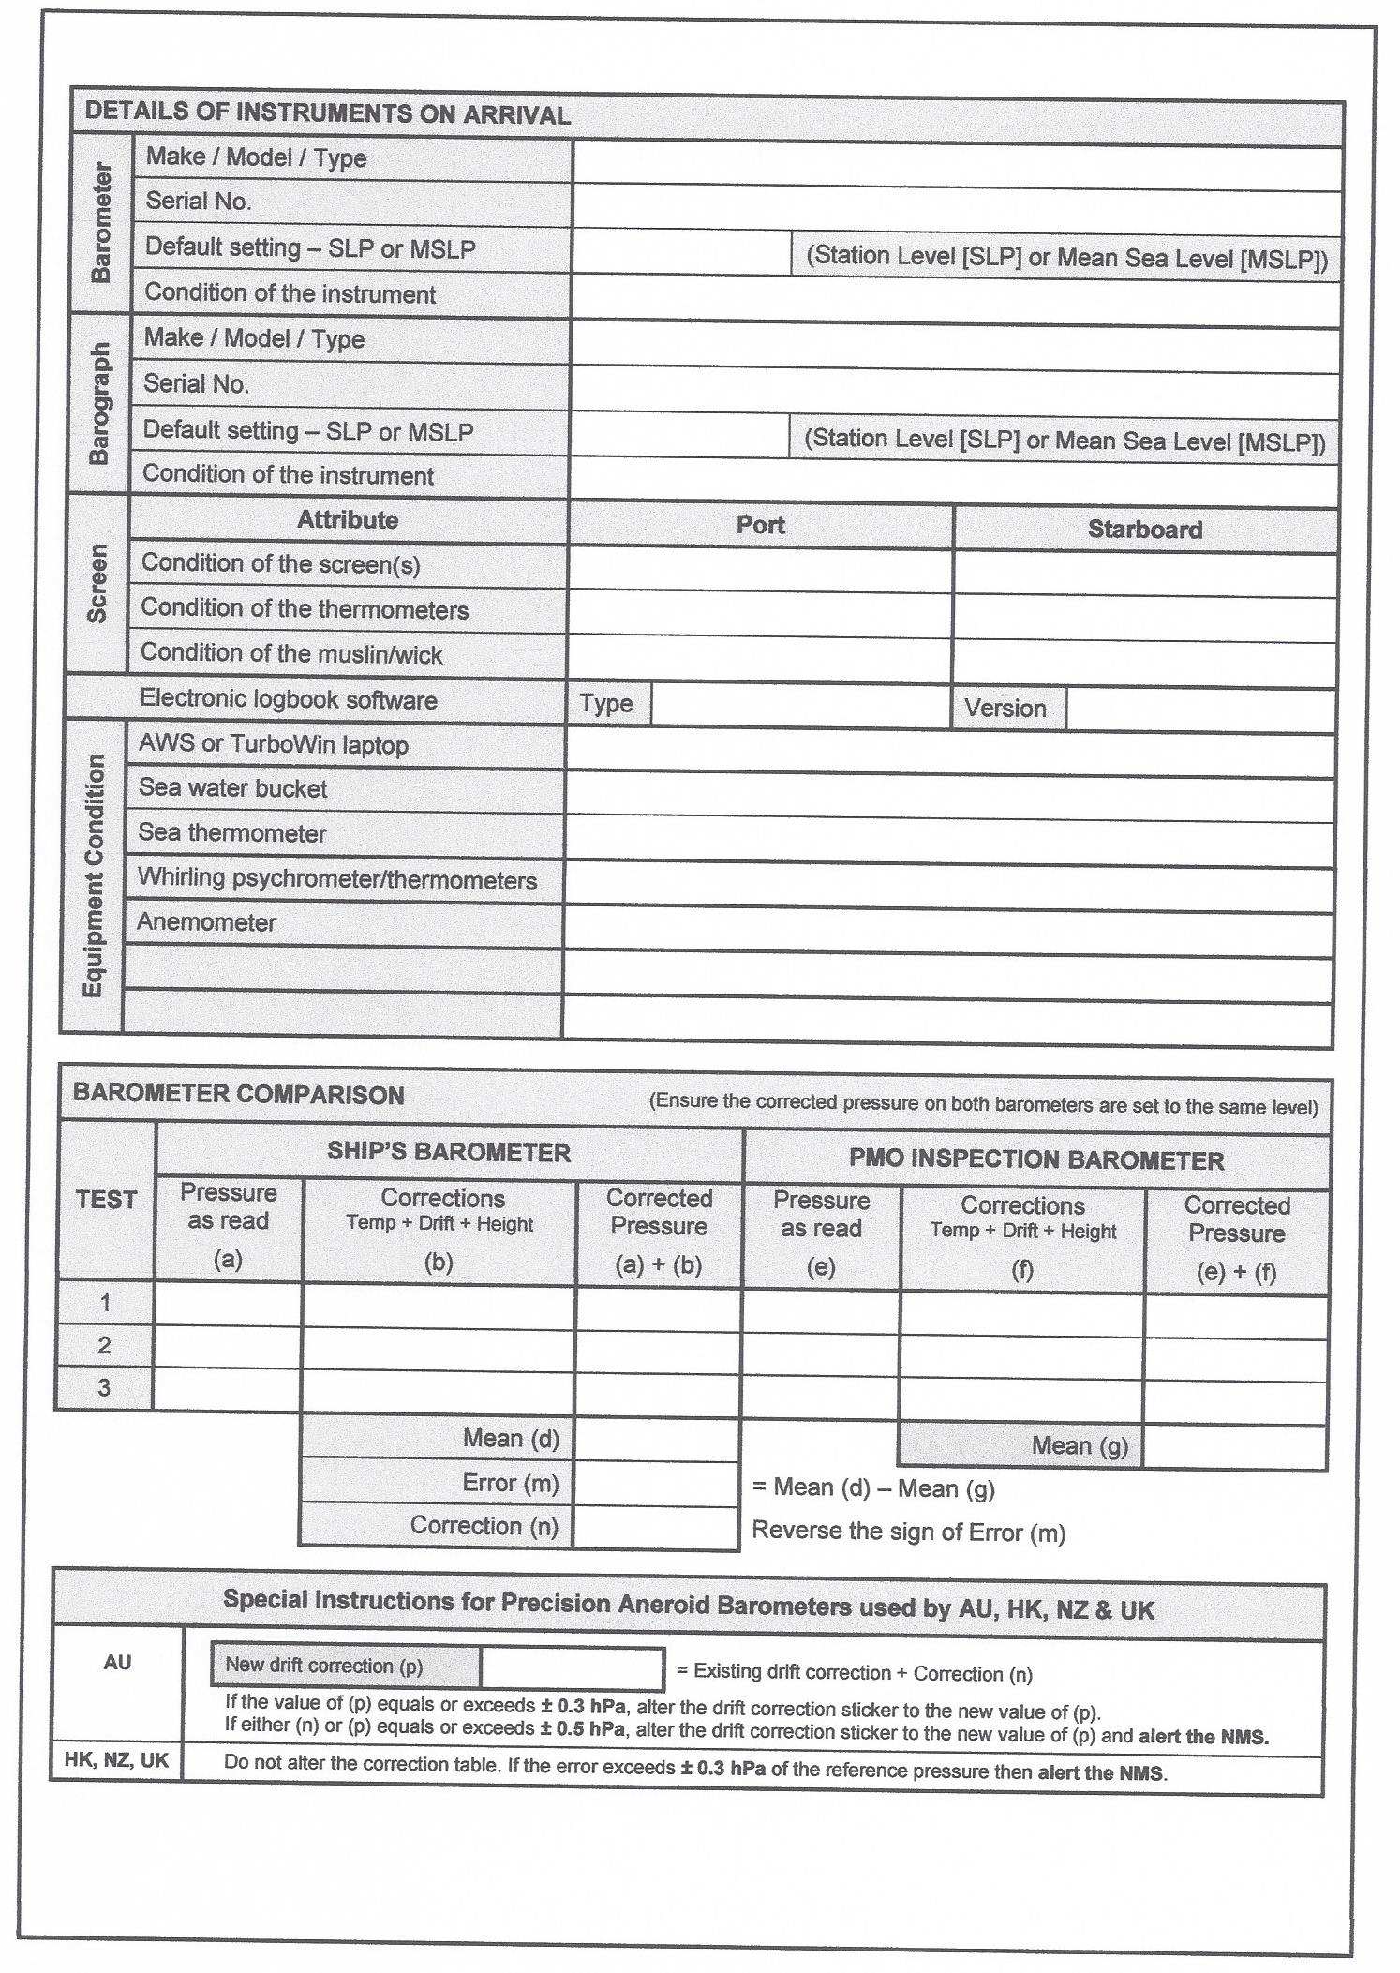
Collaboration with International PMO’s

Slide 17
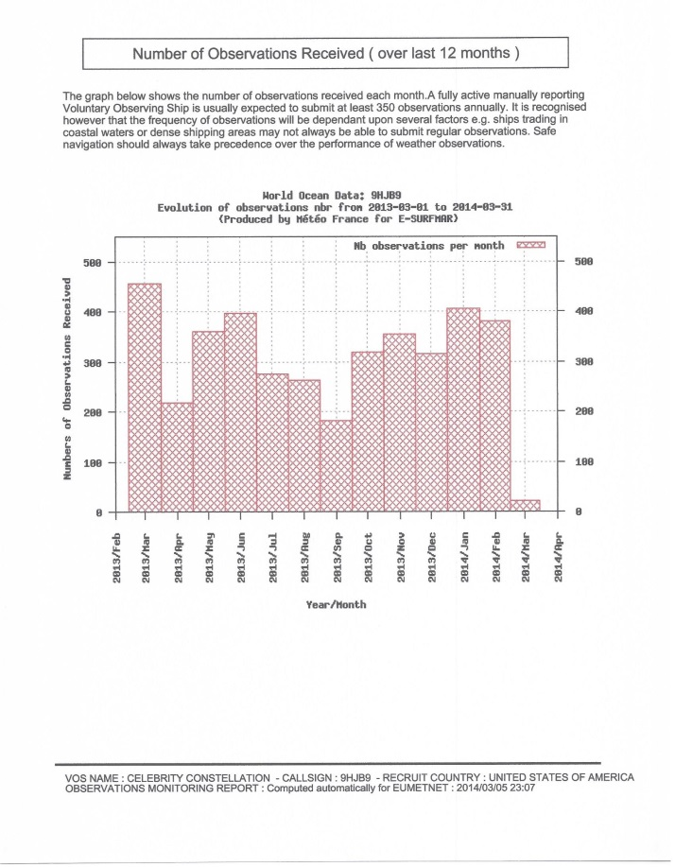
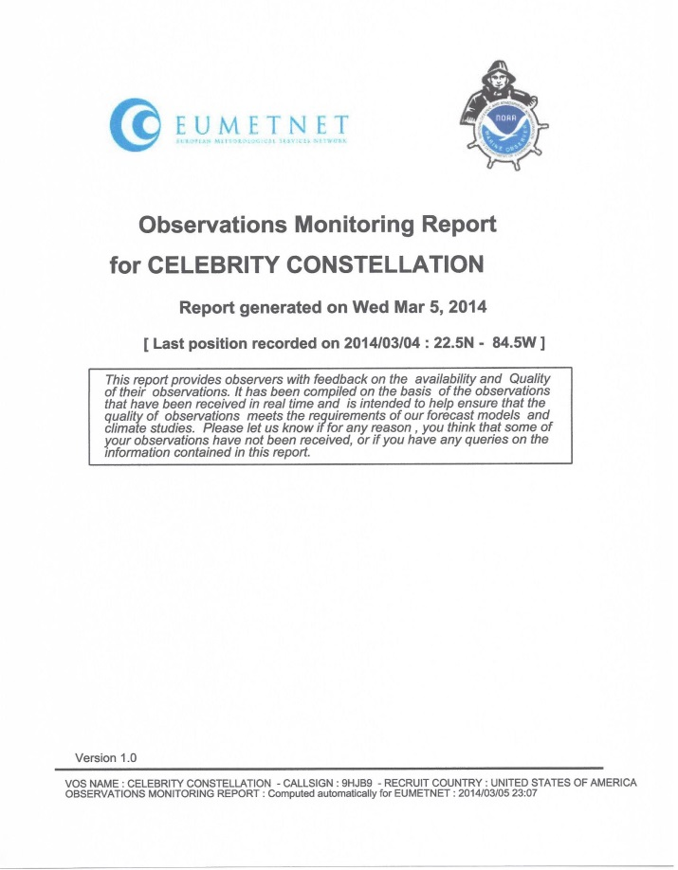
Collaboration with International PMO’s
Take the time to print out the Observations Monitoring Report from the METEO France (http://esurfmar.meteo.fr/doc/vosmetadata/index.php)
Take the time to go over each element of the report with the Captain, Navigation Officer or MET Officer assigned to assist you during your visit.
Leave a copy for the ship to read through and do hesitate to make notes for areas of improvement and encouragement.
Include a digital copy of this report back to home VOS/PMO. Detail areas you discussed with crew.
Always than them for their continued support for the VOS Program

Slide 18
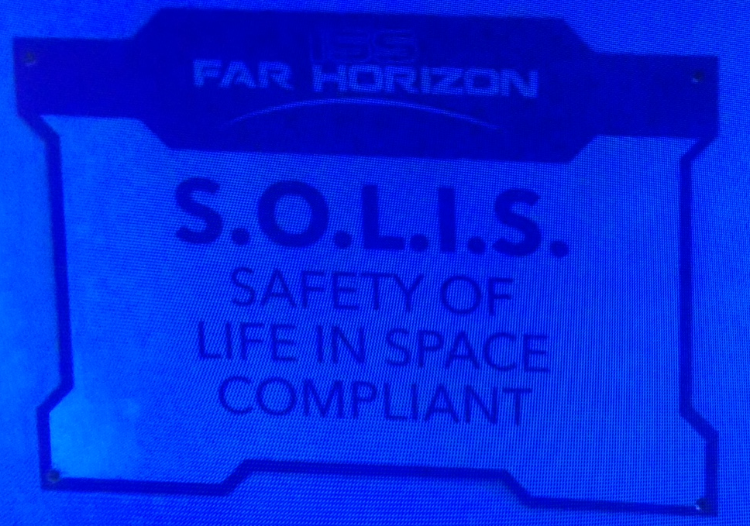
SOLAS… For Space? Our Future? Screenshot from the Syfy TV Show “Dark Matter”

Slide 19
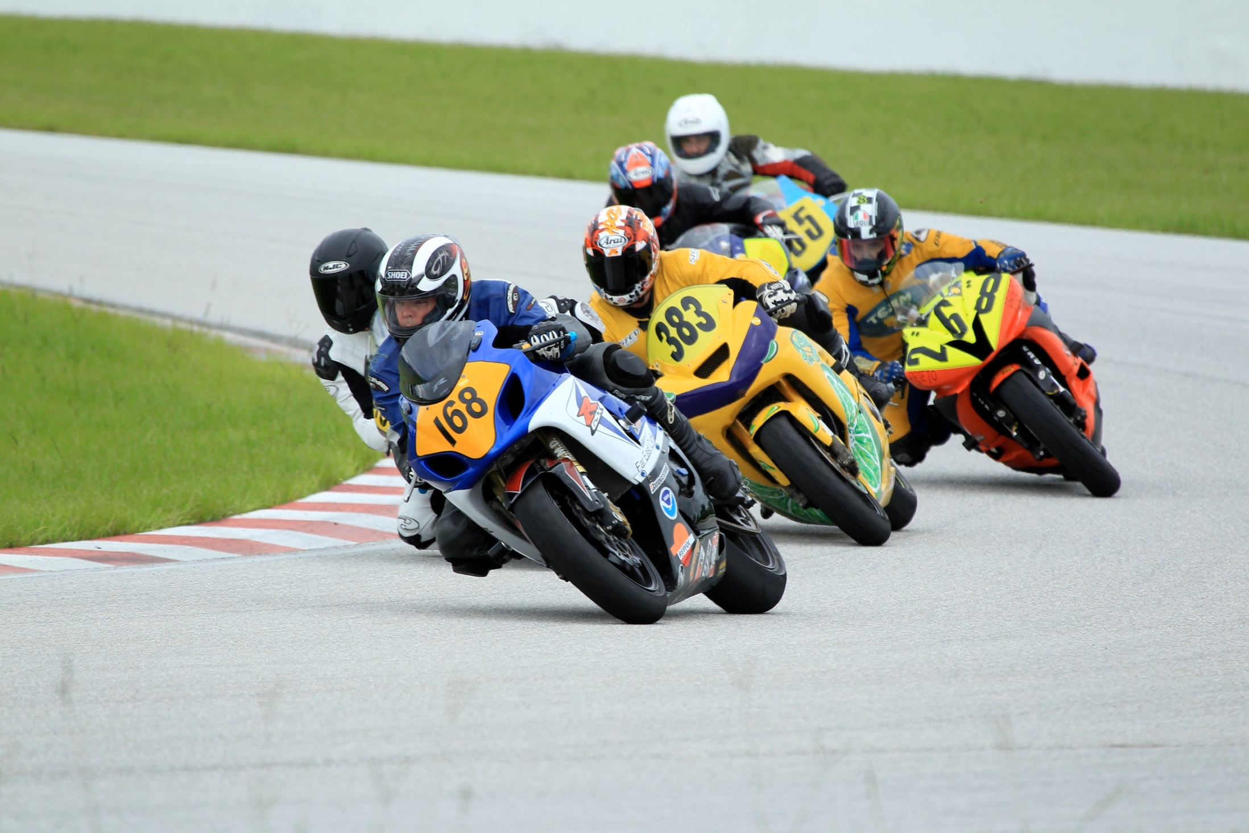
Questions?
For the lead
and the win!

