Slide 1
RSMC - Data Quality Monitoring
Sarah North - Chair Ship Observations Team (SOT) VOS Panel
PMO 5 – Chile – July 2015

Slide 2
RSMC Exeter is the WMO designated lead centre for monitoring the quality of surface marine data
Met Office RSMC Quality Monitoring
(Regional Specialised Monitoring Centre)
Monthly statistics are produced for ships, buoys, and other marine platforms comparing observations with Met Office’s global model background forecast fields for each variable
Since 2005 these monitoring stats have been available on the Met Office website
Detailed monitoring lists are also sent to WMO on a 6 monthly basis. Statistics related to suspect VOS are extracted by WMO and sent to national VOS focal points, requesting corrective action to be taken.

Slide 3
Monthly Monitoring Statistics
To maintain ship lists we use the online E-SURFMAR meta-data, as it is more up to date than the WMO Pub47 list,
The JCOMMOPS SOT, VOS & PMO mailing lists are e-mailed when new monthly suspect lists are posted on the Met Office web site (it is important to keep the Focal Point & JCOMMOPS mailing lists up to date)
Monthly suspect lists also emailed directly to some VOS operating countries and focal points. Monthly monitoring statistics are also provided for a number of national VOS fleets
The use of Masked call signs – and particularly the use of ‘SHIP’ instead of the ships assigned call sign – prevents data from being properly monitored

Slide 4
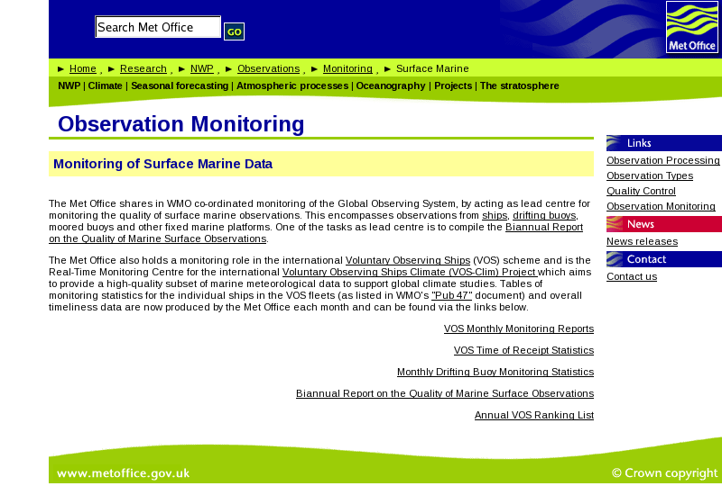
Met Office Observation Monitoring web site
Routine reports on VOS data quality distributed to JCOMM mailing lists and are available on Met Office web-site at
http:||research.metoffice.gov.uk|research|nwp|observations|monitoring|index.html

Slide 5
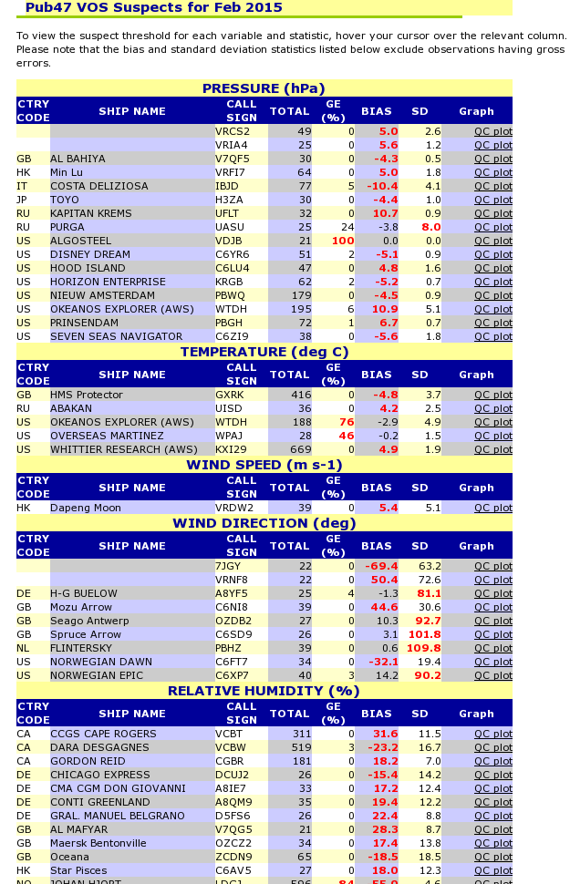
Met Office Observation Monitoring web site
Monthly o-b statistics and ‘suspect’ lists distributed - QC plots are provided on line for all ship obs that are flagged as suspect
http://research.metoffice.gov.uk/research/nwp/observations/monitoring/marine/VOF/Pub47_SUSPECTS.html

Slide 6
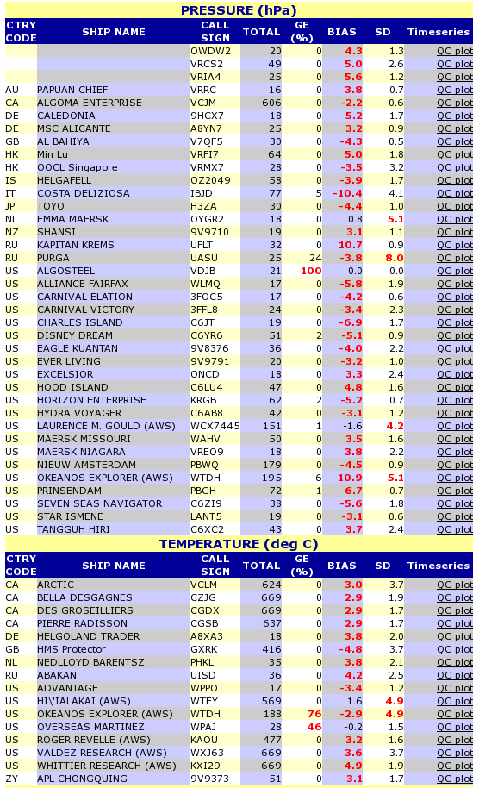
Met Office Observation Monitoring web site
Following agreement at JCOMM SOT new tighter criteria are about to be introduced – so more ships will be flagged
WMO Secretariat requested to confirm with CBS that the new criteria are fit for purpose
Monitoring will be split into ‘automatic’ and ‘manual’ ships

Slide 7
New ‘Suspect’ Criteria to be used for monthly monitoring of Automatic and Manual VOS
VOSClim Aut. |VOS Aut.| VOS Man. (+ old VOS)
Selection criteria: NOBS >= 50 | 50 | 15 (20) , plus one or more of the following:
1. Bias in pressure >= 1.5 | 2 | 3 (4) hPa
wind speed >= 4 | 4 | 4 (5) ms⁻¹
wind direction >= 20 | 25 | 30 (30) degrees
air temperature >= 1.5 | 2.5 | 3 (4) ºC
relative humidity >= 10 | 12 | 15 (15) %
SST >= 1.5 | 2 | 2.5 (3) ºC
2. Std Dev pressure >= 3 | 4 | 5 (6) hPa
wind direction >= 50 | 50 | 70 (80) degrees
air temperature >= 3 | 4 | 5 (6) ºC
relative humidity >= 15 | 20 | 25 (25) %
SST >= 3 | 3 | 4 (5) ºC
3. Gross Errors >= 10 | 15 | 25 (25) %

Slide 8
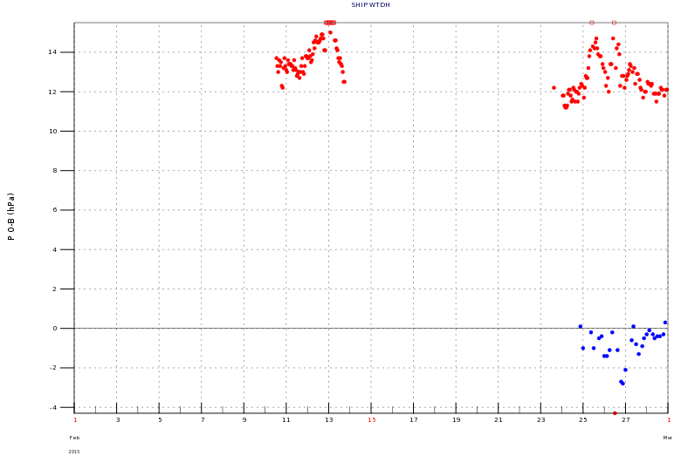
Suspect pressure for ship WTDH (February 2015) - bias at times – different observers/barometers?
Met Office Observation Monitoring web site Example of QC plot for pressure

Slide 9
Suspect pressure for ship WCX7445 (March 2013) - increasing negative bias
Met Office Observation Monitoring web site Example of QC plot for pressure

Slide 10
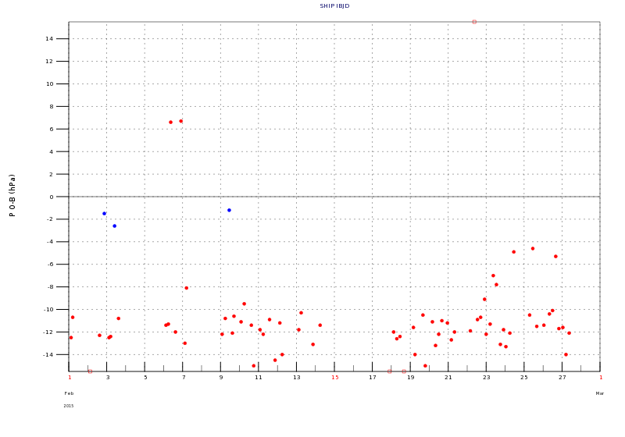
Suspect pressure for ship IBJD (February 2015) - constant negative bias
Met Office Observation Monitoring web site Example of QC plot for pressure

Slide 11
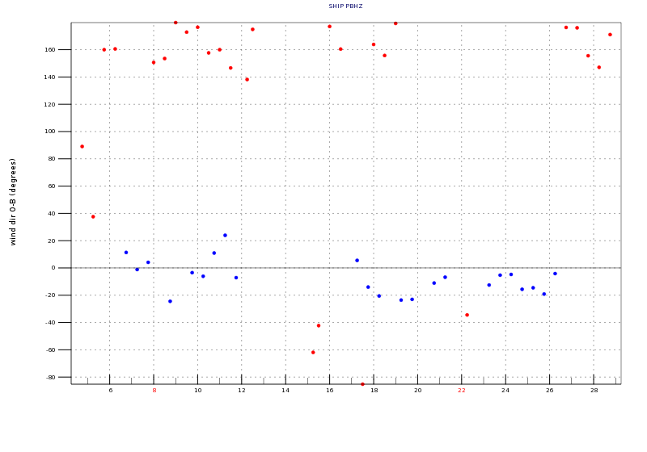
Suspect wind direction for ship PBHZ (February 2015) - sometimes a bias of ~180 degrees
Met Office Observation Monitoring web site Example of QC plot for pressure

Slide 12
Met Office Observation Monitoring web site Example of QC plot for pressure
Suspect pressure for ship UCUF constant positive bias – double height correction?

Slide 13
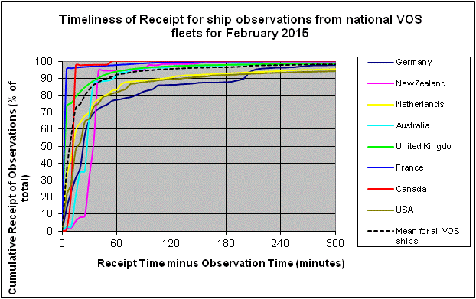
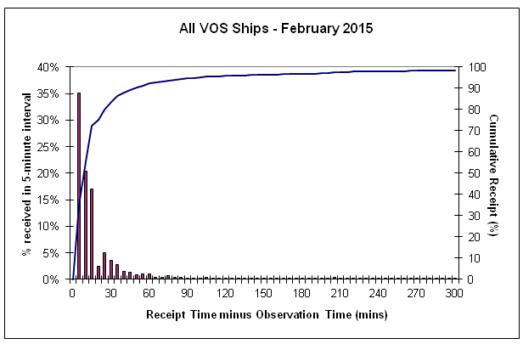
Met Office Observation Monitoring Web site - Timeliness
http://research.metoffice.gov.uk/research/nwp/observations/monitoring/marine/TOR/index.html
95% of ship reports reach the Met Office within 2 hours of the report time,
compares well with typical data cut-off times of two to three hours after the model analysis time

Slide 14
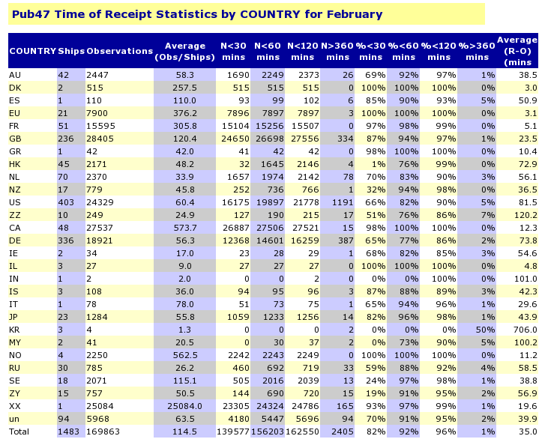
Met Office Observation Monitoring Web site – Timeliness for National Fleets

Slide 15
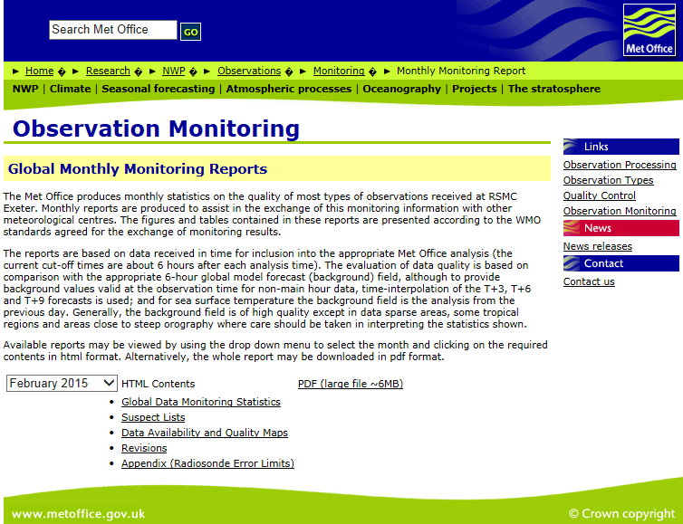
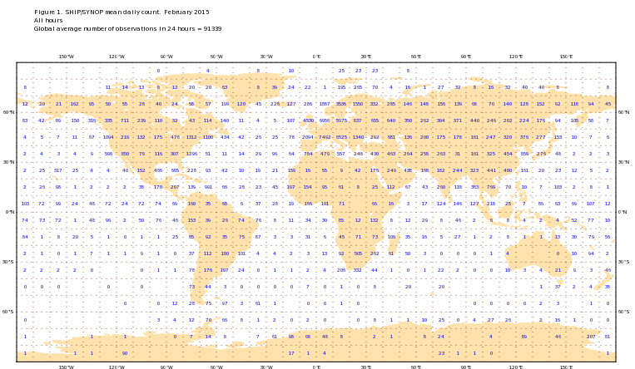
Met Office Observation Monitoring Web site – Global Monitoring
http://research.metoffice.gov.uk/research/nwp/observations/monitoring/month_rep/index.html#

Slide 16
VOSClim Real Time Monitoring Centre
(RTMC)
The Met Office also performs the role of the Real time Monitoring Centre (RTMC) for VOSClim class ships. To do this we ...
extract ship observation reports from the GTS
associate the observed variables (pressure, air temp, humidity, wind speed, wind direction & SST) with co-located model field values and compiles this into BUFR data sets
transfer the BUFR data sets to Data Assembly Centre via GTS
Provide separate monthly monitoring statistics for VOSClim observed (6) variables
It is therefore essential that VOSClim Call Sign details on the
E-SURFMAR metadata database are to be kept up to date

Slide 17
VOSClim Real Time Monitoring Centre
(RTMC)

Slide 18
VOSClim Real Time Monitoring Centre
(RTMC)

Slide 19
Met Office - VOS Ranking Scheme
http://research.metoffice.gov.uk/research/nwp/observations/monitoring/marine/VOSranking/index.html
The Met Office RSMC publishes rankings for the worlds VOS fleet in terms of the quality, quantity and timeliness of reports from each ship
It is intended to assist in presenting awards to the best performing ships.
National VOS performance rankings available on the Met Office web site – both monthly and annual

Slide 20
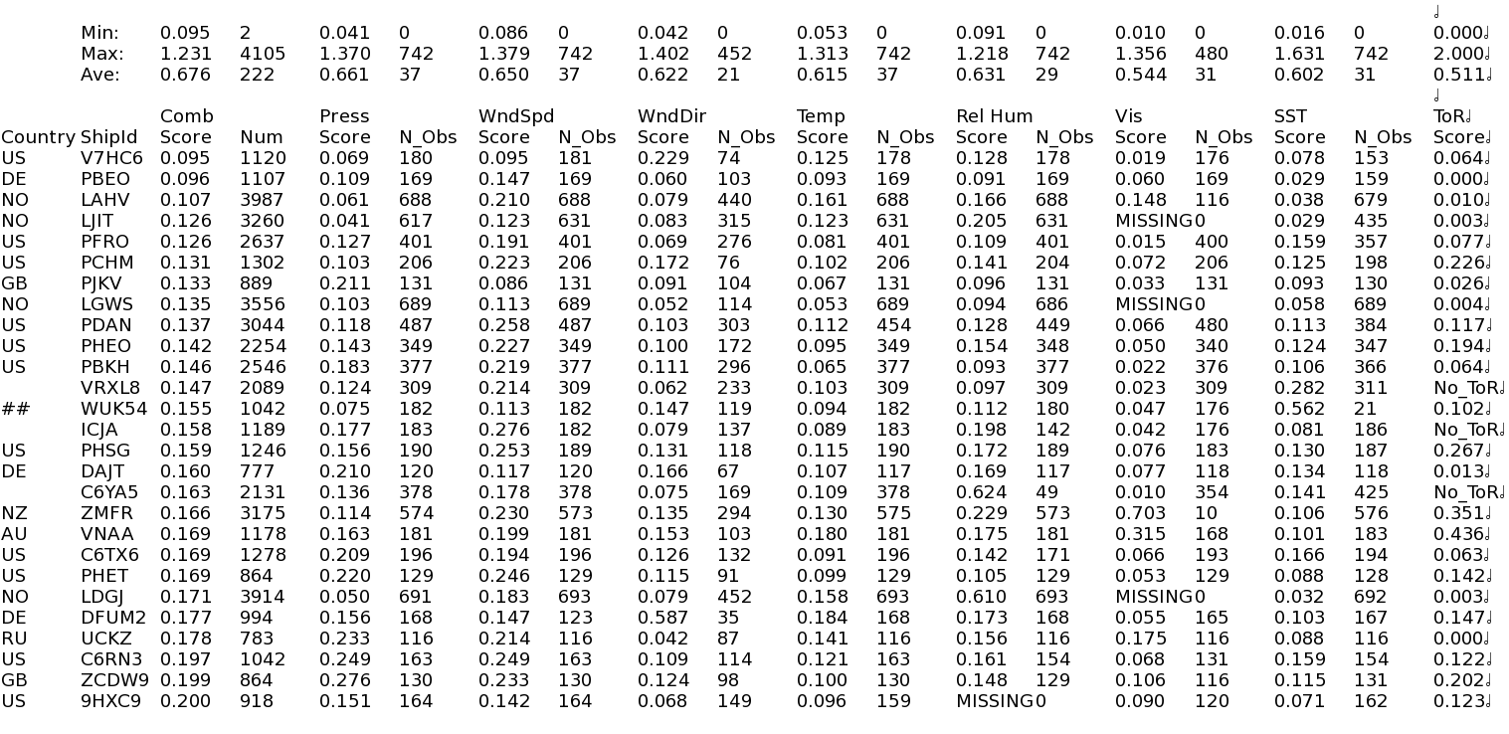
VOS scores for manual ship reports (extract of best ships) March 2015

Slide 21
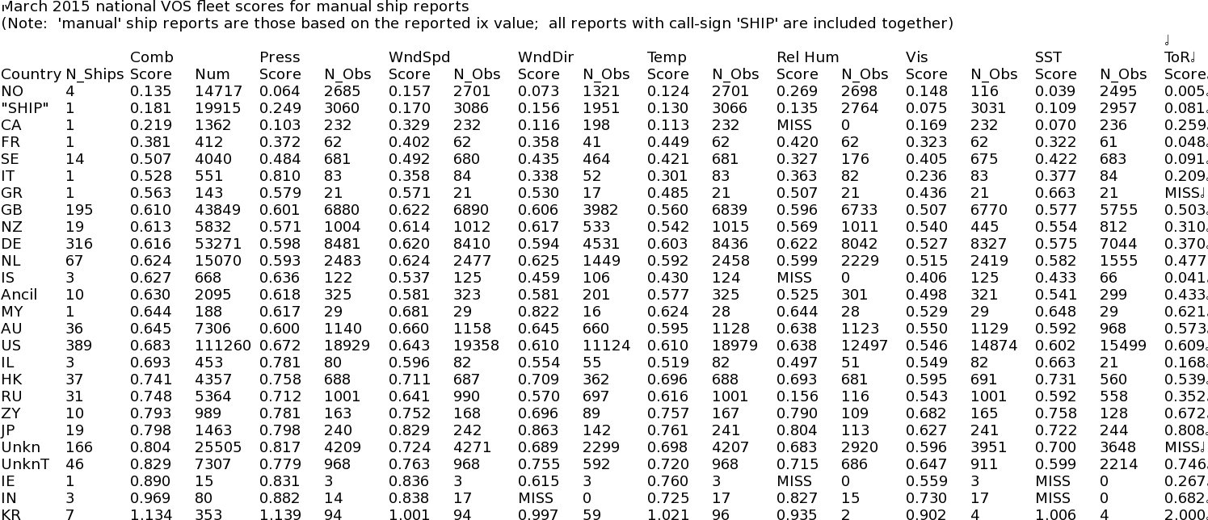
National VOS fleet scores for manual ship reports March 2015
Are annual NWP ranking lists useful for ship awards?

Slide 22
Questions
Perfect World
Real World

