Slide 1
una cálida bienvenida A warm welcome
René Rozeboom
Bert de Vries.
PMO Workshop Chili 2015

Slide 2
TurboWin+ and TurboWin
René Rozeboom, Martin Stam and Bert de Vries.
PMO Workshop Chili 2015

Slide 3
TurboWin+ History
Turbo1, Turbo2, Turbo5 [DOS] 1990 – 1997
TurboWin [Windows] 1996 – present
TurboWeb [Windows, Linux, Mac] 2010 – present
TurboWin+ [Windows, Linux, Mac] 2013

Slide 4
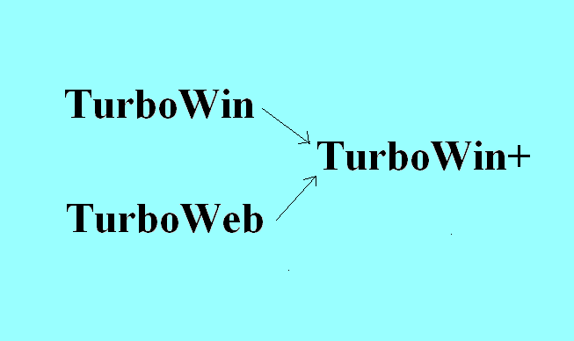
TurboWin+
‘TurboWin+’ = TurboWin + TurboWeb + AMVER + serial communication

Slide 5
TurboWin+ modes
Web version
Stand alone version

Slide 6
TurboWin+ [web mode]
Download code/program over the internet
No installation procedure
Always latest version
Run on a variety of computers (Windows,Linux, Mac, Solaris)

Slide 7
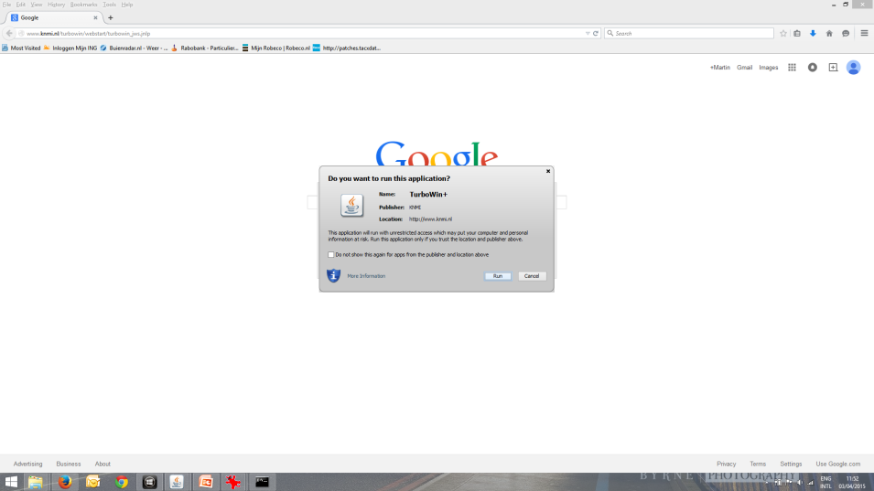
TurboWeb
Installed within a minute
Via web link (first time) or desktop icon
TurboWeb is officially signed (certificate) and checked by a Certificate Authority

Slide 8
TurboWeb
Select obs to server
Response within two seconds
Direct link to Meteorological Centre server. Faster than
E-mail

Slide 9
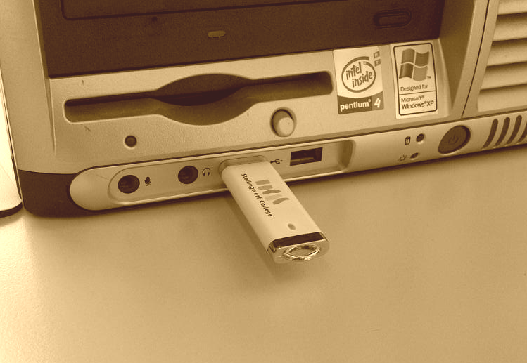
TurboWin+ [stand-alone mode]
No direct internet connection required
Can be run from usb disk (or simply copied to hard disk)

Slide 10
TurboWin+ and AMVER
Sailing plan
Deviation report
Arrival report
Position report

Slide 11
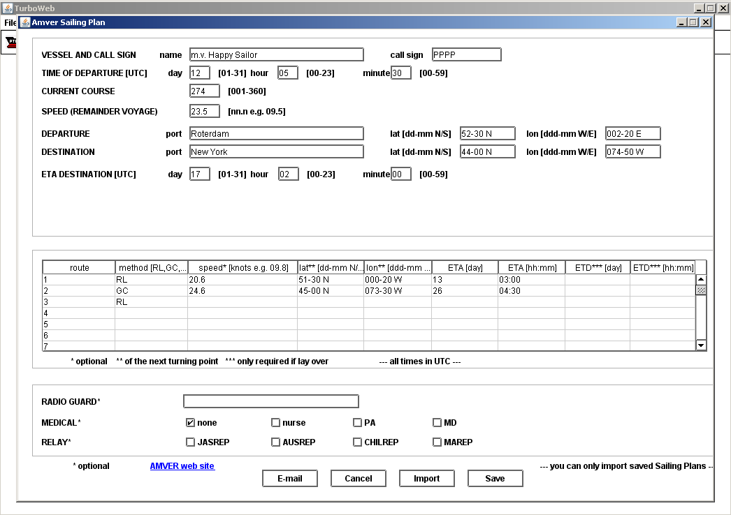
TurboWin+ and AMVER

Slide 12
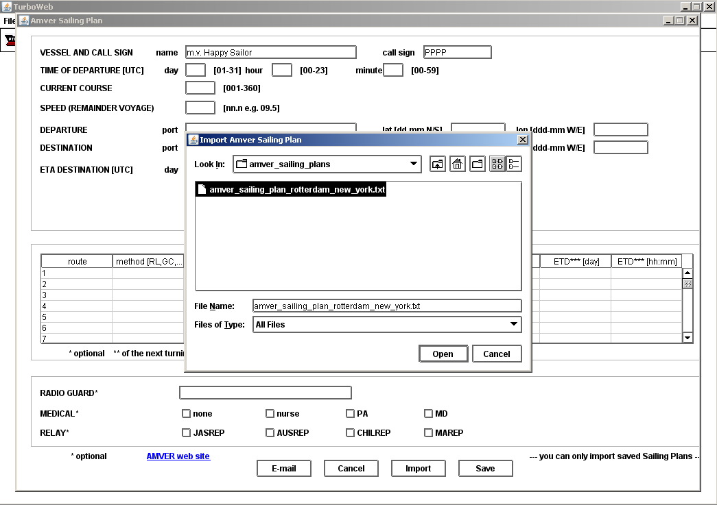
TurboWin+ and AMVER

Slide 13
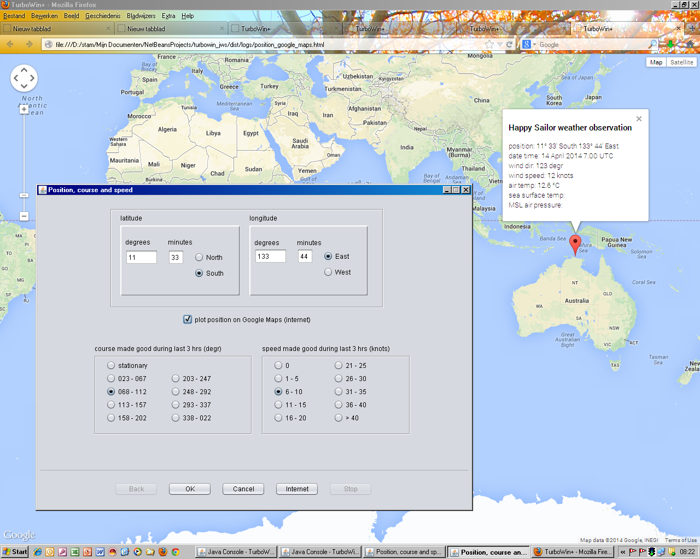
TurboWin+
Check position on Google maps (if internet available)

Slide 14
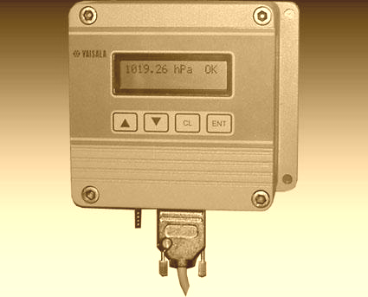
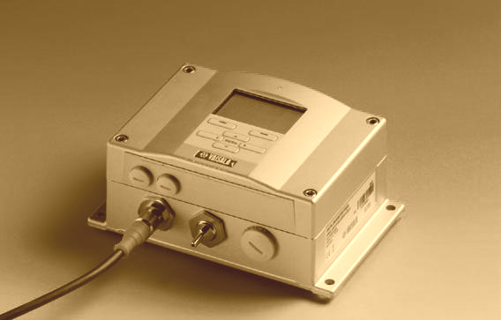
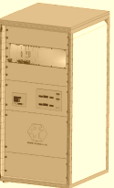
TurboWin+ and Serial Connection
Vaisala PTB220 barometer
Vaisala PTB330 barometer
Mintaka barometer
Sterela E-Surfmar AWS

Slide 15
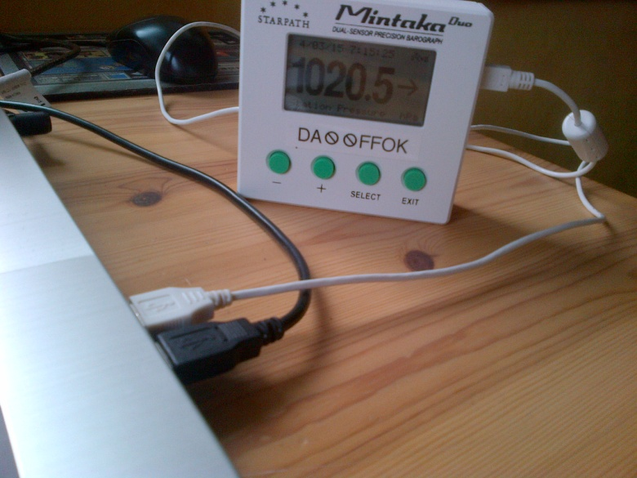
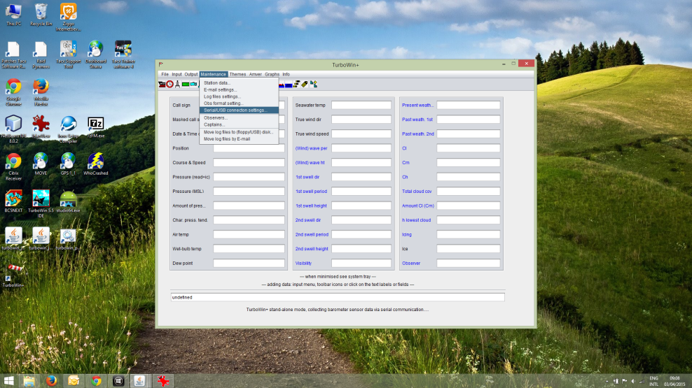
TurboWin+/TurboWeb barometer interface
Install the barometer in a few mouse clicks
1) Connect the barometer and install the USB driver (once)
2) In TurboWin+ select: Maintenance -> Serial/USB connection settings

Slide 16
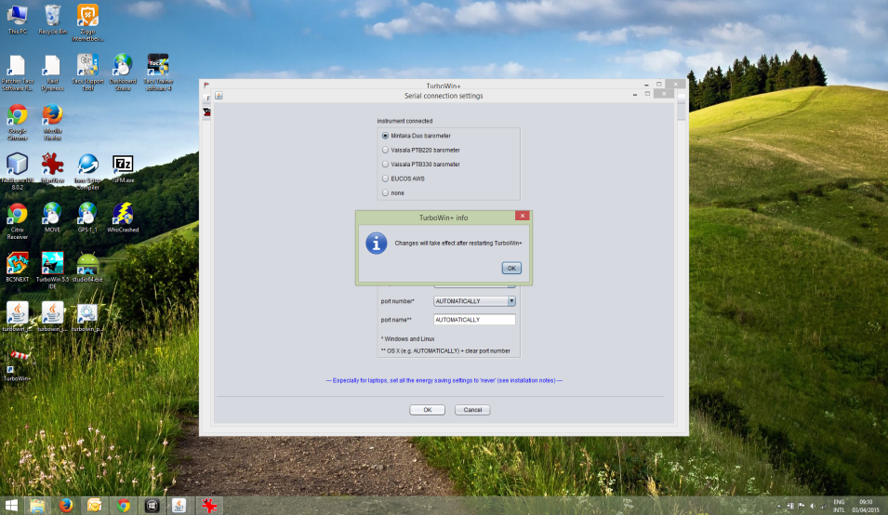
TurboWin+/TurboWeb barometer interface
Install the barometer in a few mouse clicks
3) Insert the port settings (see barometer User’s Guide)
4) Restart TurboWin+

Slide 17
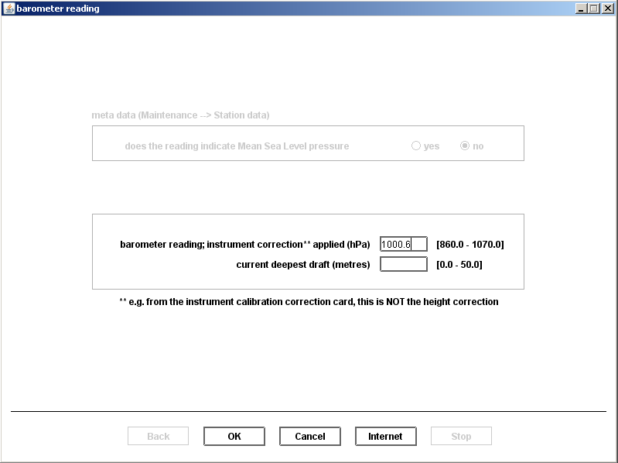
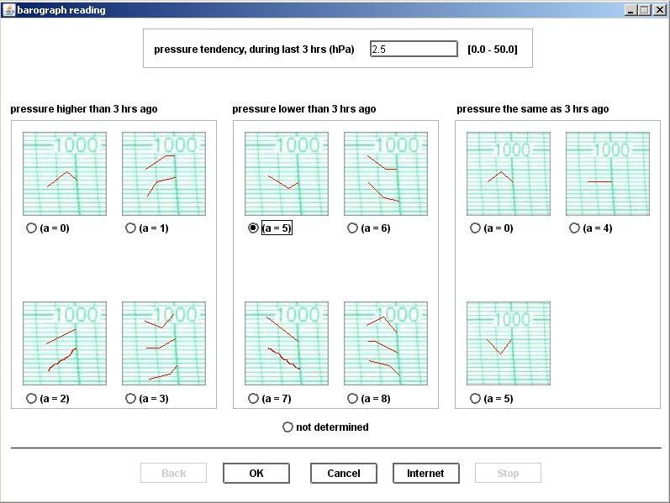
TurboWin+ and Serial Connection
If only barometer coupled (no AWS): pressure data automatically inserted into TurboWin+

Slide 18
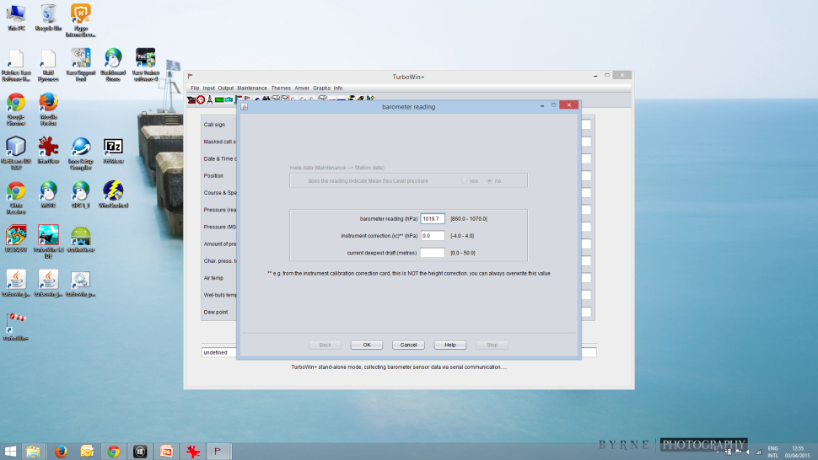
TurboWin+/TurboWeb barometer interface
No more reading and typing errors
Automatically inserting pressure tendency and characteristic
No more reading and typing errors
Automatically inserting air pressure

Slide 19
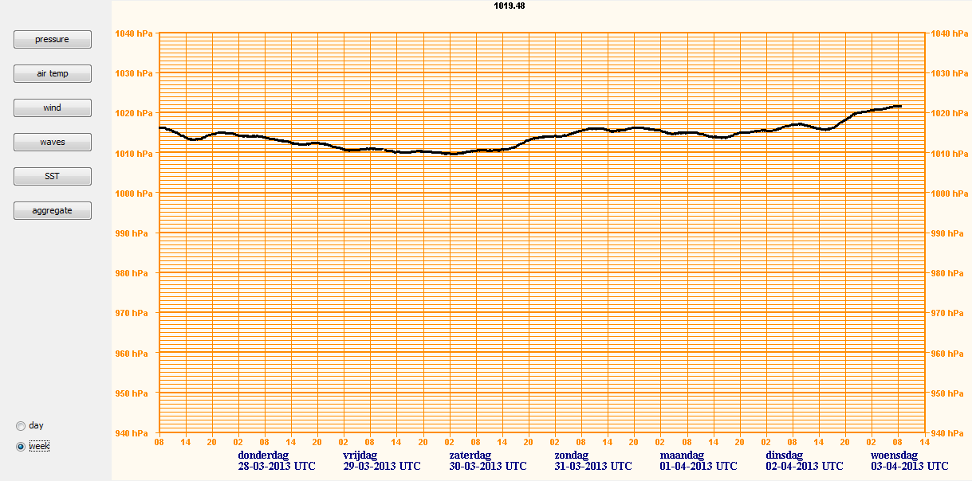
TurboWin+ and Serial Connection
Data from PTB220 or PTB330 or Sterela AWS to TurboWin+ (week view)

Slide 20
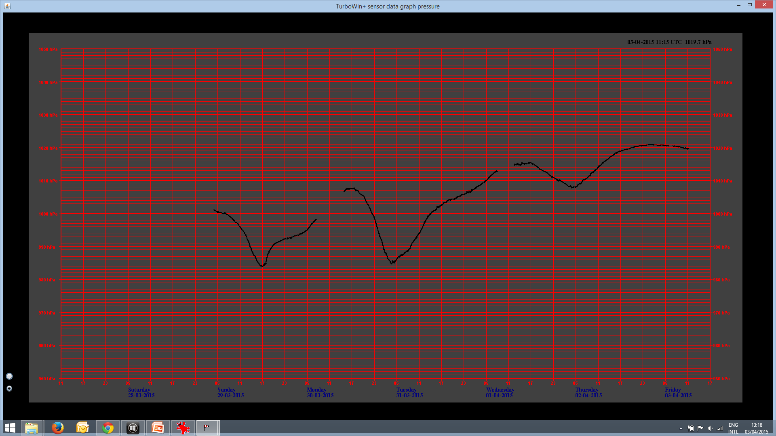
TurboWin+/TurboWeb barometer interface
No separate barograph (papers) needed anymore
Displaying air pressure trace in week or day mode
Two mouse clicks (pop-up menu) for night colours

Slide 21
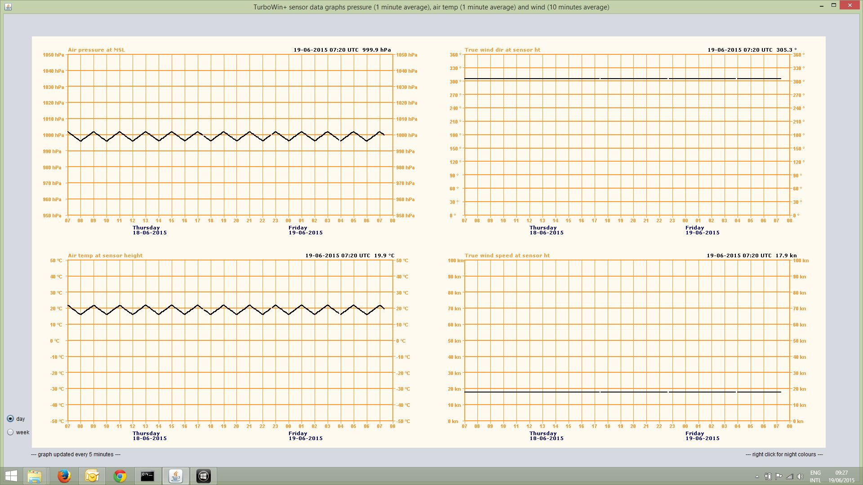
TurboWin+ Eucaws AWS data display

Slide 22
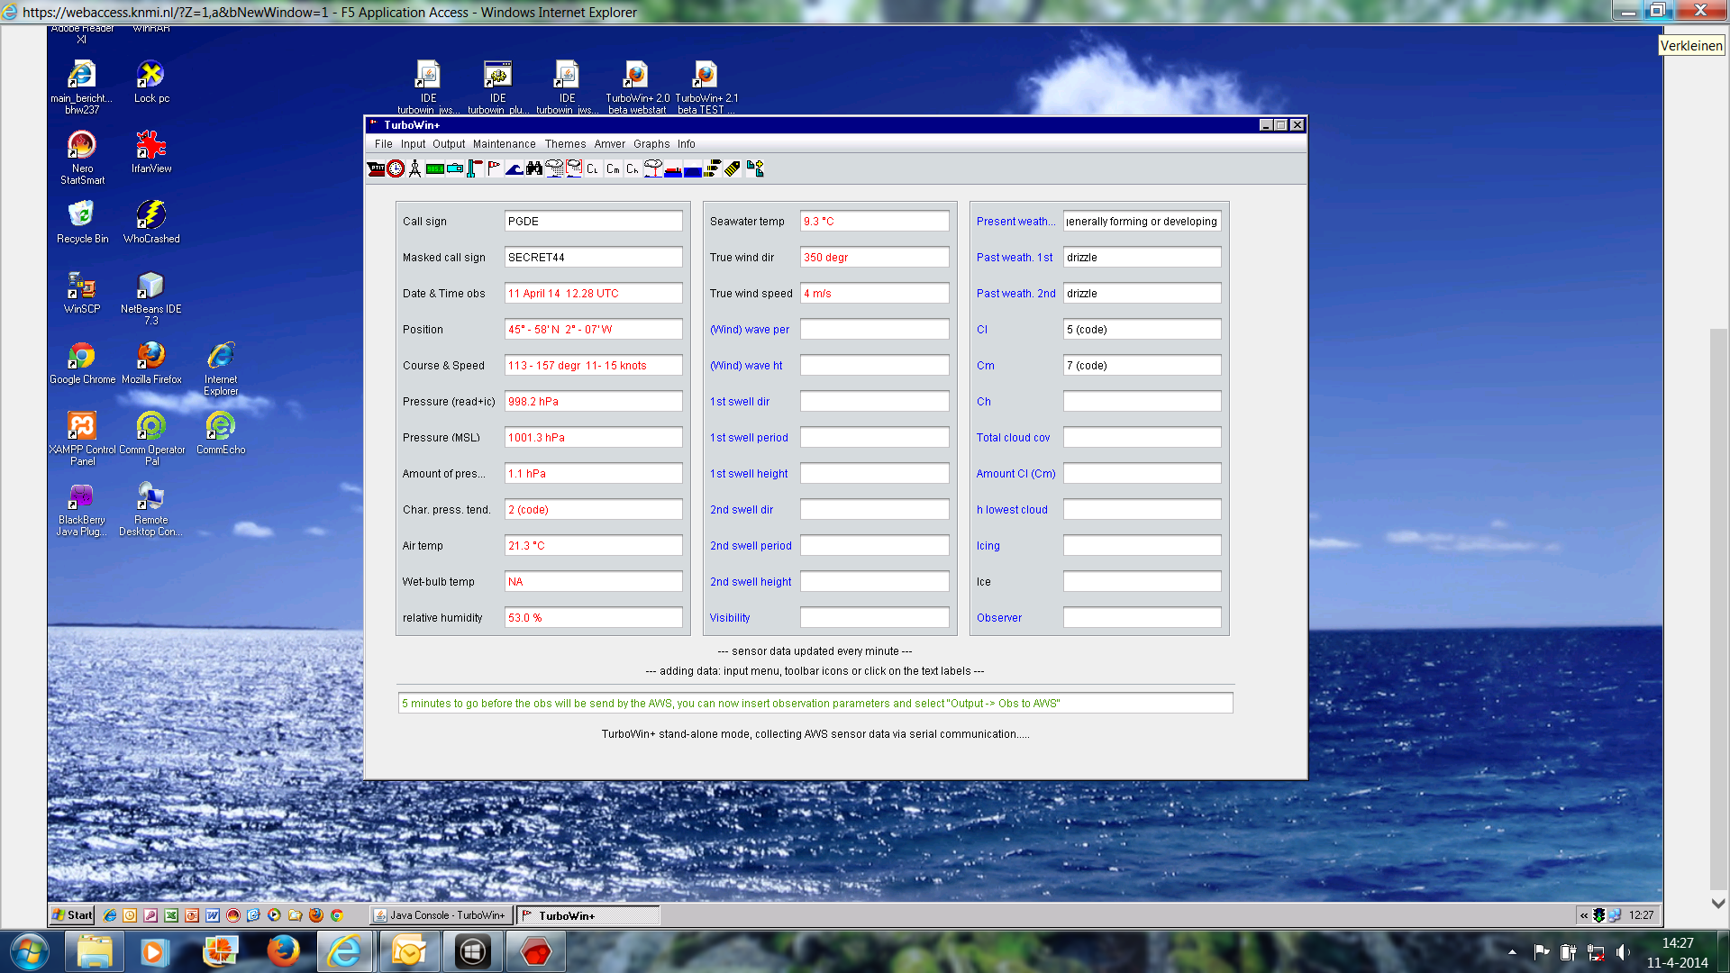
TurboWin+ EUCAWS interface

Slide 23
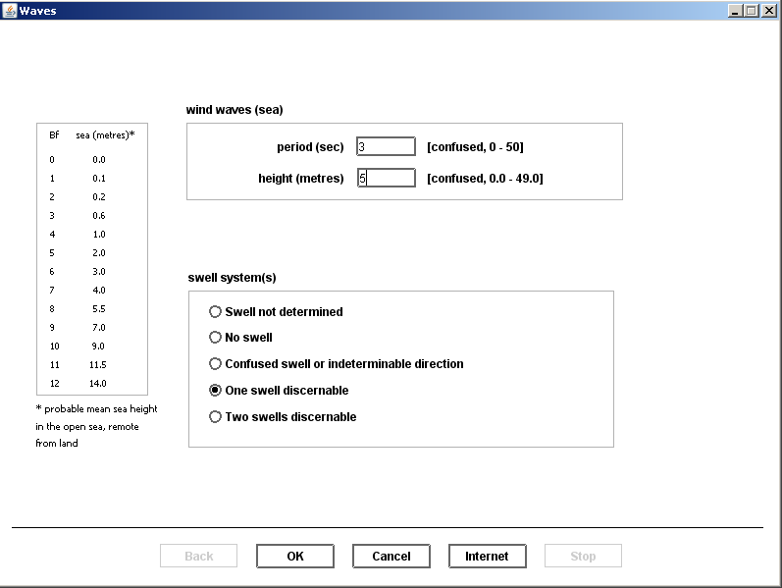
TurboWin+ and AWS Visual obs input
If AWS coupled, manual observed data from TurboWin+ to AWS (e.g. wave data)

Slide 24
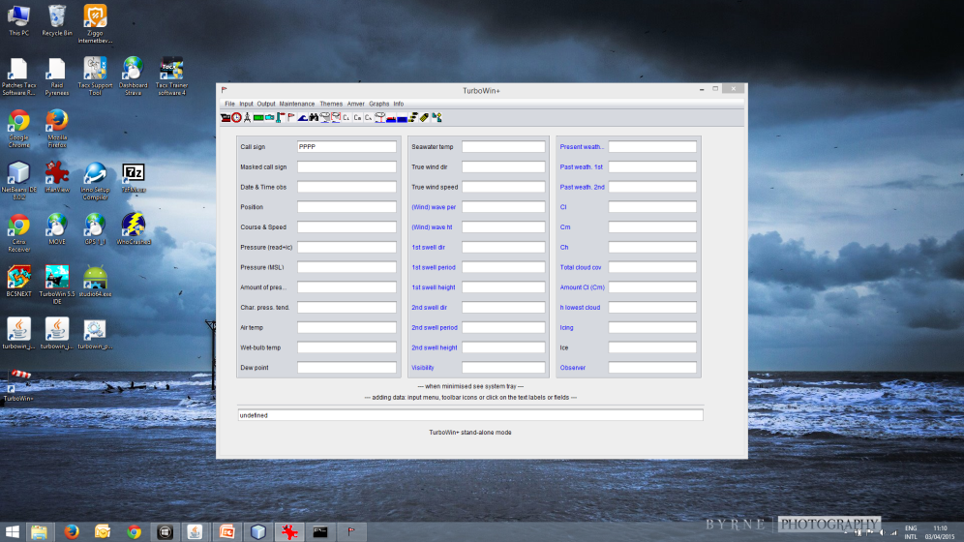
TurboWin/+/Web format 101
One mouse click away from sending your observation
- Format 101 obs automatically inserted in email message or sent to Eucaws AWS.
- After sending, TurboWin input fields automatically cleared and ready for next obs

Slide 25
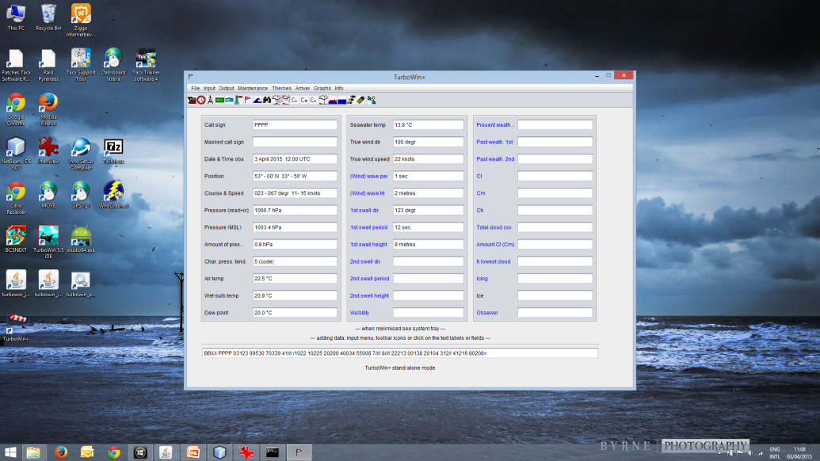
TurboWin/+/Web format 101
One mouse click from FM 13 to format 101
No difference in inserting the meteorological data between FM13 and format 101

Slide 26
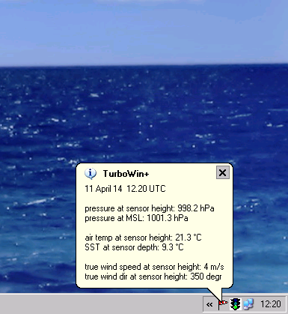
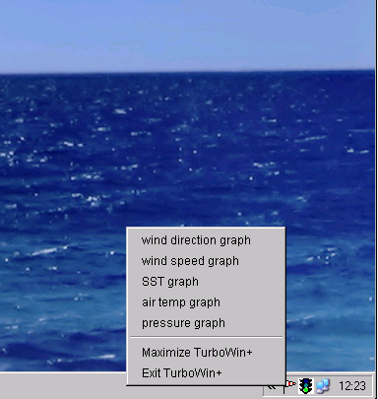
TurboWin+
System tray integration

Slide 29
TurboWin 5.5

Slide 30
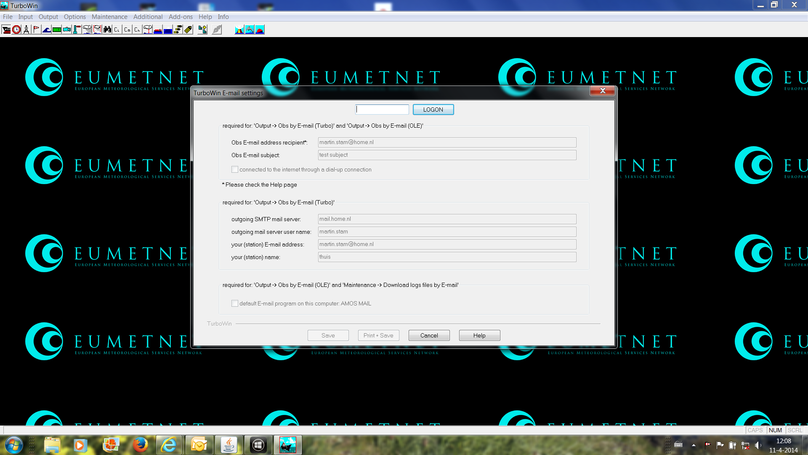
TurboWin 5.5
Email settings password protected

Slide 31
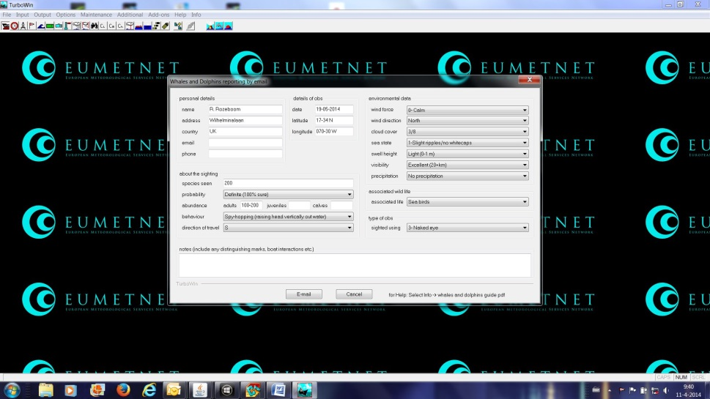
TurboWin 5.5
Whales and dolphins reporting

Slide 32
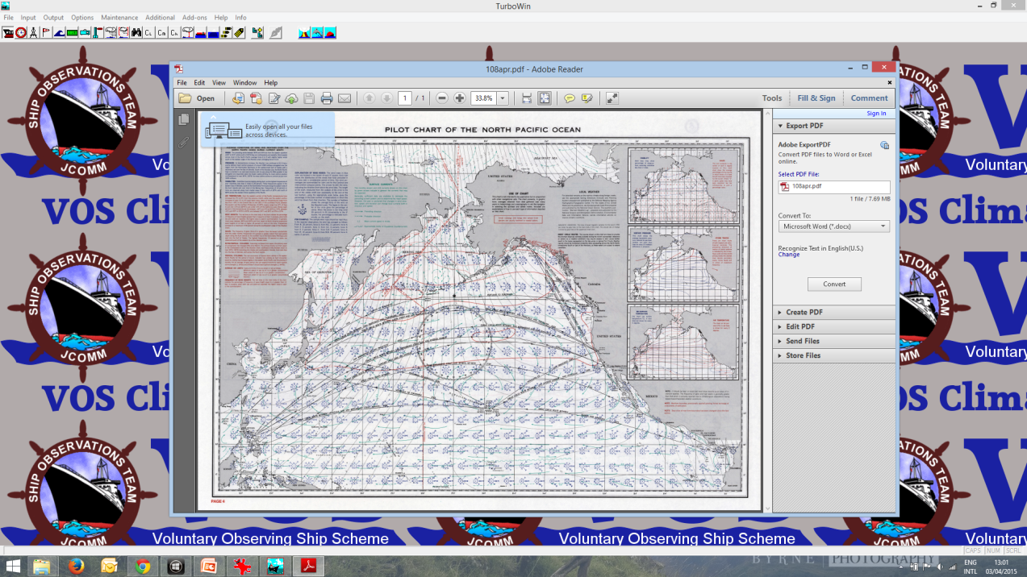
TurboWin
New
Whales and Dolphin reporting
New
Added US South Atlantic and
North Pacific pilot charts

Slide 33
TurboWin 5.5
sea state thumbnail reflects inserted wind speed

Slide 34
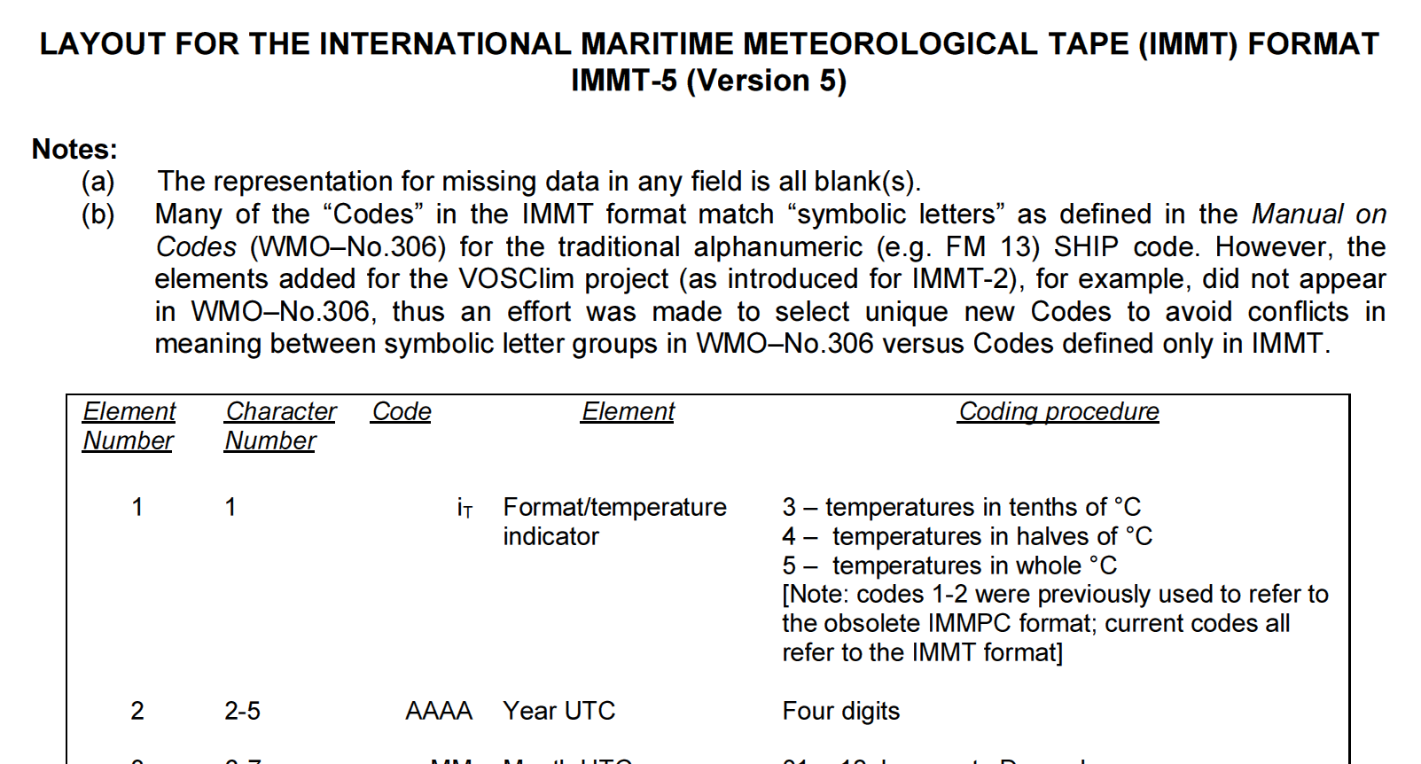
TurboWin 5.5
IMMT-5 storage

Slide 35
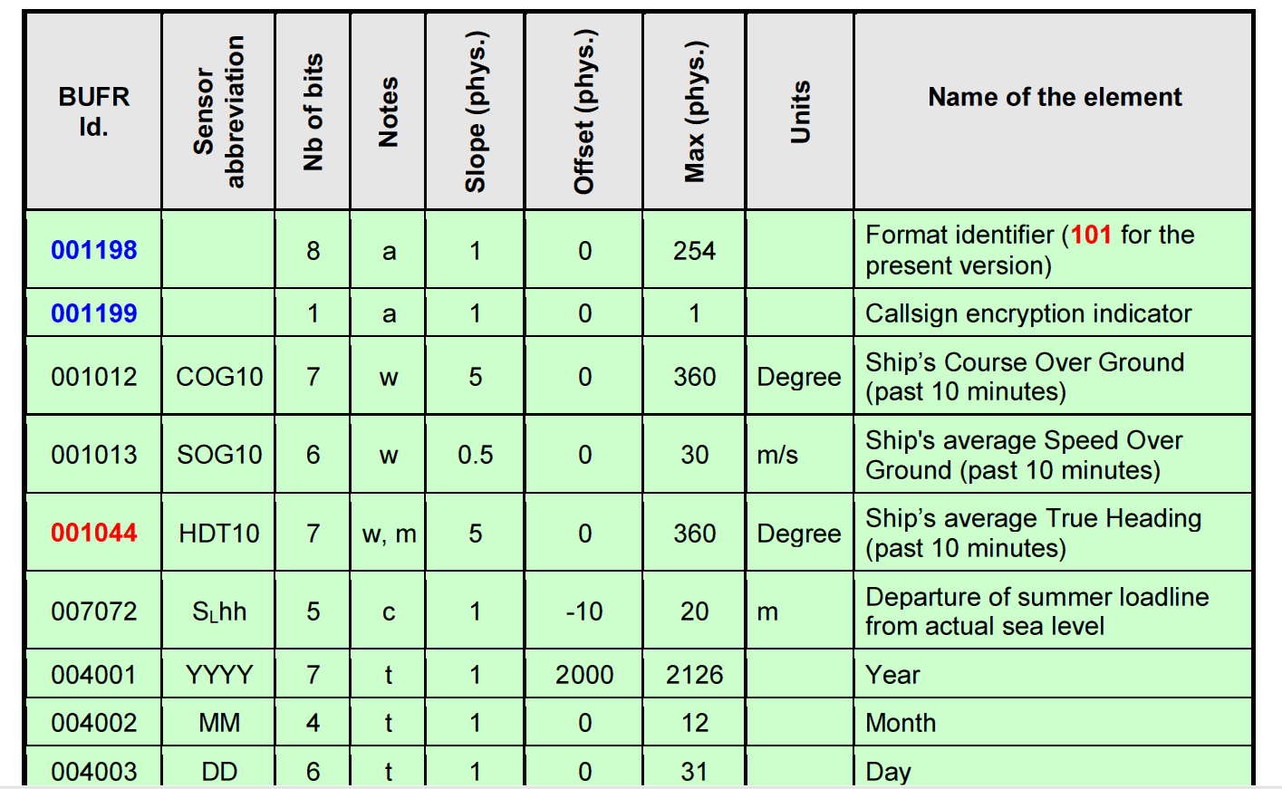
TurboWin 5.5
101 format compressed messages (compression software of Meteo France integrated into TurboWin)

Slide 36
TurboWin/+/Web format 101
Format 101 integration still beta, we need testers (approximate 20 hours)

Slide 37
Gracias por su atención / Thanks for your attention
Tienes preguntas / Questions

