Slide 1
Role of the PMO
Sarah North - Chair Ship Observations Team (SOT) VOS Panel
PMO 5 – Chile – July 2015

Slide 2
Role of the PMO
PMOs contribute directly to the effectiveness and efficiency of the VOS Scheme. The PMO is
a representative of the national meteorological service (NMS)
the primary contact with local shipping companies, maritime authorities and the maritime community at large.
a focal point for ship based observing operations
Without the dedication and enthusiasm of the PMOs to maintain an active national VOS Fleet, the quality and quantity of reported meteorological and oceanographic data from ships would be adversely affected. This could have potentially serious implications for the;
provision of operational marine forecasting and warning services;
supply of data for climate monitoring and research; and other end users

Slide 3
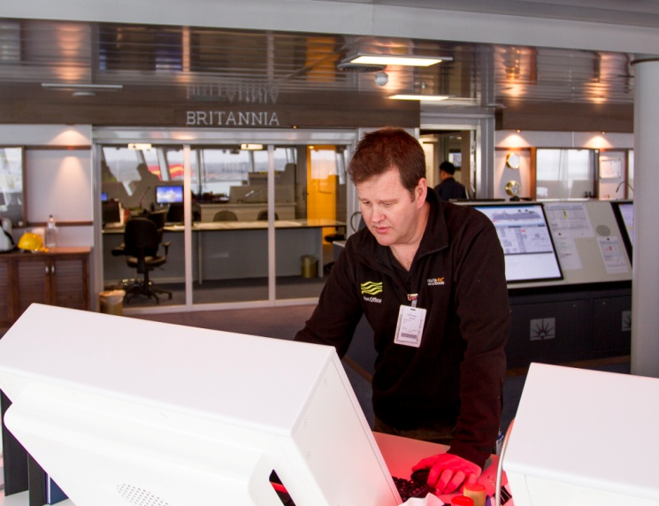
Responsibilities of the PMO
PMO Responsibilities are broadly defined in numerous WMO Publications, including:
WMO Technical Regulations (WMO No. 49);
Guide to Marine Met. Services (WMO No. 471);
Manual on Marine Met. Services (WMO No. 558).
Each National Meteorological Service (NMS) may also specifically define the functions of the PMO in national guides, manuals and work instructions:

Slide 4
Specific Functions of the PMO
To maintain a national observing fleet by;
Recruiting ships of any nationality (if not already recruited by another Met Service !) to take, record and transmit weather observations whilst at sea;
De-recruiting ships as deemed necessary.
Ensuring the frequency ,quality and timeliness of ship’s weather reports
To regularly visit and inspect ships recruited into the national VOF to:
Maintain contact with the Master and observers, and provide ongoing training
Maintain and inspect the meteorological and selected oceanographic instruments;
Ensure instruments remain within calibration
Install and check electronic logbook software, and recover log files.
Maintain the ship's supply of consumables and stationery- observing handbooks, barograph charts, muslin, wicks etc
  Ensure data quality and timeliness meets user requirements
  Provide quality monitoring feedback to observers

Slide 5
Specific Functions of the PMO
Ctd.
To maintain accurate records of the ships recruited, including:
Full ship metadata, as required for WMO Pub No 47
All instrumentation supplied and recovered;
All instrument checks and calibrations dates.
To provide the services, including
  Perform checks of ships own barometer;
  Provide advice on forecast bulletins, including SafetyNet broadcasts, local shipping forecasts and warnings, Navtex broadcasts, radiofax broadcasts schedules etc.
  Undertake courtesy inspections of overseas VOS
To promote the VOS Scheme and maintain liaison with:
National Meteorological Services
Neighboring and overseas PMOs;
Harbour authorities and shipping companies; and
Merchant marine schools and yacht clubs.

Slide 6
Specific Functions of the PMO
Ctd.
To investigate problems that may be experienced :
The transmission of meteorological and oceanographic observations
The reception and adequacy of forecasts, bulletins and facsimile broadcasts.
Provide prompt feedback on ships flagged as suspect by QC monitoring
To support complementary national, regional and international marine meteorological and oceanographic programs:
The deployment of drifting buoys (DBCP);
The deployment of profiling floats (Argo);
The Ship of Opportunity Programme (SOOP);
The Automated Shipboard Aerological Programme (ASAP).
The Drifter Donation Programme (where PMOs can act a buddies)
Regional Programmes like E-SURFMAR
To inspect, install and maintain ship AWS systems, liaising with technicians and shipping companies as required
To issue certificates and awards to qualifying observers and ships

Slide 7
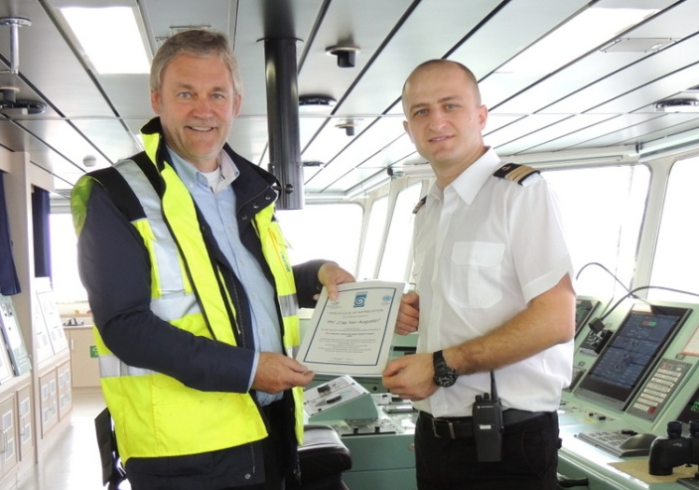
Specific Functions of the PMO
Ctd.

Slide 8
PMO
"Quick Reference Guide"
http://www.bom.gov.au/jcomm/vos/quick_reference_pmo.html
The guide is available on the VOS website to help newly appointed personnel become familiar with the functions of a PMO and to re-acquaint experienced PMOs with these functions
It contains detailed guidance for the following activities...
Monitoring Ship Movements
Recruitment Preliminaries
Recruitment Visits
Post Recruitment Monitoring
Routine VOF Monitoring
Routine Inspection Visits
Encouragement & Rewards
De-recruitment
Communication & Liaison
International Support
Supplementary Programs

Slide 9
Recruitment Guidance
FACTORS TO CONSIDER BEFORE RECRUITMENT
  Does the ship fit within the Met Service recruitment ‘strategy’? (check with HQ)
  Is the shipping company supportive of the VOS Scheme?
  Are the officers and Master likely to participate and provide the required number of obs.
  Is the ship suitable – size, type, language spoken on board, likelihood to return to home port?
  The trading pattern or route of the ship (e.g. to target particularly data-sparse areas;
  The percentage of the time sailing in desired areas; Length of charter on the route;
  Suitability of bridge computers to install electronic logbook software ( TurboWin )
  Ability to regularly inspect and check/re-calibrate instruments;
  The availability of certified NMS instruments for supply on the ship;
  Ability of ship to transmit quality observations in timely manner
  The suitability of the ship to carry and care for the loaned NMS instruments;
  The availability of a suitable communication system on the ship to send the observations;
  The availability of a computer on the Bridge on which to install electronic logbook software.
  Is the ship already recruited by another Met Service ?? Has it observed in the past
  Provide brochures, pamphlets and presentations to encourage participation
  Check AIS movement information
  Suitability for an AWS

Slide 10
Recruitment Guidance
INITIAL RECRUITMENT
Determine the most appropriate VOS Class (aim for VOSClim)
Install calibrated NMS instruments ensuring the best possible exposure.
Provide nationally prescribed marine observing stationery and reference material (e.g. marine meteorological handbooks, sea-state and cloud charts/booklets, observing handbooks, coding card/book, recruitment folders )
Provide initial training to officers – Care of instruments and use of electronic logbooks
Advise on the preferred method of transmitting the observation - SAC41, email or web
If Sat C how will the data be transferred from the electronic logbook to the Sat C (floppy/transcribed/sd card)
Advise which SAT C Land Earth Stations will accept Code 41 messages
Advise email address to send obs (and any tests required beforehand)
Available power sources for connecting digital barometer - Can the digital barometer be linked to the computer
Collect necessary metadata for WMO Pub47 including photographs or sketches
Collect necessary information for national recruitment form
Who is the principal observing officer/contact?
Somewhere to stow spare equipment?
Gauge willingness to ensure quality observations - forthcoming crew changes, tours of duty
How frequent will obs be submitted (no need for synoptic hours)

Slide 11
PMO Additional Responsibilities
Increasing operational demands are being placed upon PMO’s – including onboard support for …
    ASAP Operations
    Drifting buoy deployments
    ARGO Float deployments
    SOOP – XBT operations
    Research Activities/Projects
    Ship AWS activities ( to be considered later)
    These demands are inevitably impacting upon the range of skills and expertise needed by PMOs

Slide 12
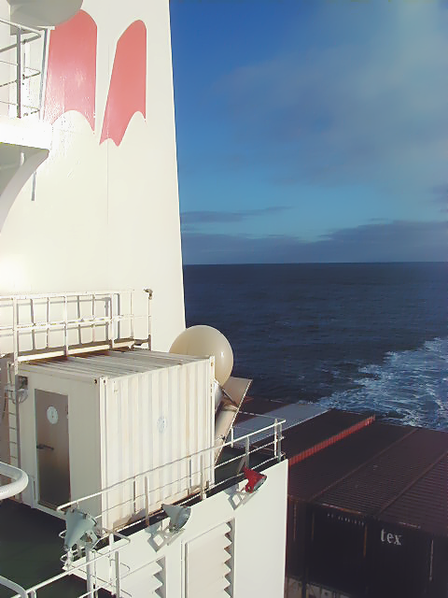
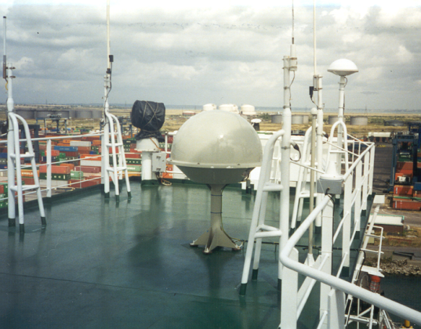
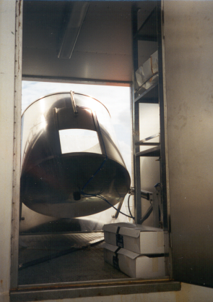
Other PMO Activities
ASAP
The majority of ASAP ships are now operated under the auspices of the Eumetnet E-ASAP programme – which currently operates 16 ships operating on North Atlantic routes
The remaining ASAP ships are mainly research ships operated by countries such as Japan and South Africa

Slide 13
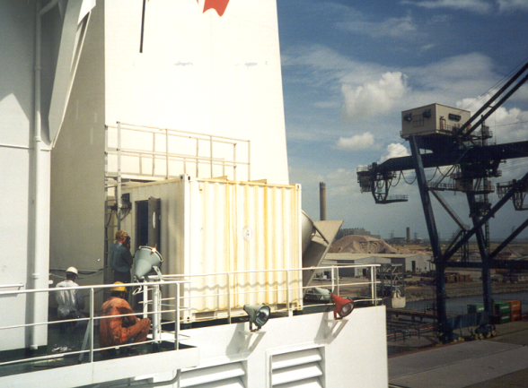
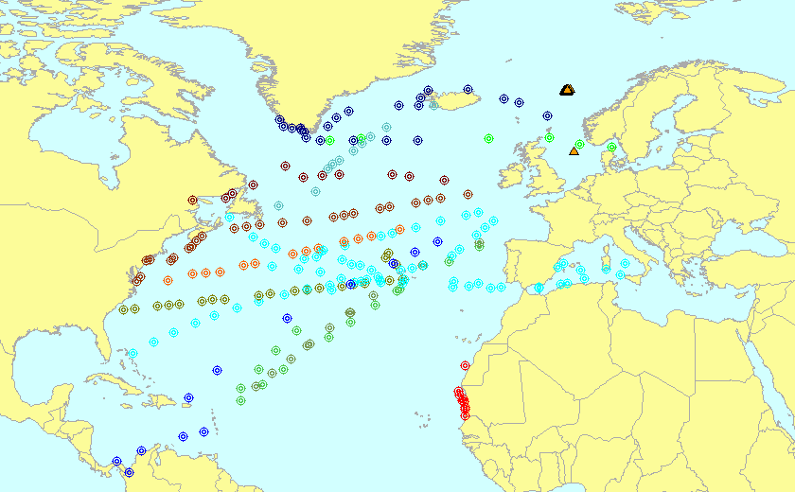
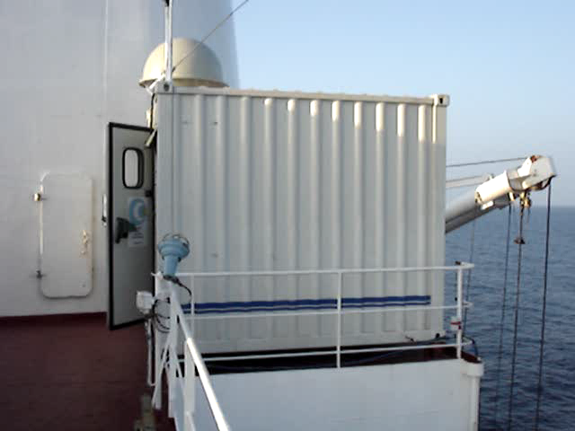
Other PMO Activities
ASAP
The range of PMO duties for ASAP include..
Helping to recruit host ships on suitable trading routes
Assisting with initial survey of host ship and installation of ASAP system
Ongoing encouragement and support for ASAP operators
Training in correct ASAP operations and practices
Resolution of any observation monitoring problems
Assisting with resolution of any equipment/transmission problems
Downloading of raw data
Collection of sounding logs
Arranging re-supply of consumables (helium gas, sondes and balloons)

Slide 14
Other PMO Activities
Drifters
The range of PMO duties for Drifting Buoys include....
  Sourcing suitable deployment ships on required routes
  Arranging storage of drifters prior to deployment
  Checking drifting buoy transmission prior to deployment
  Trans-shipment of drifters to ship
  Preparation of deployment instructions for ships staff
  Providing training and instruction to ships staff on correct deployment procedures
  Checking deployment details are correctly recorded ( e.g. in TurboWin ) and sent to Met Services
  Providing feedback to ships staff on successful/unsuccessful deployments

Slide 15
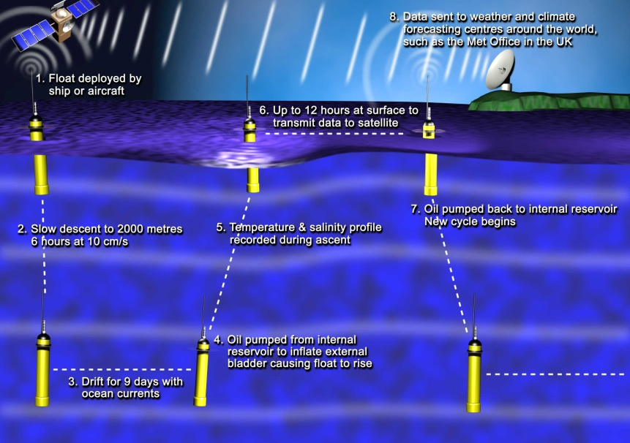
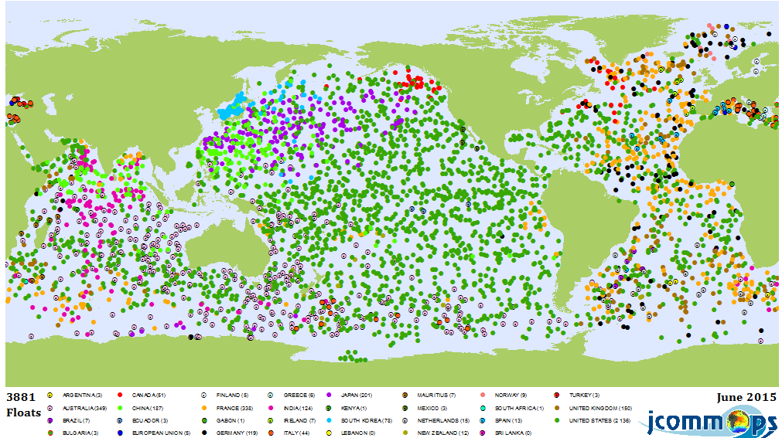
Other PMO Activities - ARGO
  Argo currently comprises 3606 active free-drifting profiling floats measuring the temperature and salinity of the upper 2,000 m of the ocean
  Argo data is freely available and is used for ocean forecasting seasonal forecasting and climate prediction

Slide 16

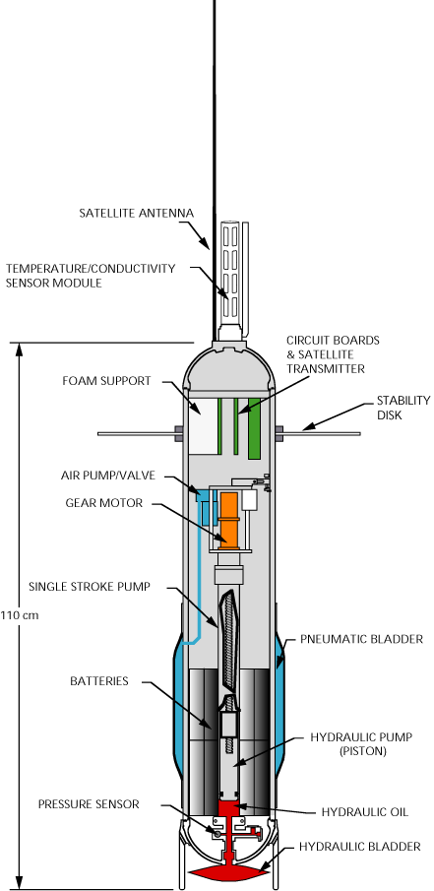
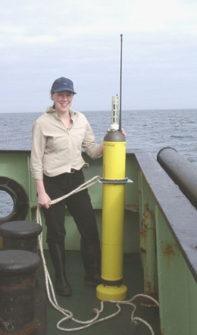
Other PMO Activities - ARGO
The range of PMO duties for ARGO Floats include....
  Sourcing suitable deployment ships on required routes
  Storage of floats prior to deployment
  Trans-shipment of floats to ship
  Providing training and instruction to ships staff on correct float deployment procedures
  Checking deployment details are correctly recorded (e.g. in TurboWin ) and details sent to Met Services
  Providing feedback to ships staff on successful/unsuccessful deployments

Slide 17
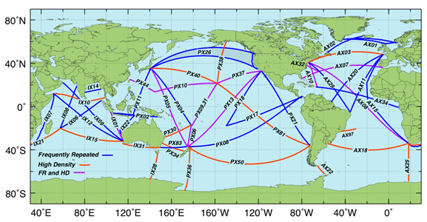
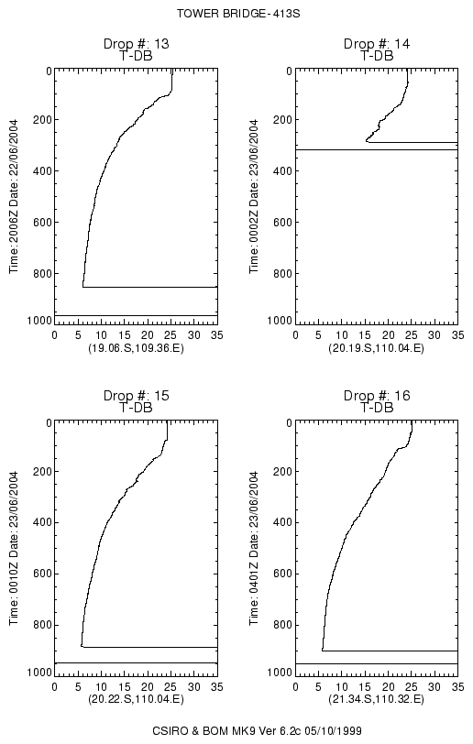
Other PMO Activities
SOOP

Slide 18
Other PMO Activities
SOOP
The range of PMO duties for SOOP include….
  Helping to source & recruit host ships on suitable routes
  Ongoing encouragement and support for operators
  Collect paperwork and the diskettes of high-resolution delayed-mode profile data.
  Re-supply of consumables (probes, disks, stationery etc).
  Provide training to new operators
  Checking equipment operation (e.g. launcher, transmitter etc)
  Provide early warning of route/crew changes
  View the XBT drops and provide immediate feedback
  Perform TEST drops
  Check cables & launcher (Wear or damage; and Intermittent problems)
  Check the laptop computer
  Confirm the understanding of the sampling instructions(Transect start & end points;Frequency of XBT drops; and Criteria for repeat drops
  Provide QC feedback to the operators

Slide 19
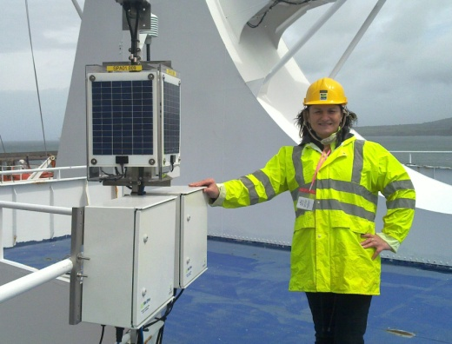
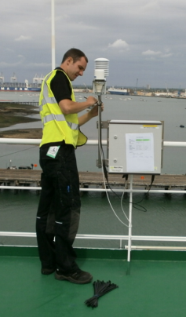
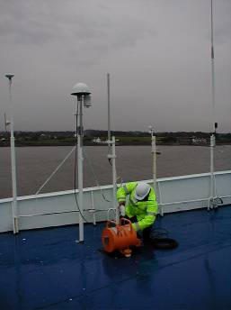
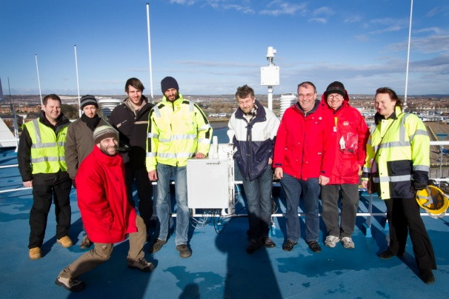
Other PMO Activities
Ship AWS
The range of PMO duties for Ship AWS include….
  Helping to source & recruit host ships on suitable routes
  Undertaking initial site surveys to determine suitability of host ship
  Liaison with ships officers and electricians regarding installation
  Verifying data transmission and data quality
  Arranging signed agreements from captain or shipowner to host ship AWS
  Inspections in service
  Sensor replacements when due – temp/humidity probes, barometers etc
  Routine checks to ensure data transmissions
  Monitoring ongoing data quality, frequency and transmissions
  Checking cables, fixings and components
  Liaising with technicians when problems are outside PMO scope

Slide 20
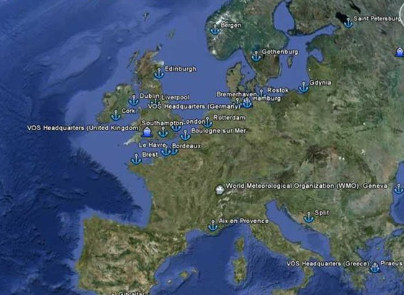
Current PMO Status
116 PMO’s are currently listed on JCOMM website
Many are only part time PMOs
Some are technical PMOs only dealing with AWS systems
The list doesn’t give a true reflection of PMO activity
Google Earth Find–a-PMO Facility to be continued when VOS website transfers to JCOMMOPS

Slide 21
Some final thoughts
      PMO/VOS budgets are under pressure – harder to justify manned VOS
      Increasing pressure to automate VOS fleets
      Need to get right balance between automatic and manned fleets
      Traditional PMO role is changing
      PMO staffing levels are being reduced and offices closed in some countries
      Some ports only have part-time PMO coverage
      There are already notable gaps in the international PMO coverage
      PMO inspection activity appears to be static - better methods are needed to monitor PMO inspection activities
      PMO ‘Buddy’ system could help enhance scope of the VOS Scheme
      PMOs needed to ensure ships aren’t over-tasked by competing demands
      Common PMO work instructions and procedures needed to ensure ships maintained and inspected to common high standard
      Growing need to crowd-source data and to make use of third party data

Slide 22
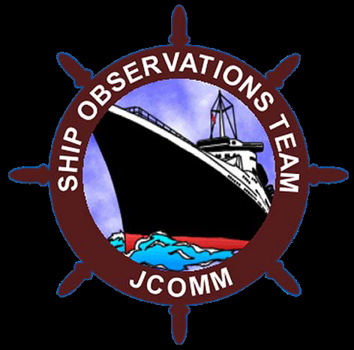
Any questions ???

