Slide 1
Goals of the PMO Workshop
Paula M. Rychtar
SOT Chair on the Task Team for Training
Deputy Program Manager, U.S. VOS

Slide 2
Examining established best practices…
What methods or techniques are currently in use which consistently show superior results compared to those achieved by other methods?
Understanding why it is vital to the success of the VOS program to embrace uniform methodology-utilizing experience and research resulting in a desired outcome.
What are the benefits to having a reference manual for PMO’s standardizing best practices?
Evaluate current best practices, develop realistic expectations and be open to change.

Slide 3
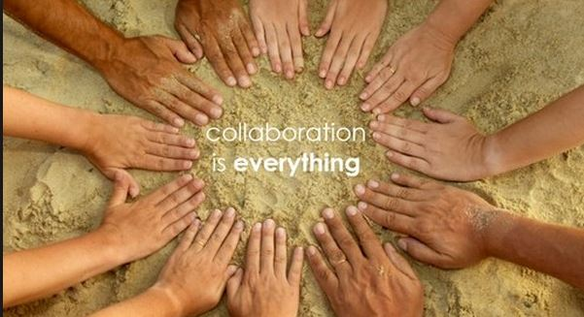
Collaboration
Establish a good rapport among your peers and associates.
Work together towards shared goals.
Sharing knowledge and experiences will provide a range of resources to be utilized towards the common goal.
Teamwork + collaboration = problem solving.

Slide 4
Mentorship
Help one another.
Take the time to offer your time, knowledge and experience.
Make the effort to provide supportive measures; encourage the professional development and the confidence of another PMO by committing to a “one on one” mutually committed relationship to promote personal and professional growth.

Slide 5
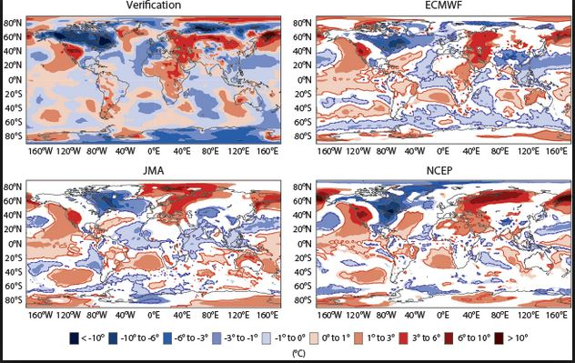
Essential: Quality data collection
How can we collectively contribute to the efforts of providing good quality data?
Understanding the need for successfully collecting ship observations within data sparse areas.
Blacklist – how can we as PMO’s improve our data quality? What methods can be established for such improvement?
Understanding some of the consequences from improperly collected data; accurate data collection is essential to maintaining the integrity of research.

Slide 6
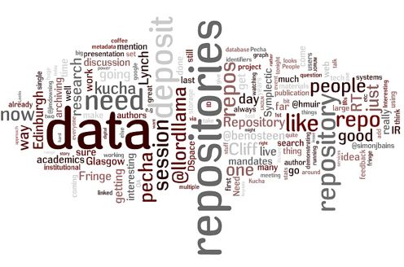
Pub 47…and Metadata
What is the significance in providing Pub 47 data?
Who and why is this required?
Understanding the need to require ships to use compliant e-logbooks to produce marine observations, and the IMMT (International Maritime Meteorological Tape).

Slide 7
This workshop is for YOU!!!
How can we help you make your program the best it can be?
What are some of the issues that cause you grief and what can be done to resolve these issues?
What are your concerns?
How can you become more involved?
Voice your ideas.
Do your best work inside the box, but think outside the box.

Slide 8
VOS: Overreaching and vital
Critical – data collection for the efforts in meteorological and oceanographic analysis and forecasting.
Environmental studies; global climate change concerns.
Water temperature and salinity studies, monitoring the health of our oceans and waterways.
VOSClim –collection of delayed mode additional metadata for future processes and analysis efforts.

Slide 9
Networking…
Remember, your day doesn't end at the end of our workshop sessions!
Get together after hours, get to know each other and talk among yourselves about concerns and new ideas. Networking is an essential part of a successful group, a team in efforts towards a common goal…success.

