Slide 1
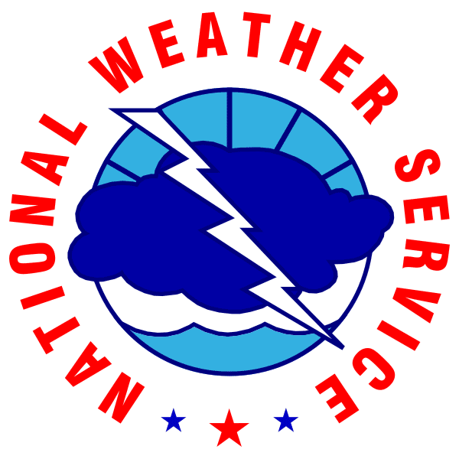
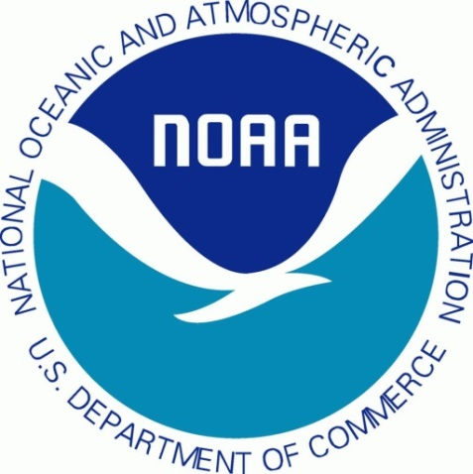
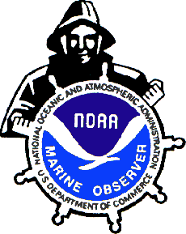
National Weather Service
Voluntary Observing Ship (VOS)
Program Importance
Steve Pritchett NWS VOS Program Manager
1

Slide 2
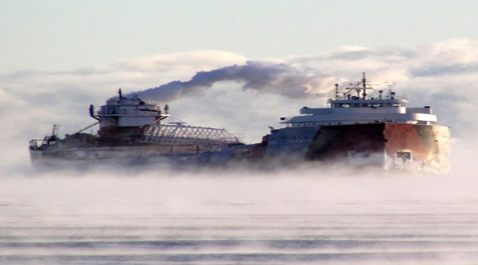
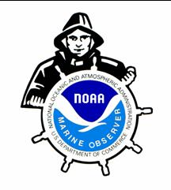
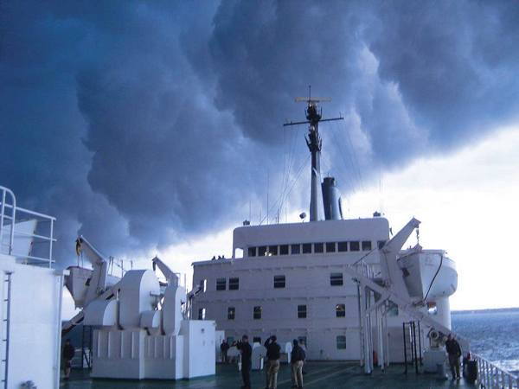
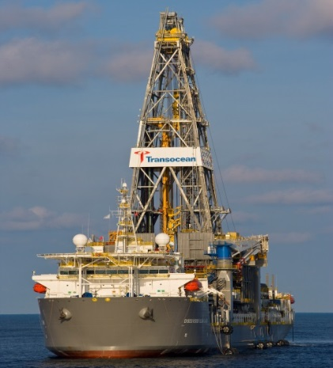
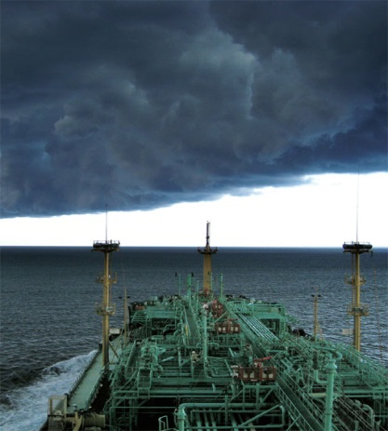
VOS Program
With approximately 70% of Earths Surface Covered With Water, Over 4000 Ships and Platforms Around the World Volunteer to Record and Transmit Meteorological Observations.

Slide 3
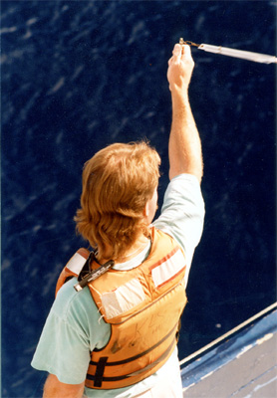
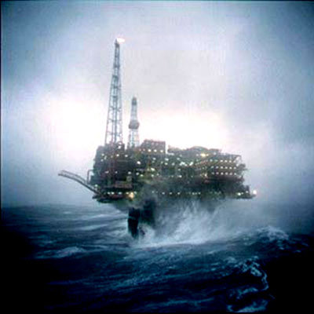
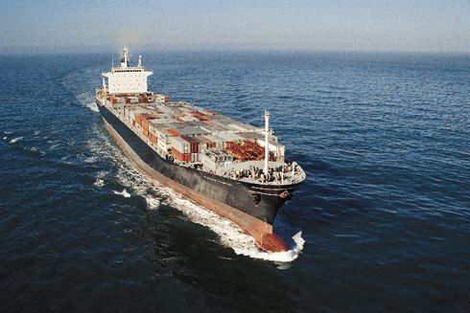
VOS Program
A worldwide program of the International Maritime Organization (IMO) and World Meteorological Organization (WMO) to recruit ships & platforms, to voluntarily observe and report marine meteorological and oceanographic conditions to ensure Safety Of Life At Sea (SOLAS), and reduce commercial loss.
23 Countries Currently Participate

Slide 4
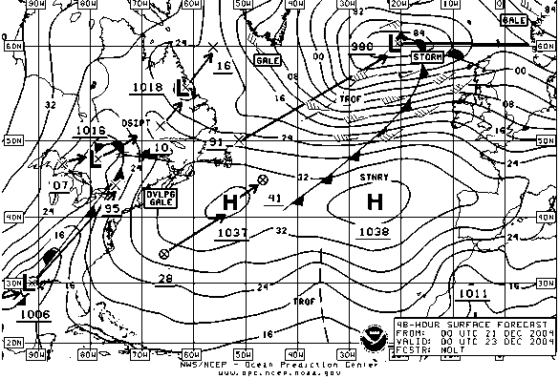
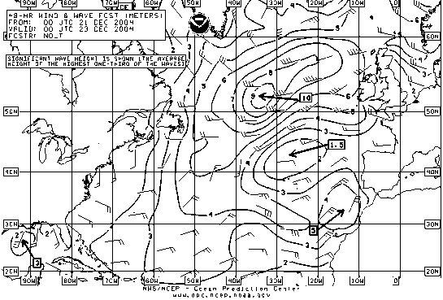
Ship Observations
The Big Picture
NOAA and WMO request that ships take and transmit observations every 6 hours at 0000Z, 0600Z, 1200Z and 1800Z. These are the main synoptic times upon which most forecasts are based.

Slide 5
Open Ocean Data Gaps
780 NM

Slide 6
Importance of Ship Obs
Ship Observations are important for numerical weather prediction (NWP) models, climate, operational marine forecasting and
environmental studies
They provide:
Data needed to construct an accurate analysis of current weather situation. (Situational Awareness - foundation for a good forecast)
Ground Truth
Verify Marine Warnings and Forecasts
Verify Satellite data (calibration adjustments are made based on ship observations)
Verify Buoy data
Verify NWP data output

Slide 7
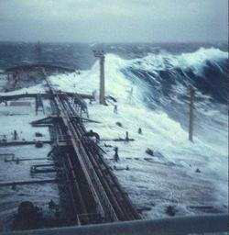
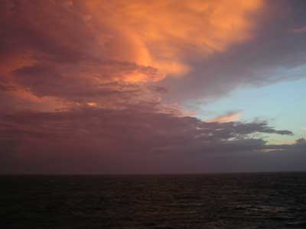
Marine Weather Forecasting
How does the forecaster use the observation?
Looks for observations that tell the Meteorologist his current forecast is accurate / inaccurate.
Looks for observations containing information about the location of fronts, dense fog or other hazards important to the Marine community.
How the Mariner can help?
Take and transmit weather observations

Slide 8
Findings of the NOAA Observing Systems Integrated Analysis
NOAA Observing System Integrated Analysis-II (NOSIA) reported to NOAA Science Advisory Board and reconfirmed VOS observations are essential to NWP models and dozens of NOAA marine products.
139 NOAA maritime products using VOS observations. NOAA Subject Matter Experts (SME) participating in the NOSIA ranked VOS as important primary data for their products
VOS was ranked in top 50% among all the NOAA observing systems through the NOSIA.
VOS’s ranking demonstrates its underlying contribution to daily products and services. The VOS Program is important to the NOAA!!

Slide 9
NOAA and NWS forecasts & products that use VOS observations
Sea Surface Temperature (SST), Time Series for Climate: Great Lakes
Sea Surface Temperature Anomaly Prediction using Linear Inverse Modeling (LIM) Medium Range Model
Ocean Surface Observations from Stations: International Comprehensive Ocean-Atmosphere Data Set (ICOADS)
Sea Surface Temperature (SST): Extended Range (ER) Reynolds Analysis
Temperature, Surface Anomaly, Global, from Sea Surface Temperature Analysis-Extended Range (SSTER) Reynolds Analysis and Global Historical Climatology Network (GHCN)
Coastal/Lakeshore Flood Warning (ANC)
Offshore Waters Forecast (OPC)
North American Land Data Assimilation System (NLDAS)
Ocean Surface and Sea State Analysis and Forecast (OPC)
20th Century Reanalysis: Effort to produce a reanalysis dataset for the entire twentieth century, using only surface observations of synoptic pressure, monthly sea surface temperature and sea ice distribution.
Unified Surface Analysis (WPC)
Unified Surface Analysis (OPC)
Hurricane Outlook
High Seas Warnings and Forecasts: Wave Heights
High Seas Forecast (NHC)
Surface, Regional and National Climate Assessments
Ocean Monitoring

Slide 10
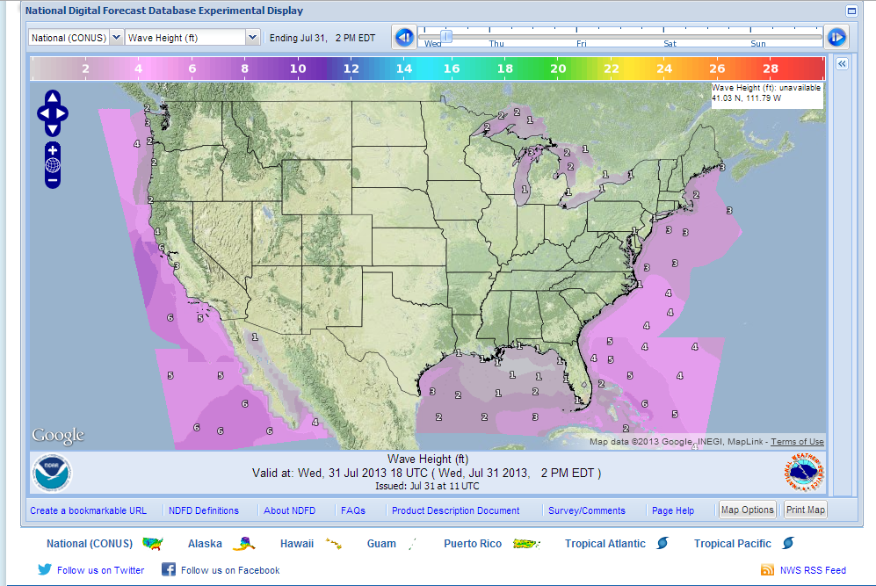
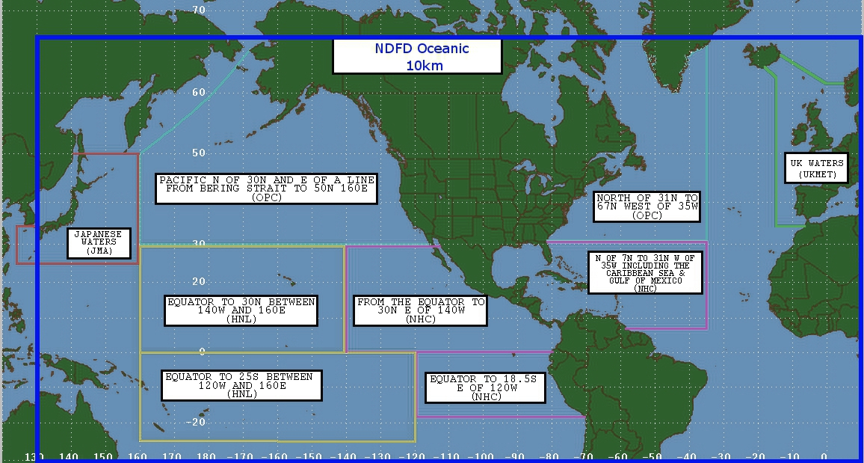
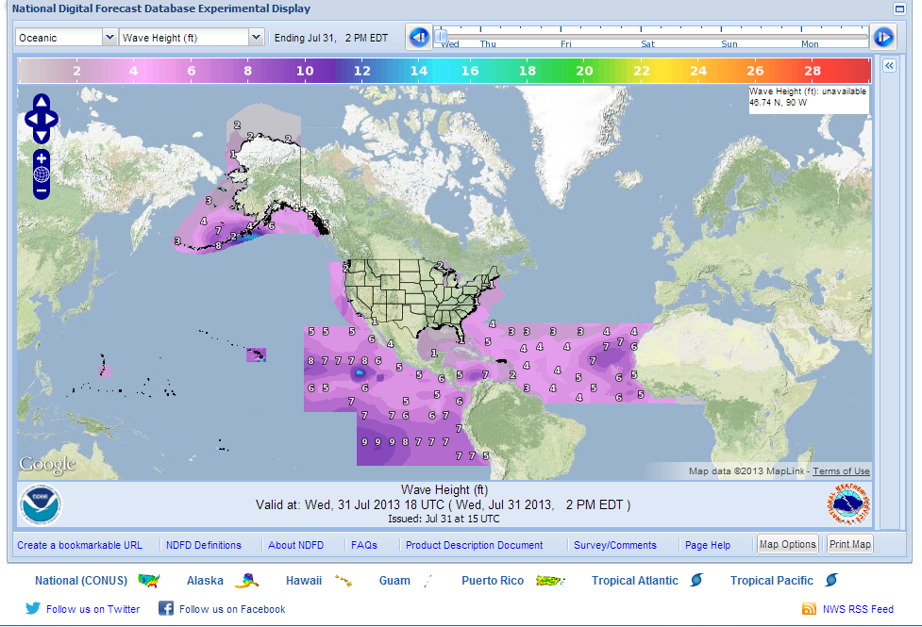
VOS Observations are used for expanding National Digital Forecast Database into
the Offshore & High Seas
Four variables to begin: wind, wind gust, wave height and marine hazards
Will be added to the new interactive graphical display
Will soon be joined by grids further north and then Hawaii and Alaska will be linked

Slide 11
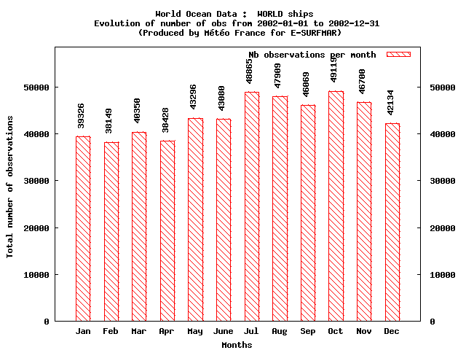
Ship Observations
CY 2002 Ship Observation Count
523,425 All Ships
523,425 All Ships

Slide 12
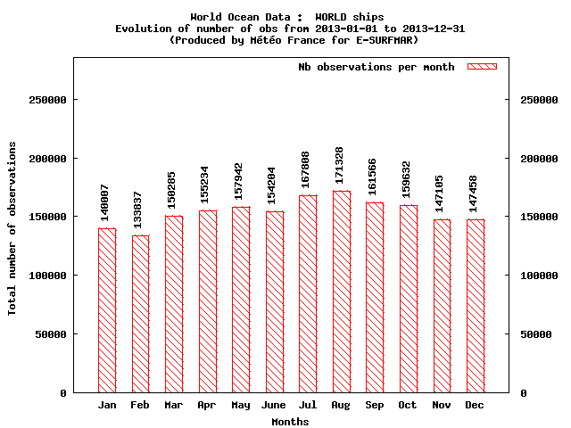
Ship Observations
CY 2013 Ship Observation Count
1,846,406 All Ships
523,425 All Ships

Slide 13
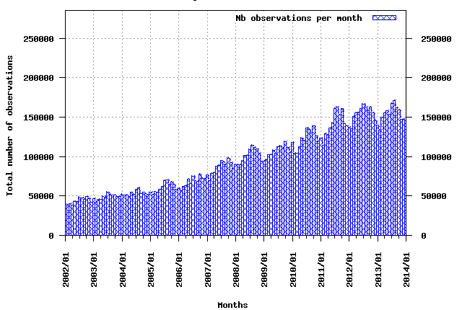
Ship Observations
A Contributing Factor to Why Marine Forecasts Have Improved Over Past 10 Years.
Increased Quality and Quantity of Marine Observations
E-Log Books (AMVERSEAS/TURBOWIN/JMAOBS)
Better Comm’s
Automated Equipment
Quality Control Software

Slide 14
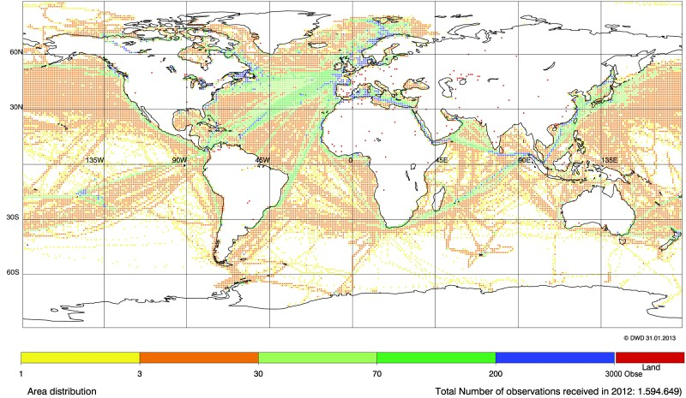
Area Distribution of Ship Obs

Slide 15
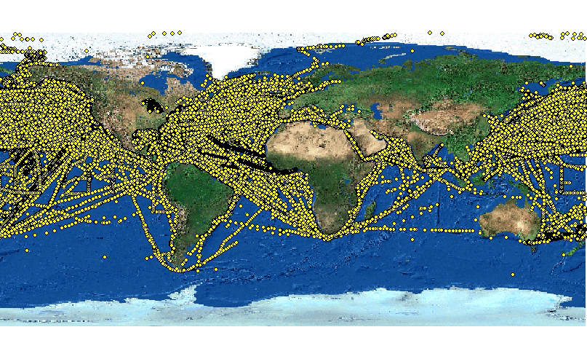
1 Year Marine Observation
2013
1,846,406 Total Marine Observations

Slide 16
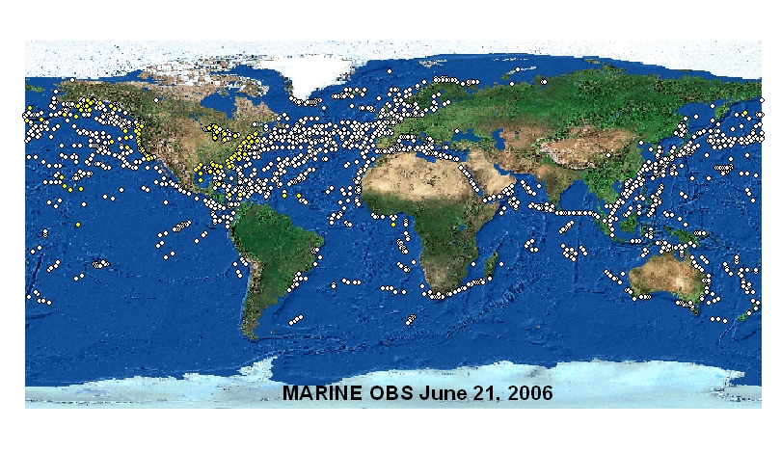
One Day of Observations

Slide 17
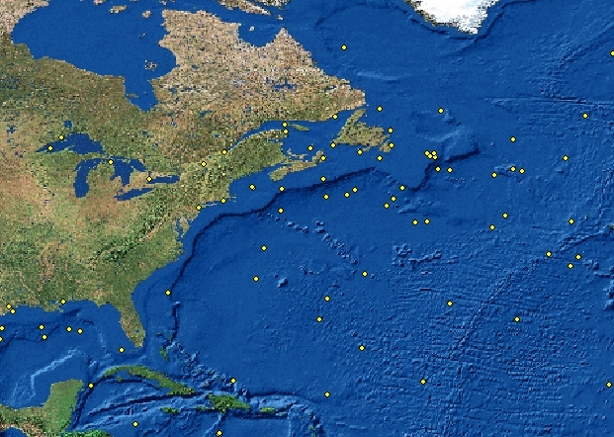
1 Synoptic Hour of Observations (1200Z)
Atlantic Seaboard – 66 Observations

Slide 18
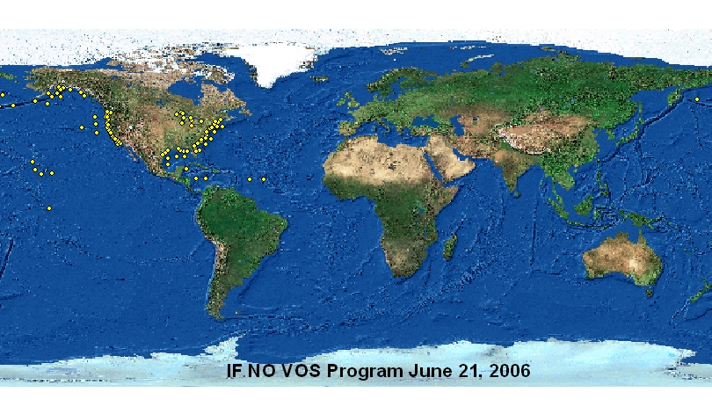
If No Ship Observations

Slide 19
National VOS Program
Support and resource the PMOs through:
Instrument standardization to ensure highest quality and metadata. Replacing the outdated existing equipment and technology from 1960’s.
Procuring equipment including barometers, calibrating existing barometers, and other new and automated instrumentation. Ensuring adequate methods are in place for property accountability.
Software Standardization - TurboWin.
Training for PMO’s including a conferences and training including safety training for new hires. Broaden opportunities for training to help in weather ready nations partnerships and project management.
Accountability to the compliancy requirements issued by the WMO and JCOMMS SOT; giving users and management reporting ability to insure complete WMO Pub47 data and quality control measures taken into account.

Slide 20
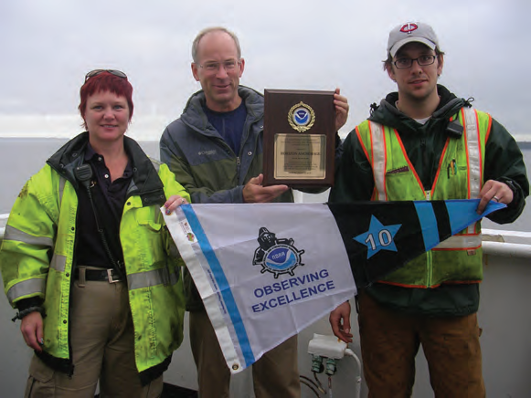
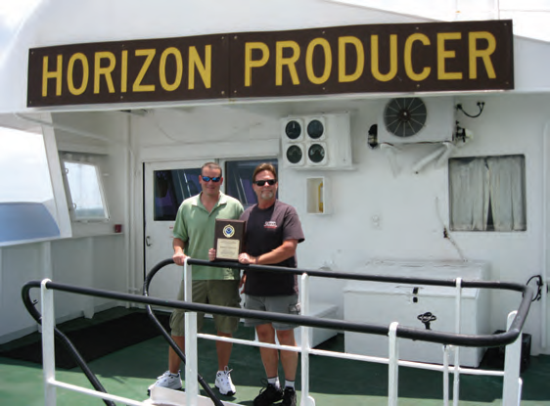
Port Meteorological Officer’s
Recruit, support and provide training for crewmembers of ships that participate in VOS program as part of the U.S. commitment to SOLAS

Slide 21
PMO Duties
Port Meteorological Officers (PMOs) support observing programs aboard Voluntary Observing Ships.
Responsible for
Recruitment of new vessels as observers, and also for ensuring the quality of observations from vessels actively participating in the program.
Visit ships, primarily assisting deck officers with marine weather observation practices, weather codes, and report transmission procedures.
Distribute observing forms, handbooks, and operating instructions, in addition they also
Equip ships and calibrate some of the weather instrumentation.
Review completed observation forms on board, point out omissions or errors, and suggest methods for improvement. They
Maintain contact with ship owners and agents, port operators, shore radio stations, and maritime academies to secure the cooperation of the maritime community.
Contribute towards building Weather Ready Nations

Slide 22
PMOs role in Building a Weather Ready Nation
NWS values the critical service of the PMOs and supports strengthening the program. The VOS program is an essential program for the weather enterprise - both in NWS and globally
Weather Ready Nation is in large part about building partnerships. PMOs are uniquely connected with the marine community and as liaisons have a key responsibility to be Ambassadors for NWS and NOAA. Like Warning and Coordination Meteorologists at NWS field offices - PMOs are the face of NOAA for the maritime community and must provide good information about our services to build partnerships.
PMOs help NWS (and NOAA) better understand maritime customers . The NWS leaders need to hear of PMO experiences and input in dealing with the maritime community.

Slide 23
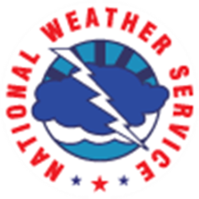
PMOs role in Building a Weather Ready Nation
The VOS program is essential for the global weather enterprise and building a Weather Ready Nation in the US
Providing in situ data for NWP such as the US Global Forecast System numerical model
Representing NOAA to the maritime shipping industry
Engaging with national and international partners
PMOs are uniquely connected with the marine community and as liaisons have a key responsibility to be ambassadors for NWS and NOAA and build partnerships.
PMOs help NWS (and NOAA) better understand the needs of maritime customers
PMOs represent One NOAA - frequently asked about issues and programs from other parts of NOAA (i.e. Right Whale information, National Hurricane Center and NOAA’s Ocean Prediction Center forecast area restructuring, PORTS and tide/current issues, etc.)

Slide 24
PMOs International Responsibilities
Comply with WMO and JCOMM reporting standards and methodologies
Recruit and sustain VOSClim Fleet
Recruit ships coordinating with VOS Program Management to meet VOS Scheme
Respond to request from International Partners to visit and service Foreign VOS Vessels
Cooperate with VOS Program Managers for US leadership and participation in WMO, JCOMM, VOS, and SOT projects, expert teams, and initiatives such as International Buddies – where countries are developing VOS programs and beginning PMO programs.

Slide 25
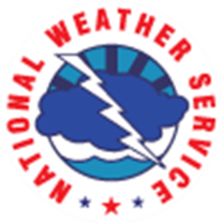
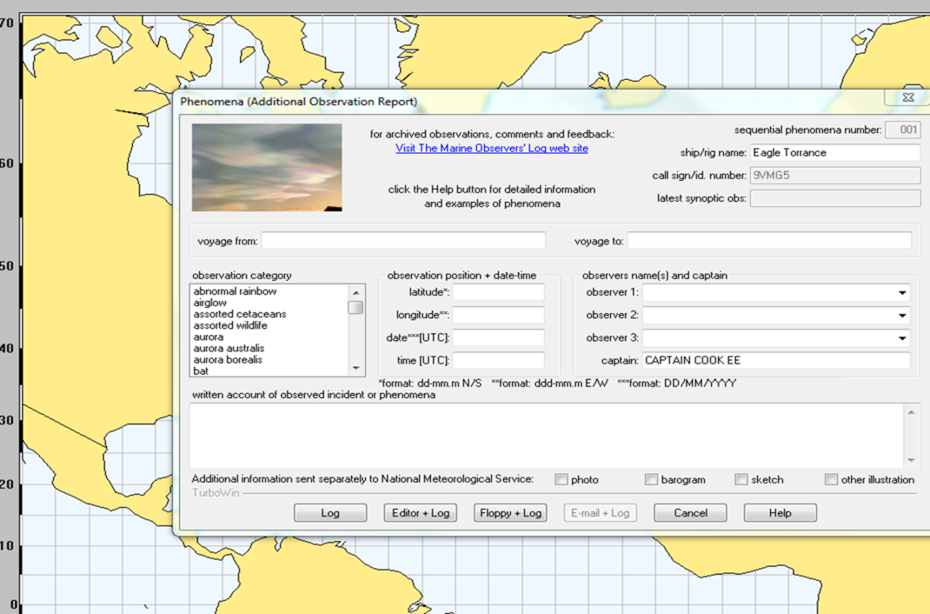
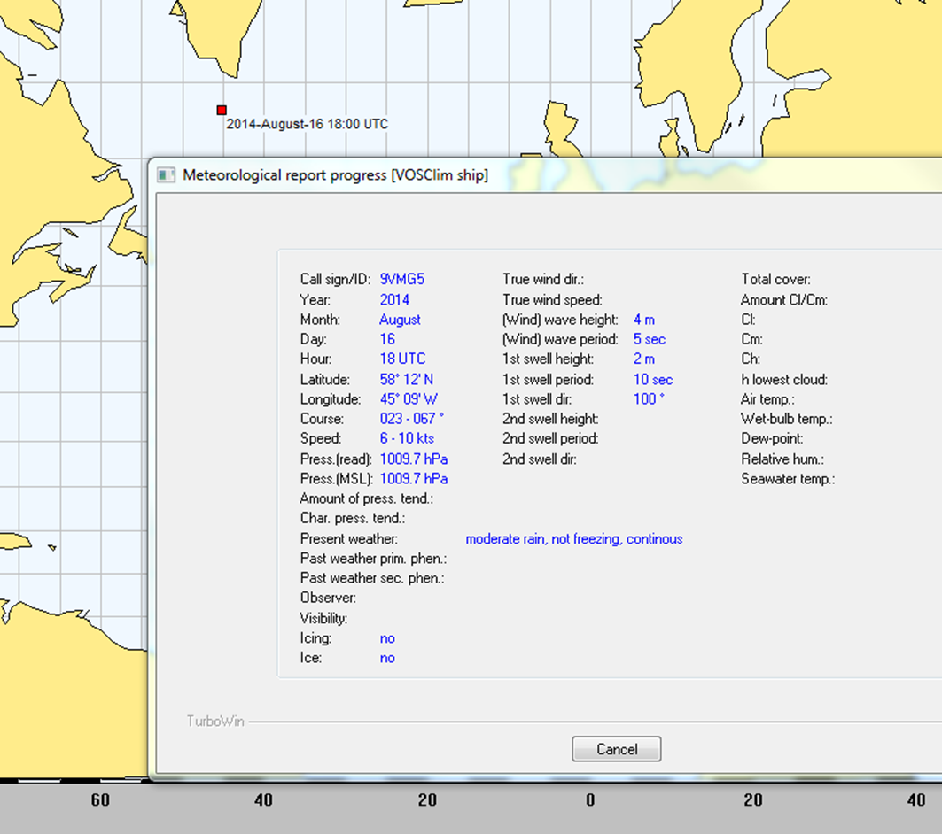
TurboWin Adopted as Standard for NWS VOS

Slide 26
