Slide 1
VOS Scheme
Sarah North - Chair Ship Observations Team (SOT) VOS Panel
PMO 5 – Chile – July 2015

Slide 2
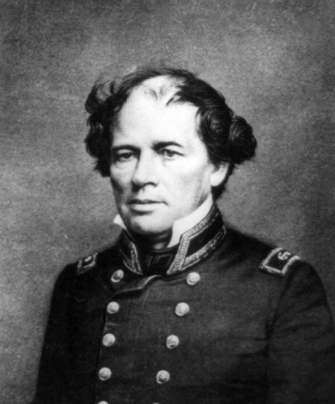
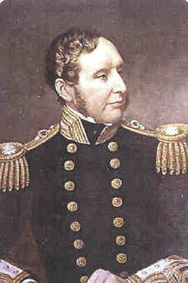
BACKGROUND
Maury was nicknamed "Father of Modern Oceanography and Naval Meteorology" and later, "Scientist of the Seas“. His produced numerous publications including ”The Physical Geography of the Sea” (1855) and made many important new contributions to charting winds and ocean currents.
FitzRoy was the Captain and then later commander of the Beagle, made famous by the voyages of Charles Darwin. He was a pioneering meteorolologist who made accurate daily weather predictions, and coined the new name "forecasts". In 1854 he established what would later be called the Met Office and created systems to get weather information to sailors and fishermen for their safety
Lieut Matthew Fontaine Maury
Vice Admiral Robert FitzRoy

Slide 3
Maury proposed that the US should convene an international conference to establish a “universal system” of meteorology. The conference was held in Brussels in 1853
Within a few years, nations owning three quarters of the world’s shipping were sending their observations to Maury at the Naval Observatory, where the information was evaluated and the results given worldwide distribution.[
Meanwhile FitzRoy was also working on strategies to make weather information more widely available for the safety of shipping and fishermen, and directed the design of a type of barometer to be fixed at every port. He laid down rules for the use of barometers at sea also introduced a system of hoisting storm warning cones at the principal ports when a gale was expected

Slide 4
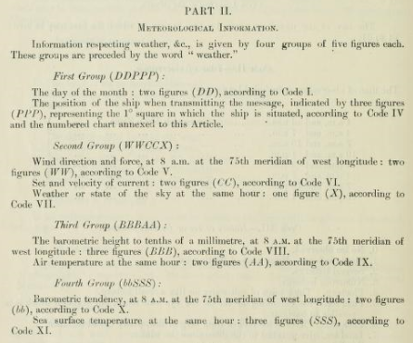
Following the 1853 conference instruments were increasingly loaned to carefully selected observing ships
In 1909 a scheme for weather reports by wireless telegraphy from trans-Atlantic ships was inaugurated
The loss of the "TITANIC“ in 1912resulted in the establishment of the Ice Patrol and in the first version of the SOLAS Convention in 1914
SOLAS 1914

Slide 5
SOLAS
Participation in the VOS Scheme was further encouraged in regulations made by the International Maritime Organisation’s (IMO) Safety of Life at Sea Conventions (SOLAS) between 1929 to 1974
Contracting Governments undertake to encourage the collection of meteorological data by ships at sea and to arrange for their examination, dissemination and exchange in the manner most suitable for the purpose of aiding navigation.
Administrations shall encourage the use of meteorological instruments of a high degree of accuracy, and shall facilitate the checking of such instruments upon request.
to arrange for a selection of ships to be equipped with tested marine meteorological instruments
to endeavour to obtain a uniform procedure in regard to the international meteorological services already specified, and as far as practicable, to conform to the technical regulations and recommendations made by the World Meteorological Organization,

Slide 6
In the 1970’s new styles of ships and ship management were taking hold and an increasing number of ships transferred to flags of convenience
Shipowners started to reduce their manning levels - which had an impact on the time that observers could allocate to preparing weather reports
Over the last two decades there has been a continual decline in the number of ships recruited to participate in the VOS Scheme

Slide 7
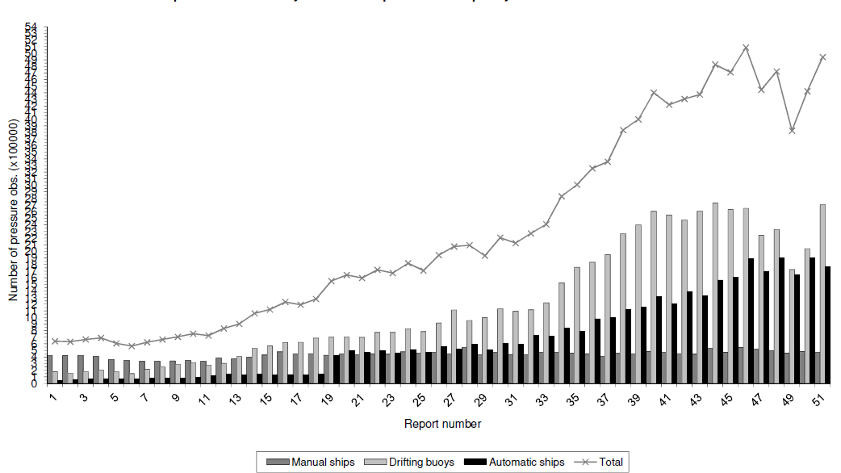
However – the number of observations from the VOS has risen over the last two decades due, in large part, to the increased use of Ship AWS systems.
Number of pressure observations on GTS from 1989 to 2014
(extract from Met Office Biennial report)

Slide 8
The VOS Scheme is a vital component of the WMO’s World Weather Watch - which also draws on observations from data buoys, oil rigs, orbiting satellites and land sites.
It is coordinated by the Ship Observations Team (SOT) which is established under the Joint WMO/IOC Technical Commission for Oceanography and Marine Meteorology (JCOMM).
Under the Scheme WMO member countries recruit ships to take, record and transmit weather observations whilst at sea.
VOS data is essential for the provision of Maritime Safety Information (MSI) forecasts and warnings and is also used for climate research.
The Scheme is also recognised by the IMO who issued a circular (MSC/Circ 1293) encouraging shipowner’s to participate.

Slide 9
Port Meteorological Officers
PMO’s are a vital component of the VOS Scheme
PMOs are essential for ...
Ensuring data quality meets user requirements
Ensuring the frequency of ship’s weather reports.
Training observers in correct methods to code and transmit obs.
Liaising with shipping companies and promoting the VOS Scheme
Collecting and checking metadata
Inspecting meteorological instruments and ensuring they remain within calibration
Inspecting and maintaining ship AWS systems
etc

Slide 10
Ships are recruited to various VOS Classes depending on the instruments supplied, area of operation, and the parameters observed
The current eight VOS classes are ...
Selected
Selected AWS
VOS Climate (VOSClim)
VOSClim (AWS)
Supplementary
Supplementary (AWS)
Auxiliary
Auxiliary (AWS)

Slide 11
Some recent developments...
The ‘Ancillary’ Pilot Project was discontinued this year (at SOT-8) and the decision was taken not to introduce the proposed new Ancillary class
Instead SOT has decided to introduce two VOS new classes
Third Party Support
Third Party Support (AWS)
A review will be undertaken into the need for so many VOS Classes and a report made to SOT9 in 2017

Slide 12
Definitions of the VOS Classes are given table 2202 (vsslM) in WMO Publication No 47 documentation
( soon to be updated )
http://www.wmo.int/pages/prog/www/ois/pub47/pub47-home.htm

Slide 13
9% reduction in VOS Participation over last two years ( compared to the global merchant fleet of ~30k ships).
VOS Class | 2013 (SOT 7) | 2015 (SOT 8)
Selected | 1,979 | 1589
Supplementary | 627 | 552
VOSClim | 305 | 382
Auxiliary | 191 | 265
VOSClim AWS | 109 | 116
Selected AWS | 68 | 60
Supplementary AWS | 57 | 78
Auxiliary AWS | 0 | 3
TOTALS VOS Classes | 3,336 | 3045

Slide 15
VOSClim Growth – currently 16% of ships and 35% of observations

Slide 16
Key Performance Indicators
25% of the global active VOS to be upgraded to VOSClim class (by SOT-8) - Just Met
Less than 3% of VOSClim class ships to be flagged on the suspect list for air pressure - Met
95% of VOSClim class observations to be received within 120 minutes - Met
At least 25% of the active international VOS Fleet registered on the E-SURFMAR metadata database to be VOSClim Class by SOT-8 - Not Met ~16.4%
All VOS ships aim to meet the reporting criteria of an ‘Active ship’ by providing an average of 20 Observations per month - Not Met ~ 42%

Slide 17
Data Coverage - January 2015

Slide 19
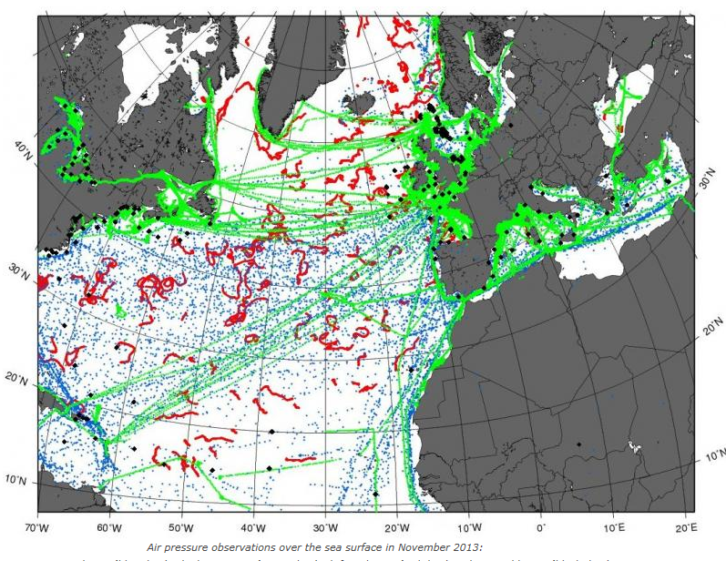
The E-SURFMAR Programme

Slide 20
90% of real time obs. from just 7 members
29 countries involved in VOS Scheme
344k obs under call sign SHIP
20k from ships not assigned to a national VOS Operator

Slide 21
Typical VOS Data Flow
Iridium
Inmarsat
Code 41,or email or compressed formats
SafetyNet High Seas Forecasts
VOS
Manual or Ship AWS
National Met Services
(which host Inmarsat LES)
Land Earth Stations
(Goonhilly, Southbury, Perth etc.)
GTS – Now BUFR !!
Other NMS’s
VOS reports are shared globally on the Global Telecommunication System (GTS)

Slide 22
Electronic Logbooks
Electronic log books such as TurboWin are cnetral to the success of the VOS Scheme
Gradual rise in the provision of e-logbook software on observing ships over the last decade - but a disappointing fall in numbers in 2014

Slide 23
The VOS Scheme - data
Real Time Data
Manually coded observations can be sent free-of-charge using Inmarsat Special Access Code 41
Email, compressed formats and Web increasingly being used now
Traditionally observations were sent 6 hourly at the main synoptic hours - but observations can now be accepted at all hours
Automatic coded observations are usually sent every hour via satellite (Inmarsat, Iridium, Argos etc)
Delayed Mode Data
Messages also stored on board in delayed mode for subsequent collection by Port Met Officers.
After quality control data are sent to the Global Collecting Centres (GCC’s) and ingested into climate databases (ICOADS)

Slide 24
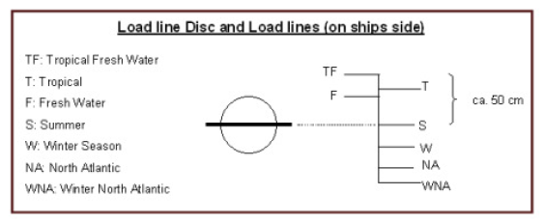
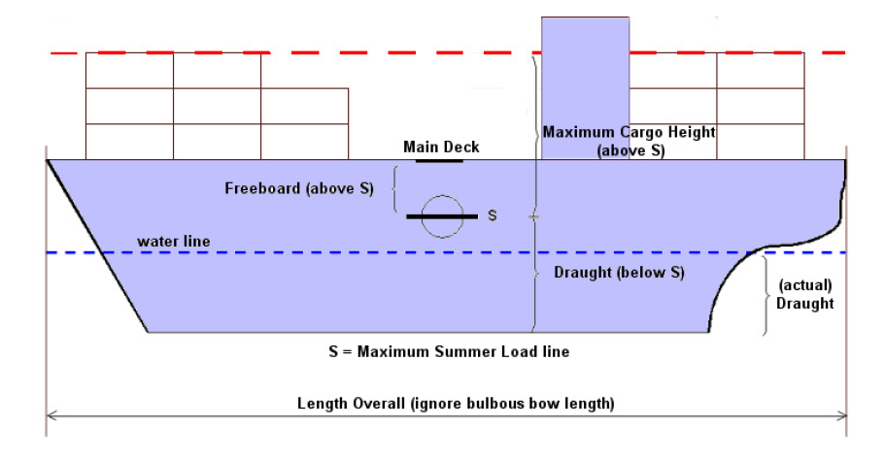
VOS Metadata
Metadata
To support the real time and delayed mode observations VOS Operators are also required to collect comprehensive metadata for WMO (Pub 47) and for the web based E-SURFMAR metadata database ( http://esurfmar.meteo.fr/doc/vosmetadata/ )

Slide 25
Data Quality
Met Office is the WMO designated lead centre for monitoring marine data and produces monthly statistics for ships, buoys, and other marine platforms
(http://research.metoffice.gov.uk/research/nwp/observations/monitoring/marine/index.html )
Comprehensive data monitoring QC tools have also been developed for the E-SURFMAR Programme and for global VOS use
http://www.meteo.shom.fr/qctools

Slide 26
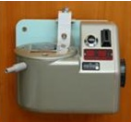
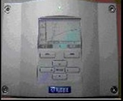
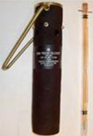
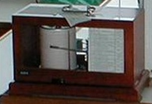
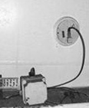
The Voluntary Observing Ship (VOS) Scheme
Weather observations are undertaken on a ‘Voluntary’ basis in all oceans and coastal areas and typically :
Atmospheric pressure.
Air temperature & Humidity.
Sea Surface Temperature.
Wind Speed & Direction.
Visibility, Present & Past Weather.
Cloud Type, Height & Amount.
Sea & Swell.
A weather observation, including message preparation & transmission, should take no more than 10 - 15 minutes to complete.
Notes:
26

Slide 27
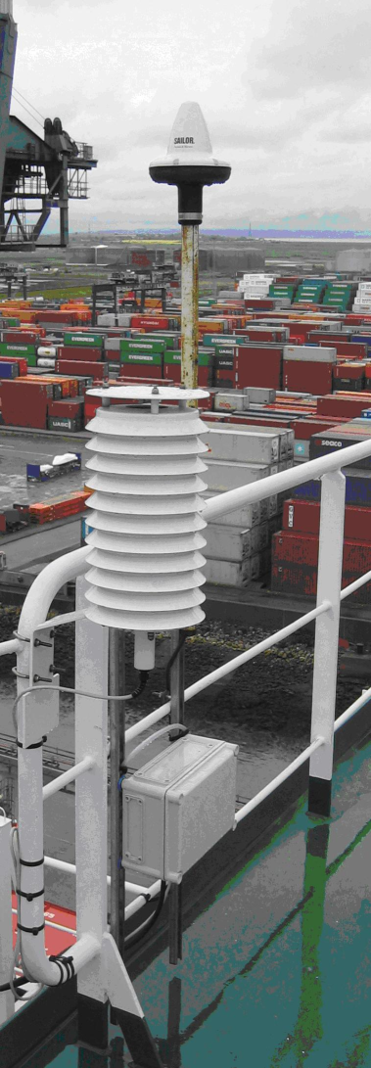
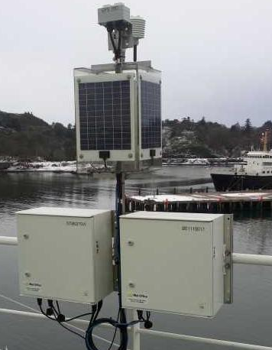
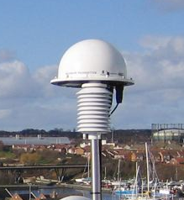
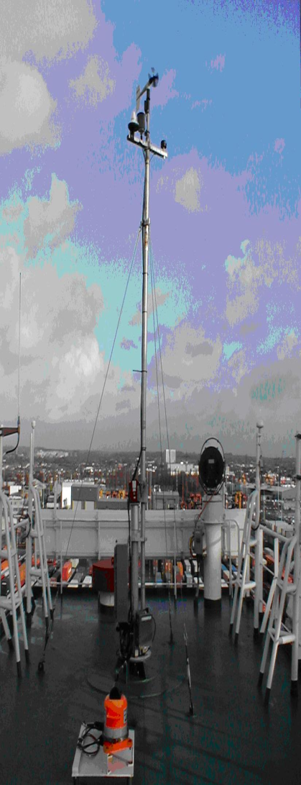
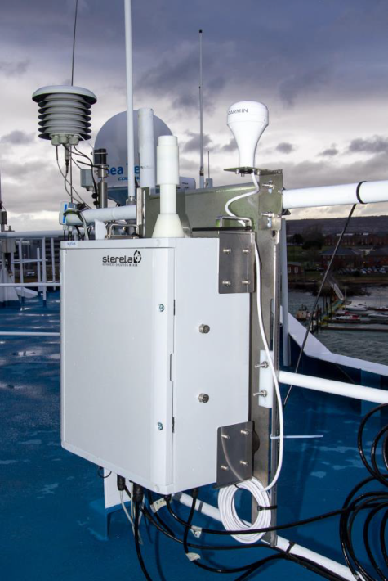
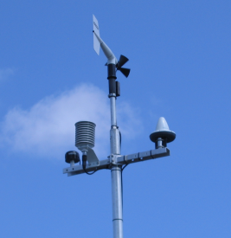
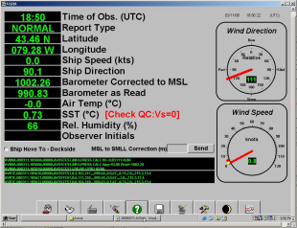
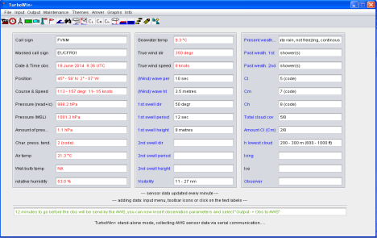
Shipboard Automatic Weather Stations
~10% of VOS are currently fitted with Automatic Weather Stations
Notes:
The Canadian AVOS system installed on the “Hudson”.
The touch screen on the Bridge displays the current conditions and allows for the manual input of visual parameters.

Slide 28
Some recent developments
Comprehensive information on the VOS Scheme is on the VOS Website
(http://www.bom.gov.au/jcomm/vos/ )
VOS Website will in future be hosted at JCOMMOPS
( sot.jcommops.org/vos )
A new VOS Questionnaire has just been drafted agreed by SOT to assess how the VOS Scheme is performing
A new VOS Brochure and VOS Poster have been developed

Slide 29
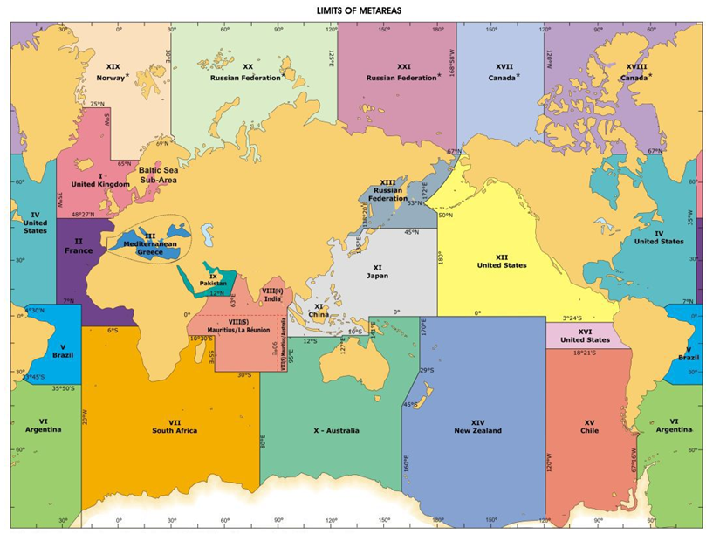
Maritime Safety Information (MSI) services
VOS data is essential for the provision of MSI
Information on MSI broadcasts by Inmarsat SafetyNet and Navtex for each METAREA is available at
http://weather.gmdss.org/index.html

Slide 30
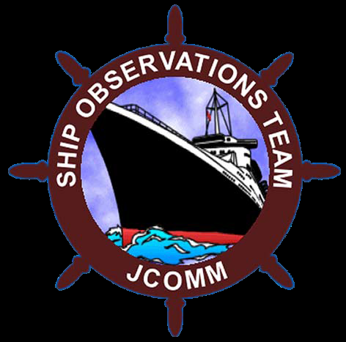
Any questions ???

