Slide 1
The WMO Integrated Global Observing System
(WIGOS)
Fifth International Workshop of Port Meteorological Officers (PMO-5)
(Viña del Mar, Chile, 20-24 July 2015)
(Etienne Charpentier, WMO Observing Systems Division)

Slide 2
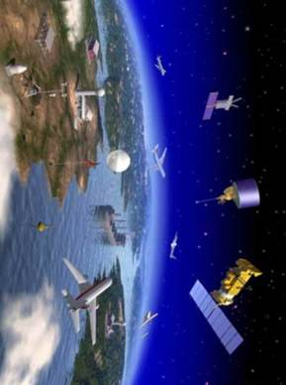
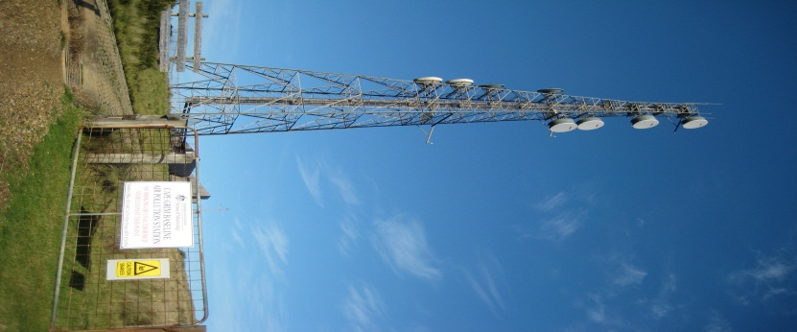
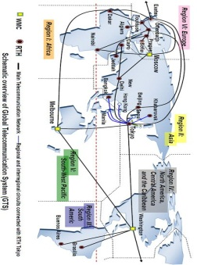
WIGOS: The future observing framework for WMO in support of weather, climate, water and relevant environment services
World Weather Watch
GAW
WIGOS
GCW
Hydro OS
GOS
GCOS
Partners
GDPFS
Co-sponsors
WIS
GTS

Slide 3
What is WIGOS?
An over-arching framework
  For the coordination and evolution of WMO observing systems
  For contributions of WMO to co-sponsored observing systems
A WMO priority & a key contribution to GFCS
A WMO contribution to GEOSS (with WIS)
Doing more & better with what we have now
For more efficient and effective service delivery
It is about changing the way WMO plans, operates and delivers observations to meet user needs
WIGOS is not:
  Replacing or taking over existing observing systems, which will continue to be owned and operated by a diverse array of organizations and programmes, national as well as international
Notes:
The change management process can allow stakeholders to buy into WIGOS concept and its implementation

Slide 4
The WIGOS Framework
The WIGOS framework is essentially about :
  Documenting and implementing standard and recommended practices and procedures for making & sharing observations
  Coordination & collaboration for efficiency and effectiveness
  Integration and interoperability
  Timely delivering observations that meet user needs in a way they can use them
  Empowering NMHSs

Slide 5
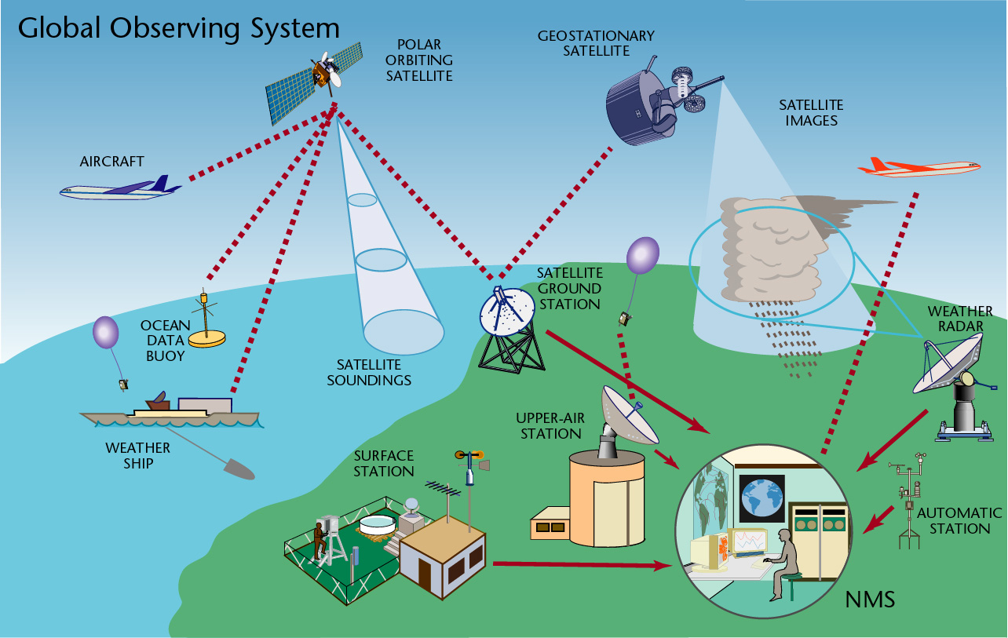
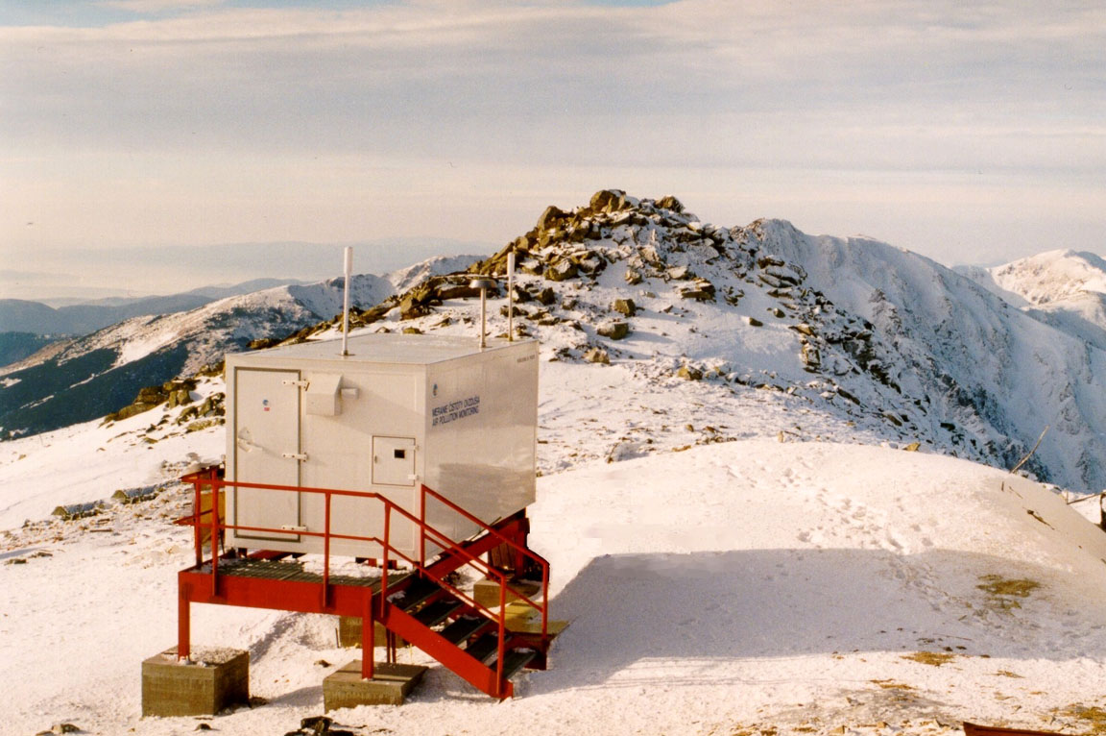
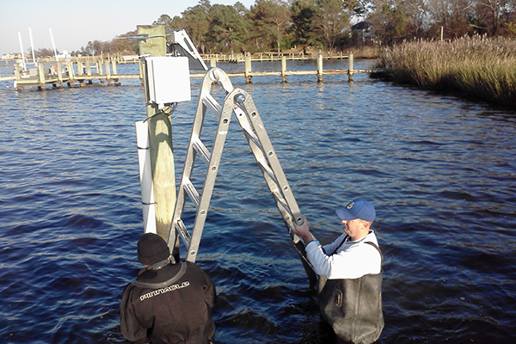
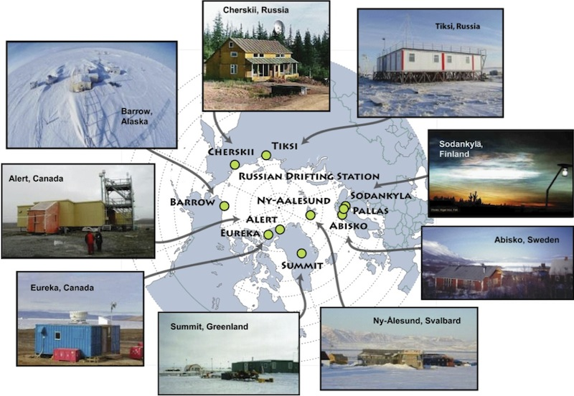
WIGOS Observing Systems
Global Observing System
(WWW/GOS)
Observing component of Global Atmospheric Watch (GAW)
WMO Hydrological Observing System (WHOS)
Observing component of Global Cryosphere Watch (GCW)
Notes:
5

Slide 6
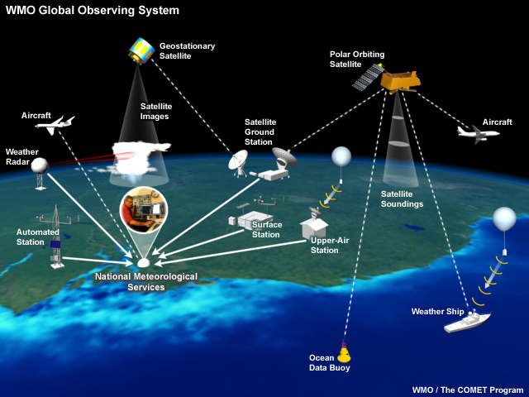
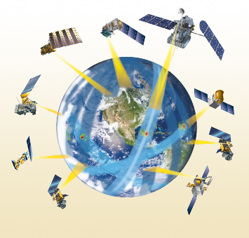

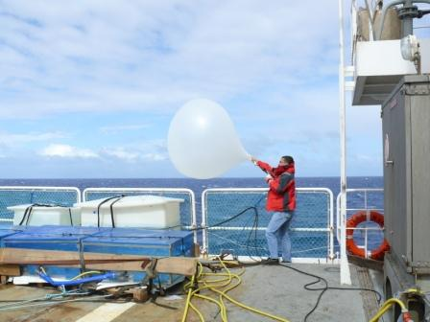
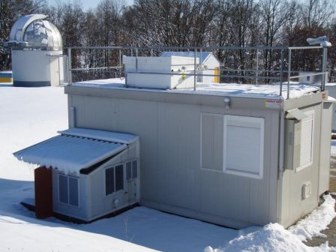
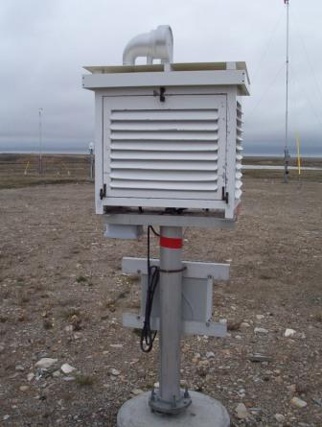
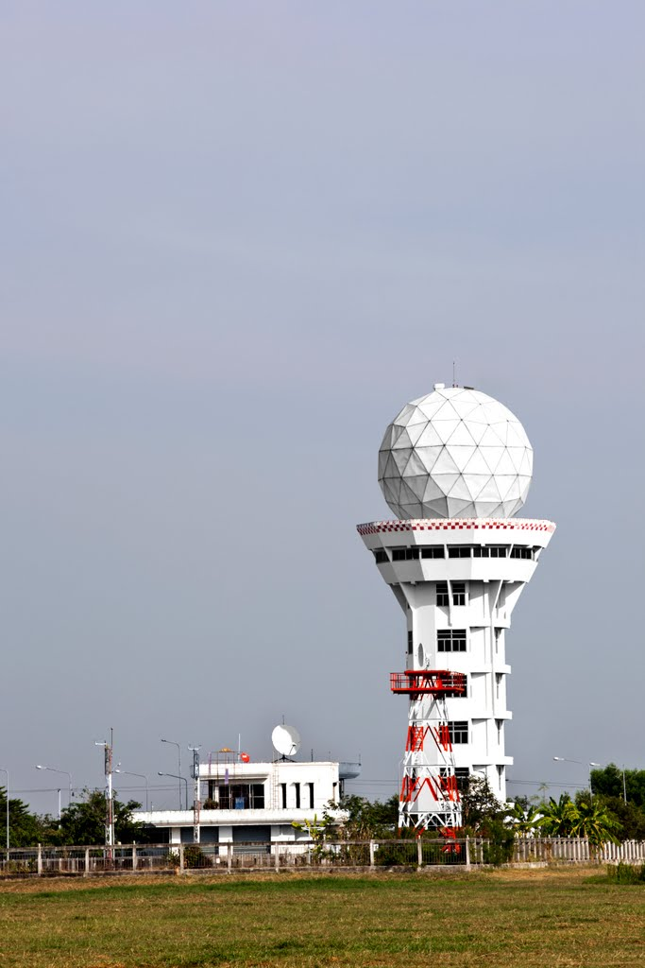
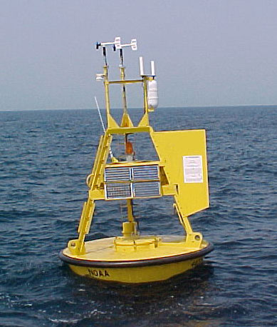
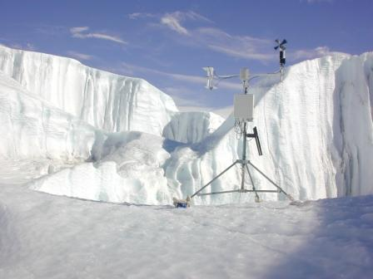
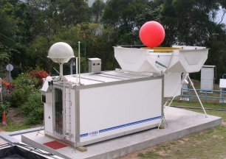
Notes:
6

Slide 7
Why WIGOS?
The mandate of modern NMHSs (Met Services) is much broader now than it was when the World Weather Watch and the GOS were created, often including e.g.
  Climate monitoring, climate change, mitigation
  Air quality, atmospheric composition from urban to planetary scales
  Oceans
  Cryosphere
  Water resources
There are challenges on how to respond to:
  Disasters (multi-sector, multi-hazard, multi-disciplinary)
  Climate change
  Resource pressures & accountability
Consideration of scientific and technical advances:
  Observing technology (improvements & new)
  Telecommunications
  Numerical modelling and data assimilation
  Increased user demand to access and use observations in decision making

Slide 8
Why WIGOS?
Current shortcomings need to be addressed:
  Obs. networks/systems not always sustainable and stable
  Design and planning not coordinated at the global & regional levels
  Obs. standards not always respected (lack of compliance)
  Databases not integrated (inconsistent, not compatible) including those of observational metadata
  Considerable deficiencies in QMS (maintenance, …)
  Lack of qualified staff
Through coordinated data sharing and networks/systems development, Members will be better equipped to address existing deficiencies and to meet future challenges

Slide 9
The WIGOS Vision
Coordinated, comprehensive, reliable & trusted observations for WMO
Addressing, in a cost-effective and sustained manner, the evolving observing requirements of Members in delivering their weather, climate, water and related environmental services
Enhanced coordination & cooperation at sub-regional and national levels for the benefit of society
Notes:
Reliable & trusted Observations: Timely, Quality assured, Quality controlled, Well documented, Compatible
9

Slide 10
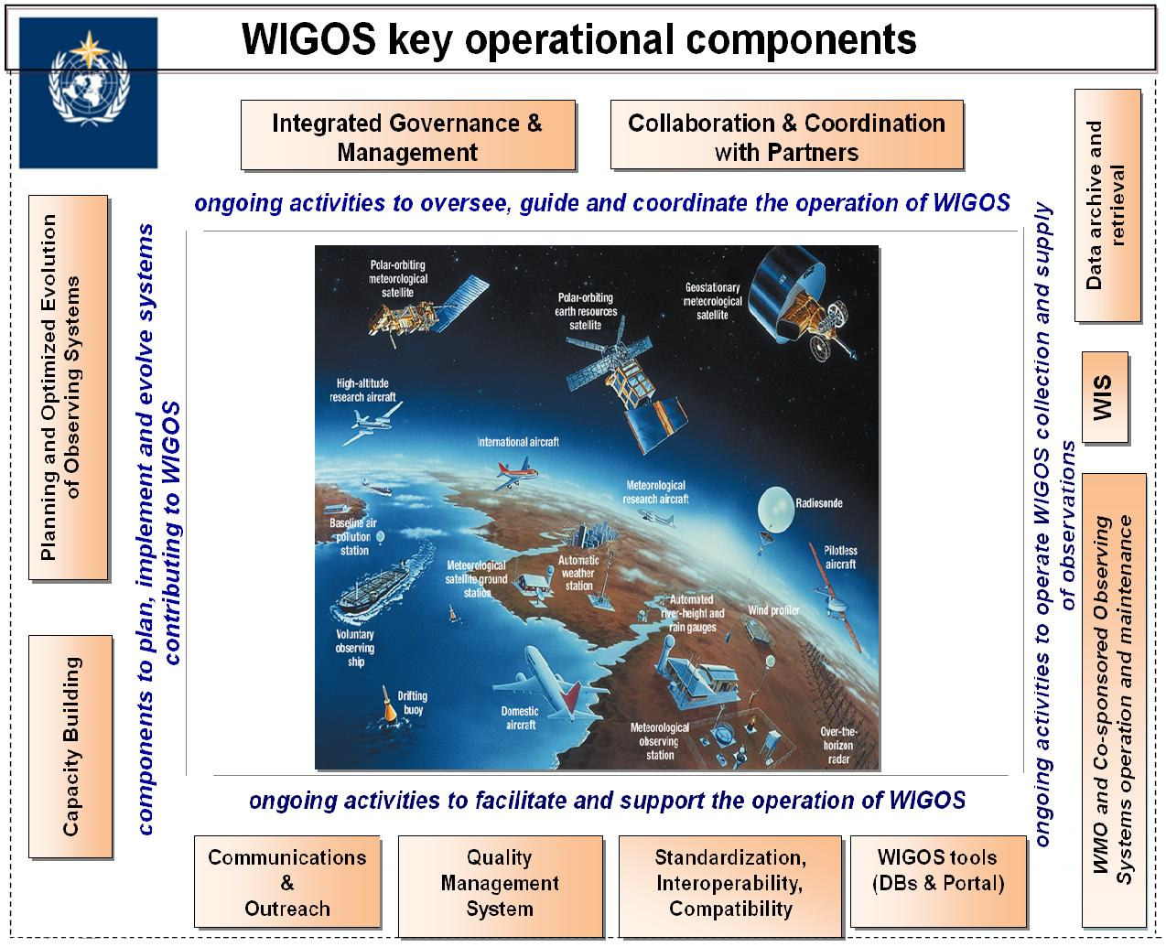

WIGOS Key areas
Management of WIGOS Implementation / operation
Collaboration with co-sponsors and partners
To oversee, guide and coordinate WIGOS
Data discovery, delivery & archival
Design, planning and optimised evolution
To ensure supply of and access to WIGOS observations
To plan, implement and evolve WIGOS component systems
Observing system operation & maintenance
Quality Management
To facilitate and support the operation of WIGOS
Communications and outreach
Capacity Development
Operational Information Resource
Standardization, interoperability & compatibility
Notes:
10

Slide 11
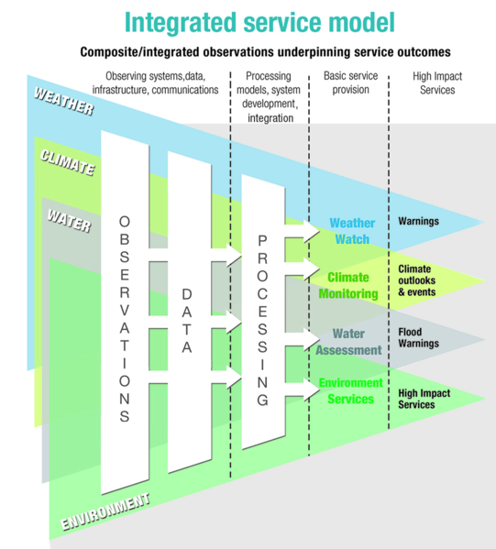
What do we mean by “integration” ?
Composite systems
'Network of networks’
Integration through:
  Supporting diverse user needs
  Systems designed for efficiency & effectiveness
  NWP data assimilation
  Partnership & collaboration
  End-to-end service model
  Data policy, access and exchange
  Coordinated network operation & maintenance
  Practices and procedures
NOT one-size-fits-all

Slide 12
Example of integration:
OSCAR – oscar.wmo.int
Observation Systems Capabilities and Review tool (OSCAR) includes
  OSCAR/Requirements, in which “technology free” requirements are provided for each application area, expressed in units of geophysical variables (260 in total currently), not measurands; not just atmosphere, also terrestrial, ocean, cryosphere, …
  OSCAR/Space, listing the capabilities of all satellite sensors, whether historical, operational or planned
  OSCAR/Surface, list surface-based capabilities; developed by MeteoSwiss for WMO, in beta-testing
  OSCAR is meant to become to official WMO repository of the WIGOS metadata that are required for international exchange

Slide 13

What do we mean by interoperability?
Ability to access, combine or compare observations from one source or system with those from another
  To achieve this, the need:
    Metadata
    Standards
    Regulatory material
Interoperability is key to turning observations into effective data, products and services that meet real user needs

Slide 14
Who is involved in WIGOS?
Global
Users
WMO and Secretariat
Other Regions
Region
Users
Member
Users
Member
S1: NMHS
Observing
System
S2: NMHS
Observing
System
etc
P1: Partner
Observing
System
P2: Partner
Observing
System
etc
Other Members
Global Co-sponsors and Partners
test footer
14

Slide 15
WIGOS Framework Implementation
To achieve the WIGOS Vision, the WIGOS framework shall be implemented to enable the integration, interoperability, optimized evolution and best-practice operation for
  WMO observing systems, and
  WMO’s contribution to co-sponsored systems.
WIGOS will use and exploit the WMO Information System (WIS) to allow continuous and reliable access to an expanded set of environmental data and products, and associated metadata.
Notes:
Framework that describes processes, principles, procedures and practices to be included in the WMO Technical Regulations (WMO-No. 49) & Guides on WIGOS and other relevant documentation;

Slide 16
WIGOS Framework Implementation Plan (WIP)
CONTENTS
KEY ACTIVITY AREAS
Introduction and Background
Key Activity Areas for WIGOS Implementation
Project Management
Implementation
Resources
Risk Assessment / Management
Outlook
Annexes
  Management of WIGOS implementation
  Collaboration with WMO co-sponsored observing systems & international partners
  Design, planning and optimized evolution
  Observing System operation and maintenance
  Quality Management
  Standardization, system interoperability and data compatibility
  The WIGOS Operational Information Resource
  Data and metadata management, delivery and archival
  Capacity development
  Communications and outreach
Notes:
2) Collaboration with the WMO co-sponsored observing systems and international partner organizations and programmes;
16

Slide 17
What does WIGOS mean at the National level?
Demonstrating national leadership in observations:
  Best practices
  Plan & design
  Sustainability, maintenance & operation
  Integration and interoperability
Compliance with WMO TR (WMO-No. 49) - standard and recommended practices and procedures
Culture change & change management;
  Supported by collaboration at Regional/Sub-regional level
WIGOS benefits will only be delivered through commitment at a national level

Slide 18
National leadership through WIGOS
WIGOS and WIS provide means & opportunities:
  To enhance national observing networks for benefit of all users
  To enhance sharing and accessibility of observations
  To reinforce central role of NMHS through partnerships & a network of networks
  To strengthen national mandate and authority
Strong national coordination & cooperation will assist in building strong regional coordination & cooperation

Slide 19
Sustain, Maintain & Operate
Most observations are sourced nationally
  Via NMHS, other agencies, space agencies
  They are basic building blocks for WIGOS
WIGOS framework for integrated planning & operating processes
  Tools for improved design & planning
  Get greater value from observations, building on potential synergies
  Develop improved support, training and maintenance practices
  Mechanisms for improved coordination with national observations providers
  Improve access, usability & benefits for users

Slide 20

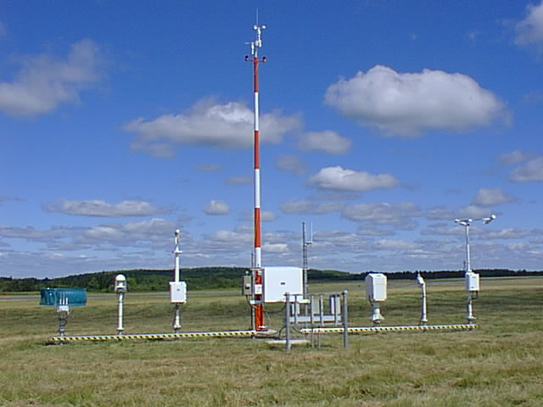
Observing Practices & Procedures
Standards and recommendations for instruments and methods of observation
All aspects of observations and observing systems:
  establishment & installation
  management & operation
  maintenance, inspection & supervision
  delivery & sharing of observations
  data and metadata management (pre-processing & processing, QC, monitoring, remedial actions, …)
Data Quality: 'fit-for-purpose' ideal
Documenting known quality is key

Slide 21
Capacity development
JCOMM Capacity Building Strategy has included WIGOS implementation needs
Capacity Building & Partnerships / PANGEA
  Developed countries providing training on data use as well as ocean instruments deployed in the region
  Developing countries contributing to the implementation of the ocean observing system on their region (e.g. ship time)
  DBCP-WIO, NPOMS & PI series of workshop are excellent examples
WMO-IOC Regional Marine Instrument Centres (RMICs) playing a key role in Capacity Development
  Training workshops (4th workshop for Asia Pacific was organized in Weihai, China, 21-23 Oct. 2014)
  Liaison groups in the regions
  Cost-effective calibration service
  Leading intercomparison activities

Slide 22
WMO Executive Bodies decisions
with regard to WIGOS
Cg-17 (Geneva, 25 May – 12 June 2015) decisions:
  Adopted WIGOS Technical Regulations and WIGOS Manual to come into force in July 2016
  WIGOS a key priority as part of WMO Strategic Planning for the next financial period 2016 to 2019
  Approved CBS Recommendation the support of Members to the Implementation plan of the marine meteorological and oceanographic observing system in support of NWP (incl. barometer drifters & tropical moored buoy array)

Slide 23
WMO Executive Bodies decisions
with regard to WIGOS
Cg-17 (Geneva, 25 May – 12 June 2015) decisions:
  Adopted Resolution on pre-operational phase of WIGOS for 2016 to 2019 with aim that Members will benefit from a fully operational WIGOS from 2020 onward
  Future WIGOS priorities:
    Develop WIGOS guidance
    Further develop WIGOS Information Resource (WIR) and OSCAR
    Develop & implement a WIGOS Data Quality Monitoring System
    Develop concept and establishment of WIGOS Regional Centres (WRCs)
    Undertake national implementation of WIGOS

Slide 24
WMO Executive Bodies decisions
with regard to WIGOS
EC-67 (Geneva, 15-17 June 2015)
  ICG-WIGOS re-established by the Executive Council (EC-67, June 2015)
  ICG-WIGOS is tasked to develop a complete Plan for the WIGOS Pre-Operational Phase (PWPP) for approval by EC-68 in June 2016

Slide 25
Summary and conclusion
The implementation of the global WIGOS framework (2012-2015) has made substantial progress
Work remains to be done, especially on
  Guidance material
  Electronic repository of all station/platform metatata (OSCAR/Surface)
  WIGOS Data Quality Monitoring System
In the Pre-Operational Phase, work will shift toward Regional and national activities
  Regional WIGOS Centers
  Regional/Sub-Regional Workshops and training events to support OSCAR/Surface and Regional priorities for WIGOS
  Support for national WIGOS implementation efforts, in particular regarding national partnerships, data guidance, and network design and operation and maintenance

