Slide 1
Marine Forecasting and Services a national perspective
Zheqing Fang
Shanghai Marine Meteorological Center,
Shanghai Meteorological Service, CMA
Shanghai 200030, China
（July 20, 2015）

Slide 2
OUTLINE
Marine Forecasts and Warnings
Marine Services
Observation Ships and Future Plan

Slide 3
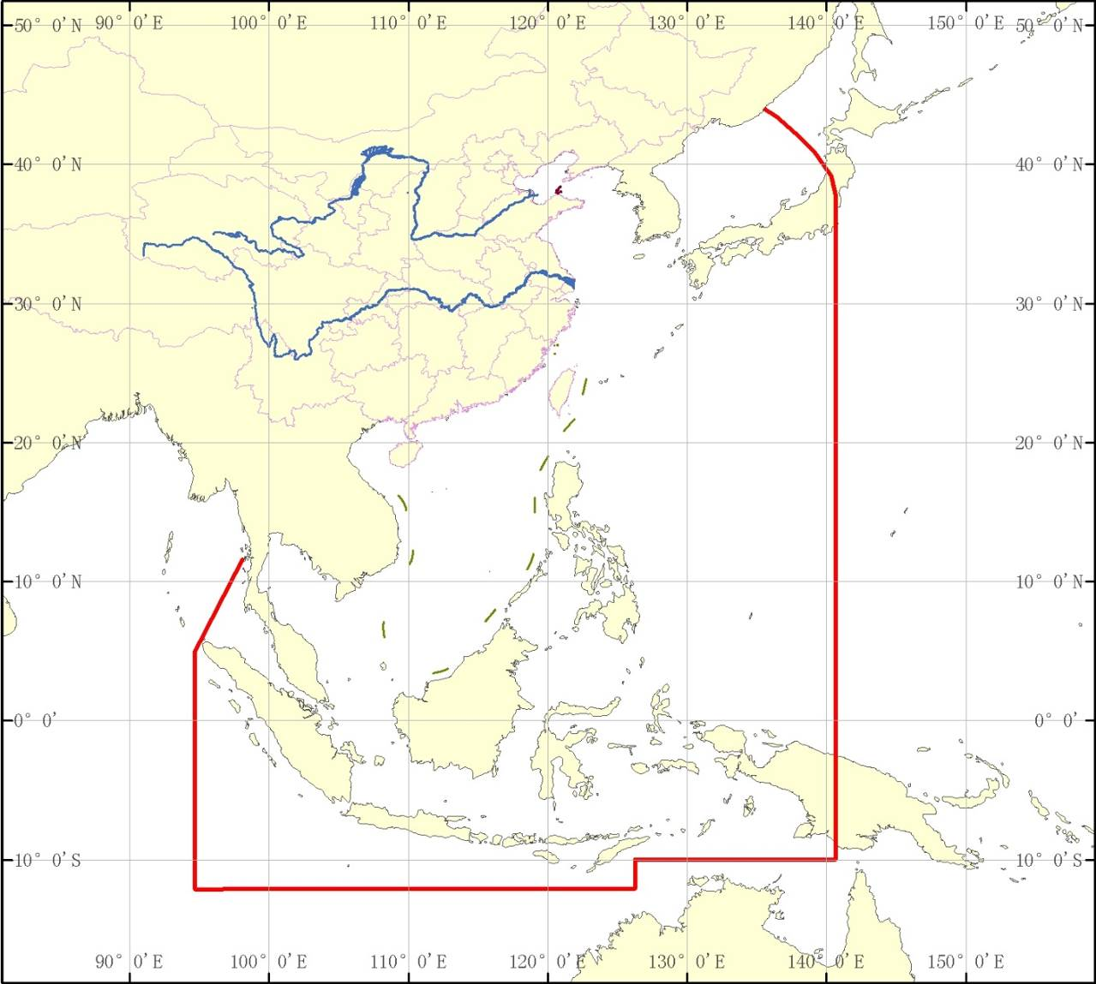
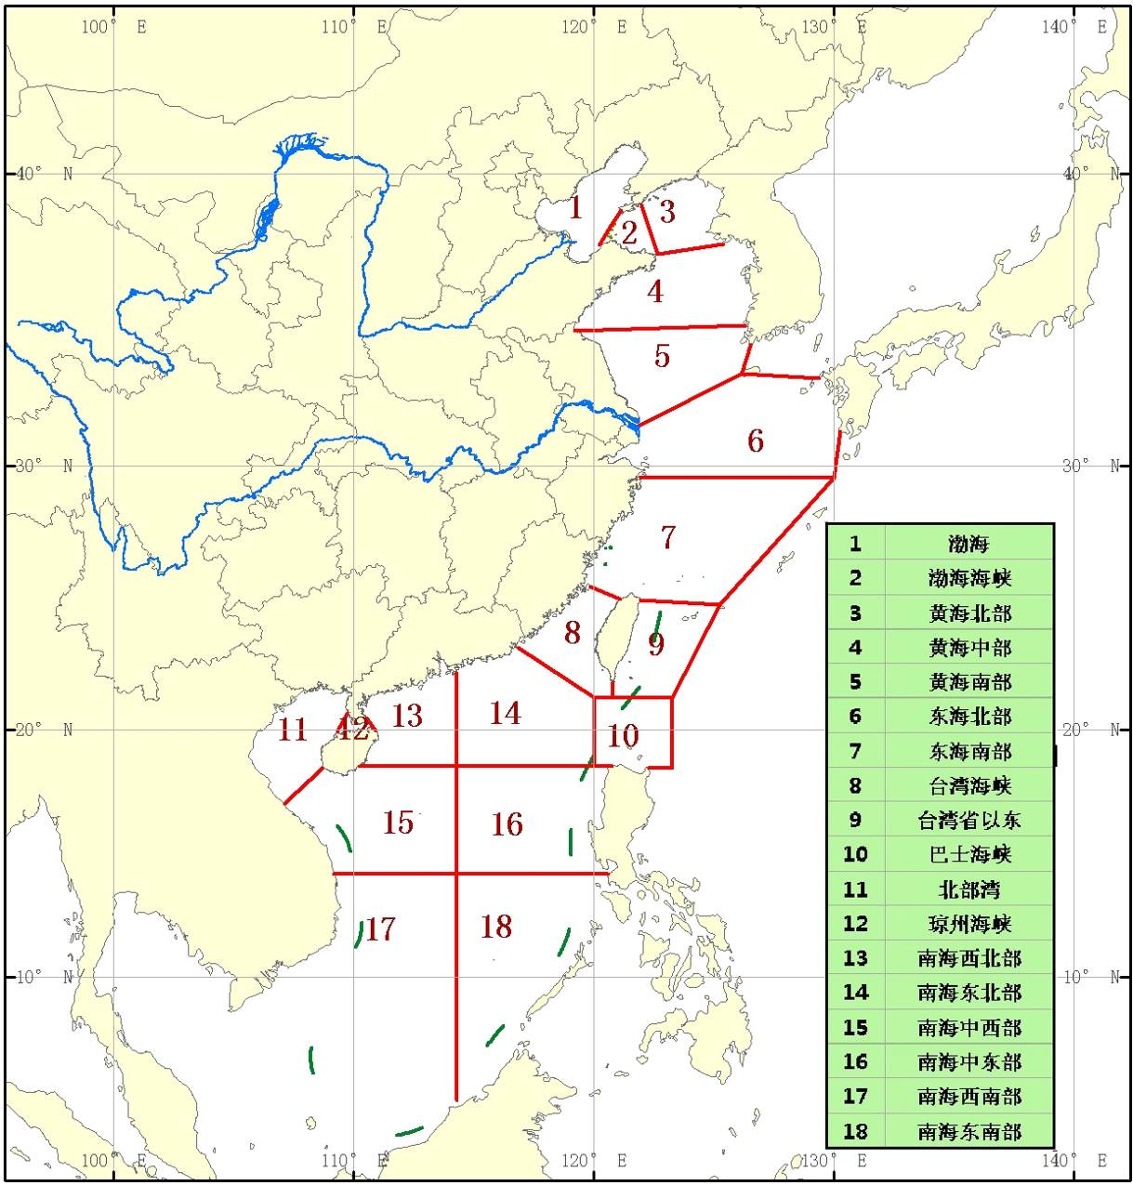
1.1 Marine Forecast Areas of CMA
China Meteorological Administration has three levels of responsibility sea area, which contain high seas area, 300km offshore sea area and 100km coastal sea area.

Slide 4
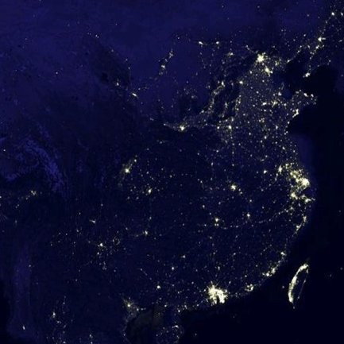
1.2 Regional Marine Meteorological Center
CMA set up three regional Marine Meteorological Centers. Tianjin Center is responsible for the Bohai rim, Shanghai Center is responsible for the East China Sea and the Yellow Sea, Guangdong Center is responsible for the South China Sea. All these centers develop their own regional NWP models and provide guidance products for local WFOs.
Tianjin
Shanghai
Guangdong
Institution | NMC | Tianjin | Shanghai | Guangdong
Model | WAVEWATCHIII | SWAN | FVCOM | WAVEWATCHIII
Region | 105°～160°E 05°～44°N | 117°～127°E 35°～41°N | 105°～145°E 5°～42°N | 100°～130°E 10°～30°N
Resolution | 1°x1° | 1km (nested) | 50m (unstructured) | 0.2°x0.2°

Slide 5
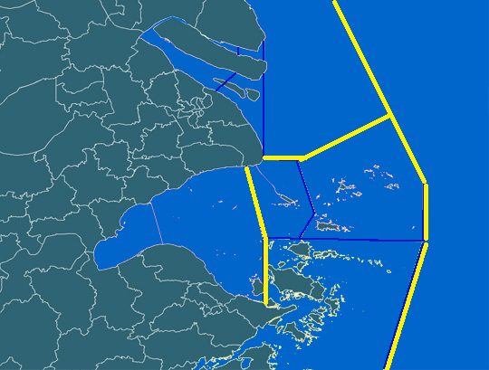
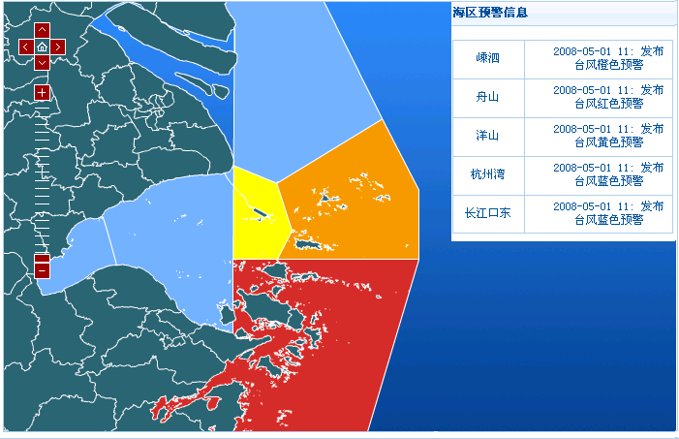
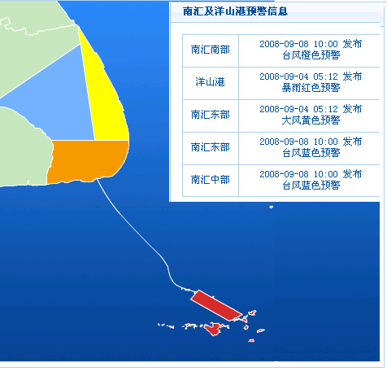
1.3 Refined Forecasting and Warning
For each WFO, it provide service for local government and public. For example, Shanghai alongshore sea area contains several Gold Water Channels with complex boundary layer conditions. We produce refined forecasts and warnings with considering the vulnerability and exposure, such as the water depth and shoaling effect.
Yangtze Estuary
Warning Center
Yangshan Port
Hangzhou Bay

Slide 6
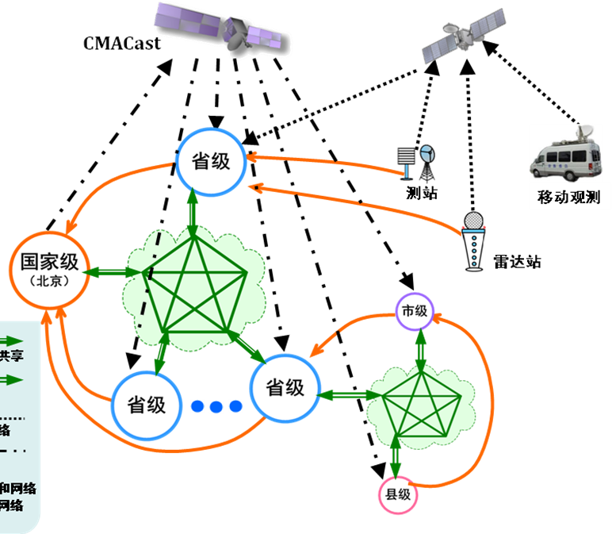
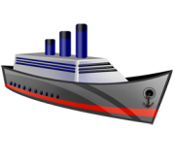
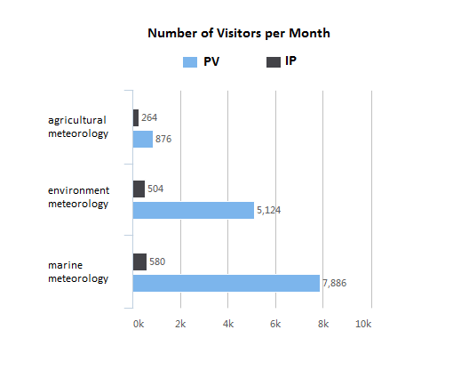



1.4 Integrated Operational System
Through CMA Integrated Operational System, regional centers and WFO share resources and data in real time.
This integrated system
makes communication and
decision making
more efficient.
TMS
Observation
CMA
WFO
SMS
GMS
WFO

Slide 7











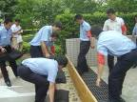
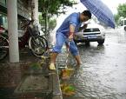
1.5 Joint Response Action
Emergency Preparedness and Response on Meteorological Hazards have been developed and issued by the Municipal Government. These plans provide detailed instructions on multi-agency joint response to warning levels.
Joint response action
according to Flood Preparedness
EMS Office
Shanghai Flood Control Headquarters
SMS
Flood Control
General Public
Coordination mechanisms of early briefing, early consultation and early joint action for heavy rain events has been established by SMG since 2010.
Traffic Administration
Early
Briefing
(Moderate,
Severe)
Water Affairs
SMS
Civil Defense
Other related agencies
Joint response action will be taken according to the level of early briefing.

Slide 8
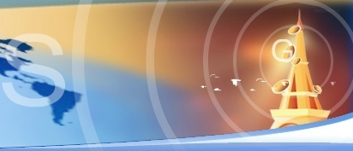
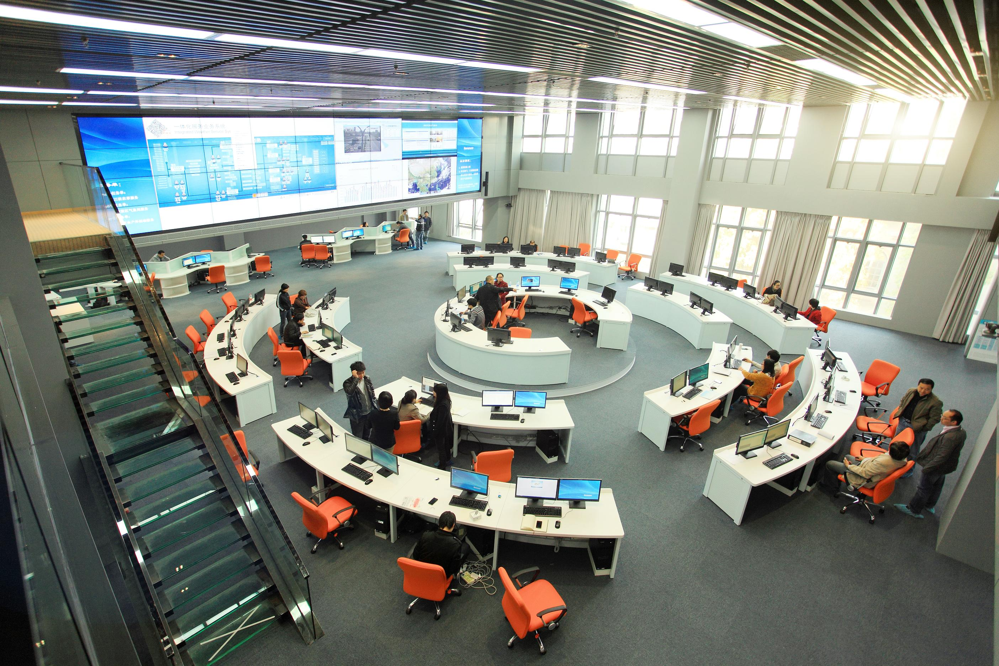
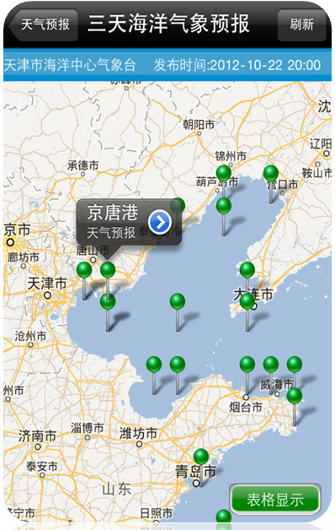
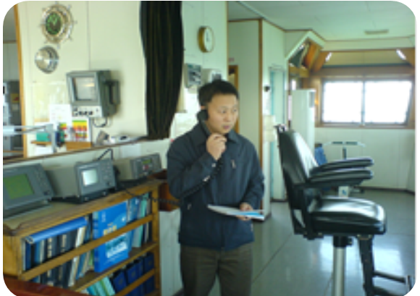
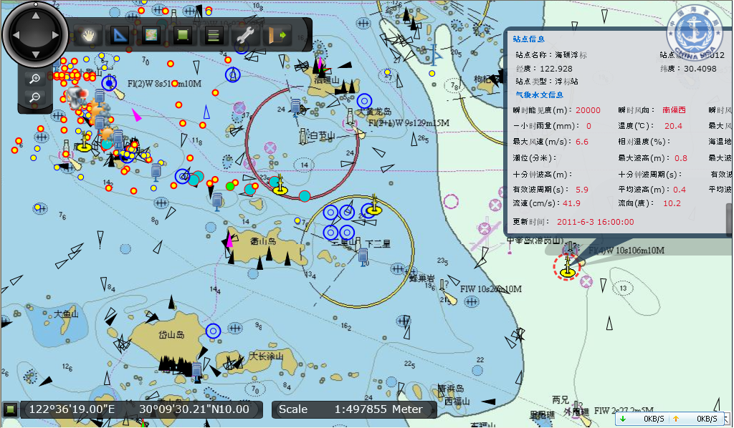
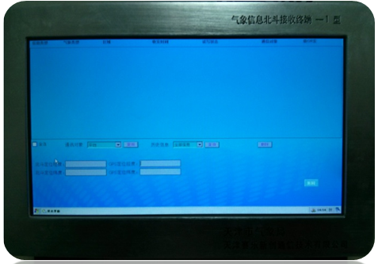
1.6 Information Dissemination
Coast Radio Station
On-site Guidance
Early Warning Center
Shipborne System
mobile app
AIS Platform

Slide 9
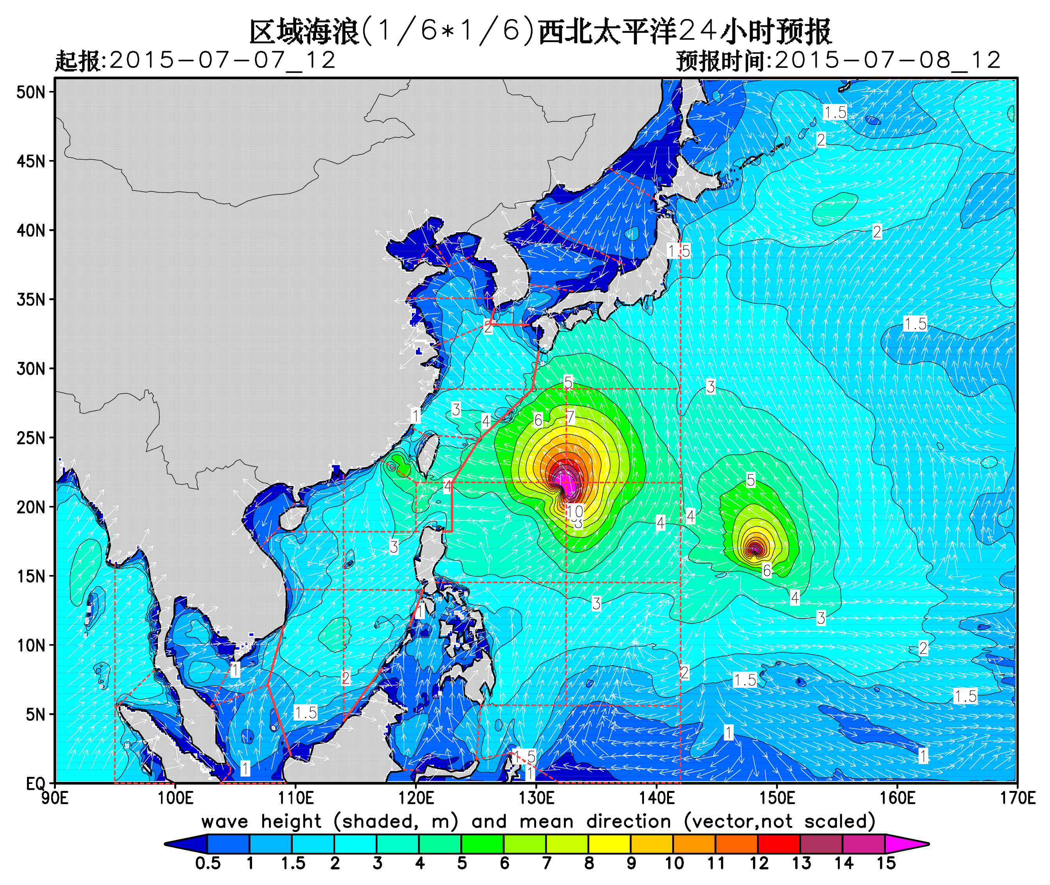
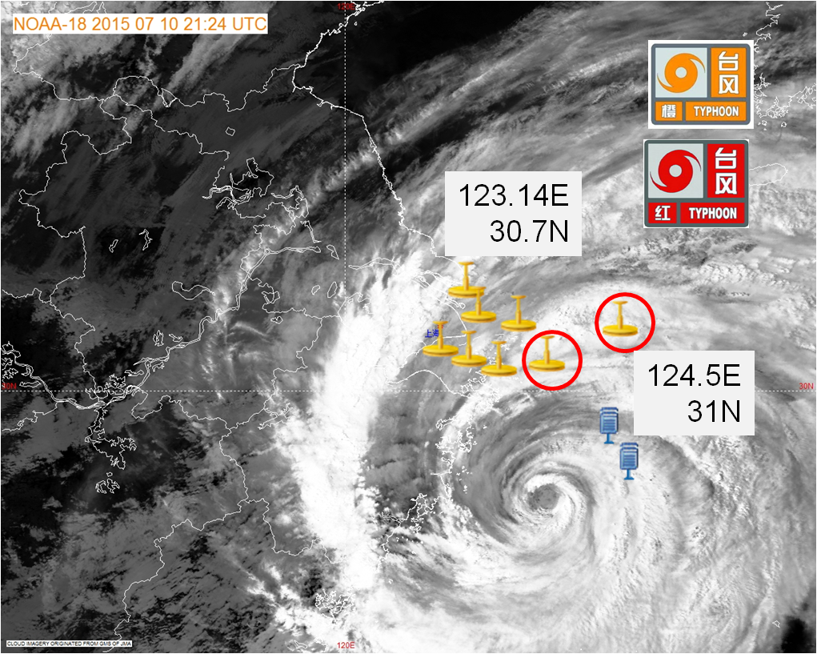
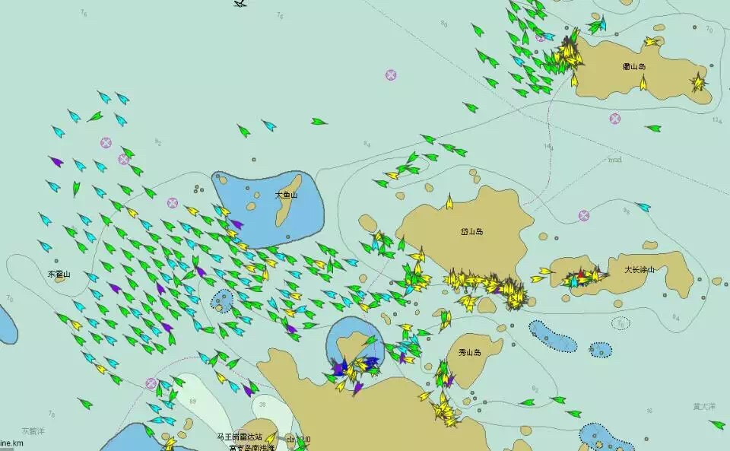
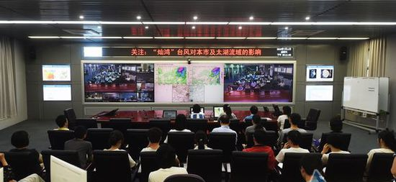
1.7 Case Study

Slide 10
OUTLINE
Marine Forecasts and Warnings
Marine Services
Observation Ships and Future Plan

Slide 11
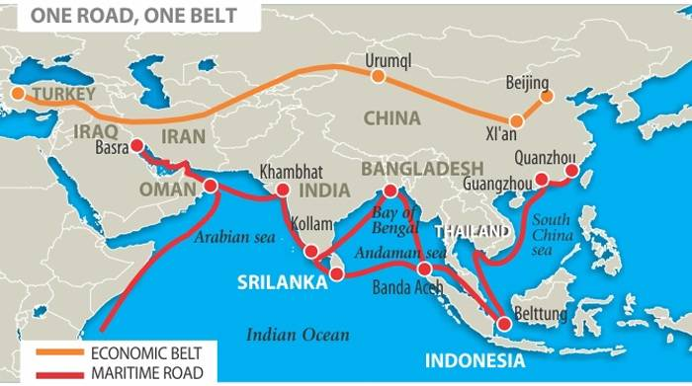
2.1 National Strategy
The 21st Century Maritime Silk Road
- Connection “China Dream” and “World Dream”

Slide 12
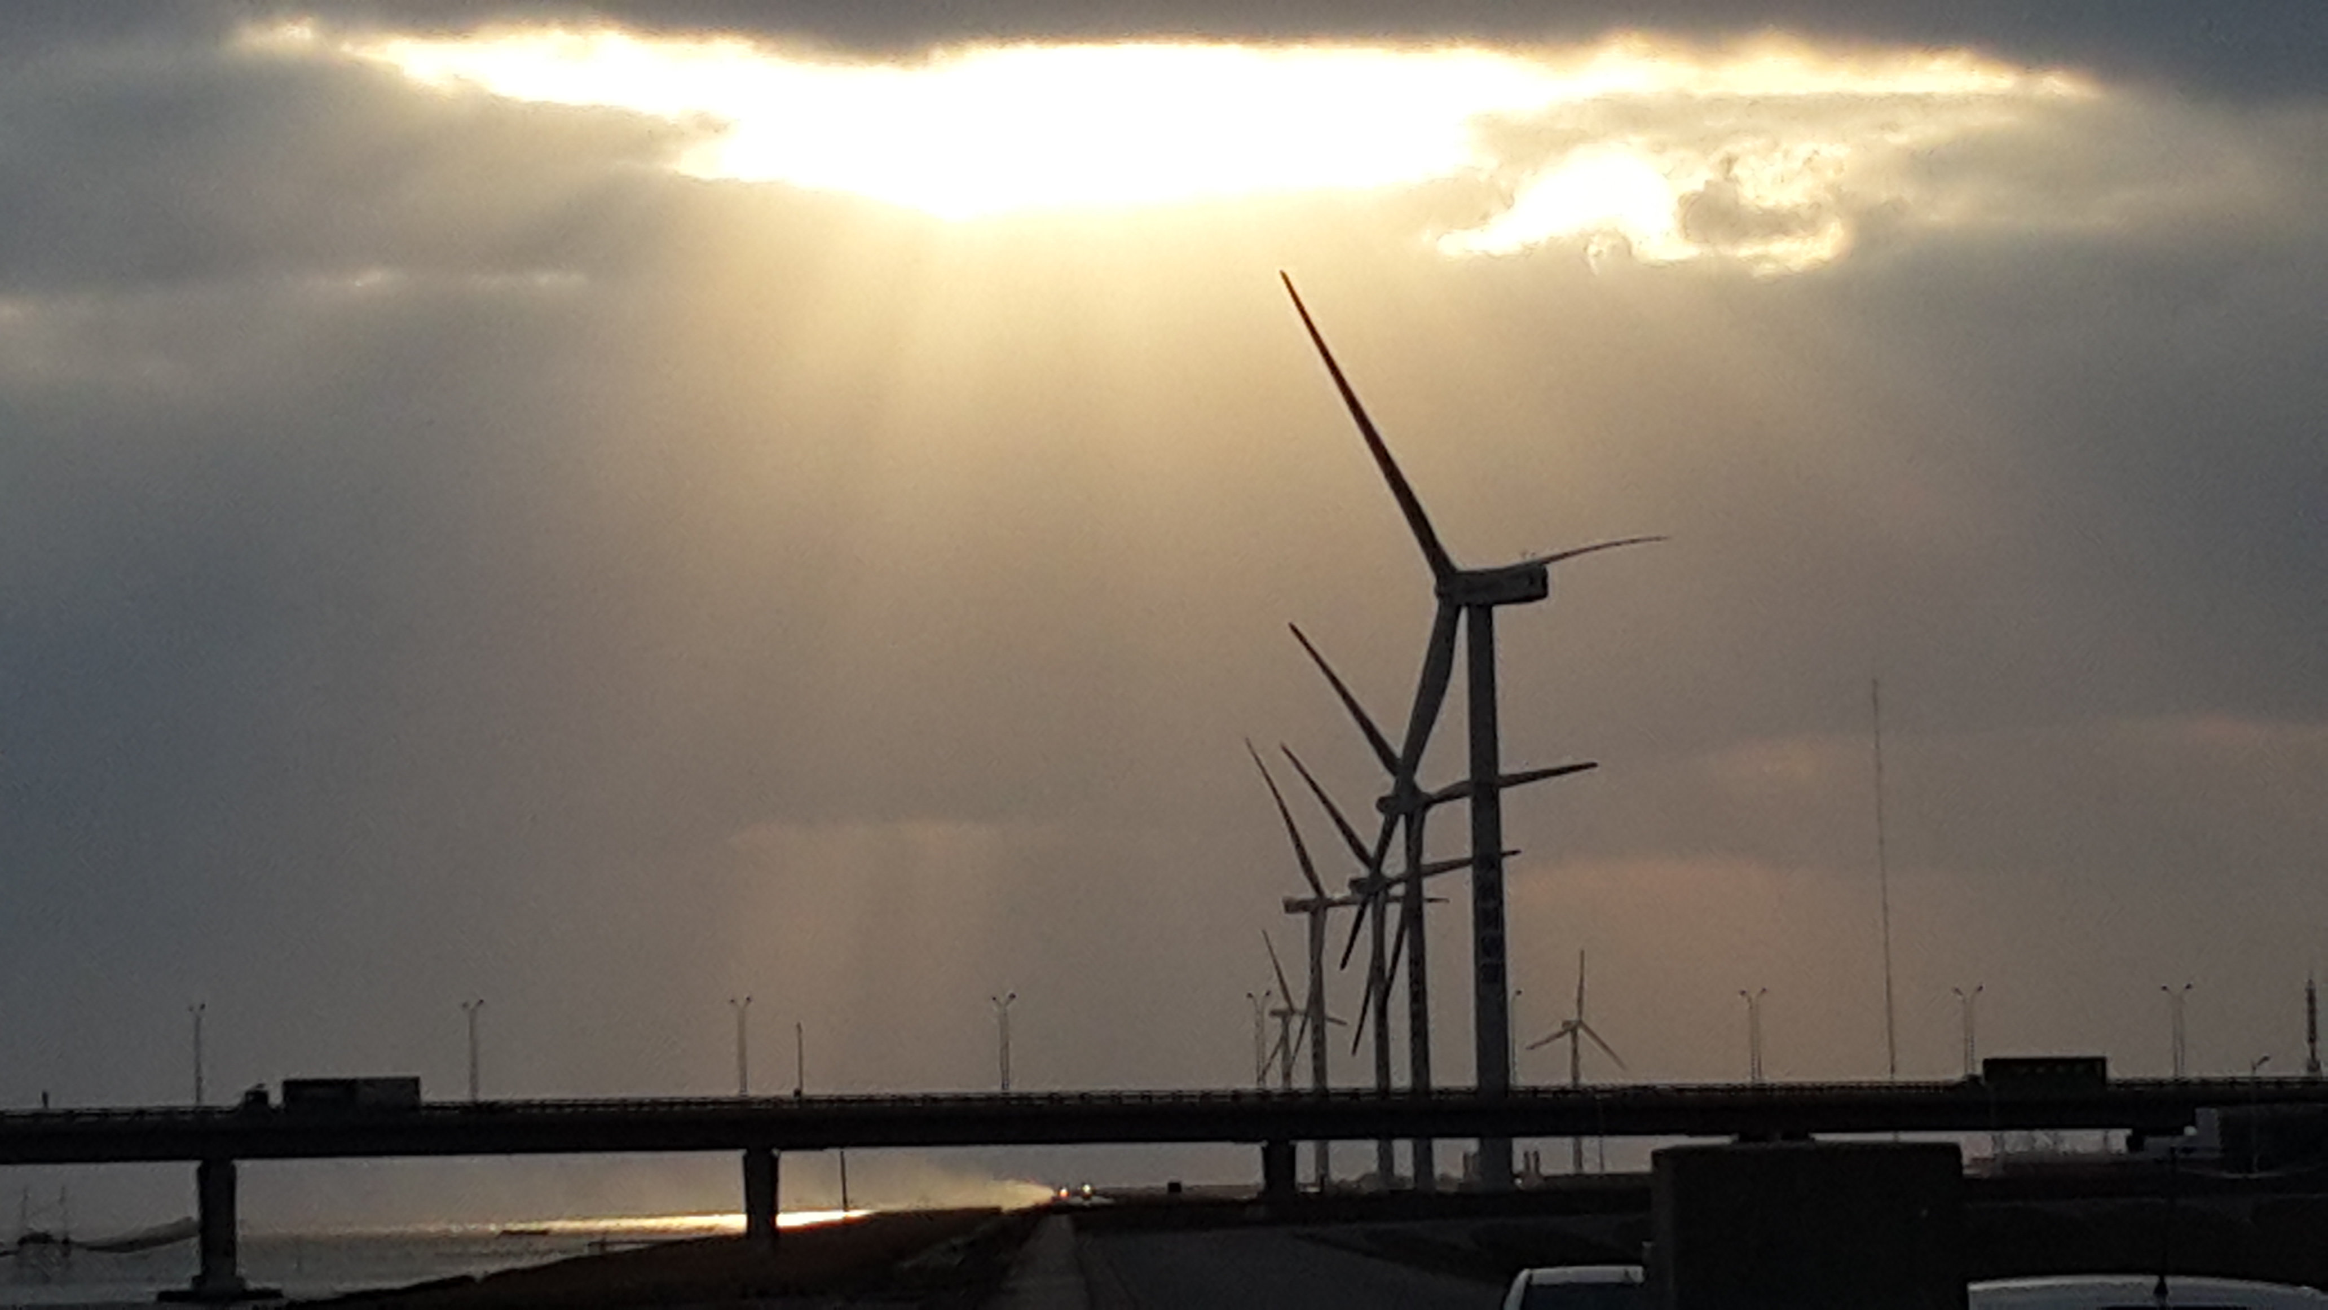
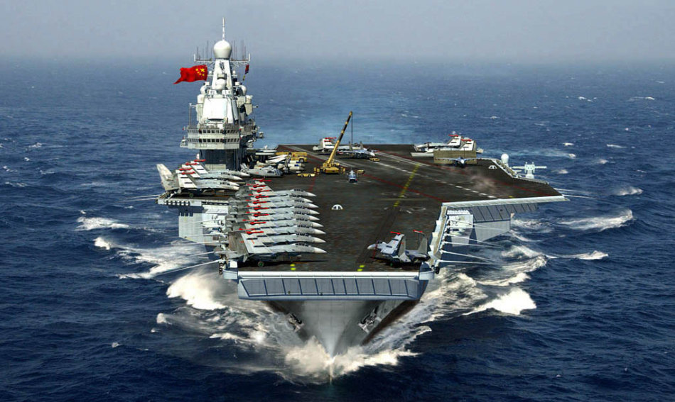
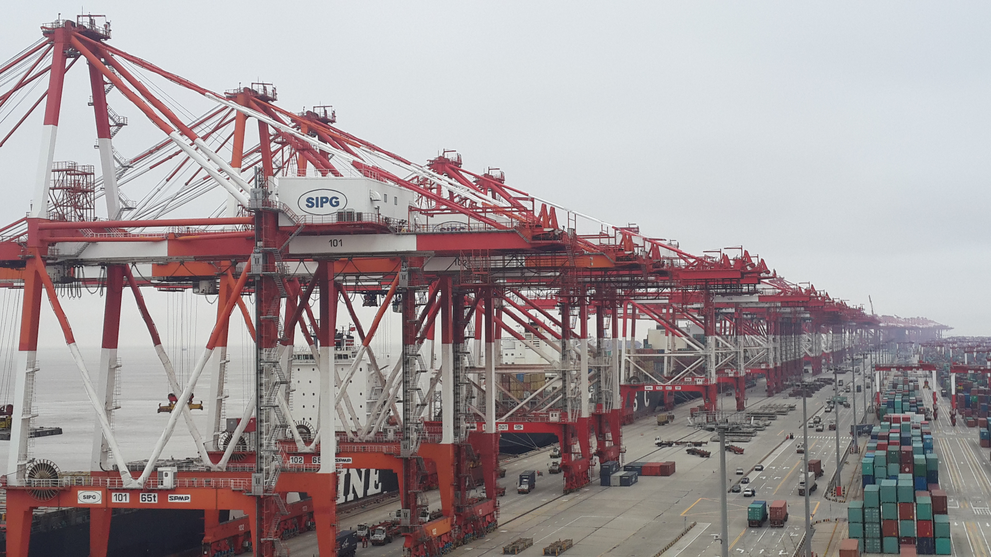
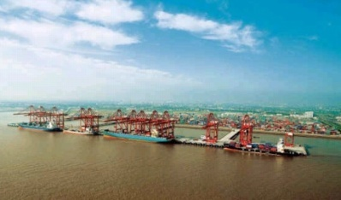
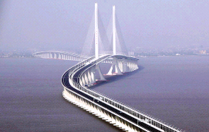
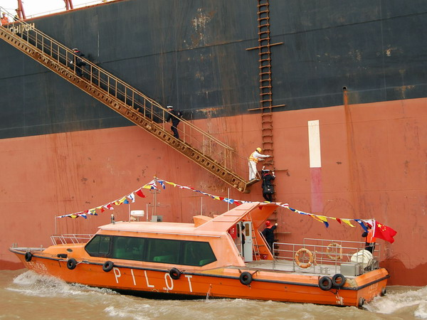
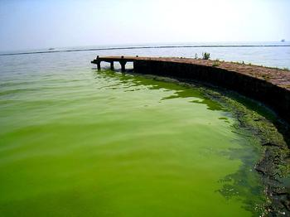
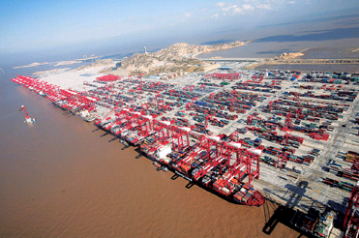
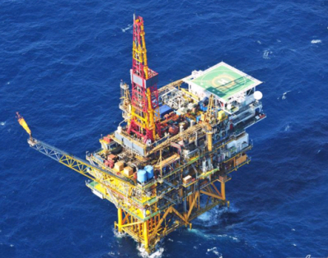
2.2 Demand and Gap Analysis
We are providing seamless and refined forecast with operations in the disaster prevention and mitigation, national defense, search and rescue, sea transportation, oil-gas industry, port operation, fishery etc. which influenced by marine and weather conditions.

Slide 13
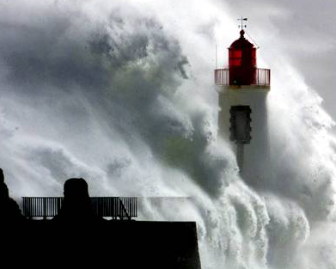
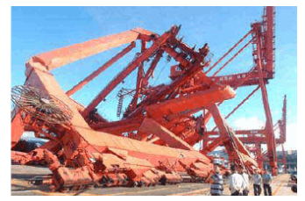
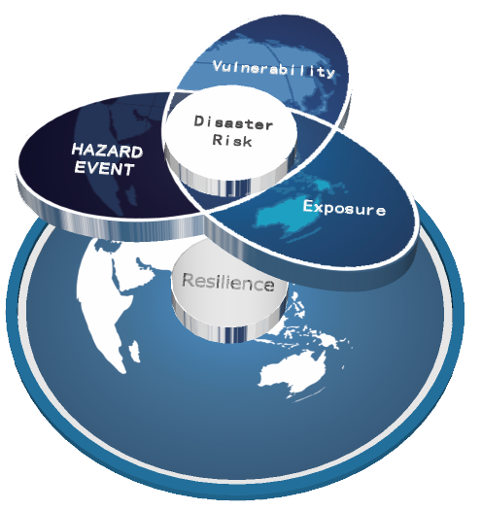
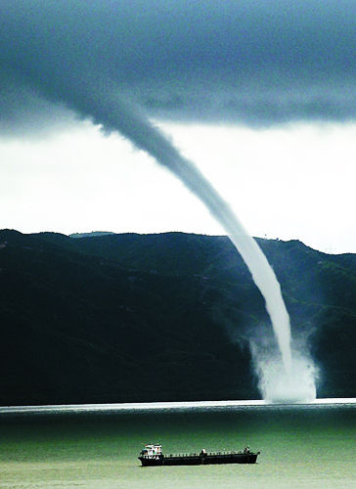
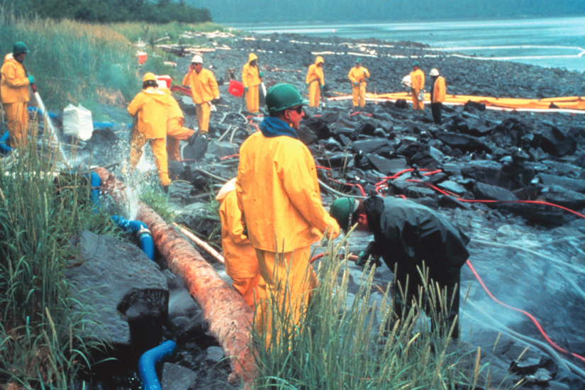
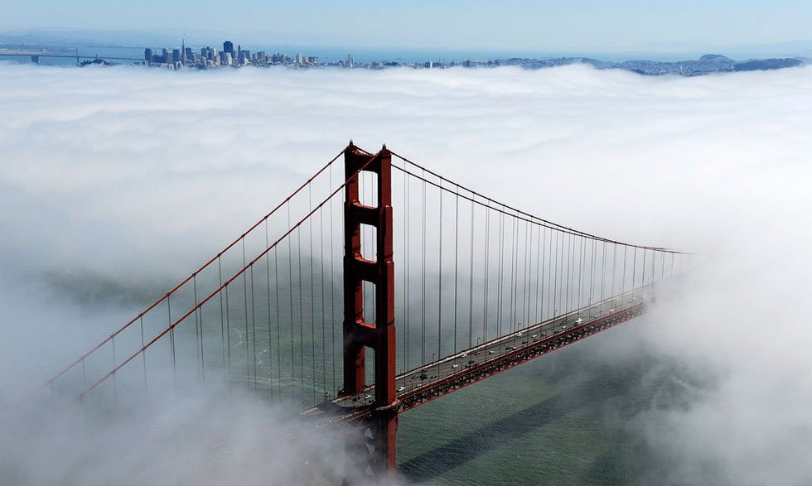
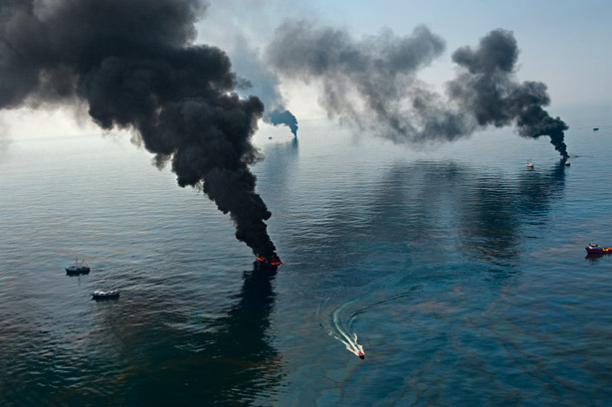
2.3 Impact Forecast for Marine Services
what the weather will be
what the weather will do

Slide 14
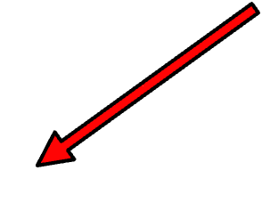
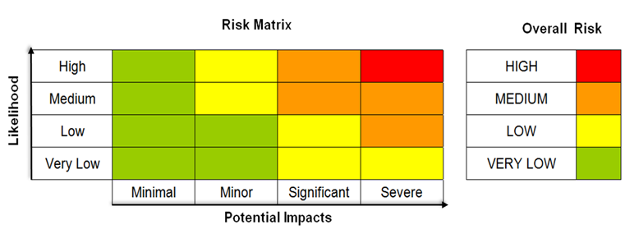
2.3 Impact Forecast for Marine Services
1.70% possibility wind speed will exceed BF Scale 8 and;
2. Displacement hull boats;
3. At shallow water
1.90% possibility wind speed will exceed BF Scale 8 and;
2. Boats at shallow water
1.30% possibility wind speed will exceed BF Scale 8 and;
2. Displacement hull boats at shallow water
1.70% possibility wind speed will exceed BF Scale 8 and;
2. Displacement hull boats;
1.50% possibility wind speed will exceed BF Scale 8 and;
2. Planning hull boats;

Slide 15
Detailed Risk Matrix for Ships Safety
2.3 Impact Forecast for Marine Services
Risk Level | VERY LOW | LOW | MEDIUM | HIGH
Type of Ship
4000-5000t Bulk cargo | wind <= scale 5 Or | wind = scale 6 Or | wind = scale 7 Or | wind >= scale 8 Or
Large ro-ro passenger | wave height< 2m | wave height ≈ 2-3m | wave height ≈ 3-4m | wave height >= 4m
<4000t Bulk cargo | wind <= scale 4 Or | wind = scale 5 Or | wind = scale 6 Or | wind >= scale 7 Or
Medium ro-ro passenger | wave height< 1.5m | wave height ≈ 1.5-2m | wave height ≈ 2-3m | wave height >= 3m
Iron shell fishing | wind < scale 7 Or | wind = scale 8 Or | wind = scale 9 Or | wind > scale 9 Or
 | wave height< 1.5m | wave height ≈ 1.5-2m | wave height ≈ 2-3m | wave height >= 2m
Wood shell fishing | wind < scale 5 Or | wind = scale 6 Or | wind = scale 7 Or | wind > scale 8 Or
 | wave height< 1.0m | wave height ≈ 1.0-1.5m | wave height ≈ 1.5-2m | wave height >= 2m
Little fishing boat near shore | wind < scale 3 Or | wind = scale 4 Or | wind = scale 5 Or | wind > scale 6 Or
 | wave height< 0.5m | wave height ≈ 0.5-1.0m | wave height ≈ 1.0-1.5m | wave height >= 1.5m
15

Slide 16
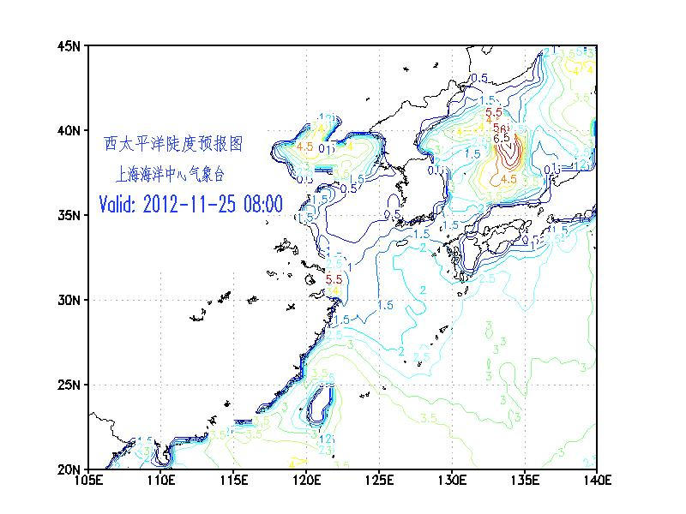
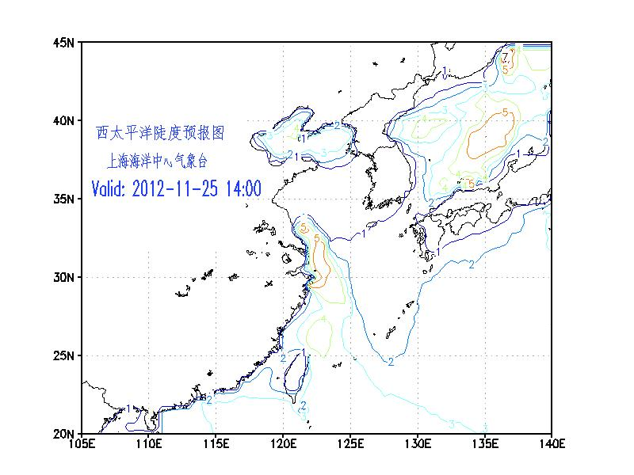
2.3 Impact Forecast for Marine Services
This is one case study of Shoaling Effect. A fishing-boat, 17m length with 7 people in it, was capsized in Nov. 25th 2012. The wind was only 5m/s but the ship was in the shallow water and the swell was high. The wave steepness product made an accurate risk predict for this event.
Notes:
这是一个浅滩效应的的个例，一个承载7人的17米长渔船，在2012年11月25日沉没。当时的风速只有5m/s，但是由于船载浅滩而涌浪很高。我们的波浪陡度产品对这一事件作出了很好的风险预报。Emanuel

Slide 17
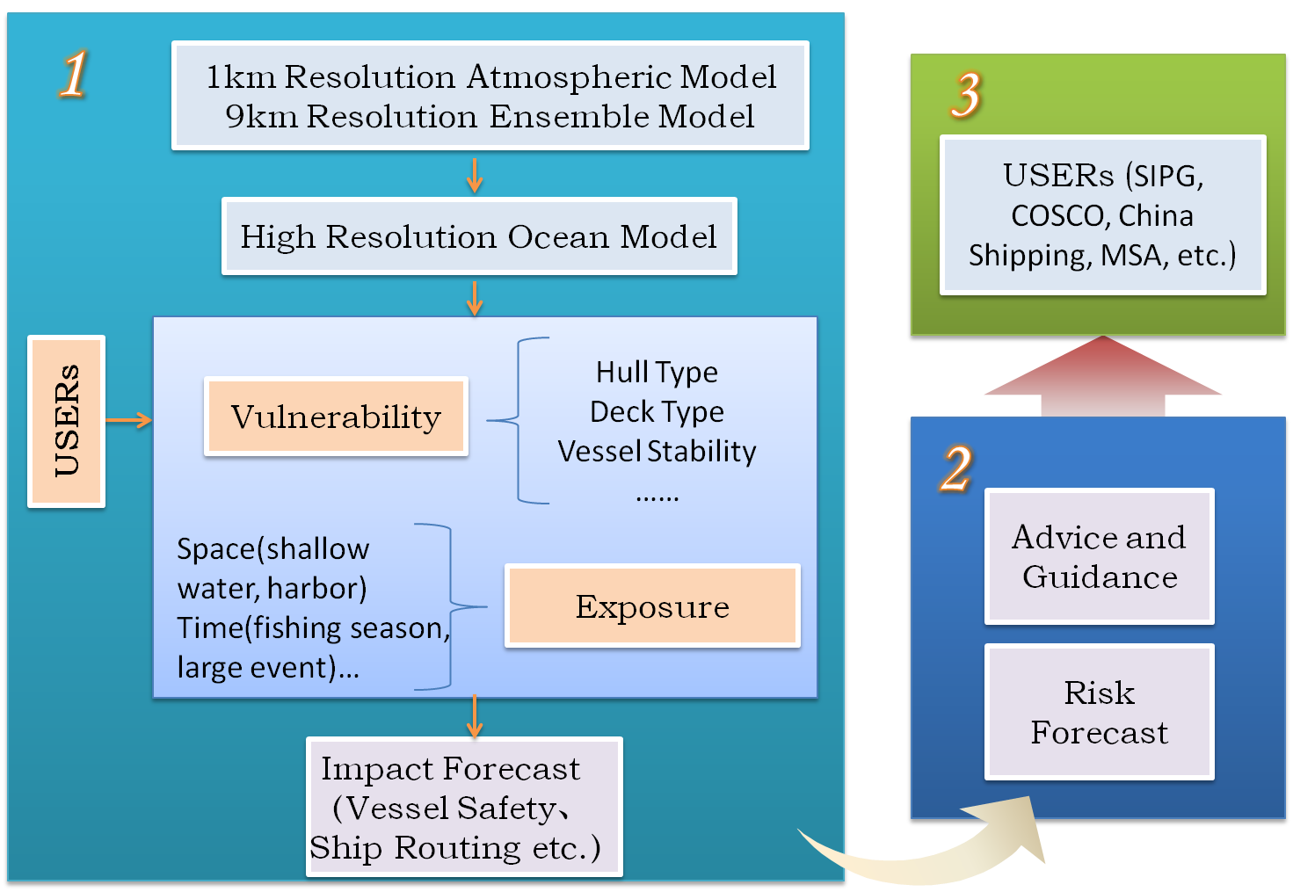
2.3 Impact Forecast for Marine Services

Slide 18
OUTLINE
Marine Forecasts and Warnings
Marine Services
Observation Ships and Future Plan

Slide 19
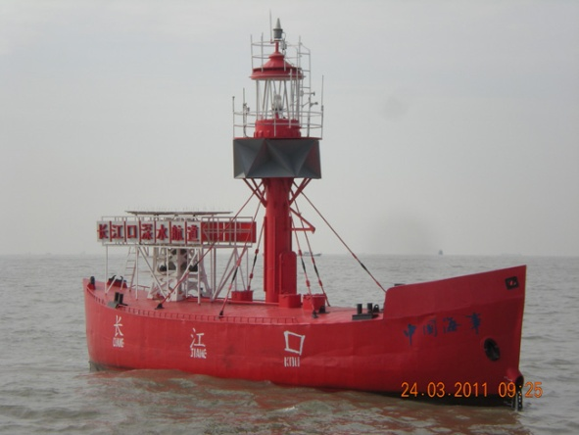
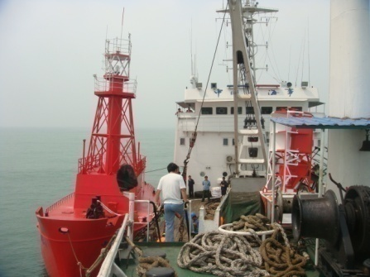
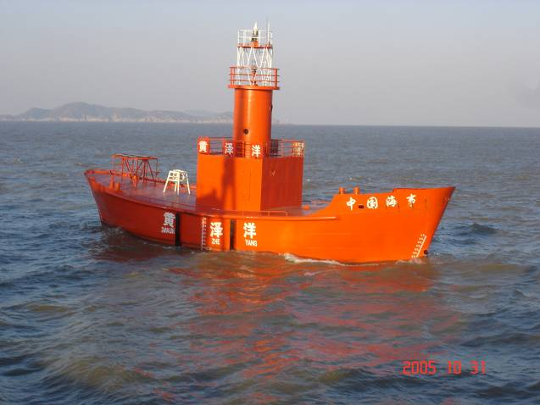
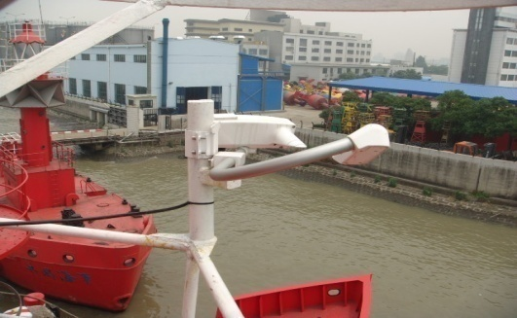
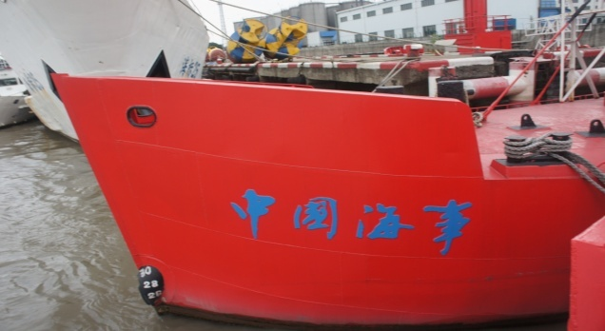
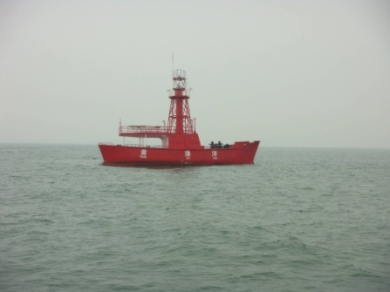
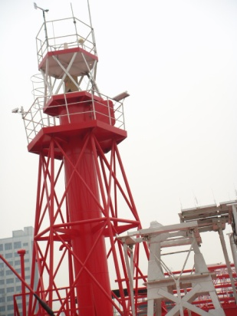



3.1 Some Attempts about Ship Observation
Cooperating with China Maritime Safety Agency, we transform maritime lightship to meteorological and hydrological equipment.

Slide 20


3.1 Some Attempts about Ship Observation
CMA recruit 57 ships(19 manual observation 38 automatic observation) from China Ocean Shipping (Group) Company and 6 ships from China Shipping (Group) Company.
China Shipping
COSCO

Slide 21




3.1 Some Attempts about Ship Observation
Standard Deviation of Ship Observation
COSCO wind
COSCO pressure
GTS wind
GTS pressure

Slide 22


3.2 Future Plan
In CMA’s 10 years plan, from 2015 to 2025, the number of buoys will expand to 100. Cooperating with COSCO, China Shipping, CSSC and Maritime Safety Agency, we will recruit 500 observation ships.

Slide 23

Thank you for your attention!

