Slide 2
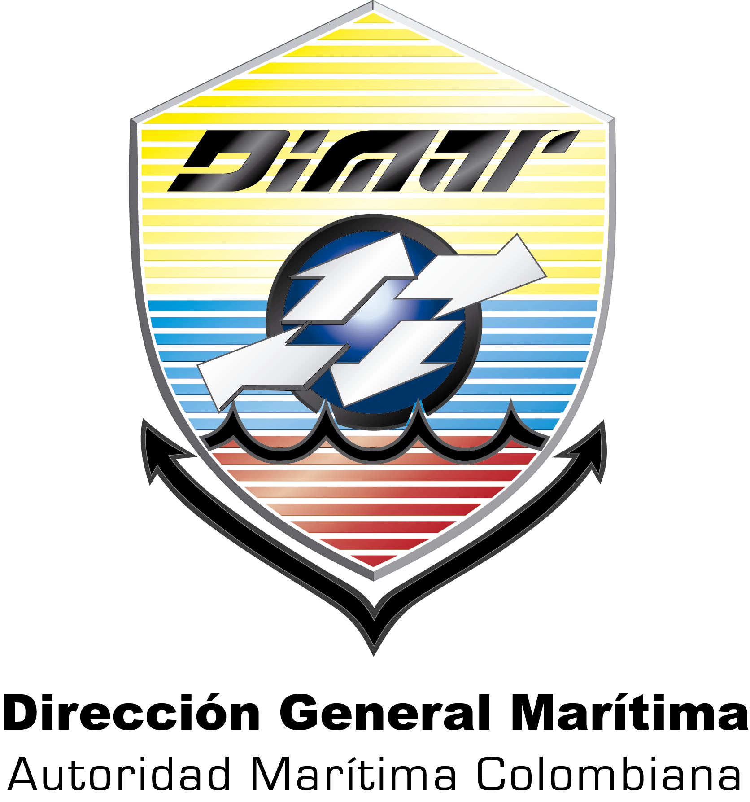
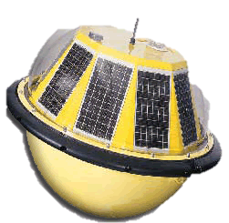
Operational Oceanography
Dirección General Marítima

Slide 3
OPERATIONAL OCEANOGRAPHY
General purpose
Generate knowledge on the behavior of the oceanographic and meteorological DIMAR jurisdictional areas , in order to establish dynamic and contribute to the development of the nation maritime conditions.
Objetivos Específicos
Generation, processing and analysis of meteorological and oceanographic conditions in the Colombian Caribbean.
Implement a base composed instrumental data , numerical models and remote sensing products that enable simulate mode diagnosis and prognosis , changes in ocean general weather conditions and local level of the Colombian Pacific and Caribbean Basin system.

Slide 4
WEATHER FORECAST FOR THE NAUTICAL ACTIVITY IN COLOMBIA
The Research for Oceanographic and Hydrographic Caribbean ( CIOH ) has a range of products and services from the area meteo-ocean operational oceanography and meteorology office in three lines :
Ocean observation
Monitoring of variables
Prediction variables
All these available on the website of the institution http://www.cioh.org.co/meteorologia/index.php with a time resolution between 24-120 hours all these useful tools for planning and decision -making.

Slide 5
OCEANOGRAPHIC AND ATMOSPHERE FORECASTING SYSTEMS - SPOA
Systematic and automated organization of information that allows you to dock last generation numerical models for forecasting results of waves, winds, pressure and precipitation , at regional and local levels with temporal resolution of 120 hours.
PRODUCTS
Operational forecast
Route forecast
Newsletter Meteo-Ocean Monthly
Bulletin Special Releases

Slide 6
OCEANOGRAPHIC AND ATMOSPHERE FORECASTING SYSTEMS - SPOA
OPERATIONAL FORECAST
Time
Observations
24 hour forescast Caribbean
Extended forescast
24 hour forescast Caribbean.
Forecasts offshore, marine and coastal major ports of the Colombian Caribbean.
Extended forescast.
Results of different, properly implemented and validated by the CIOH ocean and weather in operational mode and coupled models, extended to 120 hours.

Slide 7
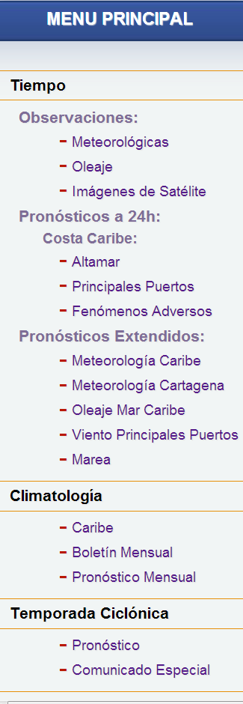
OPERATIONAL 24 HOURS FORECAST
OFFSHORE
http://www.cioh.org.co/meteorologia/PreCaAltamar.php

Slide 8
OPERATIONAL 24 HOURS FORECAST
MAJOR PORTS
http://www.cioh.org.co/meteorologia/PreCaMaritima.php

Slide 9
OPERATIONAL EXTENDED FORECAST
Results of various oceanic and meteorological models and coupled operational mode, implemented and validated by the CIOH, extended to five days. It is subdivided into:
Caribbean weather (WRF). Product forecast mesoscale atmospheric to 120 hours, convective rain, total rainfall, wind and atmospheric pressure for the Colombian Caribbean Sea.
Cartagena weather (WRF). Product forecast local atmospheric to 120 hours, convective rain, total rainfall, wind and atmospheric pressure for the sector of Cartagena.
Swell Caribbean Sea (CaribWam). Product oceanic mesoscale forecast to 120 hours, the significant wave height for the Colombian Caribbean Sea. Wind main ports. Product outputs virtual points of the atmospheric model to 120 hours, which illustrates the wind behavior for each of the main ports of the Colombian Caribbean.
Tide: Forecast High tides and low tides to 120 hours, which illustrates the behavior of the tide for each of the main ports of Colombia's Caribbean coastline.

Slide 10
OCEANOGRAPHIC AND ATMOSPHERE FORECASTING SYSTEMS - SPOA
BEFORE

Slide 11
OCEANOGRAPHIC AND ATMOSPHERE FORECASTING SYSTEMS - SPOA
CURRENT

Slide 12
OCEANOGRAPHIC AND ATMOSPHERE FORECASTING SYSTEMS - SPOA
FUTURE

Slide 13
OPERATIONALLY EXTENDED FORECAST CARIBBEAN WEATHER
http://www.cioh.org.co/meteorologia/wrf.php

Slide 14
OPERATIONALLY EXTENDED FORECAST WEATHER CARTAGENA
http://www.cioh.org.co/meteorologia/wrf.php?t=lt&dom=d02

Slide 15
OPERATIONALLY EXTENDED FORECAST CARIBBEAN SEAS
http://www.cioh.org.co/meteorologia/CaribWan.php

Slide 16
OPERATIONALLY EXTENDED FORECAST WIND MAJOR PORTS
http://www.cioh.org.co/meteorologia/vientos.php

Slide 17
OPERATIONALLY EXTENDED FORECAST TIDE
http://www.cioh.org.co/meteorologia/mareas.php

Slide 18
MONTHLY BULLETIN AND FORECAST
Climatology
Caribbean
Monthly bulletin
Monthly forecast
Caribbean
Information on the general weather patterns in the Caribbean Sea some weather events and intra-seasonal climatic periods presented this region.
Monthly bulletin
Monthly publication that describes the behavior of different meteorological phenomena that affect the Caribbean and Colombian Caribbean coast, and the behavior of meteorological and oceanic variables observed by the monitoring system
Monthly forescast
Publication that provides a long-term prognosis on weather and oceanographic conditions in the Colombian Caribbean.

Slide 19
MONTHLY BULLETIN
http://www.cioh.org.co/meteorologia/ResumenClimatologico.php

Slide 20
MONTHLY FORESCAST
http://www.cioh.org.co/meteorologia/PronosticoClimatologico.php

Slide 21
STORM SEASON
Storm Season
Forescast
Special Statement
Forescast Hurricane
It provides information about the cyclone season for each year. These forecasts are developed by other organizations specializing in the subject
Special statement
Special reports on the current conditions of a hurricane and the forecast behavior of the same , its intensity and trajectory.

Slide 22
STORM SEASON
Forescast Hurricane
http://www.cioh.org.co/meteorologia/PronosticoTemporadaCiclonica.php

Slide 23
STORM SEASON.
Special statement
http://www.cioh.org.co/meteorologia/ComunicadosEspeciales.php

Slide 24
ALERT OF ADVERSE EVENTS
This alarm is a tool used in this website to inform users that is missing or an adverse phenomenon developing over the Caribbean Sea ( cold front , tropical wave, this , among others) , generating an increased risk maritime activities . This indicator is expressed with activated flashing icon.
http://www.cioh.org.co/meteorologia/index.php

Slide 25
MEASURING SYSTEM PARAMETERS OCEAN AND MARINE METEOROLOGY
SMPOMM
SMPOM
Hs – Tp – DP - Spectrum
Temp Pressure Rain
Wind
Sea Level
Receptor station GOES
It is a network monitoring oceanographic and meteorological variables. It composed of different types of sensors , measuring in real time, arranged in the Colombian Caribbean.

Slide 26
MEASURING SYSTEM PARAMETERS OCEAN AND MARINE METEOROLOGY -SMPOMM
Wave Buoy
Height (maximum, average, significant)
Period (peak, 13)
Direction (average, predominant)
Spectrum
Weather station
Temperature (Maximum, average)
Pressure
Rain
Wind (direction, Speed)
Sea level station
Sea Level
Station earthly
Antenna reception GOES

